Slide 1
Lingerie look, X-silhouette, Turn of the Century
Period costume & Style
Lecture 9 / 19.12.2019

Slide 2
The Lingerie Look, 1870's
A Detail from the painting “Too Early” by James Tissot in 1873, depicts the softer China silk and silk tulle day and evening gowns of the time
Called “The Lingerie Look,” it embodies all things feminine with ruffles
Notes:
The typical accessory of the day is a one-inch black velvet ribbon worn around the neck.
At the end of the 1860s all of the fabric that used to encompass the hoop is all drawn to the back.

Slide 3
Lingerie Look
This slim look is created from white linen organdy to create the dress and the bustle of ruffles.
Organdy wrinkles easily, so this is as stand up gown.
Apron front conceals wrinkles.

Slide 4
Detail from the Tissot painting titled, “The Ball”, 1878
Showing the extent of the ruffling on the Mermaid gowns.

Slide 5
1879, soon much of the fabric drops away leaving the “Mermaid” silhouette of the early 1880s.
The corset is elongated, making sitting difficult and the train is diminished as these become promenade dresses.

Slide 6
Seaside Attire, South of France 1885
The rise of the middle class means that there is a population of people to take weekend trips and month long vacations by the seaside
Man in T-shirt and worn with a very popular “boater hat” or “skimmer”

Slide 7
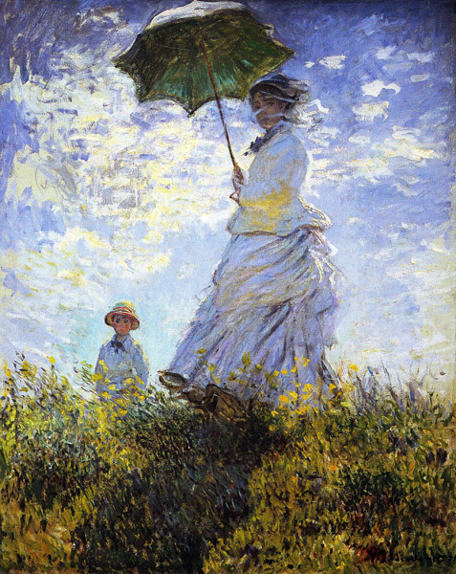
Woman with a Parasol-Madame Monet and Her Son, by Claude Monet 1875
Artists go to the countryside to paint
Windsor & Newton invent oil paint and water colors in tubes.

Slide 8
Lingerie gowns were worn loosely and stripes become popular for outwear and not just for contemporary t-shirts.
The man is wearing the new knit shirts that are not so far from our contemporary ones
1885

Slide 9
Denim
Denim - de Nimes, popularized by Levi Strauss
Created during Gold Rush
heavy cotton pants woven in a double twill called Jean
Dyed with indigo blue dye
“Blue Jeans”
Denim Fall Front Trousers, 1830
Historic Deerfield, MA

Slide 10
1875, Liberty of London opens a dress fabric store for imported Japanese cotton + décor
Cotton becomes the fashionable fabric for the seaside since it is not ruined by sea salt
Washable material
Notes:
n 1884 Liberty introduced the costume department into the Regent Street store, directed by Edward William Godwin (1833–86).
Godwin was a distinguished architect.
He was a founding member of the Costume Society in 1882. He and Arthur Liberty created in-house apparel to challenge the fashions of Paris.
n November 1885, Liberty brought forty-two villagers from India to stage a living village of Indian artisans.
Liberty's specialized in Oriental goods, in particular imported Indian silks,
and the aim of the display was to generate both publicity and sales for the store. However, it was a disaster commercially and publicly, with concern about the way the villagers were put on display.

Slide 11
Fabric Industry-Japanese Imports
1870’s - Japan mechanizes silk production
Weave is finer and superior strength.
1st non-western country to adopt industrial weaving techniques with cotton - printed with woodblock prints like India.
Left Gown is embroidered, right is a satin print from 1885
Kyoto Costume Institute, Japan

Slide 12
Walking Dress
Navy silk satin and silk faille walking dress from 1884
Kyoto Costume Institute, Japan

Slide 13
Formal Tea Gown from 1885
Intimate teas can become very formal in England.
Victoria and Albert Museum, London

Slide 14
Day Dress 1885
Made of Indian Cotton
Kyoto Costume Institute, Japan

Slide 15
The Rodrigues Reception Dress
1885 Shape of the New Bustle with all of the fullness settled higher in the back.
Way before it’s time, this silhouette not common for another 10 years
This heavy weight and position is even worse for the back.
Kyoto Costume Institute, Japan

Slide 16
The Apron Bustle
Two promenade dresses from the 1880s using the latest fashion for the “apron bustle”
An extra flounce was added to the dress that balanced some of the weight of the bustle in the back

Slide 17
Decorative boots for dress wear, Italy and France, 1875-1885
Skirts are shorter – boots become more decorated

Slide 18
Mother and daughter in promenade dresses, 1885

Slide 19
Underwear, 1885
Smaller bustle
Corset is still stiff with heavy boning and long at the front
Victoria and Albert Museum, London

Slide 20
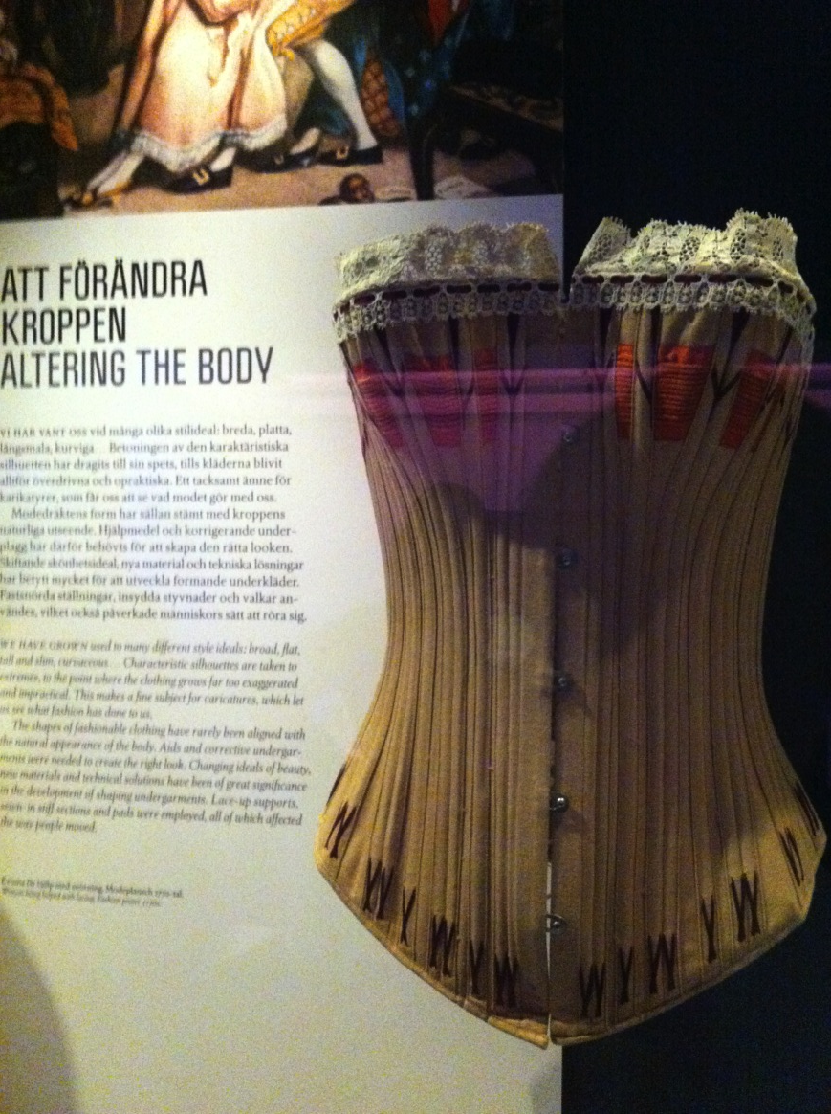

Slide 21
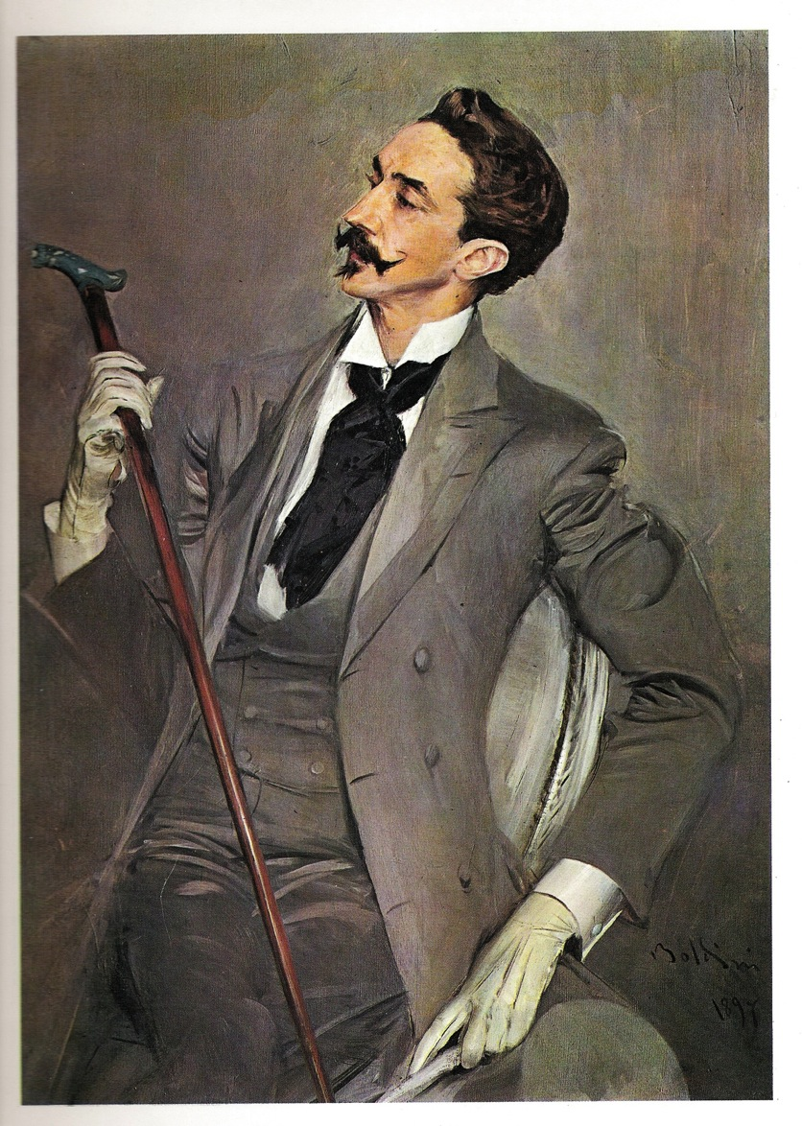
Count Montesquieu, 1885

Slide 22
Men’s Formal Wear, 1888
Popularized by the Crown Prince Edward who loved to party
This portrait by John Singer Sargent of a man in evening formal wear. The elegant top hat and tailcoat would look practically the same at the turn of the Millennium in 2000.

Slide 23
1891 Dinner Dress

Slide 24
1891 Skating Coat

Slide 25
1892 Reception Gown

Slide 26
1894 Afternoon Dress

Slide 27
1895 Afternoon Dress

Slide 28
1894 Evening Dress

Slide 29
Madame X Portrait 1890
This plunging neckline and strapless evening gown was the most daring silhouette of its day and would not be repeated until 60 years later in the 1950s.

Slide 30
Boldini, Garden Portrait 1892
Gradually the bodice (waist) is gathered over the bosom on top of the fitted shape. Black velvet waistband emphasizes waist, black ribbon shows off the long neck.

Slide 31
Portrait of Lady Volpicelli, 1894
As the 1890's begin sleeves are fitted into a high armhole with the long torso of the 80's.
A new development, the soft draping of the lace collar ends at the waist

Slide 32
Evening Gown worn by wife of the rich American Industrialist, Potter Palmer of Chicago.
Charles Worth design
Elegant and lean lines of 1890s, Art Nouveau

Slide 33
Portrait of a mother and daughter, 1895, with softer washable vacation clothing.
corsets were severely loosened if not taken off
For many women, it was dangerous to remove the corsets since they had been wearing them their whole lives and had no muscle structure to support the lower back without it

Slide 34
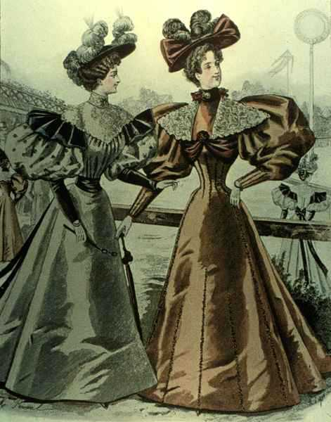
Satins are popular- emphasize the clean silhouette. In 1895, there is a short revival of the gigot sleeves from the 1830’s
Hats extend the width to match with the shoulders and the hem of the skirt
Notes:
Lapels widen to balance the sleeves and the skirt widens at the hem to do so as well.

Slide 35
Marthine C.Hjort 1895
This is a slightly more realistic version of what was actually worn.
Cutwork was a popular form for those who had access to fine hand
seamstresses
National Museum, Oslo

Slide 36
1895 Countess Karolina with her children Children’s clothes stay soft comfortable

Slide 37
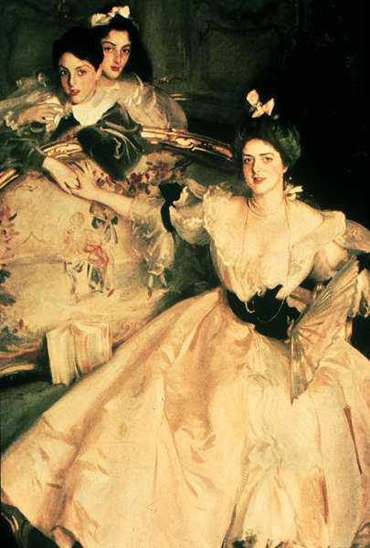
Mrs. Carl Meyer and her Children, 1896
The new low neckline is in fashion for evening wear:
The low wide neck opening is enhanced with white tulle and lace for horizontal emphasis.
The skirt is gored for fullness. The crisp pale satin is an elegant choice for evening wear

Slide 38
Men’s styles 1899

Slide 39
1895 commercial print by Alphonse Mucha
Moravian scenic artist from Brno – moves to Vienna to work as a scenic artist.
Moves Munich then Paris to study art.
First poster in 1894
Sarah Bernhardt = huge hit
Leader in Art Nouveau
Notes:
Made his fortune, returns to Prague. Paints murals for Theatre, Town Hall
, Spends last years painting 20 panels about Slav History.

Slide 40
Turn of the Century

Slide 41
The extreme corset - Turn of the century

Slide 42
Floral Corset

Slide 43
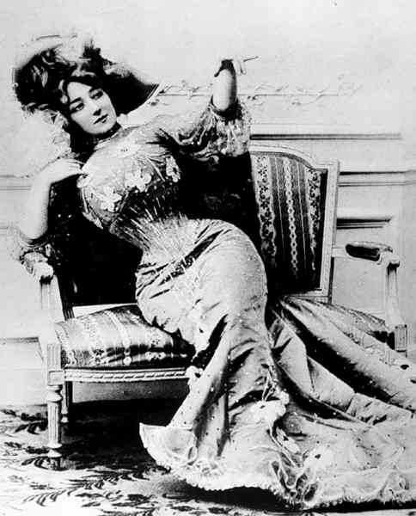
Photo of Actress Anna Held, 1900
Notice that she cannot
actually sit, due to the corset. She needs to find a very peculiar pose to sit and hold for the photo.
She was known for her
“Hourglass Shape,”and her 18” waist.

Slide 44
Burlesque Stars
Very popular entertainment.
These burlesque queens who looks relatively conservative to us, were scandalous in their day.
Museum of the City of New York.

Slide 45
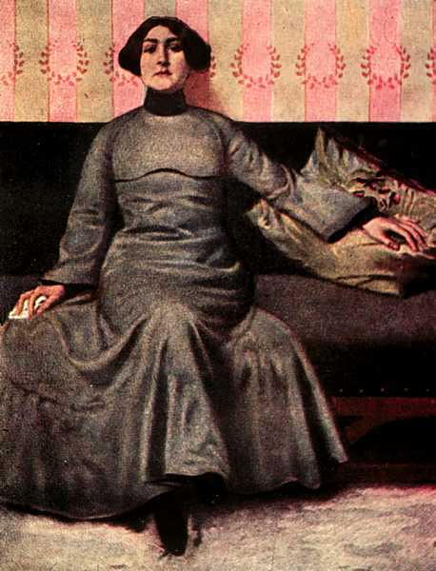
Reform Dress 1902
An actress Eugenia Spiro is a leader in the movement for reform dress, suffrage, and women’s abortion issues.
Reform dress embraces the princess line and adds flare at the hem.

Slide 46
1902 Smith College Basketball team in bloomers.

Slide 47
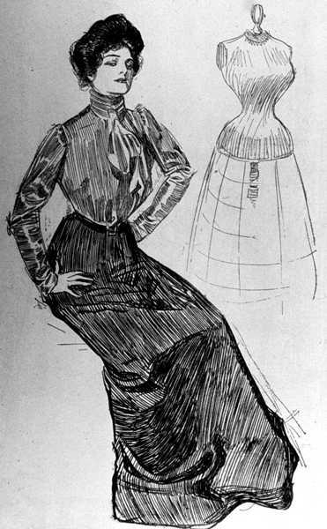
Charles Dana Gibson creates “The Gibson Girl” 1898
The Gibson Girl expressed all that was good about the clean American Middle Class Girl. She went to work and wore washable waists (substitute to corsets)
She has the perfect hourglass silhouette.

Slide 48
1898 John Singer Sargent Dorothy & Francesca Children in washable more comfortable clothing.

Slide 49
Portrait of Hans Jaeger, 1898 National Museum, Oslo Norway The look is almost contemporary with a fedora hat, pinz nez that look like glasses and an overcoat buttoned up.

Slide 50
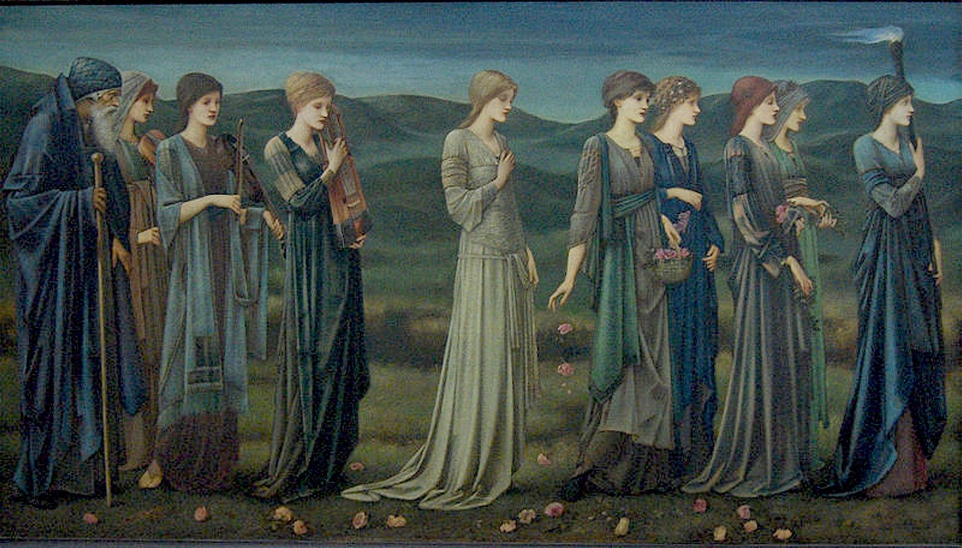
Victoria dies after nearly 70 years on the throne 1902 - A new age of optimism

Slide 51
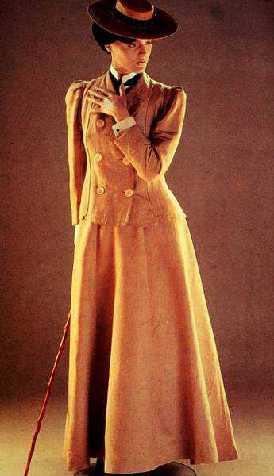
The new American Working Woman
1902 the enormously popular Man Tailored suit was worn to work
Most often made of linen that it was washable
The hat is a “Skimmer,” a female version of the Boater Hat
The new professional woman part of the work force in a man’s world

Slide 52
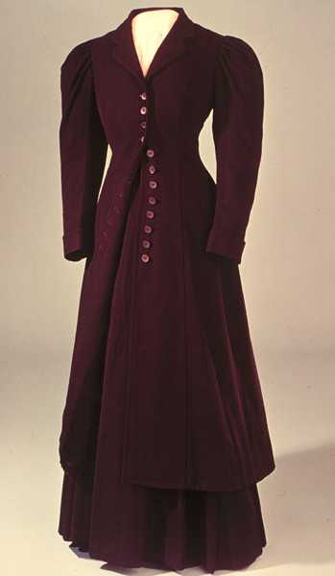
The Working Woman
The winter version of the ‘man tailored suit
This outfit is from the turn of the century
The wool suit is worn with washable waist and petticoats. Often there is a “dust ruffle” on the skirt that can be removed for cleaning and sewn back on, or exchanged for another piece.
Smithsonian, Washington, D.C.

Slide 53
Promenade outfit, 1905
Brooklyn Museum

Slide 54
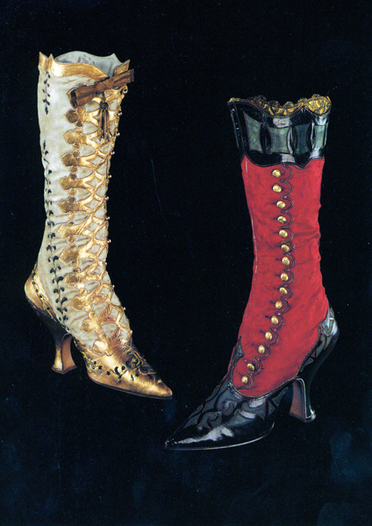
The heel begins to rise again and reaches 3” by the turn of the century.
Here are two dress boots meant to be worn to formal events.
The laced front with the skin exposed was quite common.
The high buttoned shoe replicated the look of the spat and was enormously popular.

Slide 55
1901
International Ladies Garment Workers was founded
Very influential in promoting rights for women workers in factories and for piece workers on home sewing machines

Slide 56
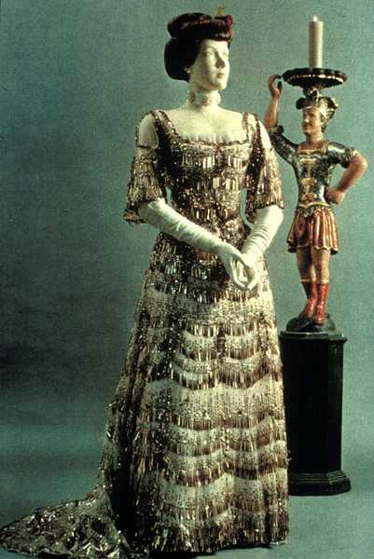
French Evening Dress 1901 AD
New square neckline, especially for evening wear
Elbow length sleeves
Evening gloves and pearl choker to accessorize.
Notes:
The Gown is made of tulle embroidered with sequins

Slide 57
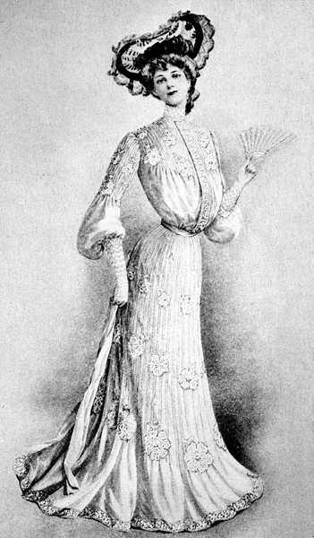
Picking up on another style from the past, the new lingerie dress is in fashion.
It is made of fine white cotton with inserts of lace. Flounces are added to the skirt width below the knee.
This Picture Frame hat pulls focus to the face.

Slide 58
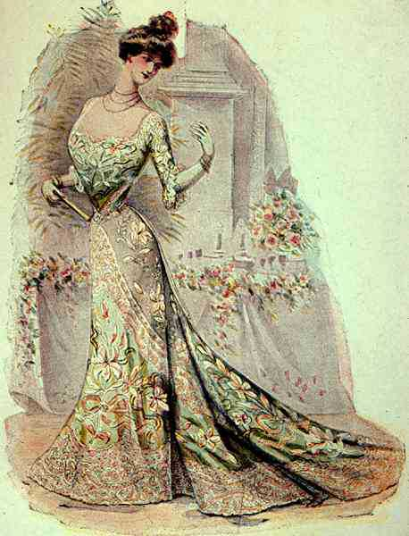
Fashion plate 1900
The long sleeved evening gown.
The neck is lower than ever
The ropes of pearls accentuate the long neck, so fashionable of the period.
The gored skirt turns into a trumpet skirt that flares out at the hem with a train.
The Gibson teapot hairdo is still in fashion.

Slide 59
1900 Dinner Dress

Slide 60
1902 Lord Dribblesdale Formal riding attire. Top hat, vest, jodphurs, boots and overcoat

Slide 61
“The suit” new look 1900 onwards
Focus on quality of cloth, tailoring, fit
1900 - 1910 shorter boxier jacket, 4 buttons, narrow trousers, no cuff, no crease
Shirts with detachable collars.

Slide 62
Men 1909
Tail coat and white tie as formal wear
Tuxedo (smokki in finnish) became popular style for formal evening wear

Slide 63
Men’s three piece suit and overcoats
Notice trousers turn-up hems and creases

Slide 64
A New age of Athleticism
1912 Hunting outfit
Plaid is in fashion for hunting and sports, this is a woolen plaid suit.
The jacket is slim with a back pleat for movement.
A split is added in the skirt to facilitate movement.
She wears knee high spats to protect her legs.

Slide 65
1906 Hiking outfit - Athleticism

Slide 66
1909 Margaret Strong Natural look. Seaside is fashionable. Washable clothing.

Slide 67
1910, Woman playing the piano

Slide 68
1914 Evening Gown

Slide 69
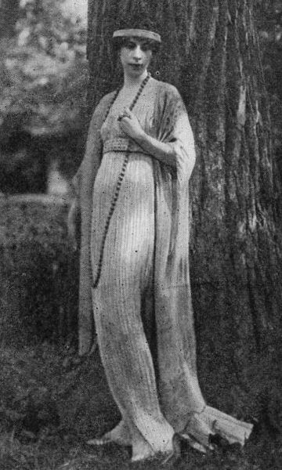
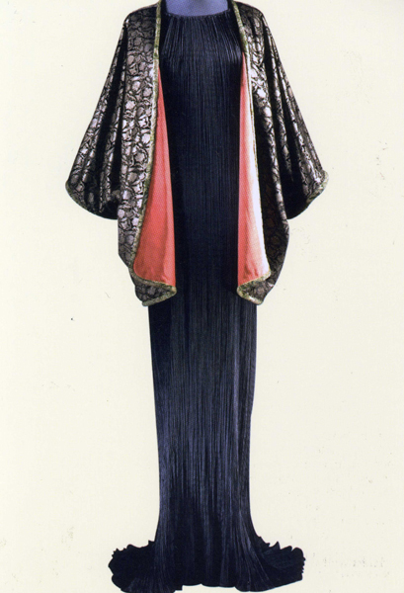
1909 Fortuny unveils the Delphos Gown
Gown below from 1920
Retains his influence until 1949

Slide 70
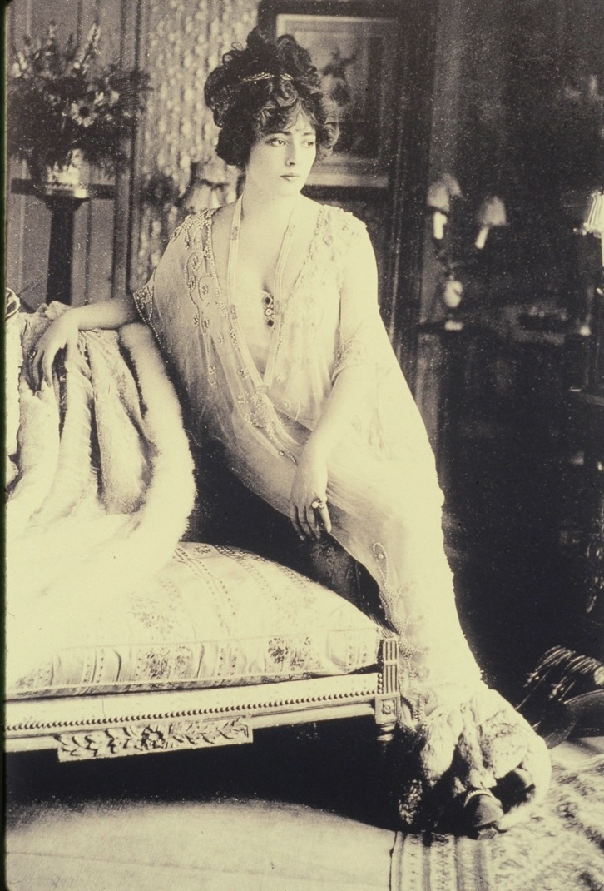
Callot Soeurs was a fashion design house opened in 1895 in Paris, France.
It was operated by the four Callot sisters. The eldest sister, Marie, was trained in dressmaking and they were all taught by their mother, a lacemaker.
Gown to the right by Madeleine Vionnet in 1908 makes the look of lingerie come out of the boudoir.
Notes:
The sisters began working with antique laces and ribbons to enhance blouses and lingerie.

Slide 71
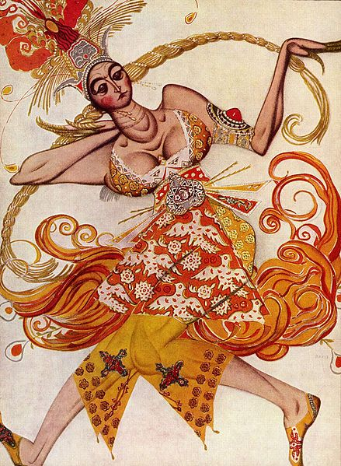
The Ballets Russes is a sensation in Paris
Sergei Diaghelev producer
Russian Dancers from Saint Petersburg.
Many Russians go to Paris prior the Russian Revolution in 1917.
Designers Alexandre Benois (scenery) & Leon Bakst influence fashion in color and form.
Michel Fokine was the first star choreographer.
Sketch by Bakst for the principle female
dancer in Firebird, Paris in 1910.
Notes:
France & Russia are allies against Germany.
Upper class Russians still speak French.

Slide 72
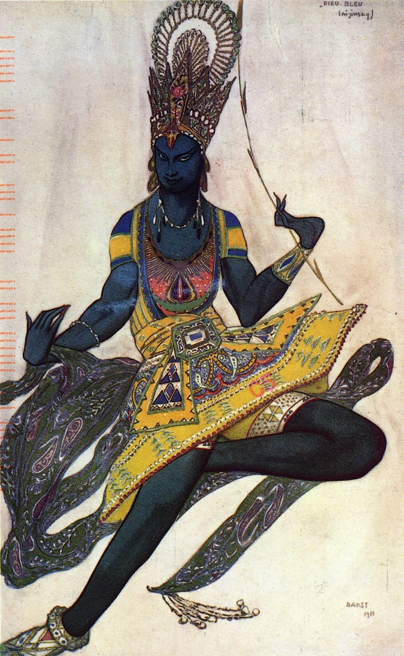
Leon Bakst Costume Design for the Ballet Russes
Notes:
Image of
Nijinsky 1910
and a sketch
for
La Bayadere
from 1911.
A new free and emotional form of expression.

Slide 73
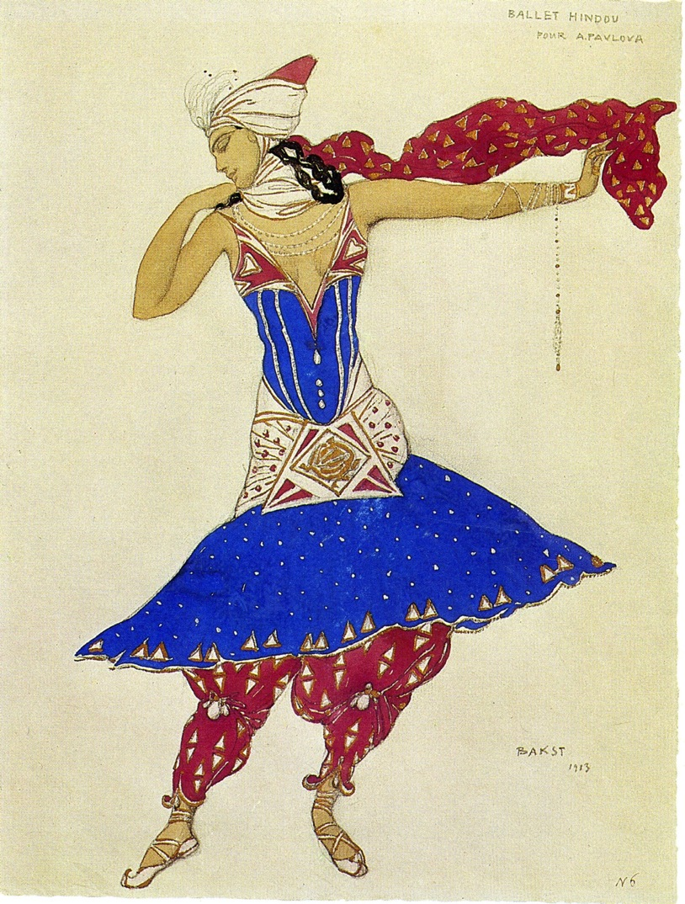
1913 Leon Bakst and the Ballets Russes
Design by Bakst for Anna Pavlova that inspired the Fashion world with color and new shapes. The harem pants were particularly sensational.

Slide 74
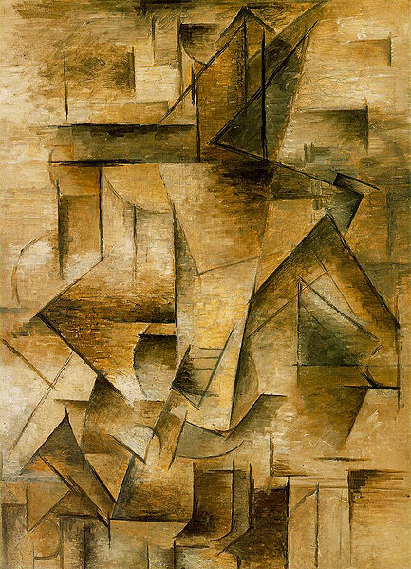
Cubists
1911 Cubist movement “Salon des Independants”
1910 Pablo Picasso
“The Guitarist”
The beginnings of Art Deco

Slide 75
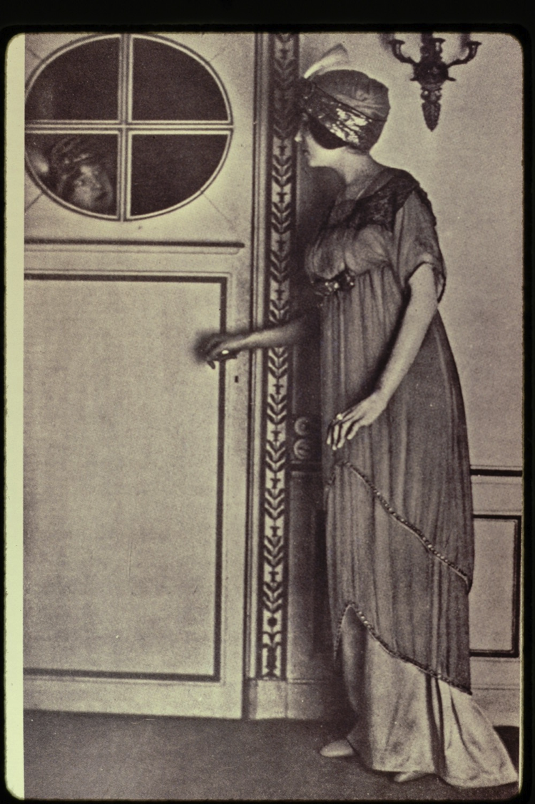
1912 Paul Poiret Fashion modeled by his wife. She was his favorite mannequin and was very petit.

Slide 76
1913 Illustration by Georges LePape showing a version of Poiret’s Lampshade dress called “Le Sorbet.”
Illustration from The Gazette du Bon Ton

Slide 77
The train disappears
1912 Paul Meras design from
The Life of The Tailor magazine.
Poiret’s new slim line, no corseted and high-waisted look takes off.
The skirt is off the ground, so she can go walking. Women take to the streets in slim lines and large hats.
Shopping becomes popular

Slide 78
1913 Mail order company Bellas Hess out of New York

Slide 79
1913, Sleek Silhouette
White satin embroidered blouse with the new sleeve cut with a softer armhole and a longer graceful length meant to be worn outside of the skirt.
Draped hobble skirt
New delicate pumps come into fashion as ankles are exposed.
Fashion plate from Les Costumes Parisiennes.
Jeanne Lanvin is the only notable woman designer at this time

Slide 80
Accessories gain a great deal of importance
1913 Illustration by Strimpl done for the Gazette du Bon Ton, showing a wide variety of fur accessories.
The use of fur is also inspired by the Ballets Russes

Slide 81
Evening Dresses stay slim
Even when the day dresses are growing bulkier with kimono inspired sleeves, the evening dresses stay slim.
This illustration by Georges Barbier in 1914 shows an evening gown with roses.
A new kimono jacket delicate for the evening made of translucent chiffon.

Slide 82
The suit 1914
Walking suit, short cropped jacket.
Skirt is bone straight with slit front for walking ease.
Spats are worn with boots
Gentleman has similar silhouette with high waist, above knee coat and spats showing beneath shorter trousers.
Georges Barbier Illustration done for Costumes Parisiennes

Slide 83
1914, The outbreak of World War I
Illustrator Ettiene Drian used the patriotic colors of the Marseillaise in the wake of the war
This illustration is from the Gazette du Bon Ton
Suddenly in 1915, the impractical hobble skirt is gone & skirts are fuller and hats are simpler.

Slide 84
Winter Coats, 1916
Georges Barbier illustration of coats in the Russian Style influenced by the Ballets Russes from just before the war
French and Russians are allies against the Germans

Slide 85
Art Nouveau
Towards the end of the war in 1917, the movement towards Art Nouveau in clothing re-emerges.
Dressing gown is experimenting with drape and Kimono sleeves
Assembly Rooms at Bath, England

Slide 86
American Mail Order
1916 Mail order catalogue showing furs.
Bellas-Hess Co., Inc is large company out of New York City
The jackets and boots are similar, but the skirt is a new fuller garment
Furs are also popular in the USA.

Slide 87
Perry-Dame Co. NYC
They are showing long, very modern looking swing coats with fur trim.
In USA beaver is more popular than fox fur
- for the practical American woman who works in the city.

Slide 88
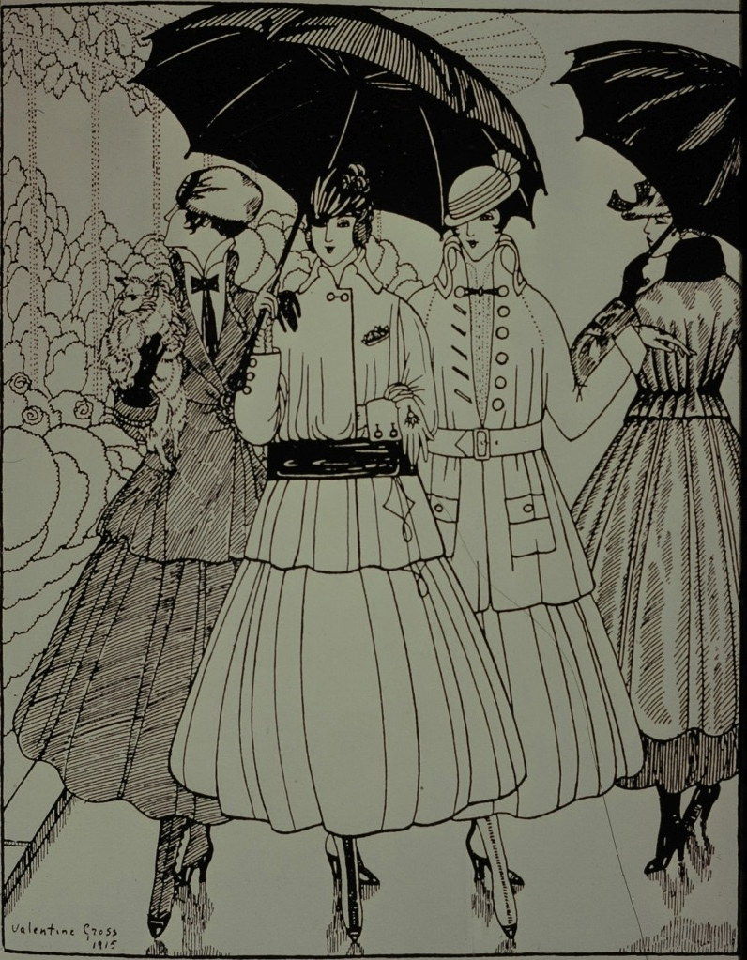
American Fashion Magazines
1917 – The USA enters WWI
Russian Revolution overthrows the last Tsar – Nicholas
Wife is Alexandra, daughter of Queen Victoria
American Fashion Mags take over during War
Harper’s Bazaar, Vogue
Valentine Cross Illustration of raincoats with a loosened waistline

Slide 89
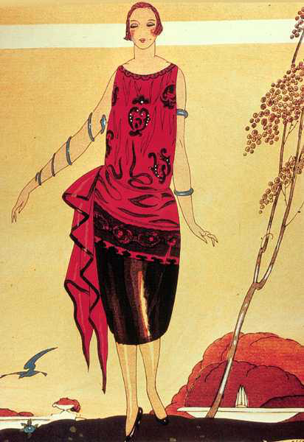
New Silhouette
In 1918 - End of WWI
- New Silhouettes developed by Paul Poiret in 1912, now finally popular
- Boat neck, waistline drops to hips
- The corset is replaced by the brassiere and girdle
- Alternative underwear is the “Step-in” Chemise

Slide 90
In 1917, this is described as semi-fitted “tailored” costume.
Cording as emphasis to the side hips
Hats push down on the head

Slide 91
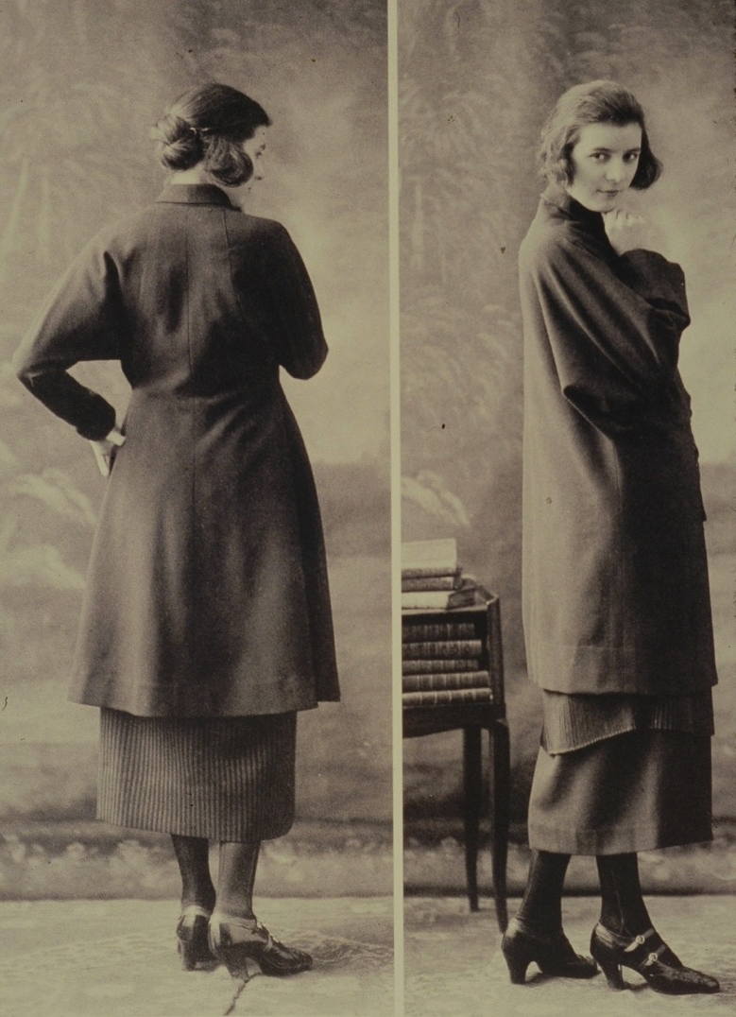
Vionnet 1919
Madeleine Vionnet, who has her own fashion house since 1912, was forced to close during the first World War.
She re-opened again after the war and built her business up to over 1000 employees. She works for women’s rights and for her employees.
Vacation time
Health care
Maternity leave
The Practical Post War Woman

Slide 92
The patent which Fortuny sent out in 1909 for his Delphos gown

Slide 93
Isadora Duncan was part of liberating women from the restrictive clothing

Slide 94
French couture designers 1920 - 1947
Notes:
French couture designers 1920 - 1947

Slide 95
1919 – The Bauhaus is established in Germany & the beginnings of Art Deco
Started much earlier, but delayed by World War I
Grows out of the Arts & Crafts Movement. Frank Lloyd Wright in Germany creating Folios in 1910 and is profoundly influenced.
Geometric style Influenced by Cubist movement.
1919 Marthe Romme is inspired by Leon Bakst, the designer from the Ballets Russes to make these new hip expanded evening gowns.

Slide 96
Loose 20s styles – kimono sleeves, shawl collars, waist drops out, hips shown off, boat necklines
Skirts shortens until mid decade, then gets longer again

Slide 97
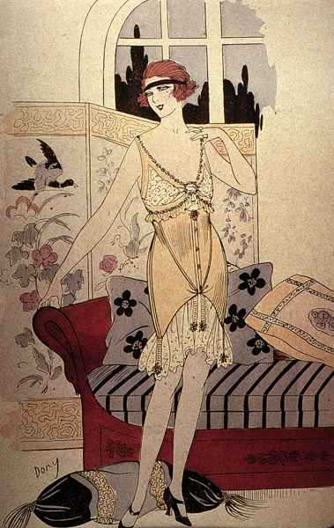
1920’s - new softer and less restrictive girdie underwear for women

Slide 99
Flapper dresses for 20s women who partied, danced, drank and smoke

Slide 100
Paul Poiret’s design 1926
Shoking Harem trousers and open backless halterneck gown, popular in the 30s

Slide 101
1927 - First bias cut dresses appear
Madeleine Vionnet is the leader of the bias cut dresses

Slide 102
Vionnet’s bias cut dresses
Style lead to 1930’s women’s main fashion style

