Slide 1
Exercise 10 (Flywheel)

Slide 2
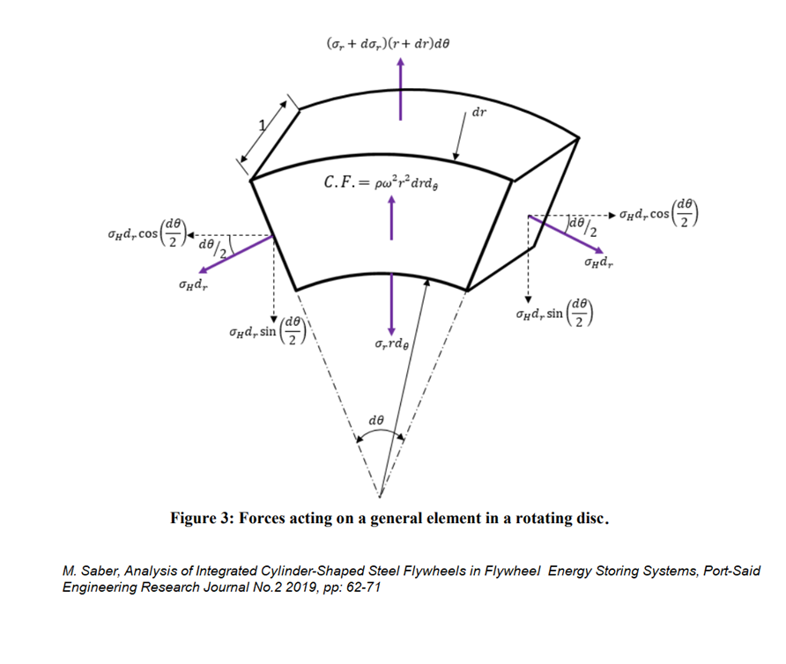

Slide 3
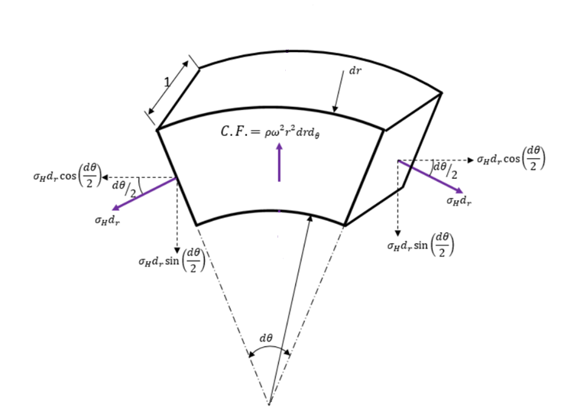
Thin disk, radial stresses can be left out
The forces due to surface stess have to match the centrifugal force (C.F.)
$σ_{H}=ω^{2}r^{2}ρ$ $ω_{max}^{2}= \frac{σ_{max}}{ρr^{2}}$

Slide 4

Energy density
$E= \frac{1}{2}Iω^{2}$ , $I=mr^{2}$
$\frac{E}{m}=\frac{1}{2}r^{2}ω^{2} , {\left(\frac{E}{m}\right)}_{max}=\frac{1}{2}r^{2}ω_{max}^{2}= \frac{1}{2}\frac{σ_{max}}{ρ}$
$→ {\left(\frac{E}{m}\right)}_{max,steel}=71\frac{\text{kJ}}{\text{kg}} , {\left(\frac{E}{m}\right)}_{max,kevlar}=388\frac{\text{kJ}}{\text{kg}}$

Slide 5

Maximum energy, rotation speed
$m=100 \text{kg} , r=0.5 \text{m}$
$E_{max,steel} =7.1 \text{MJ}$ , ${ E}_{max,kevlar} =38.8 \text{MJ}$
$ω_{max,steel}=755 \frac{rad}{s} ,{ ω}_{max,kevlar}=1761 \frac{rad}{s}$ $=7200$ rpm , $=16800$ rpm

Slide 6
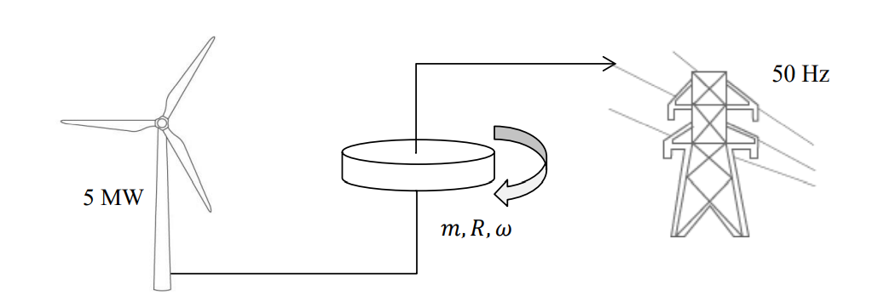
Homework

Slide 7
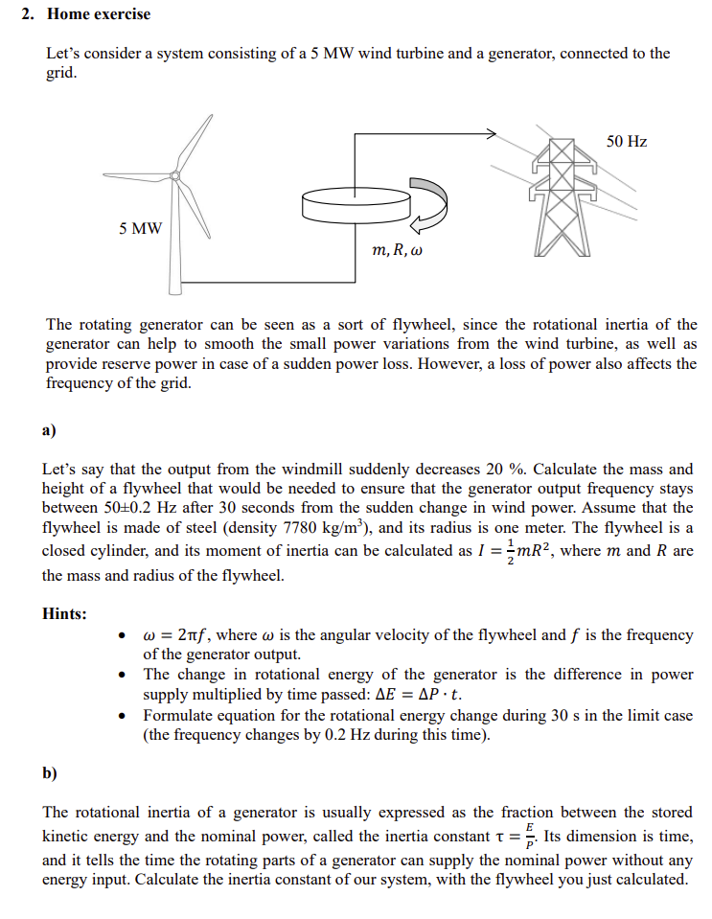
Homework tips
a) Solve the required inertia first
$E= \frac{1}{2}Iω^{2}$
$→ΔE= …=ΔP⋅t$
or
$\frac{dE}{dt}= \frac{d}{dt}\left(…\right)= ΔP ,$
$$\text{integrate} \text{and} \text{use} \text{boundary} \text{conds}\text{.}$$

