Slide 1
What is a Designer ?

Slide 2
Designer is a problem solver:
Understand the problem and parameters
Define goals
Brainstorm
Use the available tools to experiment
Reflect on experiments
Produce

Slide 3
Arrival at Aalto

Slide 4
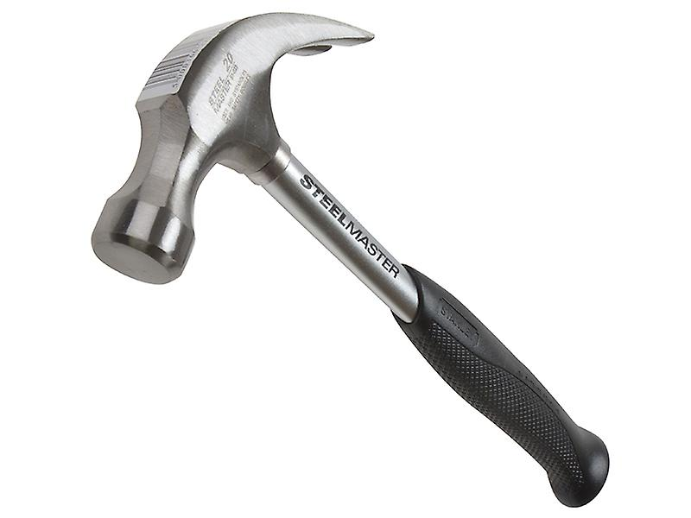
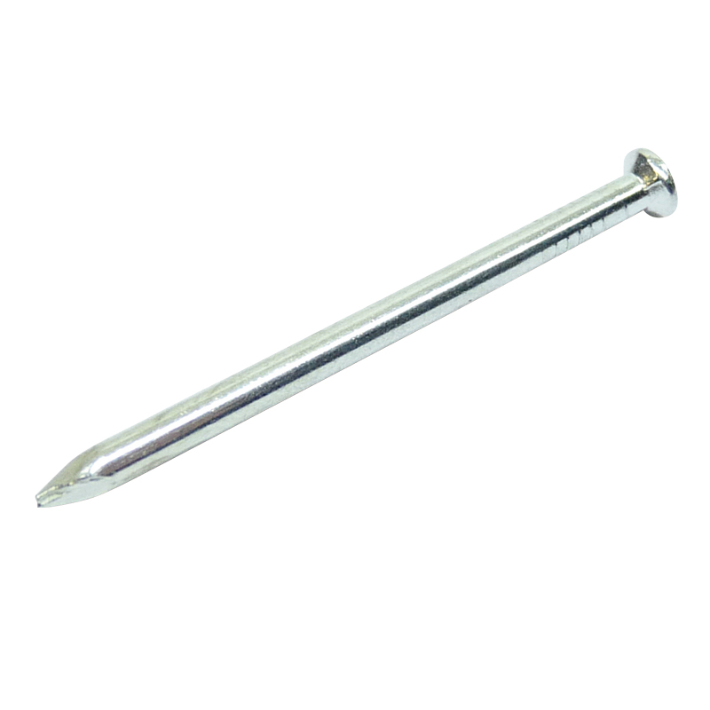
If the only tool you have is a hammer, then every problem is a nail

Slide 5
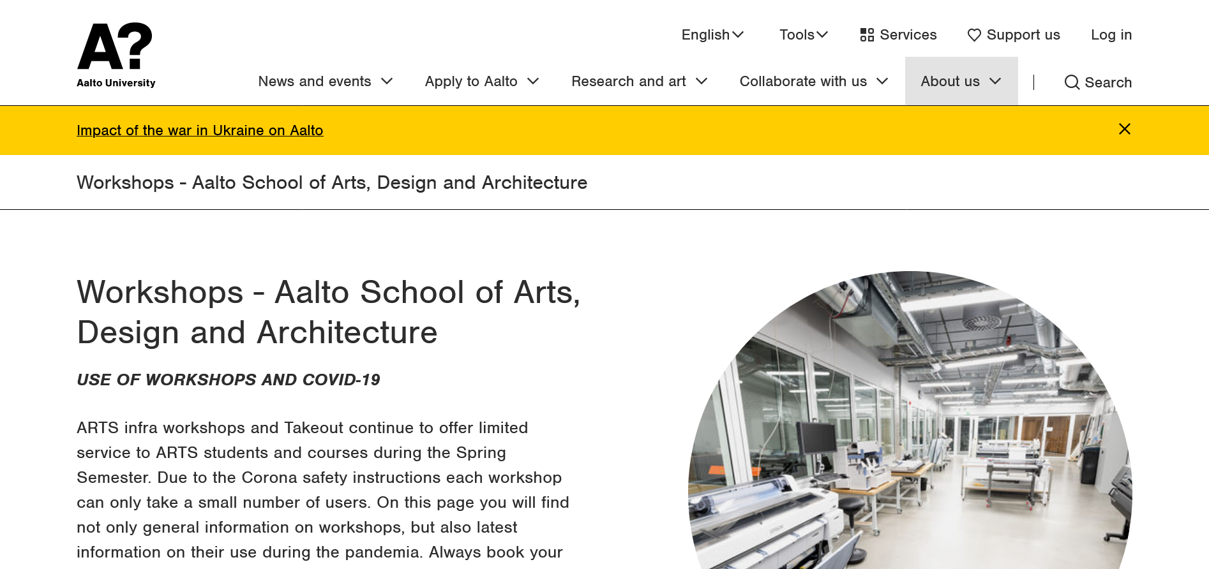

Slide 6
Graduating from Aalto

Slide 7
What do you envision when you hear Glass?

Slide 8
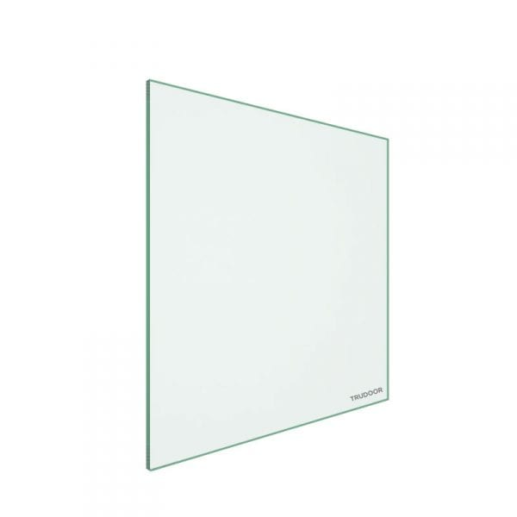
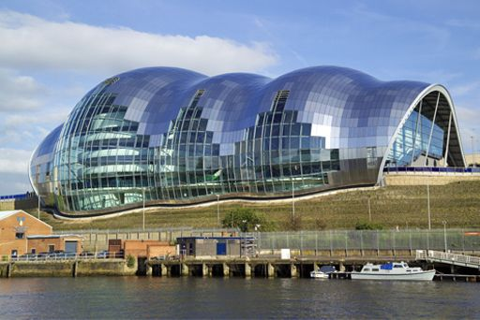
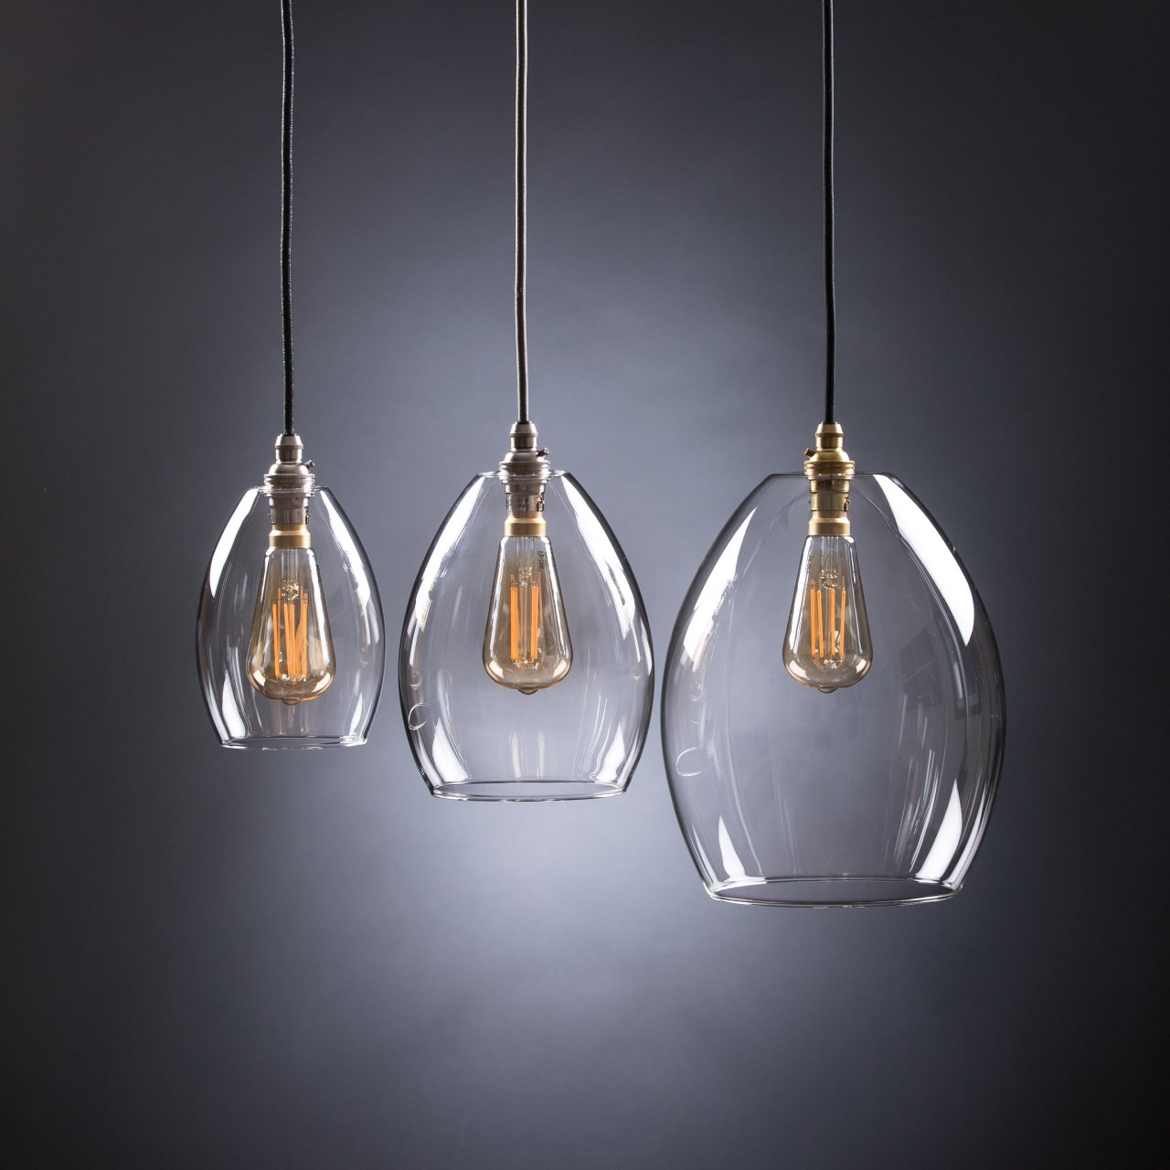
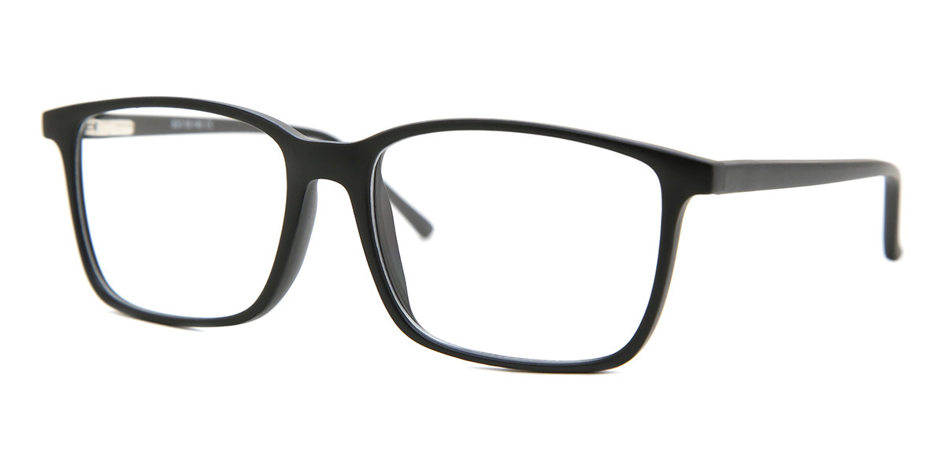
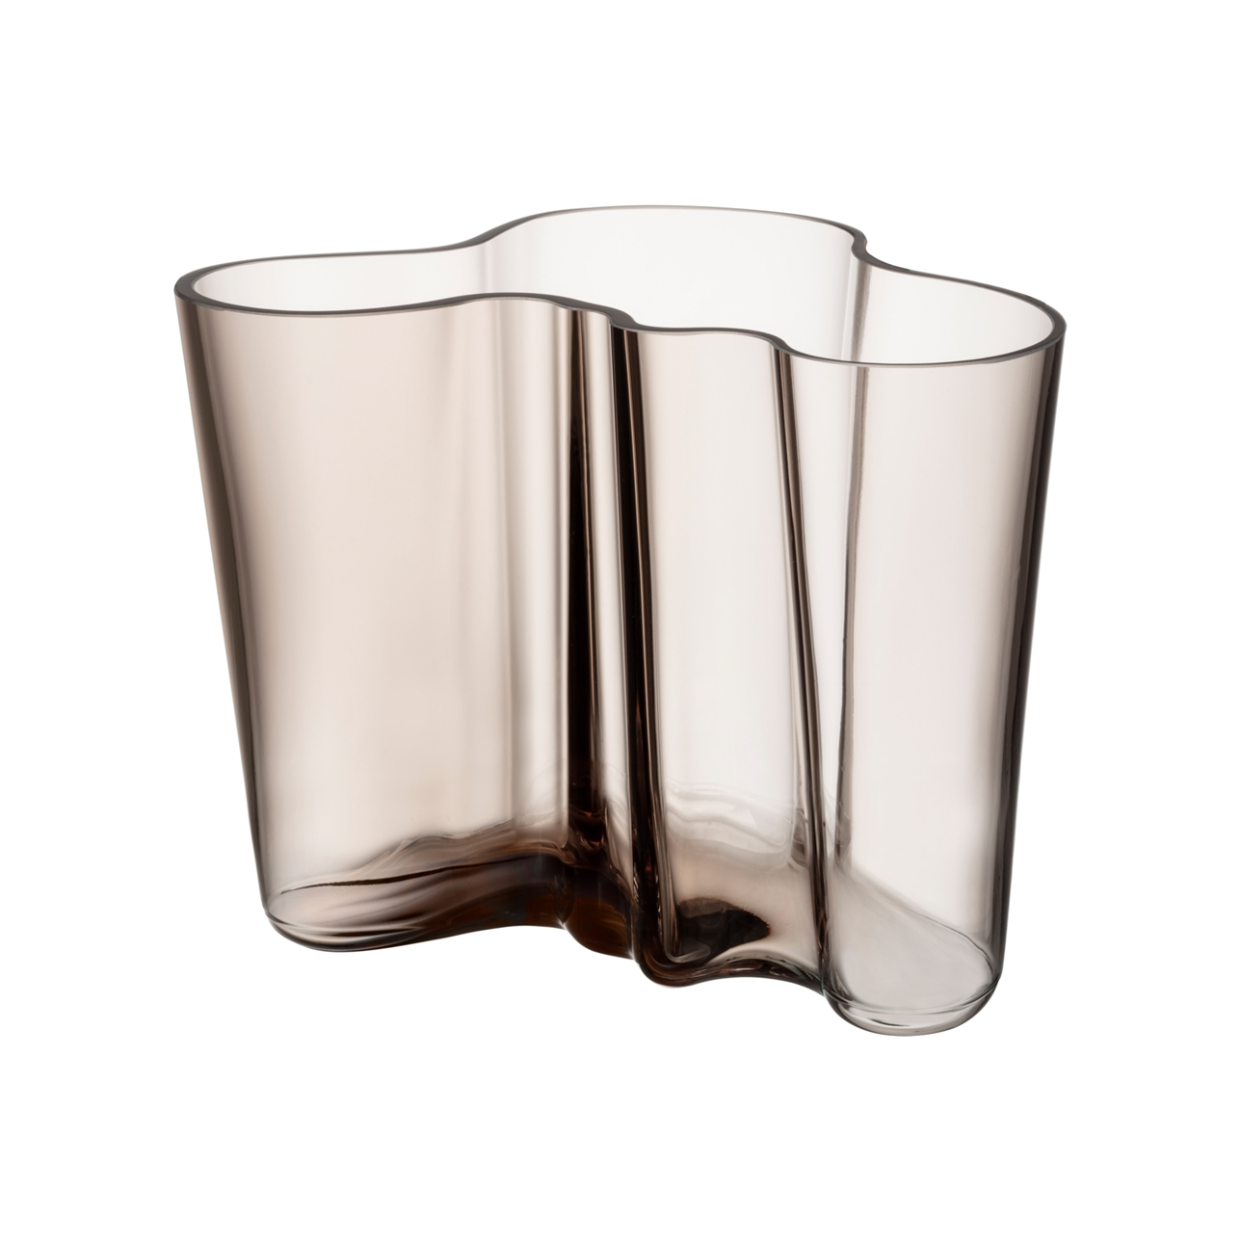
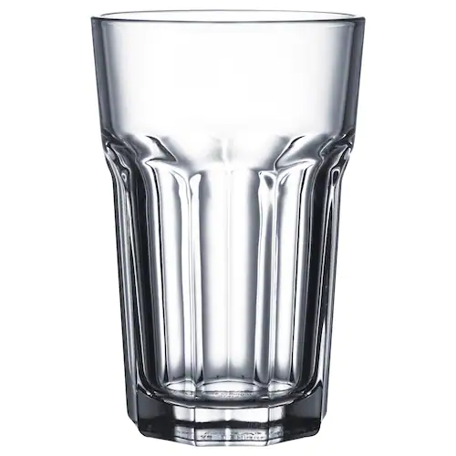

Slide 9
Lasi, Glass, Vitro, Glas 6000 years old Mesopotamia 1291 in Murano 1406 in Northern Europe 1556 in Sweden 1681 in Finland 1732 in USA

Slide 10
The Glass Age, Part 1: Flexible, Bendable Glass - YouTube

Slide 11
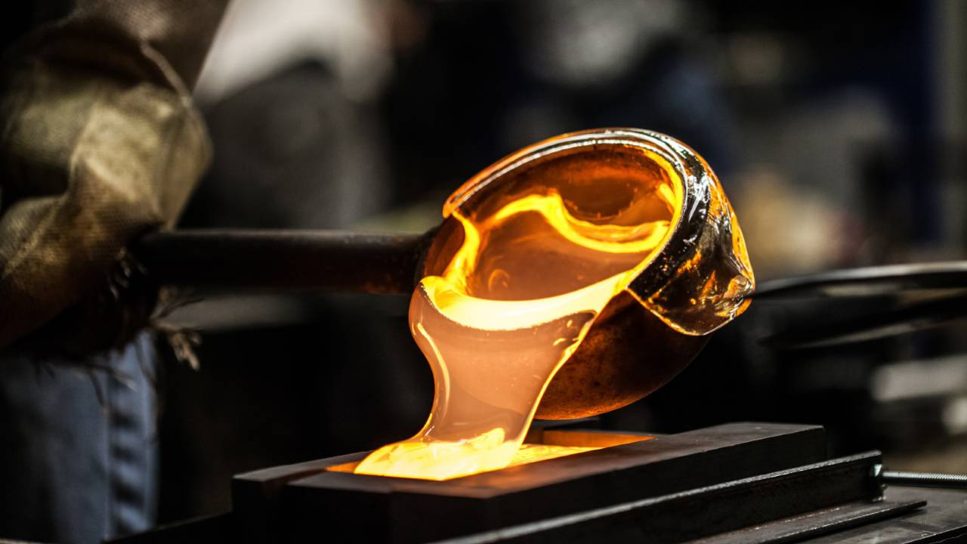
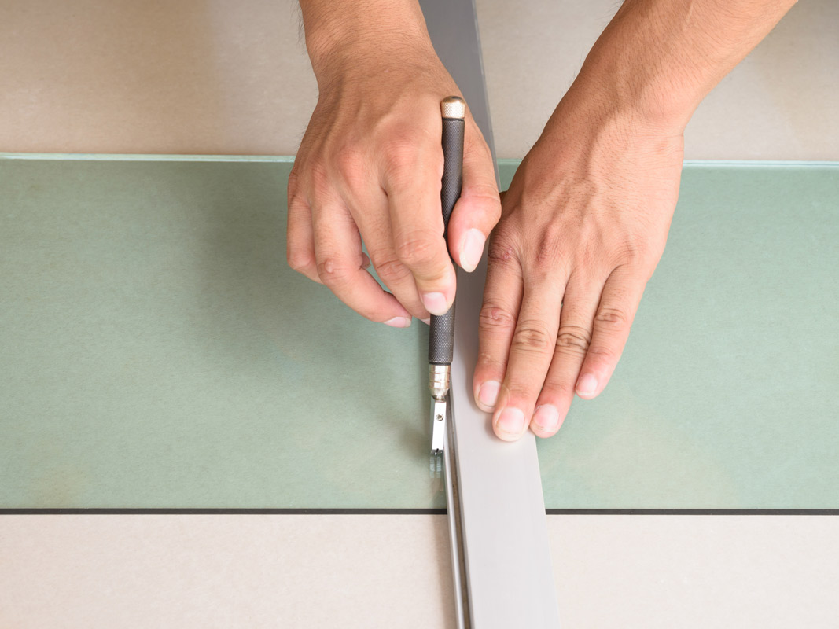
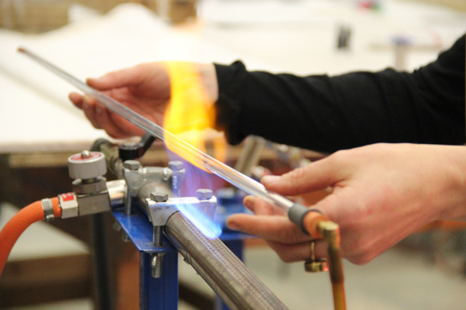
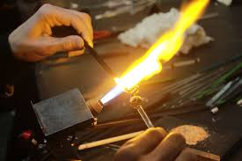
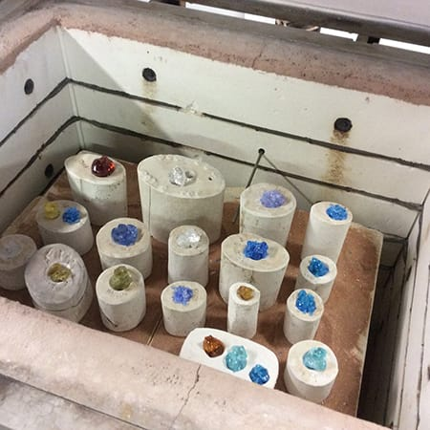
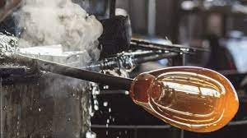
Hot Casting
Cutting
Neon Tube bending
Flameworking
Kiln Casting
Blowing

Slide 12
Glass Design in Finland
Iittalan lasitehdas 1881-
Nuutajärven lasitehdas 1973–2014
Karhulan lasitehdas 1889–2009
Humppilan lasitehdas 1952-2008
Riihimäen Lasi Oy 1910–1990
Kumelan lasitehdas 1937–1985

Slide 13
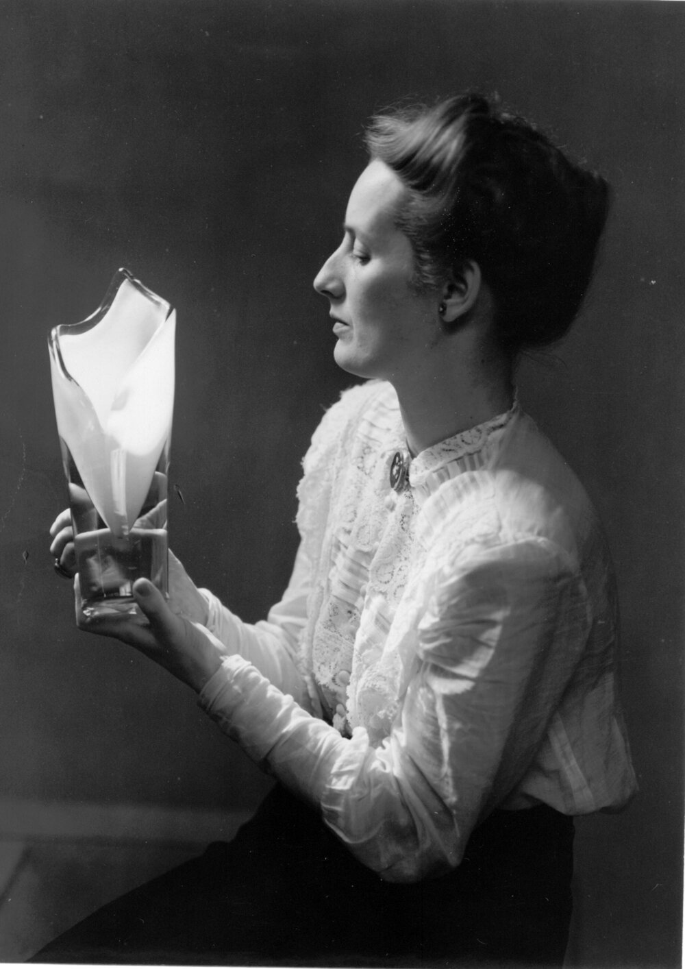
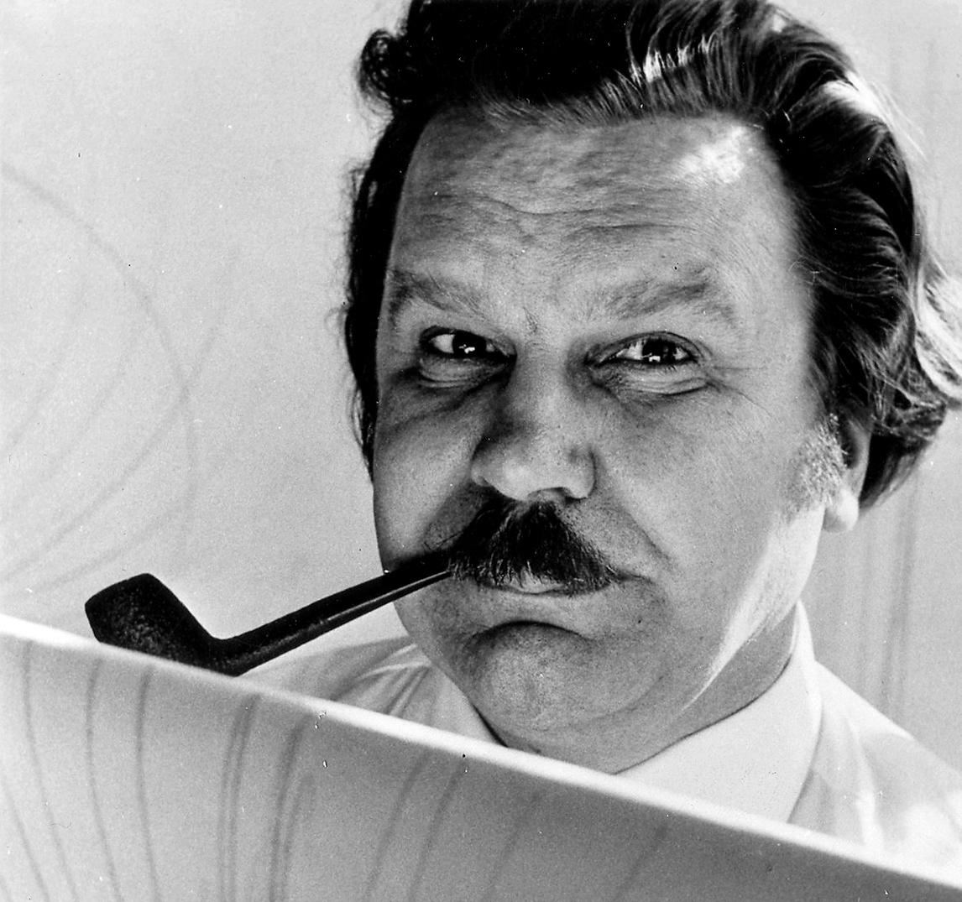
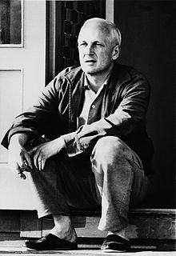
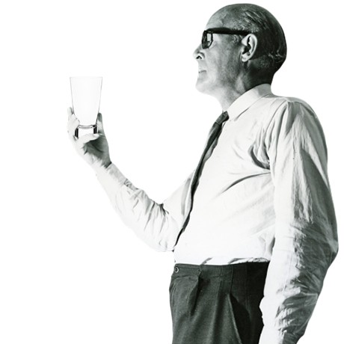
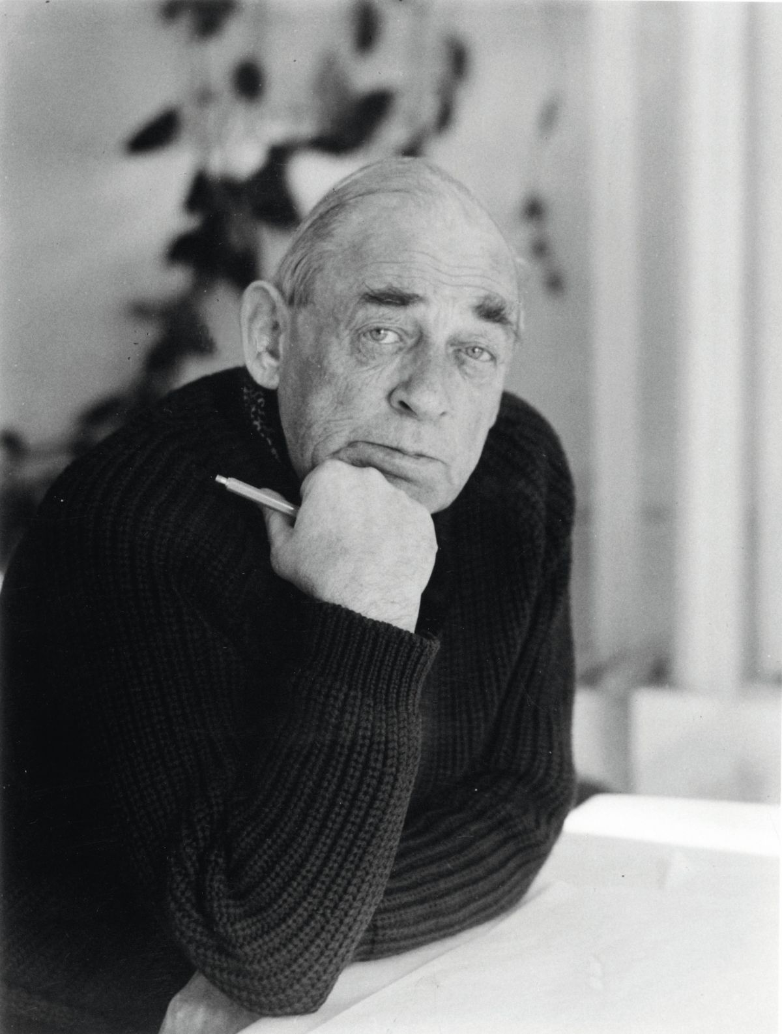
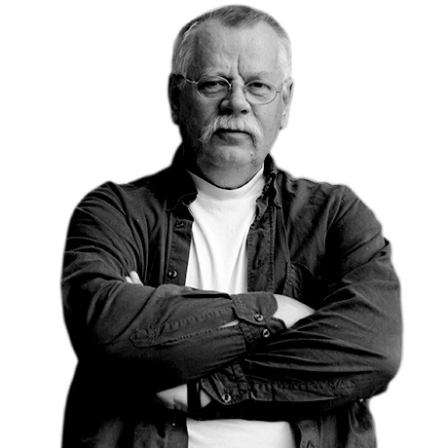
Tapio Wirkkala (1915-1985)
Oiva Toikka (1931-2019)
Alvar Aalto (1898-1976)
Timo Sarpaneva (1926-2006)
Kaj Franck (1911-1989)
Göran Hongell (1902-1973)
Gunnel Nyman (1909-1948)
Nanny Still McKinney (1926 – 2009)

Slide 14
“A composer is nothing without an orchestra“ - Timo Sarpaneva
The designer is nothing unless he is able to communicate with the people who carry out the work.
In the implementation of works, the work of professionals is important,
it is pointless to compose a brilliant symphony if the orchestra is unskilled.
Graphic Designer
Industrial Designer – Glass, Textiles, Flatware

Slide 15
Jasper Morrison
Matti Klenell
Alfredo Häberli
Antonio Citterio
Magnus Pettersen
Santtu Mustonen

