Slide 1
Realizing the power of brands
Think of a brand that you love/hate.
Now write as many characteristics about it as possible–
objects,
feelings,
images,
stories
keywords or phrases
experiences

Slide 2

Functional
Emotional
Symbolic
Experiential

Slide 3

Brand Management
In the 21st century!
Dr. Kushagra Bhatnagar
19.04.2022

Slide 4

About the instructor
Born in New Delhi, India
Bachelors in Computer Science
MBA (Triple Accredited)
Professional experience across Investment Banking, Advertising, Marketing Consulting
Co-founder – Brand consulting firm (2011-2015)
PhD, Aalto University School of Business (2015 - 2020)
Assistant Professor (2020 – current)

Slide 5














Consulting Experience

Slide 6
Course Objectives
To understand what are brands, why do they exist, what makes them powerful
To review the most important tools, theories and methods that contemporary brand managers can use to understand and manage brand performance
To understand the relevance and evolution of brand management strategies/approaches;
To identify key challenges to impactful brand management

Slide 7
Assessment Plan
Assessment
Instructor Assessment
Formative
Summative
Self Assessment
Attendance and Self-Evaluation
50%
Four weekly assignments which will be due on 1.5, 8.5, 15.5 and 22.5
35%
One ”end of period” assignment due on 19.6
15%

Slide 8
Instructions for readings
The course readings include
  14 mandatory articles
  14 supplementary articles
  A number of “if you’re interested in this further” articles
All readings are uploaded in mycourses

Slide 9
Class schedule
PLEASE CLICK A PHOTO FOR YOUR REFERENCE
19.04 (15:15-17:00) – Classroom Session V001, Väre
21.04 (15:15-17:00) - Classroom Session V001, Väre
26.04 (15:15-17:00) - Classroom Session V001, Väre
28.04 (15:15-17:00) - Classroom Session V001, Väre
03.05 (15:15-17:00) - Classroom Session V001, Väre
05.05 (15:15-17:00) - Classroom Session V001, Väre
10.05 (15:15-17:00) - Classroom Session V001, Väre
12.05 (15:15-17:00) - Classroom Session V001, Väre
17.05 – Recorded online session
19.05 – Guest Lecture: Percy Smend

Slide 10
Weekly plan
Week 1
Week2
Week3
Week4
Week 5
Introduction to the course and practicalities
Approaches and Building blocks of Brand Management
Mindshare Branding
Emotional Branding
Cultural Branding
Experiential branding
Managing Brand Portfolios
Aligning Brand Strategy, Research and Context
Future of Brand management
Guest Lecture – Percy Smend

Slide 11
Attendance Policy
Everyone is an Adult
There are going to be 8 contact-sessions with me
You can miss two without any penalty.
If you miss more than two, then your assessment goes down proportionally
E.g. if you miss three sessions, the maximum you can score from “Attendance and Self-Evaluation” is ((5/8)*15)%.

Slide 12

A brief history of branding

Slide 13


Slide 14
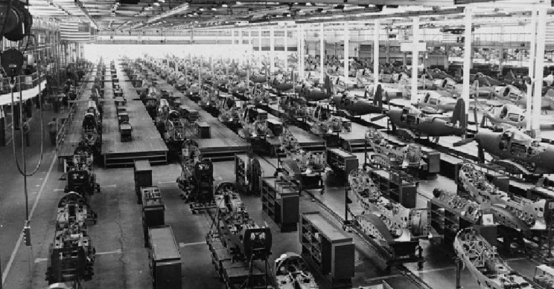

Slide 15
Mass production creates the need for branding
The emergence of mass production enabled catering to mass markets​
The rise of mass media enabled communicating brand positions across geographic distances​
The rise of transportation systems enabled branded goods to start competing head-on with unbranded retailer goods​
The importance of trademark laws!​

Slide 16
Companies make Brand Management Systems
From the1930s, “brand management” was already considered an organizational discipline, as championed by Proctor & Gamble (P&G) (Low & Fullerton 1994) ​
By the 1950s, the majority of companies had followed P&G’s lead ➔ “brand management systems”​
As markets expanded and goods could be found in practically all product categories, brand awareness efforts became necessary to break through the market clutter​

