Slide 1
Weekly plan
Week 1
Week2
Week3
Week4
Week 5
Introduction to the course and practicalities
Approaches and Building blocks of Brand Management
Mindshare Branding
Emotional Branding
Cultural Branding
Experiential branding
Managing Brand Portfolios
Aligning Brand Strategy, Research and Context
Future of Brand management
Guest Lecture – Percy Smend

Slide 2
Approaches and Building blocks of Brand Management
Session - 2
Dr. Kushagra Bhatnagar
21.04.2022

Slide 3
RECAP
Brands are complex entities
They are difficult to ‘Manage’
They mean different things to different people

Slide 4
In-Class Reflective activity
Think of a brand created in the 2020s? What makes this brand catch your attention?

Slide 5
What is a Brand?

Slide 7
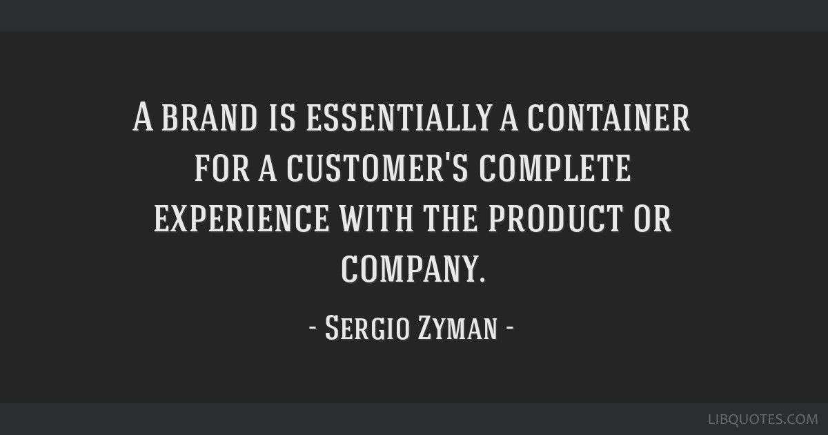
“A brand is essentially a container for a customer’s complete experience with the product or company.” ​
-- Sergio Zyman​

Slide 8
American Marketing Association definition
“name, term, sign, symbol, or design, or a combination of them, intended to identify the goods and services of one seller or group of sellers and to differentiate them from those of competition.”
IS THIS DEFINITION ENOUGH??

Slide 9
Why do Brands exist?
Simplify choice?
Promise quality?
Reduce risk?
Charge a premium?
Add to a company’s assets on the balance sheet?

Slide 10
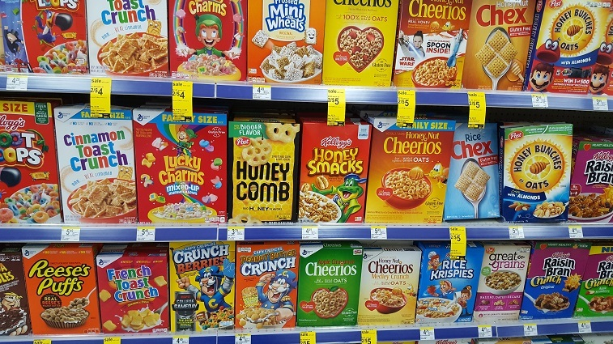
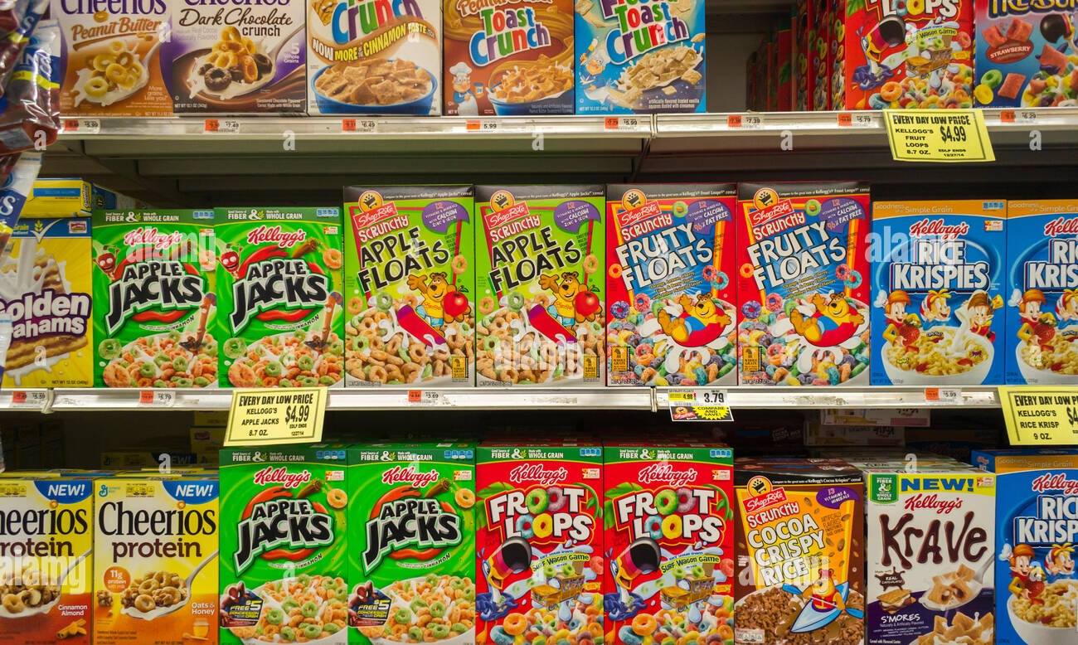
Simplify choice?

Slide 11
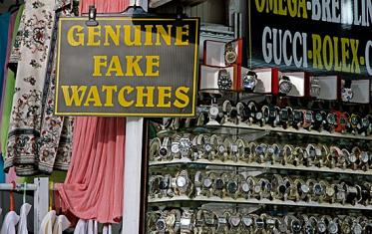
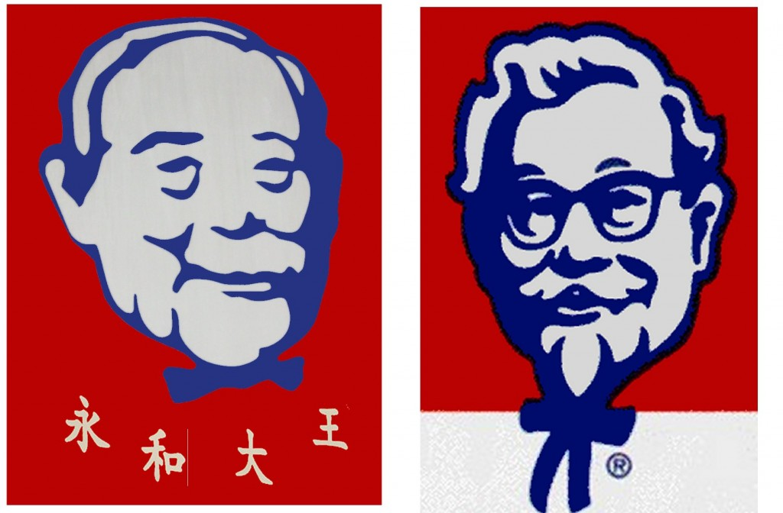
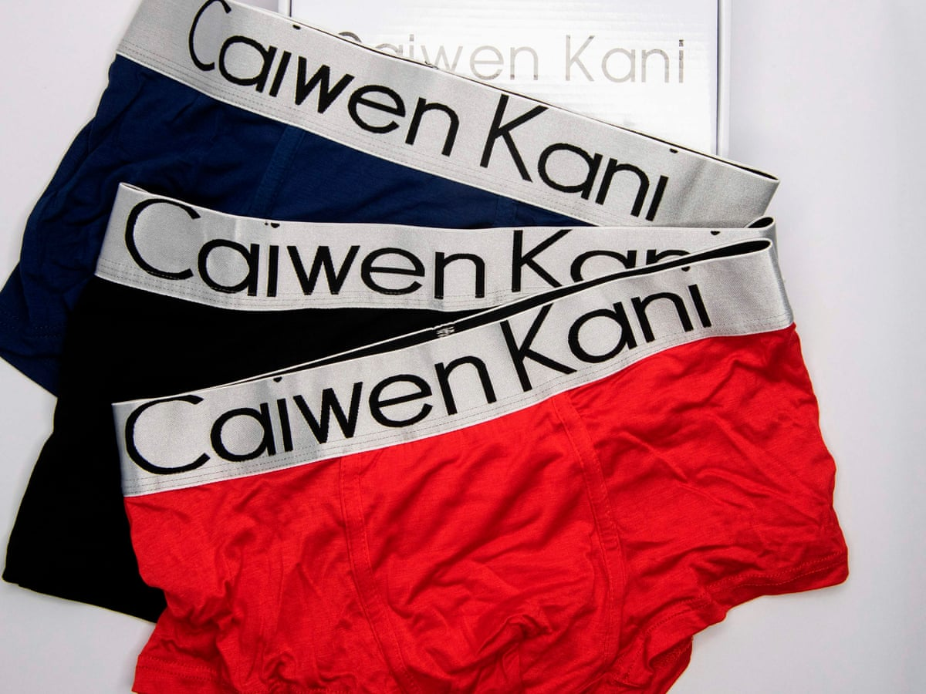
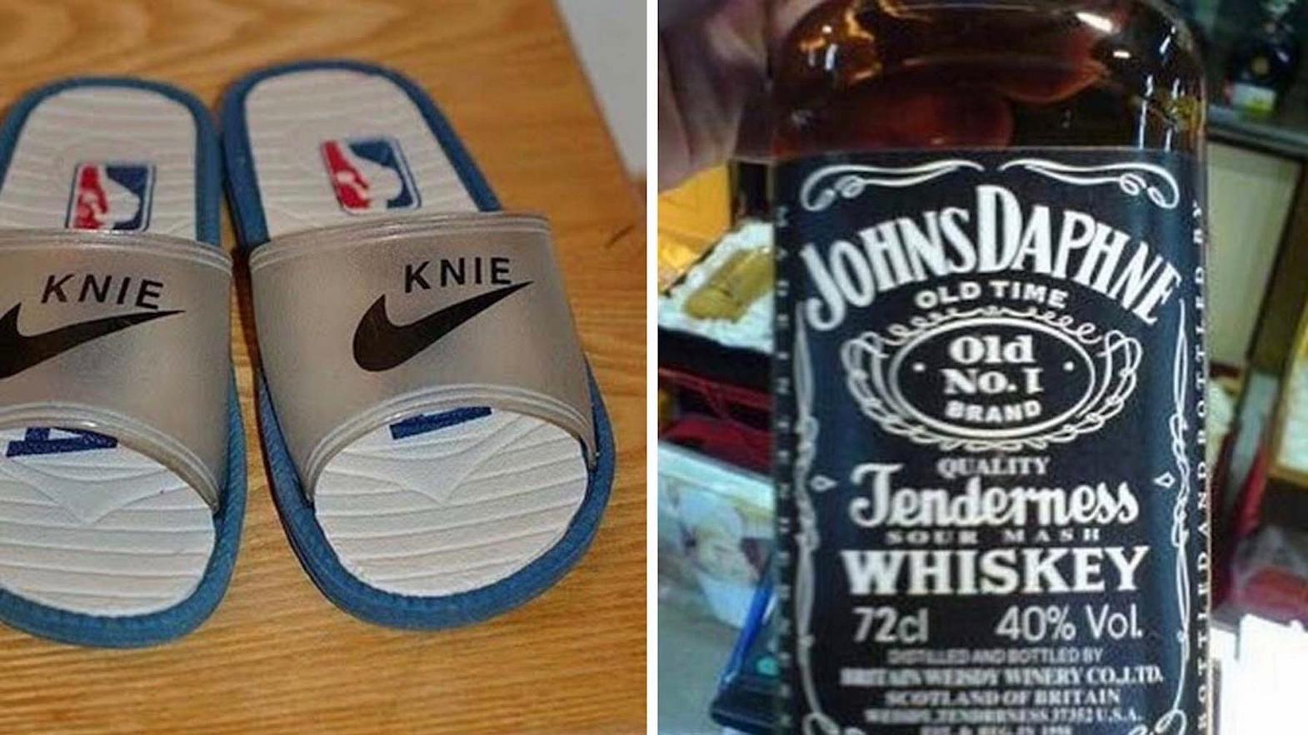
Promise Quality?

Slide 12
Reducing Risk?

Slide 13
Why is brand-building difficult?
If brands are so important, why isn’t everybody building strong brands?​
How should we look at brand building?​

Slide 14
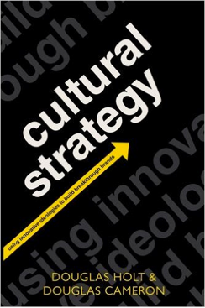
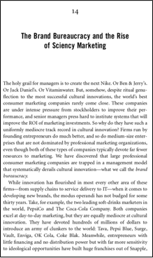
“brand bureaucracies” create weak branding

Slide 15
Unmanageable Brands!!
Brand Identity
Brand Values
Brand Image
Brand Architecture
Brand Portfolio
Brand DNA
DEFINE
CONNECT
Brand Report Card
Brand Audit
Brand Equity
MEASURE

Slide 16
Whose responsibility is branding?
Sales Rep?
Marketing Manager?
Brand Manager?
Product Manager?
All of the above?

Slide 17
Price of this shirt?
Mentimeter

Slide 18
Price of this shirt?
Mentimeter

Slide 19
Market Researcher
Set of Associations/
Impressions/
benefits
Accountant
Intangible Asset on the balance sheet
Micro-Economist
Mechanism to charge premium

Slide 20
Brand equity = the additional sum of money a consumer is willing to pay vs. a similar, unbranded product (de Chernatory & McDonald 1992)

Slide 21
Brand Equity
“when a relevant constituent reacts more positively to, for example, an ad campaign, a product or service than if it would have been issued by an unknown or fictitious company” (Schulz et al. 2000; Farquah 1989)​
“a set of assets (and liabilities) linked to a brand’s name and symbol that adds to (or subtracts from) the value provided by a product or service to a firm and/or that firm’s customers.” (Aaker 1996, p. 7-9)​

Slide 22
Awakening to the financial value of brands
E.g., Brand Asset Valuator (BAV)
Brand as a trademark whose value is never really exploitable
”Spreadsheet” view of brands and branding
Useful for Mergers & Acquisitions but not much else

Slide 23
BAV

Slide 25
What branding is NOT

Slide 26
Positioning is NOT branding
Positioning = Identifying a value/adjective/feeling that the brand can associate itself with through paid communication or other media
Pepsi = Young + Refreshing
Apple = Creative + Futuristic

Slide 27
Advertising is NOT branding
Advertising = Paid media that reinforces a particular story or benefit or value through repeated exposure to the message
Budweiser beer = Cool + Anti-establishment
McDonalds = Indulgent
(But do you get that feeling from the brand)

Slide 28
Paradigms for Brand Management

Slide 29
What is a brand management paradigm?
“a deep-seated way of seeing and managing brands and their value, shared by the members of an organizational community marked by a common culture” (Louru 2001)

Slide 30
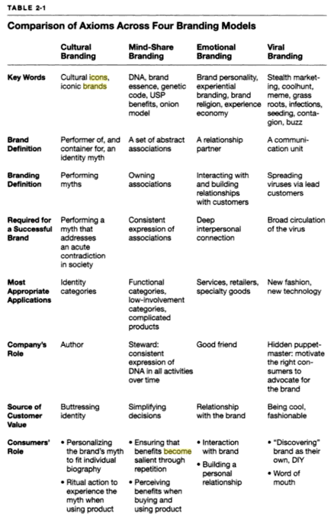
Branding Paradigms
Notes:
Figure out different elements of each branding paradigm and make the paradigm shifts as the main red thread of the course

Slide 31
Mindshare Branding: ’It’s Toasted’

Slide 32
Brand = Rational Differentiation
@Pic credit: IMDB
Notes:
Someone who sat on the other side of the table as charismatic admen told them what their brand meant.

Slide 33
Abstract, associative brand management
Simplified research: Keeping complexity out of marketing​
Rich consumer research is reduced to keywords that can be distributed efficiently to insiders and outsiders
Mindshare branding: Debating abstract adjectives​ as characteristics or associations
Brands = manageable essences

Slide 34
Emotional Branding: ’Kodak Carousel’

Slide 35
Brand = Emotional Journey
@Pic credit: IMDB
Notes:
Someone who sat on the other side of the table as charismatic admen told them what their brand meant.

Slide 36
Cultural Branding: WeWork
Cultural conversation + Brand Meaning + Product

Slide 37
https://www.youtube.com/watch?v=X2LwIiKhczo

Slide 38
Experiential Branding: Disneyworld

Slide 40
Resources
Gobe, Marc (2001), Emotional Branding: The New Paradigm for Connecting Brands to People. New York: Allworth Press.
Al Ries and Jack Trout (1998) Positioning: The battle for your mind
Doug Holt (2006) How brands become Icons
Bernd Schmitt (1999) Experiential Marketing

Slide 41
Assignment 1 – Projective Techniques to understand brand complexity and width
Think of your favorite brand. Now imagine this brand as each one of the elements below. Explain your choice of each element in 2 to 3 sentences.
an animal
an image
a public persona (PS: Not the official brand ambassador)
a feeling/emotion
a relationship
a place

