Slide 1
Resources (if you want to go deeper)
Gobe, Marc (2001), Emotional Branding: The New Paradigm for Connecting Brands to People. New York: Allworth Press.
Al Ries and Jack Trout (1998) Positioning: The battle for your mind
Doug Holt (2006) How brands become Icons
Bernd Schmitt (1999) Experiential Marketing

Slide 2
Weekly plan
Week 1
Week2
Week3
Week4
Week 5
Introduction to the course and practicalities
Approaches and Building blocks of Brand Management
Mindshare Branding
Emotional Branding
Cultural Branding
Experiential branding
Managing Brand Portfolios
Aligning Brand Strategy, Research and Context
Future of Brand management
Guest Lecture – Percy Smend

Slide 3
Mindshare Branding
Session - 3
Dr. Kushagra Bhatnagar
25.04.2022

Slide 4
CATEGORY
EMPLOYEES
STAKEHOLDERS
BRANDING
PRODUCT
CUSTOMERS
INSTITUTIONS

Slide 5
What does a mindshare-centric brand “do”?​

Slide 6
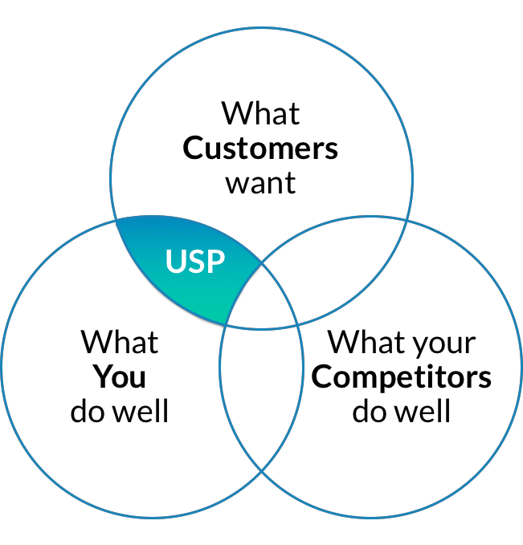

Slide 7
Brand = Interface between disconnected parties
To be able to find common ground between customers and company stakeholders
To “orient” different parts of an organization towards a shared understanding
Thus, keeping it simple and concretely-connected to products

Slide 8

Go to www.menti.com and use the code 4901 9561

Slide 9
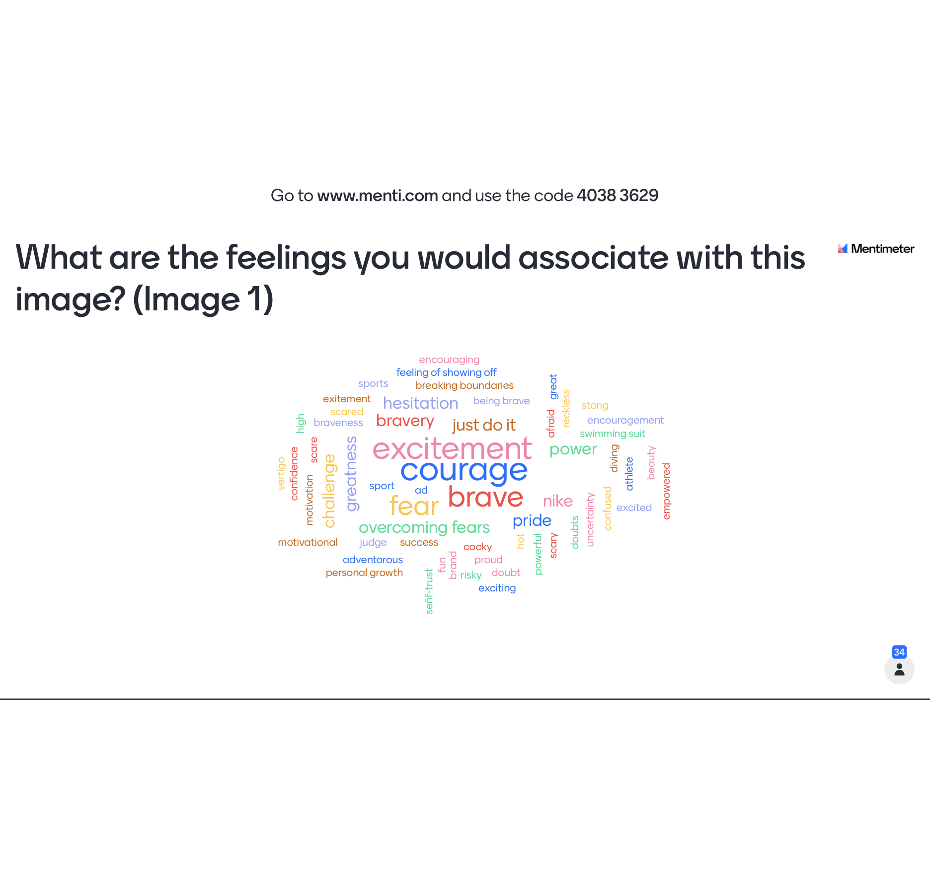

Slide 10


Slide 11
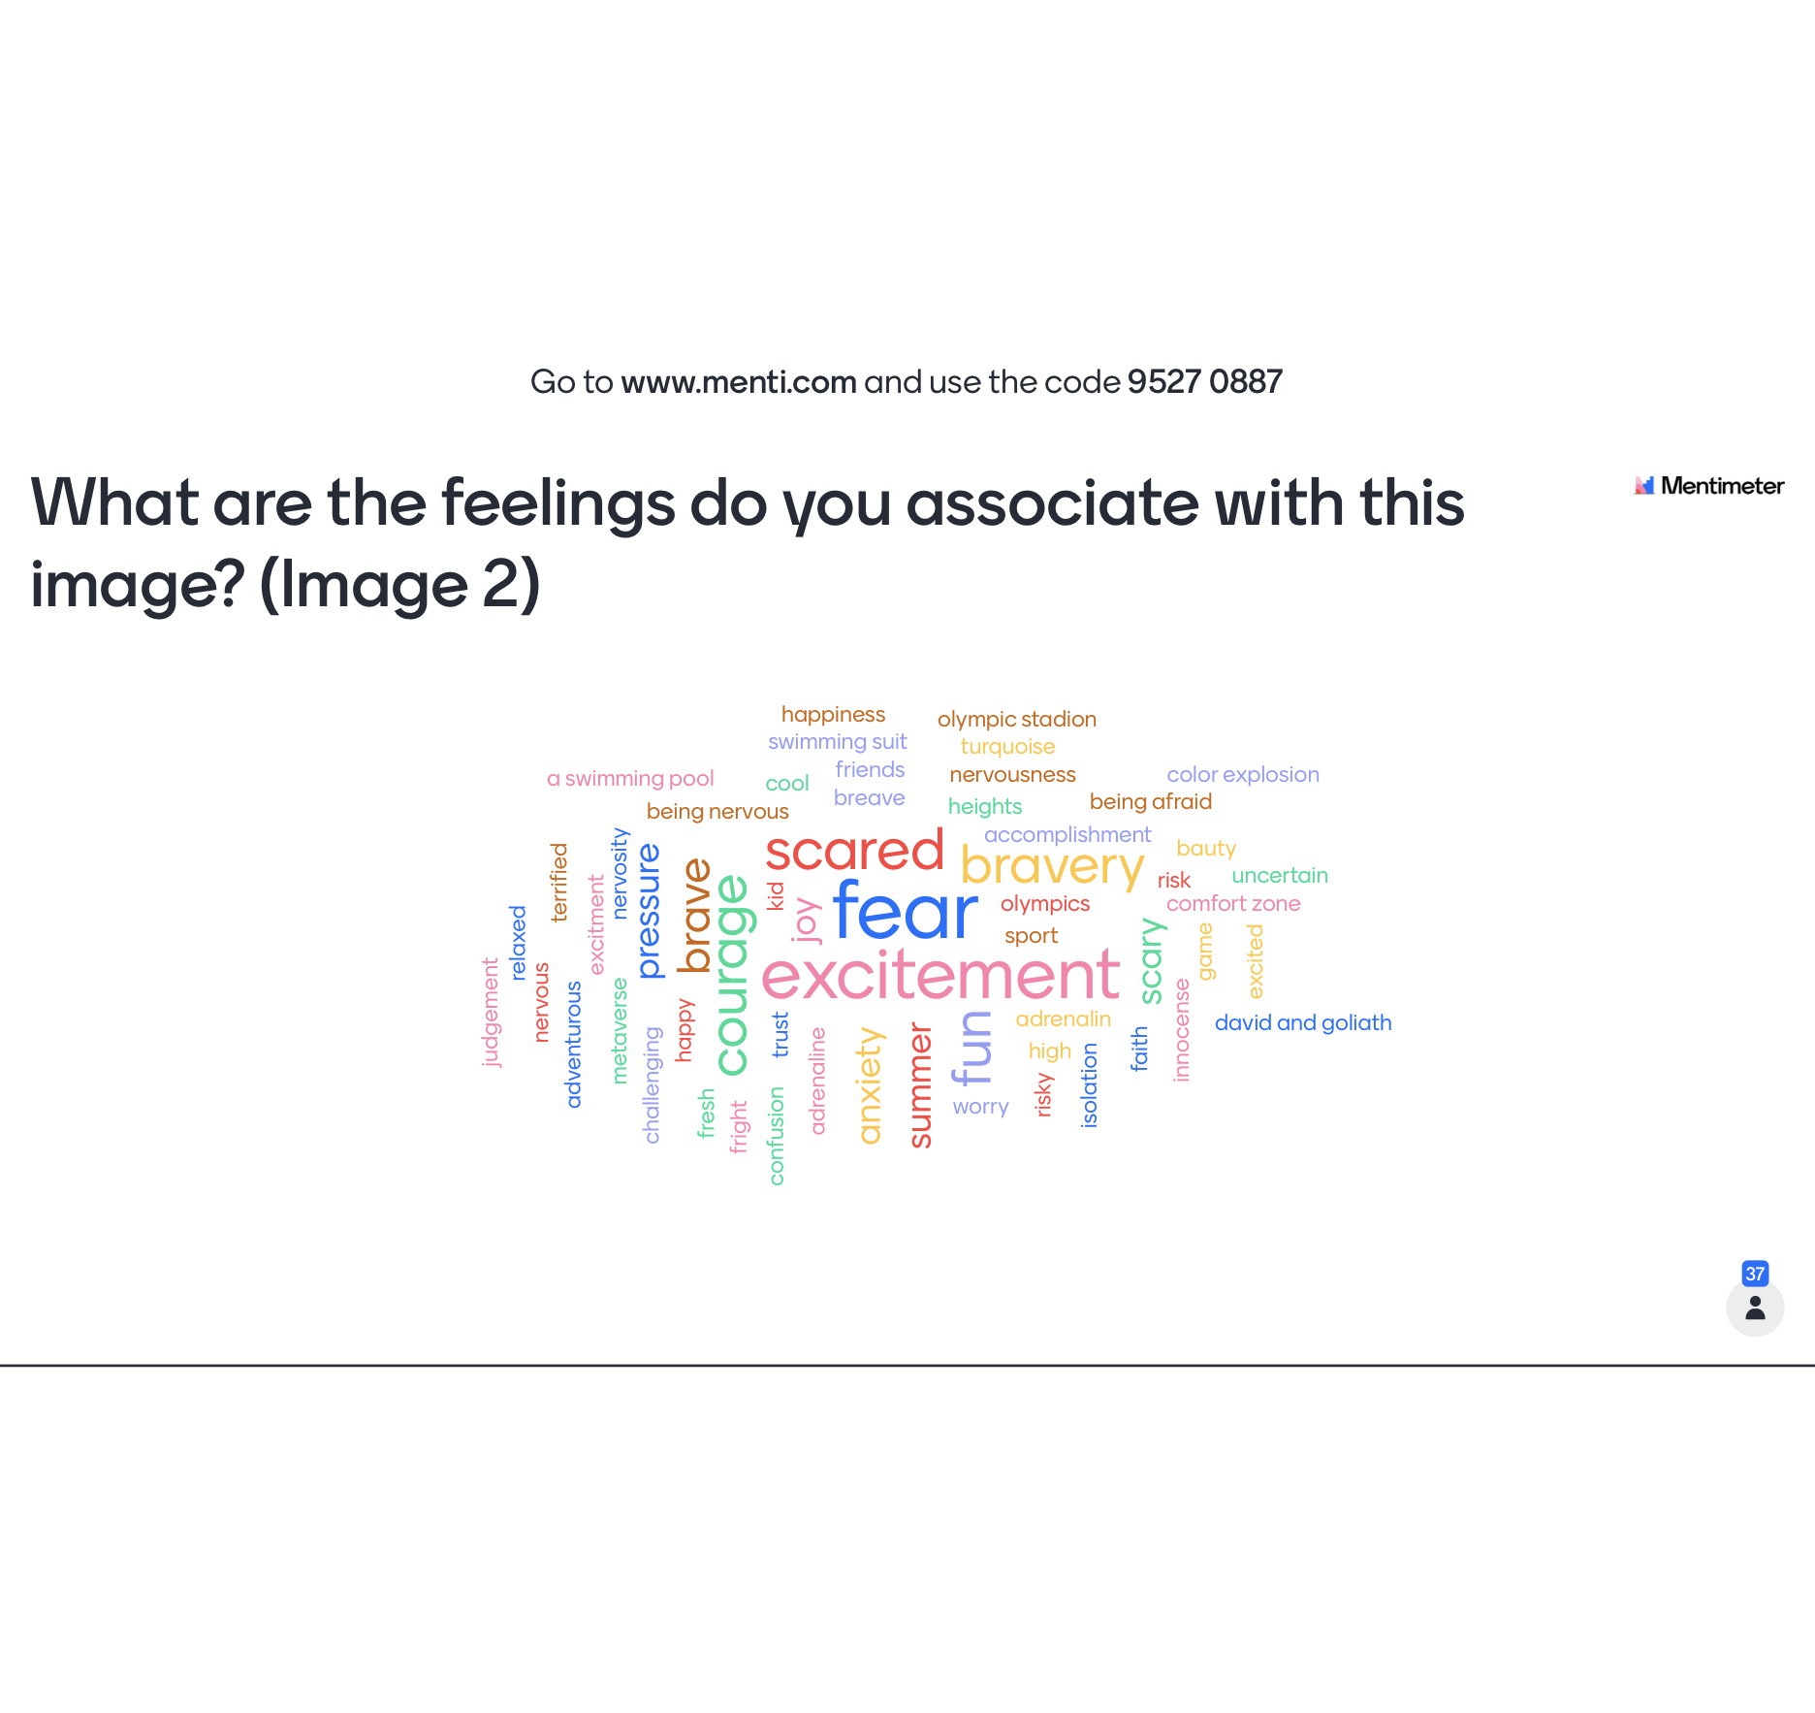

Slide 12
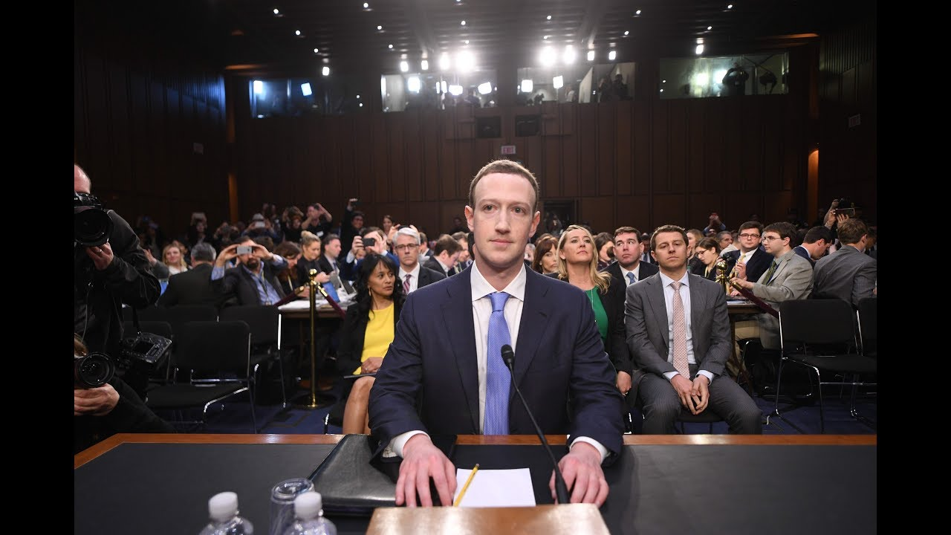
What does it take to create brand associations or positioning?

Slide 13

What are the associations that come to your mind for this brand?
Go to www.menti.com and use the code 6468 6256

Slide 14
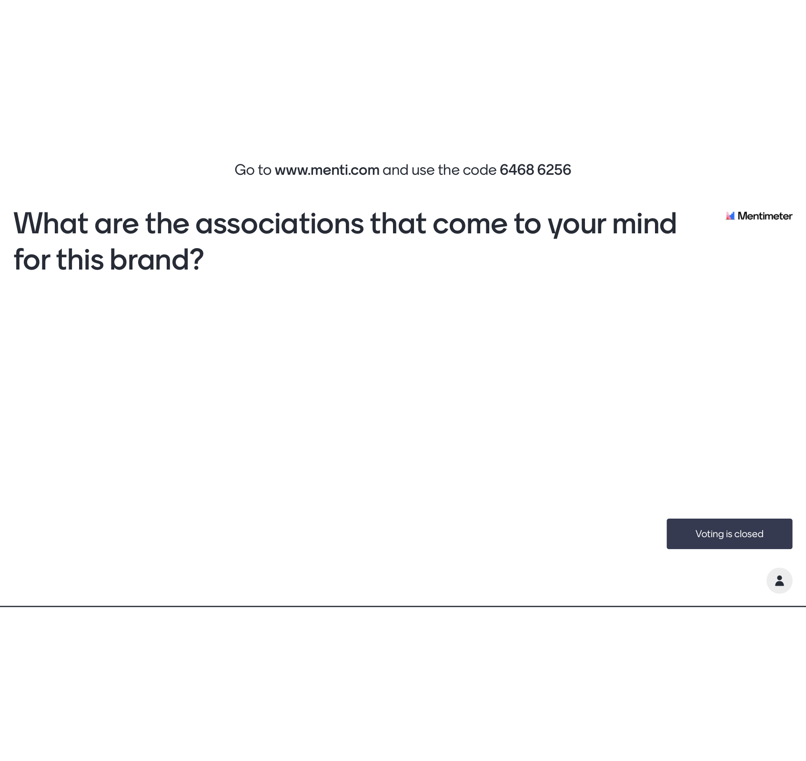
Notes:
https://www.mentimeter.com/app/presentation/859f5e21df400f4f0067fc6763e75e48/ff2c74d1e769/edit

Slide 15

What are the associations that come to your mind for this brand?
Go to www.menti.com and use the code 64 79 58 6

Slide 16

https://www.mentimeter.com/app/presentation/8ed908c3a4eae8721e254954950b7c7f/c040faeb828b/edit?

Slide 17
What changes when FB becomes Meta?
Products/Offerings remain the same
Personnel remain the same
Customer experience remains the same
‘Ambassador’ of the brand remains the same
Value proposition remains the same

Slide 18
The Necessary Pre-Requisites
Predictable Consumer Needs and wants
Branding as last-mile symbolic association bridging product and customer
Product innovation as source of differentiation

Slide 19
Building and signaling a better mousetrap
Developing Key Brand Associations
For The Appropriate Audience
To establish (and own) a clear space

Slide 20
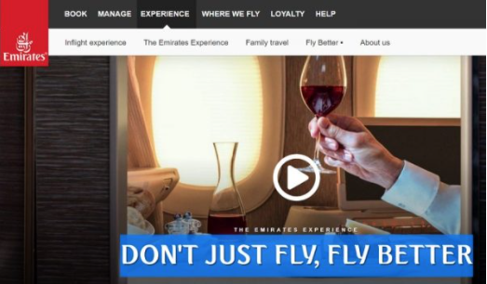
Searching for product differentiation
https://www.youtube.com/watch?v=p17LnQp6SBE

Slide 21




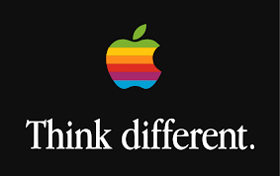

Slide 22
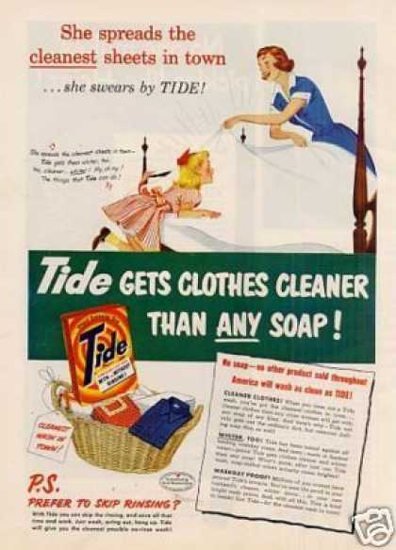
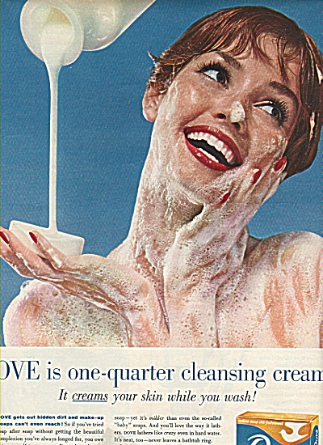
Competitive/Category Benchmarking

Slide 23
The Category-centric Brand Funnel
Source: Business Owner Elevation
Product 3
…
Product N
Product 2
Product 1
Notes:
Conventional wisdom: All the products in the category are passing through the same funnel

Slide 24

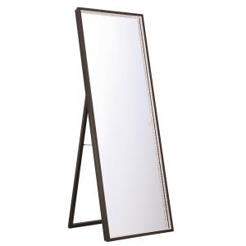

Looking for Purchasers
Mindshare Brands traditionally want to influence purchase behavior
Focus on “reason to buy”
“product association”
“reason to buy”
Notes:
See article by Bonchek and Bapat

Slide 26
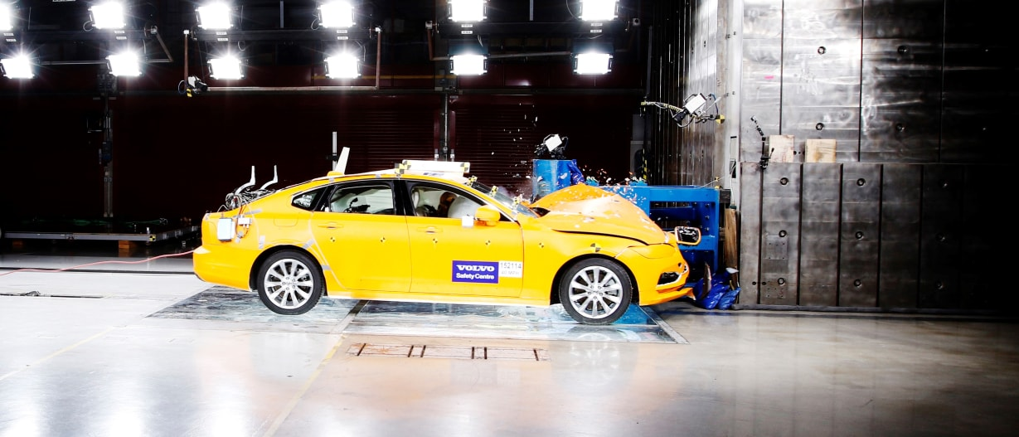
VOLVO = SAFE

Slide 27
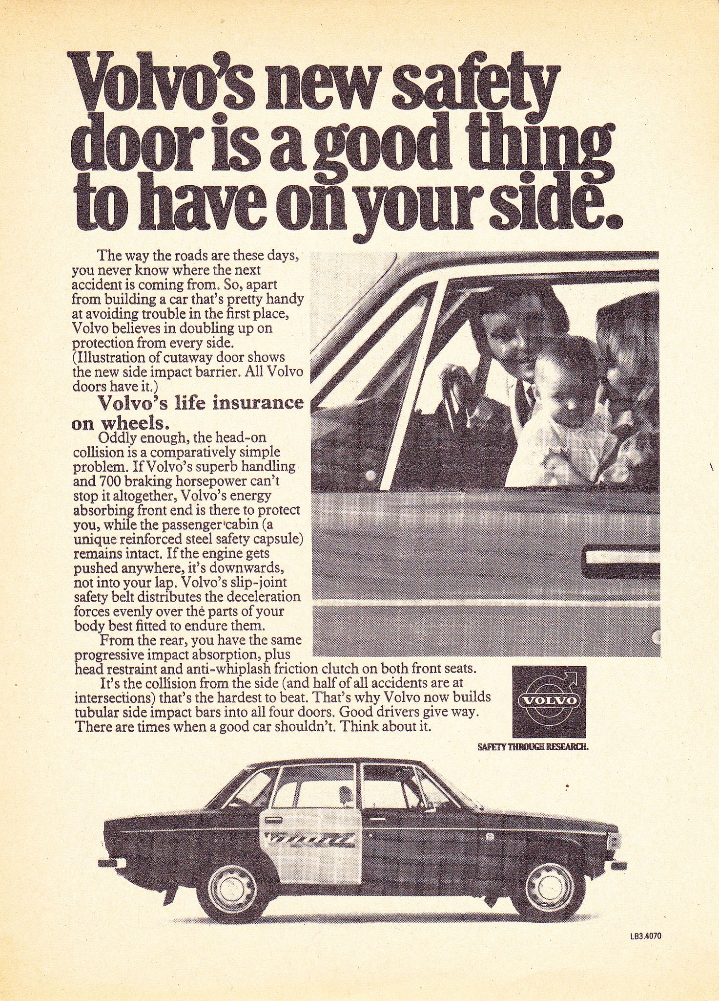

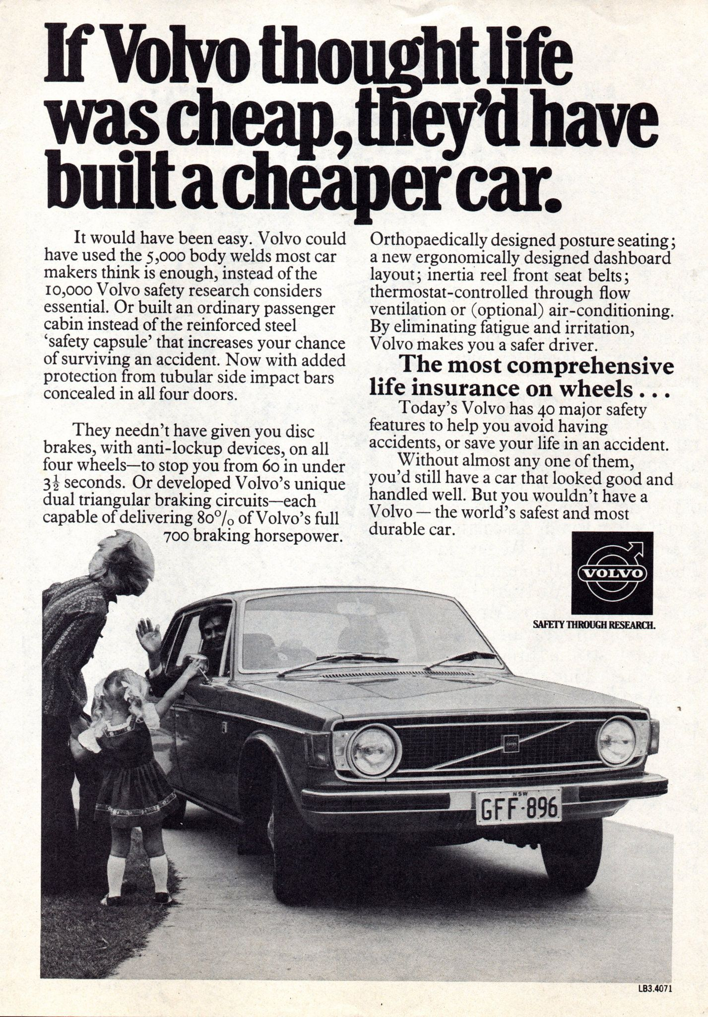
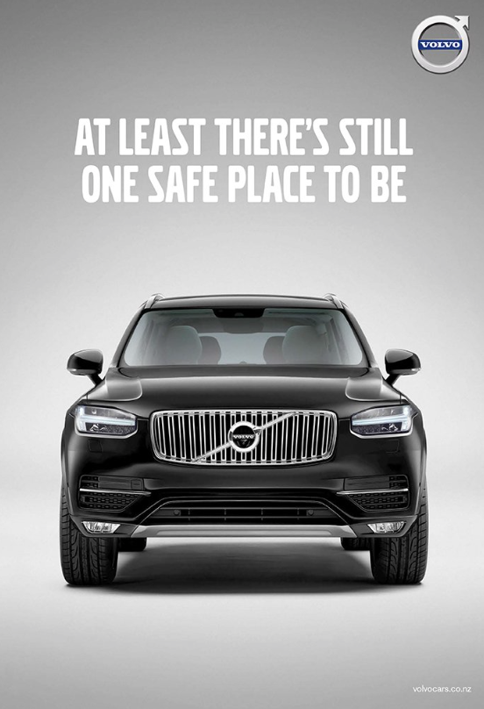



Slide 28


Slide 29

The Biggest Branding Opportunity since…

Slide 30
Managing within a symbolic boundary
The key to branding is that consumers perceive differences among brands in a product category.
- Kevin Keller

Slide 32
Brand Management = Product Management
CATEGORY
EMPLOYEES
STAKEHOLDERS
BRANDING
PRODUCT
CUSTOMERS
INSTITUTIONS

Slide 33
What happens when brands try to break out of the category

Slide 34
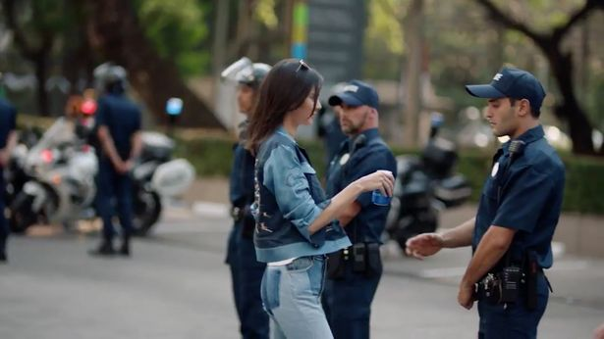


Pepsi – The Cultural Misstep from a Product-Centric brand
https://www.youtube.com/watch?v=uwvAgDCOdU4
Notes:
Give background of ad and Kendall Jenner before showing the video

Slide 35
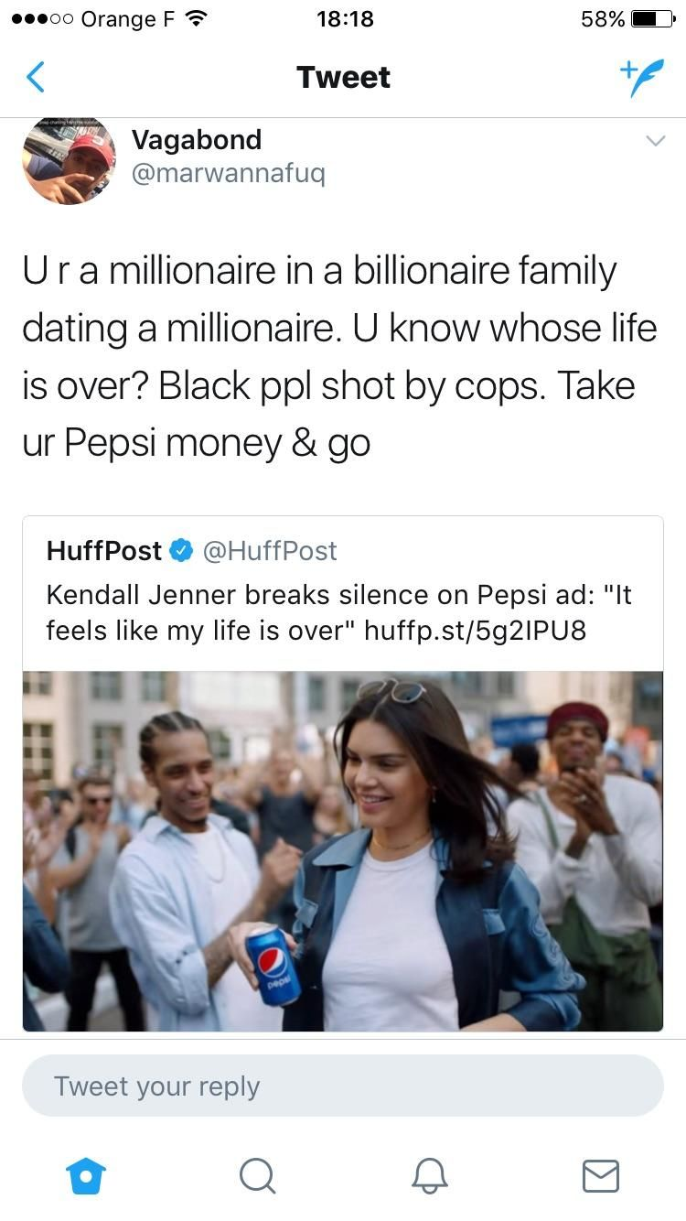
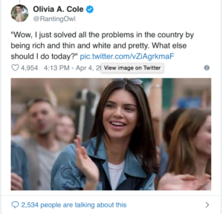
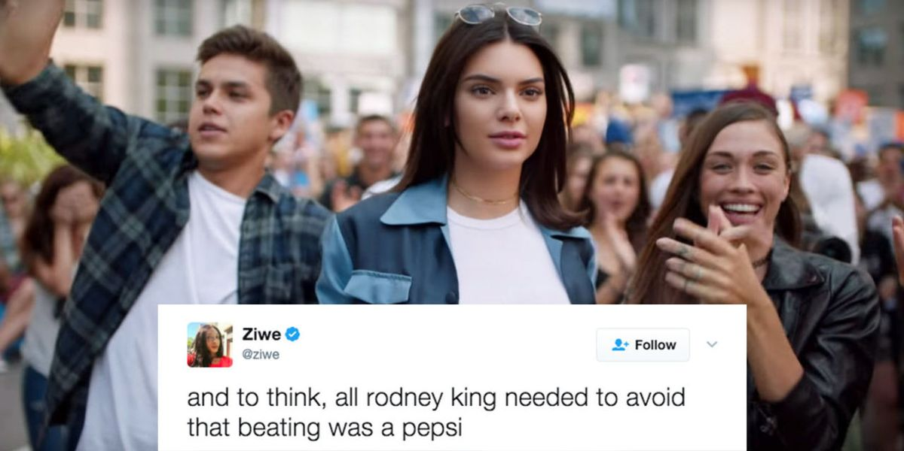
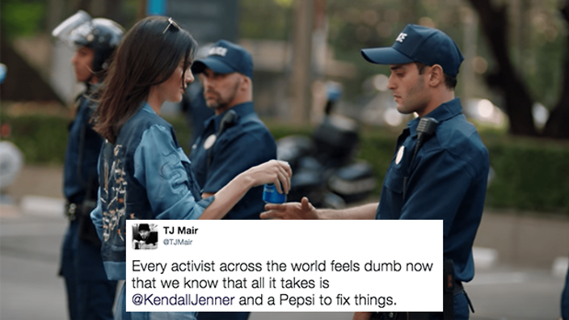
The Backlash

Slide 36
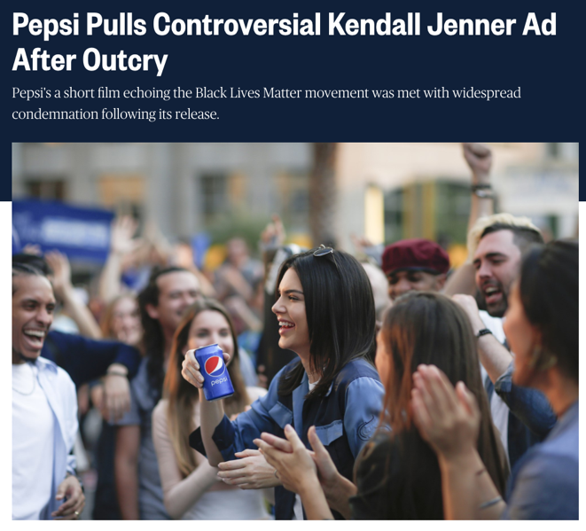
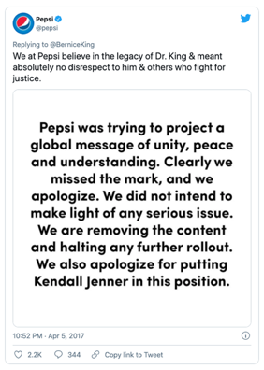
The Result

Slide 37
Difficulties of maintaining product superiority

Slide 38
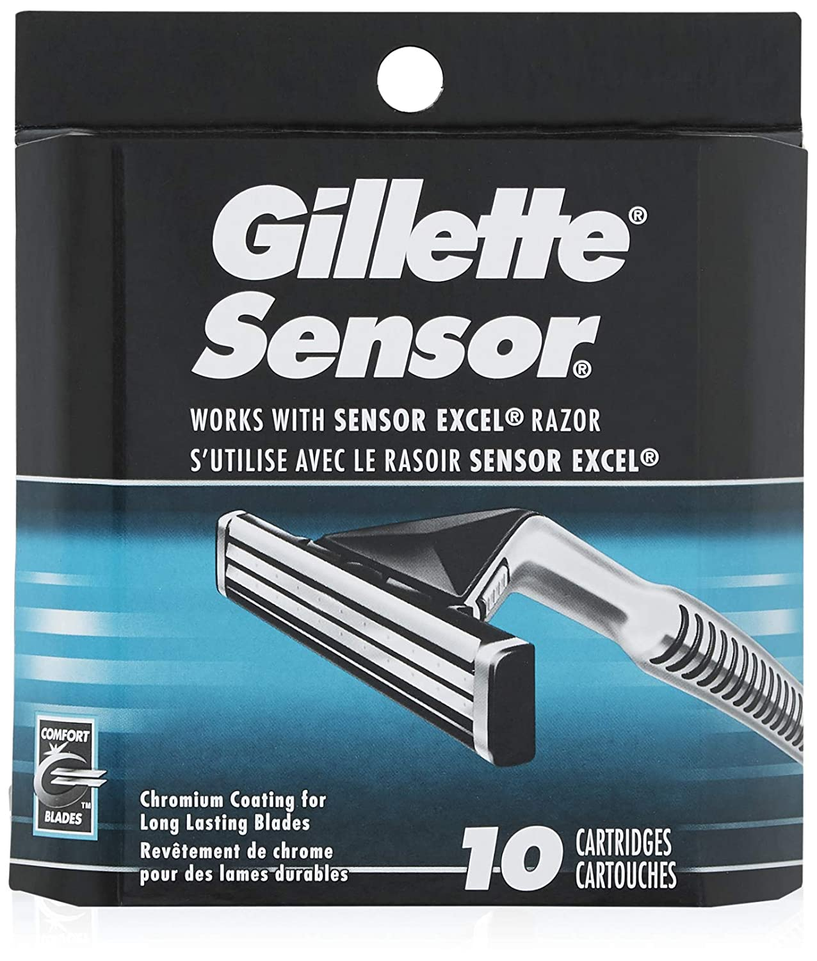
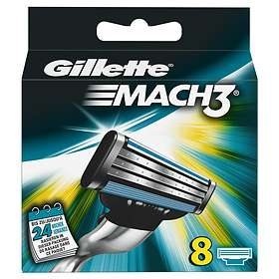
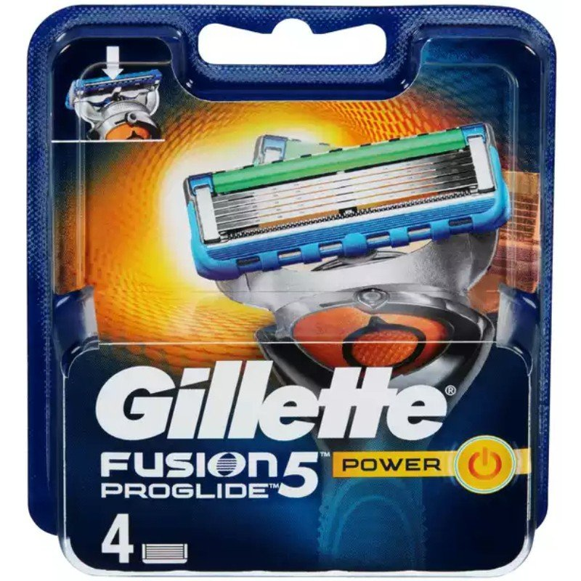
Continuous battle for product-innovation with competitors

Slide 39
Something to reflect upon
What are the necessary conditions for mindshare branding to be successful?

Slide 40
Something to reflect upon
What were the things you agreed with?
What were the things you disagreed with?

