Slide 1
Weekly plan
Week 1
Week2
Week3
Week4
Week 5
Introduction to the course and practicalities
Approaches and Building blocks of Brand Management
Mindshare Branding
Emotional Branding
Cultural Branding
Experiential branding
Managing Brand Portfolios
Aligning Brand Strategy, Research and Context
Future of Brand management
Guest Lecture – Percy Smend

Slide 2
Emotional Branding
Session - 4
Dr. Kushagra Bhatnagar
03.05.2022

Slide 3
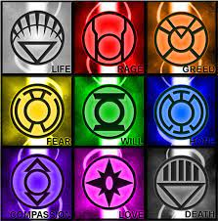

Slide 4
Why Emotion?
Emotions drive behaviour
Emotions drive relationships
Emotions move the focus away from rationality
Emotions anthropomorphize a thing
BUT
Emotions are also complex

Slide 5
Emotional Branding
Brand Manager looking for strong emotional connection
Mystery, magic, sensuality
Insight into the consumer’s emotional life
Measures such as brand love or love marks (Roberts 2004)

Slide 6



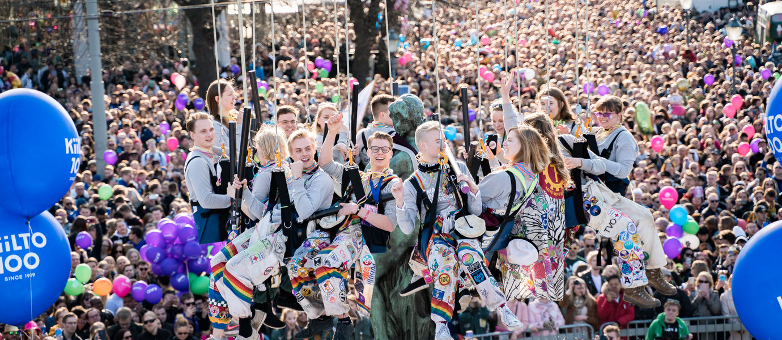
https://www.youtube.com/watch?v=rdQrwBVRzEg

Slide 7
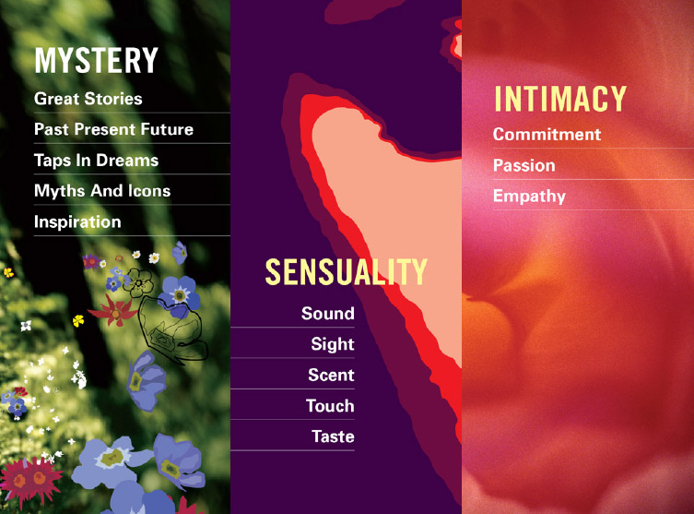
Source: Saatchi & Saatchi,
Kevin Roberts
Source: Saatchi & Saatchi, Kevin Roberts

Slide 8
Brand = Partner in Relationships
https://www.youtube.com/watch?v=6BSlJlKYSWg

Slide 9

Branding = Building Interpersonal Relationships
https://www.youtube.com/watch?v=rdQrwBVRzEg

Slide 10

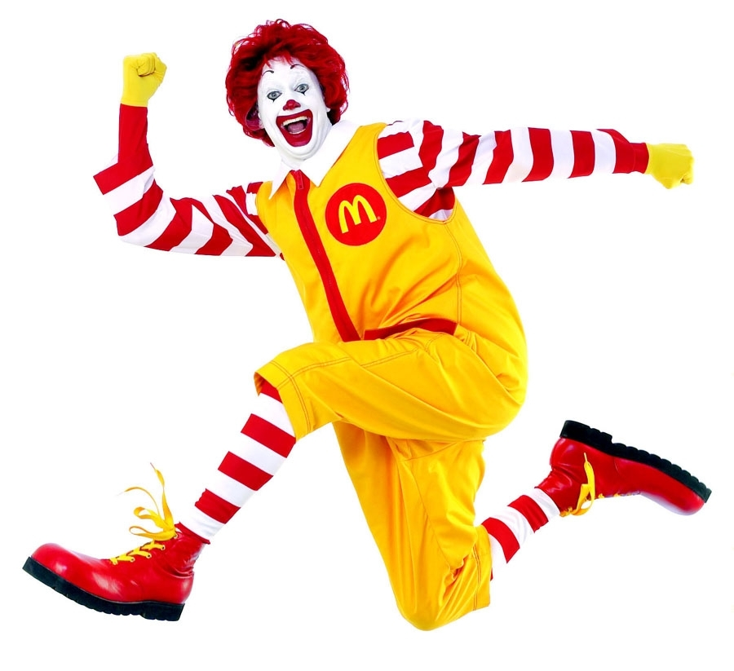
How? Building Brand Narratives!

Slide 11

From Product Characteristic to Brand Personality

Slide 12
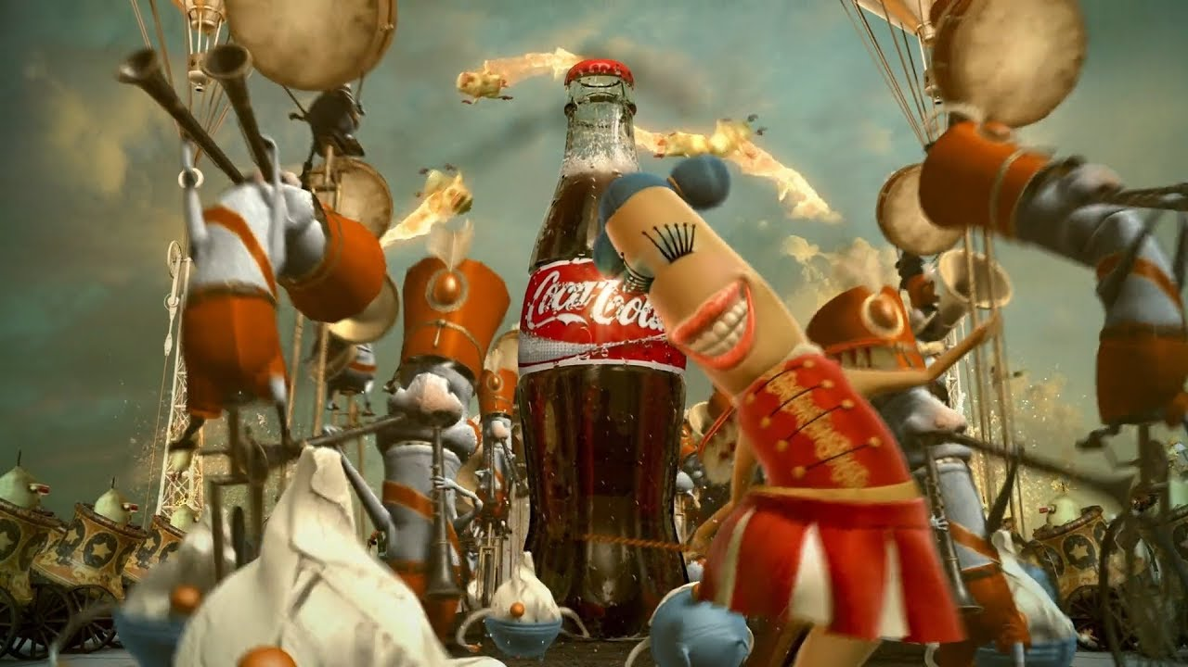
Shift from Benefit to Feeling
https://www.youtube.com/watch?v=gx-zPheFnHo

Slide 13

What is needed for an emotional exchange?
Go to www.menti.com and use the code 8685 6459

Slide 14
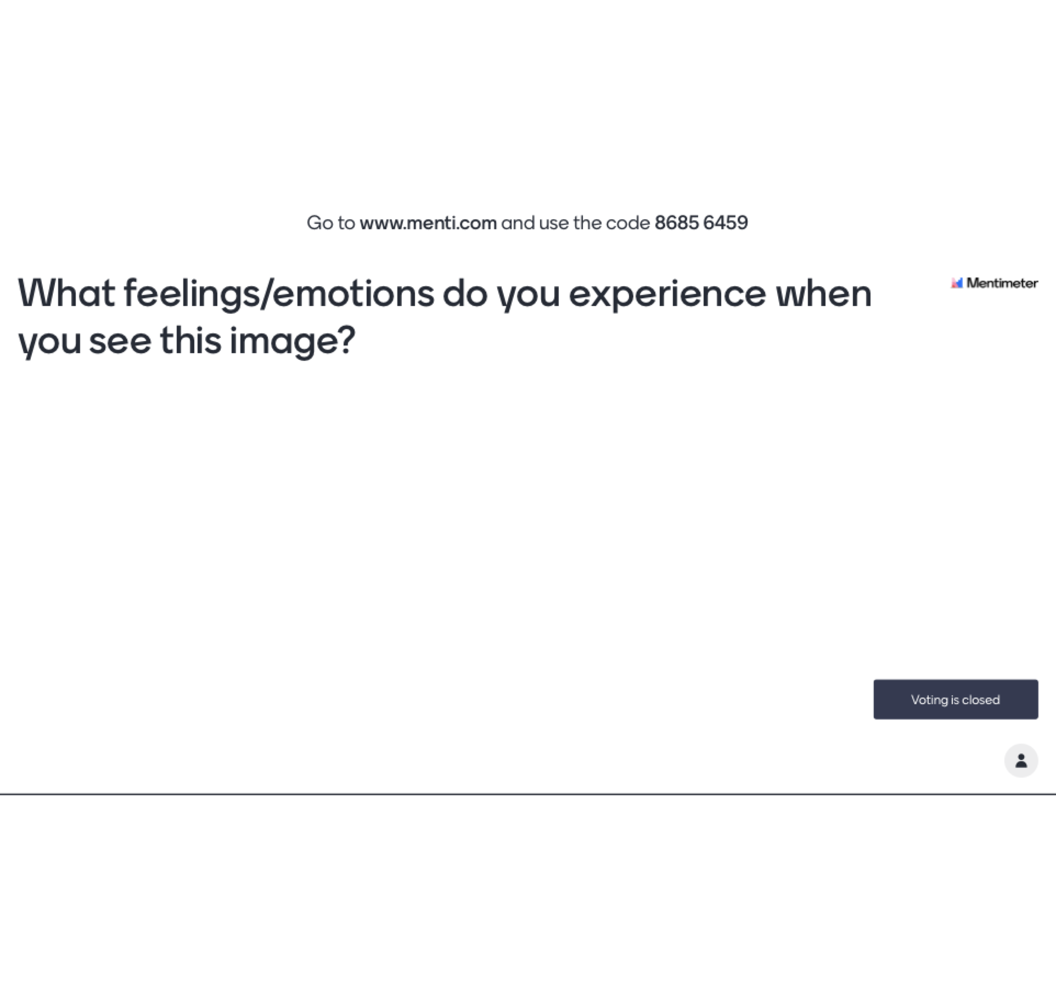

Slide 15
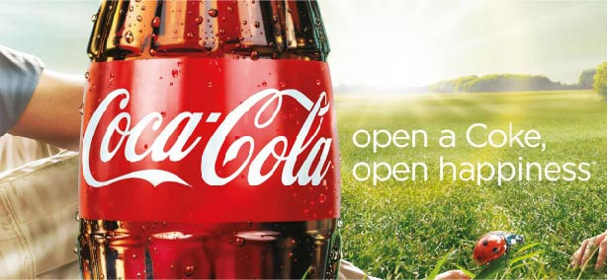
What is needed for an emotional exchange?
Go to www.menti.com and use the code 6945 0392

Slide 16
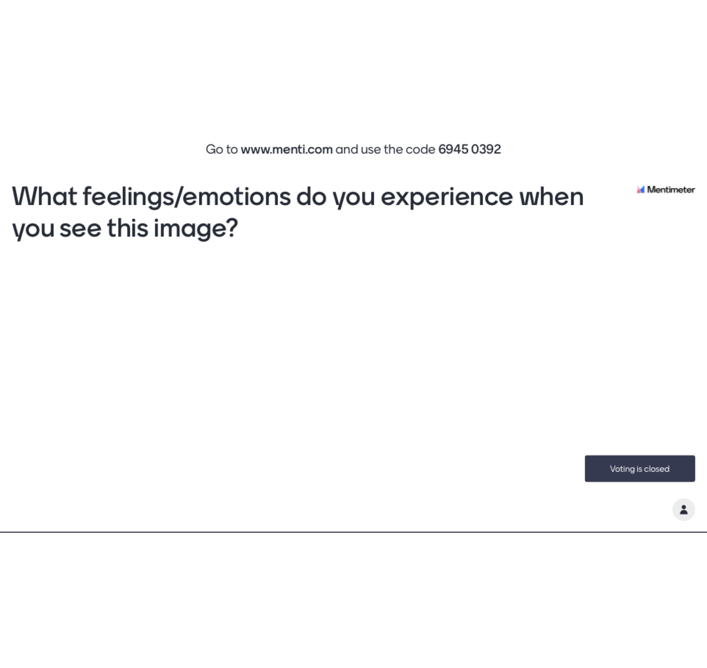
Notes:
https://www.mentimeter.com/app/presentation/8b55f10b7321dc379e02321ceb85acff/dfc6324412b7/edit?

Slide 17
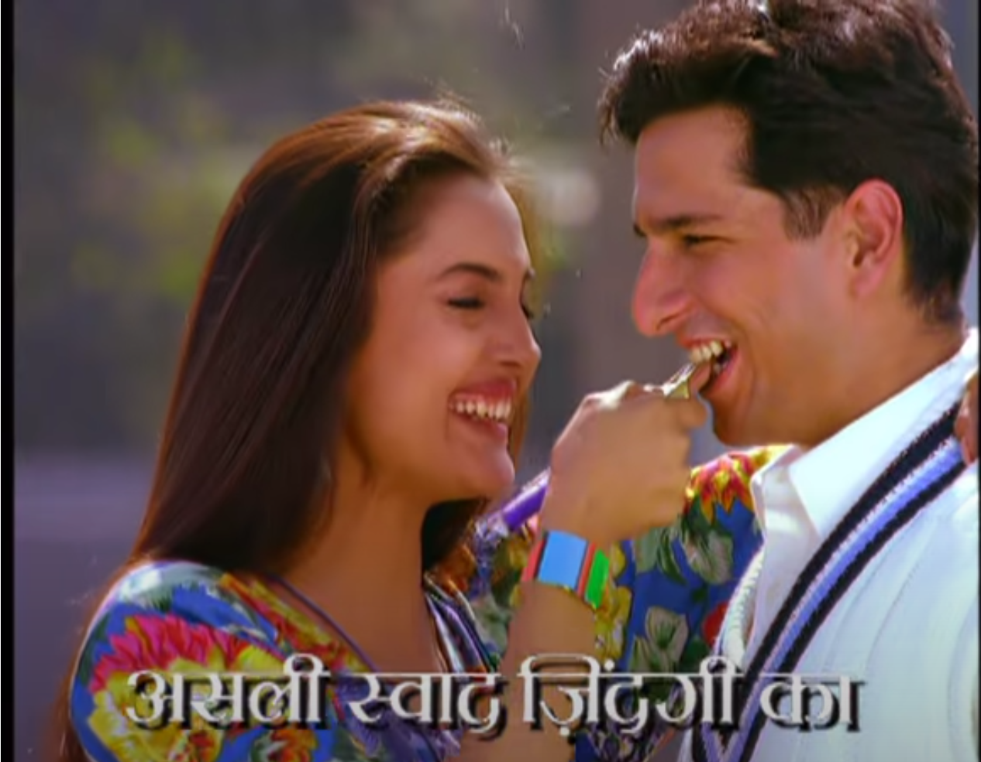
Brand Imagery => Consumer Feelings
https://www.youtube.com/watch?v=e7JATezA1nY

Slide 18
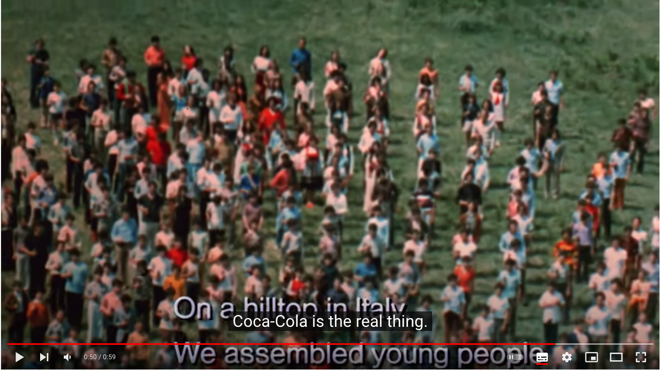
Feeling trumps Benefits
https://www.youtube.com/watch?v=1VM2eLhvsSM

Slide 19

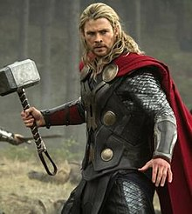
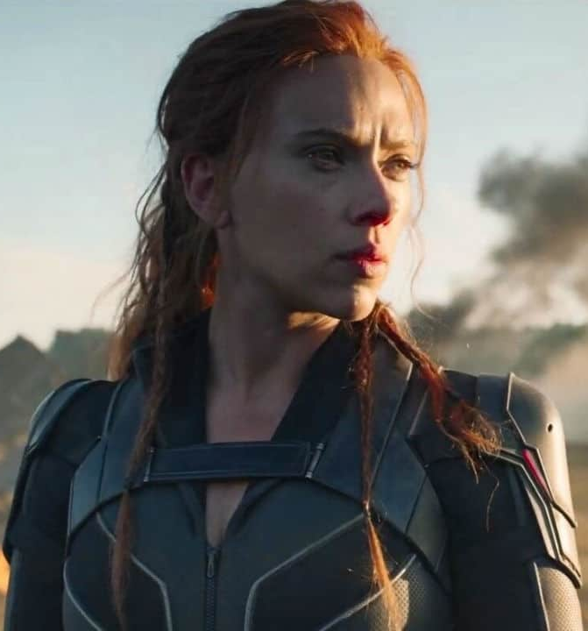
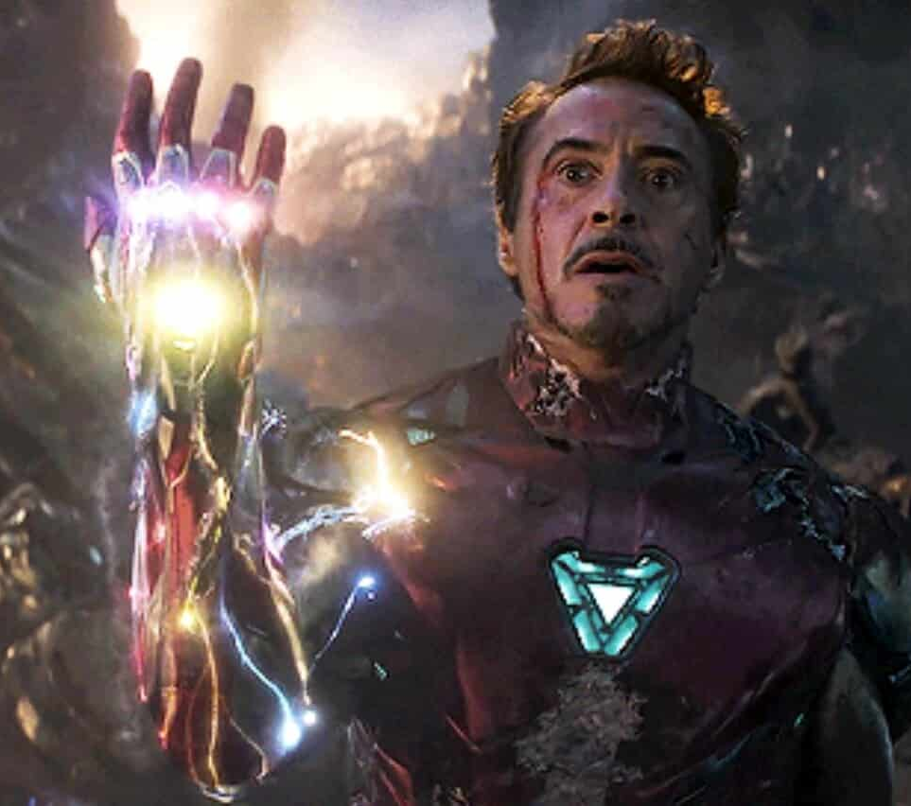
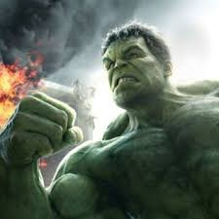
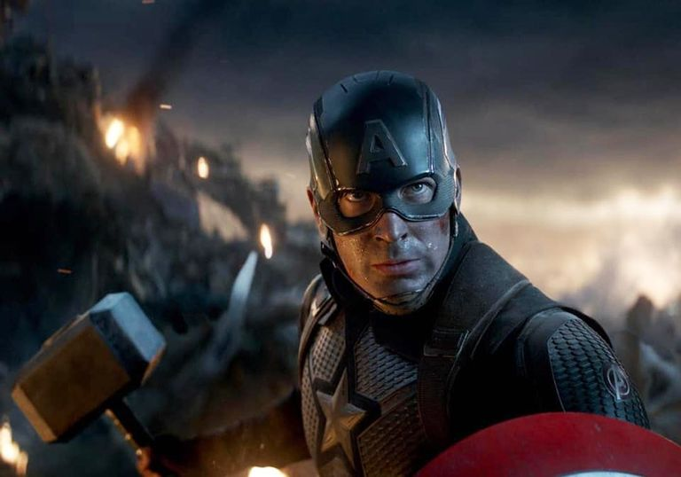

Slide 20
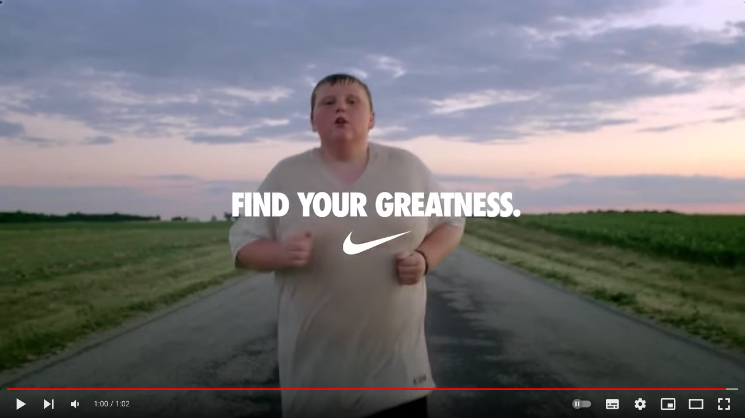
From Product to Content
https://www.youtube.com/watch?v=YkNMulA1SEI

Slide 21
Condition 1: When Products are complex
Product becomes less transparent
Consumers can’t easily see the connection between product characteristics and benefits

Slide 22
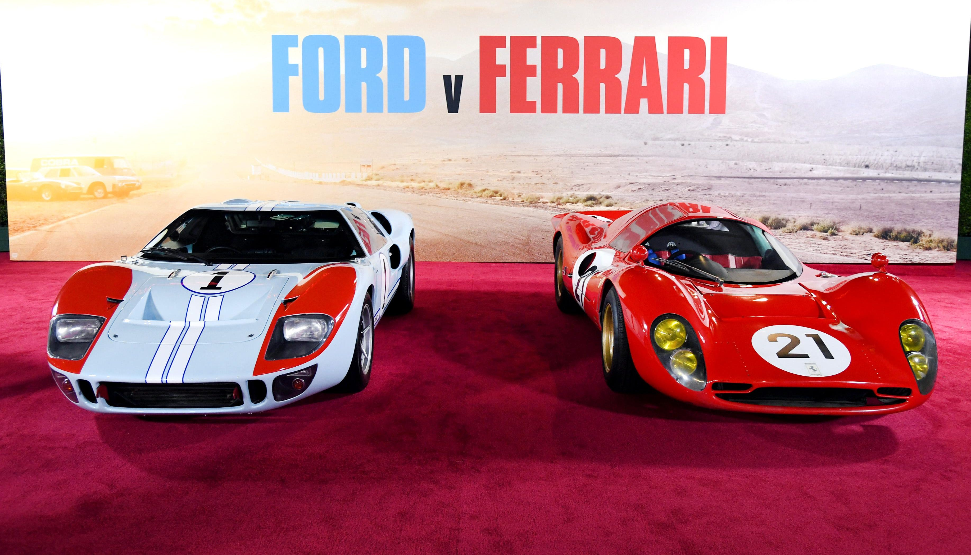
https://www.youtube.com/watch?v=6XBYg2S2GuY

Slide 23
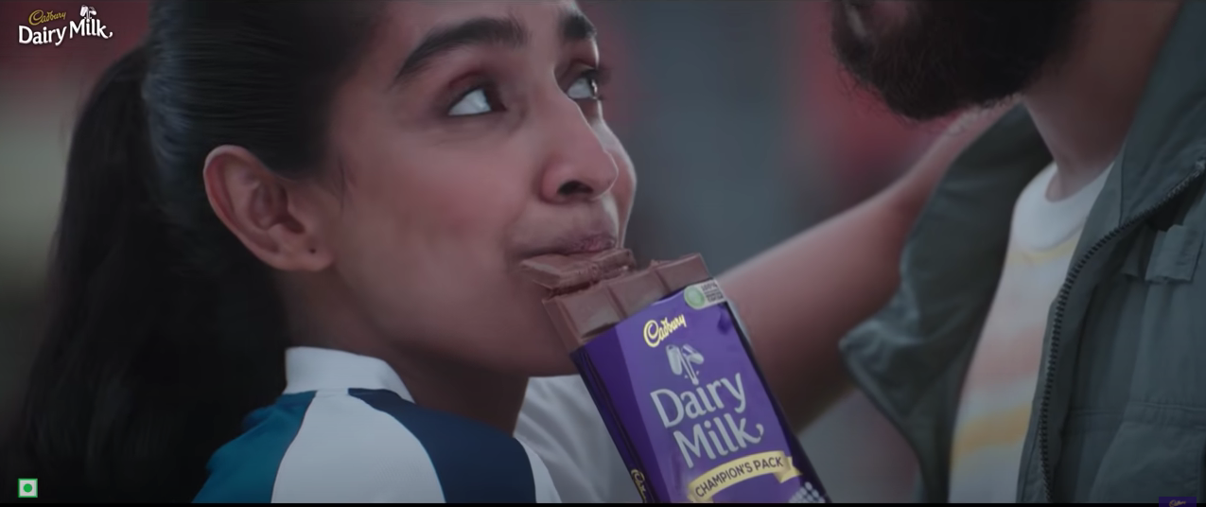
Condition 2: When product innovation doesn’t add significant value
https://www.youtube.com/watch?v=z_OtC06ndUE

Slide 24

Condition 3: When a product can deliver on the emotional brand promise
https://www.youtube.com/watch?v=wTcNtgA6gHs&t=53s

Slide 25

Challenge 1: The Difficulty of Branding/Owning Emotions
Dangers of emotional promise not being delivered in experience

Slide 26
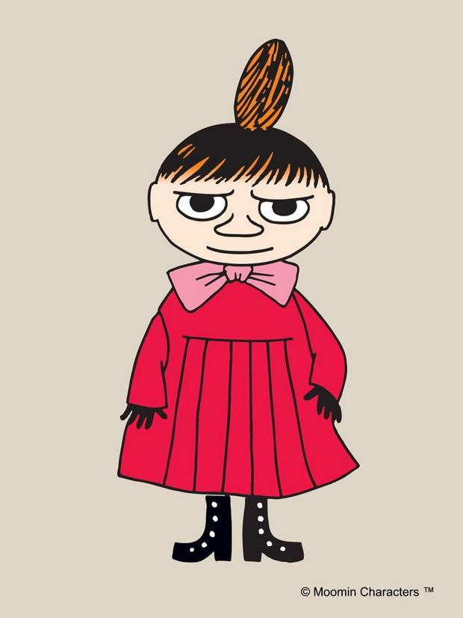
Challenge 2: Transferring Emotional connections to New Markets

Slide 27


Challenge 3: The Authenticity Paradox

Slide 28

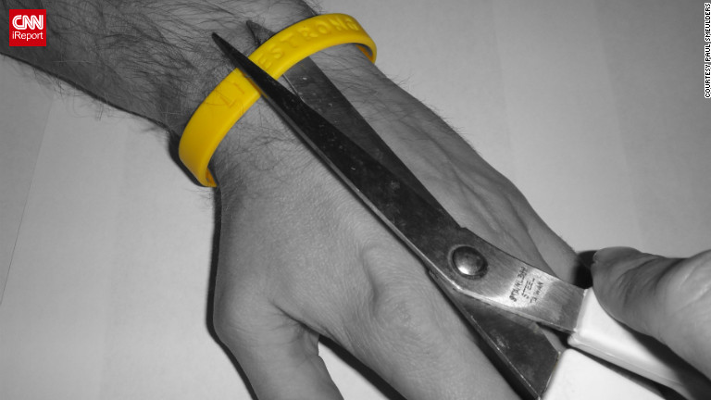
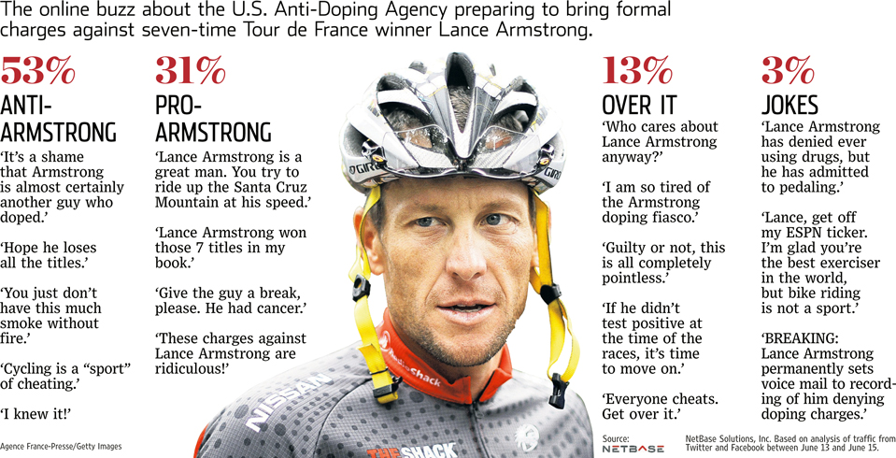
Challenge 4 – The Hard Fall

Slide 29
Summing Up – The paradox of emotional branding
Emotions are powerful motivators.
They might seem easier to access than product innovation.
Yet, it is often difficult to sustain an emotional connection to consumers.

Slide 30
Key Questions to answer
Who are we?
Are we loved?
What’s our passion?
Who do we want to share our passion with?
Are we believable?

Slide 31
Thank You

