Slide 1
Weekly plan
Week 1
Week2
Week3
Week4
Week 5
Introduction to the course and practicalities
Approaches and Building blocks of Brand Management
Mindshare Branding
Emotional Branding
Cultural Branding
Experiential branding
Managing Brand Portfolios
Aligning Brand Strategy, Research and Context
Future of Brand management
Guest Lecture – Percy Smend

Slide 2
Cultural Branding
Session - 4
Dr. Kushagra Bhatnagar
03.05.2022

Slide 3
Scenarios for Brand Management
Growing a new brand in a mature category: Differentiation
Volvo, Rovio, Red Dead Redemption
Growing a new brand in a nascent category: Category-building
Tesla, Sony Walkman, Microsoft Kinect, Oatly
Moving a brand beyond product innovation: Emotional connection
Red Bull, Coke, Cadbury’s
Giving a brand a powerful role in consumer society: Cultural participation
Dove, Ben & Jerry’s, “Halal”

Slide 4
Controversial Statement #1
Consumer or B2B brands that sell goods or services are not the best “branders” out there
…
It is the “culture” industry

Slide 5
Controversial Statement #2
We live in a post-truth world where everything is up for revision/interpretation
…
Which makes cultural branding all the more powerful

Slide 6
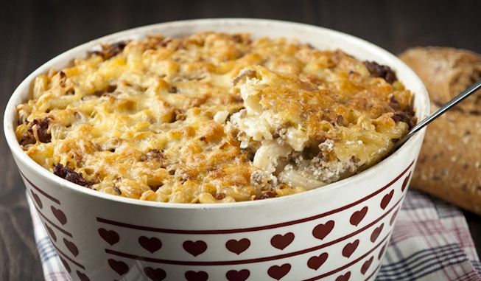
Controversial Statement #3 – All brands are “cultural” whether they know it or not
Every brand is culturally imprinted
…
This is “someone’s” food

Slide 7
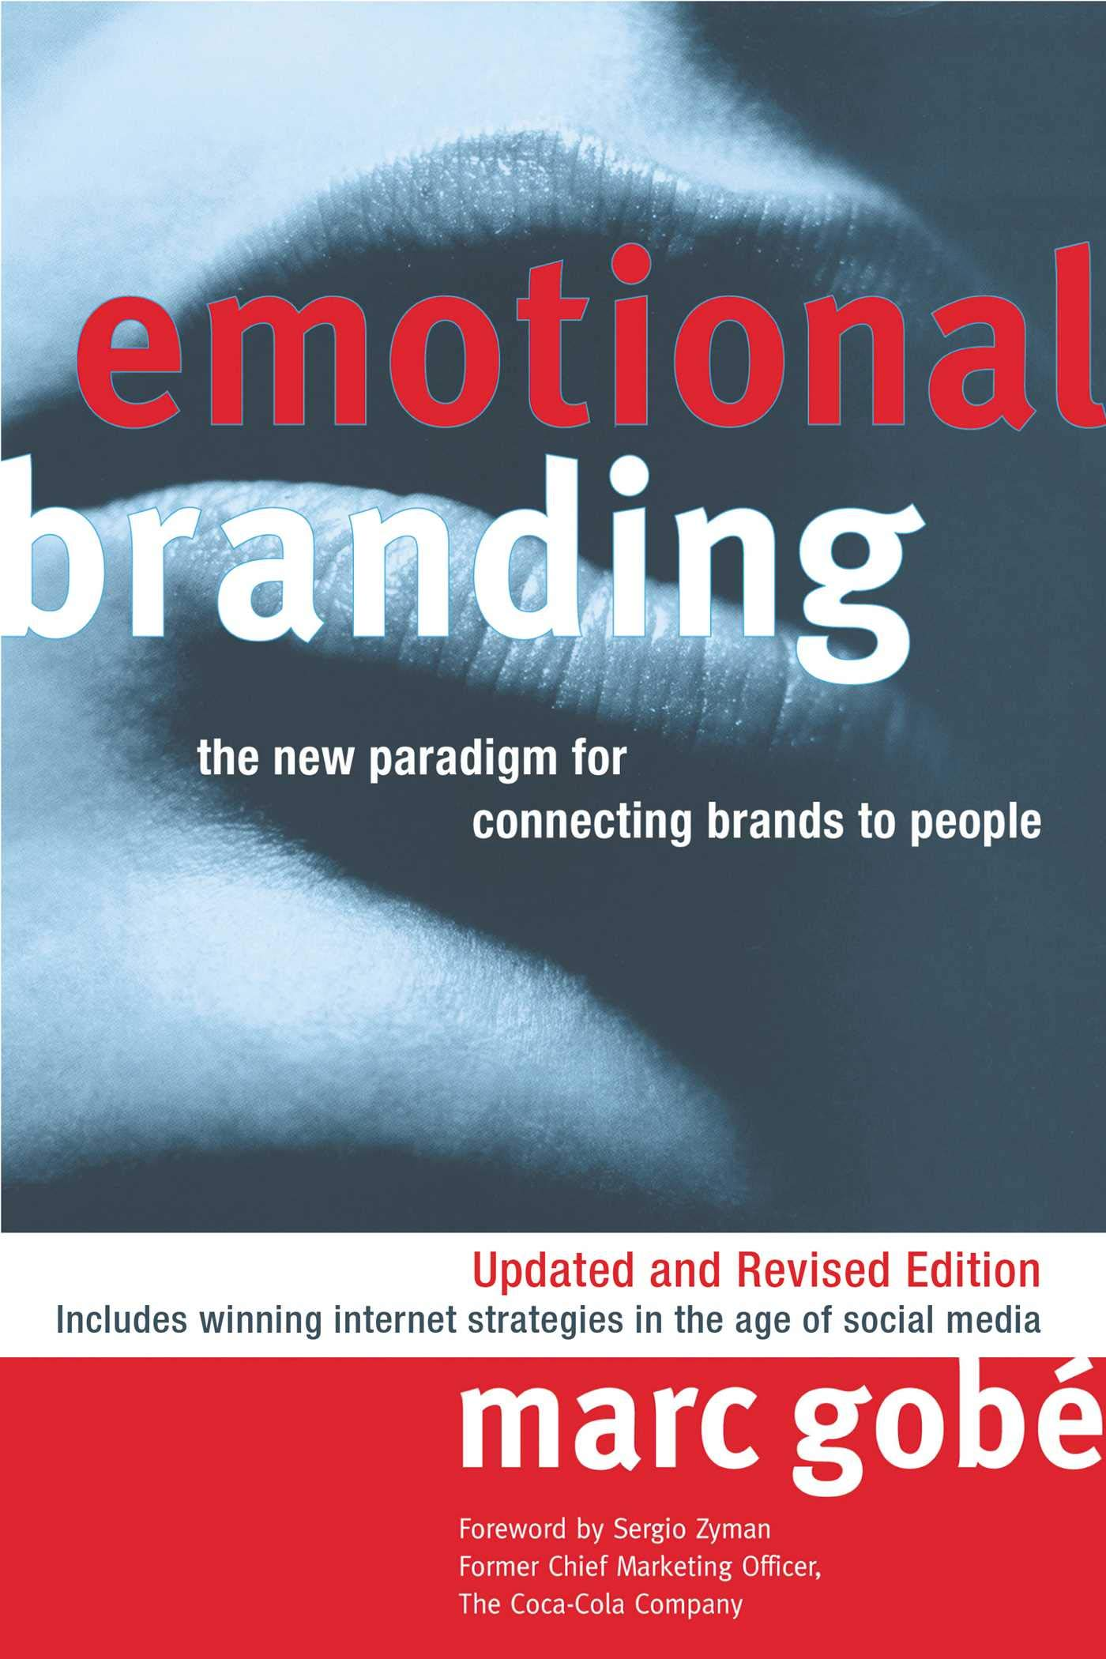

Slide 8
Culture imposes meaning on experience (Clifford Geertz)

Slide 9
Cultural Branding
Brand Manager as cultural analyst
Market research as generation of cultural Insight
Relevant fast vs slow culture
Branding as cultural entrepreneurship
Cultural activist, cultural reactionary, cultural accelerator

Slide 10
CULTURE
Brand
Actions
CONSUMER
BRAND
Consumer
Reactions

Slide 11
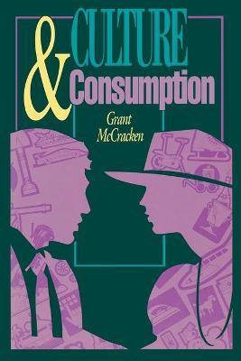
“It is not to brands that consumers will be loyal, but to images and symbols, especially to images and symbols that they produce while they consume.” (Alladi Venkatesh & A. Fuat Firat, 1995)

Slide 12
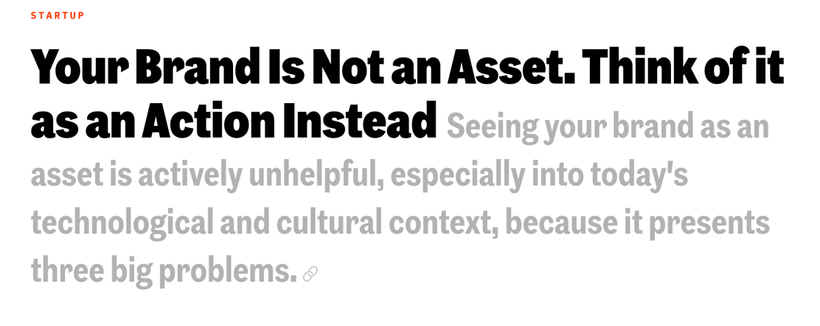
Defensive branding
Piggyback branding
Noun Stacking

Slide 13
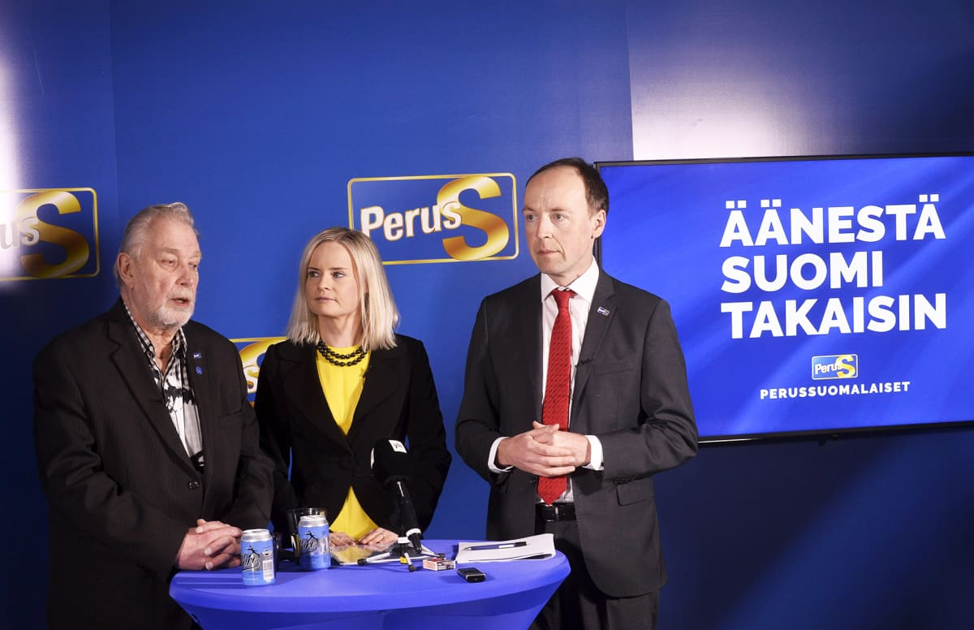

Slide 14
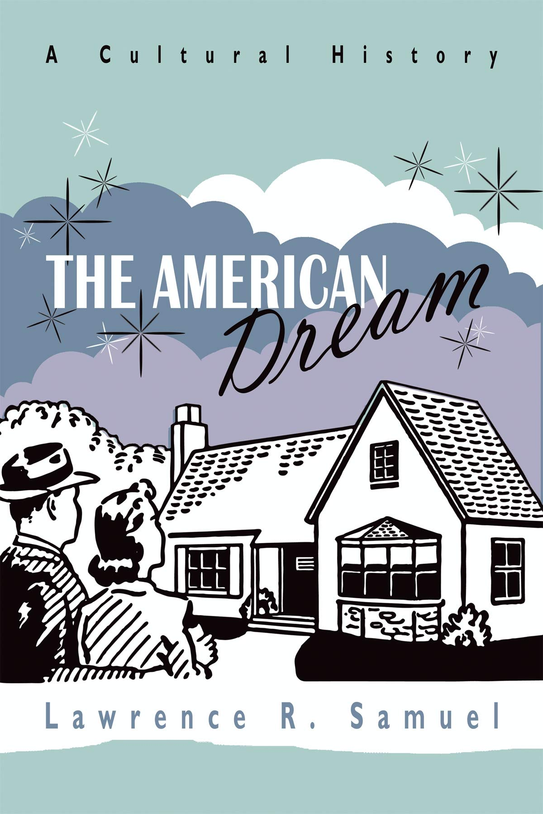

Slide 15
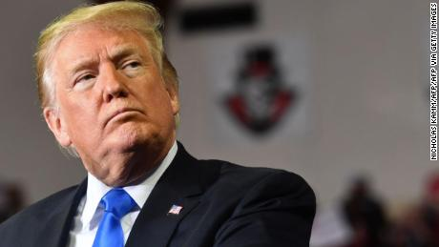

Slide 16
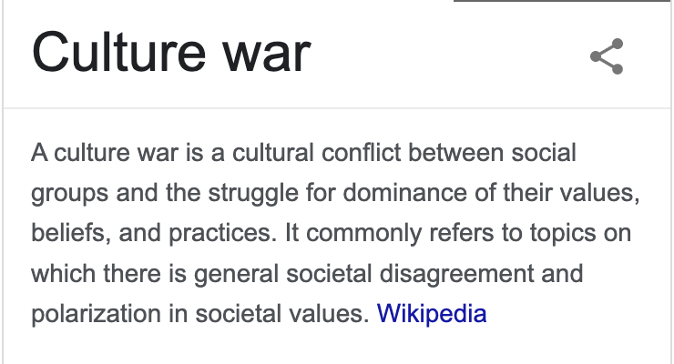
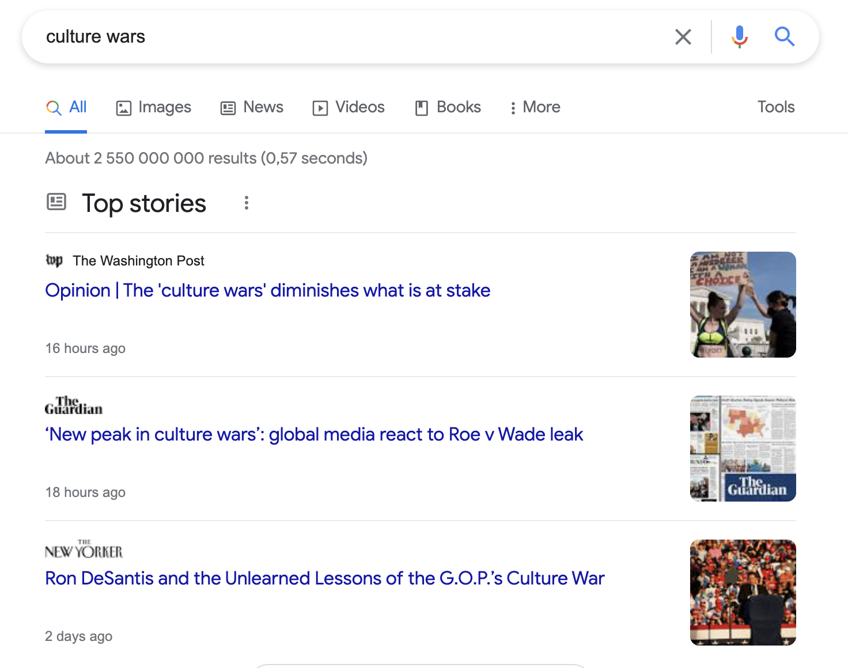
The Post-Modern
Condition

Slide 17
Culture = Rules + Meanings
“the very knowledge and scripts we will someday build into robots to make them socially sentient creatures” (Grant McCracken)
Looking for Cultural Insight, not consumer moment of truth

Slide 18
Anti-Segmentation: What “unites” us

Slide 19
The Cultural Branding Playbook

Slide 20
1. Identify a relevant, emergent cultural conversation
2. Identify a powerful role for the brand
3. Create original expressive culture
4. Develop an authentic socio-political voice

Slide 21
1. Identify a relevant, emergent cultural conversation
RESOLVE
CONFLICT
ENTER
CHALLENGE
DEBATE
NORM
CULTURAL
CONVERSATION
CREATE
PROBLEMATIZE
MEANINGS
CONVENTIONS
OFFER
CODES

Slide 22
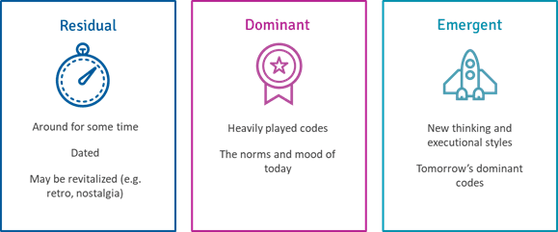

Slide 23
“Thick” marketing research
Cultural insight, not consumer insight
No man is an island
Cultural conversation + Brand Meaning + Product

Slide 24
2. Identify a powerful role for the brand
The brand can offer a new “identity myth”/”identity narrative”
Help give a new answer to the age-old question: Who am I?

Slide 25
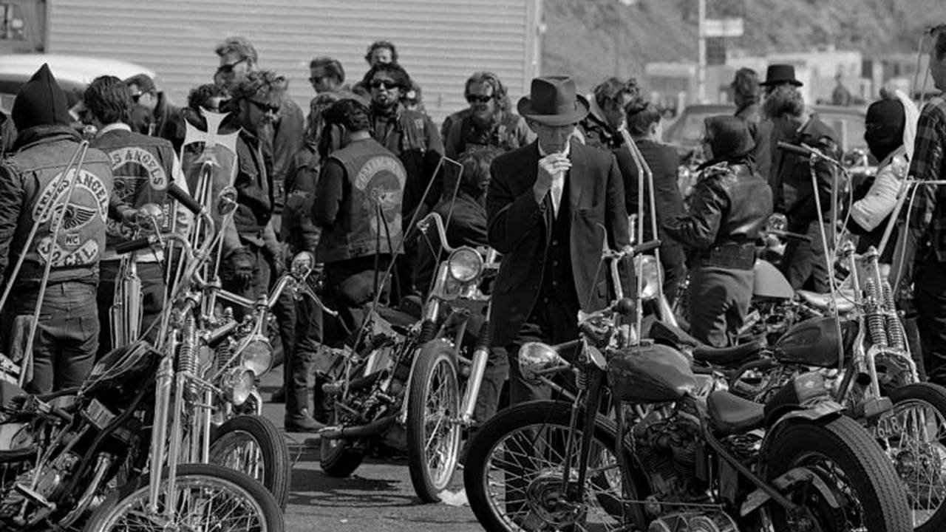

Slide 26
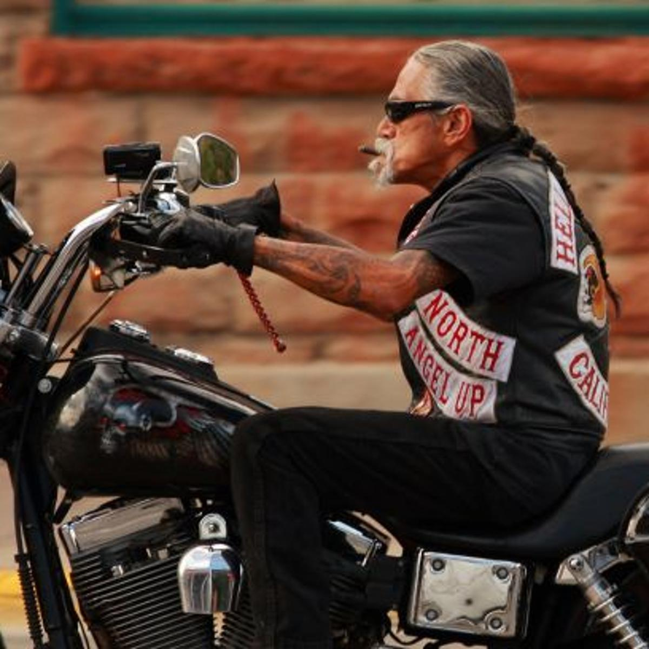
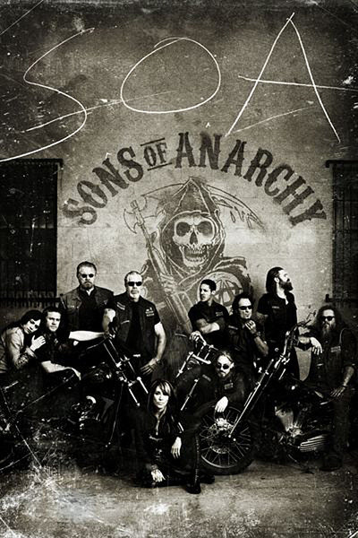
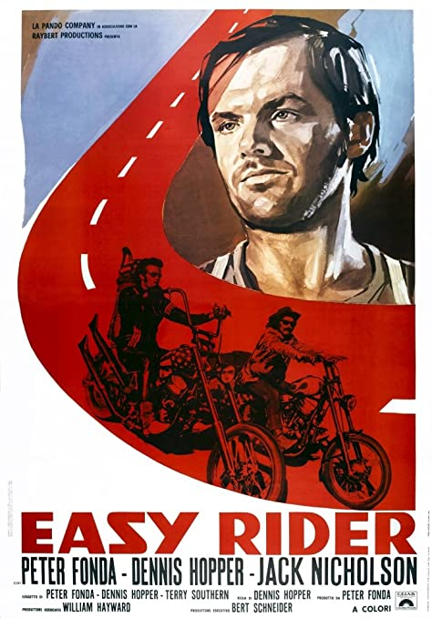
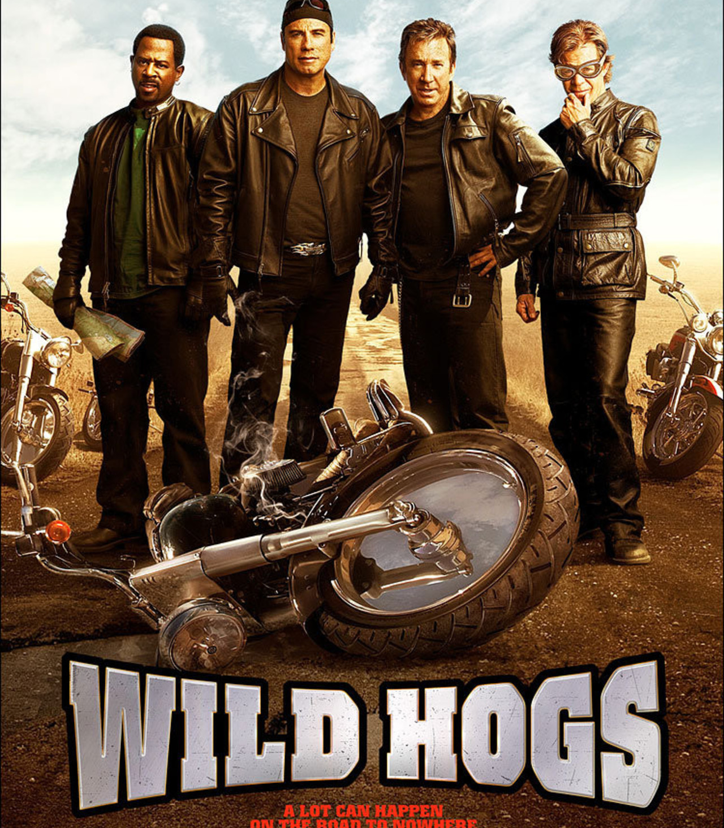

Slide 27
When the Risks pay off: Nike
Moving away from the superhuman athlete
https://www.youtube.com/watch?v=lomlpJREDzw
https://www.youtube.com/watch?v=A1hDscZfE2w
Notes:
Give background of ad and Colin Kaepernik before showing the video

Slide 28
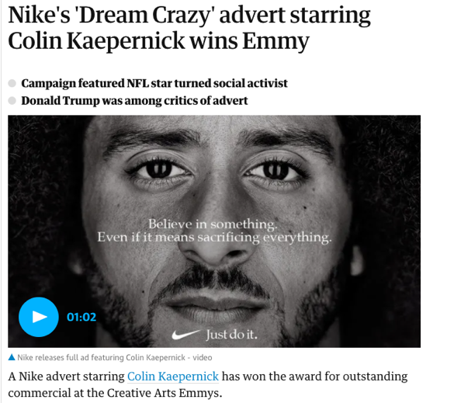

Slide 29
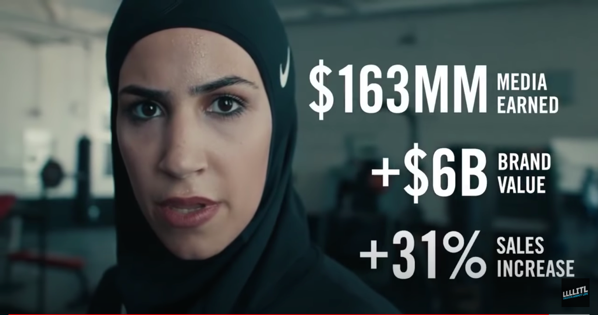

Slide 30
3. Create original, expressive culture

Slide 31
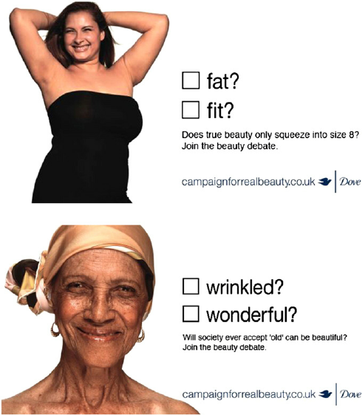
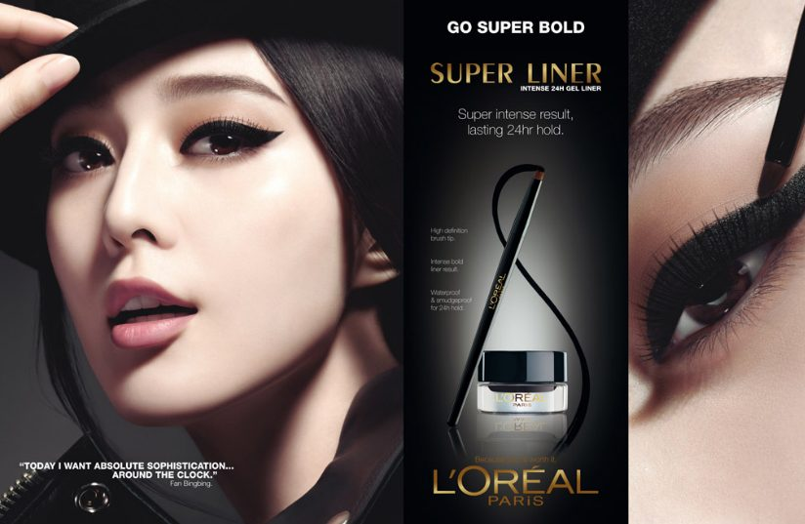
Dove: Evolution + Onslaught
Creating your own space with a point of view or a statement among the cliches of the industry
https://www.youtube.com/watch?v=iYhCn0jf46U
https://www.youtube.com/watch?v=9zKfF40jeCA

Slide 33
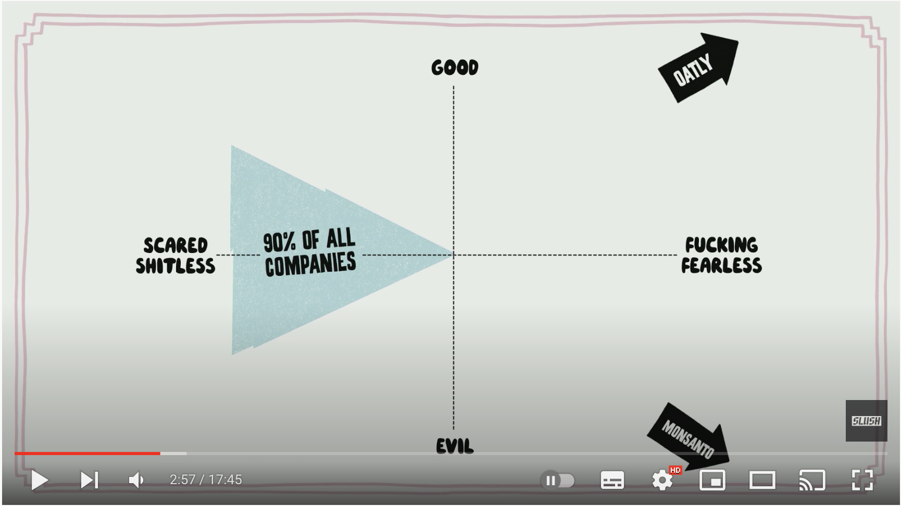
https://www.youtube.com/watch?v=XUcPYqWa-Ng

Slide 34
https://www.youtube.com/watch?v=JJmqCKtJnxM

Slide 36
4. Develop an authentic socio-political voice!!
Almost impossible to discover or sustain

Slide 37
Skewed approach to market research
Dominant approach to market research is “event-oriented”
“Let’s test this new feature/benefit” – Survey/Focus Group
“Let’s figure out what our target segment connects to emotionally” - Survey/Interview
Cultural insight demands continuous, big-picture interaction
Cultural Zeitgeist – Immersion in media and popular culture

Slide 38
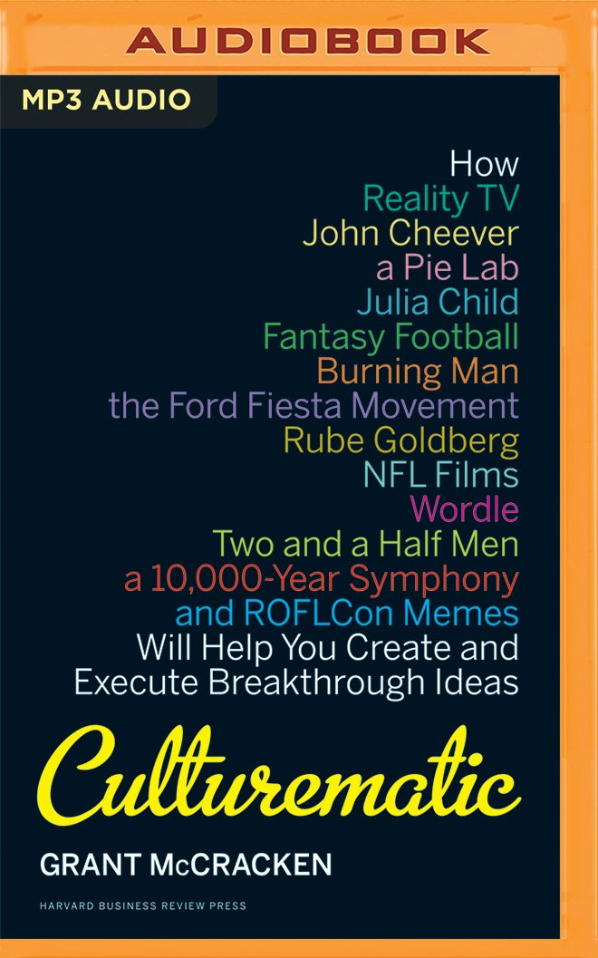

Slide 39
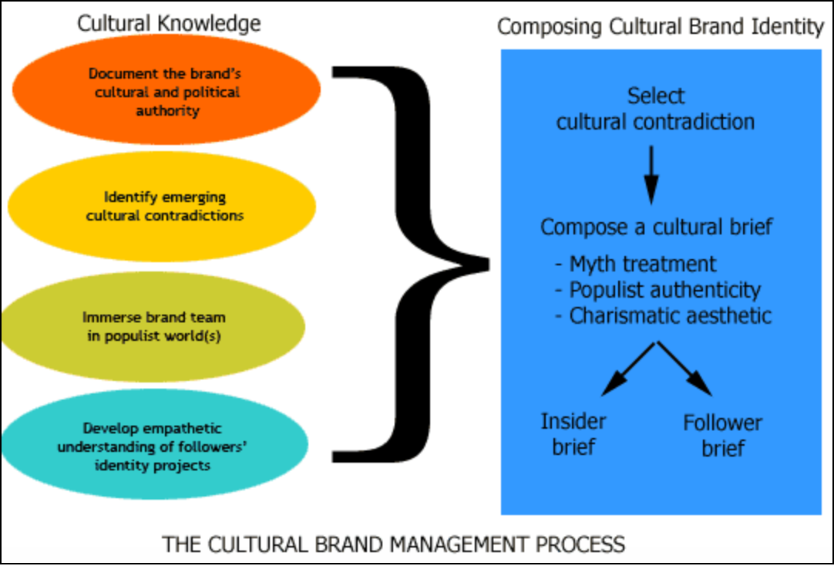

Slide 40
Key Challenge #1: Fish doesn’t see water
Cultural brands are Time-stamped and Space-stamped
But this stamping can be explicit or implicit

Slide 41
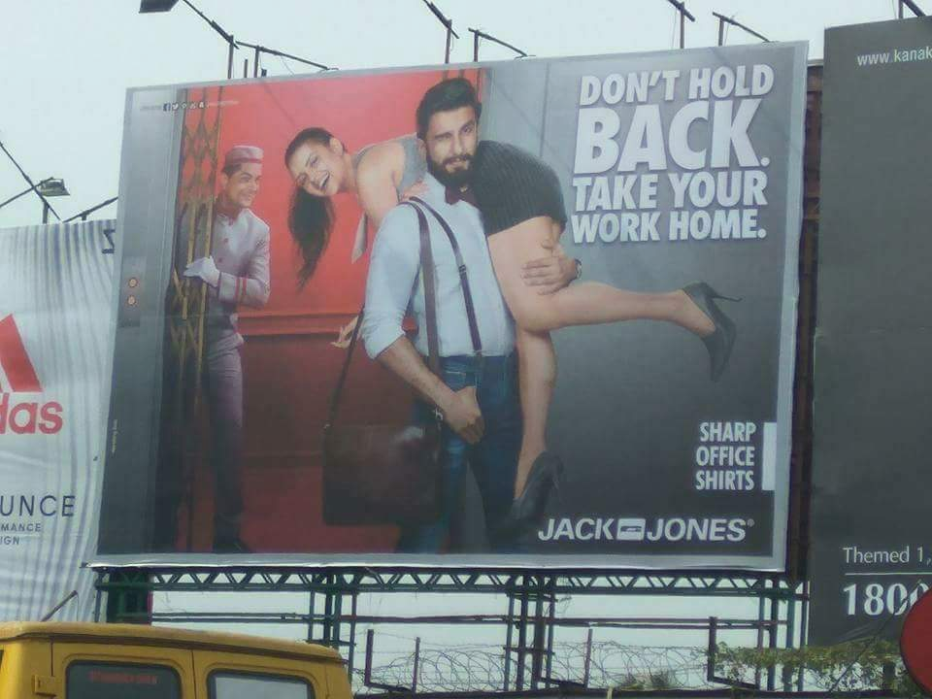
Go to www.menti.com and use the code 7732 0630

Slide 44
Notes:
https://www.mentimeter.com/app/presentation/41f1cd4dbffc2a230149dc99928da0d8/36d1b872b89f/edit?

Slide 45
Key Challenge #2 – Only works when the brand has “cultural authority”
Cultural authority = “the ability to construct reality through definitions of fact and value”
‘Halal’ Brands!!

Slide 46
Thank You

