Slide 1
Weekly plan
Week 1
Week2
Week3
Week4
Week 5
Introduction to the course and practicalities
Approaches and Building blocks of Brand Management
Mindshare Branding
Emotional Branding
Cultural Branding
Experiential branding
Managing Brand Portfolios
Aligning Brand Strategy, Research and Context
Future of Brand management
Guest Lecture – Percy Smend

Slide 2
Kushagra Bhatnagar
18.05.2022
Aligning Brand Strategy, Research and Context
Session - 8

Slide 3
Pitfalls of being a Brand Manager

Slide 4
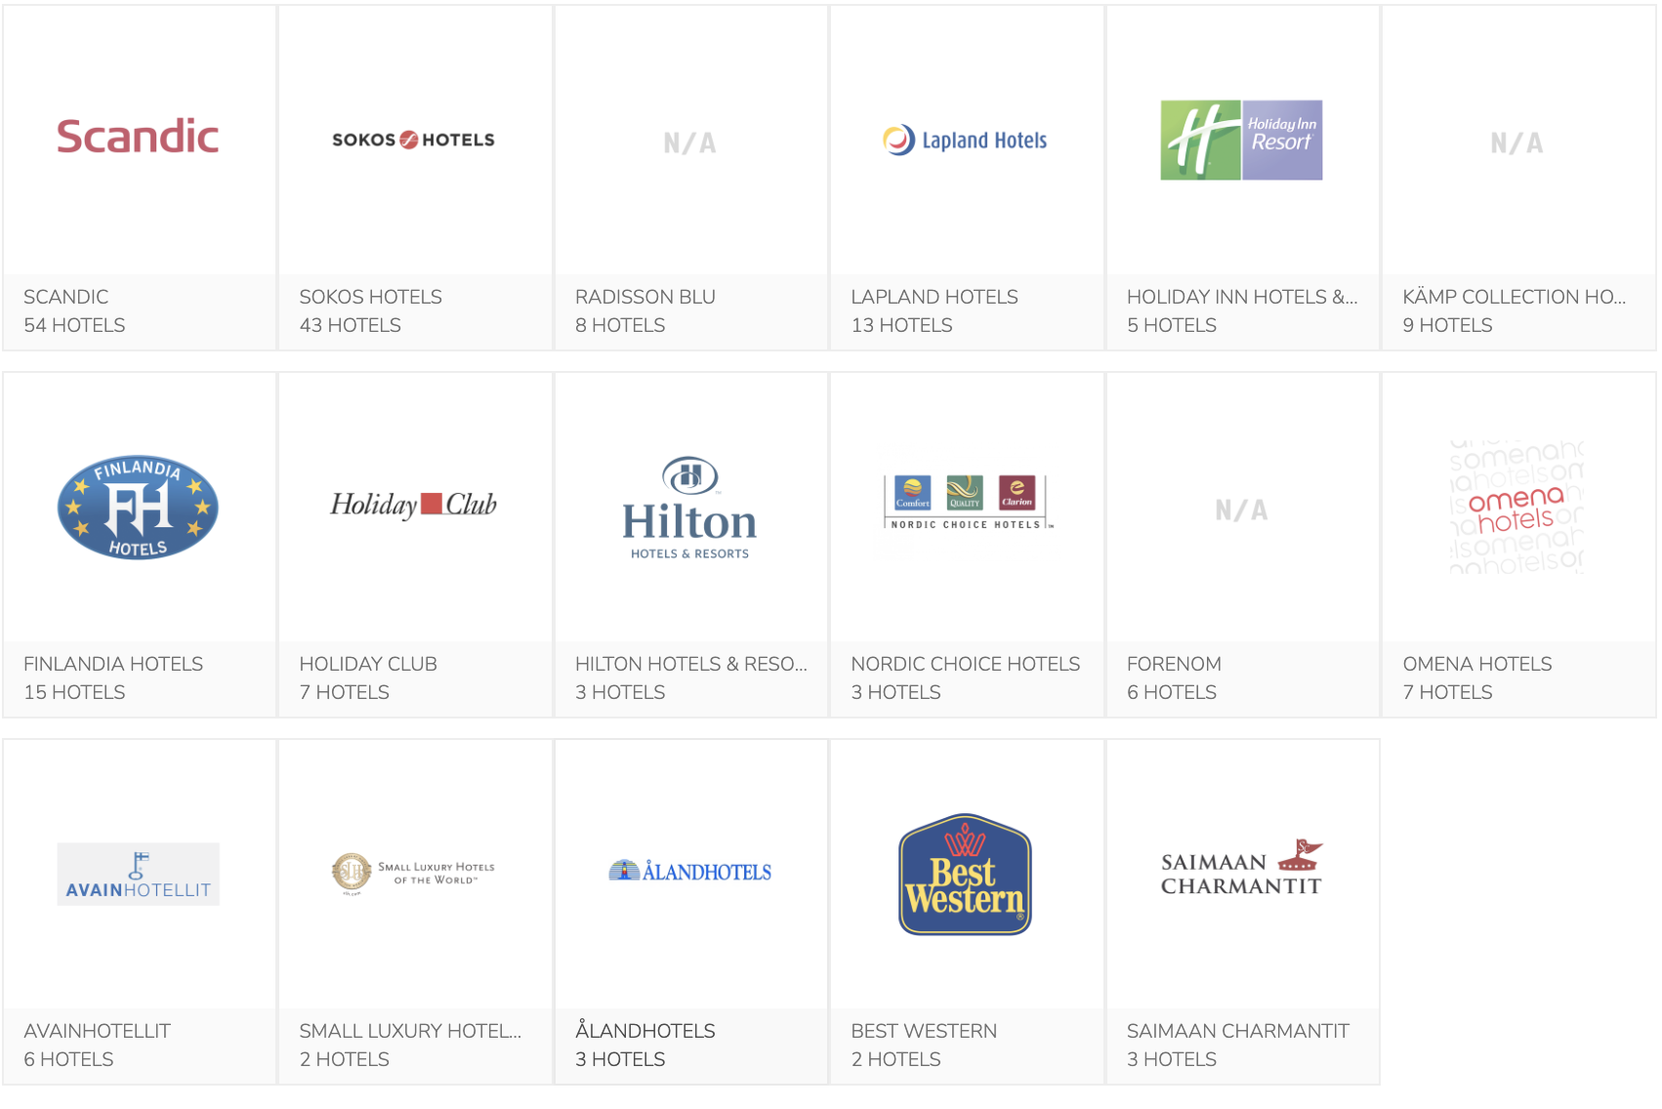
1. Looking narrowly at your brand
Hospitality brands in Finland

Slide 5
Asking context-independent questions
How many amenities should a luxury/superior/family room have?
What kind of locations?
What is the key consumer demographic?
What kind of architecture/lighting/interior should our rooms have?

Slide 6
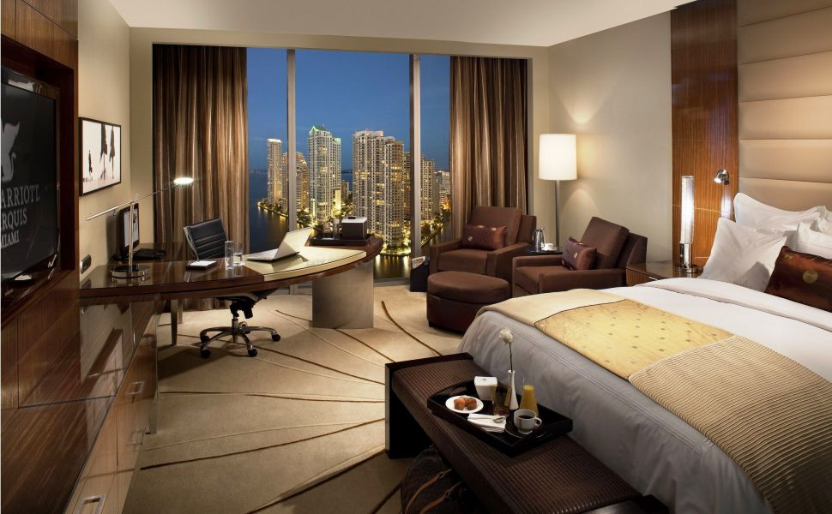

Slide 7
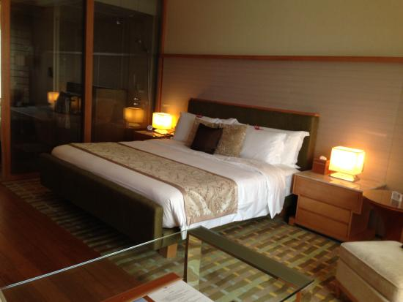

Slide 8
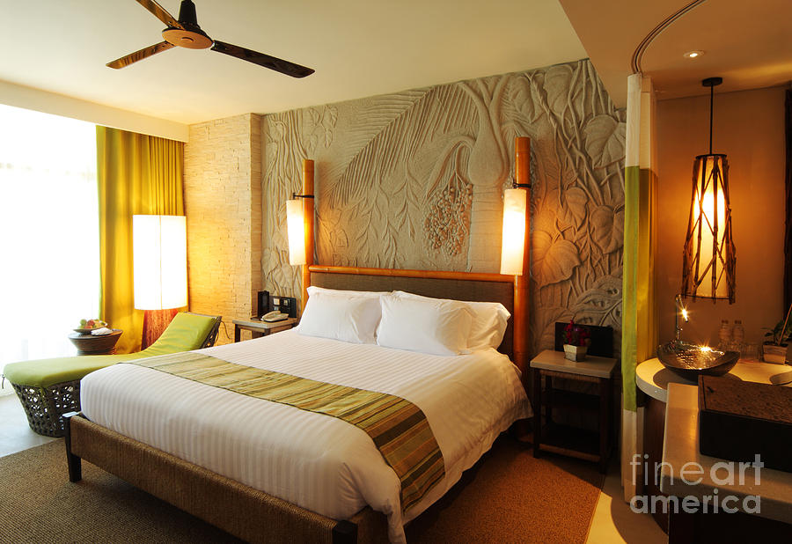

Slide 9
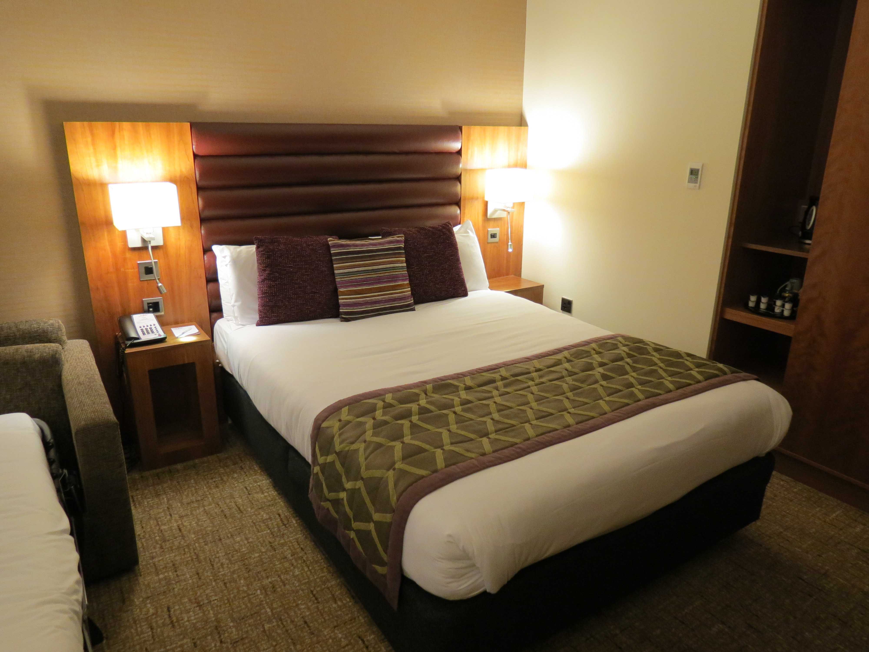

Slide 10
Tourism = Living in a “paradise”
The absence of “real” autonomous locals

Slide 11
BMs not asking the right questions
Better Hotel experience? More personalized experience?
Which target customers
Young OR Old
18-30 OR 31-50
Male or Female
Couples or Families
Budget or Premium?

Slide 12
Two seemingly exclusive customer groups
1. Either you backpack your way across a country, living in youth hostels and getting a more authentic experience
2. Or you live in cookie cutter hotels in the town center and visit the touristy areas

Slide 13
What about a new kind of ‘tourist’?
French Anthropologist Marc Auge distinguishes between places and non places
A place is relational, historical and concerned with identity
  It is an anthropological place
A non-place does not integrate earlier places
  It is listed, classified and promoted to a place of memory

Slide 14
The new promise of travel
Popular media shows travel as life changing
Newspapers and lifestyle magazines are filled with people who have gone on sabbaticals and world tours

Slide 15


Slide 16
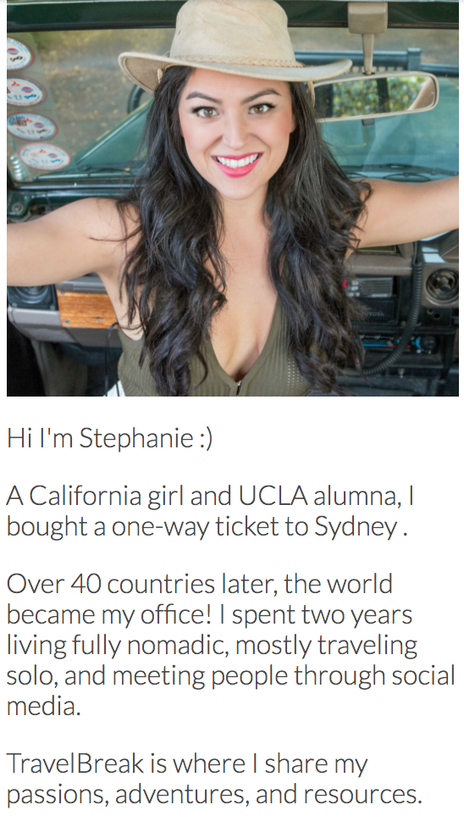
AirBnB - From Tourist to Traveller

Slide 17
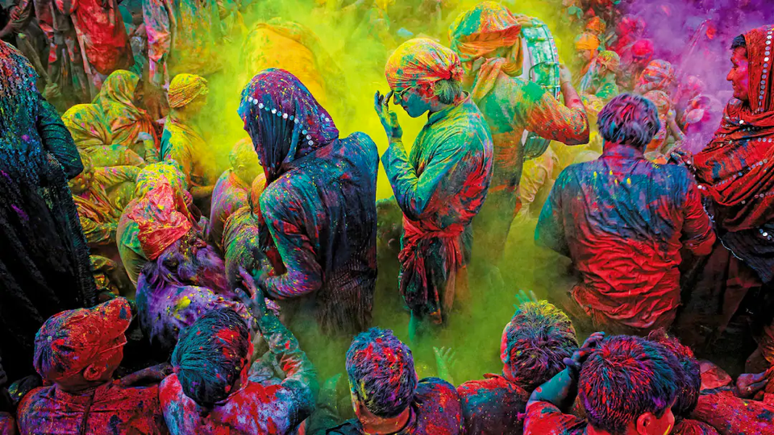

Slide 18
What is the future of Coca-Cola??

Slide 19
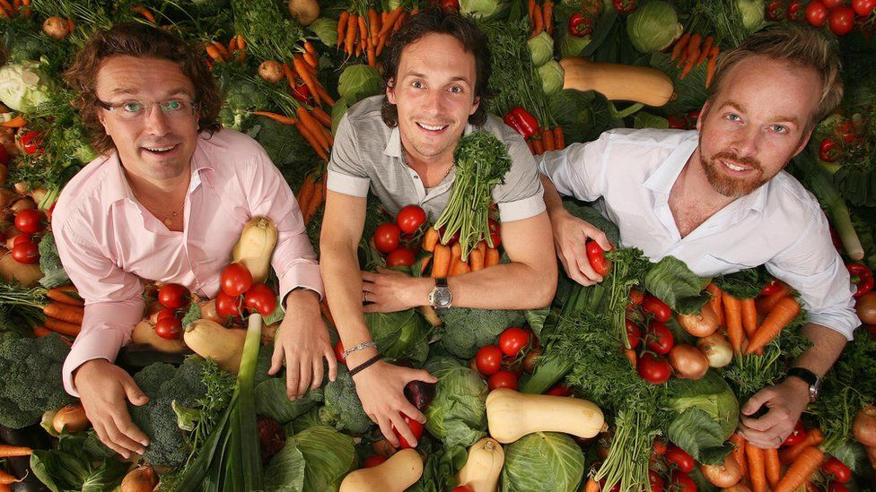
https://www.youtube.com/watch?v=UjY0X2HNUxo

Slide 20
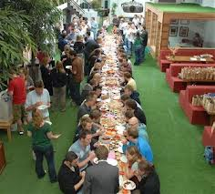
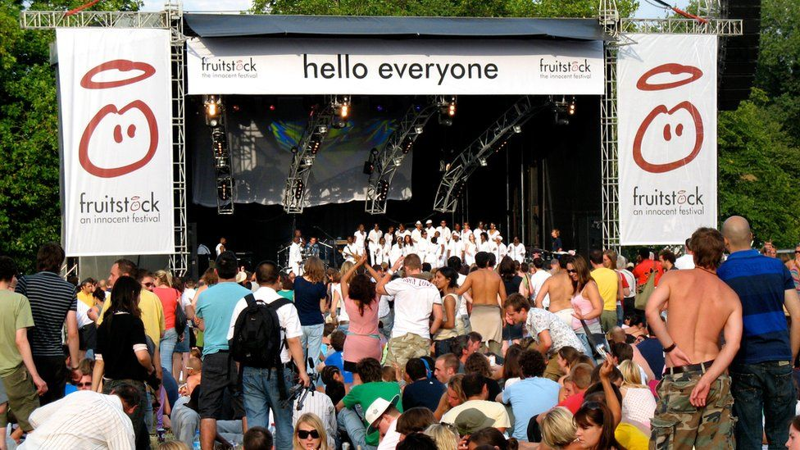

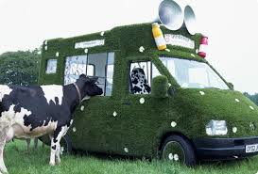
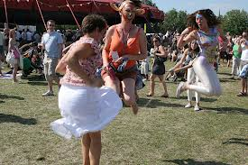

Slide 21
The opportunity - Move From ‘Category’ to ‘Culture Play’
Category Microcosm
Hartwall
Narrow-cast category language with little
meaningful differentiation – Old Language
Deconstructing and reconstructing
the category discourse
Coke
Pepsi
Category
Youth
Culture
Cultural Macrocosm
Locating the brand within the larger
Consumer Culture – New Language
Studying both invisible deep culture and
Visible moving culture
Pepsi

Slide 22
2. Getting locked up in category conventions

Slide 23
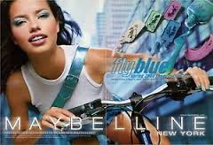
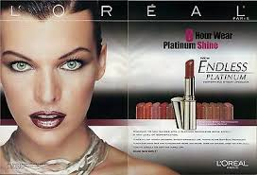
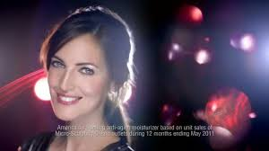
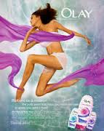
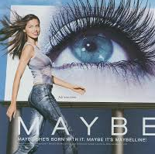

Slide 24
Unilever ‘Path to Growth’
  Reduce the number of brands
  Deepen consumer engagement with remaining brands
  Find higher order benefits beyond product differentiation and USP

Slide 25
Development vs Building
Unilever split each master brand into two teams
Brand Development team thinks about the idea behind the brand and innovation funnel
Brand Building team is responsible for short term market share and brand activation
Notes:
This is a great way to do “perspective-taking”

Slide 26
Dove needed to find common ground between diverse categories
Beyond functional benefits or product differentiation
Functional superiority meant different things in different categories

Slide 27
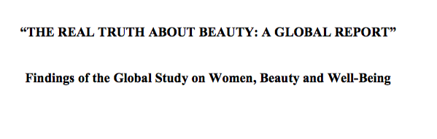
Asking the right questions
Beyond product preferences or characteristics

Slide 29
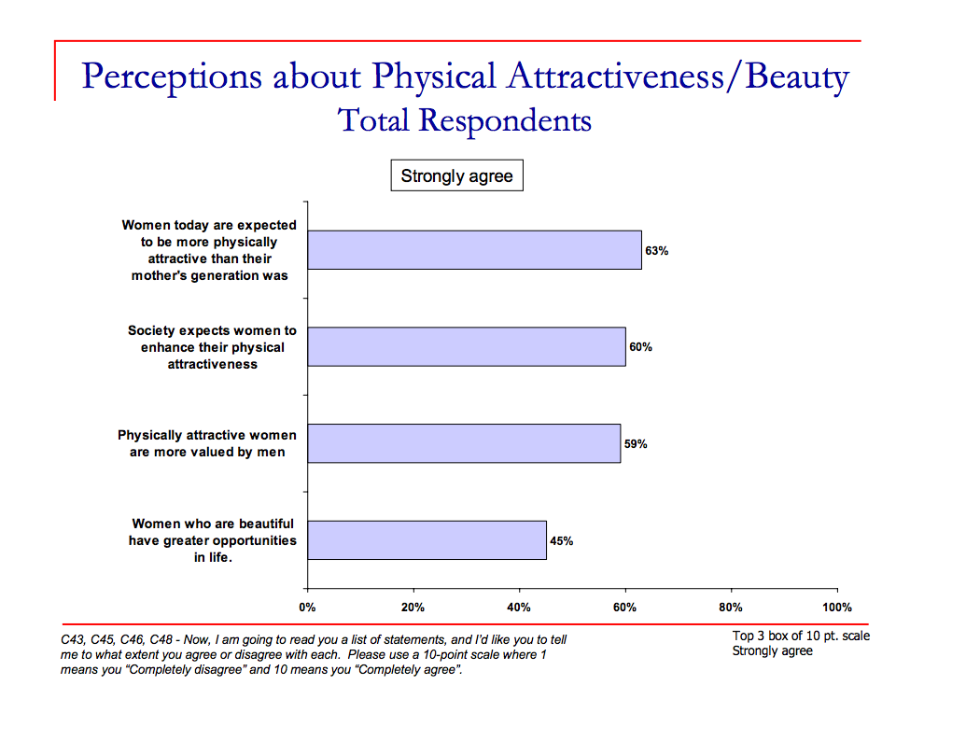

Slide 30
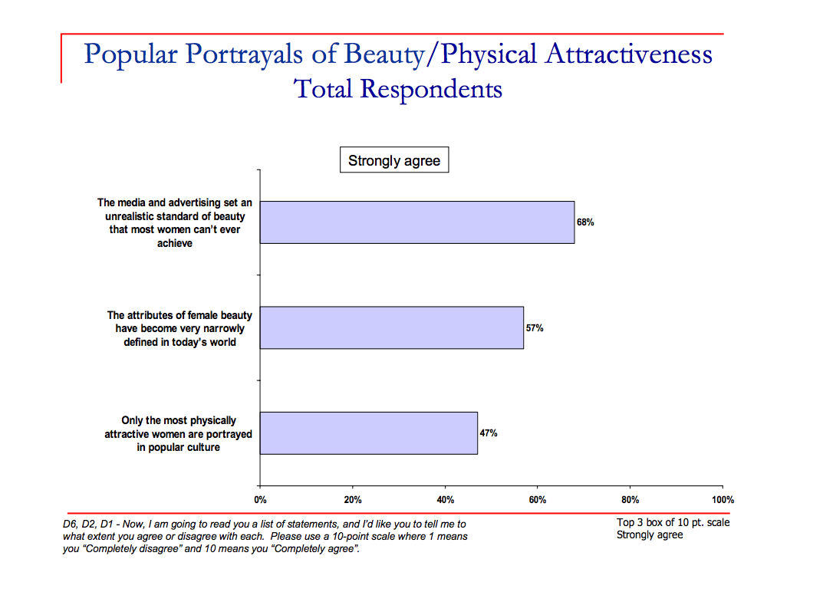

Slide 31
Brand Development’s key insight
It is not about making women feel more beautiful
It is about making more women feel beautiful

Slide 32
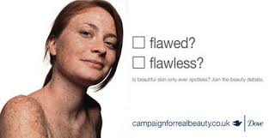

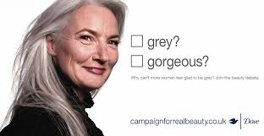
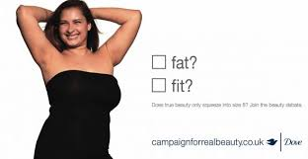

Slide 33
Superbrand based on Research
“Without having a foundation in the global research study, which showed that the image of beauty was unattainable, we wouldn’t have had the credibility in creating the materials, in pitching stories and being able to answer some of the folks that didn’t agree with the campaign.”
  Vice President of consumer brands, Edelman

Slide 34
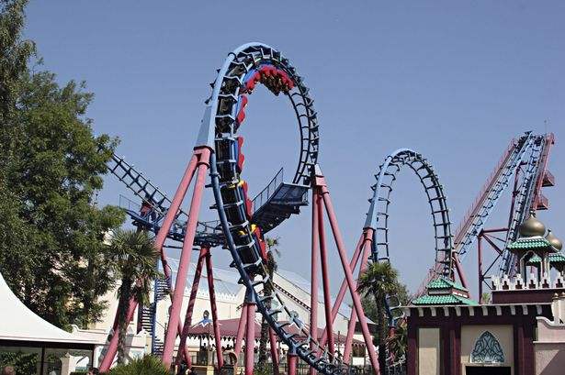
Notes:
Amusement parks

Slide 35
Desire for Consumer Deceleration

Slide 36

Detoxing from Digital Nativity

Slide 37
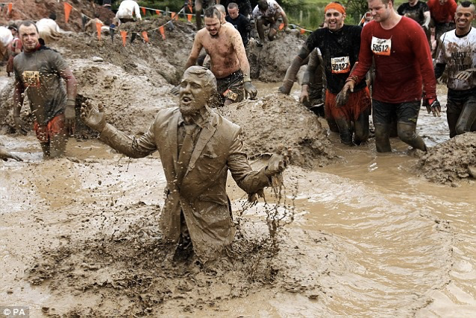
For those whose hands are “soft”

Slide 38
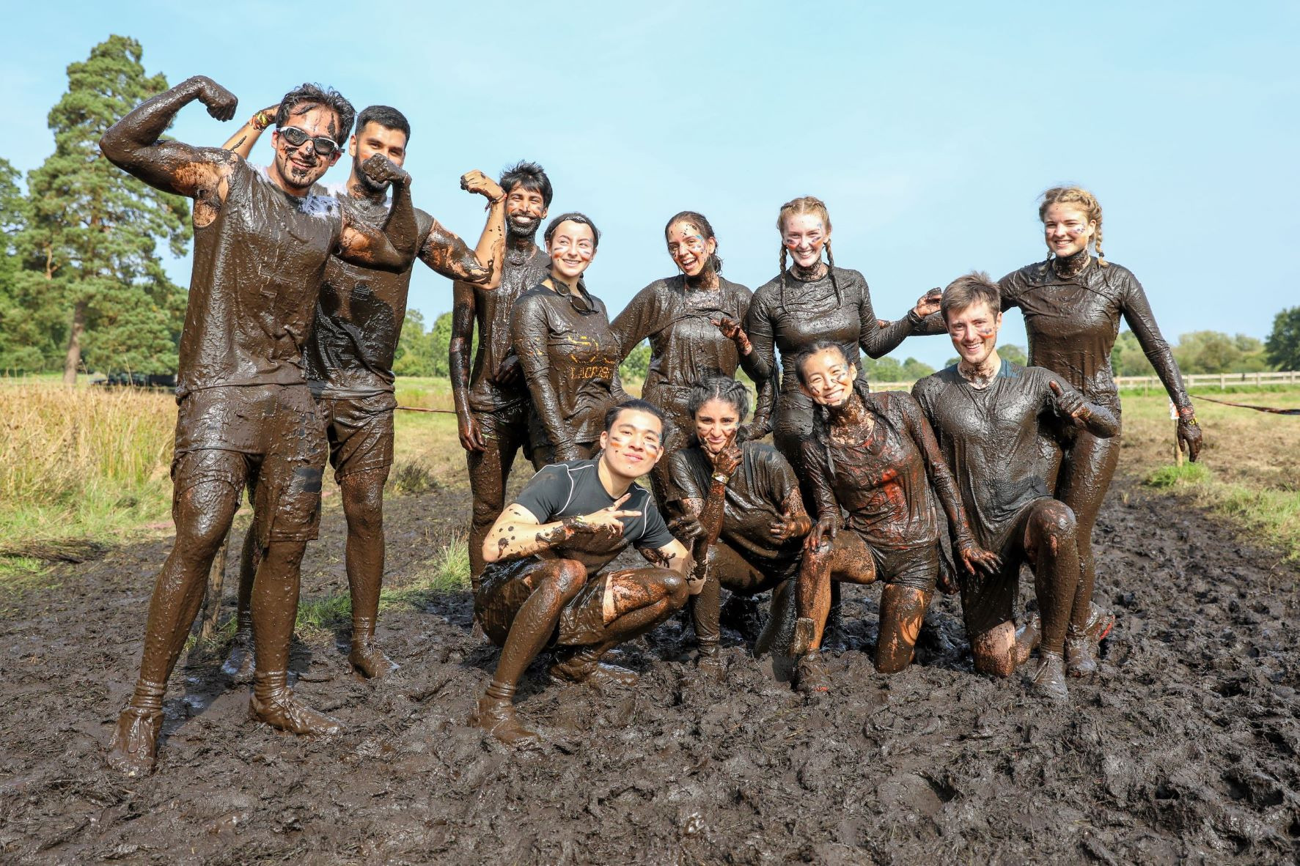

Slide 39

Antidote to Modern Life

Slide 40
3. Not finding the right balance between “home” brand and “new” market

Slide 41
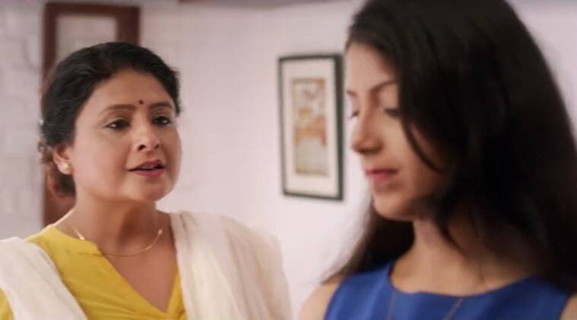
https://www.youtube.com/watch?v=oEnxT8Z5-1c

Slide 42
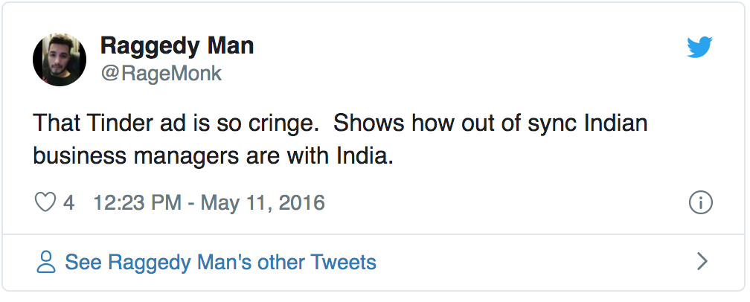
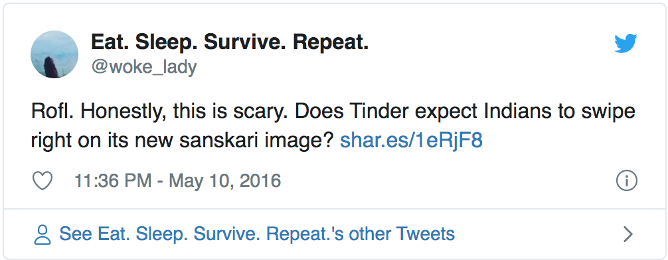

Slide 43
How far to continue
with the influence
of “Home”

Slide 44
From Custodianship to Co-Creatorship!!
Photo courtesy Eudaimonia
Reference: Marshall McLuhan
Notes:
Connect this to time-stamped and space-stamped brands – medium stamped brands

Slide 45
From Distant to Immediate
Brands no longer abstract entities or entries in company balance sheet
Consumers can have conversations with Brands as if they are real people
  Anthropomorphizing brands
Notes:
You can friend a brand, tag a brand, complain to a brand, post on its facebook page or have an extended twitter conversation with the brand

Slide 46
Changing Modes of Interaction: Brand-Brand Conversations
Notes:
Be careful what you are going to measure

Slide 47
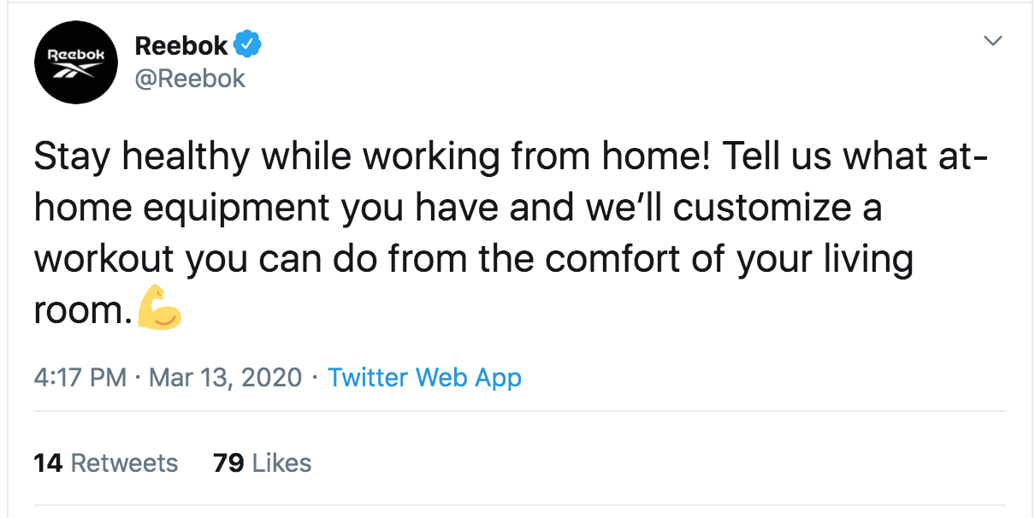
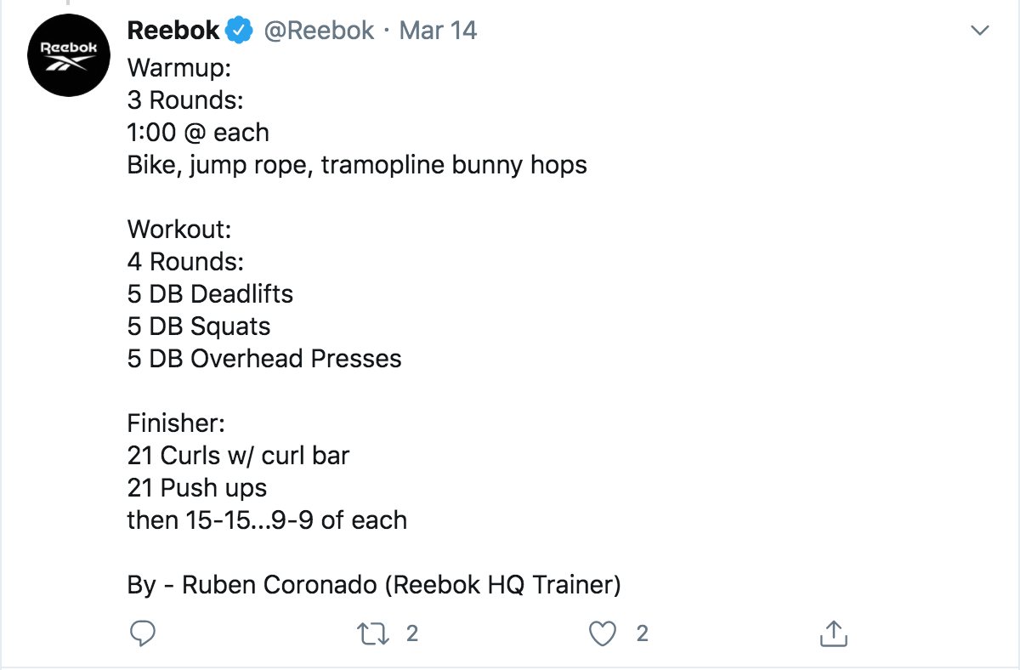
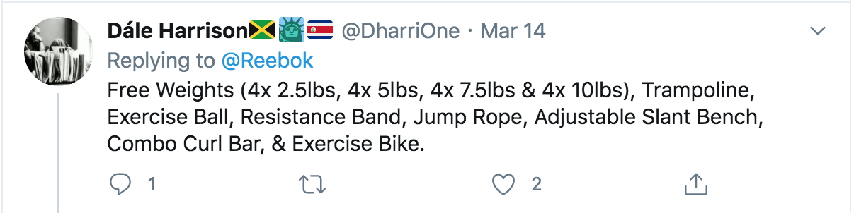
Humanized Brands: 1 to 1 engagement

Slide 48
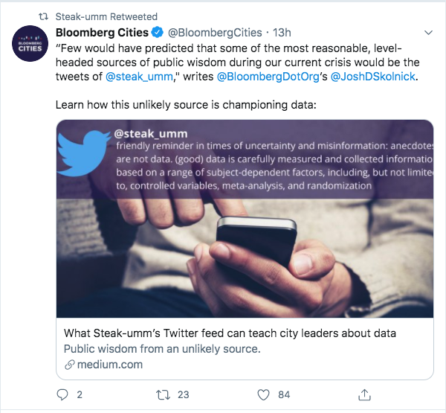
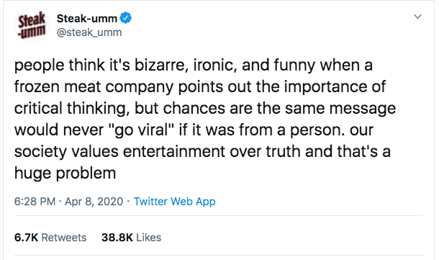
New Modes of Engagement: Branded Agility

Slide 49
Thank You

