Slide 1
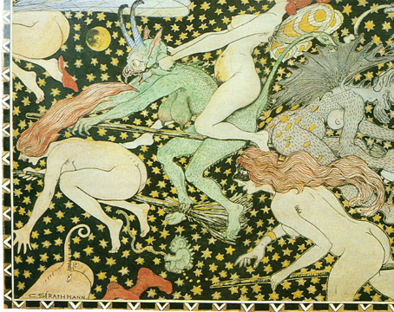
Walpurgisnacht
Vappu

Slide 2
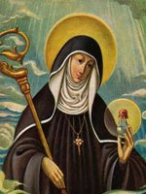
Walpurgis Night
is the eve of the Christian feast day of Saint Walpurga,
an 8th-century abbess in Francia
and is celebrated on the night
of 30 April and the day of 1 May
Saint Walpurga was hailed by the Christians of Germany for battling
pest, rabies and whooping cough, as well as against witchcraft.

Slide 3
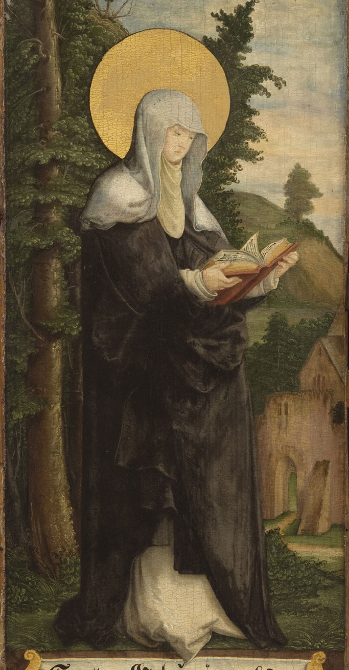
Saint Walpurga or Walburga (Latin: Valpurga, Walpurga, Walpurgis, Swedish: Valborg; c. AD 710 – 25 February 777 or 779),
was an Anglo-Saxon missionary to the Frankish Empire.
Saint Walpurgis Night (or "Sankt Walpurgisnacht") is the name for the eve of her feast day in the Medieval period,
which coincided with May Day; her feast is no longer celebrated on that day, but the name is still used for May Eve.
St. Martinskirche, Heilige Walburga als Märtyrerin
16. Jahrhundert, Meßkirch

Slide 4
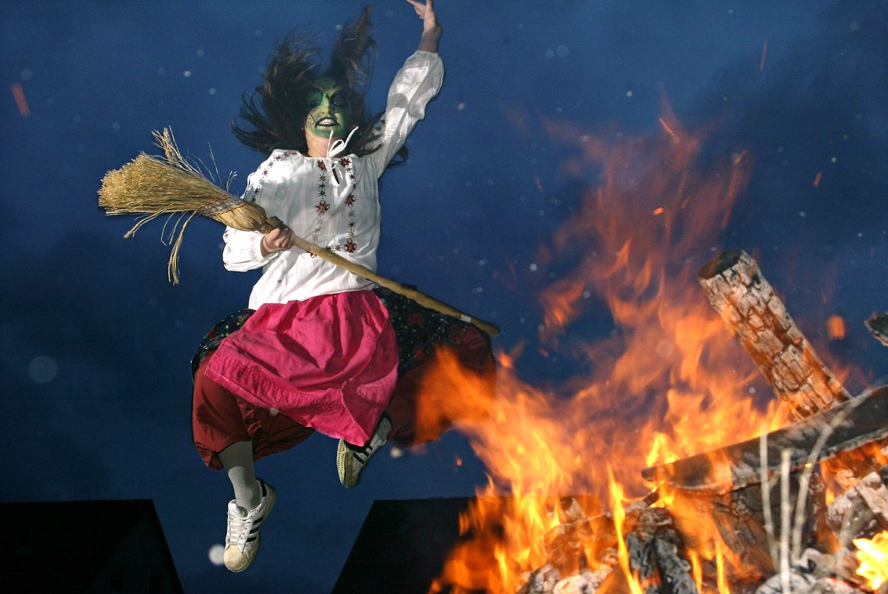
The date of Saint Walpurga's feast,
has become associated with other May Day celebrations
and regional traditions, especially in Finland and Sweden.
Given that the intercession of Saint Walpurga was believed to be efficacious
against evil magic, medieval and Renaissance tradition held that,
during Walpurgis Night, witches celebrated a sabbath and evil powers
were at their strongest.

Slide 5
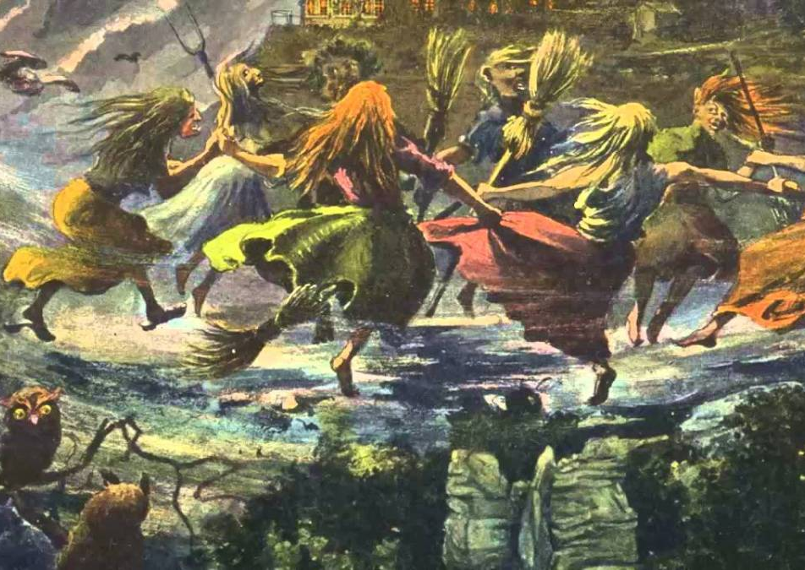
Literature:
A scene in Goethe's Faust Part One is called "Walpurgisnacht,"
and one in Faust Part Two is called "Classical Walpurgisnacht."
The last chapter of book five in Thomas Mann's The Magic Mountain (Zauberberg) is also called "Walpurgisnacht."
In Edward Albee's 1962 play Who's Afraid of Virginia Woolf?, Act Two is entitled "Walpurgisnacht."

Slide 6
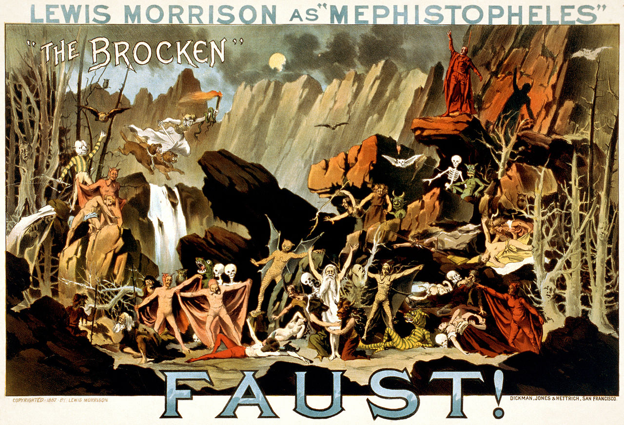
Poster for a theatrical performance of Goethe's play showing Mephistopheles conjuring supernatural creatures on the German mountain, the Brocken (or Blocksberg), which according to the tale is the scenery for the Walpurgisnight, from 30 April to 1 May.

Slide 7
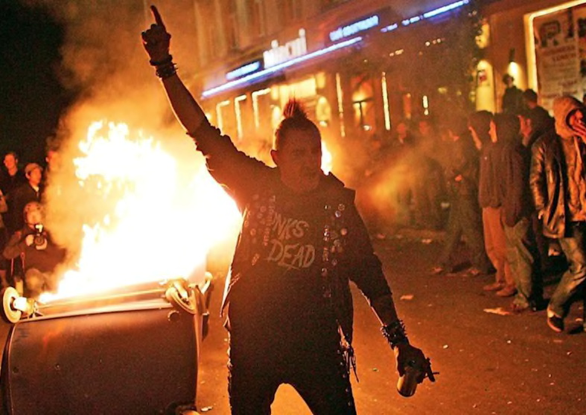
In rural parts of southern Germany, it is part of popular youth culture
to play pranks such as tampering with neighbours' gardens,
hiding possessions or spraying graffiti on private property.
In Berlin, traditional leftist May Day riots usually start at Walpurgis Night
in the Mauerpark in Prenzlauer Berg.

Slide 8
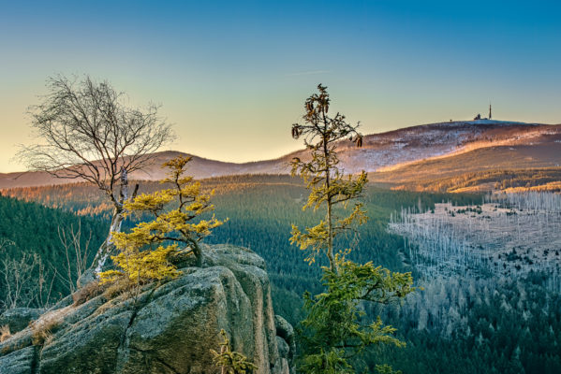
In German folklore, Walpurgis Night was believed to be the night of a witches' meeting on the Brocken, the highest peak in the Harz Mountains, a range of wooded hills in central Germany.
To ward off evil and protect themselves and their livestock, people would traditionally light fires on the hillsides, a tradition that continues in some regions today.
Notes:
In Bavaria, the feast day is sometimes called Hexennacht (Dutch: heksennacht), literally "Witches' Night",
on which revelers dress as witches and demons, set off fireworks, dance and play loud music,
which is said to drive the witches and winter spirits away

Slide 9
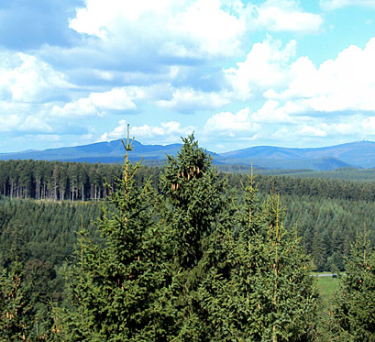
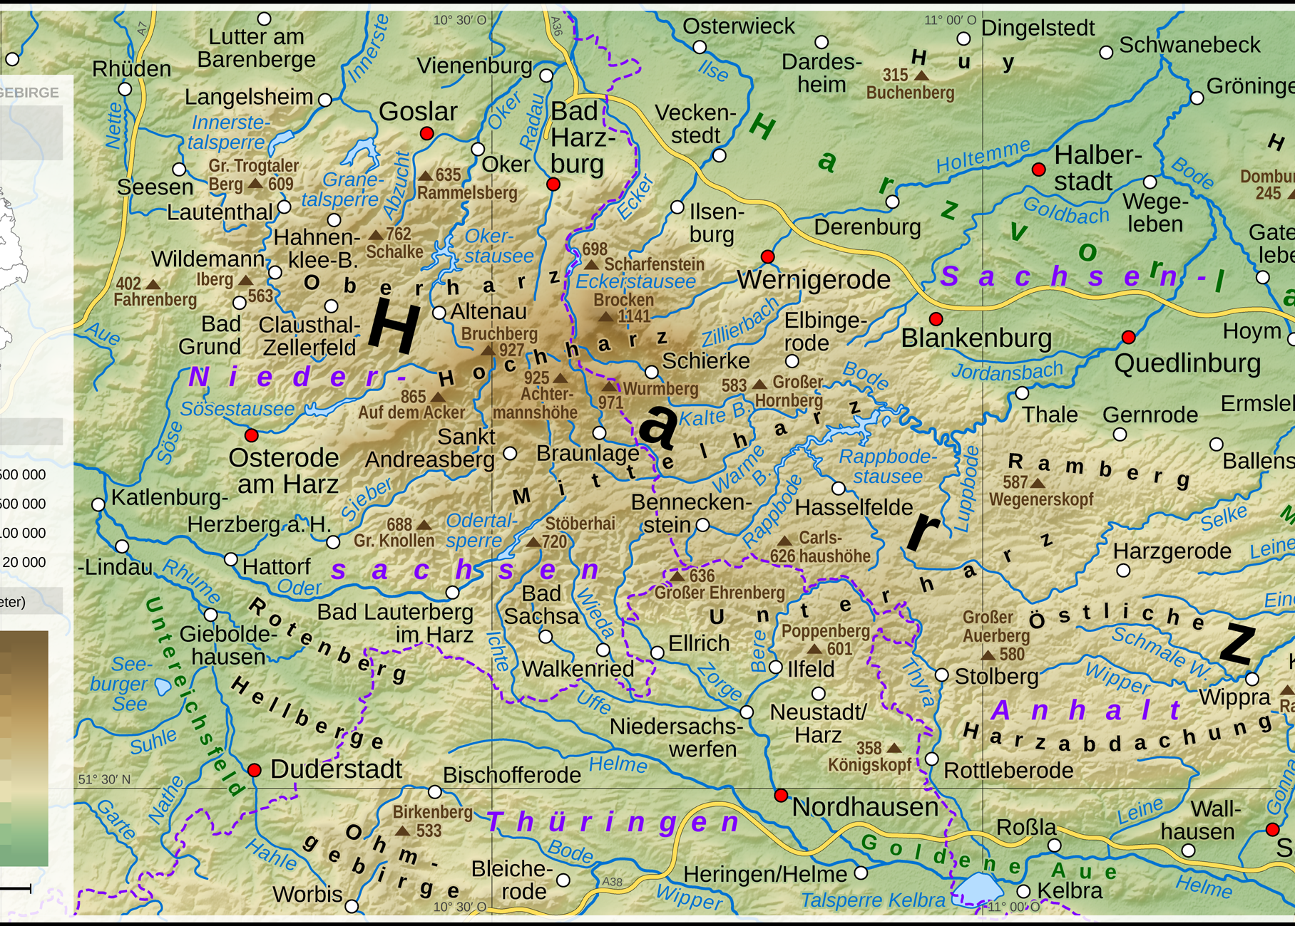

Slide 10
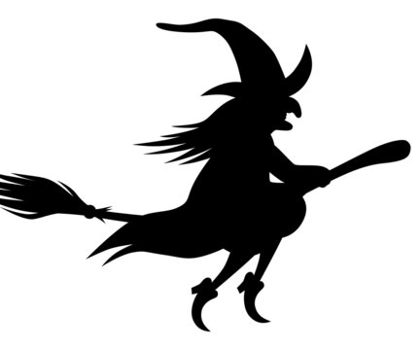
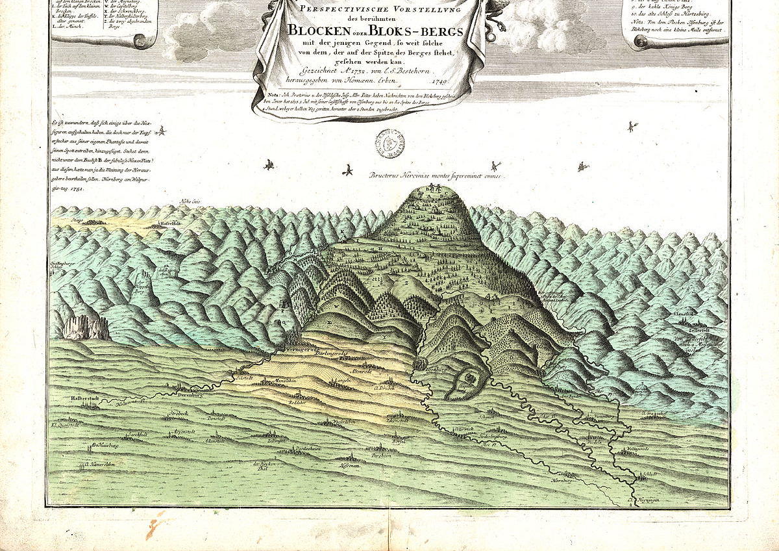

Slide 11
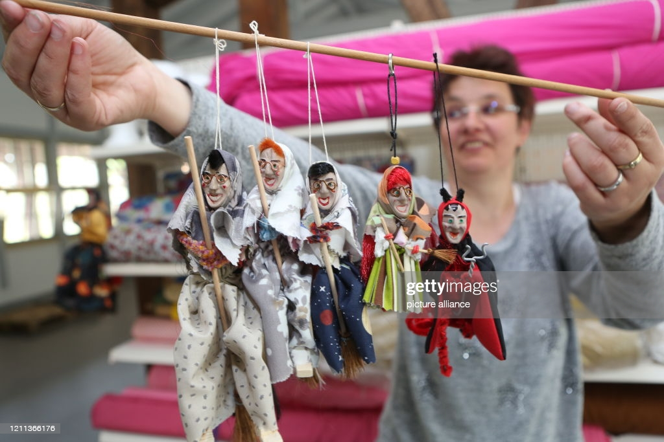
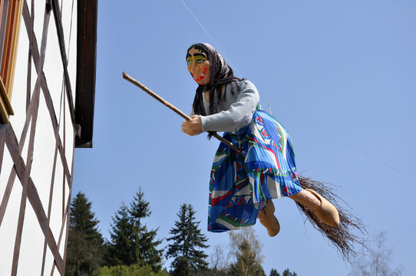
Brocken-Hexen

Slide 12
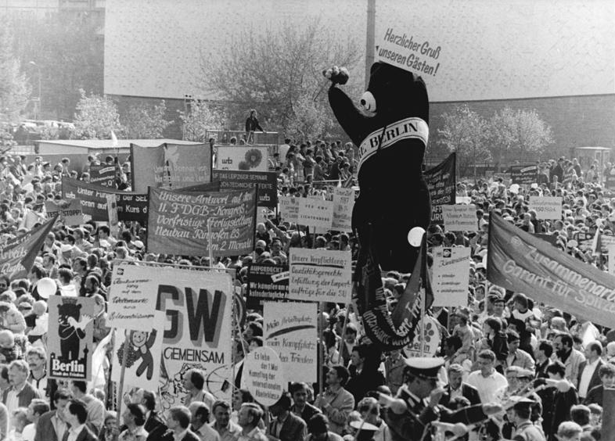
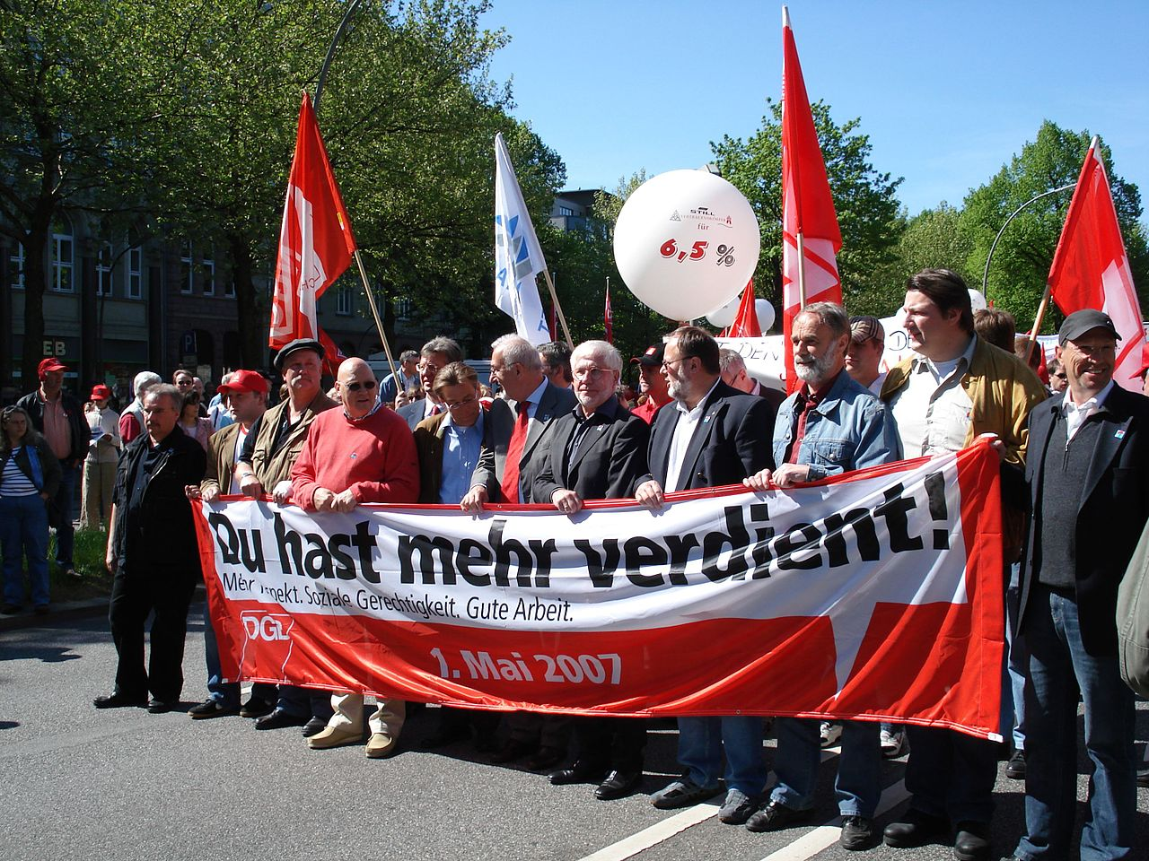
Erster Mai
International Workers' Day, also known as Labour Day in most countries and often referred to as May Day,
is a celebration of labourers and the working classes that is promoted by the international labour movement
and occurs every year on May Day (1 May).
Notes:
http://www.goethezeitportal.de/index.php?id=6644

Slide 13
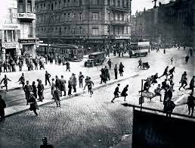
Blutmai (English: Bloody May) refers to the 1929 killing
of 33 Communist Party of Germany (KPD) supporters and uninvolved civilians by the Berlin Police
(under the control of the Social Democratic Party of Germany [SPD]) over a three-day period,
after a KPD International Workers' Day (May Day) celebration was attacked by police.
In defiance of a ban on public gatherings in Berlin, the KPD had organized a rally to celebrate May Day.
Although fewer supporters showed than what the KPD had hoped, the response by the police
was immediate and harsh, using firearms against mostly unarmed civilians.
Notes:
https://www.youtube.com/watch?v=OtYTSx32hOY

Slide 14
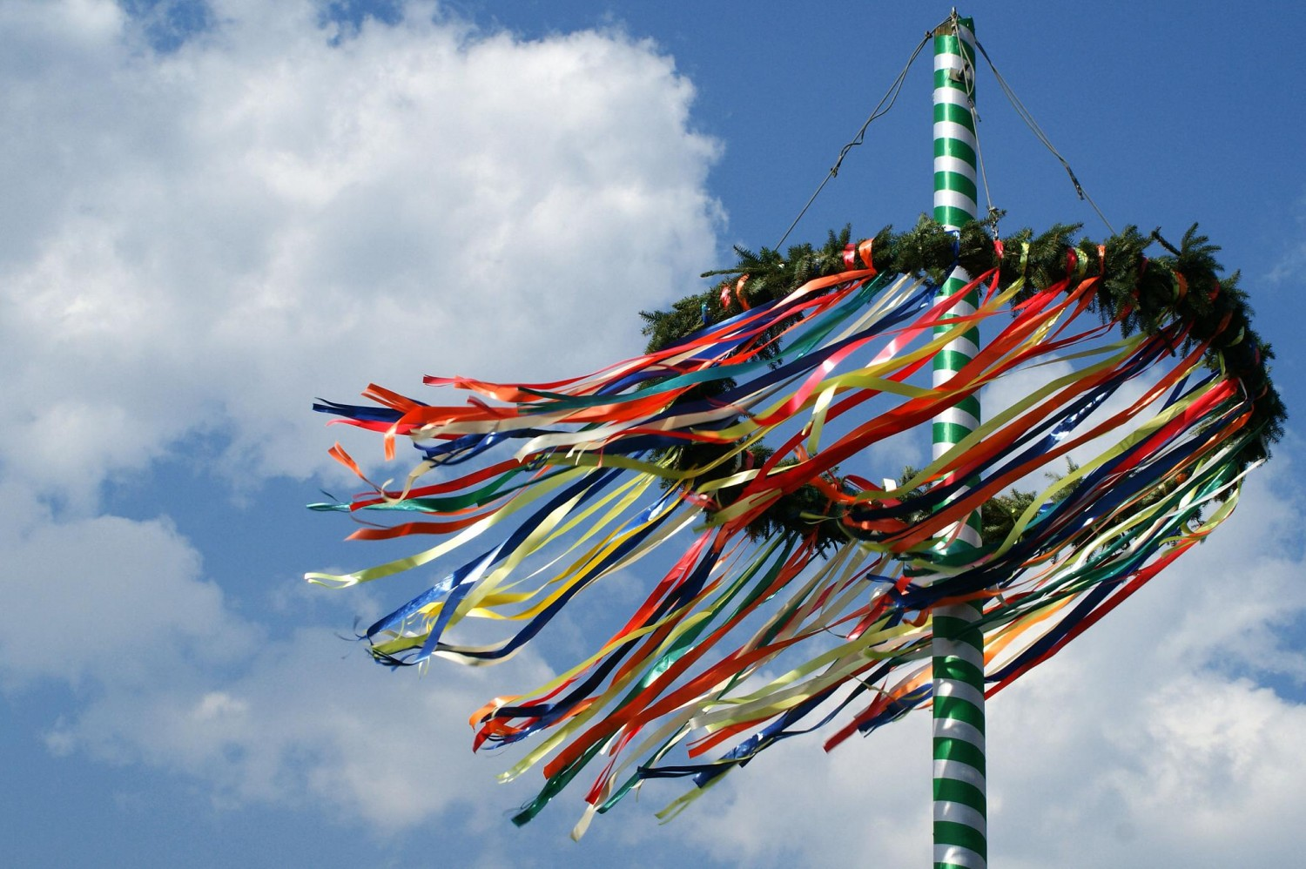
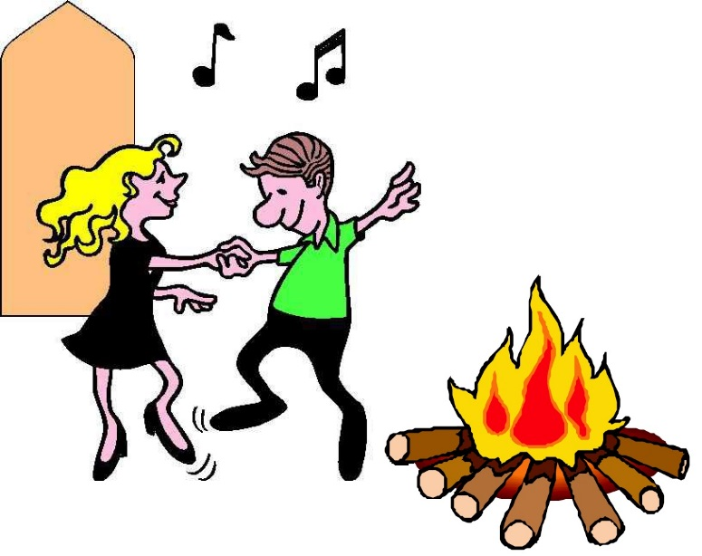
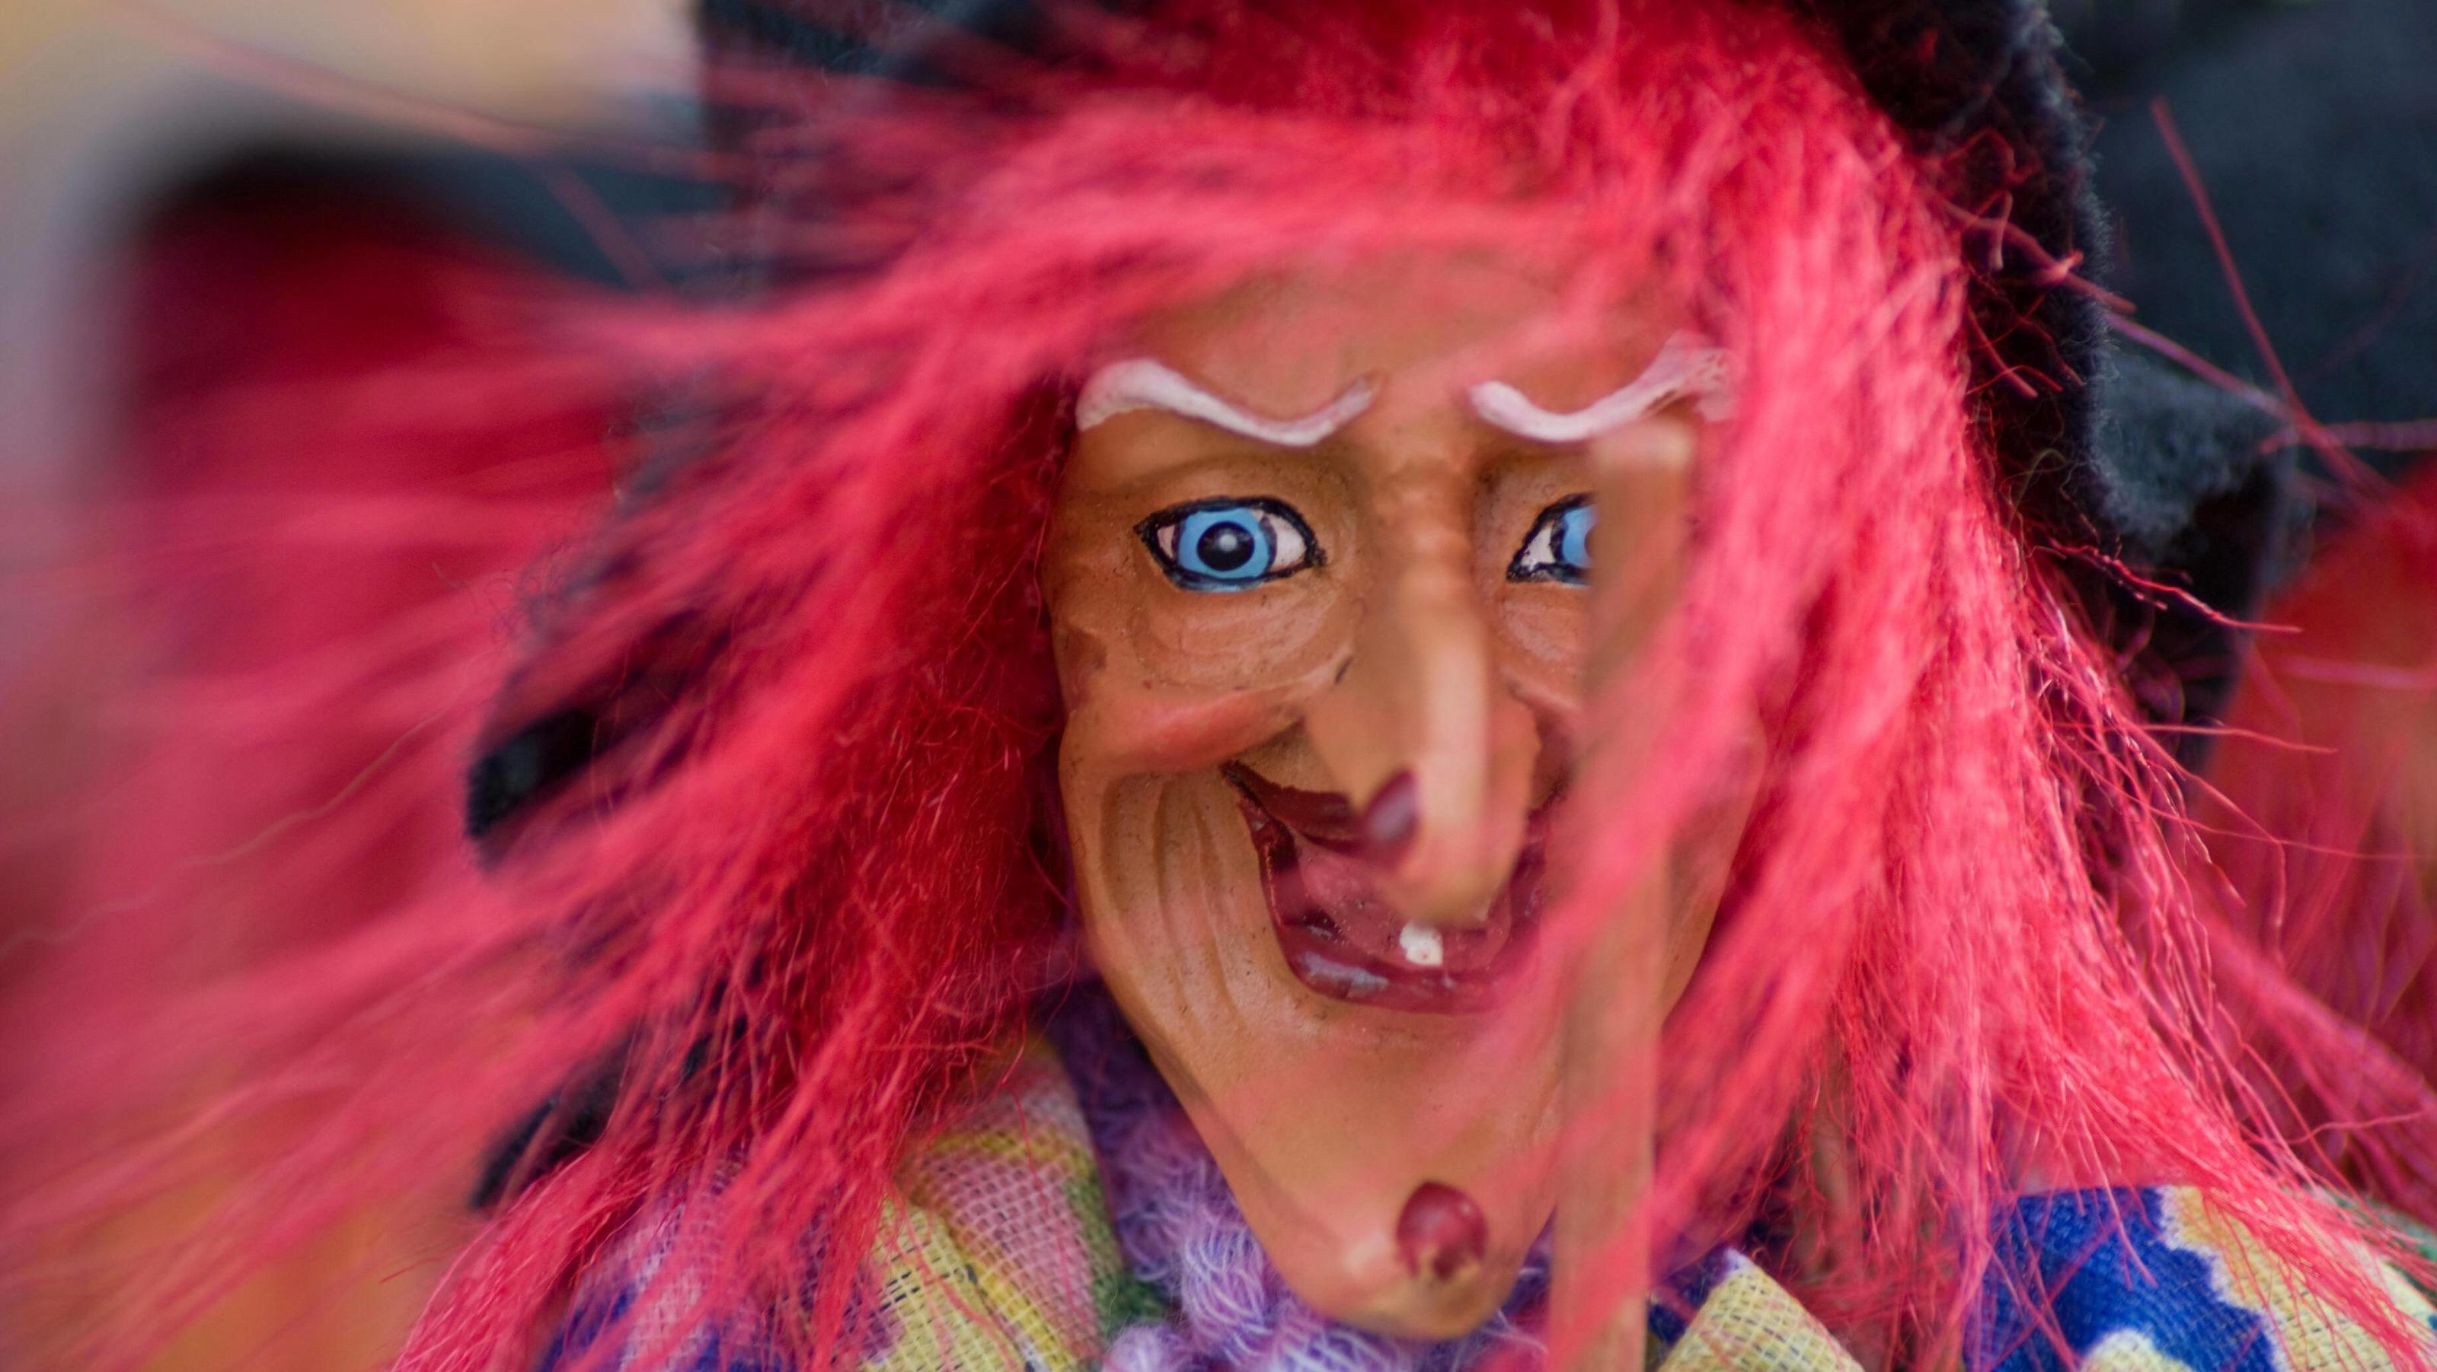

Slide 15
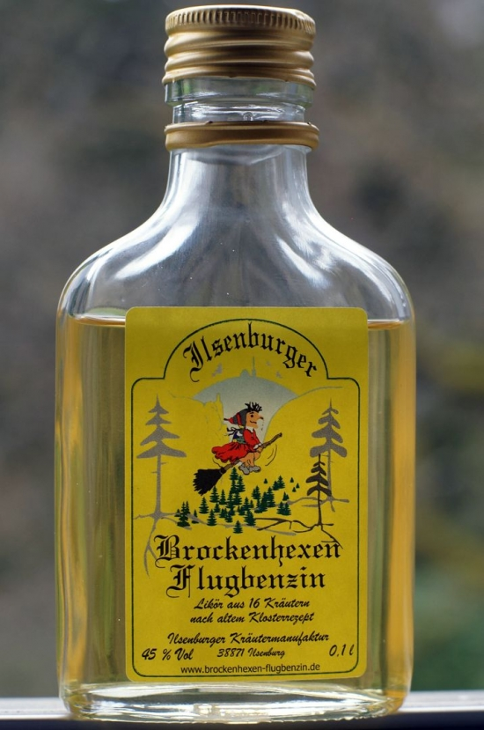
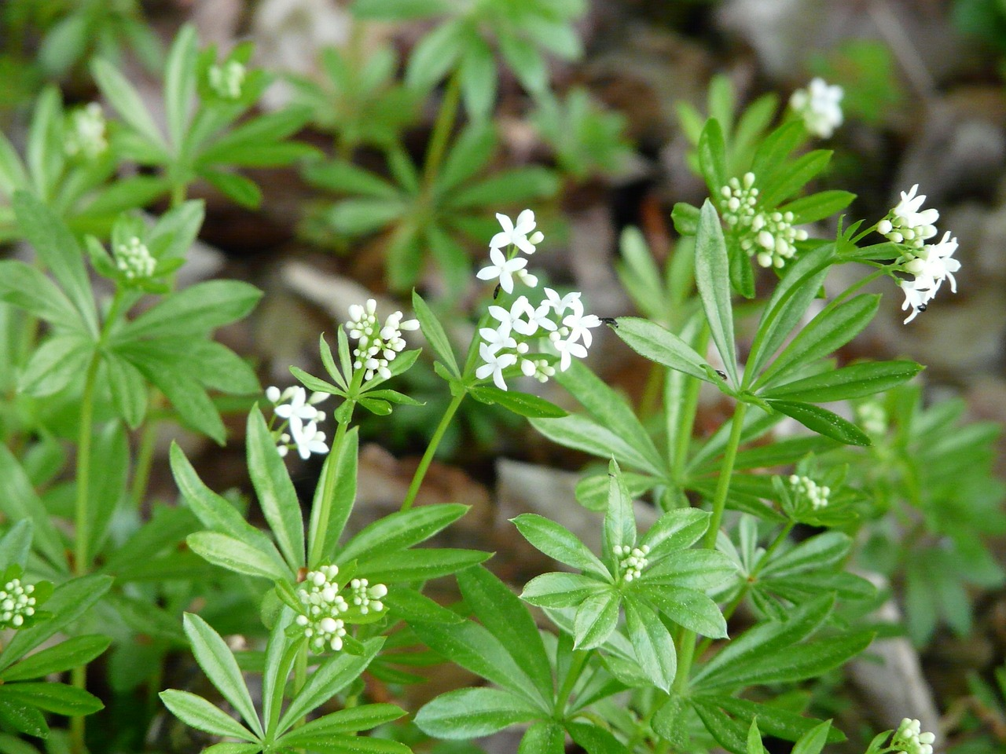
Maibowle
Waldmeister (Galium odoratum)
sweetscented bedstraw
Tuoksumatara

