Slide 1
Emotions in sustainability
Sanni Saarimäki
Study psychologist, sanni.saarimaki@aalto.fi
Aalto University
Notes:
Origins: that what needs to be sustained -> the term itself does not tell, what needs to be sustained, it’s a question of negotiation
What is to be sustained?
How are needs defined in different culture?
(SD is necessary for us all, but it is differently defined in different cultures)
What actions are more sustainable? Who decides? On what basis?

Slide 2
Why emotions matter in (un)sustainability questions & higher education?
Emotions related to these issues are common and very human – individuals shouldn’t be left alone to deal with them
When we encounter something new, huge or complex, it can be e.g. scary and overwhelming, and also provoke feelings of inadequacy and uncertainty
Emotions can be energy for actions if one finds ways to channel it, but too heavy emotional burden and feeling that there is nothing one can do to make situation better can cause one to freeze or get stuck
The way we deal (or not deal) with difficult emotions can affect learning, creativity and motivation to take part in solving these issues

Slide 3
Emotions: what and why?
Emotions impact everything, and are present for a reason. They have evolutionary basis; physiological and social, connected to thoughts and behaviour
Basic emotions: fear, sadness, anger, disgust, joy, surprise
Secondary emotions function as reactions – e.g. eco-anxiety is often built on many emotions
Eco-emotions: Emotions related to environmental and climate issues, ecology and nature or natural phenomena

Slide 4
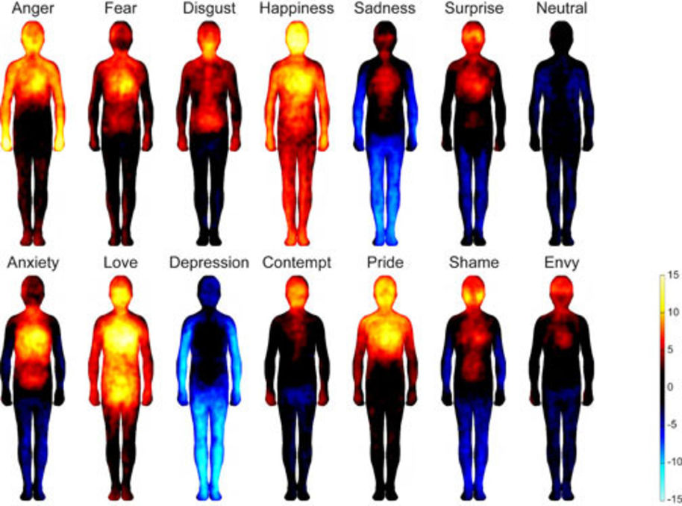
Emotions (in general) are experienced also in the body, not just in your mind.
https://www.aalto.fi/en/news/finnish-research-team-reveals-how-emotions-are-mapped-in-the-body

Slide 5
Research on eco-emotions
Research on eco-emotions has increased remarkably during the last five years.
Results from a new, global study* on young people’s climate anxiety:
10 000 16–25-year-old respondents from 10 countries
59% very or extremely worried, 84% at least moderately worried about climate change
75 % feel that the future is frightening
45 % report negative impact on daily functioning
In Finland, people feeling both climate anxiety and hope are most likely to act on mitigating climate change (**Sangervo, 2020)
*https://papers.ssrn.com/sol3/papers.cfm?abstract_id=3918955, **https://trepo.tuni.fi/handle/10024/123166

Slide 6
Fourfold table PART 1
A
B
What thoughts, emotions and body-sensations could
A) you
B) your students
experience related to e.g. climate and environmental crises, diversity loss and pollution, and taking part in (teaching of) these issues?

Slide 7
Discussion
What emotions are easy or difficult to notice, name or deal with? Why?
In which situations have your own or others’ eco-emotions appeared in your work/studying/volunteer-work/daily life/social life?

Slide 8
How we might behave when not able to face/deal with these emotions?
Denial, belittling, “shooting the messenger”
Conscious avoidance, surrogate functions & addictions, dissociation
Cynicism, “not worth it” thinking
“Horror devouring” or crippling worrying
“Over-performing,” acting beyond your own limits
Compulsive thinking and action
Excessive blaming, condemning, punishing
As an extreme reaction, (self)destructive thinking and behavior

Slide 9
Fourfold table PART 2
A
B
What kind of reactions can/could C) your eco-emotions cause in others (students)? D) others’ (students’) eco-emotions cause in you?
C
D

Slide 10
Questions
What kind of notions you made about reactions to eco-emotions?
What helps to deal, cope and thrive with eco-emotions and reactions to them?
E.g. what to take into account when communicating with others? How to help yourself or ”colleagues” when encountering difficult eco-emotions?

Slide 11
Why eco-emotions matter?
Emotions are messengers, travel-partners, and can be the engines of change
It’s rational to e.g. feel fear and anxiety when facing threats to our existence. It’s also rational to feel joy, awe and love when we connect with other humans, species and nature around us. We are interconnected.
Don’t try to get rid of certain emotions but consider them as travel companions. Difficult and unpleasant emotions are also important – they are trying to tell something.
Dare to be vulnerable, dare to share your feelings and allow this to others as well.
Action? Or connection? “It's said that action is the antidote to anxiety, but maybe connection is a much better remedy.”

Slide 12
Tools for teachers
Pausing and observing ourselves and surroundings
Adequate amount of facts + accepting and admitting that they might evoke emotions. Not knowing yet and being unsure is allowed, and while we are learning, we are also bound to make mistakes
Emotional skills:
Recognizing our own emotions, reactions and basic assumptions
Separating facts from own interpretations
Uncertainty handling, acceptance, and skill of “two-level vision” or ambivalence
Conscious presence, compassion towards self and others
Action: Working on values (becoming aware of the things that are meaningful) and acting based on them, slightly testing your limits to learn to set them in future
Everyday routines, rest, taking time and space to recover
Cooperation, communality, sharing, connection with non-human-world, nature

Slide 13
Notions from my own practical work
Recognizing where the limit is now is not always easy!
Taking a necessary break or avoiding?: Relaxing and resting vs. harmful avoidance of emotions
Confronting and processing emotions vs. over-ruminating
Sharing one’s emotions and discussing these themes, especially about difficult ones, requires feeling of safety – How can you make the it safe enough for others to open and grow/learn from their eco-emotions?

Slide 14
Questions for reflecting with colleagues
What makes it easier/harder for you to encounter difficult feelings and emotions related to these issues?
What kind of “tools” (as a teacher) you already have?
What kind of tools higher education teachers would need to develop/learn in future?
What kind of support you would need to able to use those tools?
Notes:
- What thoughts do you have on indoctrination, and concerning values "hidden" or intentionally taught in higher education?
- What do you think about dissonance experienced by students, when you think about your own field (values addressed/hidden in your official curriculum vs. values in your fields' profession)
Do you agree with the authors that critical thinking and reflection ought to be the key in values-education (for sustainability)?
How could you embed critical reflection in your own teaching (about sustainability)?
Tänne voisi ehkä ottaa myös jotain roolimallina olemisesta (sen herättämät tunteet) sekä arvioinnista suhteessa arvolatautuneisiin aiheisiin.

Slide 15
How to continue?
http://ecoanxietyandhope.blogspot.com/ (Panu Pihkala’s blog)
https://mieli.fi/sites/default/files/materials_files/mieli_climate_anxiety_30_10_2019.pdf (Climate anxiety report)
https://tunne.org/english/ (Tunne ry – Känsla rf. provides possibilities for groups and individuals to process eco-emotions and thoughts)
https://www.ymparistoahdistus.fi/ (in Finnish)

