Slide 1
Demand, Supply, Elasticity review
IF you haven’t taken Principles of Microeconomics in a while, this would be helpful before Module 3

Slide 2
Before you get to Module 3
Demand, Supply, Elasticity are topics you must remember well from principles of microeconomics. The following slides area brief review of these topics.
Module 3 will assume you know these without reminders.

Slide 3
Demand and Quantity Demanded
Demand: relationship between the quantity of a good consumers are willing and able to buy and the price for all possible prices, ceteris paribus.
Quantity Demanded: the quantity of a good consumers are willing and able to buy at a particular price, ceteris paribus.
Law of Demand: there is an inverse relationship between price and Qd (which is driven by an income effect and a substitution effect).
Reminder: the axes are reversed. An increase in demand is a shift to the right.

Slide 4
Change in demand caused by a change in
P
Income (normal and inferior goods)
Tastes and preferences
Prices of related goods
  (complements and substitutes)
Expected future prices
Number of consumers (demographics)
D1
D2
Q

Slide 5
Supply and Quantity Supplied
Supply: relationship between the quantity of a good firms are willing and able to sell and the price for all possible prices, ceteris paribus.
Quantity Supplied: the quantity of a good firms are willing and able to sell at a particular price, ceteris paribus.
Law of Supply: Does NOT exist in microeconomics. Supply is generally upward sloping, but is based on cost. Macroeconomists will tell you there is a law of supply because, in aggregate, supply slopes upward.
Reminder: the axes are reversed. An increase in supply is a shift to the right.

Slide 6
Change in supply caused by a change in
P
Technology
Resource prices
Expected future prices
Number of firms
S1
S2
Q

Slide 7
Equilibrium
What is an equilibrium, in general?
How do we describe an equilibrium in economics?

Slide 8
Equilibrium
In general, equilibrium is a balancing of opposing forces. Physics, chemistry, & biology provide good examples.
In demand and supply, the equilibrium price is the price where Qd=Qs.
The market must move toward the equilibrium, and once arriving at the equilibrium must remain there.
Proving that the point where Qd=Qs is an equilibrium is difficult. We can make reasonable logical arguments that it is true to reassure ourselves that we have an equilibrium.

Slide 9
Changes in equilibrium caused by changes in demand and supply
Change in Demand
Income (normal and inferior goods)
Tastes and preferences
Prices of related goods
  (complements and substitutes)
Expected future prices
Number of consumers (demographics)
Change in Supply
Technology
Resource prices
Expected future prices
Number of firms

Slide 10
Equilibrium with math
Suppose Qd = 30 – 2P and Qs = -6+4P
Graph demand and supply on a fully labeled graph.
Find the quantity demanded and quantity supplied when P=8
Is there a surplus or shortage? How big?
Find the equilibrium price (where Qd=Qs).
Find the equilibrium quantity.

Slide 11
Practice getting these correct
Consider four examples of the demand and supply for a product.
Qd = 420 – 6P, Qs = – 80 + 4P
Qd = 480 – 6P, Qs = – 80 + 4P
Qd = 420 – 6P, Qs = – 40 + 4P
Qd = 480 – 6P, Qs = – 40 + 4P
For each example
Draw a properly labeled graph of demand and supply.
If the current price is $40, is there a shortage or surplus? How big?
Find the equilibrium price and quantity in the market.
Lastly, graph all four demand and supply combinations on one graph.

Slide 12
Elasticity
Elasticity is a mathematical tool used to measure responsiveness.
Elasticity is related to the slope, but is calculated with percentages.
Slope = ΔY/ΔX
Elasticity = %ΔY/%ΔX
Why the difference?
  Percentages and proportions fit the way we think and analyze.
  Percentages allow us to make comparisons that slopes do not allow.

Slide 13
How can we use the concept of Elasticity?
Elasticity = %ΔY/%ΔX
There are many economic relationships we can study using the elasticity. The most common in microeconomics involve the relationships between
  quantity demanded and price
  quantity supplied and price
  quantity demanded and income, and
  quantity demanded and the price of another good.
I will teach you the concept of elasticity using the Elasticity of Demand: the responsiveness of quantity demanded to price.

Slide 14
Elasticity of Demand
Definition of elasticity of demand: Ed = %ΔQd / %ΔP
The law of demand tells us that Ed is always negative or zero.
When calculating we always use the sign.
When discussing we talk about the magnitude and ignore the sign.
This is only true for Ed. For other elasticities the sign will be discussed.

Slide 15
Elasticity of Demand: possible values
The terminology we use with the values?
(We are, for the moment, ignoring the negative sign and discussing the magnitude.)
Perfectly Inelastic | Ed = 0
Inelastic | 0 < Ed < 1
Unit elastic | Ed = 1
Elastic | Ed > 1
Perfectly Elastic | Ed → ∞

Slide 16
Elasticity of Demand: Effect on TR
Ed = %ΔQd / %ΔP, therefore %ΔQd = Ed * %ΔP
Revenue: TR = P*Q
What happens to revenue for each good when the price rises by 6%?
Good | Elasticity | Price Change | Quantity Change | Revenue Change
H | 0 | +6%
J | - 1/3 | +6%
K | -1/2 | +6%
L | -1 | +6%
M | -3 | +6%
N | -5 | +6%

Slide 17
What determines the Ed?
What makes people sensitive to some prices and not others?
Are there close substitutes? If so, then consumers have alternatives to paying a higher price.
Proportion of budget.
Time since price change.

Slide 18
Calculating elasticity of demand
Concerns:
How do we handle calculating the percentages?
Arc elasticity (Midpoint formula)
What should we use for the denominator?
  Textbook: Wholesale = $150, Retail=$200
  Markup = $50. markup% = (200-150)/150 = 33.3%
  Margin = $50. margin% = (200-150)/200 = 25%
We solve this problem by using the average in the denominator.

Slide 19
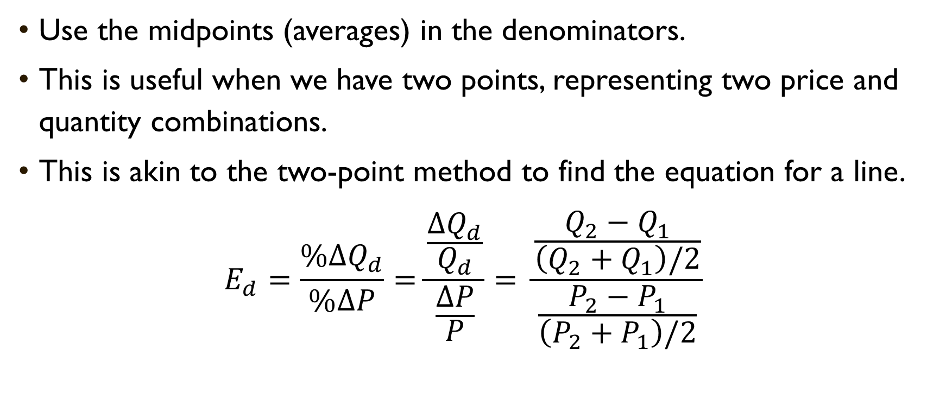
Using Arc Elasticity
Use the midpoints (averages) in the denominators.
This is useful when we have two points, representing two price and quantity combinations.
This is akin to the two-point method to find the equation for a line.
$$E_{d}=\frac{\%∆Q_{d}}{\%∆P}=\frac{\frac{∆Q_{d}}{Q_{d}}}{\frac{∆P}{P}}= \frac{\frac{Q_{2}−Q_{1}}{\left(Q_{2}+Q_{1}\right)/2}}{\frac{P_{2}−P_{1}}{\left(P_{2}+P_{1}\right)/2}}$$

Slide 20
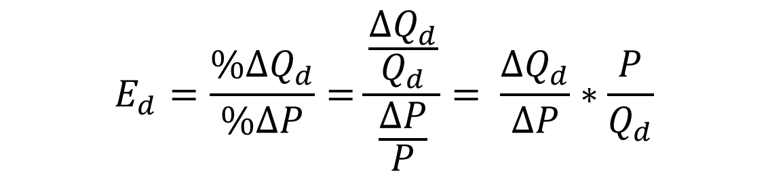
Using Point Elasticity
If we have an equation for demand, there is a shorter method.
This is akin to the point/slope method to find the equation for a line.
Look carefully at the final equation. We need three numbers, not four. The first part of this is the slope of demand.
$$E_{d}=\frac{\%∆Q_{d}}{\%∆P}=\frac{\frac{∆Q_{d}}{Q_{d}}}{\frac{∆P}{P}}= \frac{∆Q_{d}}{∆P}∗\frac{P}{Q_{d}}$$

Slide 21
Applying elasticity to other uses is very important in Environmental Economics
Price Elasticity of Demand =%ΔQd/%ΔP is always negative
Price Elasticity of Supply =%ΔQs/%ΔP is generally positive
Income Elasticity of Demand =%ΔQd/%ΔY can be positive or negative.
  What do the sign and magnitude tell us?
Cross-Price Elasticity of Demand =%ΔQda/%ΔPb can be positive or negative.
  What do the sign and magnitude tell us?
Intertemporal elasticity =%ΔQd_{(t)} / %ΔP_{(t+1)}

