Slide 1
Benefit Cost Analysis and Criteria for Policy Evaluation
Session 5: Field and Field CH 9 and two science fiction short stories.

Slide 2
Learning Objectives
Understand categories of benefit
Understand categories of cost
Calculate and interpret present value / net present value
Use PV / NPV for financial discounting of private investment
Use PV / NPV for social discounting of public projects and programs with appropriate assumptions
Concept of intergenerational discounting of long-term public projects and programs with appropriate assumptions
Understand methodological differences and social implications of differences among financial, social and intergenerational discounting
Criteria for Environmental Policy Evaluation

Slide 3
Benefits
Benefits are gains from environmental improvement such as reduction of damage costs
Calculating benefits from damage cost reduction
Measure emissions
Determine levels of ambient quality from emissions
Estimate human exposure to ambient quality
Estimate physical impact on humans of ambient quality
Estimate value in currency of physical impact

Slide 4
Measuring Damage Costs Directly
Health Costs
Direct expenses such as prescription costs, inpatient care, outpatient care, office visits, etc.
Indirect expenses such as lost time at work, employer cost of absence
Does not include value of time lost that is not compensated such as retirees, homemakers, etc.
Does include the amount people are willing to pay to avoid illness.
Benefits are reduction in damages. This slide is about benefits, not costs. Costs are what we spend to reduce damage.

Slide 5
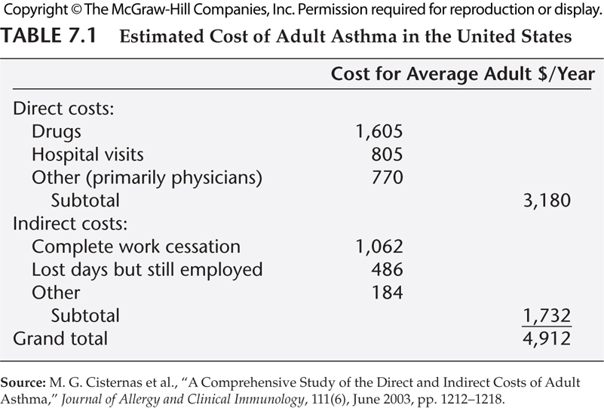
Benefit = Reducing Harm

Slide 6
Measuring Damage Costs Directly
Effects of pollution on production costs
Agricultural loss such as livestock loss, crop yield loss, timber loss, resource deterioration (water quality, soil contamination)
Commercial loss such as machinery maintenance and repair, facility repair, building deterioration, employee costs
We must use net effects.
Include change in producer surplus
Do not include change in revenue. Why?

Slide 7
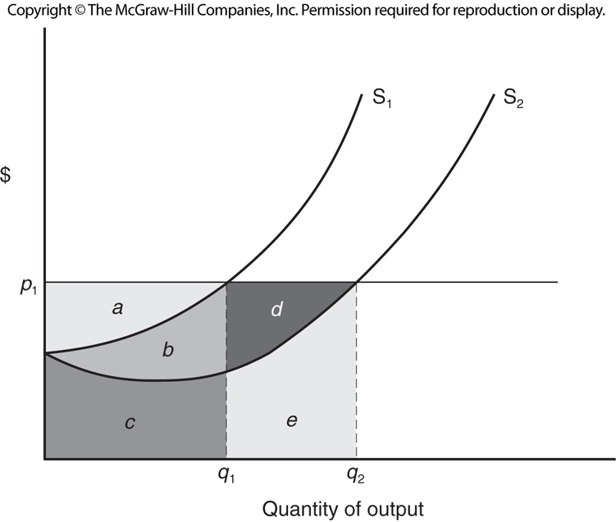
Increasing Producer Surplus

Slide 8
Limitations of Direct Measurement of Damages
Monetary damages tend to be measured more easily.
Non-monetized damages are often not included.
Example: How do we determine loss of family services?
Losses accrued to people who have no legal claim.
Environmental damage may cause a market reaction that makes us underestimate or overestimate damage.
Averting behaviour to avoid effects of damage may mask some of the damage.

Slide 9
Willingness to Pay: Estimation
How much are we willing to pay to reverse or avoid damage?
Revealed Preferences
Averting costs: the expenses we incur to reduce and mitigate damage in a situation where will experience it.
Price differentials: what is the price difference between situations with and without exposure to the damage?
Stated Preferences
Contingent valuation: carefully structured surveys.

Slide 10
WTP: Averting Costs
How much are we willing to pay to mitigate the damage?
Averting costs: the expenses we incur to reduce and mitigate damage
Examples
Rustproofing a vehicle
Soundproofing a house
Building a privacy fence

Slide 11
WTP: Hedonic Price Differentials
Estimate what people pay for environmental characteristics.
What is the price premium for
Houses in a quieter/cleaner/safer neighborhood.
Houses with a view.
Houses near an amenity.
What is the wage difference
in a bad neighborhood
In an air conditioned office
In a resort city

Slide 12
WTP: Travel Cost Pricing
How much will people pay to travel to a nice place?
What is the Grand Canyon worth?
What is Machu Picchu worth?
We must be careful to recognize that this ignores non-use value, but it does tell us something important about the value of uniqueness.

Slide 13
Value of Human Life using Wages
Value of a statistical life vs. value of a specific life
We need to clarify what we are measuring.
We are estimating the value of a hypothetical life
Assuming we do not know who it is.
Assuming people correctly assess risk.
We are not equating this to the price of taking a specific life.
What probability of death will you risk to save 15 minutes?
How you drive helps answers this question!
What probability of death will you risk to earn $10,000?
Wages and occupational mortality risk helps answer this.

Slide 14
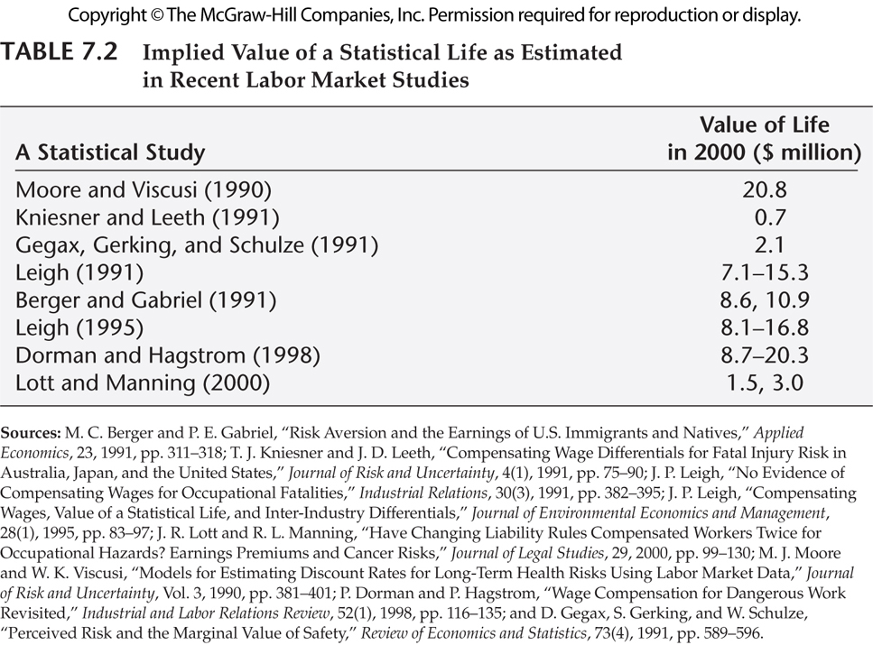

Slide 15
WTP: Stated Preferences
Contingent Valuation (not for amateurs!)
How do we ask people about WTP and get honest, thoughtful answers?
Simple surveys seems obvious but…
Anchoring problem: do they have any idea?
Cynicism: they think we will try to sell.
We can offer alternative scenarios with prices.
We can write a referendum question with tax.

Slide 16
WTP vs. WTA
If your marginal benefit for a good is 30 EURO and you are offered 31 EURO, do you sell the good?
Theoretically, willingness to pay and willingness to accept should be almost equal. Psychology research says this is not true.
”Predictably Irrational” Dan Arielly. College basketball tickets
Option value, existence value, bequest value and stewardship value play a part to create a wedge between WTP and WTA.

Slide 17
Costs: Direct and Indirect
Costs are all opportunity costs of environmental improvement
Direct costs of environmental improvement project
Reporting and Compliance
Regulatory cost of improvement
Indirect economic impacts of project
Effects on local industry
Effects on labor market and regional economy
Macroeconomic multiplier effects
Why is opportunity cost an important issue?
With/Without vs. Before/After
Must consider replacing a prior action with a new action
What else could we do with the resources?
How might unintended consequences reverse the gains?

Slide 18
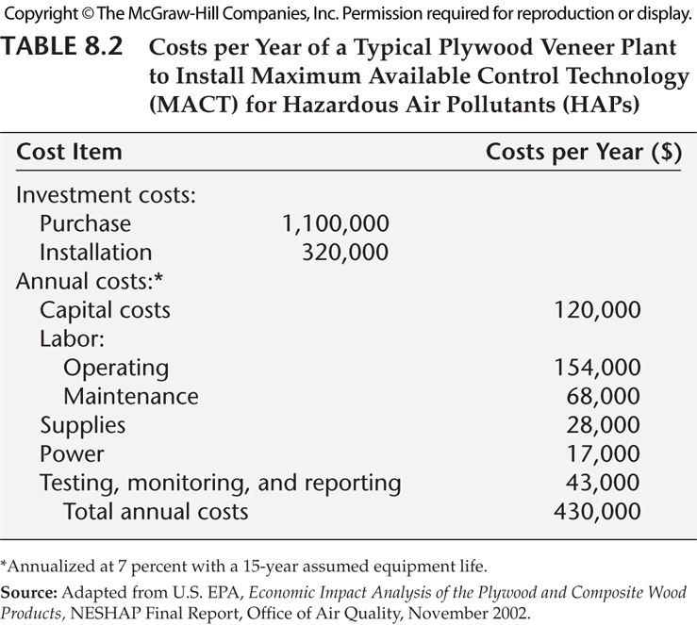

Slide 19
Costs: Basis for Comparison
Compare Before and After regulation or
Compare With and Without regulation?
What’s the difference?
Must consider replacing a prior action with a new action
Holding everything else constant

Slide 20
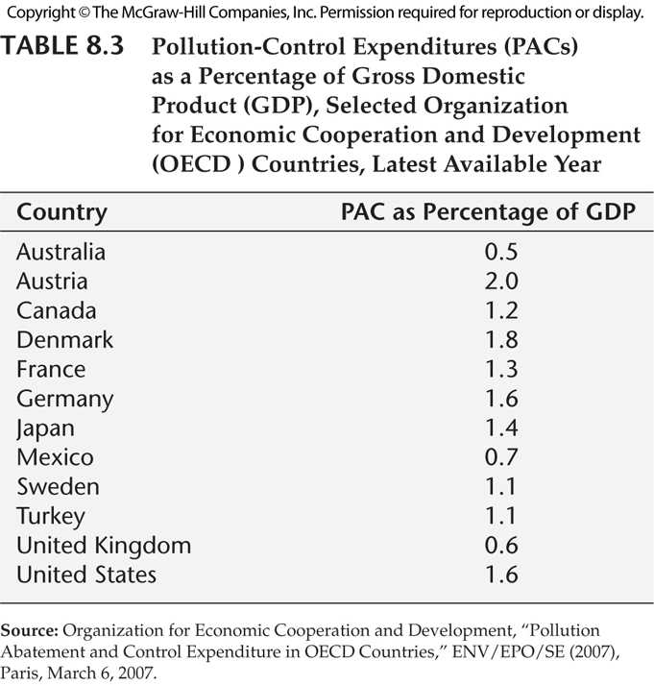
National Environmental Costs

Slide 21
Financial Cost Benefit Analysis
For a single period $PV=\frac{A}{(1+r)}$
For multiple periods, from now until time T
$$PV=\sum_{t=0}^{T}{\frac{A_{t}}{{(1+r)}^{t}}}$$
Net present value includes both Benefits and Costs
$$NPV=\sum_{t=0}^{T}{\frac{B_{t}−C_{t} }{{(1+r)}^{t}}}$$
All numbers must be either nominal or real, no mixing!

Slide 22
Financial Cost Benefit Analysis
$$NPV=\sum_{t=0}^{T}{\frac{B_{t}−C_{t} }{{(1+r)}^{t}}}$$
Project begins now, lasts three more years. Assume r=.08,
Costs: 5000, 5000, 2000, 0
Benefits: 0, 0, 6000, 7500
What is the NPV? Is this worth undertaking?

Slide 23
How does timing matter?
r | t | C | B | B-C | Discount | PV(B-C)
0,08 | 0 | 5000 | 0 | -5000 | 1,0000 | -5 000,00 €
0,08 | 1 | 5000 | 0 | -5000 | 0,9259 | -4 629,63 €
0,08 | 2 | 2000 | 6000 | 4000 | 0,8573 | 3 429,36 €
0,08 | 3 | 0 | 7500 | 7500 | 0,7938 | 5 953,74 €
 |  |  |  | 1500 | NPV | -246,53 €
r | t | C | B | B-C | Discount | PV(B-C)
0,08 | 0 | 0 | 7500 | 7500 | 1,0000 | 7 500,00 €
0,08 | 1 | 2000 | 6000 | 4000 | 0,9259 | 3 703,70 €
0,08 | 2 | 5000 | 0 | -5000 | 0,8573 | -4 286,69 €
0,08 | 3 | 5000 | 0 | -5000 | 0,7938 | -3 969,16 €
 |  |  |  | 1500 | NPV | 2 947,85 €

Slide 24
Social Cost Benefit Analysis
This is different from financial cost benefit analysis because
Government investment displaces private investment.
Social discount rate = private borrowing rate.
But, governments pay no risk premium like private interest rate.
Social investment has a lower discount rate. US Government uses 7 percent social discount rate and 3%. Circular A-94.
http://ec.europa.eu/regional_policy/sources/docgener/studies/pdf/cba_guide.pdf page 301.
It is not a single entity seeking an internal rate of return. Costs and benefits may accrue to different parties.
Concerns about political manipulation of methodology.
But, the calculations are done in the same manner.

Slide 25
Choosing Social Discount Rate
SRRI: Social Rate of Return on Private Investment. Government borrowing displaces private investment and consumption, so SDR ≥ private borrowing rate.
SRTP: Social Rate of Time Preference. Government does not crowd out private investment b/c International capital flows.
Governments less risky, should pay no risk premium
Social time preference is low. Society more patient than firms
Moral issue related to future generations.
US Government follows SRRI, uses 7% SDR.
EU, countries choose between SRRI and SRTP, Page 301 of http://ec.europa.eu/regional_policy/sources/docgener/studies/pdf/cba_guide.pdf

Slide 26
Distributional Issues
Not a single entity like a firm.
A project with a higher NPV might hurt vulnerable groups.
Manipulation of time horizons.
What if we limit analysis to 10 or 20 years?
Vertical equity: we might badly distort incentives.
Intergenerational issues
People who are not born yet don’t get input.

Slide 27
Intergenerational Discounting
Social cost benefit analysis needs to be adjusted for programs that have impacts over long time periods.
What ethical issues are implied by this process?
Avoid devaluation of future.
Concerns about political manipulation get worse.
Why is this so important for environmental issues?
Climate change is long-term
Nuclear power plant retirement
How might changes in preferences over time affect this?
Possible lack of substitution (pre-commitment)
Key adjustment: very low discount rate for intergenerational issues.

Slide 28
Intergenerational Discounting
Theoretical explanations for all of this are complicated.
The math for changes in preferences over time is complex.
There is another way to grasp why this is important.
Module 6 Discussion Board Assignment uses two short stories.
Read the Discussion board assignment, read the stories, and participate thoughtfully.
How do these stories help us understand the key issues?
“The Cost of Living” by Sheckley
“The Perfect Coordinates to Raise a Child” by Barnett

Slide 29
“The Cost of Living” by Sheckley
What decisions are being made?
What is “fictionalized” making this situation different from reality?
Is intended effect on future generation positive, negative, neutral?
What creates conflict between intent of decisions and result?
Is future generation treated as important as current generation?
How do differences in preferences or knowledge across generations come into play?
What does this tell us about importance of discount rate?

Slide 30
“The Perfect Coordinates to Raise a Child” by Barnett
What decisions are being made?
What is “fictionalized” making this situation different from reality?
Is intended effect on future generation positive, negative, neutral?
What creates conflict between intent of decisions and result?
Is future generation treated as important as current generation?
How do differences in preferences or knowledge across generations come into play?
What does this tell us about importance of discount rate?

Slide 31
Criteria for evaluating environmental policies
These are described in Field and Field Chapter 9
Efficiency: MDC=MAC
Cost effectiveness: Given the emissions reduction target, is this the least cost method, or, given a budget for emission reduction, is this maximum reduction possible?
Fairness: Geographic, demographic, income, etc.
Incentives for technological innovation: A more effective policy will also result in reduced costs in the future.
Enforceability: can regulators enforce policy in a practical and cost effective manner?
Agreement with moral precepts: Is our approach consistent with social justice?
These are key points from Chapter 9 that we skipped.

Slide 32
Required Reading
Field & Field, Environmental Economics: An Introduction, chapters 7 and 8

