Slide 1
ACRIS – Aalto Current Research Information System
Eeva Savolainen & Laura Mure
Research services, Open science and ACRIS team
acris@aalto.fi

Slide 2
Agenda
Short introduction to ACRIS
Demo: Editing your profile
Demo: Public portal Research. Aalto.fi
Demo: Adding content
Sneak peek to recent functionalities

Slide 3
Why ACRIS?
Benefits for you
Increases visibility
You can download your outputs and activities using several CV templates, e.g. TENK CV
Integrations reduce maintenance work
Free platform for green open access publishing
Benefits for the university
Brings and links together key information on all aspects of research and artistic outputs at Aalto
Reporting tool both internally and externally

Slide 4
ACRIS
Information in
Information out
REPORTS
Measure
research
perfomance
Aalto portal research.aalto.fi
Aalto.fi (publications)
CV’s
National portal Research.fi
Google
OpenAPC
Research assessment
Reporting to Ministry of Education
Media and other public impact
Synchronized
HR
Finance
Student Systems
Press/media service
Created in ACRIS
Research outputs (article imports from Scopus/WoS)
Activities
Datasets
Prizes
Infrastructures
.
PROFILES
Showcasing individual researchers
RESEARCH
INFRA-STRUCTURE
Track
resources
used
in research
ACTIVITIES
and
PRIZES
Scientific and
artistic
achievements
University’s research information system
PUBLICATIONS and DATASETS
Track and
manage
published
research
PROJECTS
Track funded
research

Slide 5
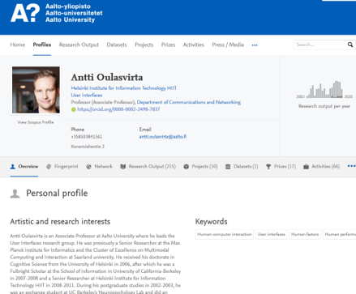
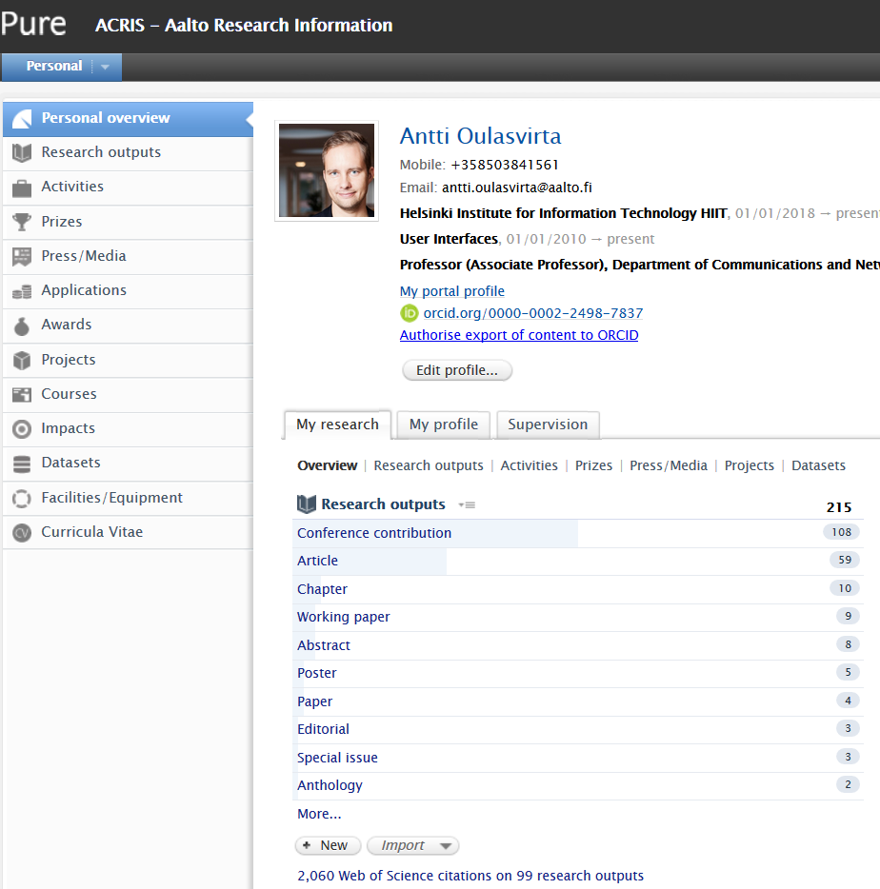
Academic staff and doctoral students have automatically a profile page in ACRIS
Public portal: research.aalto.fi
Internal side: acris.aalto.fi
Your profile and academic outputs are there to anyone to see and search
Login with your Aalto identifiers and
manage your profile

Slide 6
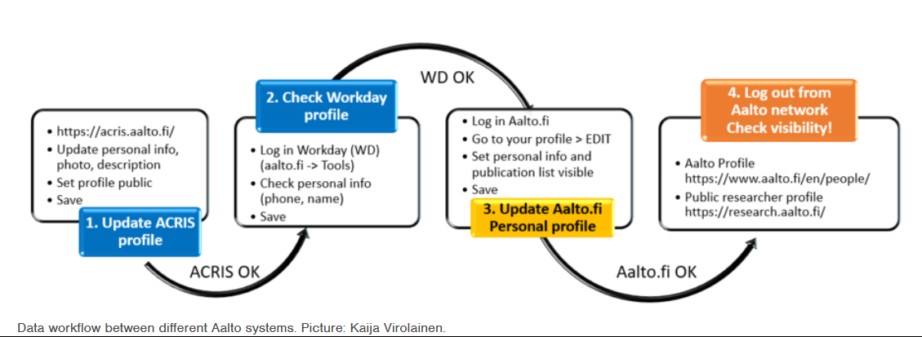
Profile data workflow between Aalto systems
Help: https://www.aalto.fi/en/services/guide-for-updating-your-profile-on-acris-for-the-research-portal-and-aaltofi

Slide 7
Demo

Slide 8
What to fill in: a journal article
Field / Section | Mandatory (marked with red *) | Recommended
Publication category | Scientific/professional/general
Peer-reviewed | Peer-reviewed/not peer-reviewed
Publication status | Accepted/Published/…+ Date
Publication information | Original language, title | Abstract
Contributors | Link/create contributors
Publication managed by | Will be generated automatically
Electronic version(s) |  | DOI or link
Field of Science, Statistics Finland by departments |  | Add one according to your department
Relations |  | Link projects and facilities/equipment (=Aalto infrastructures)

Slide 9
Checklist
Check your access in https://acris.aalto.fi (use VPN connection outside of campus)
Check your profile: add a picture and a description, check the visibility
Link ORCID to ACRIS
ACRIS staff will import most of the publications for you. Check your publications at the end of the year and add those that are missing.
Link project name (external funding) and number and used infrastructure name to the article
Add information about your published dataset to ACRIS or send DOI or info to researchdata@aalto.fi and we add it for you.
Optional
7. Make your profile interesting and add activities and prizes you have achieved

Slide 10
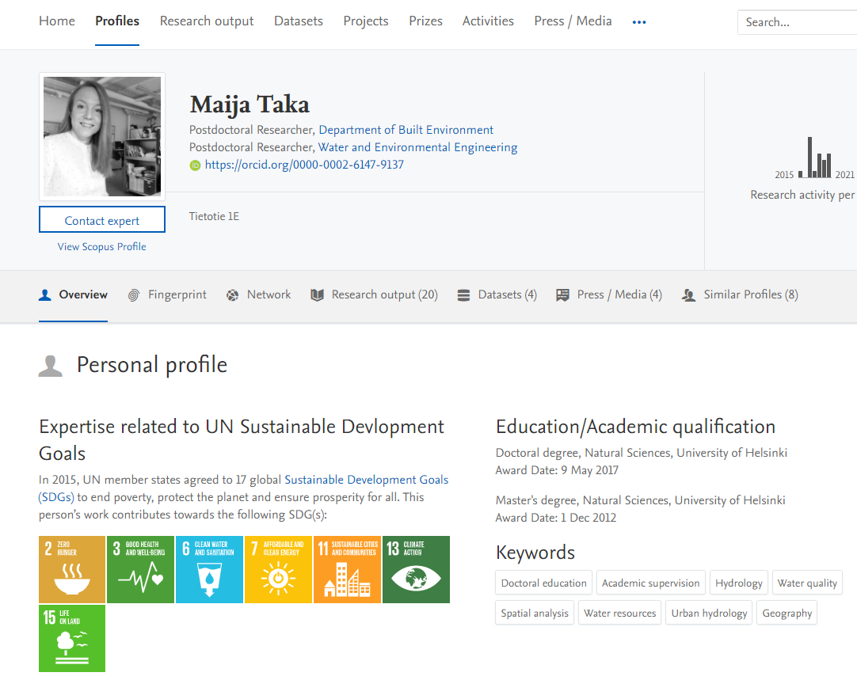
Research portal – recent Recent functionalities
You can link multimedia (Youtube, Vimeo) to research outputs
United Nation’s Sustainable Development Goals keywords to publications and profiles
SDG filters in search queries

Slide 11
Thank you! If you need help: acris@aalto.fi or https://www.aalto.fi/en/acris-instructions

