Slide 1
Ethnography
Facilitation Assignment
Authors:
Anoop Adhur Kutty, Miriam Etz, Misa Bakajic
12.10.2022

Slide 2
Ethnography Purpose
Modern ethnography is the in-depth study of a culture (or a facet of a culture), involving researcher observation through direct participation in that culture.
Notes:
Q: Was there ethnography before 1922?) Is modern history really the entire evolution of ethnography?​

Slide 3
Etymology
Ethnography comes from ancient Greek
Ethnos = nation, people, tribe; (probably akin to Greek ēthos custom)
Graphy = writing
Group
VS
Outsiders
Ethnos implies:
-cohesion
-belonging
-border
Notes:
Q1: How would you classify e.g. Finnish diaspora?

Slide 4
Q: What are some examples of groups?

Slide 5
Q: Can a clear border always be defined?
Notes:
Human relationships are often interconnected and messy.

Slide 6
Defining a group
Group implies geographical proximity (e.g., Community)
However, arrival of the internet complicates things
Today digital communities exist connective people across the globe
They are still bounded by a commonality
(e.g., lifestyle choice, belief system, etc.)
? ​

Slide 7
Q: Do the individuals within the group need to know they are part of a community
Notes:
Human relationships are often interconnected and messy.

Slide 8
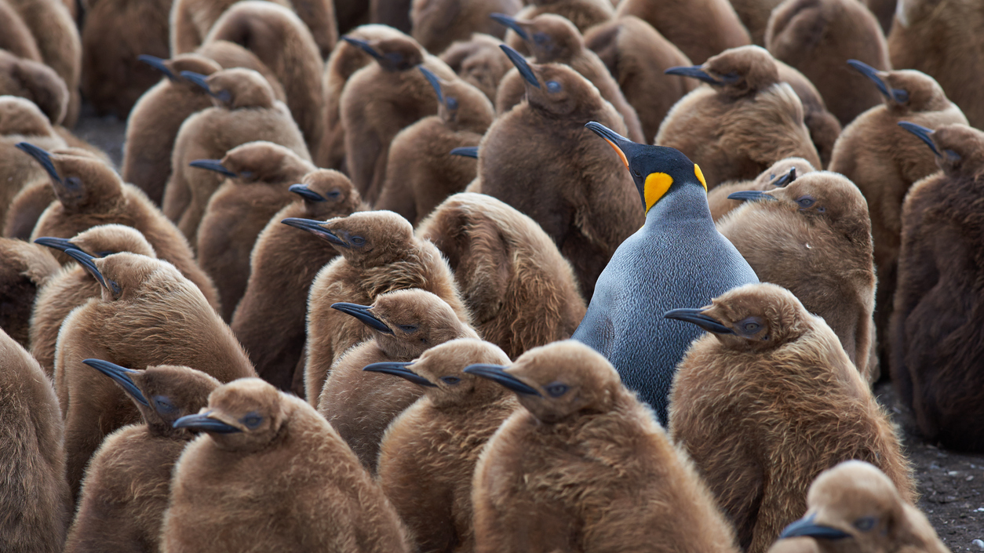
Attempting to understand from outside in
Notes:
Transition to case – highlight the challenge of outsider attempting to learn about a group.

Slide 9
Many believers make use of social media to spread their views
CASE: Modern flat Earth believers
Individuals claim that the Earth is flat while denying the Earth's sphericity.
Flat Earth groups of the modern era date from mid 20th century
Many believers make use of social media to spread their views
LINK:
https://www.youtube.com/watch?v=1gHbwT_R9t0

Slide 10
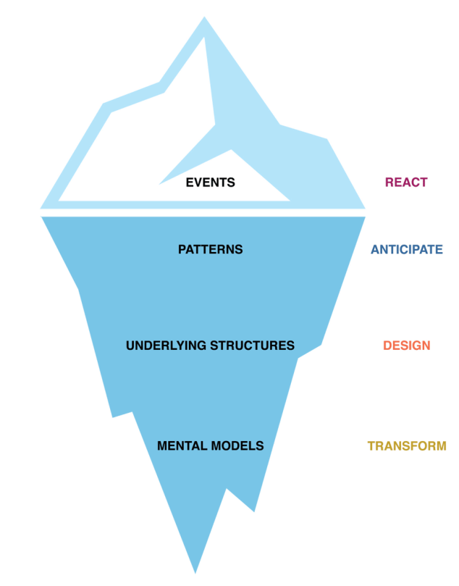
Ethnographical inquiry of modern flat movement
OVERVIEW OF RELATED STUDIES
Toseland, N. and RONALD, E., 2019. Truth,“ Conspiracy Theorists”, and Theories: An Ethnographic Study of “Truth-Seeking” in Contemporary Britain (Doctoral dissertation, Durham University).
Park, R., Zax, D. and Goldberg, B., 2020, October. Fighting Conspiracy Theories Online at Scale. In Ethnographic Praxis in Industry Conference Proceedings (Vol. 2020, No. 1, pp. 265-278).
Olshansky, A., 2018. Conspiracy theorizing and religious motivated reasoning: Why the earth ‘must’be flat (Doctoral dissertation).
Sandrin, P.O., 2021. Science as feeling: the emotions of the Flat Earth movement and its political alignments (Doctoral dissertation, PUC-Rio).
Assumption 1
Flat-earthers are acting with malice
Assumption 1
Flat-earthers are acting without malice
Assumption 2
There is a novelty to their belief
Assumption 2
In the past people contemplated this way before
Broad Question A
How can the societal threat of this belief be better understood?
Broad Question B
What can we learn from this belief that will help us better understand society?

Slide 11
Foundations of Ethnography

Slide 12
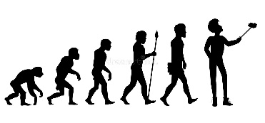
Anthropology
Anthropology is the scientific study of humanity, concerned with human behaviour, human biology, cultures, societies, and linguistics, in both the present and past, including past human species.
Anthropology
Human biology
Human behaviour
Societies and cultures
Linguistics

Slide 13
Ethnology
An academic field that compares and analyses the characteristics of different peoples and the relationships between them
Anthropology
Human biology
Human behaviour
Societies and cultures
Linguistics
Ethnology
Notes:
human behavior, human biology, cultures, societies, and linguistics,

Slide 14
Ethnography
The study of single group through direct contact with that culture.
Anthropology
Ethnology
Ethnography
ethnography is both a process and an outcome of the research.
ethnography is different than oral history
Notes:
Mention history

Slide 15
Q: Can a historian be a type of ethnographer?
Notes:
From slide 16

Slide 16
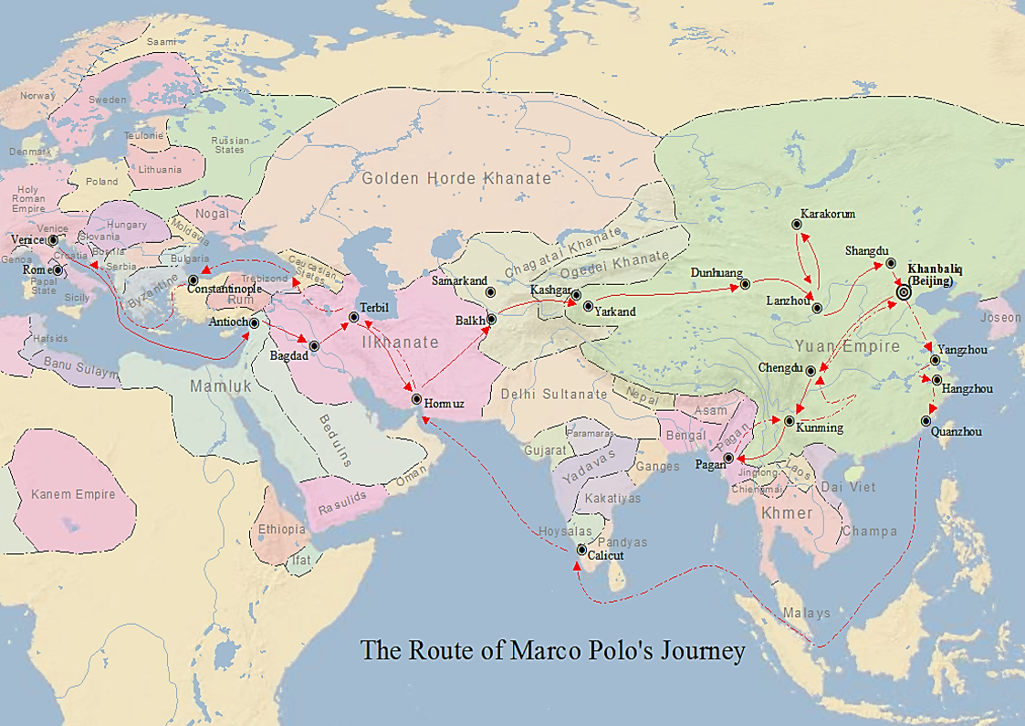
Marco Polo (1254-1324)
Roots of ethnography: geographers, sociologists, historians all applied methods that are predecessors or facets of today’s ethnography

Slide 17
Q: Can ethnography be done by modern scholars attempting to understand beliefs of ancient societies? (e.g., Greece)
Notes:
-Can review ancient texts relating to a topic
-Ethnoarcheology

Slide 18
Historians VS Ethnographers
Historians are concerned with the continuous, methodical narrative and research of past events as relating to the human race; as well as the study of all history in time.
Inquiry follows a determined methodology
ethnographers allow the informants to portray the fluidity of their cultures and societies.
Relies on first-hand experience
A
B
Q: How would historians study the flat-earth movement compare to ethnographers?
Notes:
Apply example of flat earth here again

Slide 19
Elements of ethnography
WHAT?
Ethnography study of single groups through direct contact with the culture.
HOW?
A key principle is participant-observation ethnographic fieldwork
Open-ended inductive long-term living with and among the people to be studied
WHY?
Purpose is to uncover "POV of natives", ( local values, practices, etc.)
Task is to contextualize insight for wider significations
Rendering them probable; showing theirs is a meaningful alternative as a way of life

Slide 20
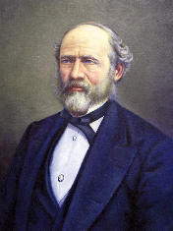
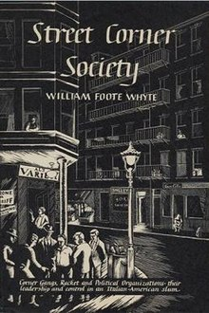
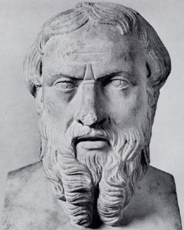
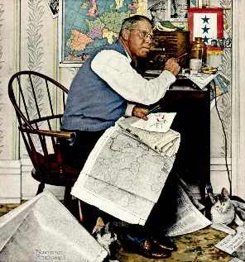
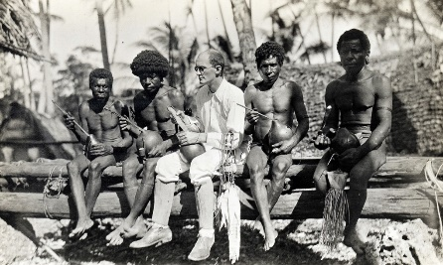
Evolution of Ethnography
Realist Ethnography
Focused Ethnography
Critical Ethnography
Autoethnography
Confessional ethnography
Feminist ethnography
Virtual ethnography
Etc.
Pre-ethnography
Ethnography
Modern Ethnography
Period of travel reports and field expeditions
Herodotus (~450 BC) as first recorded ethnographer
“Armchair Anthropologists”
1860s: Lewis H. Morgan sets cultural and social dimensions
1922: Bronislaw Malinowski and “Participant Observation”
1920s-40s: Chicago School and “Urban Sociology”
Ongoing developments
Relational and digital
Notes:
Pre-ethnography
Pre-ethnography (meaning before the first acknowledged methods) is a wild mixture of travel reports, field expeditions → what many geographers, sociologicsts, anthropologists and their predecessors did, like Marco Polo
This started very early: Herodotus (484 BCE to 425 BCE) is recorded to have written the first ethnography in anything like the present sense.
A special group to be mentioned here, that is closer to modern ethnography than to e.g. Herodotus, are the “armchair anthropologists”: those that sit in their armchairs at home and read reports and send out surveys to make judgements and inferences, but never experience the groups they study first-hand
Ethnography:
Hard to say who exactly started it, but there are different roots to be considered from anthropology and sociology → those set the baselines and rules that we still apply today
Lewis Henry Morgan (1859 to 1862) - study of native american groups/ Iroquois (Ugwu, 2016) → founder of cultural and social dimensions (focusing on culture and society in-depth)
1922 Malinowski (you will hear from him again), concept of “participant observation” → participation + observation, no longer only observing from distance
Sociology: Chicago school which founded “urban sociology”, which means studying modern city life. This takes the focus closer to home, away from only studying foreign groups and minorities
Modern Ethnography
Today, ethnography is a common approach in various social science fields,
ever developing and various forms exist
we gathered some forms here on the right, they are all suitable to different contexts and requirements. Don’t talk further about this, just to point out that if you want to do an ethnography, there are many possibilities
main distinction: relational (in-person, like previously) and digital (online, account for modern days)

Slide 21
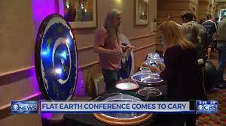
Four Principles of (Modern) Ethnography
Natural settings
Holistic
Descriptive
Member‘s Point-Of-View
Bloomberg, Mosher und Swenton-Hall (1993)
Notes:
Bloomberg, Mosher und Swenton-Hall (1993) defined four principles of ethnography:
natural settings: the studies are done in the natural settings, not in a lab. The ethnographer studies the people in their daily life.
Holism: Studies are done holistically. Behavior is understood in its context, meaning the ethnographer tries understanding and including all facts that might have an influence (people, activities, things)
Descriptive: Ethnographic inquiry develops a descriptive understanding, the ethnographer needs to always stay objective
Member’s point-oview: ethnographic research is based on the view of the members; the ethnographer has to integrate into their group to see the world with their eyes (has to dispose of his/ her own views and values)
REMEMBER: apply to flat earth
Natural settings: could be in person (attend conferences, …) but probably mainly online
Holism: don’t just understand one aspect (e.g., one line of explanation) but all of the culture (experiments, leaders, different ideas)
Descriptive: we as researchers cannot take position on the people and their ideas (think them to be enlightened or stupid)
Members POV: need to understand the members and accept their thinking

Slide 22
Q: What is needed for an ethnography to differ from “hanging out”?
Notes:
Our ideas:
Preparation, RQ and some sort of structure
Long time period
Conscious, detail-oriented
Documentation (field notes) and writing up afterwards
In a strict sense; in a non-strict sense, we can all be ethnographers

Slide 23
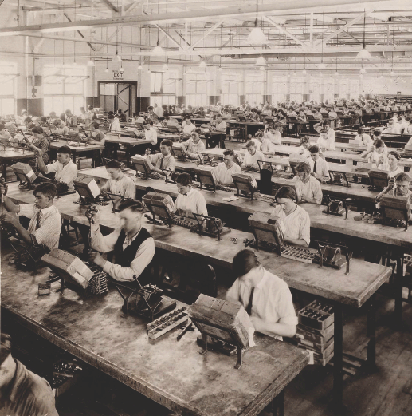
Criticism – Bias and Influence
Researcher bias (misinterpretation, assimilation)
Influence of researcher on the setting

Slide 24
Criticism – Lack of generalizable theories
Descriptive studies with theories which are not generalizable
Idiosyncratic use of constructs, generation of constructs peculiar to a given group only

Slide 25
Criticism – Lack of Precision
Lack of precision – leading to popularity of quantitative methods based on logical positivism
Validity and Reliability – Internal and External

Slide 26
Crisis of ethnography
Bronislaw Malinowski’s diaries (1967) started a controversy
Clifford Geertz (1973) tried to resolve this with “Thick Description”
George Marcus and James Clifford (1986) published “Writing Culture” as another response

Slide 27
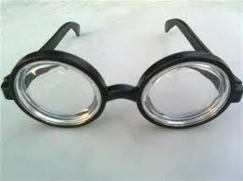
Alternative – Interpretive Anthropology
Clifford Geertz (1973) – Thick description
Ethnographer as interpreter who creates a thick description
Interpretation is the search for meanings and hence assumes there are meanings behind observable actions
Clifford and Marcus “Writing Culture”
Notes:
“positive racism”

Slide 28
Other Alternatives
Grounded theory – Focus on developing theory rather than making descriptive understanding;
Theoretical sampling; collect data till saturation
Phenomenology – Focusing on lived experiences
Collects data through Interviews to study individual experiences

Slide 29
Ethical concerns
Lack of informed consent at individual level
Unable to clearly articulate the research problem or question in advance
Affective reactions on participants
Altering the setting

Slide 30
Practical approach to case study of flat earthers
Step 1. Determine common element that unifies the group
Step 2. Establish the environment(s) you will include in your study
Step 3. Identify research study type (e.g., longitudinal VS cross-sectional)
Step 4. Develop the thematic questions that can be answered:
What are the core beliefs of flat earthers?
How are these beliefs justified?
How are they challenged?
What motivates flat earthers?
Etc.

Slide 31
Q - Is it necessary for the researcher to suspend their preconceived notions about the shape of the earth? Should the researcher themselves also be a flat earther?
Notes:
Our ideas:
Preparation, RQ and some sort of structure
Long time period
Conscious, detail-oriented
Documentation (field notes) and writing up
In a strict sense; in a non-strict sense, we can all be ethnographers

Slide 32
Thank you for your attention and participation!

Slide 33
Purpose
Basic idea: researcher is part of a social setting for a longer time period
Method: participant observation, fieldwork, with a variety of other methods
Objective: Understanding and describing a culture, norms and values, social environment of a group. The aim is to ‘get inside’ the way each group of people sees the world.’(Reeves et al., 2008)
Today, ethnography is a common approach in various social science fields, not just anthropology. It is used not only to study distant or unfamiliar cultures, but also to study specific communities within the researcher’s own society.
Ethnography is a qualitative research method that comes from the discipline of anthropology but is applicable to other disciplines. Ethnography is the in-depth study of a culture or a facet of a culture. Because of this, ethnographic research often looks very different compared with other research designs.
Ethnography is anthropology’s “methodological baby”; how to they differ: The short answer is that anthropology is a discipline while ethnography is a methodology. Anthropology refers to the study of human cultures and humanity in general. Ethnography is a methodological approach to learning about a culture, setting, group, or other context by observing it yourself and/or piecing together the experiences of those there
Ethnographic methods establish the claim of ethnology to be a scientific discipline (= "field research").

Slide 34
Bigger picture
This slide belongs at start or at the end of the presentation. It looks like it could fit within the evolution of ethnography (Marco polo) discussion. Stating that modern ethnography is a continuation of the human desire to know more about ourselves through belonging.
• How did X (or its most successful forms) succeed in reaching the aim? • And, last but not least, if this has not been answered already, if “X” is the answer, what was the question?

Slide 35
Questions for Discussion
This slide can be a summary of all our questions, we show it at the end and we revisit them or then leave them "unanswered". Alternatively it can just be a summary slide with no other actions needed.
Idea: we could also do a Kahoot quiz or a mindmap or Jamboard, to engage everyone?
https://jamboard.google.com/d/11p0Kp5K-wPyhYuo5wcd-1sl3HqJX6FHsiLR0BrwngWI/viewer?f=0
How do we find/ define groups today (online)?
Does the group need to have a group identify to use ethnography?
Can the researcher really adapt their world view to analyze exteme group behavior? E.g. flat earther, convicts, etc.
How does the researcher control being influenced.
How does the researcher control truthful responses from participants
Was Marco Polo an ethnographer?
The ethics of ethnography: what do ethnographers need to be aware of? Is ethnology capable of forming a dialogue with its subjects and benefit both sides?
What research context is the most suitable for ethnography?
What research context is the least suitable for ethnography?

Slide 36
Speech for ethnography
Taken from existing slide needs to be shortened
The text in the original form can be our speech so what we will read in this slide.
Today, ethnography is a common approach in various social science fields, not just anthropology. It is used not only to study distant or unfamiliar cultures, but also to study specific communities within the researcher’s own society.
Ethnography is a qualitative research method that comes from the discipline of anthropology but is applicable to other disciplines. Ethnography is the in-depth study of a culture or a facet of a culture. Because of this, ethnographic research often looks very different compared with other research designs.
Ethnography is anthropology’s “methodological baby”; how to they differ: The short answer is that anthropology is a discipline while ethnography is a methodology. Anthropology refers to the study of human cultures and humanity in general. Ethnography is a methodological approach to learning about a culture, setting, group, or other context by observing it yourself and/or piecing together the experiences of those there
Ethnographic methods establish the claim of ethnology to be a scientific discipline (= "field research").

Slide 37
Criticisms
Criticism and external competition • How has X been criticized after its introduction? • What external competition has emerged after introduction of X? • Who won (or who is winning) in that competition?
Criticism:
Bias of ethnographers because of their own person (e.g., gender, culture, …)
Ethnographic inquiry itself influencing the answers
Ethnographers immersing too deeply into the culture → stop being objective
→ This are ongoing challenges that researchers have to be aware of and do their best to avoid
The crisis of ethnography: Malinowskis diaries, Geertz’s “Thick description” and Clifford and Marcus’s “Writing Culture”

Slide 38
Questions for facilitation(read your topic into ”X
History • When was X introduced and by whom? • What was the point of introducing X? • What was X meant to replace? Elements • What are the main features of X? • What do they mean, one by one? Variation and internal competition • What forms did X take (or what forms has it taken)? • Is there (or has there been) competition between different interpretations of X? • What kind of competition? • Who won (or who is winning)? Criticism and external competition • How has X been criticized after its introduction? • What external competition has emerged after the introduction of X? • Who won (or who is winning) in that competition? Bigger picture • How did X (or its most successful forms) succeed in reaching the aim? • And, last but not least, if this has not been answered already, if “X” is the answer, what was the question?
≈ ≈ ≈​ Questions to be considered in your subsequent work (in the preparation of the detailed​ presentation of your approach and methodology – and in your future research)​ • What is X’s relation to my work?​ • If I am working within X, what is my justification for the choice?​ • If I am not working within X, why (what is my justification for not choosing X as my​ primary approach)?​ • What is my approach (if not X)?​ • Why do I think that my approach is the best for my purposes?​

Slide 39
An example of a thick description

Slide 40
Alternatives within the qualitative research paradigm
Ethnography
Study of culture
Participatory observations, interviews
Grounded theory
Study of situations that have a symbolic, and, or interactional element to them
Flexible in terms of data, but requires theoretical sampling and saturation of both data and theory, before theory development can be claimed
Phenomenology
Study of how human beings experience a certain phenomenon
In-depth interviews of small samples of participants, with open-ended questions
Relationship marketing, sales, etc.
Inter-departmental dynamics, gender issues, etc.
Strategic decision making, reactions to major events, etc.
(Goulding, 2005)

