Slide 1
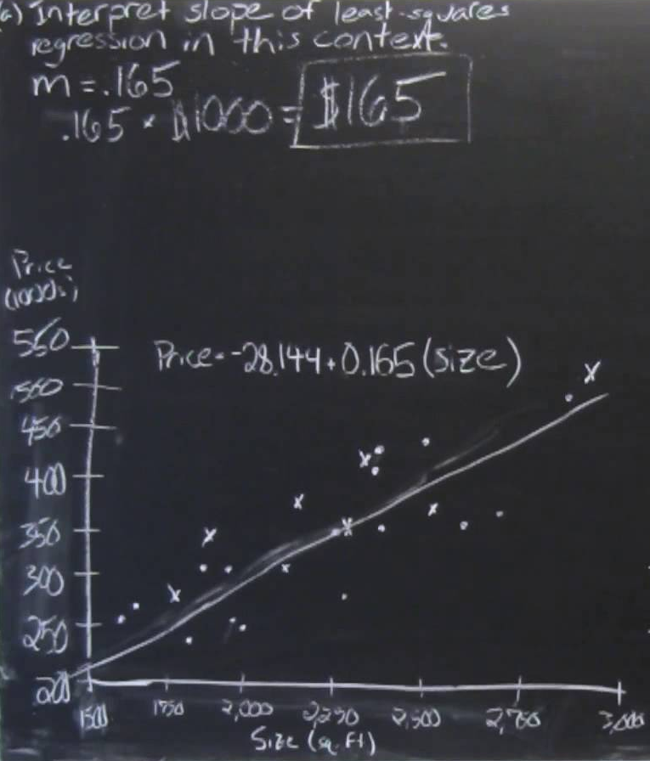

WAT-E1100
Water and Environmental Engineering
Statistical Analysis
Confused.png (GNU Artistic license)
2010 AP Statistics FRQ #6: Regression and Residuals
Teemu Kokkonen
Email: firstname.surname@aalto.fi
Tel. 09-470 23838
Room: 272 (Tietotie 1 E)
Water Engineering
Department of Built Environment
Aalto University School of Engineering

Slide 2
Warm-up
Topics of today
  What is a time series?
  Basic statistical concepts
  Correlation
  Linear regression
  Hypothesis testing
This is a brief, practically oriented introduction to the magical world of statistics
  Department of Mathematics and Systems Analysis offers courses on statistical methods

Slide 3
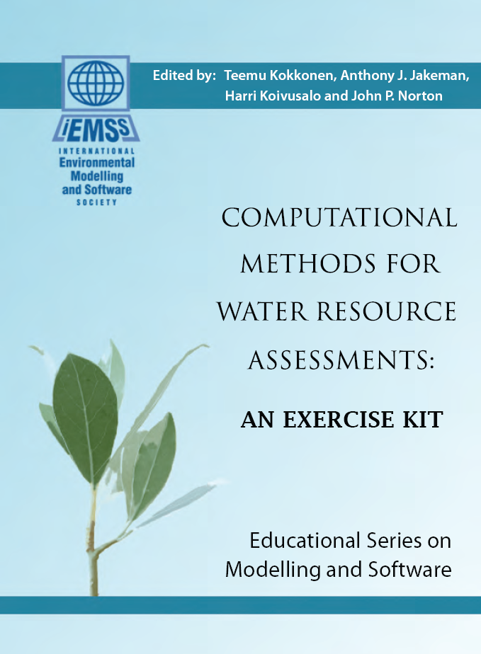
Electronic Exercise Book
Some of the material shown on these slides is based on the electronic exercise book Computational Methods for Water Resources Assessments: An exercise kit
  Available in MyCourses

Slide 4
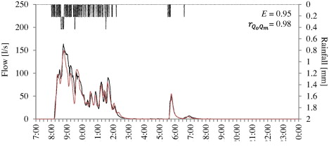
Time series
A time series is a series of data points listed (or graphed) in time order. Most commonly, a time series is a sequence taken at successive equally spaced points in time.
  Wikipedia –
Krebs G, Kokkonen T, Valtanen M, Setälä H, Koivusalo H, 2014. Spatial resolution considerations for urban hydrological modelling. Journal of Hydrology, 512, 482-497.

Slide 5
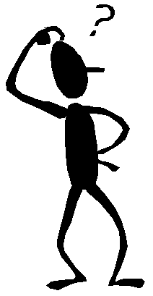
Time series
Stationarity: statistical properties of a stationary time series do not change with time
Common violations
  Mean changes (trend)
  Variance changes (heteroscedasticity)
Is the shown time series stationary? Why / why not?

Slide 6
Basic concepts
Mean
  Describes the central tendency of a set of values
Median
  Describes the central tendency of a set of values
  The middle value that separates the higher half from the lower half of the data set
Compare the following two data sets
  Set1 = {1, 2, 3}
  Set2 = {1, 2, 102}

Slide 7

Basic concepts
Variance
  Describes the spread of a set of values around their mean
  Standard deviation σ is the square root of variance
  Coeffcient of variation (CV) is standard deviation divided by the mean
$$σ^{2}=\frac{1}{N−1}\sum_{i=1}^{N}{{\left(x_{i}−\overline{x}\right)}^{2}}$$

Slide 8
Basic Concepts
Data for age, height, and weight of Londond 2012 athletes is available from here
Variance: 31.9
CV:0.03
Variance: 6.1
CV: 0.10
Which one of these series varies more?

Slide 9
Basic Concepts
Covariance
  Measures the dependency between two variables
  Describes how closely the variables change together
  Positive covariance: when x increases y is also likely to increase
  Negative covarianse: when x increases y is likely to decrease

Slide 10
Basic Concepts
Correlation (Pearson)
  The value of covariance depends on the magnitude of x and y values
  It is difficult to interpret whether a given covariance value indicates a weak or a strong dependency
  Correlation is a standardized covariance
    Varies between -1 and 1

Slide 11
Correlation
Correlation measures the strength of association between two variables
Pearson correlation presended in the previous slide is widely used but it is subject to the following assumptions
  Both variables should be normally distributed
  The relationship between the two variables should be linear
  Homoscedasticity (constant variance in the residual term)
If the assumptions for the Pearson correlation are violated correlation coefficients based on the ranks of the data are preferred
  Spearman and Kendall correlations

Slide 12
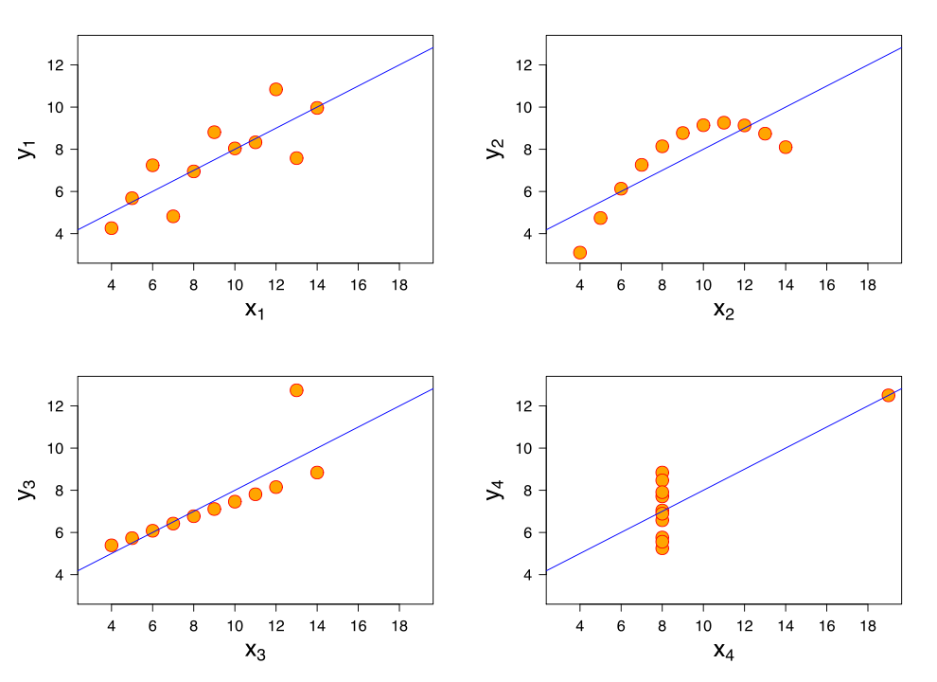
Correlation
a)
b)
The correlation coefficient for all data sets is 0.816
  Correlation coefficient cannot serve as a substitute for visual inspection of data!
c)
d)
Which panels have the greatest correlation coefficients (Pearson)?
Wikipedia: Correlation and dependence

Slide 13
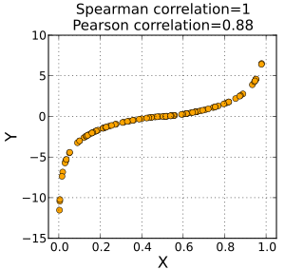
Correlation
Correlation based on the rank values obtains the value of 1 (or -1) suggesting a perfect association when the scatterplot of y against x is a monotonically increasing (decreasing) curve
  Spearman and Kendall correlations
What could be the value for Spearman correlation and Pearson correlation for the data shown here?

Slide 14
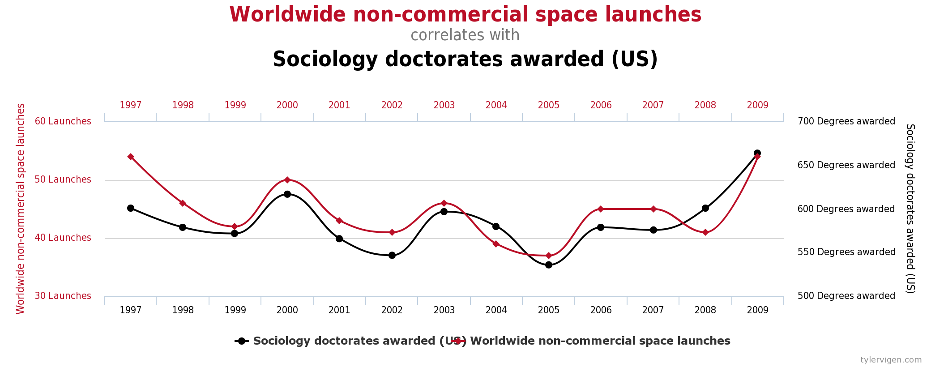
Correlation
Correlation measures association – but it does not imply causation!
  Reverse causation: ”The faster windmills are observed rotate, the stronger is the wind”
  Common causal variable: ”The more ice cream is consumed the more people drown.”
  Relationship is just a coincidence: this appears to be the case for the data shown below…
Source: Tylervigen.com Spurious correlations

Slide 15
Linear Regression
A simple model describing some phenomenon: the line
  The explanatory (independent) variable is here denoted with x
  The predicted (dependent) variable is here denoted with y
Two points are sufficient to define a line fully
If a third point becomes available and does not fall on the line
  What could be the reason for that?
  What should we do?

Slide 16
Linear Regression
It sounds reasonable to define some criterion that defines how well the line fits the data
  A commonly used objective function is the sum of square errors
    Punishes more large than small errors
So we are searching for:

Slide 17
Linear Regression
Minimizing a function requires the first derivative to be zero and the second derivative to be positive
  f ’(x) = 0
  f ’’(x) > 0

Slide 18
Linear Regression
Let us state the relation between x and y shown in the figure below in matrix form

Slide 19
A few notes on matrix algebra
Matrix algebra
  Matrix product
  Transpose of the product
  Symmetric matrix
  http://en.wikipedia.org/wiki/Matrix_(mathematics)
Notation
  Scalars in lower case
  Vectors bold and lower case
  Matrices bold and upper case

Slide 20
Linear Regression
From it follows that
Now the sum of squared errors (SSE) can be written as
Note that tems and are both scalars and identical, from which it follows the equality between the second and third line

Slide 21
Linear Regression
Now requiring the first derivative of SSE with respect to parameter vector p (slope and intercept) to be zero yields

Slide 22
Linear Regression
The Ordinary Least Square (OLS) estimate is a good estimate subject to a number of assumptions:
  The relationship between X and y is linear, i.e. in the case of two variables the straight line is the correct model structure
  There is no error in the X values (and there is no exact linear relationship between two or more x’s)
  The measurement error in y has zero expected value and a constant variance, and there is no correlation between errors
  The normality of the measurement error is also sometimes required for statistical testing of the parameter significance
  If some of the assumptions are violated, one can try to transform the data.

Slide 23
Linear Regression
Model result will differ from the data due to inaccuracies both in the measurements and in the model structure
How is this inaccuracy reflected in the accuracy of the parameter vector p_{LS}?

Slide 24
Linear regression
Assume for a moment that the linear model structure is fully correct and the error arises solely from measurement inaccuracies
We do not know how large those errors are for each individual observation
  If we did, we could easily calculate the correct value and hence obtain an error-free observation record
But we may have and idea of the magnitude of the error
  Assume the error is a zero mean random variable having the variance of σ²
  If we further assume the error to be normally distributed we can write:

Slide 25
Linear regression
As the error is a random number it can take different values even for the same observation when the measurement is repeated
  If the measurement campaign, which produced the observations shown in the figure, were run again the deviations from d₁ to d₃ (and as a consequence the observations from y₁ to y₃) would generally take different values
  Consequently, also the optimal parameter values (slope and intercept) would change
How much can we trust the parameter estimates?

Slide 26
Linear regression
Parameter estimates depend on the measurements, and hence on the measurement errors
As the measurement error is a random number, the parameter estimates are also random numbers
The covariance of the parameter estimate gives information about the accuracy of the parameter estimate derived from any single campaign
  This is important as typically there is only one set of measurements available

Slide 27
Linear regression
It can be shown that the covariance of the OLS parameters can be estimated from
  Derivation of the above equation is shown in the Computational Methods for Water Resources Assessments: An exercise kit book
Better accuracy of the measurements (smaller variance of e, σ²) naturally improves the parameter estimate
Clever design of the experiments also improves the accuracy of the parameter etsimate
  Number, location, timing of observations
  The experimental setup ’lives’ in matrix X

Slide 28
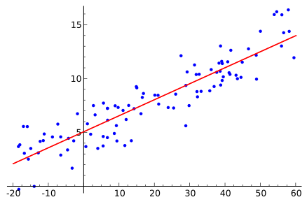
Coefficient of Determination
Coefficient of determination (R²) describes the proportion of the variance in the dependent variable that is predictable from the independent variable
  To put it simply: if the relationship between x and y is strong, R2 is close to 1; if the relationship is weak R2 has a lower value (under certain assumptions the range is from 0 to 1)

Slide 29
Hypothesis Testing
The probability density function (PDF) describes the likelihood for a random variable to take on a given value
Probability density function of the normal distribution
  Mean of 0 and variance of 64, and
  The associated 95% confidence interval also shown

Slide 30
Hypothesis Testing
Courtroom analogy
  Defendant is assumed to be innocent
  Is there a sufficient amount of evidence to reject the assumption of defendant being innocent?
In statistics
  H₀ (null hypothesis): In the US children watch TV 3 hours a day
  H₁ (alternative hypothesis): In the US children do not watch TV 3 hours a day
  H₁ (alternative hypothesis): In the US children watch TV more than 3 hours a day
  H₁ (alternative hypothesis): In the US children watch TV less than 3 hours a day
OR

Slide 31
Hypothesis Testing
How to test and decide whether the null hypothesis should be retained, or rejected in favour of the alternative hypothesis?
  Collect data (e.g. the number of hours a child watches TV a day) for a group of children
  Compute the sample mean from those data
  If the sample mean is close to three hours, then the null hypotheis is retained
  If the sample mean is far from three hours, then the null hypotheis is rejected
What is close? What is far?

Slide 32
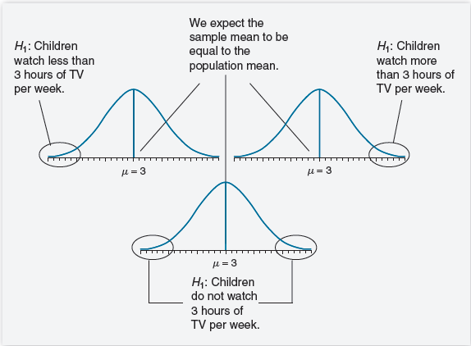
Hypothesis Testing

Slide 33
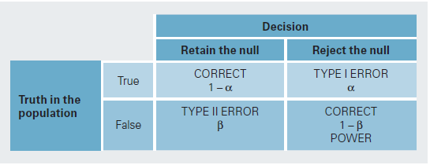
Hypothesis Testing
Four steps for hypothesis testing
  Step 1: State the hypotheses
  Step 2: Set the criteria for a decision
  Step 3: Compute the test statistic
  Step 4: Make a decision
Example: Pearson correlation
  Step 1: H₀: Correlation (r) equals zero, i.e. there is no linear relationship between the examined variables
  Step 2: α = 0.05, i.e. the probability of erroneously deciding the two varaibles to have a linear relation even though in reality there is no linear relationship
  Step 3: Compute a test statistc that detemines how probable (in the light of the limited number of available data) it is that the correlation coefficient differs from zero although it is zero in reality. This probability is referred to as the p-value.
  Step 4: If the p-value < 0.05 => reject H₀, i.e. we accept a risk smaller than 5% that we think the correlation coefficient to be unequal to zero even though it is zero in reality

Slide 34
Hypothesis Testing
Rule of thumb for hypothesis testing (for engineers…)
  Make sure you know what is the null hypothesis H₀
  Choose the risk level α (typically 0.05 or 0.01)
  Compute the p-value
  If p-value is smaller than the risk level α, reject the null hypothesis H₀

Slide 35
Hypothesis Testing
We will work with hypothesis testing in the exercise
Very clear text on this topic
  http://www.sagepub.com/upm-data/40007_Chapter8.pdf
  Pages 1-20

