Slide 1
Value-based actions in start-up world: How can we achieve what is important for our team?
Study psychologists Sanni Saarimäki & Alli Mattila
Start-up experience 29.9.2022

Slide 2
Values = what is important for us and what makes our life worth living
The compass when making decisions & creating something to this world
If we know our values, we are more willing to face the challenges on our path
Taking actions that are align with our values gives us meaning even if we can never fully achieve them

Slide 3
Market-plaza for values
Part A) 3 min:
Your team gets 5 cards. Discuss together and choose 3 of them that you agree to keep (that is, which are the common shared values ​​of your team or/and your project).
Part B: 7 min:
Then, go to trade these two cards with the other teams. When you give a card for the other team, you have to get one of theirs back in return. Your purpose is to get a collection of five values ​​that are shared and agreed in your team's project.

Slide 4
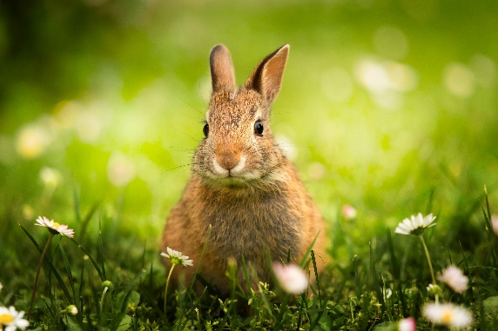
Why clarifying our values matters?
If it is clear for us, where we want to go, we are more willing to continue a journey even when it gets difficult.

Slide 5
Why clarifying our values matters?
If it is clear for us, where we want to go, we are more willing to face also the uncomfortable thoughts and emotions that belong to the path towards our valued life

Slide 6
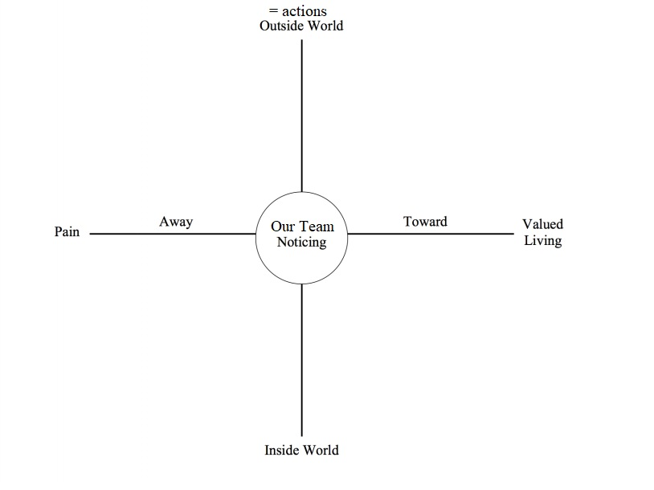
What kind of actions hinder us from going towards to our team’s values?
What kind of actions do we need to take to get closer to our team’s values?
What could be the potential thoughts and feelings that could interfere with our courage to try during this process and lead to e.g. avoidance or otherwise moving further away from what is important to us?
What is important to our team? What do we want to bring to this world with our start-up idea?

Slide 7
-Procrastinating with an important email
-Avoid asking for feedback
-Collaborating with a company whose values are against our own ones
-Playing safe: selling only vanilla
-Giving up without trying
-Sending the email even if it is scary
-Setting up a tasting booth and asking for feedback
-Collaborating with a company that is also interested in sustainability issues
-Offering adventurous variety of vegan options
What kind of actions hinder us from going towards to our team’s values?
What kind of actions do we need to take to get closer to our team’s values?
What could be the potential thoughts and feelings that could interfere with our courage to try during this process and lead to e.g. avoidance or otherwise moving further away from what is important to us?
-”What if they will say no and we will get rejected?”
-”What if they won’t like our flavors”
-”Every other kiosk is performing better than us”
-”Is it even worth trying now, when the economic depression is coming?”
What is important to our team? What do we want to bring to this world with our start-up idea?
-Love for ice cream
-Courage
-Sustainability: vegan food
-Spreading happiness to people
-Getting income to support studies

Slide 8
What kind of actions hinder us from going towards to our team’s values?
What kind of actions do we need to take to get closer to our team’s values?
What could be the potential thoughts and feelings that could interfere with our courage to try during this process and lead to e.g. avoidance or otherwise moving further away from what is important to us?
What is important to our team? What do we want to bring to this world with our start-up idea?

Slide 9
Summarize your team’s thoughts about today’s topics and this exercise

Slide 10
Thank you !
sanni.saarimaki@aalto.fi
alli.mattila@aalto.fi

