Slide 1
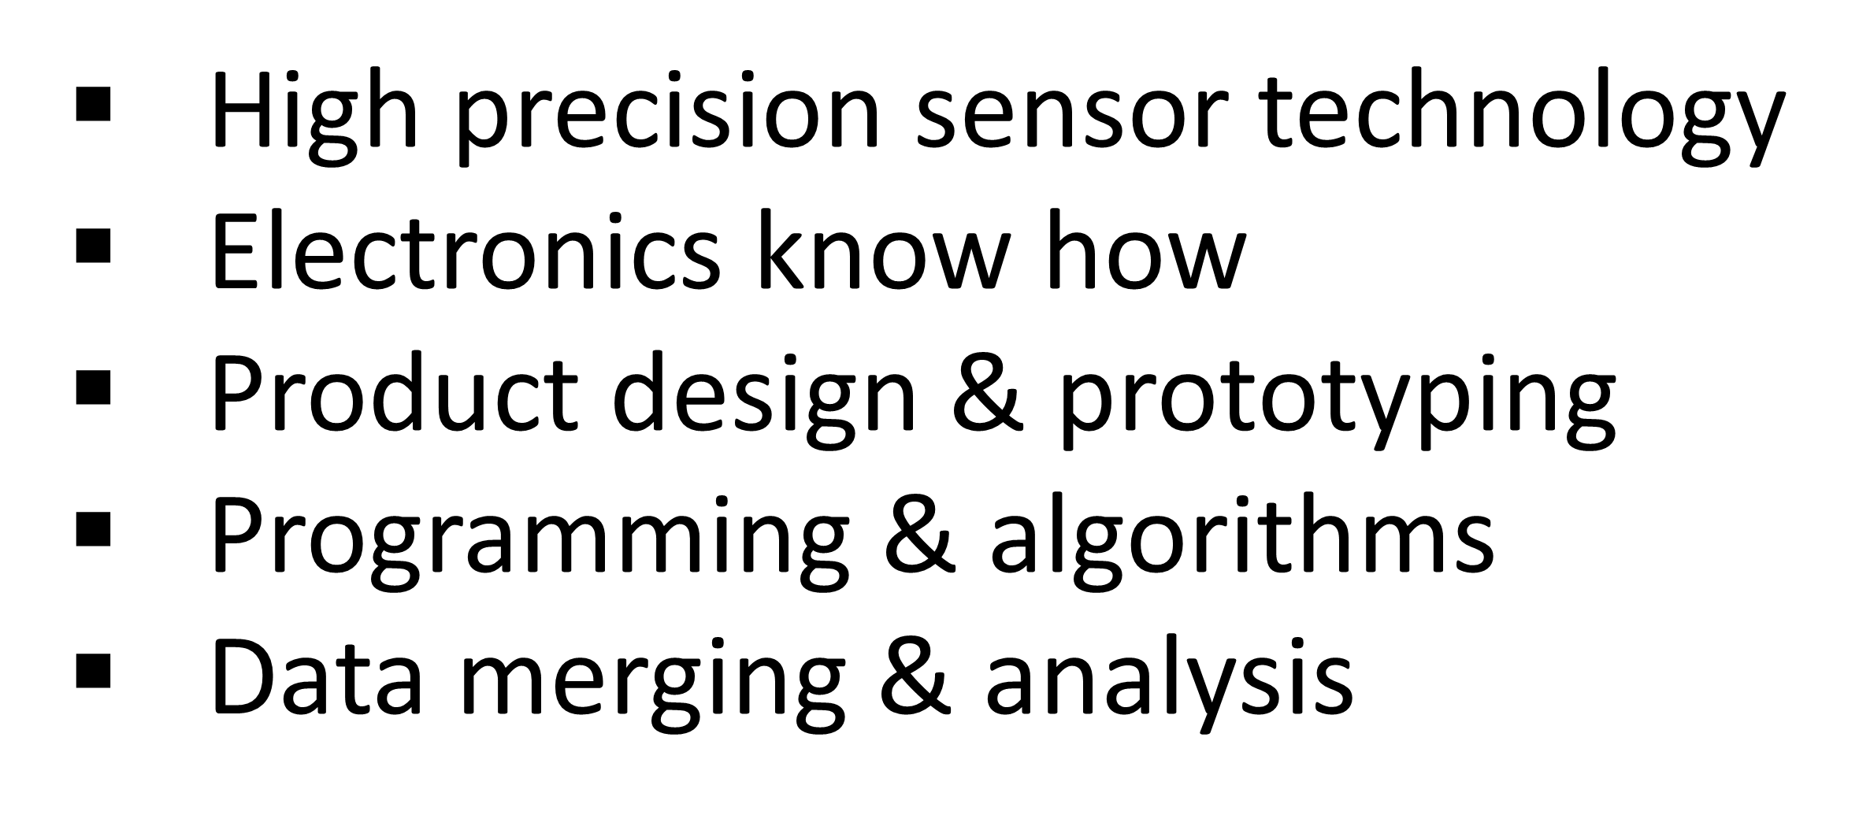
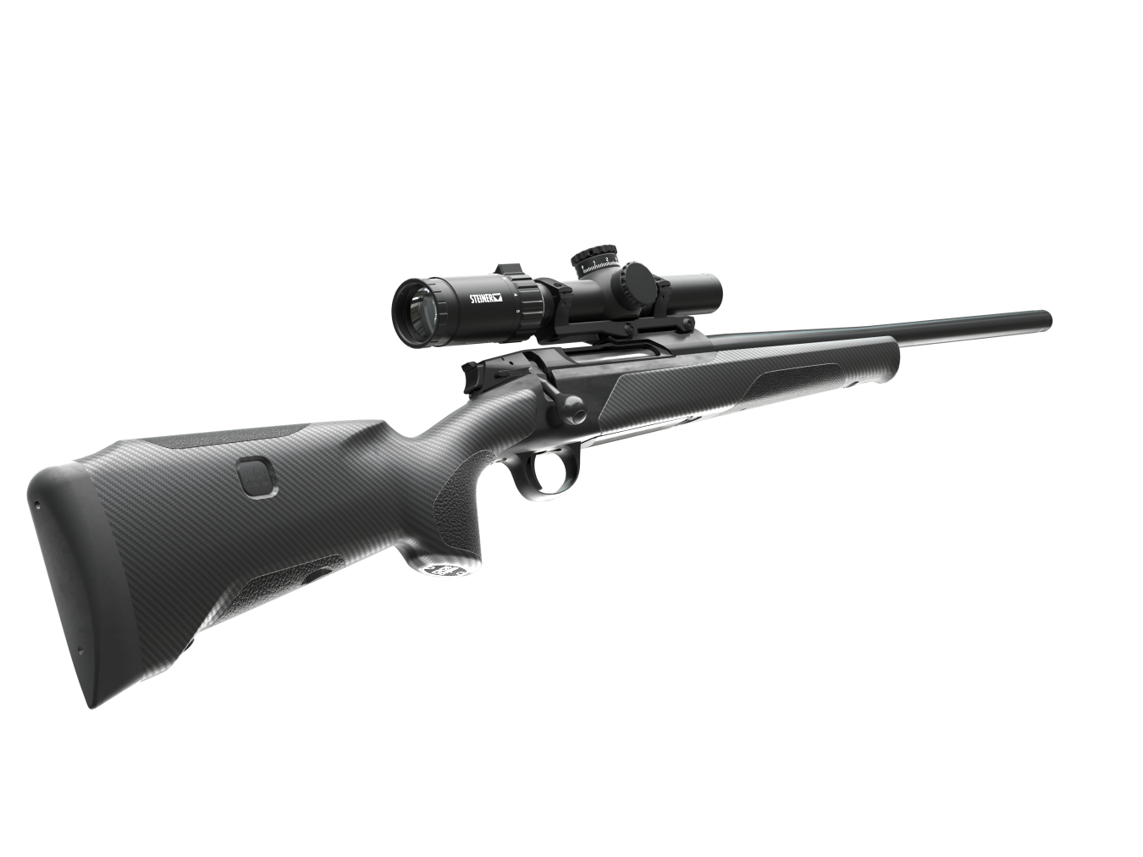
VELOCITY ON DEMAND
GOAL
NEW WAY TO MEASURE SPEED OF THE BULLET
WE SEEK

