Slide 1
TU-EV006: Strategic Project Management
4th session:
Buying projects in project networks
Pre-material

Slide 2
Watch introduction videos
In the upcoming session, we will watch together quite many pre-recorded and edited videos so please ensure that you have a good connection to the web.
There may be relevant content in both feeds (video and slides) so you may want to switch the views in Panopto viewer (example picture below) from time to time.
Autoplay is disabled
so use Youtube controls in
these introduction videos.
During lecture only Panopto
controls are needed.

Slide 3
This will be a Guest lecture by Sisko Hellgren
We aim to provide you with an experience of a visiting expert lecturer, so the themes presented are just meant to structure the lecture – please take this opportunity to connect what Sisko explains to what you have already learned.
Sisko introduction:
https://aalto.cloud.panopto.eu/Panopto/Pages/Viewer.aspx?id=9d594d6c-c2de-49f1-a66d-ad2d00b8cee5

Slide 4
Background videos for the industry:
Oasis of the Seas:
https://aalto.cloud.panopto.eu/Panopto/Pages/Viewer.aspx?id=44da75f9-1094-4563-bc82-ad2d00ebb89f
Sister vessels:
https://aalto.cloud.panopto.eu/Panopto/Pages/Viewer.aspx?id=95daa5cc-cdd0-4051-bb58-ad3500c66659

Slide 5
We will start the session with Sisko discussing the list in this slide from the viewpoint from Shipbuilding.
Buying in shipbuilding network, what is special?
The scope
Initial information
The quality demands
The rules & regulations
The schedule & related milestones as part of the whole product
The building practice as part of the whole product
Inspection plan
Resource plan
The price
The references
The risks
Payment terms

Slide 6
Prepare for polling sessions
Presemo will be used throughout the lecture:
https://presemo.aalto.fi/fitech2022/
Based on your knowledge of some industry (whether learned or experienced), list in Presemo things that you think are similar or special between company networks in shipbuilding and the industry you are thinking of. You can use the list on the previous slide to guide your thought.

Slide 7
Familiarize yourself with the themes touched in the lecture
Peek on the following themes before the lecture – Presemo will be used for voting for your choice on the central theme in each video clip (voting is not open yet).
This will not be exact science, and the aim is to discuss with you about the possible connections. Not all the themes in the following slides are relevant to the pre-recorded video material but they will be used if the time allows ☺

Slide 8
Project management themes possibly discussed in the lecture
Integration Management | Uncertainty | Activity Network | Boundaries of a Project
Knowledge Transfer | Schedule Management | Project Constraints | Stakeholders
Procurement Management | Project Team | Coordination Practices | Network Evolution
Dynamic Capabilities | Make or Buy | Impact Assessment | Fast Tracking
Notes:
5 / 45 min

Slide 9
Theme 1
Integration Management
Project integration management refers to procedures that integrate various parts of the project and its management and help in realizing project objectives. The tasks of integration management are to coordinate project execution, deal with the dependencies among activities, and manage issues related to various knowledge areas, including specifying objectives, refining objectives during the project, and managing change.
This is the project manager’s main task, to which many of the tools and methods connect to.

Slide 10
Uncertainty – See also material from first lecture
Amount of data
Uncertainty

Slide 11
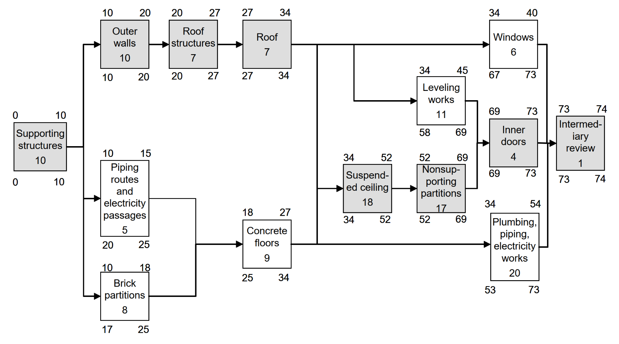
Activity Network
Project scheduling is one of the most central topics in project business development
An activity is a work package that must be completed with allocated duration, cost, and resource requirements.
A critical activity is an activity situated on the critical path of the project affecting the duration of the whole project.
The critical path is the path in the activity network consisting of the critical activities that determine the earliest possible completion for the project.
Float is the timeframe in which the activity can be set to start and end without it affecting the duration of the entire project.
As a connection to other scheduling tools, a milestone can be marked into the activity network as a principal event important in the project
Artto K., Martinsuo M., Kujala J., 2011. Project business. Helsinki, Finland, http://pbgroup.tkk.fi/en/

Slide 12
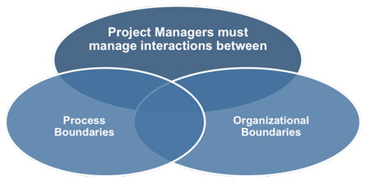
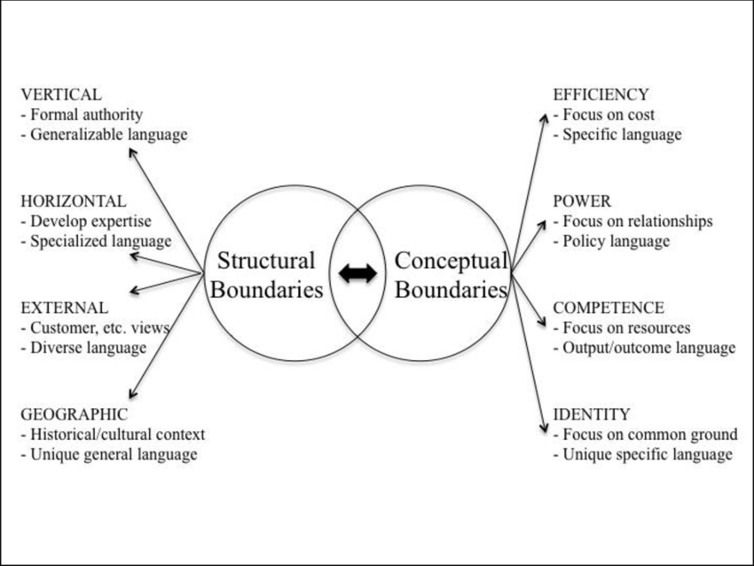
Boundaries of a Project
Project Management Institute. (2017). A guide to the Project Management Body of Knowledge (PMBOK guide) (6th ed.).
Wolfberg, Adrian. (2017). At the Street-level Intersection of Organizational Boundaries: Competencies for Sustainable Change.

Slide 13
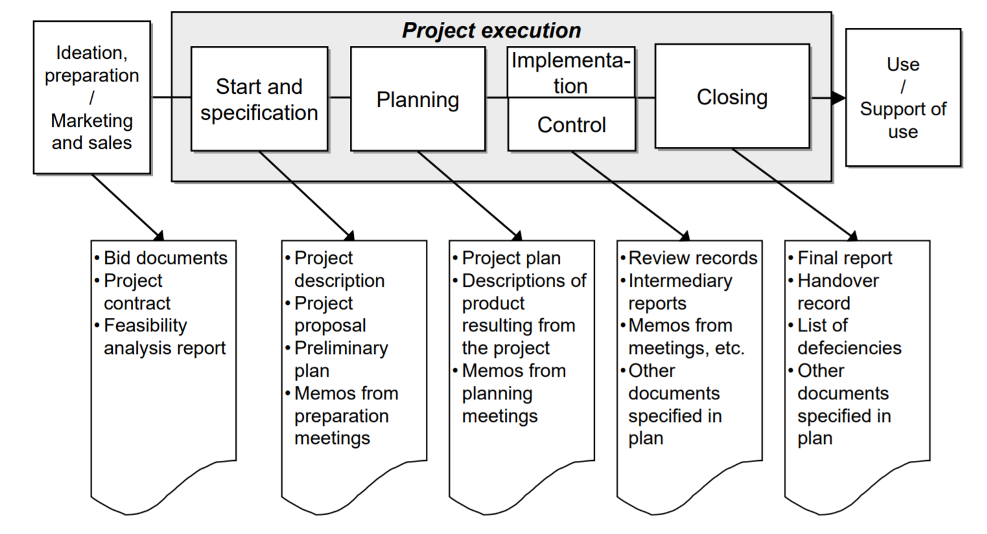
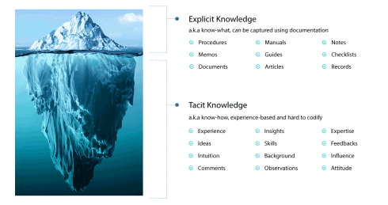
Knowledge Transfer
Artto K., Martinsuo M., Kujala J., 2011. Project business. Helsinki, Finland, http://pbgroup.tkk.fi/en/
Hendriks, P. (1999) Why Share Knowledge? The Influence of ICT on the Motivation for Knowledge Sharing. Knowledge & Process Management, 6

Slide 14
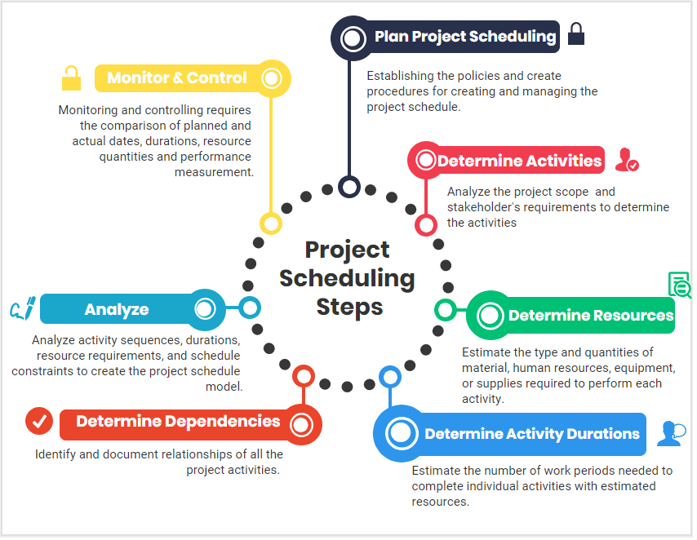
Schedule Management
A project is an entity restricted by a schedule. Schedule management ensures that the project can be realized and finished in the agreed-upon and planned timeframe.
The activities to be scheduled are derived directly from the WBS. In the project plan the scheduled activities are described as rough-level activity packages, for example, as a Gantt chart fixed to calendar dates or milestones. The reporting and control principles used to control the schedule during execution are described as part of the schedule.
Artto K., Martinsuo M., Kujala J., 2011. Project business. Helsinki, Finland, http://pbgroup.tkk.fi/en/
"Project Scheduling Steps" by Irma Gilda is licensed under CC BY 4.0

Slide 15
Project Constraints
Schedule: The duration of the project until its completion or intermediate project milestones.
Budget: All the financial resources needed to complete the project on time, in its predetermined scope.
Resources: Specific human resources, work material, services, supplies.
Risk: An uncertain event or condition that occurs, causing a positive or negative effect on the project.
Scope: The specific goals, deliverables and tasks that define the boundaries of the project.
Quality: The degree of reaching the project expectations set in the planning stages.
Customer Satisfaction: Meeting the customer expectations regarding conformance to requirements and fitness for use.
Project Management Institute. (2017). A guide to the Project Management Body of Knowledge (PMBOK guide) (6th ed.).

Slide 16
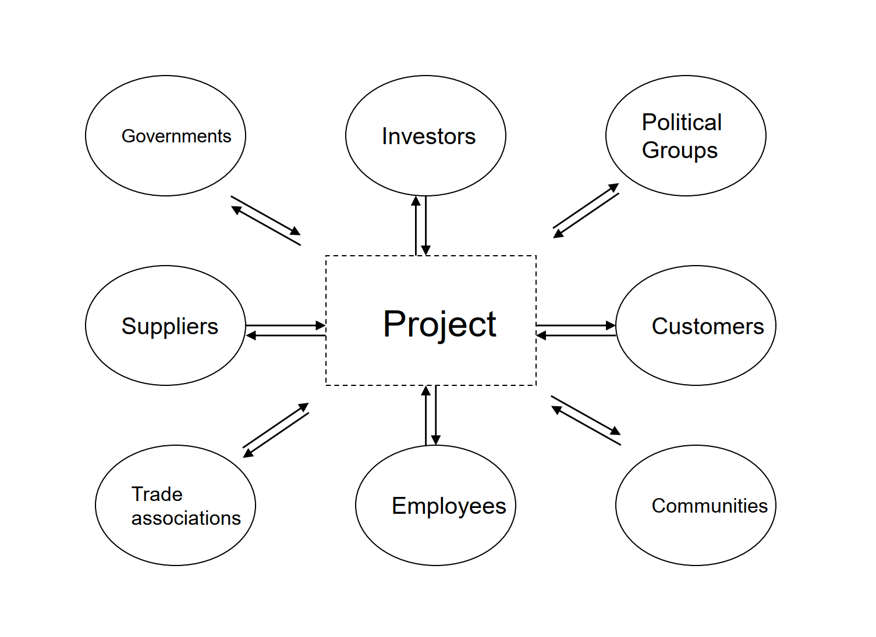
Stakeholders
Stakeholders are individuals, groups, or organizations that the project may affect or that can affect the project.
I addition to typical stakeholders, a project has several other possible stakeholders directly or indirectly connected to the project:
suppliers and service providers,
officials and authorities,
financers,
media,
target groups,
competitors,
family members of the project team, and
society in a broad sense

Slide 17
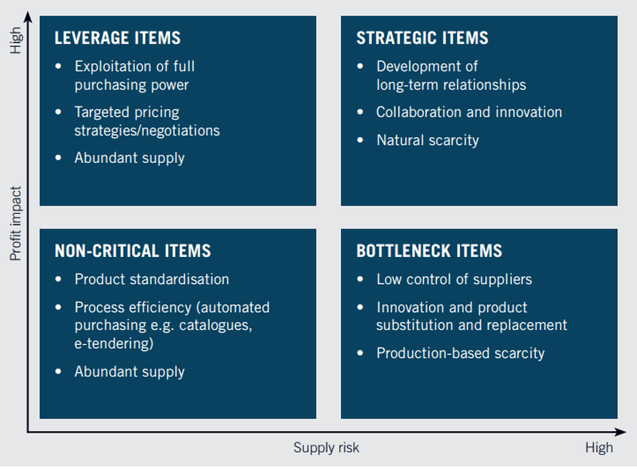
Procurement Management
Procurement management involves the search, choice, and use of resources external to the project or company, managing procurement-related contracts and collaboration, and monitoring deliveries. From the perspective of the customer‘s work breakdown structure, this delivery can be:
partial delivery
complete system delivery
project management service delivery
turnkey delivery
From the strategic point of view, for example Kraljic matrix can be used to segment the external resources (both material and services) into four classes, based on the complexity (or risk) of the supply market and the importance of the external resource. This subdivision allows the company to define the optimal purchasing strategies (including timing) for each of the four types of resources.
Source: Kraljic, P. (1983). "Purchasing Must Become Supply Management". Harvard Business Review.

Slide 18
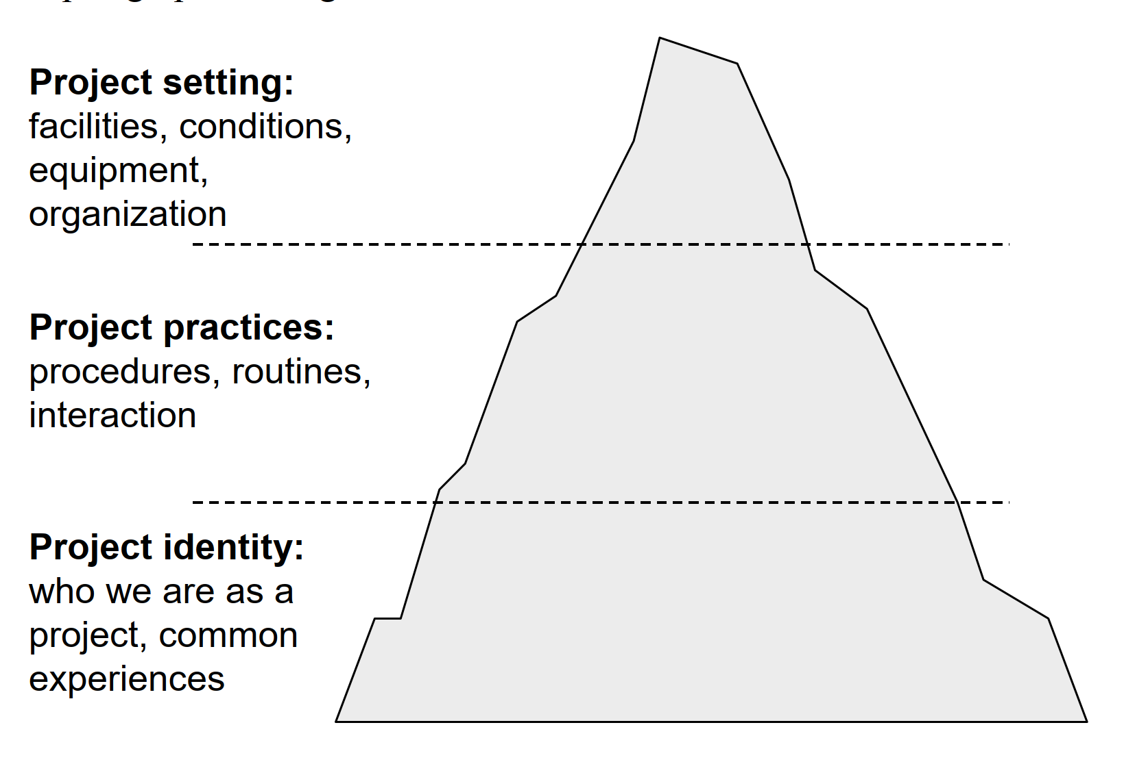
Project Team
Project settings (top) level:
The tools and facilities needed to execute the work
Supportive conditions in the organization
Proper organization of the project
Project processes and practices (middle) level:
Work form and routines in a project (project culture)
Interaction with the surrounding organizations or the customer
Project identity (bottom) level:
An identity formed for the project that the whole project team relates to
Created over time from experiences
Artto K., Martinsuo M., Kujala J., 2011. Project business. Helsinki, Finland, http://pbgroup.tkk.fi/en/

Slide 19
Coordination Practices
Organizational structure in different companies affects the work and roles of the project manager and the members of the project team. In practice, the tasks, position, use of time, and many other requirements of the project manager differ from one company to another in project network.
For this reason, all areas of project management should typically be covered in the subcontracting contract: executing the project plan, monitoring results, exercising quality management, and implementing change and risk management.
During the project, meetings are among the most valuable tools used to manage and coordinate the activities of a network organization. Other options include online collaboration platforms with coordination features or for example “war room” or “big room” concepts.

Slide 20
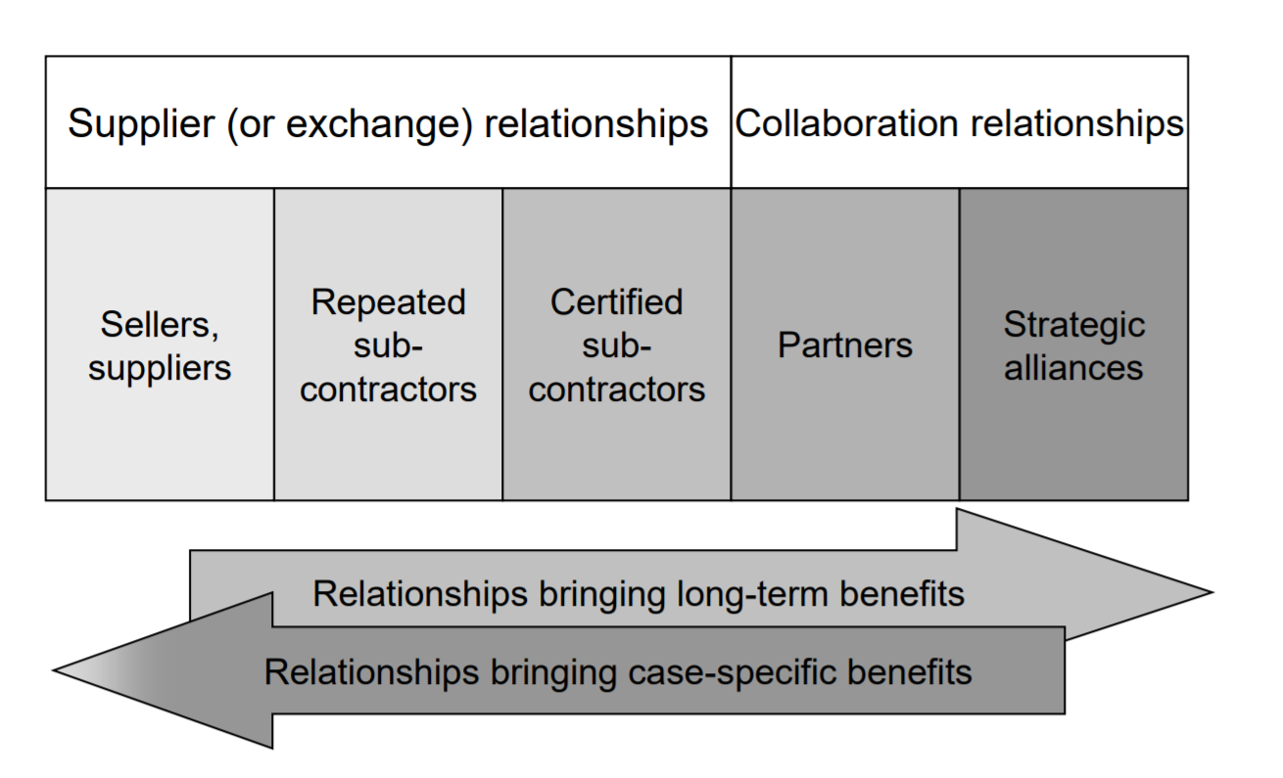
Network Evolution
Several partnership options can be identified in collaboration situations, and the terms operative partnership, tactical partnership, and strategic partnership can be used to describe them.
In an operative partnership, both parties aim at making their own activity more effective and, in that way, achieve lower costs. In a tactical partnership, the goal is to develop common practices that, from the perspective of both parties, are judged to be more effective than the earlier ones. In a strategic partnership, the objective is to achieve common product and business innovations that provide both parties with a strategic competitive advantage.
Artto K., Martinsuo M., Kujala J., 2011. Project business. Helsinki, Finland, http://pbgroup.tkk.fi/en/

Slide 21
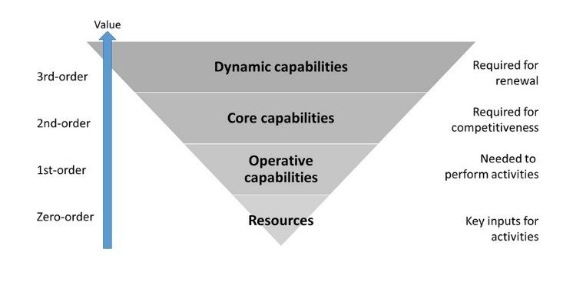
Dynamic Capabilities
Teece, D. J., Pisano, G., & Shuen, A. (1997). Dynamic capabilities and strategic management. Strategic management journal, 18(7): The firm’s ability to integrate, build, and reconfigure internal and external competences to address rapidly changing environments. Main elements:
Learning - requiring on operational level employees and managers to reorganize their routines to promote interactions and on strategic level to recognize and avoid strategic blind spots.
Transformation of existing assets - inexpensive reconfiguration and transformation of processes ahead of the competition. This can be supported by decentralization, local autonomy and strategic alliances.
New assets - the integration of external activities and technologies through alliances and partnerships.
Co-specialization – these new capabilities, having developed together to become more valuable in combination than separately, gives a firm a sustainable competitive advantage.
Yrjola, S. & Matinmikko, M. & Mustonen, M. & Ahokangas, P. (2016). Analysis of dynamic capabilities in the citizens broadband radio service. Wireless Innovation Forum Conference on Wireless Communication Technologies and Software Defined Radio (WInnComm ‘16).

Slide 22
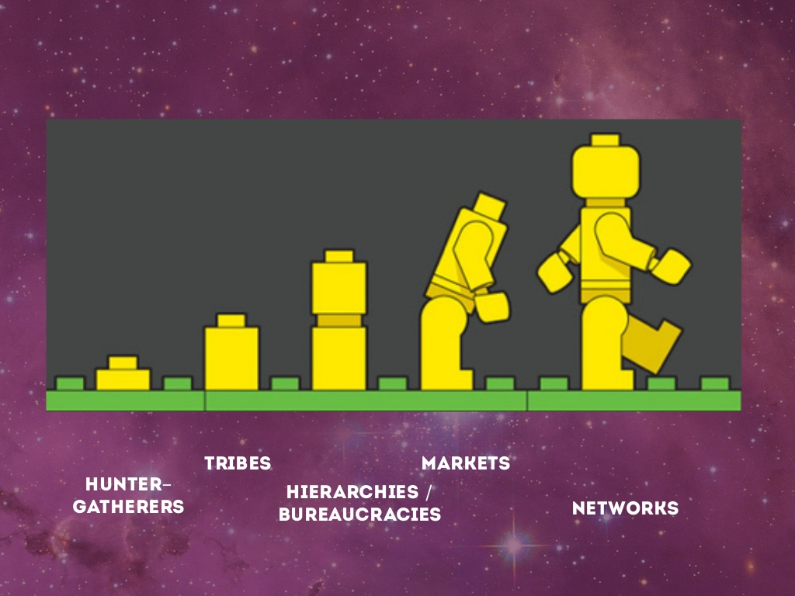
Make or Buy
In strategic management, we may think the division of resources as a spectrum of arrangements: from loose to tight, from arms-length bargaining to total integration, from spot transactions via standing relations to the internalization of markets.
At one end of the spectrum is what we may call the open resource market. At the other we find the firm which is relatively self-sufficient in terms of vertical or functional integration. In this spectrum there are several in-between forms that could be called networks.
Strategic issues typically resolved in a networking context include:
turnkey contracts and 'systems selling’,
make-lease-or-buy decisions,
split vs. unified sourcing,
diversification,
etc.
(Adapted from Thorelli, H. (1986). Networks: Between Markets and Hierarchies. Strategic Management Journal, 7(1))

Slide 23
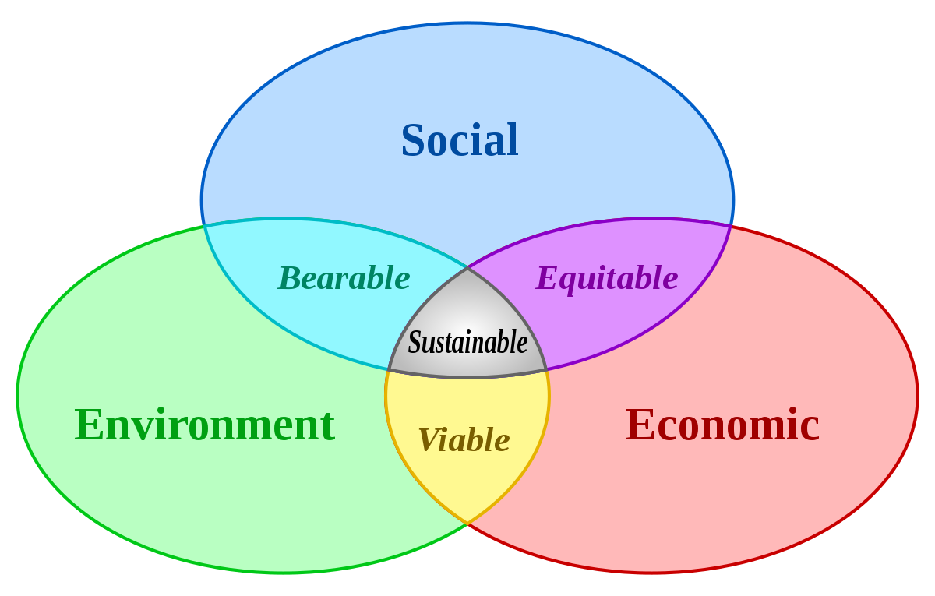
Impact assessment
The three pillars of sustainability in projects:
Economic sustainability embraces general aspects of a project/organization that must be respected in order to remain in the market for long time.
Ecological sustainability deals with environmental impacts due to project activities – for example, from resource use, emissions and waste.
Social sustainability is connected to present and future relationships with stakeholders – for example, supporting ethical behavior and human rights, no controversial activities such as corruption or cartel activities, embracing corporate citizenship

Slide 24
Fast Tracking
Fast-tracking involves compression of the project schedule by:
simultaneously executing activities,
making effective use of results from earlier projects,
taking risks in specific solutions,
or procuring external resources to speed up the execution of the project.
In the fast-tracking principle, it is essential to keep a reasonable balance between the risks and expected financial benefits from the quickened execution.
See also materials from lecture 2 of this course about the evolution and sensitivity of the information in fast-tracking.

