Slide 1
Wind power project: planning procedures and environmental impacts
Mattias Järvinen / wpd Finland & EIA association
Aalto Course in wind power
28.10.2022 klo 14-16

Slide 2
Content
Introduction – Me, where I work & the EIA association
Environmental Impact Assessment
Land use planning
Various permits
Summary, main take aways of the lecture

Slide 3
Mattias Järvinen
Deputy Managing Director & Project development Director at wpd Finland Oy
MSc. in Environmental and Marine biology
Chairman of Finnish Environmental Impact Assessment association
Background in Environmental Consulting and Land use planning services in wind farm projects since 2009
Taken part in various development projects in relation to EIAs

Slide 4
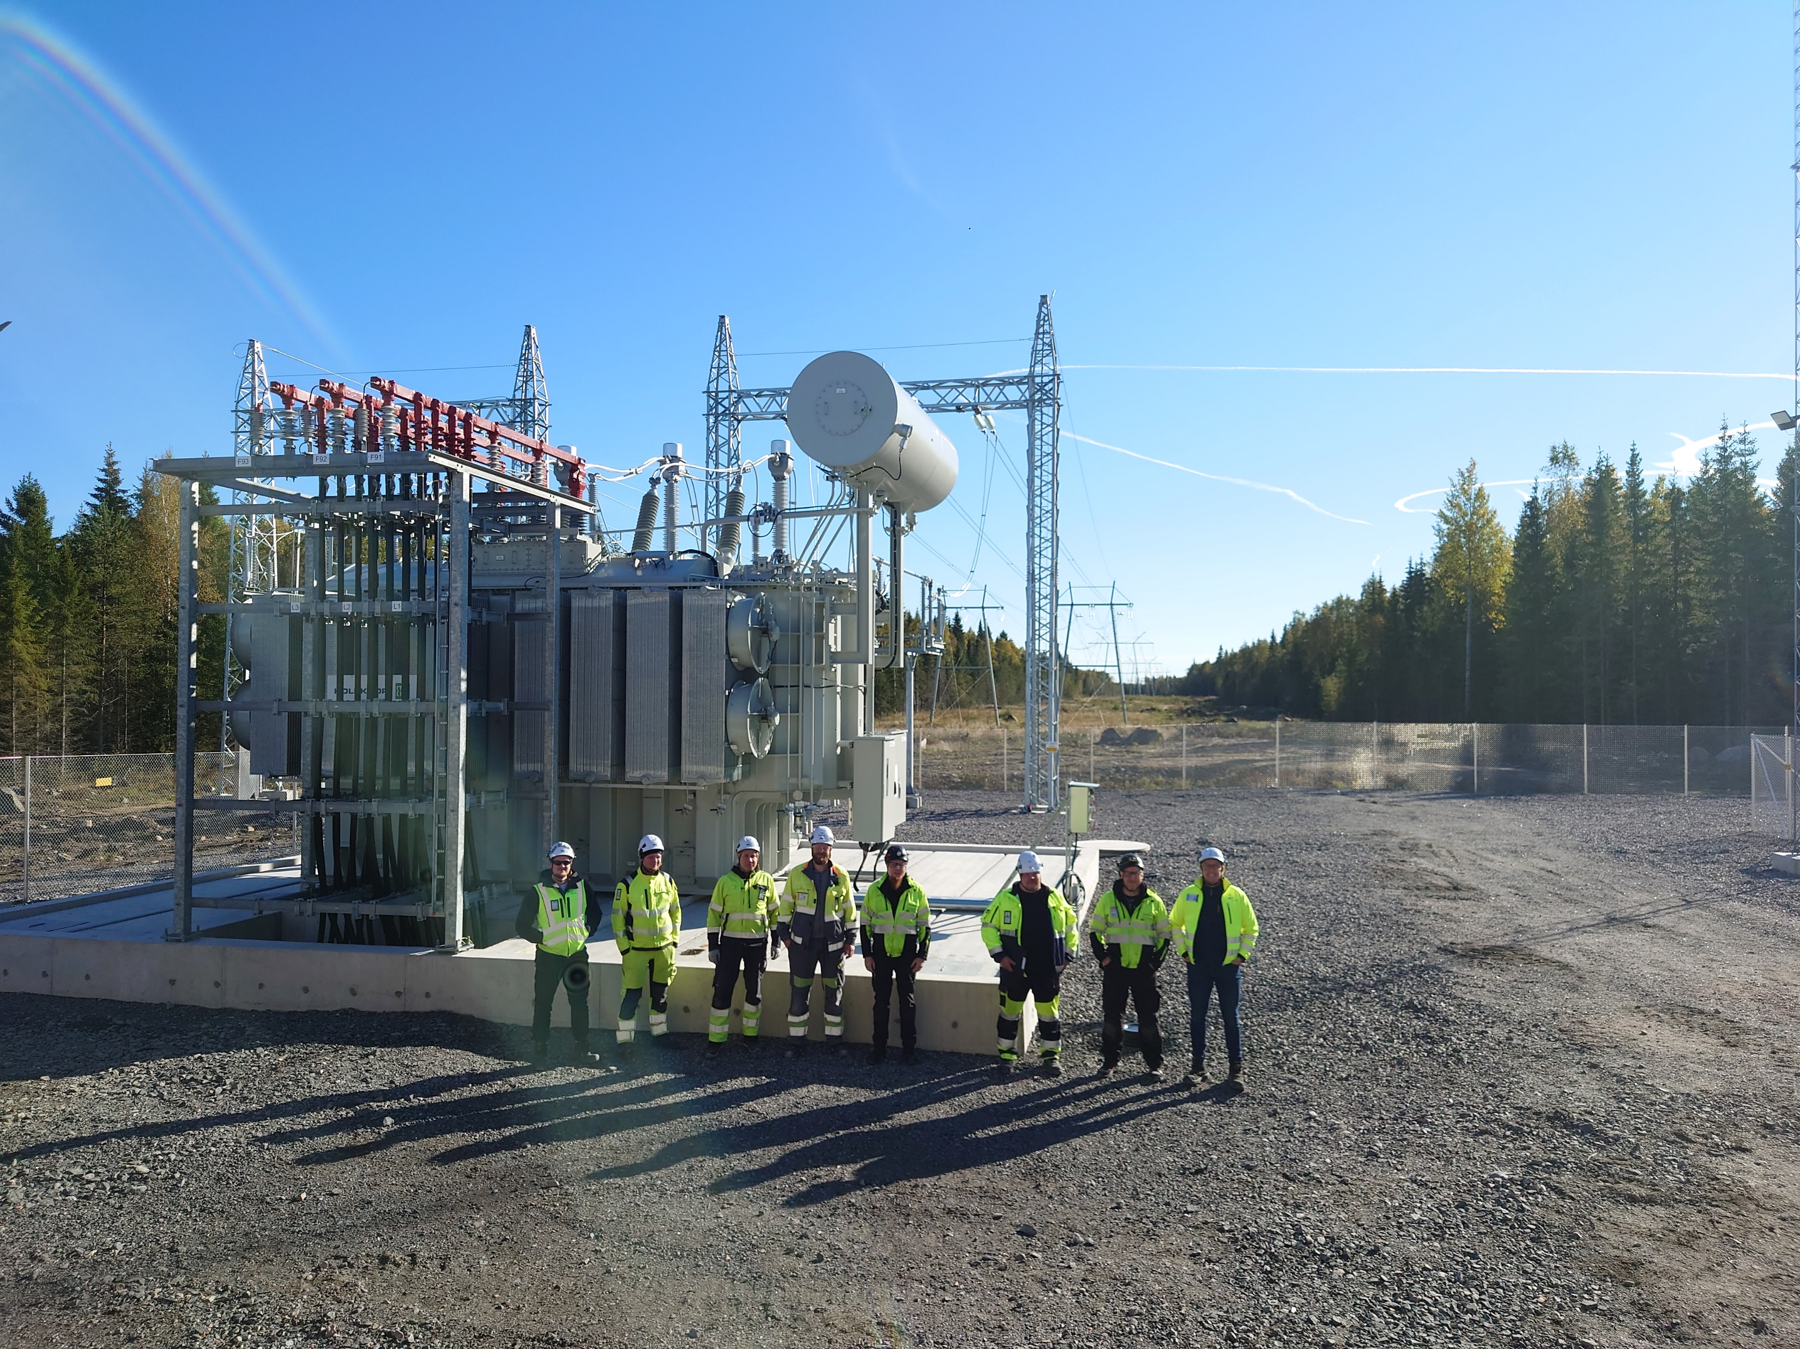
wpd Finland Oy wpd = wind project development
wpd AG, founded in Bremen in 1996, operates in the field of renewable energy in 30 countries with 3,500 employees
wpd Finland Oy was founded in 2007. The main office is located in Keilaniemi, Espoo. A branch office was opened in Oulu in 2021. Altogether 23 employees work in Finland.
-> We work on project development, financing and implementation of wind power parks.
wpd construction Finland Oy; responsible for the construction
wpd windmanager Suomi Oy; Responsible for operation and maintenance of wind turbines
Wpd has by 2022 built 110 turbines in Finland, corresponding to ~2% of Finnish consumption

Slide 5
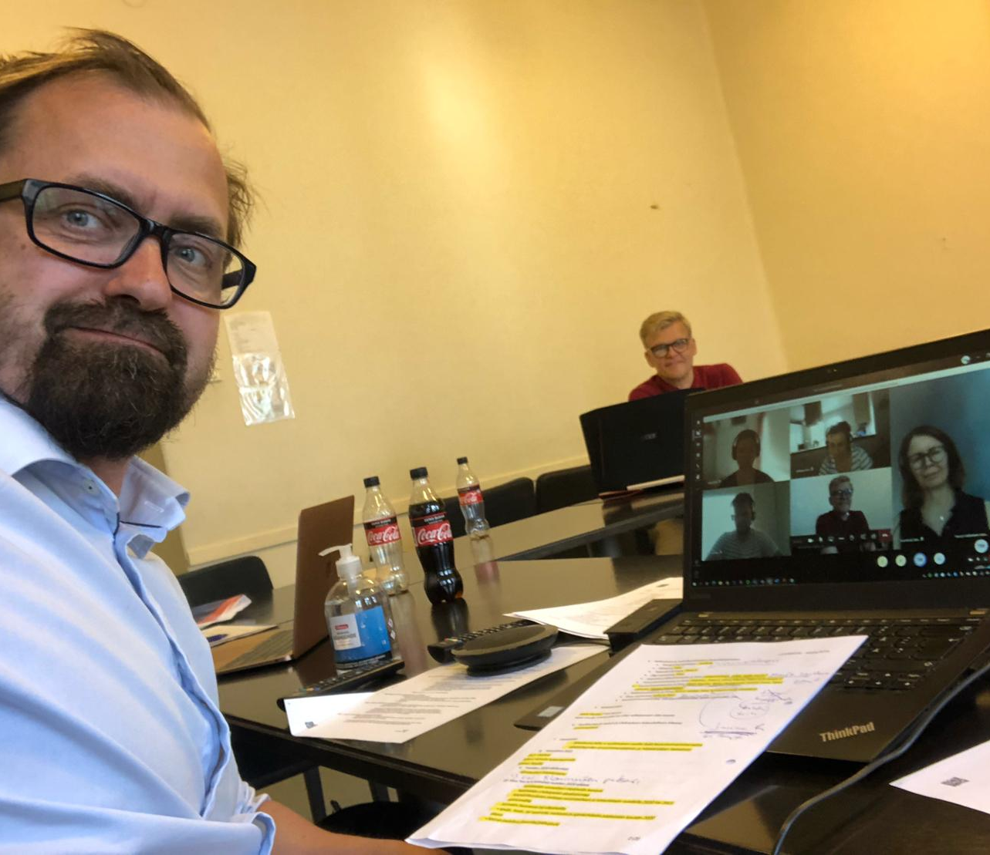
Finnish EIA association
Founded in 1994
200 personal and more than 10 corporate members: eg. consultants, project developers & Environmental authorities
Information & Networking forum for those working in the field of environmental impact assessment
Promotes development of EIA -> participation and consideration of the environment in project planning
Participates in EIA development projects
Gives statements in legislation development projects concerning EIA

Slide 6
Stages of wind farm development
Technical development of project continues throughout the process
Land use planning (municipality)
Greenfield & Start of project development
Permits:
Building permits (munic)
Environmental permit (munic)
Aviation statement/permit (Aviation auth)
Defence force statement
Construction
Environmental impact assessment (ELY centre)
Procedures required by law

Slide 7
Stages of wind farm development
Technical development of project continues throughout the process
Land use planning (municipality)
Greenfield & Start of project development
Permits:
Building permits (munic)
Environmental permit (munic)
Aviation statement/permit (Aviation auth)
Defence force
Construction
Environmental impact assessment (ELY centre)
Procedures required by law

Slide 8
Environmental impact assessment procedure in wind farm development

Slide 9
History of the EIA procedure
The EIA originates from the USA
Objective was to comprehensively respond to environmental problems and combine economic, social and ecological interests
National Environmental Policy Act (NEPA) – 1970
Other countries soon followed
EC EIA Directive (85/337/EEC) in the mid-1980s
In Finland, committee report 1982
However, the drafting of the EIA law only started in the 1990s
Finland's EIA law entered into force in 1994
EIA has been implemented as a statutory procedure in more than a hundred countries
Environmental impact assessment
=
EIA

Slide 10
EIA is not a permitting procedure, but…
The EIA procedure is a prerequisite for permit decisions, which are stipulated in other laws and regulations
No decision is made for the project within the EIA procedure
No possibility to appeal

Slide 11
The EIA anticipates Environmental impacts already in the early project planning phase
Environmental impacts from project alternatives (0, 1, 2, 3, etc.) are assessed in advance
Planning of mitigation, prevention, or compensation of significant environmental impacts
Relevant authorities, communities and individuals whose conditions or interests may be affected by the project are consulted
The environmental impacts of the project and their significance are identified, assessed and described.

Slide 12
How many EIAs in Finland?
In Finland, 30 to 50 projects are subject to EIA per year
Most have been related to energy production, waste management projects, then natural resource projects and transport projects
In the 2010s, the wind power boom heated up EIA statistics

Slide 13
How does the EIA procedure proceed?
In Finland, a two-phase procedure:
1. Assessment program phase
2. Assessment report phase
Whereafter the procedure ends

Slide 14
All wind farms larger than 10 turbines or 45 MW. Smaller projects goes without EIA, but can require EIA based on separate consideration by ELY centre

Slide 15
Content of EIA program
Who – Project developer
What – Project
Why – Background and reasons
Where – Project environment
How – Assessment methodology
When – Time schedule of procedure

Slide 16
Content of the EIA report
Includes the same as the EIA program and in addition:
The result of the environmental impact assessment (significance of the impact)
Comparison of alternatives
Mitigation Impact
Monitoring of impacts
Feasibility of the project
Explanation of how the contact authority's statement on the evaluation program has been taken into account

Slide 17
Impacts to be assessed
The Finnish EIA legislation requires the above impacts to be assessed
The impacts are divided into three phases: construction phase, operation phase and decommissioning
As a new type of impact in 2017: "impacts on material assets"

Slide 18
Typical impacts from a wind farm
Abiotic environment
Impacts on the soundscape (noise)
Impacts on light conditions (flicker)
Impacts on air, quality and climate
Impacts on soil, surface and groundwater
Biotic environment
Impacts on vegetation and valuable natural sites
Impacts on birds
Impacts on other fauna
Impacts on nature reserves
Human environment
Impacts on land use and the built environment
Impacts on traffic
Impacts on the landscape and cultural environment
Impacts on ancient remains
Impacts on human health, living conditions and comfort

Slide 19
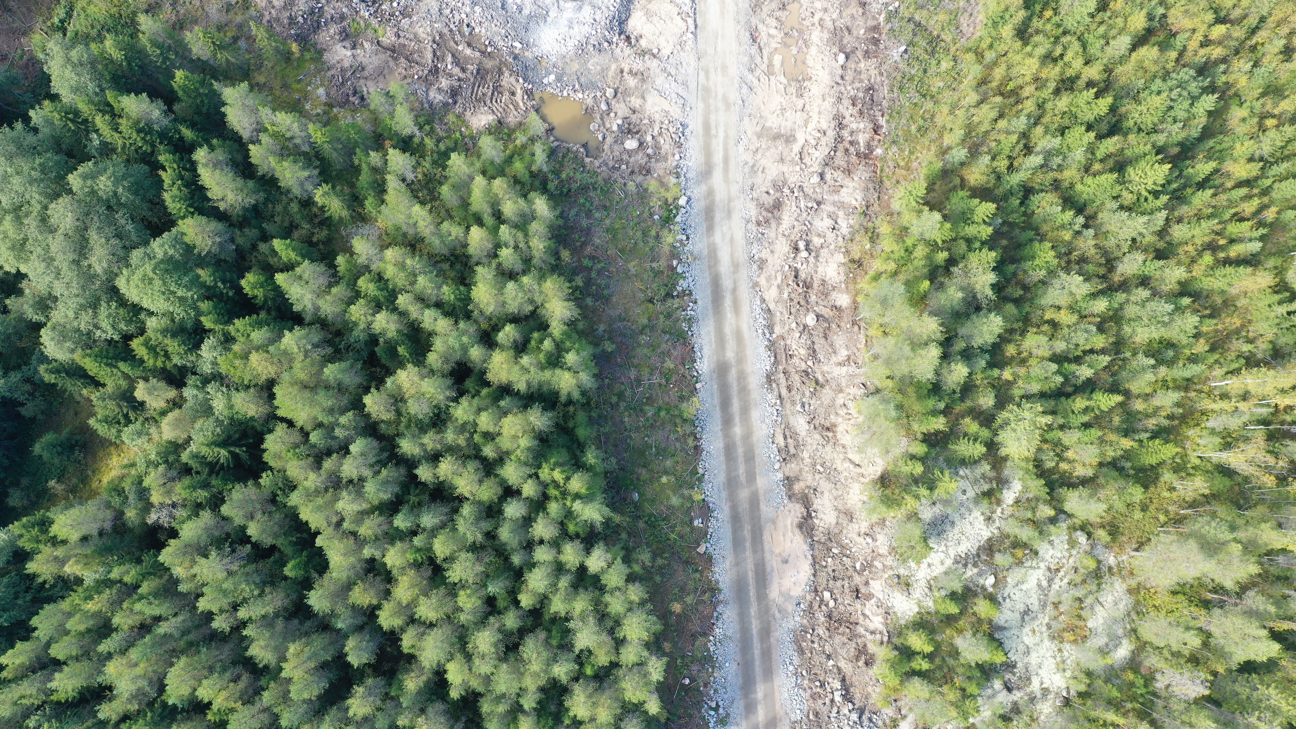
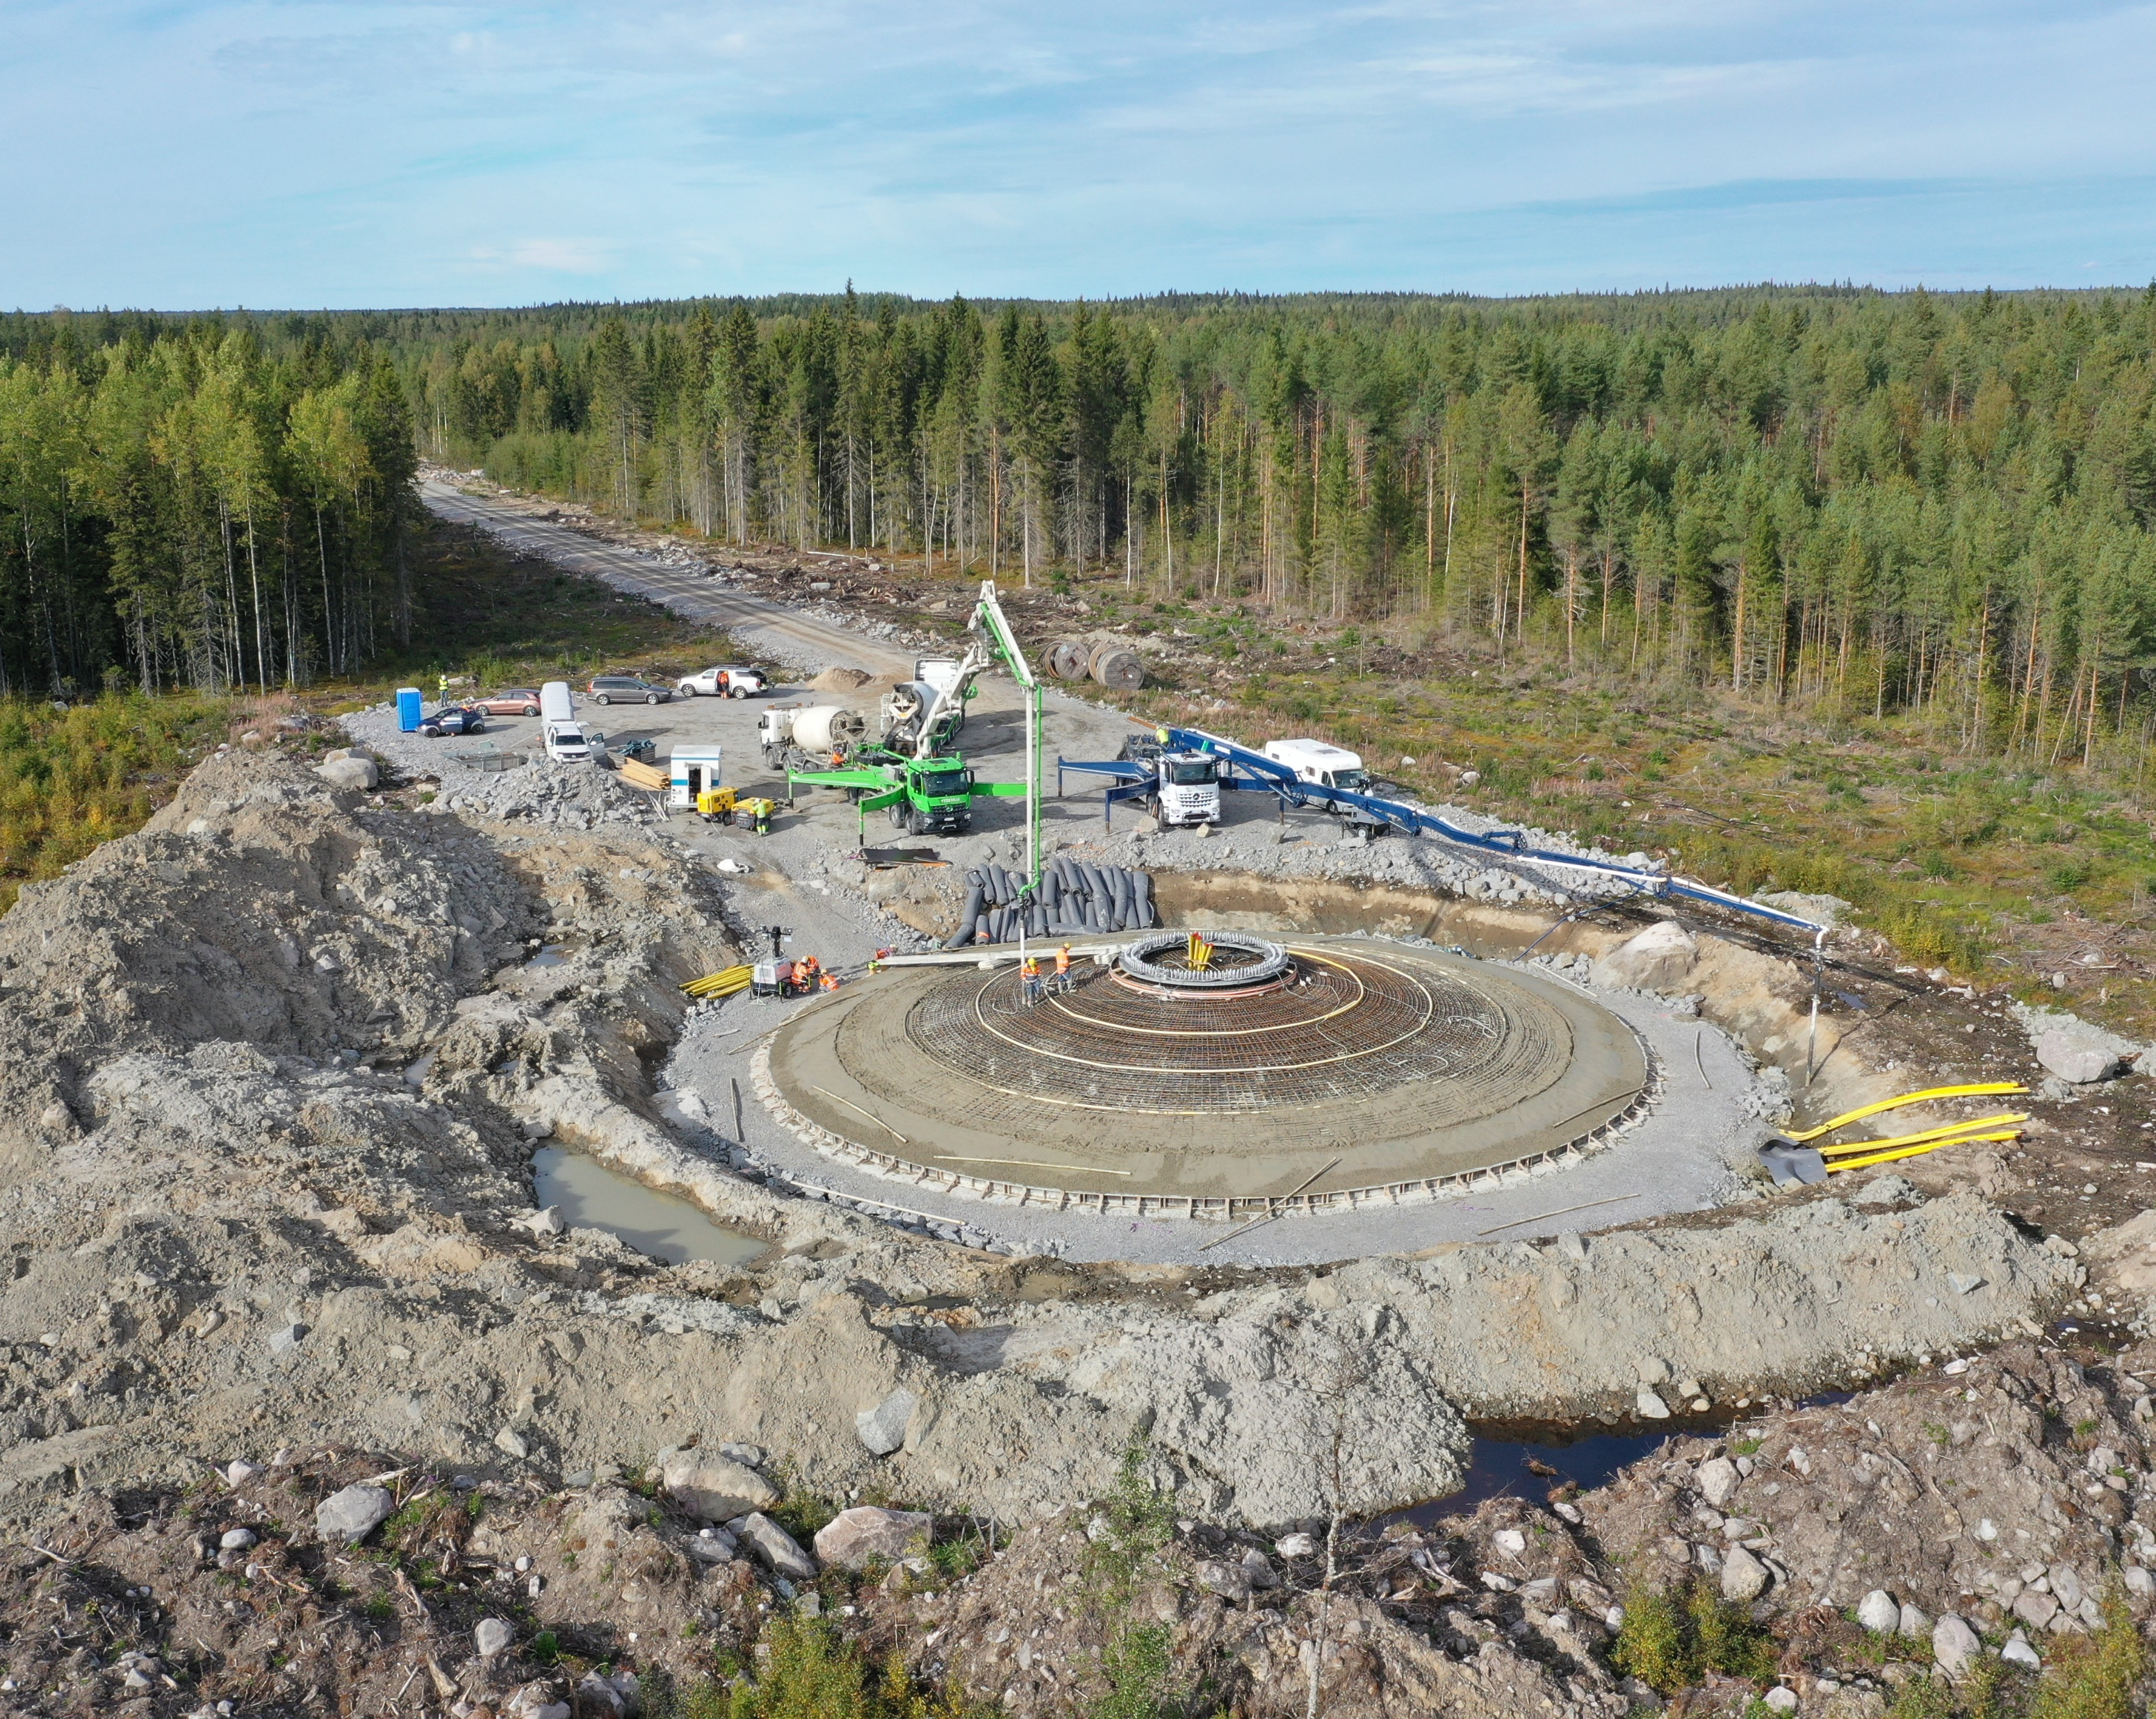
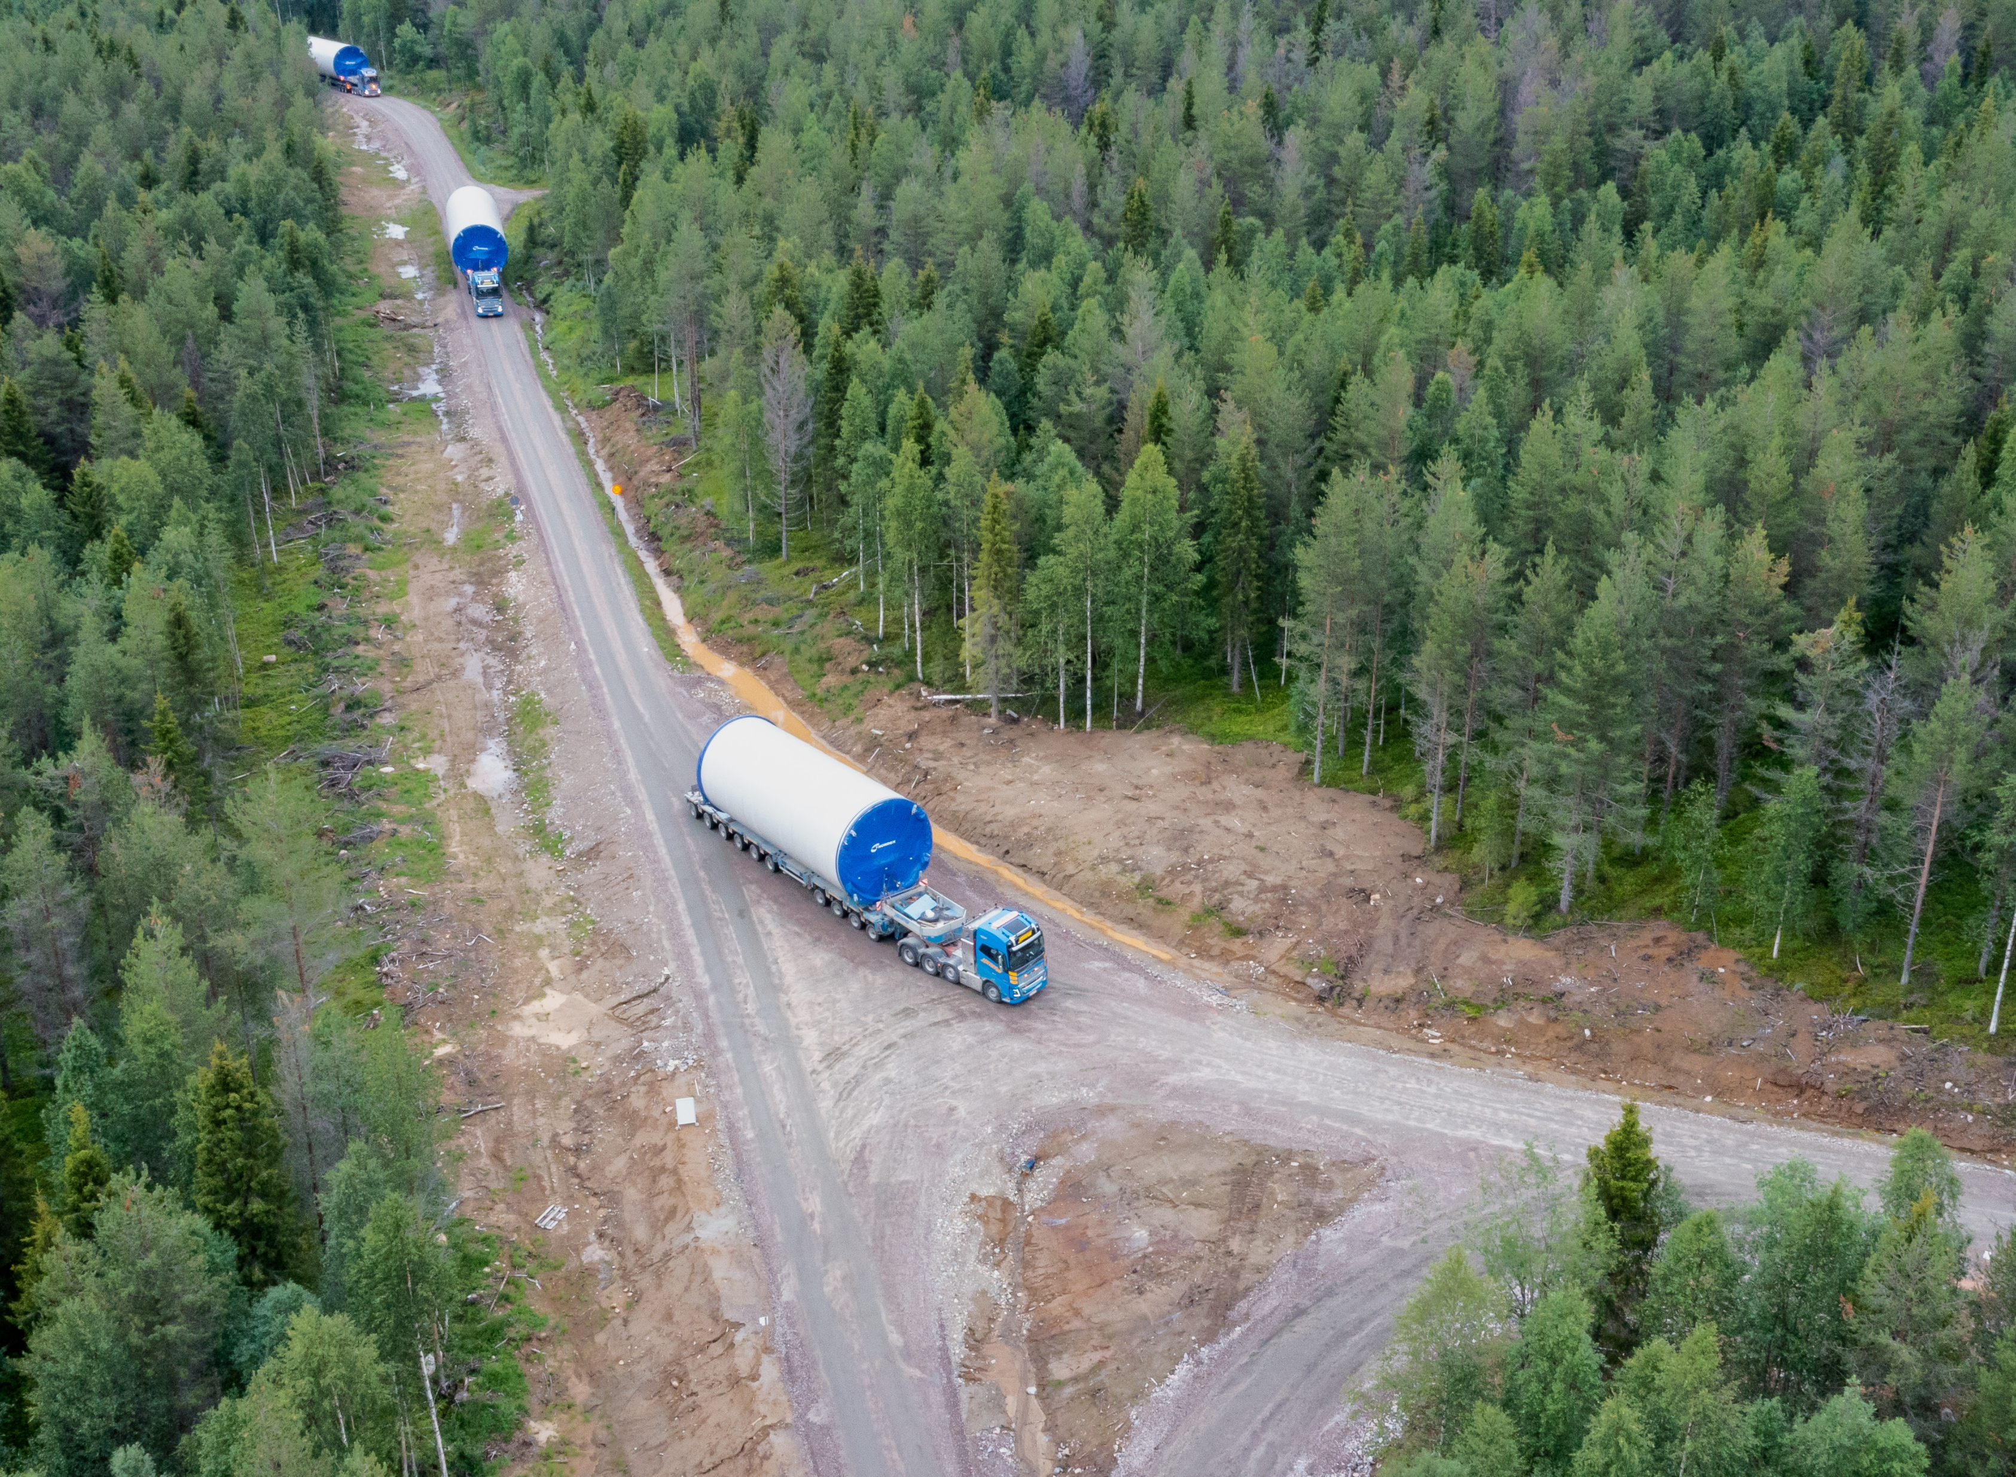
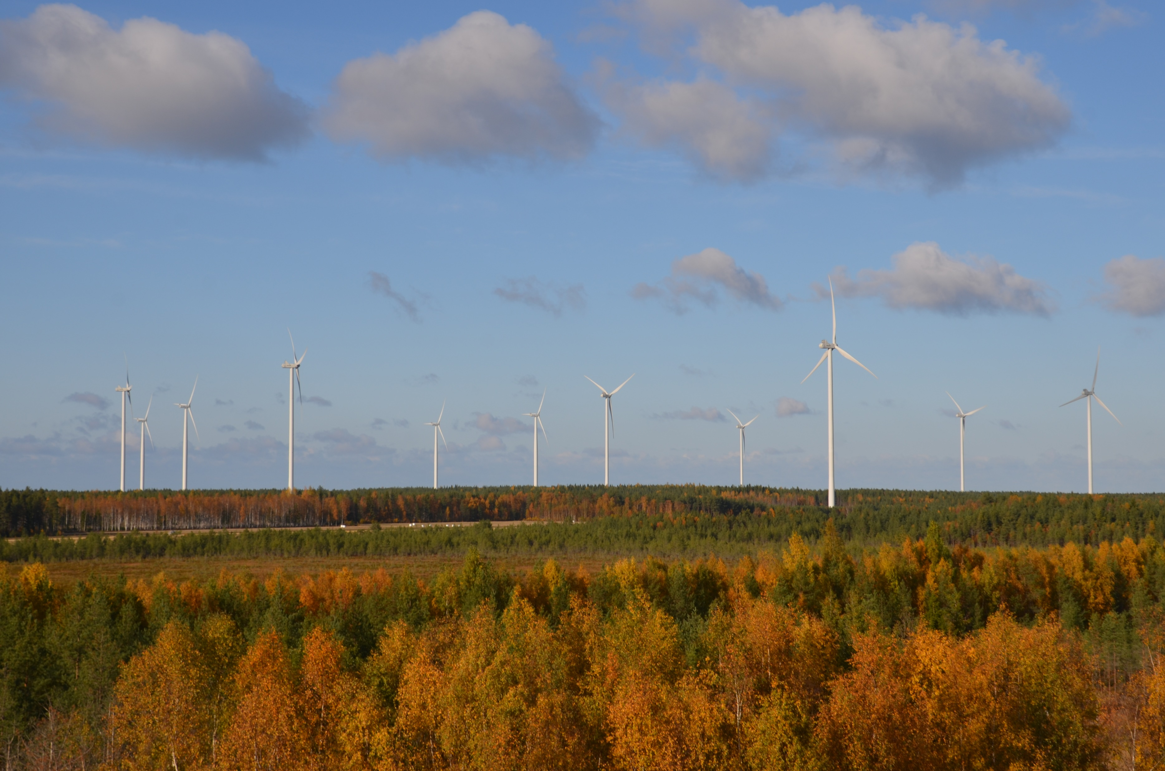
All project activities are assessed in the EIA
Gravel extraction
Enforcing bridges/crossings
Road network
Torni
Foundations
Turbine installations
Transportations
Wind farm in operation

Slide 20
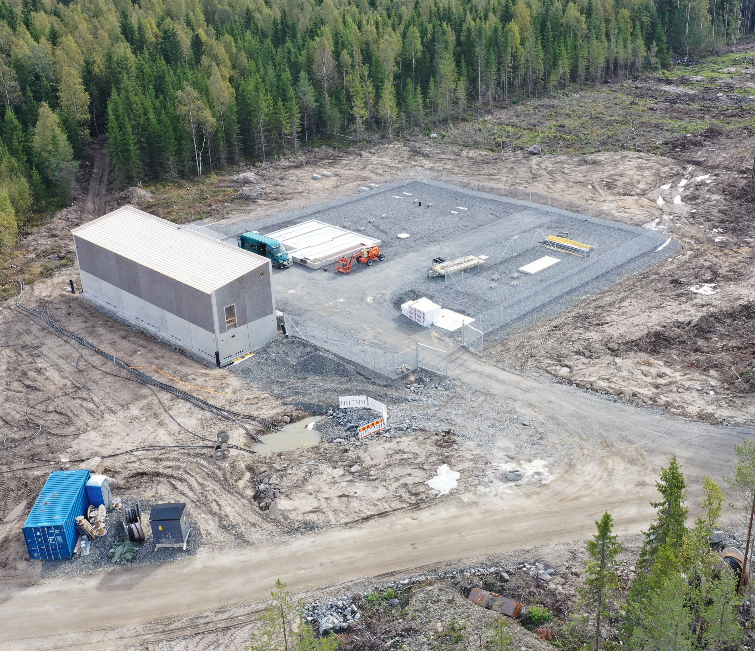
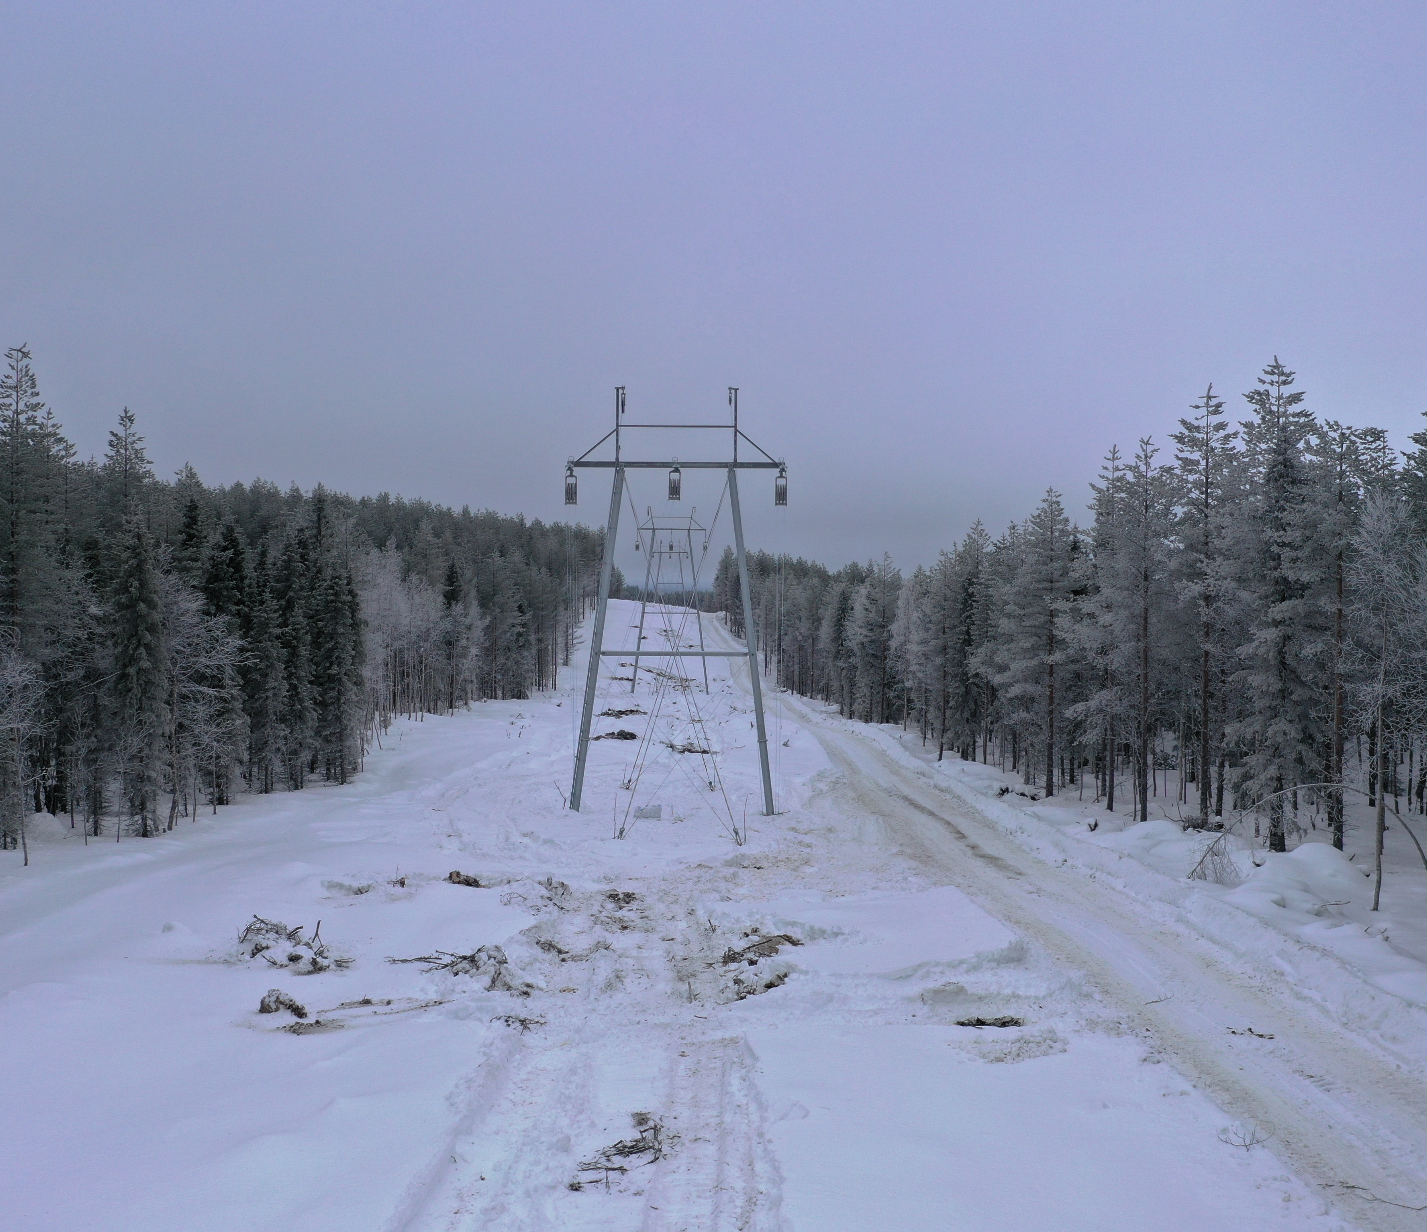
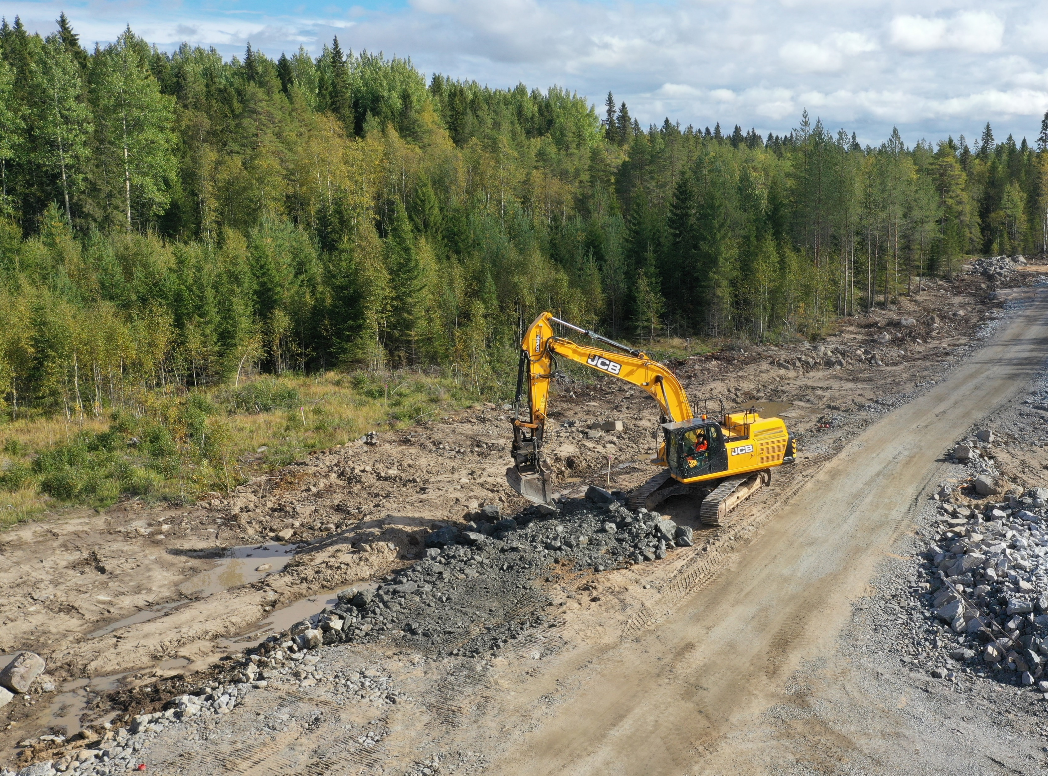
Also, the power transmission is assessed in the EIA
Substation
High voltage overhead lines
Cable trenches

Slide 21
Stages of wind farm development
Technical development of project continues throughout the process
Land use planning (municipality)
Greenfield & Start of project development
Permits:
Building permits (munic)
Environmental permit (munic)
Aviation statement/permit (Aviation auth)
Defence force
Construction
Environmental impact assessment (ELY centre)
Procedures required by law

Slide 22
Stages of wind farm development
Technical development of project continues throughout the process
Land use planning (municipality)
Greenfield & Start of project development
Permits:
Building permits (munic)
Environmental permit (munic)
Aviation statement/permit (Aviation auth)
Defence force
Construction
Environmental impact assessment (ELY centre)
Procedures required by law

Slide 23
Land use planning in wind farm development

Slide 24
The Land use planning system
National land use guidelines – State council
Regional plan – regional council
Master plan - municipality
Detailed plan - municipality
Building ordinance – municipality
Decision concerning the need for planning - municipality
Increase in details
Increase in details
Building permit - municipality

Slide 25
National land use guideline (VAT)
Provides objectives for land use plannings and related authorities
Facilitates land use planning in accordance with Land use and building legislation
Emphasizes participatory (eg. with public, NGOs, authorities) planning
The guidelines must be taken into account in all land use planning
Examples of points in guidelines that concerns wind farms:
”Renewable/Low CO2 energy projects are of priority.
”Wind farm planning must consider availability of decent infra structure and adjacent communities”
”Planning must be done by ensuring the endurance of a good status of nature and living environment”

Slide 26
Regional land use plan
A general plan for the use of areas in a region or a part of it.
It contains the principles of land use planning and community structures
The regional plan points out areas for the development of the projects that are of priority with respect to the land use objectivs
The regional plan solves land use topics on national, provincial and regional levels.
The regional plan can also be drawn up in stages, for a specific topic or certain sub-areas.
With regards to wind farming: A regional plan points out areas suitable (“tv-areas”) for wind energy production and larger project entities (<9 turbines) are difficult/impossible to realize without such definition

Slide 27
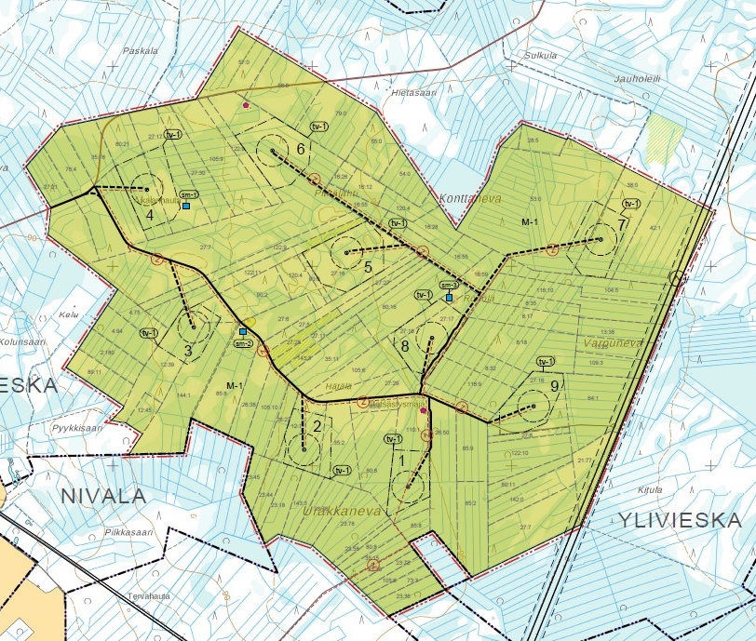
Master plan
Master plan is the municipality’s plan for future land use in an area, on a general level
It defines how various activities should be placed in the area, e.g. settlements, services and workplaces and recreation areas and how they should be coordinated.
Environmental impact assessment is always carried out as a part of the land use planning
A master plan is of very flexible character; It can be very strategic and general but on the other hand it can be drawn to be guide/direct construction on very detailed level.
The master planning for a wind farm is almost always carried out as a component master plan. This means the that the objectives of such CMP is to direct only the land use of the planned wind farm
Right to appeal on the CMP approval!

Slide 28
(Component) Master plan procedure
The master plan procedure consists of the following steps:
1. Submitting of a planning initiative to the municipality
2. Preparation of a Participation and Assessment Plan
3. PAP on public display 14-30 days
4. Drawing up a draft plan
5. Availability of the plan draft 14-30 days
6. Drafting a Master plan proposal
7. Plan proposal on public display for 14-30 days
8. Approval by municipal council
9. Right of appeal 30 days
10. Entry into force

Slide 29
Example of Component master plan: Tohkoja II
Only Masterplan border and wind turbine areas (tv) are legally binding
All other activities, such as roads, cables, overhead lines indicative
The total amount and height of wind turbines must not exceed the defined limit
Impact limitations, e.g. noise etc.
Other case dependent requirements.
Indicative wind turbine location
Road to be improved
”tv”-wind turbine area
Indicative cable
Indicative road
4

Slide 30
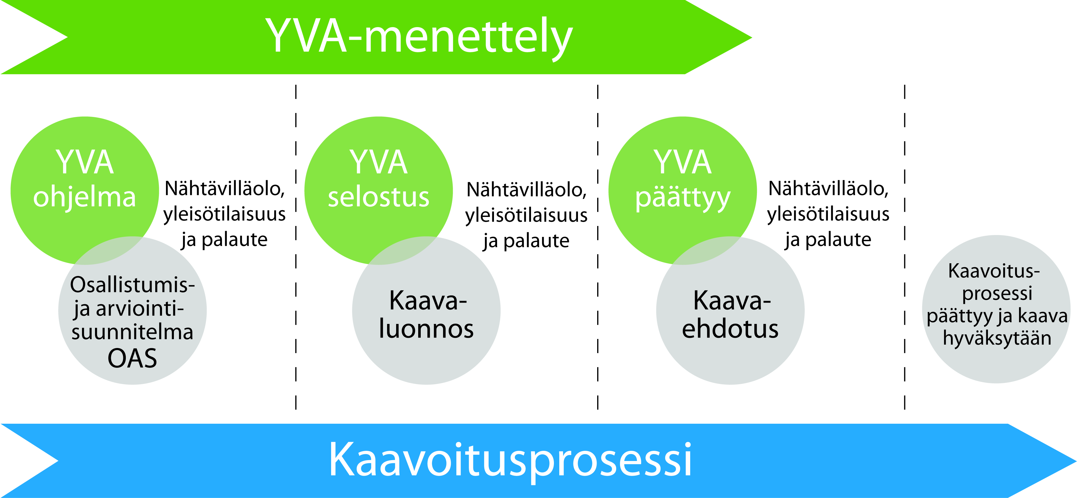
Parallell coordination of EIA and masterplan
EIA procedure
EIA progr-amme
EIA report
EIA ends
PAP
Plan draft
Plan propo-sal
End of land use procedure and approval
Land use procedure

Slide 31
Stages of wind farm development
Technical development of project continues throughout the process
Land use planning (municipality)
Greenfield & Start of project development
Permits:
Building permits (munic)
Environmental permit (munic)
Aviation statement/permit (Aviation auth)
Defence force
Construction
Environmental impact assessment (ELY centre)
Procedures required by law

Slide 32
Stages of wind farm development
Technical development of project continues throughout the process
Land use planning (municipality)
Greenfield & Start of project development
Permits:
Building permits (munic)
Environmental permit (munic)
Aviation statement/permit (Aviation auth)
Defence force
Construction
Environmental impact assessment (ELY centre)
Procedures required by law

Slide 33
Permits
Once EIA and CMP are finished and happily in force, the its time to apply for permits enabling the construction of the wind farm
Building permits
A BP for each turbine separately
Application submitted to building inspecor at municipality with necessary documents, primary:
Detailed drawing of turbine (asemapiirros)
Frontal drawing of turbine (julkisivu)
Soil study and foundations
Environmental survey
Master plan
Processing for documentation at municipality
Hearing of neighbours
Possible request and and respondings
Permit decision (either by building inspector or the municipal board)

Slide 34
Other permits
In case the wind farm may cause significant harm for environment, especially to neighbours, an Environmental permit must be applied from the Enviromental authority at the municipality
Other relevant permits for a wind farm is an approving statement from the Defence force; usually applied at the beginning of the project development and updated/checked prior to construction phase
Also an Aviation statement must be applied for prior to construction from Fintraffic
A project permit from the Energy authority and a redemption permit is need for the power transmission between the windfarm and the grid

Slide 35
Take aways
The main permitting procedures required for a wind farm are Environmental impact assessment, Component Maser plan procedure and building permits.
A small wind farm does not require and EIA, but Environmental impacts must however always be assessed.
The EIA is a two-phased (2 public displays) procedure where environmental impacts are assessed in close interaction with stakeholders, such as relevant authorities, NGOs and local citizens. The local ELY centre is the coordinating authority for EIA.
The Component Masterplan defines how various planned activities should placed in an area. The CMP procedure is three-phased and contains planning of land use in interaction with stakeholders. The municipality is in charge of the CMP procedure.
EIA and and CMP have shared objectives can be jointly coordinated
After the Masterplan has got legal force, building permits can be applied from the municipality. Each turbine requires and own BP.
A wind farm requires also other permits/approvals, such as statements from Aviation authority, Defence force, Environmental permits (not always) and the power transmission from the wind farm reuquires project and redemption permits.

Slide 36
THANK YOU AND PLEASE ASK QUESTION!

