Slide 1
TU-L0021 - Statistical Research Methods
Mikko Rönkkö

Slide 2

If TEKES funded companies grow more is it because
TEKES selects good companies (selection effect)
TEKES funding helps the selected companies (treatment effect)
How would you study how much TEKES grants help companies grow?
THINK 2-5 MINUTES IN GROUPS OF 3-5 PEOPLE

Slide 3
What makes factors influence article citations?
What is the model like in this paper (table 3)?

Slide 4
Define a model that gives the expected number of citations for an article
Each variable can appear in the model more than once and should be multiplied with a regression coefficient β_{x}
You can use the following operators
  Exp - exponential
  Ln -logarithm
  + - sum
  * - multiplication
  / - division
  ^ - power
You can use more than one models (e.g. zero inflation)

Slide 5
What is a statistical model and an estimator? What are the characteristics of good estimators? What kind of assumptions estimators can make and why it is important to test these?
Explain the concepts of estimate, standard error, test statistic, null-hypothesis significance testing, and p-value.
Explain statistical inference and causal inference.
Why are control variables used in management research and what are the characteristics of good control variables and good reporting of control variables?
Explain the concept of endogeneity and how it can be addressed in research.
Explain the workflow of regression analysis.
Explain the concept of nested model comparison and two commonly used nested model tests.
Explain what "linear model implies a correlation matrix" means. Explain what this means for model estimation and give two examples of models that can be estimated from a correlation matrix.
Explain the idea of generalized linear model and when and why the technique should be used.
Why plotting marginal effects of non-linear models is nearly always a good idea.
Explain two strategies for estimating a mediation model. What are the advantages and disadvantages of each?
Define experiment, survey research, field research, and archival/ secondary data research. Explain briefly the advantage of each design.
What is a quasi-experiment and why would you want to do one?

Slide 6
What is endogeneity?
What does it mean that R is exogenous?
treatment: e.g. patients receive medicine, new incentive packed given to employees, new teaching methods applied, are forced to use a new information system etc.
R
X
O
TREATMENT GROUP
this group receives treatment
Characteristic Y of this group measured
is there difference?
Y_{T} - Y_{C} = ?
if yes, that must be caused by treatment
POPU LATION OF INTEREST
assigned randomly to
CONTROL GROUP
Characteristic Y of this group measured
When would R be endogenous?
on average, these groups are approximately similar as long as
The assignment is random
We have large enough n
Distribution of the underlying characteristic in the population is ”well behaving”
What justifies interpreting this difference as causal effect?
& repeated several times
What if:
People vary in how sick they are
The treatment is an experimental medicine with potential side effects
People get to choose between treatment and control
(usually) we want to show that the effect is not caused by SELECTION EFFECTS but is caused by TREATMENT EFFECT

Slide 7
Endogeneity
What the error term u represents?
Endogenous
explanatory variable
Endogeneity
y = β₀ + β₁x₁ + β₂x₂ + … + β_{k}x_{k} + u
Example
  Patient satisfaction = β₀ +
  β₁ physician productivity +
  β₂ physician quality +
  β₃ physician accesibility + u
x₁
β₁
u
x₂
β₂
y
β₀
…
β_{k}
x_{k}

Slide 8
Endogeneity: Three simple cases
E
u
X
Y
X
Y
X
Y
X and Y are correlated because they have a common cause
X is correlated with unmodeled causes of Y
X and Y has a reciprocal causal relationship (simultaneity)
Hamilton, B. H., & Nickerson, J. A. (2003). Correcting for endogeneity in strategic management research. Strategic Organization, 1, 51–78.
http://strategicmanagement.net/pdfs/SMJ_Guidelines_Regarding_Endogeneity.pdf
Ketokivi, M., & Guide, D. (2015). Notes from the editors: Redefining some methodological criteria for the journal. Journal of Operations Management, 37, v–viii. http://doi.org/10.1016/S0272-6963(15)00056-X (p. v)
Antonakis, J. (2017). On doing better science: From thrill of discovery to policy implications. The Leadership Quarterly, 28(1), 5–21. https://doi.org/10.1016/j.leaqua.2017.01.006

Slide 9
Guide, D., & Ketokivi, M. (2015). Notes from the editors: Redefining some methodological criteria for the journal. Journal of Operations Management, 37, v–viii. http://doi.org/10.1016/S0272-6963(15)00056-X (p. v)
Ketokivi, M., & McIntosh, C. N. (2017). Addressing the endogeneity dilemma in operations management research: Theoretical, empirical, and pragmatic considerations. Journal of Operations Management, 52, 1–14. https://doi.org/10.1016/j.jom.2017.05.001

Slide 10
Do we have an endogeneity problem?
Firms
strategy
u
Investment in new factories
ROA
What does ”Investment in new factories” depend on?

Slide 11
Instrumental variable solution to endogeneity

Slide 12
Instrumental variable model
u
X
Y
β
Z
Cor(X,Y) = β + Cor(X,u)
Cor(Z,Y) = β * Cor(X,Z)
β = Cor(Z,Y) / Cor(X,Z)
Criteria for valid instrumental variable:
Cor(X,Z) ≠ 0 Relevance criterion
Cor(Z,u) = 0 Exclusion criterion

Slide 13
Criteria for valid instrumental variable:
Cor(X,Z) ≠ 0 Relevance criterion
Cor(Z,u) = 0 Exclusion criterion
If TEKES funded companies grow more is it because
TEKES selects good companies (selection effect)
TEKES funding helps the selected companies (treatment effect)
How would you study how much TEKES grants help companies grow using instrumental variable(s)?
THINK 2-5 MINUTES IN GROUPS OF 3-5 PEOPLE

Slide 14
If TEKES funded companies grow more is it because
TEKES selects good companies (selection effect)
TEKES funding helps the selected companies (treatment effect)
IV approach
  Find variables that correlate with selection but not growth
  E.g. number of applications TEKES receives, the characteristics of the persons processing the applications, month of application
u
X
Y
β
Z

Slide 15
Two-stage least squares
u_{z}
u_{y}
X
Y
β_{y}
β_{z}
Y = β_{y} X + u_{y}
Y = β_{y} (β_{z}Z + u_{z}) + u_{y}
Y = β_{y} (β_{z}Z) + u_{y} + β_{y} u_{z}
Z
Stage 1: Regress X on Z
Stage 2: Regress Y on fitted X
Fitted value

Slide 16
Endogeneity dilemma
Approach | Advantage | Endogeneity Dilemma
Regression or ANOVA model (experimental) | Experimentally manipulated regressors are plausibly exogenous | Many variables of theoretical and practical interest may be impossible to make exogenous by experimental manipulation (e.g., experience)
Cross-sectional regression model (observational) | Provides trustworthy inference when regressors are plausibly exogenous | Requires the assumption that regressors do not correlate with the disturbance term
Cross-sectional IV regression model (observational) | Introduces additional variables called instruments to take into account the fact that regressors may correlate with the disturbance term | Requires the assumption that instruments do not correlate with the disturbance term
Cross-sectional multiple-IV regression model (observational) | Enables a test of whether instruments correlate with the disturbance term | Requires multiple instruments per troublesome regressor and the assumption that at least one instrument per troublesome regressor is valid
Panel regression model, fixed effects (observational) | Mitigates unobserved heterogeneity, alleviating endogeneity arising from omitted variables | Requires the assumption that all regressors and fixed effects are uncorrelated with the disturbance term, and disallows the inclusion of time-invariant regressors of theoretical interest
Panel regression model, random effects (observational) | Mitigates unobserved heterogeneity, alleviating endogeneity due to omitted variables; allows inclusion of time-invariant regressors | Requires the assumption that all regressors are uncorrelated with the random effect, and that all regressors and random effects are uncorrelated with the disturbance term
Latent change model (experimental or observational) | Focuses on individual-level change over time, which is consistent with most theories of development and change | Requires the assumption that all regressors and the latent change components are uncorrelated with the disturbance term
Ketokivi, M., & McIntosh, C. N. (2017). Addressing the endogeneity dilemma in operations management research: Theoretical, empirical, and pragmatic considerations. Journal of Operations Management, 52, 1–14. https://doi.org/10.1016/j.jom.2017.05.001 Table 1

Slide 17
Learning diary questions for previous lecture
What is a statistical model and an estimator? What are the characteristics of good estimators? What kind of assumptions estimators can make and why it is important to test these?
Explain the concept of endogeneity and how it can be addressed in research.
Explain what "linear model implies a correlation matrix" means. Explain what this means for model estimation and give two examples of models that can be estimated from a correlation matrix.
Why plotting marginal effects of non-linear models is nearly always a good idea.
Explain to strategies for estimating a mediation model. What are the advantages and disadvantages of each?

Slide 18
Learning diary questions
What is a statistical model and an estimator? What are the characteristics of good estimators? What kind of assumptions estimators can make and why it is important to test these?
Explain the concept of nested model comparison and two commonly used nested model tests.
Explain the idea of generalized linear model how the maximum likelihood principle can be used to estimate the model.
Why plotting marginal effects of non-linear models is nearly always a good idea.

Slide 19
Overview of OLS assumptions

Slide 20
Graphical illustration of linear regression
One dependent and one or more independent variables
Explains conditional mean of the dependent variable
The dependent variable should be normally distributed around the mean
The variance (width) of the dependent variable should not depend on the independent variables
Wooldridge, J. M. (2009). Introductory econometrics: a modern approach (4th ed.). Mason, OH: South Western, Cengage Learning.

Slide 21
Consistency and unbiasedness 1/2

Slide 22
Consistency and unbiasedness 2/2
No endogeity assumption
Wooldridge, J. M. (2009). Introductory econometrics: a modern approach (4th ed.). Mason, OH: South Western, Cengage Learning. Chapter 3

Slide 23
Consistency of standard errors
Both estimate and SE should be
consistent and unbiased
Assumptions 1-5 are known as Gauss-Markov assumptions.
OLS is also efficient under these assumptions
Wooldridge, J. M. (2009). Introductory econometrics: a modern approach (4th ed.). Mason, OH: South Western, Cengage Learning. Chapter 3

Slide 24
Normality of estimates
MLR.6 implies MLR.4 and MLR.5
Assumptions 1-6 are called classical linear model assumptions
In practice MLR.6 can be often ignored because OLS estimates are asymptotically normal under MLR.1-MLR.5
Wooldridge, J. M. (2009). Introductory econometrics: a modern approach (4th ed.). Mason, OH: South Western, Cengage Learning. Chapter 3

Slide 25
Summary of the assumptions
Assumption | Notes
All relationships are linear | Always check after estimation
Independence of observations | Feature of research design, can be checked after estimation.
No perfect collinearity and non-zero variances of independent variables | Prevents regression estimation
Error term has expected value of zero given any values of independent variables | No endogeneity assumption, can be checked with instrumental variables
Error term has equal variance given any values of independent variables | Always check after estimation, influences standard errors
Error term is normally distributed | Can be ingnored because of asymptotic normality

Slide 26
Non-linear effects with log transformation

Slide 27
The base of the logarithm
does not make a difference
Absolute units
Relative units
Broschak, J. P., & Block, E. S. (2014). With or Without You: When Does Managerial Exit Matter for the Dissolution of Dyadic Market Ties? Academy of Management Journal, 57(3), 743–765. https://doi.org/10.5465/amj.2011.0169 p. 753
Notes:
data <- read.csv("ROAs in 2005.csv")
head(data)
options(scipen=999)
# Take the Revenue for 2005 from the data
Revenue <- as.numeric(as.character(data[,3]))
# Select the first 500 nonmissing values
# (the data are sorted in descending order by revenue)
Revenue <- Revenue[! is.na(Revenue)]
Revenue <- Revenue[1:500]
plot(density(Revenue/1000000), main = "Revenues of the largest 500 Finnish companies in 2005, millions", ylab = "", yaxt='n')
plot(density(log10(Revenue)), main = "Revenues of the largest 500 Finnish companies in 2005, logarithm", ylab = "", yaxt='n', xaxt = 'n')
at <- 7:10
axis(1, at = at, labels = paste(at,"\n(",10^at/1000000, "M)",sep=""), padj = 0.3)

Slide 28
Regression with log transformation
Notes:
library(carData)
library(effects)
library(texreg)
m1 <- lm(income ~ prestige, data=Prestige)
m2 <- lm(log(income) ~ prestige, data=Prestige)
screenreg(list(m1))
screenreg(list(m1,m2))
plot(Prestige$prestige, Prestige$income)
abline(m1, col = "red")
plot(Prestige$prestige, Prestige$income)
abline(m1, col = "red")
eff <- effect("prestige",m, xlevels = 100, transformation = list(link = log, inverse = exp))
lines(eff$x[,"prestige"], exp(eff$fit), col = "blue")

Slide 29
Regression with log transformation
Notes:
library(carData)
library(effects)
library(texreg)
m1 <- lm(income ~ prestige, data=Prestige)
m2 <- lm(log(income) ~ prestige, data=Prestige)
screenreg(list(m1))
screenreg(list(m1,m2))
plot(Prestige$prestige, Prestige$income)
abline(m1, col = "red")
plot(Prestige$prestige, Prestige$income)
abline(m1, col = "red")
eff <- effect("prestige",m, xlevels = 100, transformation = list(link = log, inverse = exp))
lines(eff$x[,"prestige"], exp(eff$fit), col = "blue")

Slide 30
Regression with log transformation
Notes:
library(carData)
library(effects)
library(texreg)
m1 <- lm(income ~ prestige, data=Prestige)
m2 <- lm(log(income) ~ prestige, data=Prestige)
screenreg(list(m1))
screenreg(list(m1,m2))
plot(Prestige$prestige, Prestige$income)
abline(m1, col = "red")
plot(Prestige$prestige, Prestige$income)
abline(m1, col = "red")
eff <- effect("prestige",m, xlevels = 100, transformation = list(link = log, inverse = exp))
lines(eff$x[,"prestige"], exp(eff$fit), col = "blue")

Slide 31
Regression with log transformation
=====================================
Income log(Income)
-------------------------------------
(Intercept) -1465.03 7.47 ***
(860.47) (0.12)
prestige 176.43 *** 0.03 ***
(17.26) (0.00)
-------------------------------------
R^2 0.51 0.55
Adj. R^2 0.51 0.54
Num. obs. 102 102
RMSE 2983.64 0.40
=====================================
*** p < 0.001, ** p < 0.01, * p < 0.05

Slide 32
Interpretation of log transformation
Call:
lm(formula = log(income) ~ prestige, data = Prestige)
Coefficients:
Estimate Std. Error t value Pr(>|t|)
(Intercept) 7.467395 0.115100 64.88 <2e-16 ***
prestige 0.025476 0.002308 11.04 <2e-16 ***
Prestige | Income | Exp(Income)
20 | 7.98 | 2913
30 | 8.23 | 3758
40 | 8.49 | 4848
50 | 8.74 | 6255
60 | 9.00 | 8070
70 | 9.25 | 10412
80 | 9.51 | 13433

Slide 33
Call:
lm(formula = log(income) ~ prestige, data = Prestige)
Coefficients:
Estimate Std. Error t value Pr(>|t|)
(Intercept) 7.467395 0.115100 64.88 <2e-16 ***
prestige 0.025476 0.002308 11.04 <2e-16 ***
  log(income)= β₀ + β₁prestige + β₃ women + u
  β₁ ~ “how much income will increase relative to current level when prestige increases by one unit”
Wooldridge, J. M. (2009). Introductory econometrics: a modern approach (4th ed.). Mason, OH: South Western, Cengage Learning. p. 44

Slide 34
Logistic regression

Slide 35
What if we have a binary dependent variable?
Probability exceeds 1
Regression line:
Expected value of Menarche given Age
i.e. probability
What problems do we have?
Negative probability
Proportions of female children from Warsaw in 2965 at various ages during adolescence who have reached menarche, converted to 3918 observations
http://stat.ethz.ch/R-manual/R-patched/library/MASS/html/menarche.html

Slide 36
Rolling average
Girls 1-500
Girls 2-501
Girls 3-502
Girls 2001-2500
3918 girls
Notes:
library(MASS)
library(ggplot2)
data <- do.call(rbind,apply(menarche,1,function(x){data.frame(Age = x["Age"] + runif(x["Total"], min = -.3, max = .3), Menarche = as.numeric(1:x["Total"] <= x["Menarche"]))}))
ma <- function(x,n=500){filter(x,rep(1/n,n), sides=2)}
data <- data[order(data$Age),]
qplot(Age, Menarche, data = data) +
geom_line(aes(y= ma(data$Menarche, n = 500)))

Slide 37
A better approach
Fit a curve instead of a line
The example is the logit function
Interpretation stays the same:
Expected value of Menarche given Age
i.e. probability
Notes:
library(MASS)
library(ggplot2)
data <- do.call(rbind,apply(menarche,1,function(x){data.frame(Age = x["Age"] + runif(x["Total"], min = -.3, max = .3), Menarche = as.numeric(1:x["Total"] <= x["Menarche"]))}))
qplot(Age, Menarche, data = data) +
geom_smooth(method = "lm", se = FALSE) +
geom_smooth(method="glm", family="binomial", se=F, color ="red")

Slide 38
Model
Linear regression model
y = β₀ + β₁x₁ + β₂x₂ + … + β_{k}x_{k} + u
Nonlinear regression model
y = f(β₀ + β₁x₁ + β₂x₂ + … + β_{k}x_{k}) +u
f(x) = 1/(1+e^{-x})
Remarks
The inverse of f(x), g(x) is called link function
g(x) = ln(g/1-x) is the logit function
g(x) = x reduces to linear regression model

Slide 39
OLS estimation of non-linear model
OLS estimation
Choose the parameter values to minimize the sum of squared residuals
Problems with residuals
Non-normality (MLR.6)
Heteroskedasticity (MLR.5)
Independent mean (MLR.4)
We need a different estimation approach!
Notes:
library(MASS)
library(ggplot2)
library(stats4)
data <- do.call(rbind,apply(menarche,1,function(x){data.frame(Age = x["Age"] + runif(x["Total"], min = -.3, max = .3), Menarche = as.numeric(1:x["Total"] <= x["Menarche"]))}))
qplot(Age, Menarche, data = data) +
geom_smooth(method = "lm", se = FALSE)
qplot(Age, Menarche, data = data) +
geom_smooth(method = "lm", se = FALSE) +
geom_smooth(method="glm", family="binomial", se=F, color ="red")
# Estimate with ML
ll <- function(b0 = -13, b = 1, u = 1) {
if(u<=0) return(NA)
print(paste(b0,b,u))
cmeans <- 1/(1+exp(-(b0 + b * data$Age)))
-sum(
log(dnorm(data$Menarche, cmeans, u))
)
}
mle1 <- mle(ll)
# Plot the residuals
data$Fitted <- 1/(1+exp(-(coef(mle1)["b0"] + coef(mle1)["b"] * data$Age)))
data$Residuals <- data$Menarche - data$Fitted
ggplot(data, aes(x=Residuals)) +
stat_function(fun = dnorm, colour = "red", args = list(mean = 0, sd = coef(mle1)["u"])) +
geom_line(stat="density")
ggplot(data, aes(y=Residuals, x=Fitted)) +
geom_point()

Slide 40
Maximum likelihood estimation

Slide 41
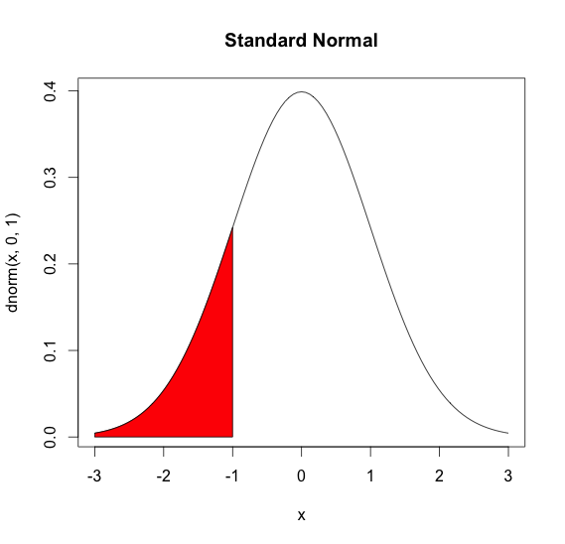
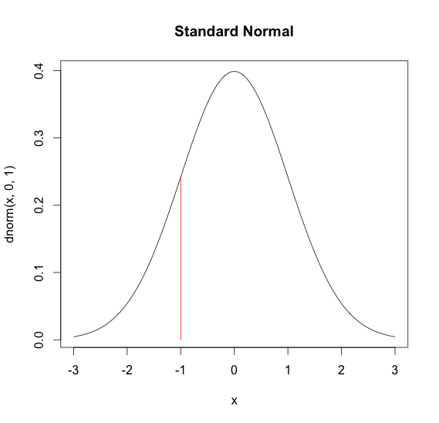
Cumulative probability and probability density
Cumulative probability
Probability density
Notes:
cord.x <- c(-3,seq(-3,-1,0.01),-1)
cord.y <- c(0,dnorm(seq(-3,-1,0.01)),0)
curve(dnorm(x,0,1),xlim=c(-3,3),main='Standard Normal')
polygon(cord.x,cord.y,col='red')
curve(dnorm(x,0,1),xlim=c(-3,3),main='Standard Normal')
lines(c(-1,-1),c(0,max(cord.y)), col = 'red')

Slide 42
Probability of independent events
Die 1: 1-6
⚀⚀ | ⚁⚀ | ⚂⚀ | ⚃⚀ | ⚄⚀ | ⚅⚀
⚀⚁ | ⚁⚁ | ⚂⚁ | ⚃⚁ | ⚄⚁ | ⚅⚁
⚀⚂ | ⚁⚂ | ⚂⚂ | ⚃⚂ | ⚄⚂ | ⚅⚂
⚀⚃ | ⚁⚃ | ⚂⚃ | ⚃⚃ | ⚄⚃ | ⚅⚃
⚀⚄ | ⚁⚄ | ⚂⚄ | ⚃⚄ | ⚄⚄ | ⚅⚄
⚀⚅ | ⚁⚅ | ⚂⚅ | ⚃⚅ | ⚄⚅ | ⚅⚅
Die 2: 1-6
p(Die 1 = x & Die 2 = y) = p(Die 1 = x) p(Die 2 = y)

Slide 43
Probability density of multiple observation from normal distribution
Value | Probability density | Cumulative probability density
2 | 0.053991 | 0.053990967
3 | 0.004432 | 0.000239280
4 | 0.000134 | 0.000000032

Slide 44
Likelihood of multiple observation from normal distribution
Value | Likelihood | Cumulative likelihood | Log likelihood | Cumulative log likelihood
2 | 0.053991 | 0.053990967 | -2.92 | -2.92
3 | 0.004432 | 0.000239280 | -5.42 | -8.34
4 | 0.000134 | 0.000000032 | -8.92 | -17.26

Slide 45
Likelihood of multiple observation from normal distribution
Value | Likelihood | Cumulative likelihood | Log likelihood | Cumulative log likelihood
2 | 0.24197 | 0.2419707 | -1.42 | -1.42
3 | 0.05399 | 0.0130642 | -2.92 | -4.34
4 | 0.00443 | 0.0000579 | -5.42 | -9.76

Slide 46
Likelihood of multiple observation from normal distribution
Value | Likelihood | Cumulative likelihood | Log likelihood | Cumulative log likelihood
2 | 0.399 | 0.3989400 | -0.919 | -0.919
3 | 0.242 | 0.0965300 | -1.419 | -2.338
4 | 0.054 | 0.0052100 | -2.919 | -5.257

Slide 47
Likelihood of multiple observation from normal distribution
Value | Likelihood | Cumulative likelihood | Log likelihood | Cumulative log likelihood
2 | 0.242 | 0.2420000 | -1.419 | -1.42
3 | 0.399 | 0.0965000 | -0.919 | -2.34
4 | 0.242 | 0.0234000 | -1.419 | -3.76

Slide 48
Likelihood function
Value | Likelihood | Cumulative likelihood | Log likelihood | Cumulative log likelihood
2 | 0.242 | 0.2420000 | -1.419 | -1.42
3 | 0.399 | 0.0965000 | -0.919 | -2.34
4 | 0.242 | 0.0234000 | -1.419 | -3.76

Slide 49
Maximum likelihood estimation of logistic regression model

Slide 50
Logistic regression model
Fit a curve instead of a line
The example is the logit function
Interpretation stays the same:
Expected value of Menarche given Age
i.e. probability
Proportions of female children from Warsaw in 2965 at various ages during adolescence who have reached menarche, converted to 3918 observations
http://stat.ethz.ch/R-manual/R-patched/library/MASS/html/menarche.html
Notes:
library(MASS)
library(ggplot2)
data <- do.call(rbind,apply(menarche,1,function(x){data.frame(Age = x["Age"] + runif(x["Total"], min = -.3, max = .3), Menarche = as.numeric(1:x["Total"] <= x["Menarche"]))}))
qplot(Age, Menarche, data = data) +
geom_smooth(method = "lm", se = FALSE) +
geom_smooth(method="glm", family="binomial", se=F, color ="red")

Slide 51
Basic principle
Sample of 9 observations
Population has Bernoulli distribution
Only 0 and 1
0’s are twice as prevalent as 1’s
The population is very large
Probabilities of getting:
0: 66.7%
1: 33.3%
Observed value | Probability | Cumulative Probability
0 | 0.667 | 0.667
0 | 0.667 | 0.444
0 | 0.667 | 0.296
0 | 0.667 | 0.198
0 | 0.667 | 0.132
0 | 0.667 | 0.088
0 | 0.667 | 0.059
1 | 0.333 | 0.02
1 | 0.333 | 0.007
Probability
of the sample
Notes:
obs <- sample(c(0,0,1), 9, replace = TRUE)
p <- abs(2/3 - obs)
cbind(obs,p,cumprod(p))
round(cbind(obs,p,cumprod(p)), digits = 3)

Slide 52
Basic principle
Sample of 9 observations
Population has bernoulli distribution
Only 0 and 1
Relative frequencies of 0 and 1 unknown
The population is very large
The estimation principle:
Find the relative frequency that will maximize the likelihood of the sample
Observed value | Likelihood | Cumulative Likelihood
0 | ? | ?
0 | ? | ?
0 | ? | ?
0 | ? | ?
0 | ? | ?
0 | ? | ?
0 | ? | ?
1 | ? | ?
1 | ? | ?
Likelihood of the sample
Maximum likelihood
estimate
Notes:
obs <- c(rep,
p <- abs(2/3 - obs)
cbind(obs,p,cumprod(p))
round(cbind(obs,p,cumprod(p)), digits = 3)

Slide 53
Basic principle
Sample of 9 observations
Population has bernoulli distribution
Only 0 and 1
Relative frequencies of 0 and 1 estimated to be 7 to 2
The population is very large
The estimation principle:
Find the relative frequency that will maximize the likelihood of the sample
Observed value | Probability | Cumulative probability
0 | 0.778 | 0.778
0 | 0.778 | 0.605
0 | 0.778 | 0.471
0 | 0.778 | 0.366
0 | 0.778 | 0.285
0 | 0.778 | 0.221
0 | 0.778 | 0.172
1 | 0.222 | 0.038
1 | 0.222 | 0.009
Likelihood of the sample
Notes:
p <- abs(2/9 - obs)
cbind(obs,p,cumprod(p))
round(cbind(obs,p,cumprod(p)), digits = 3)

Slide 54
Maximum likelihood (ML) estimation of nonlinear regression model
ML estimation
Choose the parameter values to maximize the likelihood of the sample given the model
Regression line:
Expected value of Menarche given Age
i.e. probability

Slide 55
Example
Estimated function:
Menarche = f(-20.0 + 1.54 Age) + u
 | Age | Menarche | Linear prediction | Fitted | l
Girl 1 | 13.6 | 1 | 0.94 | 73.6% | 73.6%
Girl 2 | 11.4 | 0 | -2.44 | 8.0% | 92.0%
Girl 3 | 12.6 | 1 | -0.60 | 35.2% | 35.2%
Girl 4 | 13.1 | 1 | 0.17 | 56.2% | 56.2%
Girl 5 | 12.6 | 0 | -0.60 | 34.6% | 65.4%
Girl 6 | 10.3 | 0 | -4.14 | 1.5% | 98.5%
Girl 7 | 10.2 | 0 | -4.29 | 1.3% | 98.7%
Girl 8 | 15.4 | 1 | 3.72 | 97.8% | 97.8%
Girl 9 | 15.2 | 1 | 3.41 | 96.9% | 96.9%
Girl 10 | 13.8 | 1 | 1.25 | 79.2% | 79.2%
Likelihood | (product) |  |  |  | 6.4%

Slide 56
Example
Estimated function:
Menarche = f(-20.0 + 1.54 Age) + u
 | Age | Menarche | Linear prediction | Fitted | l | ln(l)
Girl 1 | 13.6 | 1 | 0.94 | 73.6% | 73.6% | -0.306
Girl 2 | 11.4 | 0 | -2.44 | 8.0% | 92.0% | -0.083
Girl 3 | 12.6 | 1 | -0.60 | 35.2% | 35.2% | -1.045
Girl 4 | 13.1 | 1 | 0.17 | 56.2% | 56.2% | -0.576
Girl 5 | 12.6 | 0 | -0.60 | 34.6% | 65.4% | -0.425
Girl 6 | 10.3 | 0 | -4.14 | 1.5% | 98.5% | -0.015
Girl 7 | 10.2 | 0 | -4.29 | 1.3% | 98.7% | -0.013
Girl 8 | 15.4 | 1 | 3.72 | 97.8% | 97.8% | -0.022
Girl 9 | 15.2 | 1 | 3.41 | 96.9% | 96.9% | -0.031
Girl 10 | 13.8 | 1 | 1.25 | 79.2% | 79.2% | -0.233
Likelihood | (product) |  |  |  | 6.4%
Log-likelihood | (sum) |  |  |  |  | -2.749

Slide 57
Interpretation of logistic regression results

Slide 58
lreg1 <- glm(Menarche ~ Age, data = data, family = "binomial")
summary(lreg1)
Call:
glm(formula = Menarche ~ Age, family = "binomial", data = data)
Deviance Residuals:
Min 1Q Median 3Q Max
-3.0863 -0.1988 0.0324 0.2216 2.8285
Coefficients:
Estimate Std. Error z value Pr(>|z|)
(Intercept) -21.07621 0.76637 -27.50 <2e-16 ***
Age 1.62044 0.05863 27.64 <2e-16 ***
---
Signif. codes: 0 ‘***’ 0.001 ‘**’ 0.01 ‘*’ 0.05 ‘.’ 0.1 ‘ ’ 1
(Dispersion parameter for binomial family taken to be 1)
Null deviance: 5306.5 on 3917 degrees of freedom
Residual deviance: 1664.2 on 3916 degrees of freedom
AIC: 1668.2
Number of Fisher Scoring iterations: 7
The ML estimates are normally distributed in large samples. If this is the case, the z statistic follows the z distribution (i.e normal distrribution) under H₀
H₀: parameter is 0 in population
Instead of raw estimates, we interpret odds ratios
z statistic is
Est / S.E
Notes:
library(MASS)
data <- do.call(rbind,apply(menarche,1,function(x){data.frame(Age = x["Age"] + runif(x["Total"], min = -.3, max = .3), Menarche = as.numeric(1:x["Total"] <= x["Menarche"]))}))
lreg1 <- glm(Menarche ~ Age, data = data, family = "binomial")
summary(lreg1)
Call:
glm(formula = Menarche ~ Age, family = "binomial", data = data)
Deviance Residuals:
Min 1Q Median 3Q Max
-3.0863 -0.1988 0.0324 0.2216 2.8285
Coefficients:
Estimate Std. Error z value Pr(>|z|)
(Intercept) -21.07621 0.76637 -27.50 <2e-16 ***
Age 1.62044 0.05863 27.64 <2e-16 ***
---
Signif. codes: 0 ‘***’ 0.001 ‘**’ 0.01 ‘*’ 0.05 ‘.’ 0.1 ‘ ’ 1
(Dispersion parameter for binomial family taken to be 1)
Null deviance: 5306.5 on 3917 degrees of freedom
Residual deviance: 1664.2 on 3916 degrees of freedom
AIC: 1668.2
Number of Fisher Scoring iterations: 7
> exp(cbind(OR = coef(lreg1), confint(lreg1)))
Waiting for profiling to be done...
OR 2.5 % 97.5 %
(Intercept) 7.026143e-10 1.489302e-10 3.008804e-09
Age 5.055322e+00 4.523059e+00 5.692381e+00

Slide 59
Interpretation of logistic model
Odds are the ratio of the outcomes
If 1 in 100 girls have had menarche, the odds for having had a menarche are 1:99
If the probability of an outcome is p, the odds for that versus alternative outcome is p:(1-p)
The exponential of logistic regression coefficients are odds ratios
One unit increase in x causes the odds to change proportionally to b.
Cohen, J., Cohen, P., West, S. G., & Aiken, L. S. (2003). Applied Multiple Regression/Correlation Analysis for the Behavioral Sciences (3rd edition). London: Lawrence Erlbaum Associates., Chapter 13
Hosmer, D. W., Lemeshow, S., & Sturdivant, R. X. (2013). Applied logistic regression (3rd ed.). Hoboken, N.J: Wiley., p 51

Slide 60
Example odds for the data
Menarche = g(-20.0 + 1.54 Age) + u
 | Age | Menarche | Linear prediction | Fitted p | Fitted odds | Value of odds
Girl 1 | 13.6 | 1 | 0.94 | 73.60 % | 74% : 26% | 2.79
Girl 2 | 11.4 | 0 | -2.44 | 8.00 % | 8% : 92% | 0.09
Girl 3 | 12.6 | 1 | -0.60 | 35.20 % | 35% : 65% | 0.54
Girl 4 | 13.1 | 1 | 0.17 | 56.20 % | 56% : 44% | 1.28
Girl 5 | 12.6 | 0 | -0.60 | 34.60 % | 35% : 65% | 0.53
Girl 6 | 10.3 | 0 | -4.14 | 1.50 % | 2% : 98% | 0.02
Girl 7 | 10.2 | 0 | -4.29 | 1.30 % | 1% : 99% | 0.01
Girl 8 | 15.4 | 1 | 3.72 | 97.80 % | 98% : 2% | 44.45
Girl 9 | 15.2 | 1 | 3.41 | 96.90 % | 97% : 3% | 31.26
Girl 10 | 13.8 | 1 | 1.25 | 79.20 % | 79% : 21% | 3.81

Slide 61
Marginal predictions
b₁
Menarche = g(-20.0 + 1.54 Age) + u
Age | Linear prediction | Fitted p | Fitted odds | Value of odds | Odds_{age}/Odds_{age-1}
9 |  | 0.22 % | 0% : 100% | 0.0
10 |  | 1.00 % | 1% : 99% | 0.0 | 4.66
11 |  | 4.48 % | 4% : 96% | 0.0 | 4.66
12 |  | 17.95 % | 18% : 82% | 0.2 | 4.66
13 |  | 50.50 % | 51% : 50% | 1.0 | 4.66
14 |  | 82.64 % | 83% : 17% | 4.8 | 4.66
15 |  | 95.69 % | 96% : 4% | 22.2 | 4.66
16 |  | 99.04 % | 99% : 1% | 103.5 | 4.66
17 |  | 99.79 % | 100% : 0% | 483.0 | 4.66
18 |  | 99.96 % | 100% : 0% | 2253.0 | 4.66
This constant rate of change is called odds ratio and it is given by e
b₁

Slide 62
lreg1 <- glm(Menarche ~ Age, data = data, family = "binomial")
summary(lreg1)
Call:
glm(formula = Menarche ~ Age, family = "binomial", data = data)
Deviance Residuals:
Min 1Q Median 3Q Max
-3.0863 -0.1988 0.0324 0.2216 2.8285
Coefficients:
Estimate Std. Error z value Pr(>|z|)
(Intercept) -21.07621 0.76637 -27.50 <2e-16 ***
Age 1.62044 0.05863 27.64 <2e-16 ***
---
Signif. codes: 0 ‘***’ 0.001 ‘**’ 0.01 ‘*’ 0.05 ‘.’ 0.1 ‘ ’ 1
(Dispersion parameter for binomial family taken to be 1)
Null deviance: 5306.5 on 3917 degrees of freedom
Residual deviance: 1664.2 on 3916 degrees of freedom
AIC: 1668.2
Number of Fisher Scoring iterations: 7
The ML estimates are normally distributed in large samples. If this is the case, the z statistic follows the z distribution (i.e normal distribution) under H₀
H₀: parameter is 0 in population
Instead of raw estimates, we interpret odds ratios
z statistic is
Est / S.E
round(exp(cbind(OR = coef(lreg1), confint(lreg1))), digits = 5)
OR 2.5 % 97.5 %
(Intercept) 0.00000 0.00000 0.00000
Age 5.05532 4.52306 5.69238
Odds =
“Each year of age increases the odds of having had the first period about five-fold”
Probability of having had menarche
Probability of not having had menarche
Notes:
library(MASS)
data <- do.call(rbind,apply(menarche,1,function(x){data.frame(Age = x["Age"] + runif(x["Total"], min = -.3, max = .3), Menarche = as.numeric(1:x["Total"] <= x["Menarche"]))}))
lreg1 <- glm(Menarche ~ Age, data = data, family = "binomial")
summary(lreg1)
Call:
glm(formula = Menarche ~ Age, family = "binomial", data = data)
Deviance Residuals:
Min 1Q Median 3Q Max
-3.0863 -0.1988 0.0324 0.2216 2.8285
Coefficients:
Estimate Std. Error z value Pr(>|z|)
(Intercept) -21.07621 0.76637 -27.50 <2e-16 ***
Age 1.62044 0.05863 27.64 <2e-16 ***
---
Signif. codes: 0 ‘***’ 0.001 ‘**’ 0.01 ‘*’ 0.05 ‘.’ 0.1 ‘ ’ 1
(Dispersion parameter for binomial family taken to be 1)
Null deviance: 5306.5 on 3917 degrees of freedom
Residual deviance: 1664.2 on 3916 degrees of freedom
AIC: 1668.2
Number of Fisher Scoring iterations: 7
> exp(cbind(OR = coef(lreg1), confint(lreg1)))
Waiting for profiling to be done...
OR 2.5 % 97.5 %
(Intercept) 7.026143e-10 1.489302e-10 3.008804e-09
Age 5.055322e+00 4.523059e+00 5.692381e+00

Slide 63
More on interpretation: Example data
Contains data from http://www.stata-press.com/data/r14/lbw.dta
obs: 189 Hosmer & Lemeshow data
vars: 11 15 Jan 2014 05:01
size: 2,646
-------------------------------------------------------------------------------------------------------
storage display value
variable name type format label variable label
-------------------------------------------------------------------------------------------------------
id int %8.0g identification code
low byte %8.0g birthweight<2500g
age byte %8.0g age of mother
lwt int %8.0g weight at last menstrual period
race byte %8.0g race race
smoke byte %9.0g smoke smoked during pregnancy
ptl byte %8.0g premature labor history (count)
ht byte %8.0g has history of hypertension
ui byte %8.0g presence, uterine irritability
ftv byte %8.0g number of visits to physician during 1st trimester
bwt int %8.0g birthweight (grams)
-------------------------------------------------------------------------------------------------------
Notes:
webuse lbw, clear
Desc

Slide 64
More on interpretation
Logistic regression
Linear probability model
-------------------------------------
low | Odds Ratio Std. Err.
-------------+-----------------------
age | .9732636 .0354759
lwt | .9849634 .0068217
|
race |
black | 3.534767 1.860737
other | 2.368079 1.039949
|
smoke | 2.517698 1.00916
ptl | 1.719161 .5952579
ht | 6.249602 4.322408
ui | 2.1351 .9808153
_cons | 1.586014 1.910496
-------------------------------------
-------------------------------------
low | Coef. Std. Err.
-------------+-----------------------
age | -.0034688 .0063194
lwt | -.0025213 .0011532
|
race |
black | .2214043 .1001543
other | .1436247 .0765303
|
smoke | .1595568 .0710842
ptl | .1153871 .06806
ht | .3635326 .134455
ui | .1560515 .0927102
_cons | .5074597 .2085242
-------------------------------------
How would you interpret the effects of race and smoke?
What is the expected difference between black smokers and white non-smokers?

Slide 65
Marginal prediction plots
Notes:
graph drop _all
webuse lbw, clear
regress low age lwt i.race smoke ptl ht ui
margins race, at(lwt=(80(20)250))
marginsplot, noci name(logistic)
logistic low age lwt i.race smoke ptl ht ui
margins race, at(lwt=(80(20)250))
marginsplot, noci name(linear)
graph combine logistic linear

Slide 66
Generalized linear model

Slide 67
Genaralized Linear Model (GLM)
Nonlinear regression model
y = f(β₀ + β₁x₁ + β₂x₂ + … + β_{k}x_{k}) + u
Alternatively
E[y] = f(β₀ + β₁x₁ + β₂x₂ + … + β_{k}x_{k})
AND
Probability distribution for y | E[y]

Slide 68
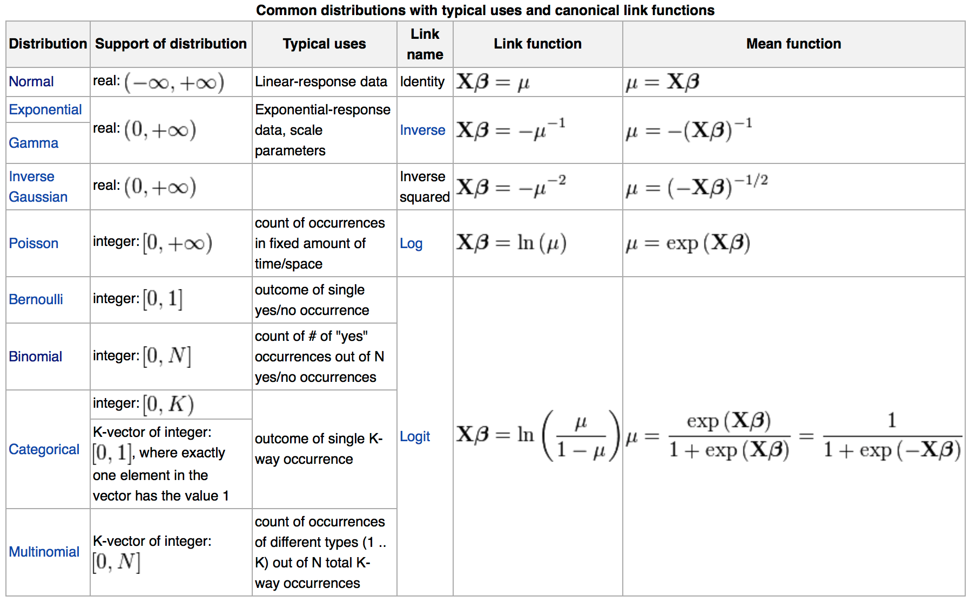
Common GLM variants
Poisson regression
Logistic regression
Multinomial logistic regression
http://en.wikipedia.org/wiki/Generalized_linear_model

Slide 69
Family and link in Stata
[0,1]
Categorical
models
Count
models
Survival
models
Rhemtulla, M., Brosseau-Liard, P. É., & Savalei, V. (2012). When can categorical variables be treated as continuous? A comparison of robust continuous and categorical SEM estimation methods under suboptimal conditions. Psychological Methods, 17(3), 354–373. http://doi.org/http://dx.doi.org/10.1037/a0029315

Slide 70
lreg1 <- glm(Menarche ~ Age, data = data, family = "binomial")
summary(lreg1)
Call:
glm(formula = Menarche ~ Age, family = "binomial", data = data)
Deviance Residuals:
Min 1Q Median 3Q Max
-3.0863 -0.1988 0.0324 0.2216 2.8285
Coefficients:
Estimate Std. Error z value Pr(>|z|)
(Intercept) -21.07621 0.76637 -27.50 <2e-16 ***
Age 1.62044 0.05863 27.64 <2e-16 ***
---
Signif. codes: 0 ‘***’ 0.001 ‘**’ 0.01 ‘*’ 0.05 ‘.’ 0.1 ‘ ’ 1
(Dispersion parameter for binomial family taken to be 1)
Null deviance: 5306.5 on 3917 degrees of freedom
Residual deviance: 1664.2 on 3916 degrees of freedom
AIC: 1668.2
Number of Fisher Scoring iterations: 7
Model summary
Residual statistics
Estimates
Model quality indices
Notes:
library(MASS)
data <- do.call(rbind,apply(menarche,1,function(x){data.frame(Age = x["Age"] + runif(x["Total"], min = -.3, max = .3), Menarche = as.numeric(1:x["Total"] <= x["Menarche"]))}))
lreg1 <- glm(Menarche ~ Age, data = data, family = "binomial")
summary(lreg1)
Call:
glm(formula = Menarche ~ Age, family = "binomial", data = data)
Deviance Residuals:
Min 1Q Median 3Q Max
-3.0863 -0.1988 0.0324 0.2216 2.8285
Coefficients:
Estimate Std. Error z value Pr(>|z|)
(Intercept) -21.07621 0.76637 -27.50 <2e-16 ***
Age 1.62044 0.05863 27.64 <2e-16 ***
---
Signif. codes: 0 ‘***’ 0.001 ‘**’ 0.01 ‘*’ 0.05 ‘.’ 0.1 ‘ ’ 1
(Dispersion parameter for binomial family taken to be 1)
Null deviance: 5306.5 on 3917 degrees of freedom
Residual deviance: 1664.2 on 3916 degrees of freedom
AIC: 1668.2
Number of Fisher Scoring iterations: 7

Slide 71
Practical considerations when using GLMs
Decisions in model building
  Linear predictor
  Response distribution
  Link function
Assumptions and diagnostics
  ML assumptions: large random sample and model is correct
  Plots of linear predictions, fitted values, various residuals, and observed values
  Model comparisons using likelihood ratio tests
Interpretation
  Pseudo-R² statistics
  Plot marginal predictions on response metric
  Some link/distribution combinations have special interpretations

Slide 72
Deviance and deviance residuals

Slide 73
Deviance residuals and deviance
Menarche = g(-20.0 + 1.54 Age) + u
 | Age | Menarche | Linear prediction | Fitted | p | ln(p) | Deviance residual | Deviance residual²
Girl 1 | 136 | 1 | 0.94 | 73.6% | 73.6% | -0.306 | 0.782 | 0.612
Girl 2 | 11.4 | 0 | -2.44 | 8.0% | 92.0% | -0.083 | -0.407 | 0.166
Girl 3 | 12.6 | 1 | -0.60 | 35.2% | 35.2% | -1.045 | -1.446 | 2.09
Girl 4 | 13.1 | 1 | 0.17 | 56.2% | 56.2% | -0.576 | 1.073 | 1.152
Girl 5 | 12.6 | 0 | -0.60 | 34.6% | 65.4% | -0.425 | 0.922 | 0.85
Girl 6 | 10.3 | 0 | -4.14 | 1.5% | 98.5% | -0.015 | 0.173 | 0.03
Girl 7 | 10.2 | 0 | -4.29 | 1.3% | 98.7% | -0.013 | -0.161 | 0.026
Girl 8 | 15.4 | 1 | 3.72 | 97.8% | 97.8% | -0.022 | -0.210 | 0.044
Girl 9 | 15.2 | 1 | 3.41 | 96.9% | 96.9% | -0.031 | -0.249 | 0.062
Girl 10 | 13.8 | 1 | 1.25 | 79.2% | 79.2% | -0.233 | 0.683 | 0.466
Likelihood (product) |  |  |  |  | 6.4%
Log-likelihood (sum) |  |  |  |  |  | -2.749
Deviance (sum of squares) |  |  |  |  |  |  |  | 5.498

Slide 74
lreg1 <- glm(Menarche ~ Age, data = data, family = "binomial")
summary(lreg1)
Call:
glm(formula = Menarche ~ Age, family = "binomial", data = data)
Deviance Residuals:
Min 1Q Median 3Q Max
-3.0863 -0.1988 0.0324 0.2216 2.8285
Coefficients:
Estimate Std. Error z value Pr(>|z|)
(Intercept) -21.07621 0.76637 -27.50 <2e-16 ***
Age 1.62044 0.05863 27.64 <2e-16 ***
---
Signif. codes: 0 ‘***’ 0.001 ‘**’ 0.01 ‘*’ 0.05 ‘.’ 0.1 ‘ ’ 1
(Dispersion parameter for binomial family taken to be 1)
Null deviance: 5306.5 on 3917 degrees of freedom
Residual deviance: 1664.2 on 3916 degrees of freedom
AIC: 1668.2
Number of Fisher Scoring iterations: 7
Residual statistics
Model quality indices
Notes:
library(MASS)
data <- do.call(rbind,apply(menarche,1,function(x){data.frame(Age = x["Age"] + runif(x["Total"], min = -.3, max = .3), Menarche = as.numeric(1:x["Total"] <= x["Menarche"]))}))
lreg1 <- glm(Menarche ~ Age, data = data, family = "binomial")
summary(lreg1)
Call:
glm(formula = Menarche ~ Age, family = "binomial", data = data)
Deviance Residuals:
Min 1Q Median 3Q Max
-3.0863 -0.1988 0.0324 0.2216 2.8285
Coefficients:
Estimate Std. Error z value Pr(>|z|)
(Intercept) -21.07621 0.76637 -27.50 <2e-16 ***
Age 1.62044 0.05863 27.64 <2e-16 ***
---
Signif. codes: 0 ‘***’ 0.001 ‘**’ 0.01 ‘*’ 0.05 ‘.’ 0.1 ‘ ’ 1
(Dispersion parameter for binomial family taken to be 1)
Null deviance: 5306.5 on 3917 degrees of freedom
Residual deviance: 1664.2 on 3916 degrees of freedom
AIC: 1668.2
Number of Fisher Scoring iterations: 7

Slide 75
lreg1 <- glm(Menarche ~ Age, data = data, family = "binomial")
summary(lreg1)
Call:
glm(formula = Menarche ~ Age, family = "binomial", data = data)
Deviance Residuals:
Min 1Q Median 3Q Max
-3.0863 -0.1988 0.0324 0.2216 2.8285
Coefficients:
Estimate Std. Error z value Pr(>|z|)
(Intercept) -21.07621 0.76637 -27.50 <2e-16 ***
Age 1.62044 0.05863 27.64 <2e-16 ***
---
Signif. codes: 0 ‘***’ 0.001 ‘**’ 0.01 ‘*’ 0.05 ‘.’ 0.1 ‘ ’ 1
(Dispersion parameter for binomial family taken to be 1)
Null deviance: 5306.5 on 3917 degrees of freedom
Residual deviance: 1664.2 on 3916 degrees of freedom
AIC: 1668.2
Number of Fisher Scoring iterations: 7
Deviance residual is the contribution of individual observations to the likelihood function
(or more accurately, it’s square root)
Interpreted similarly to OLS residuals.
http://stats.stackexchange.com/questions/1432/what-do-the-residuals-in-a-logistic-regression-mean
Notes:
library(MASS)
data <- do.call(rbind,apply(menarche,1,function(x){data.frame(Age = x["Age"] + runif(x["Total"], min = -.3, max = .3), Menarche = as.numeric(1:x["Total"] <= x["Menarche"]))}))
lreg1 <- glm(Menarche ~ Age, data = data, family = "binomial")
summary(lreg1)
Call:
glm(formula = Menarche ~ Age, family = "binomial", data = data)
Deviance Residuals:
Min 1Q Median 3Q Max
-3.0863 -0.1988 0.0324 0.2216 2.8285
Coefficients:
Estimate Std. Error z value Pr(>|z|)
(Intercept) -21.07621 0.76637 -27.50 <2e-16 ***
Age 1.62044 0.05863 27.64 <2e-16 ***
---
Signif. codes: 0 ‘***’ 0.001 ‘**’ 0.01 ‘*’ 0.05 ‘.’ 0.1 ‘ ’ 1
(Dispersion parameter for binomial family taken to be 1)
Null deviance: 5306.5 on 3917 degrees of freedom
Residual deviance: 1664.2 on 3916 degrees of freedom
AIC: 1668.2
Number of Fisher Scoring iterations: 7

Slide 76
lreg1 <- glm(Menarche ~ Age, data = data, family = "binomial")
summary(lreg1)
Call:
glm(formula = Menarche ~ Age, family = "binomial", data = data)
Deviance Residuals:
Min 1Q Median 3Q Max
-3.0863 -0.1988 0.0324 0.2216 2.8285
Coefficients:
Estimate Std. Error z value Pr(>|z|)
(Intercept) -21.07621 0.76637 -27.50 <2e-16 ***
Age 1.62044 0.05863 27.64 <2e-16 ***
---
Signif. codes: 0 ‘***’ 0.001 ‘**’ 0.01 ‘*’ 0.05 ‘.’ 0.1 ‘ ’ 1
(Dispersion parameter for binomial family taken to be 1)
Null deviance: 5306.5 on 3917 degrees of freedom
Residual deviance: 1664.2 on 3916 degrees of freedom
AIC: 1668.2
Number of Fisher Scoring iterations: 7
Model fit information. Deviance can be used for model comparison and testing.
AIC only for model comparison
Deviance = – 2 ln(L)
AIC = 2k – 2 ln(L)
Notes:
library(MASS)
data <- do.call(rbind,apply(menarche,1,function(x){data.frame(Age = x["Age"] + runif(x["Total"], min = -.3, max = .3), Menarche = as.numeric(1:x["Total"] <= x["Menarche"]))}))
lreg1 <- glm(Menarche ~ Age, data = data, family = "binomial")
summary(lreg1)
Call:
glm(formula = Menarche ~ Age, family = "binomial", data = data)
Deviance Residuals:
Min 1Q Median 3Q Max
-3.0863 -0.1988 0.0324 0.2216 2.8285
Coefficients:
Estimate Std. Error z value Pr(>|z|)
(Intercept) -21.07621 0.76637 -27.50 <2e-16 ***
Age 1.62044 0.05863 27.64 <2e-16 ***
---
Signif. codes: 0 ‘***’ 0.001 ‘**’ 0.01 ‘*’ 0.05 ‘.’ 0.1 ‘ ’ 1
(Dispersion parameter for binomial family taken to be 1)
Null deviance: 5306.5 on 3917 degrees of freedom
Residual deviance: 1664.2 on 3916 degrees of freedom
AIC: 1668.2
Number of Fisher Scoring iterations: 7

Slide 77
Published example

Slide 78
Published example
Likelihood ratio test. Difference between deviances of null model and alternative model.
Follows the χ² distribution under
H₀= “There is no difference between model fits”
Deviance
The model does not have R²
various pseudo R² that each have some characteristics of R² of OLS regression are
commonly reported
Odds ratios e^b
Kraimer, M. L., Shaffer, M. A., Harrison, D. A., & Ren, H. (2012). No Place Like Home? An Identity Strain Perspective on Repatriate Turnover. Academy of Management Journal, 55(2), 399–420. doi:10.5465/amj.2009.0644
Cohen, J., Cohen, P., West, S. G., & Aiken, L. S. (2003). Applied Multiple Regression/Correlation Analysis for the Behavioral Sciences (3rd edition). London: Lawrence Erlbaum Associates., Chapter 13
http://www.ats.ucla.edu/stat/mult_pkg/faq/general/Psuedo_RSquareds.htm

Slide 79
Nested model comparison with likelihood ratio test

Slide 80
F test
Model 1 is nested in (is a special case of) Model 2
Model 2: unrestricted model (ur)
Model 1: restricted model (r)
Some math:
df = n – k – 1
df_{r}=113 – 15 – 1 = 97
df_{ur}=113 – 18 – 1 = 94
F = (R²_{ur} – R²_{r}) / (df_{r} – df_{ur})
(1 – R²_{ur}) / df_{ur}
F = .07 / 3 = 3.22
(1 – .32) / 94 (p = 0.026)
Your software will do this calculation for you
0
0
0
Wooldridge, J. M. (2013). Introductory econometrics: a modern approach (5th ed.). Mason, OH: South Wenterstern, Cengage Learning. Section 4.5
Stata: test, R: anova, linearHypothesis
Notes:
R2_ur <- .32
R2_r <- .25
df_r <- 113 - 15 - 1
df_ur <- 113 - 18 - 1
F <- ((R2_ur - R2_r)/(df_r - df_ur)) /
((1-R2_ur)/df_ur)
pf(F,df_r-df_ur,df_ur, lower.tail = FALSE)

Slide 81
LR test
Model 1 is nested in (is a special case of) Model 2
Model 2: unrestricted model (r)
Model 1: restricted model (ur)
Some math:
D = -2 ln( Likelihood of model 2 )
D = -2 ln(Likelihood of model 1) +
2 ln(Likelihood of model 2)
D = model 1 deviance –
model 2 deviance
D = 73.40 – 69.61 = 3.79
D follows the χ² distribution (p = 0.052)
Likelihood of model 1
0
Kraimer, M. L., Shaffer, M. A., Harrison, D. A., & Ren, H. (2012). No Place Like Home? An Identity Strain Perspective
on Repatriate Turnover. Academy of Management Journal, 55(2), 399–420. doi:10.5465/amj.2009.0644
Stata: lrtest R: lrtest

Slide 82
Perfect prediction:
Introduction to computational issues

Slide 83
Example dataset for logistic regression
Y | X1 | X2
0 | 1 | 3
0 | 2 | 2
0 | 3 | -1
0 | 3 | -1
1 | 5 | 2
1 | 6 | 4
1 | 10 | 1
1 | 11 | 0
https://stats.idre.ucla.edu/other/mult-pkg/faq/general/faqwhat-is-complete-or-quasi-complete-separation-in-logisticprobit-regression-and-how-do-we-deal-with-them/

Slide 84
Analysis setup
Stata
R
clear
input y x1 x2
0 1 3
0 2 2
0 3 -1
0 3 -1
1 5 2
1 6 4
1 10 1
1 11 0
end
logit y x1 x2, asis
y <- c(0,0,0,0,1,1,1,1)
x1 <- c(1,2,3,3,5,6,10,11)
x2 <- c(3,2,-1,-1,2,4,1,0)
glm(y ~ x1 + x2,
family=binomial)

Slide 85
Stata
Logistic regression Number of obs = 8
LR chi2(-1) = 11.09
Prob > chi2 = .
Log likelihood = 0 Pseudo R2 = 1.0000
------------------------------------------------------------------------------
y | Coef. Std. Err. z P>|z| [95% Conf. Interval]
-------------+----------------------------------------------------------------
x1 | 33.49629 . . . . .
x2 | 30.99369 . . . . .
_cons | -210.4106 . . . . .
------------------------------------------------------------------------------
Note: 4 failures and 4 successes completely determined.
Coefficients:
(Intercept) x1 x2
-66.098 15.288 6.241
Degrees of Freedom: 7 Total (i.e. Null); 5 Residual
Null Deviance: 11.09
Residual Deviance: 4.545e-10 AIC: 6
Warning message:
glm.fit: fitted probabilities numerically 0 or 1 occurred
R

Slide 86
Example dataset for logistic regression
y | x1 | x2
0 | 1 | 3
0 | 2 | 2
0 | 3 | -1
0 | 3 | -1
1 | 5 | 2
1 | 6 | 4
1 | 10 | 1
1 | 11 | 0
https://stats.idre.ucla.edu/other/mult-pkg/faq/general/faqwhat-is-complete-or-quasi-complete-separation-in-logisticprobit-regression-and-how-do-we-deal-with-them/

Slide 87
Example dataset for logistic regression
y | x1
0 | 1
0 | 2
0 | 3
0 | 3
1 | 5
1 | 6
1 | 10
1 | 11
https://stats.idre.ucla.edu/other/mult-pkg/faq/general/faqwhat-is-complete-or-quasi-complete-separation-in-logisticprobit-regression-and-how-do-we-deal-with-them/

Slide 88
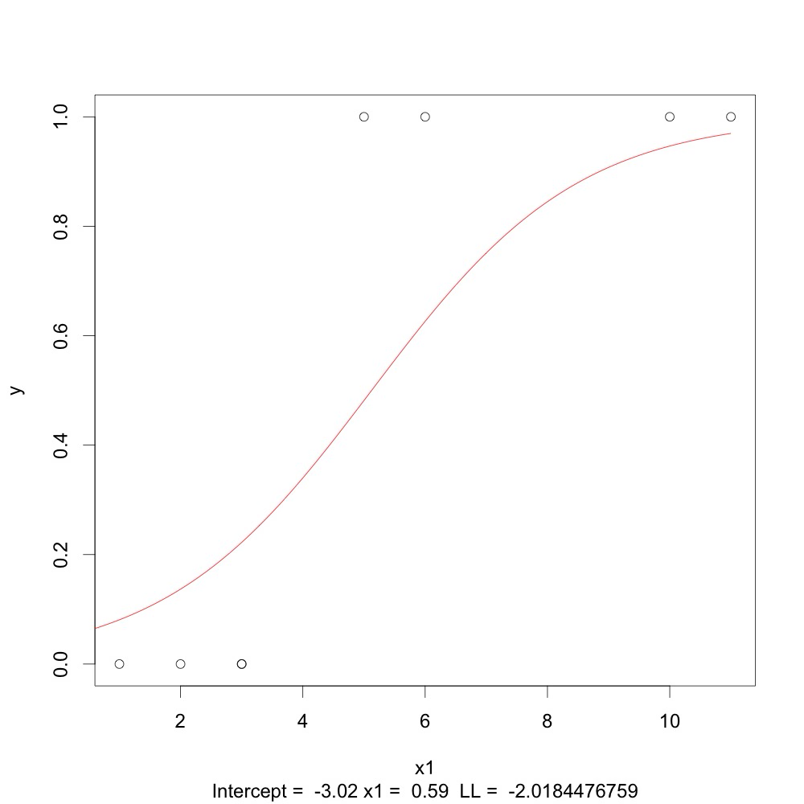
Maximum likelihood estimation
Maximum of likelihood does not exist
Maximum likelihood estimates do not exist
Estimation continues indefinitely
Coefficient of x1 approaches infinity
Log likelihood approaches zero
Notes:
specify_decimal <- function(x, k) trimws(format(round(x, k), nsmall=k))
options(scipen = 999)
y<- c(0,0,0,0,1,1,1,1)
x1<-c(1,2,3,3,5,6,10,11)
x2<-c(3,2,-1,-1,2,4,1,0)
summary(glm(y ~ x1 + x2, family=binomial))
m <- lapply(1:25,function(i){
glm(y ~ x1, family=binomial, control = list(maxit = i))
})
co <- c("red",paste("gray",(0:9)*5+40,sep=""))
co <- c(co,rep("gray90",14))
x <- (1:110)/10
pdf("plot0.pdf", width = 5, height = 5)
plot(x1,y)
dev.off()
for(j in 1:25){
jpeg(paste("plot",str_pad(j, 2, pad = "0"),".jpg",sep=""), bg="white", width = 1000, height = 1000, pointsize = 24)
plot(x1,y, sub =
paste("Intercept = ",specify_decimal(coef(m[[j]])[1],2),
"x1 = ",specify_decimal(coef(m[[j]])[2],2),
" LL = ",specify_decimal(m[[j]]$deviance/-2,10),
collapse ="")
)
for(i in 1:j){
rev(co[1:j])
lines(x,predict(m[[i]], newdata = list(x1=x), type ="response"), col = rev(co[1:j])[i])
}
dev.off()
}
unlink("output.mp4")
my_command <- 'ffmpeg -r 1 -i plot%02d.jpg output.mp4'
system(my_command)

Slide 89
How statistical programs handle this?
. logit y x1 x2
outcome = x1 > 3 predicts data perfectly
r(2000);
StataCorp LP. (2017). Stata Base Reference Manual (Version 15). College Station, TX: Stata Press. p. 1360

Slide 90
Another example
Stata
R
clear
input y x1 x2
0 1 3
0 2 2
0 3 -1
0 3 -1
1 5 2
1 6 4
1 10 1
1 11 0
0 11 0
end
logit y x1 x2
y <- c(0,0,0,0,1,1,1,1,0)
x1 <- c(1,2,3,3,5,6,10,11,
11)
x2 <- c(3,2,-1,-1,2,4,1,0,
0)
glm(y ~ x1 + x2,
family=binomial)

Slide 91
Stata
Iteration 15999: log likelihood = -1.3862945 (not concave)
Iteration 16000: log likelihood = -1.3862945 (not concave)
convergence not achieved
Logistic regression Number of obs = 9
LR chi2(1) = 9.59
Prob > chi2 = 0.0020
Log likelihood = -1.3862945 Pseudo R2 = 0.7758
------------------------------------------------------------------------------
Y | Coef. Std. Err. z P>|z| [95% Conf. Interval]
-------------+----------------------------------------------------------------
X1 | 40.92326 .1285649 318.31 0.000 40.67128 41.17524
X2 | 130.8733 1045.517 0.13 0.900 -1918.303 2180.049
_cons | -450.1559 . . . . .
------------------------------------------------------------------------------
Note: 3 failures and 2 successes completely determined.
convergence not achieved
r(430);
...
Warning message:
glm.fit: fitted probabilities numerically 0 or 1 occurred
R

Slide 92
Meaning of likelihood
”not concave”
Value | Likelihood | Cumulative likelihood | Log likelihood | Cumulative log likelihood
2 | 0.242 | 0.2420000 | -1.419 | -1.42
3 | 0.399 | 0.0965000 | -0.919 | -2.34
4 | 0.242 | 0.0234000 | -1.419 | -3.76

Slide 93
Meaning of likelihood
”not concave”
--------------------------------------------------
Iteration 16000:
Parameter vector:
Y: Y: Y:
X1 X2 _cons
r1 40.92326 130.8733 -450.1559
log likelihood = -1.3862945
(not concave)
Gradient vector (length = 4.14e-08):
Y: Y: Y:
X1 X2 _cons
r1 -4.03e-08 -4.60e-15 -9.21e-09
Hessian matrix:
Y: Y: Y:
X1 X2 _cons
Y:X1 -60.5
Y:X2 -1.10e-06 -9.15e-07
Y:_cons -5.500001 -3.66e-07 -.5000002
-------------------------------------------------------------------------------------------------------------------------------------
convergence not achieved

Slide 94
------------------------------------------------------------------------------
Y | Coef. Std. Err. z P>|z| [95% Conf. Interval]
-------------+----------------------------------------------------------------
X1 | 40.92326 .1285649 318.31 0.000 40.67128 41.17524
X2 | 130.8733 1045.517 0.13 0.900 -1918.303 2180.049
_cons | -450.1559 . . . . .
------------------------------------------------------------------------------
Note: 3 failures and 2 successes completely determined.
y | x1 | x2
0 | 1 | 3
0 | 2 | 2
0 | 3 | -1
0 | 3 | -1
1 | 5 | 2
1 | 6 | 4
1 | 10 | 1
1 | 11 | 0
0 | 11 | 0

Slide 95
------------------------------------------------------------------------------
Y | Coef. Std. Err. z P>|z| [95% Conf. Interval]
-------------+----------------------------------------------------------------
X1 | 40.92326 .1285649 318.31 0.000 40.67128 41.17524
X2 | 130.8733 1045.517 0.13 0.900 -1918.303 2180.049
_cons | -450.1559 . . . . .
------------------------------------------------------------------------------
Note: 3 failures and 2 successes completely determined.
y | x1 | x2 | predicted
0 | 1 | 3 | 0.000000061
0 | 2 | 2 | 0
0 | 3 | -1 | 0
0 | 3 | -1 | 0
1 | 5 | 2 | .9999999
1 | 6 | 4 | 1
1 | 10 | 1 | 1
1 | 11 | 0 | .5
0 | 11 | 0 | .5

Slide 96
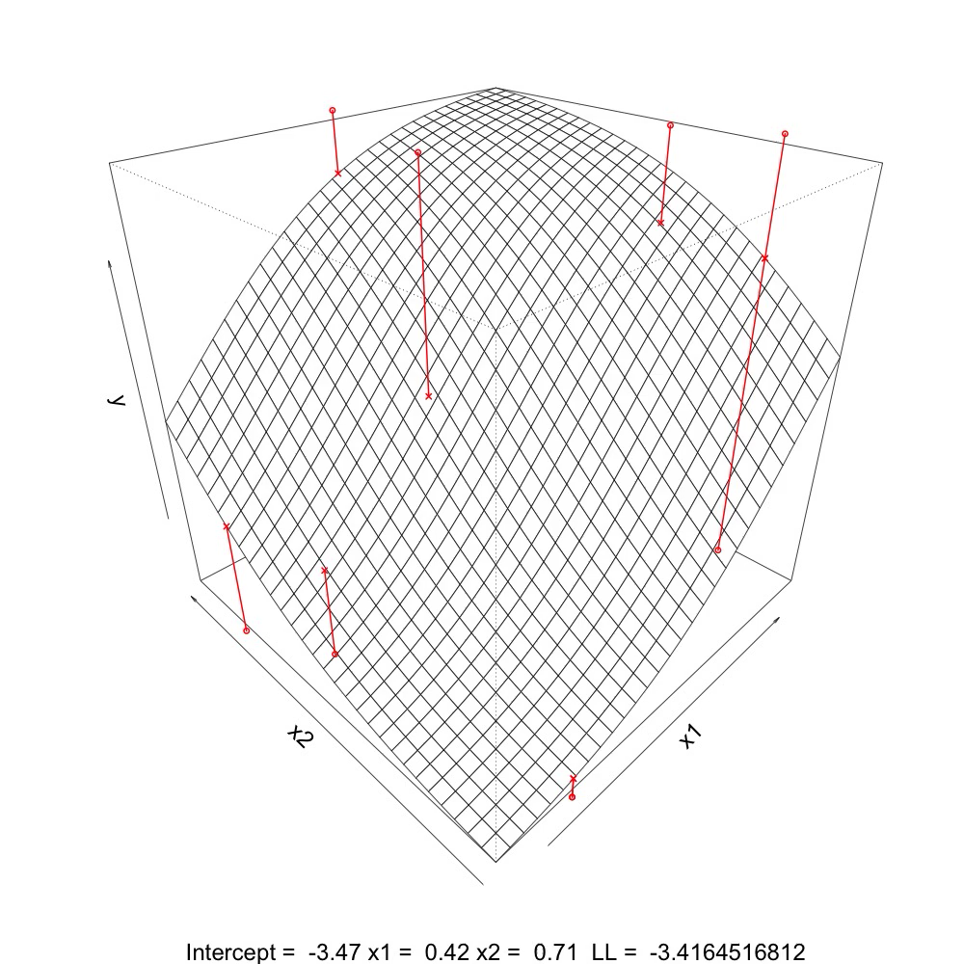
y | x1 | x2
0 | 1 | 3
0 | 2 | 2
0 | 3 | -1
0 | 3 | -1
1 | 5 | 2
1 | 6 | 4
1 | 10 | 1
1 | 11 | 0
0 | 11 | 0
Notes:
specify_decimal <- function(x, k) trimws(format(round(x, k), nsmall=k))
library(stringr)
y <- c(0,0,0,0,1,1,1,1,0)
x1 <- c(1,2,3,3,5,6,10,11,11)
x2 <- c(3,2,-1,-1,2,4,1,0,0)
m1 <- glm(y ~ x1 + x2, family=binomial)
m <- lapply(1:25,function(i){
glm(y ~ x1 + x2, family=binomial, control = list(maxit = i))
})
i <- 30
d <- expand.grid(x1 = seq(min(x1),max(x1),length.out = i),
x2 = seq(min(x2),max(x2),length.out = i))
for(j in 1:25){
jpeg(paste("plot",str_pad(j, 2, pad = "0"),".jpg",sep=""), bg="white", width = 1000, height = 1000)
p <- persp(unique(d$x1),unique(d$x2),
matrix(predict(m[[j]], newdata = d, type ="response"), i, i),
xlab = "x1", ylab = "x2", zlab ="y",
theta = -45, phi = 30,
sub = paste("Intercept = ",specify_decimal(coef(m[[j]])[1],2),
"x1 = ",specify_decimal(coef(m[[j]])[2],2),
"x2 = ",specify_decimal(coef(m[[j]])[3],2),
" LL = ",specify_decimal(m[[j]]$deviance/-2,10),
collapse =""), cex.lab = 2, cex.sub =2 )
points(trans3d(x1,x2,y,p), col ="red", lwd=2)
points(trans3d(x1,x2,predict(m[[j]], type ="response"),p), col ="red", lwd=2, pch= 4)
for(k in seq_along(x1)){
lines(trans3d(x1[k],x2[k],c(y[k],predict(m[[j]], type ="response")[k]),p), col ="red",lwd=2)
}
dev.off()
}
unlink("output.mp4")
my_command <- 'ffmpeg -r 1 -i plot%02d.jpg output.mp4'
system(my_command)

Slide 97
Four options for dealing with estimation problems
Ignore the warnings report the estimates anyway
Modify the model or data by trial and error until the warning no longer occurs
Learn each special case and how to deal with them
Understand the general estimation principle so that you understand why estimation fails and can make an informed decision
Give up

Slide 98
Pseudo-R²
in logistic regresssion

Slide 99
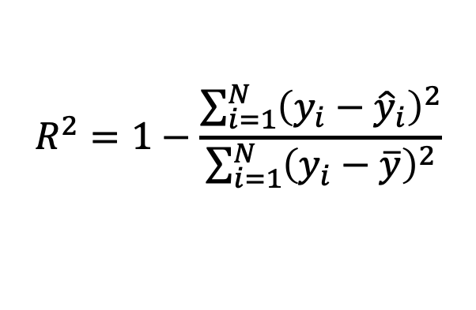
What R² quantifies and is used for
$$R^{2}=1−\frac{\sum_{i=1}^{N}{{\left(y_{i}−{\hat{y}}_{i}\right)}^{2}}}{\sum_{i=1}^{N}{{\left(y_{i}−\overline{y}\right)}^{2}}}$$
Interpretation of R² | Explanation
Degree of explained variance | R²=0: the model does not explain the data at all R²=1: the model does not explain the data perfectly
Improvement over the null model toward the saturated model | R²=0: the model fits equally well as the null model R²=1: the model fits equally well as the saturated model
Squared correlation between the observed and predicted values | R²=0: the model does not predit the dependent variable at all R²=1: the model predicts the dependent variable perfectly
OLS estimation criterion | Maximizing the R²
Nested model test | Difference in R² is used in F test

Slide 100
What pseudo-R² quantifies and is used for
Interpretation of R² | Explanation
Degree of explained variance | R²=0: the model does not explain the data at all R²=1: the model does not explain the data perfectly
Improvement over the null model toward the saturated model | R²=0: the model fits equally well as the null model R²=1: the model fits equally well as the saturated model
Squared correlation between the observed and predicted values | R²=0: the model does not predit the dependent variable at all R²=1: the model predicts the dependent variable perfectly
OLS estimation criterion | Maximizing the R²
Nested model test | Difference in R² is used in F test
A pseudo R² has at most two of these interpretations

Slide 101
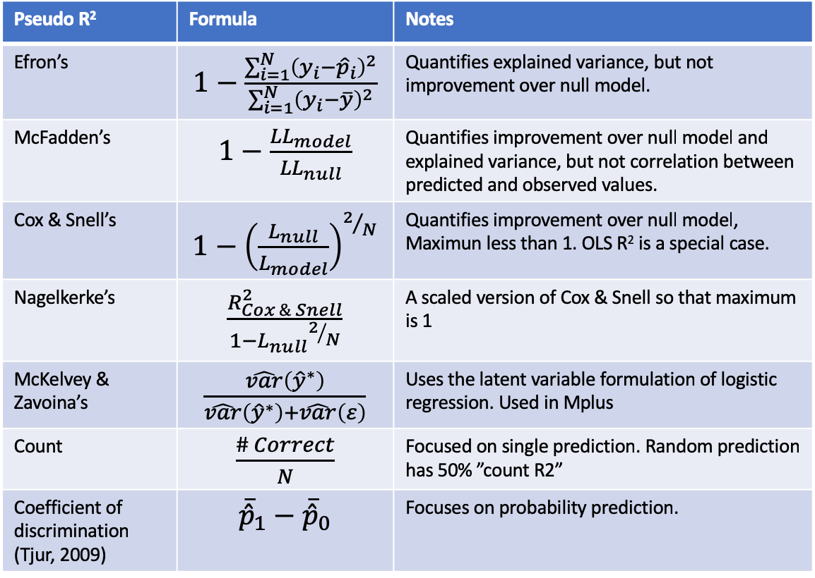
Some pseudo-R²s
Pseudo R² | Formula | Notes
Efron’s | $1−\frac{\sum_{i=1}^{N}{{\left(y_{i}−{\hat{p}}_{i}\right)}^{2}}}{\sum_{i=1}^{N}{{\left(y_{i}−\overline{y}\right)}^{2}}}$ | Quantifies explained variance, but not improvement over null model.
McFadden’s | $1−\frac{{LL}_{model}}{{LL}_{null}}$ | Quantifies improvement over null model and explained variance, but not correlation between predicted and observed values.
Cox & Snell’s | $1−{\left(\frac{L_{null}}{L_{model}}\right)}^{2/N}$ | Quantifies improvement over null model, Maximun less than 1. OLS R² is a special case.
Nagelkerke’s | $\frac{R_{Cox \& Snell}^{2}}{1−{L_{null}}^{2/N}}$ | A scaled version of Cox & Snell so that maximum is 1
McKelvey & Zavoina’s | $\frac{\hat{var}\left({\hat{y}}^{∗}\right)}{\hat{var}\left({\hat{y}}^{∗}\right)+\hat{var}\left(ε\right)}$ | Uses the latent variable formulation of logistic regression. Used in Mplus
Count | $\frac{\# Correct}{N}$ | Focused on single prediction. Random prediction has 50% ”count R2”
Coefficient of discrimination (Tjur, 2009) | $${\overline{\hat{p}}}_{1}−{\overline{\hat{p}}}_{0}$$ | Focuses on probability prediction.
https://stats.idre.ucla.edu/other/mult-pkg/faq/general/faq-what-are-pseudo-r-squareds/
Tjur, T. (2009). Coefficients of Determination in Logistic Regression Models—A New Proposal: The Coefficient of Discrimination. The American Statistician, 63(4), 366–372. https://doi.org/10.1198/tast.2009.08210

Slide 102
Examples
Notes:
options(digits=2)
library(gridExtra)
library(grid)
library(DescTools)
library(psych)
pdf(paste("PseudoR2.pdf"), width = 10)
par(mfrow=c(2,2))
par(mar=c(.2,.2,.2,12))
for(i in 1:4){
set.seed(1)
x <- seq(-1,1,length.out=100)
fit <- logistic(switch(i,
1,
x*1.5+1,
x*3+2,
x*100+50))
y <- runif(100)<fit
m1 <- glm(y ~ x, family=binomial)
m2 <- lm(y ~ x)
r2 <- c(PseudoR2(m1, which =c("Effron", "McFadden","McFaddenAdj","CoxSnell","Nagelkerke","McKelveyZavoina")),
Count = sum(round(predict(m1, type ="response"))==y)/100,
PseudoR2(m1, which = "Tjur"),
"R2 (OLS)" = summary(m2)$r.squared)
plot(x,y,axes=F)
box()
lines(x,predict(m1, type ="response"), col = "red")
lines(x,predict(m2), col = "blue")
ta <- matrix(format(round(r2, 2), nsmall = 2),ncol = 1)
rownames(ta) <- names(r2)
colnames(ta) <- "R2"
if(i == 1) pushViewport(viewport(y=.75, x=.40))
else if (i == 2) pushViewport(viewport(x= 1))
else if (i == 3) pushViewport(viewport(y=0, x= 0))
else if (i == 4) pushViewport(viewport(x= 1))
grid.table(ta)
}
dev.off()

Slide 103
Examples

Slide 104
Published example
Kraimer, M. L., Shaffer, M. A., Harrison, D. A., & Ren, H. (2012). No Place Like Home? An Identity Strain Perspective on Repatriate Turnover. Academy of Management Journal, 55(2), 399–420. doi:10.5465/amj.2009.0644

Slide 105
Hoetker, G. (2007). The use of logit and probit models in strategic management research: Critical issues. Strategic Management Journal, 28(4), 331–343. https://doi.org/10.1002/smj.582

Slide 106
Don’t include pseudo-R²
  Unless you have a specific reason to include a specific one
  Interpret the effect size graphically instead
If you are asked to include pseudo-R²
  Use multiple
  McFadden, Cox&Snell, Coefficient of Discrimination (Tjur)
  Interpret Tjur
Hoetker, G. (2007). The use of logit and probit models in strategic management research: Critical issues. Strategic Management Journal, 28(4), 331–343. https://doi.org/10.1002/smj.582

Slide 107
Hosmer, D. W., Lemeshow, S., & Sturdivant, R. X. (2013). Applied logistic regression (3rd ed). Hoboken, N.J: Wiley p , 185.

Slide 108
Interpretation of non-linear, non-additive effects

Slide 109
Moderation in non-linear models
Monthly salary of average persons by gender
Woman: 2000 eur
Man: 3000 eur
Scenario 1 | Scenario 2 | Scenario 3
An additional year of education increses salary by 300 eur | An additional year of education increses salary by 10% | An additional year of education increses woman’s salary by 12% and man’s salary by 10%
An additional year of education increses woman’s salary by 15% and man’s salary by 10% | An additional year of education increses woman’s salary by 200 and man’s salary by 300 | An additional year of education increses woman’s salary by 240 and man’s salary by 300
Is the effect of education moderated by gender?
Is the moderation effect of being a woman positive or negative?

Slide 110
Confusion on moderation and non-linear models
Becker, T. E., Robertson, M. M., & Vandenberg, R. J. (2018). Nonlinear transformations in organizational research: Possible problems and potential solutions. Organizational Research Methods, 109442811877520. https://doi.org/10.1177/1094428118775205

Slide 111
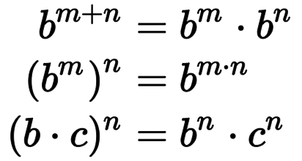

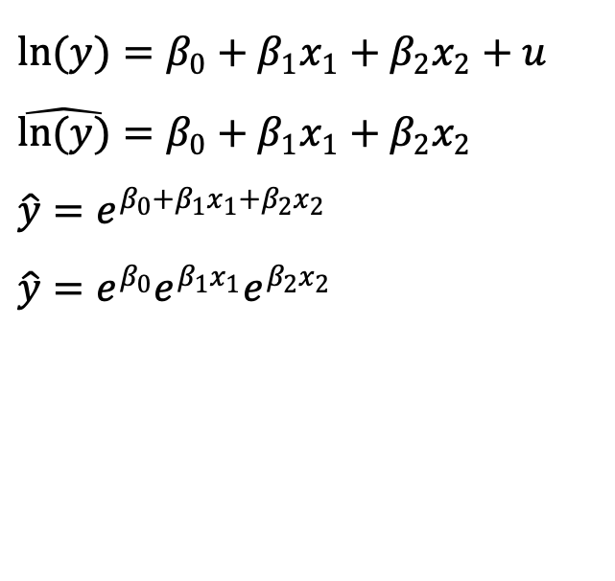
Confusion on moderation and non-linear models
Linear model
Log transformed model
$$y=β_{0}+β_{1}x_{1}+β_{2}x_{2}+u$$
$$\hat{y}=β_{0}+β_{1}x_{1}+β_{2}x_{2}$$
$$ln(y)=β_{0}+β_{1}x_{1}+β_{2}x_{2}+u$$
$$\hat{ln(y)}=β_{0}+β_{1}x_{1}+β_{2}x_{2}$$
$$\hat{y}=e^{β_{0}+β_{1}x_{1}+β_{2}x_{2}}$$
$$\hat{y}=e^{β_{0}}e^{β_{1}x_{1}}e^{β_{2}x_{2}}$$
Additive effect
Basic rules for exponents:
Multiplicative
effect
https://en.wikipedia.org/wiki/Exponentiation#Identities_and_properties

Slide 112



Confusion on moderation and non-linear models
Linear - additive
Nonlinear - multiplicative
$$\hat{y}=a+β_{1}x_{1}$$
$$\hat{y}=a × e^{β_{1}x_{1}}$$
$$a$$
= effects of other variables that are held constant
Notes:
library(psych)
x <- 1:100
pdf("Lines.pdf")
plot(0,type='n',axes=FALSE,
xlim = c(1,100), ylim = c(0,100),
xlab = "x", ylab ="y",
cex.lab = 1.5)
box()
for(a in 1:5){
lines(x,a*exp(x/35))
}
plot(0,type='n',axes=FALSE, ann = FALSE,
xlim = c(1,100), ylim = c(0,100))
for(a in 1:5){
lines(x,predict(lm(a*exp(x/35) ~x)), col = "red")
}
plot(0,type='n',axes=FALSE,
xlim = c(1,100), ylim = c(0,150),
xlab = "x", ylab ="y",
cex.lab = 1.5)
box()
for(a in 1:5){
lines(x,x+a*10)
}
x <- seq(from = -2.5, to = 2.5, length = 100)
plot(0,type='n',axes=FALSE,
xlim = range(x), ylim = c(0,1),
xlab = "x", ylab ="y",
cex.lab = 1.5)
box()
for(a in -2:2){
lines(x,logistic(x+a))
}
x <- seq(from = -3, to = -1, length = 100)
plot(0,type='n',axes=FALSE,
xlim = range(x), ylim = c(0,1),
xlab = "x", ylab ="y",
cex.lab = 1.5)
box()
for(a in -2:2){
lines(x,logistic(x+a))
}
plot(0,type='n',axes=FALSE, ann = FALSE,
xlim = range(x), ylim = c(0,1))
for(a in -2:2){
lines(x,predict(lm(logistic(x+a) ~x)), col = "red")
}
dev.off()

Slide 113
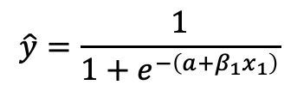


S-curve models
Linear - additive
Nonlinear – nonadditive and nonmultiplicative
$$\hat{y}=a+β_{1}x_{1}$$
$$\hat{y}=\frac{1}{1+e^{−\left(a+β_{1}x_{1}\right)}}$$
a = how far along the
S-curve you start
Nonlinear - multiplicative
$$\hat{y}=a × e^{β_{1}x_{1}}$$
$$a$$
= effects of other variables that are held constant

Slide 114
S-curve models
Linear - additive
Nonlinear – nonadditive and nonmultiplicative
$$\hat{y}=a+β_{1}x_{1}$$
$$\hat{y}=\frac{1}{1+e^{−\left(a+β_{1}x_{1}\right)}}$$
Nonlinear - multiplicative
$$\hat{y}=a × e^{β_{1}x_{1}}$$
$$a$$
= effects of other variables that are held constant

Slide 115
Partial additivity of S-curve
If you want additive, linear model, just use regression
[20%, 80%]
[-1.5, 1.5]

Slide 116
Published example
Reid, E. M., & Toffel, M. W. (2009). Responding to public and private politics: corporate disclosure of climate change strategies. Strategic Management Journal, 30(11), 1157–1178. https://doi.org/10.1002/smj.796

Slide 117
Another published example
”When the criterion variable is a proportion, it is important to screen the data so as to determine an appropriate regression method. For example, the relationship between a continuous predictor and a proportion response variable may be sigmoidal (i.e., a flattened S) rather than linear. When a sigmoidal curve is present in the data, it is customary to apply an alternative regression model (e.g., probit regression or beta regression). In the present instance, however, an examination shows that the data on within- team participation rate fall primarily between .3 and .8, otherwise known as the middle, or linear section of the sigmoidal curve. As such, given that in our case the proportion response variable was effectively linear, we used ordinary least squares regression. We deemed this to be the most straight- forward approach to testing our propositions.”
Hirschfeld, R. R., Cole, M. S., Bernerth, J. B., & Rizzuto, T. E. (2013). Voluntary survey completion among team members: Implications of noncompliance and missing data for multilevel research. Journal of Applied Psychology, 98(3), 454–468. https://doi.org/10.1037/a0031909 Footnote 2, p.458

Slide 118
Yet another published example
McCann, B. T., & Folta, T. B. (2011). Performance differentials within geographic clusters. Journal of Business Venturing, 26(1), 104–123. https://doi.org/10.1016/j.jbusvent.2009.04.004

Slide 119
Age 13 1
Average marginal effect of Age =
-0.0709 -0.0009*50 = -0.1159
Effect of 12 years = 12*-0.1159 = -1.39
Average marginal effect of Age =
-0.0565 -0.0115*3.5 = -0.0978
Effect of 12 years = 12*-0.1159 = -1.16
McCann, B. T., & Folta, T. B. (2011). Performance differentials within geographic clusters. Journal of Business Venturing, 26(1), 104–123. https://doi.org/10.1016/j.jbusvent.2009.04.004

Slide 120
Current practice
Hoetker, G. (2007). The use of logit and probit models in strategic management research: Critical issues. Strategic Management Journal, 28(4), 331–343. https://doi.org/10.1002/smj.582

Slide 121
Guidelines for interpretation
Always plot any non-linear effects
  Choose a set of interesting and reasonable values for other covariates and plot the curve on the response metric
Hoetker, G. (2007). The use of logit and probit models in strategic management research: Critical issues. Strategic Management Journal, 28(4), 331–343. https://doi.org/10.1002/smj.582
Dawson, J. F. (2014). Moderation in Management Research: What, Why, When, and How. Journal of Business and Psychology, 29(1), 1–19. https://doi.org/10.1007/s10869-013-9308-7

Slide 122
Fractional response models

Slide 123
Fractional data
Either [0,1] or (0,1)
  0-100%
  Share of employees that join a pension plan, the share of time spent working, etc.
We are interested in explaining the expected value
Note: independence of observations
  E.g. no market shares of firms operated in the same markets

Slide 124
General modeling approaches
Transform the dependent variable
Generalized linear model
Inverse of S-curve
Data cannot contain 0,1 or ad hoc workarounds are required
Apply OLS regression with heteroskedasticity robust SEs
S-curve link
  Logit, probit
Distribution
  Bernoulli – robust, but less efficient
  Beta – more efficient, but sensitive to misspecification
Heteroskedasticity robust standard errors
Baum, C. F. (2008). Stata tip 63: Modeling proportions. Stata Journal, 8(2), 299.
https://www3.nd.edu/~rwilliam/stats3/FractionalResponseModels.pdf

Slide 125
Interpretation by plotting or marginal effects, like any S-curve model
Adegbesan, J. A., & Higgins, M. J. (2011). The intra-alliance division of value created through collaboration. Strategic Management Journal, 32(2), 187–211. https://doi.org/10.1002/smj.872

Slide 126
Probit regression

Slide 127
Model
Linear regression model
y = β₀ + β₁x₁ + β₂x₂ + … + β_{k}x_{k} + u
Logistic regression model
y = f(β₀ + β₁x₁ + β₂x₂ + … + β_{k}x_{k}) +u
f(x) = 1/(1+e^{-x})
y distributed as bernoulli
Probit regression model
y = f(β₀ + β₁x₁ + β₂x₂ + … + β_{k}x_{k}) +u
f(x) = Φ(1+e^{-x})
y distributed as bernoulli

Slide 128
Probit model
Fitted value = -1
Assumes underlying normally distributed latent variable
y* = β₀ + β₁x₁ + β₂x₂ + … + β_{k}x_{k} + u
u ~ standard normal distribution
y = 1 if y* > 0
0 otherwise
Probability of observing 1
Notes:
twoway function y=normalden(x+1), range(0 3) color(red) recast(area) ///
|| function y=normalden(x+1), range(-5 3) lstyle(foreground) ///
|| , ///
ysca(off) ///
legend(off) ///
xtitle("")

Slide 129
Probit vs logit
Logit
Can be interpreted as odds ratios
Probit
Has some properties that are important when e.g. dealing with sample selection
In most cases it makes no difference which one is used

Slide 130
Ordinal data models

Slide 131
Levels of measurement
Level | Description
Nominal | Cases are assigned to categories, but categories cannot be compared numerically. We can just say that 1, 2, and 3 are different. E.g. 1 = Finland, 2 = Sweden, 3 = Norway
Ordinal | Adds order to categories. We can say 1 < 2, 2 < 3, 1 < 3. E.g. 1 = ”Disagree”, 2= ”Not agree or disagree”, 3= ”Agree”, Ranks in sports competitions
Interval | Adds constant interval between categories. We can say 2-1 = 3-2. E.g. Temperatures in °F or °C
Ratio | Adds a meaningful zero point. We can say 2 is twice 1 and 3 is three times 1. E.g. Length in meters, weight in kilograms
Assumed by regression
Singleton, R. A. J., & Straits, B. C. (2009). Approaches to social research (5th ed.). New York, NY: Oxford University Press. pp. 126-129

Slide 132
Ordered probit and ordered logit regression
Latent variable formulation
y* = β₁x₁ + β₂x₂ + … + β_{k}x_{k} + u
1 if t1 > y*
y = 2 if t2 > y* > t1
3 if y* > t2
t1
t2
Notes:
library(psych)
x <- seq(from = -5, to = 5, length = 100)
pdf("Plot.pdf", width = 4, height = 4)
plot(x, dnorm(x), type ="l",
xlab = "y*", ylab ="density")
abline(v = c(1,3), col = "red")
plot(x, dnorm(x-2), type ="l",
xlab = "y*", ylab ="density")
abline(v = c(1,3), col = "red")
plot(x, logistic(x-1), type ="l",
xlab = "x", ylab ="probability")
lines(x, logistic(x+1))
# Add first line
plot(x, logistic(x-1), type ="l",
xlab = "x", ylab ="probability")
lines(x, logistic(x+1))
lines(x, 1-logistic(x+1), col ="red")
# Add second line
plot(x, logistic(x-1), type ="l",
xlab = "x", ylab ="probability")
lines(x, logistic(x+1))
lines(x, logistic(x+1)-logistic(x-1), col ="red")
# Add third line
plot(x, logistic(x+1), type ="l",
xlab = "x", ylab ="probability")
lines(x, logistic(x-1), col = "red")
# All lines
plot(x, logistic(x+1), type ="l",
xlab = "x", ylab ="probability")
lines(x, logistic(x-1), col = "red")
lines(x, 1-logistic(x+1), col ="red")
lines(x, logistic(x+1)-logistic(x-1), col ="red")

Slide 133
Ordered probit and ordered logit regression
Latent variable formulation
Link function formulation
y* = β₁x₁ + β₂x₂ + … + β_{k}x_{k} + u
1 if t1 > y*
y = 2 if t2 > y* > t1
3 if y* > t2
P(y>1)
P(y>2)
t1
t2
Notes:
library(psych)
x <- seq(from = -5, to = 5, length = 100)
pdf("Plot.pdf", width = 4, height = 4)
plot(x, dnorm(x), type ="l",
xlab = "y*", ylab ="density")
abline(v = c(1,3), col = "red")
plot(x, dnorm(x-2), type ="l",
xlab = "y*", ylab ="density")
abline(v = c(1,3), col = "red")
plot(x, logistic(x-1), type ="l",
xlab = "x", ylab ="probability")
lines(x, logistic(x+1))
# Add first line
plot(x, logistic(x-1), type ="l",
xlab = "x", ylab ="probability")
lines(x, logistic(x+1))
lines(x, 1-logistic(x+1), col ="red")
# Add second line
plot(x, logistic(x-1), type ="l",
xlab = "x", ylab ="probability")
lines(x, logistic(x+1))
lines(x, logistic(x+1)-logistic(x-1), col ="red")
# Add third line
plot(x, logistic(x+1), type ="l",
xlab = "x", ylab ="probability")
lines(x, logistic(x-1), col = "red")
# All lines
plot(x, logistic(x+1), type ="l",
xlab = "x", ylab ="probability")
lines(x, logistic(x-1), col = "red")
lines(x, 1-logistic(x+1), col ="red")
lines(x, logistic(x+1)-logistic(x-1), col ="red")

Slide 134
Ordered probit and ordered logit regression
Latent variable formulation
Link function formulation
y* = β₁x₁ + β₂x₂ + … + β_{k}x_{k} + u
1 if t1 > y*
y = 2 if t2 > y* > t1
3 if y* > t2
P(y=1)
t1
t2
Notes:
library(psych)
x <- seq(from = -5, to = 5, length = 100)
pdf("Plot.pdf", width = 4, height = 4)
plot(x, dnorm(x), type ="l",
xlab = "y*", ylab ="density")
abline(v = c(1,3), col = "red")
plot(x, dnorm(x-2), type ="l",
xlab = "y*", ylab ="density")
abline(v = c(1,3), col = "red")
plot(x, logistic(x-1), type ="l",
xlab = "x", ylab ="probability")
lines(x, logistic(x+1))
# Add first line
plot(x, logistic(x-1), type ="l",
xlab = "x", ylab ="probability")
lines(x, logistic(x+1))
lines(x, 1-logistic(x+1), col ="red")
# Add second line
plot(x, logistic(x-1), type ="l",
xlab = "x", ylab ="probability")
lines(x, logistic(x+1))
lines(x, logistic(x+1)-logistic(x-1), col ="red")
# Add third line
plot(x, logistic(x+1), type ="l",
xlab = "x", ylab ="probability")
lines(x, logistic(x-1), col = "red")
# All lines
plot(x, logistic(x+1), type ="l",
xlab = "x", ylab ="probability")
lines(x, logistic(x-1), col = "red")
lines(x, 1-logistic(x+1), col ="red")
lines(x, logistic(x+1)-logistic(x-1), col ="red")

Slide 135
Ordered probit and ordered logit regression
Latent variable formulation
Link function formulation
y* = β₁x₁ + β₂x₂ + … + β_{k}x_{k} + u
1 if t1 > y*
y = 2 if t2 > y* > t1
3 if y* > t2
P(y=2)
t1
t2
Notes:
library(psych)
x <- seq(from = -5, to = 5, length = 100)
pdf("Plot.pdf", width = 4, height = 4)
plot(x, dnorm(x), type ="l",
xlab = "y*", ylab ="density")
abline(v = c(1,3), col = "red")
plot(x, dnorm(x-2), type ="l",
xlab = "y*", ylab ="density")
abline(v = c(1,3), col = "red")
plot(x, logistic(x-1), type ="l",
xlab = "x", ylab ="probability")
lines(x, logistic(x+1))
# Add first line
plot(x, logistic(x-1), type ="l",
xlab = "x", ylab ="probability")
lines(x, logistic(x+1))
lines(x, 1-logistic(x+1), col ="red")
# Add second line
plot(x, logistic(x-1), type ="l",
xlab = "x", ylab ="probability")
lines(x, logistic(x+1))
lines(x, logistic(x+1)-logistic(x-1), col ="red")
# Add third line
plot(x, logistic(x+1), type ="l",
xlab = "x", ylab ="probability")
lines(x, logistic(x-1), col = "red")
# All lines
plot(x, logistic(x+1), type ="l",
xlab = "x", ylab ="probability")
lines(x, logistic(x-1), col = "red")
lines(x, 1-logistic(x+1), col ="red")
lines(x, logistic(x+1)-logistic(x-1), col ="red")

Slide 136
Ordered probit and ordered logit regression
Latent variable formulation
Link function formulation
y* = β₁x₁ + β₂x₂ + … + β_{k}x_{k} + u
1 if t1 > y*
y = 2 if t2 > y* > t1
3 if y* > t2
P(y=3)
t1
t2
Notes:
library(psych)
x <- seq(from = -5, to = 5, length = 100)
pdf("Plot.pdf", width = 4, height = 4)
plot(x, dnorm(x), type ="l",
xlab = "y*", ylab ="density")
abline(v = c(1,3), col = "red")
plot(x, dnorm(x-2), type ="l",
xlab = "y*", ylab ="density")
abline(v = c(1,3), col = "red")
plot(x, logistic(x-1), type ="l",
xlab = "x", ylab ="probability")
lines(x, logistic(x+1))
# Add first line
plot(x, logistic(x-1), type ="l",
xlab = "x", ylab ="probability")
lines(x, logistic(x+1))
lines(x, 1-logistic(x+1), col ="red")
# Add second line
plot(x, logistic(x-1), type ="l",
xlab = "x", ylab ="probability")
lines(x, logistic(x+1))
lines(x, logistic(x+1)-logistic(x-1), col ="red")
# Add third line
plot(x, logistic(x+1), type ="l",
xlab = "x", ylab ="probability")
lines(x, logistic(x-1), col = "red")
# All lines
plot(x, logistic(x+1), type ="l",
xlab = "x", ylab ="probability")
lines(x, logistic(x-1), col = "red")
lines(x, 1-logistic(x+1), col ="red")
lines(x, logistic(x+1)-logistic(x-1), col ="red")

Slide 137
Ordered probit and ordered logit regression
Latent variable formulation
Link function formulation
y* = β₁x₁ + β₂x₂ + … + β_{k}x_{k} + u
1 if t1 > y*
y = 2 if t2 > y* > t1
3 if y* > t2
P(y=1)
P(y=3)
P(y=2)
t1
t2
Notes:
library(psych)
x <- seq(from = -5, to = 5, length = 100)
pdf("Plot.pdf", width = 4, height = 4)
plot(x, dnorm(x), type ="l",
xlab = "y*", ylab ="density")
abline(v = c(1,3), col = "red")
plot(x, dnorm(x-2), type ="l",
xlab = "y*", ylab ="density")
abline(v = c(1,3), col = "red")
plot(x, logistic(x-1), type ="l",
xlab = "x", ylab ="probability")
lines(x, logistic(x+1))
# Add first line
plot(x, logistic(x-1), type ="l",
xlab = "x", ylab ="probability")
lines(x, logistic(x+1))
lines(x, 1-logistic(x+1), col ="red")
# Add second line
plot(x, logistic(x-1), type ="l",
xlab = "x", ylab ="probability")
lines(x, logistic(x+1))
lines(x, logistic(x+1)-logistic(x-1), col ="red")
# Add third line
plot(x, logistic(x+1), type ="l",
xlab = "x", ylab ="probability")
lines(x, logistic(x-1), col = "red")
# All lines
plot(x, logistic(x+1), type ="l",
xlab = "x", ylab ="probability")
lines(x, logistic(x-1), col = "red")
lines(x, 1-logistic(x+1), col ="red")
lines(x, logistic(x+1)-logistic(x-1), col ="red")

Slide 138
Ordered probit and ordered logit regression
Assumtion: ”proportional odds”
or ”parallel lines”
Should be
tested
Latent variable formulation
Link function formulation
y* = β₁x₁ + β₂x₂ + … + β_{k}x_{k} + u
1 if t1 > y*
y = 2 if t2 > y* > t1
3 if y* > t2
P(y>1)
P(y>2)
t1
t2
Intercept = - threshold
Notes:
library(psych)
x <- seq(from = -5, to = 5, length = 100)
pdf("Plot.pdf", width = 4, height = 4)
plot(x, dnorm(x), type ="l",
xlab = "y*", ylab ="density")
abline(v = c(1,3), col = "red")
plot(x, dnorm(x-2), type ="l",
xlab = "y*", ylab ="density")
abline(v = c(1,3), col = "red")
plot(x, logistic(x-1), type ="l",
xlab = "x", ylab ="probability")
lines(x, logistic(x+1))
# Add first line
plot(x, logistic(x-1), type ="l",
xlab = "x", ylab ="probability")
lines(x, logistic(x+1))
lines(x, 1-logistic(x+1), col ="red")
# Add second line
plot(x, logistic(x-1), type ="l",
xlab = "x", ylab ="probability")
lines(x, logistic(x+1))
lines(x, logistic(x+1)-logistic(x-1), col ="red")
# Add third line
plot(x, logistic(x+1), type ="l",
xlab = "x", ylab ="probability")
lines(x, logistic(x-1), col = "red")
# All lines
plot(x, logistic(x+1), type ="l",
xlab = "x", ylab ="probability")
lines(x, logistic(x-1), col = "red")
lines(x, 1-logistic(x+1), col ="red")
lines(x, logistic(x+1)-logistic(x-1), col ="red")

Slide 139
Empirical example
No intercept
Tresholds
Some kind of pseudo-R²
Antonakis, J., Fenley, M., & Liechti, S. (2011). Can Charisma Be Taught? Tests of Two Interventions. Academy of Management Learning & Education, 10(3), 374–396. https://doi.org/10.5465/amle.2010.0012

Slide 140
Empirical example - interpretation
Antonakis, J., Fenley, M., & Liechti, S. (2011). Can Charisma Be Taught? Tests of Two Interventions. Academy of Management Learning & Education, 10(3), 374–396. https://doi.org/10.5465/amle.2010.0012

Slide 141
When should ordinal models be applied?
Rating scale:
Can it be considered as interval scale?
  Single item: probably not
  More than one items: maybe
Rhemtulla, M., Brosseau-Liard, P. É., & Savalei, V. (2012). When can categorical variables be treated as continuous? A comparison of robust continuous and categorical SEM estimation methods under suboptimal conditions. Psychological Methods, 17(3), 354–373. http://dx.doi.org/10.1037/a0029315

Slide 142
Nominal data models

Slide 143
Levels of measurement
Level | Description
Nominal | Cases are assigned to categories, but categories cannot be compared numerically. We can just say that 1, 2, and 3 are different. E.g. 1 = Finland, 2 = Sweden, 3 = Norway
Ordinal | Adds order to categories. We can say 1 < 2, 2 < 3, 1 < 3. E.g. 1 = ”Disagree”, 2= ”Not agree or disagree”, 3= ”Agree”, Ranks in sports competitions
Interval | Adds constant interval between categories. We can say 2-1 = 3-2. E.g. Temperatures in °F or °C
Ratio | Adds a meaningful zero point. We can say 2 is twice 1 and 3 is three times 1. E.g. Length in meters, weight in kilograms
Assumed by regression
Singleton, R. A. J., & Straits, B. C. (2009). Approaches to social research (5th ed.). New York, NY: Oxford University Press. pp. 126-129

Slide 144
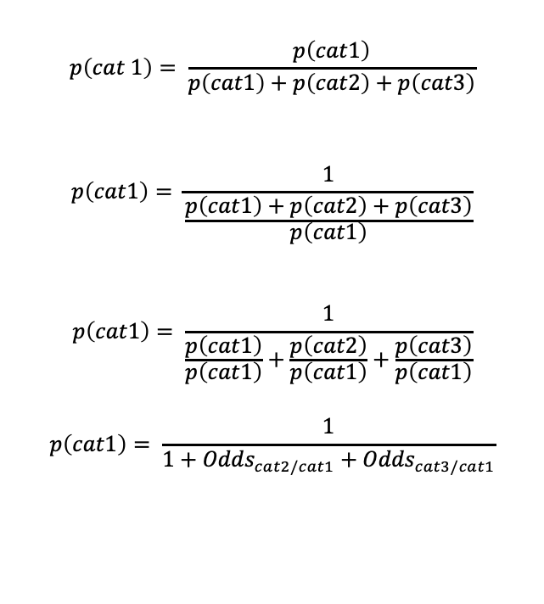
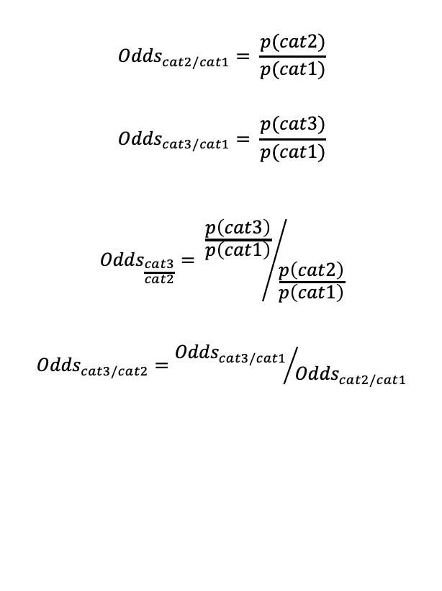
Odds and probabilities of three categories
$${Odds}_{cat2/cat1}= \frac{p(cat2)}{p(cat1)}$$
$${Odds}_{cat3/cat1}= \frac{p(cat3)}{p(cat1)}$$
$${Odds}_{\frac{cat3}{cat2}}= {\frac{p\left(cat3\right)}{p\left(cat1\right)}}/{\frac{p\left(cat2\right)}{p\left(cat1\right)}}$$
$${Odds}_{cat3/cat2}={{Odds}_{cat3/cat1}}/{{Odds}_{cat2/cat1}}$$
$$p\left(cat 1\right)= \frac{p\left(cat1\right)}{p\left(cat1\right)+p\left(cat2\right)+p\left(cat3\right)}$$
$$p\left(cat1\right)= \frac{1}{\frac{p\left(cat1\right)+p\left(cat2\right)+p\left(cat3\right)}{p\left(cat1\right)}}$$
$$p\left(cat1\right)= \frac{1}{\frac{p\left(cat1\right)}{p\left(cat1\right)}+\frac{p\left(cat2\right)}{p\left(cat1\right)}+\frac{p\left(cat3\right)}{p\left(cat1\right)}}$$
$$p\left(cat1\right)= \frac{1}{1+{Odds}_{cat2/cat1}+{Odds}_{cat3/cat1}}$$
Category 1 is the reference category

Slide 145
Multinomial regression
One category set as reference
M-1 logistic regression models of odds
  log(cat2/cat1) = β₁₂x₁ + β₂₂x₂ + … + β_{k2}x_{k}
  log(cat3/cat1) = β₁₃x₁ + β₂₃x₂ + … + β_{k3}x_{k}
  …
  log(catM/cat1) = β_{1M}x₁ + β_{2M}x₂ + … + β_{kM}x_{k}
Independence of irrelevant alternatives assumption
Wulff, Jesper N. "Interpreting Results From the Multinomial Logit Model Demonstrated by Foreign Market Entry." Organizational Research Methods (2014): 1094428114560024.

Slide 146
Redundant
Reference
category
Wulff, J. N. (2015). Interpreting Results From the Multinomial Logit Model: Demonstrated by Foreign Market Entry. Organizational Research Methods, 18(2), 300–325. https://doi.org/10.1177/1094428114560024

Slide 147
Pseudo R²
AIC
LR test
Pseudo R²
LR test
Wulff, J. N. (2015). Interpreting Results From the Multinomial Logit Model: Demonstrated by Foreign Market Entry. Organizational Research Methods, 18(2), 300–325. https://doi.org/10.1177/1094428114560024

Slide 148
Graphical interpretation
Wulff, J. N. (2015). Interpreting Results From the Multinomial Logit Model: Demonstrated by Foreign Market Entry. Organizational Research Methods, 18(2), 300–325. https://doi.org/10.1177/1094428114560024

Slide 149
Graphical interpretation
Wulff, J. N. (2015). Interpreting Results From the Multinomial Logit Model: Demonstrated by Foreign Market Entry. Organizational Research Methods, 18(2), 300–325. https://doi.org/10.1177/1094428114560024

Slide 150
Wulff, J. N. (2015). Interpreting Results From the Multinomial Logit Model: Demonstrated by Foreign Market Entry. Organizational Research Methods, 18(2), 300–325. https://doi.org/10.1177/1094428114560024

Slide 151
Relationship between ordinal and nominal models

Slide 152
Typology of logistic regression models
Ordered logistic regression
Multinomial logistic regression
Fullerton, A. S. (2009). A Conceptual Framework for Ordered Logistic Regression Models. Sociological Methods & Research, 38(2), 306–347. https://doi.org/10.1177/0049124109346162

Slide 153
Approaches to comparison
Linear predictor:
Fullerton, A. S. (2009). A Conceptual Framework for Ordered Logistic Regression Models. Sociological Methods & Research, 38(2), 306–347. https://doi.org/10.1177/0049124109346162

Slide 154
Proportional odds / parallel lines assumption
The effects of the explanatory variables are the same for all values of y
Some effects are the same and some can vary
The effects of the explanatory variables can vary freely between values of y
Fullerton, A. S. (2009). A Conceptual Framework for Ordered Logistic Regression Models. Sociological Methods & Research, 38(2), 306–347. https://doi.org/10.1177/0049124109346162

Slide 155
Choosing a modeling approach
What is the nature of the phenomenon that the dependent variable represents
How does your theory explain the phenomenon
Fullerton, A. S. (2009). A Conceptual Framework for Ordered Logistic Regression Models. Sociological Methods & Research, 38(2), 306–347. https://doi.org/10.1177/0049124109346162

Slide 156
Exponential models for counts

Slide 157
Introduction to counts
Not true generally
Page numbers to book citations
Blevins, D. P., Tsang, E. W. K., & Spain, S. M. (2015). Count-Based Research in Management Suggestions for Improvement. Organizational Research Methods, 18(1), 47–69. https://doi.org/10.1177/1094428114549601

Slide 158
Consistency Unbiasedness
Efficiency
No ”cannot be count” assumption
Wooldridge, J. M. (2013). Introductory econometrics: a modern approach (5th ed). Mason, OH: South-Western Cengage Learning. p. 105

Slide 159
Empirical demonstration
# Dice | # 6s | # Dice | # 6s
27 | 1 | 50 | 11
38 | 7 | 72 | 10
58 | 7 | 100 | 19
91 | 18 | 39 | 9
21 | 3 | 78 | 6
90 | 13 | 94 | 15
95 | 20 | 22 | 5
67 | 13 | 66 | 9
63 | 10 | 13 | 3
7 | 1 | 27 | 3
21 | 4 | 39 | 6
18 | 3 | 2 | 0
69 | 10 | 39 | 9
39 | 6 | 87 | 18
77 | 13 | 35 | 9
Notes:
library(texreg)
set.seed(1)
x <- sample(1:100,30, replace = TRUE)
y <- unlist(lapply(x,function(x){
sum(sample(1:6,x, replace = TRUE)==6)
}))
cbind(x,y)
pdf("Plot.pdf", width = 4, height = 4)
plot(x,y, ylab = "Number of 6s", xlab ="Number of die throws")
lines(1:100,predict(lm(y~x), newdata = list(x= 1:100)), col ="red")
screenreg(list(lm(y~x), glm(y~x, family = poisson)))
plot(x,y, ylab = "Number of 6s", xlab ="Number of die throws")
lines(1:100,predict(lm(y~x), newdata = list(x= 1:100)), col ="red")
lines(1:100,predict(glm(y~x, family = poisson), type ="response", newdata = list(x= 1:100)), col ="blue")
dev.off()

Slide 160
Empirical demonstration
Regression Poisson
-------------------------------------
(Intercept) -0.11 0.93 ***
(0.90) (0.17)
x 0.17 *** 0.02 ***
(0.02) (0.00)
-------------------------------------
R^2 0.82
Adj. R^2 0.81
Num. obs. 30 30
RMSE 2.43
AIC 142.59
BIC 145.39
Log Likelihood -69.29
Deviance 27.44
=====================================
*** p < 0.001, ** p < 0.01, * p < 0.05
Notes:
library(texreg)
set.seed(1)
x <- sample(1:100,30, replace = TRUE)
y <- unlist(lapply(x,function(x){
sum(sample(1:6,x, replace = TRUE)==6)
}))
cbind(x,y)
pdf("Plot.pdf", width = 4, height = 4)
plot(x,y, ylab = "Number of 6s", xlab ="Number of die throws")
lines(1:100,predict(lm(y~x), newdata = list(x= 1:100)), col ="red")
screenreg(list(lm(y~x), glm(y~x, family = poisson)))
plot(x,y, ylab = "Number of 6s", xlab ="Number of die throws")
lines(1:100,predict(lm(y~x), newdata = list(x= 1:100)), col ="red")
lines(1:100,predict(glm(y~x, family = poisson), type ="response", newdata = list(x= 1:100)), col ="blue")
dev.off()

Slide 161
Poisson regression
GLM model with
  E[y] = exp(β₀ + β₁x₁ + β₂x₂ + … + β_{k}x_{k})
  y follows Poisson distribution
Poisson distribution
  Number of independent events that occur at a constant rate
Commonly used for counts

Slide 162
Variance equals
expected value
Dispersion increases with expected value
Notes:
library(psych)
x <- seq(from = -5, to = 5, length = 100)
pdf("Plot.pdf")
par(mfrow=c(3,3))
par(mar=c(2,1,1,1))
for(i in 1:9){
barplot(dpois(1:20,i), names.arg = 1:20, main =paste("Expected value:",i))
box()
}
for(i in 1:9){
i <- 2^i
s <- round(qpois(0.0001,i)):round(qpois(0.9999,i))
barplot(dpois(s,i), names.arg = s,main =paste("Expected value:",i))
box()
}
dev.off()

Slide 163
With large expected
values, poisson
approximates normal
distribution

Slide 164
Interpretation
Expected number of events
  Effects relative to current level
  Multiplicative effects

Slide 165
Exposure and offset
The interest is in rates instead of counts
  number of deaths due to cancer per population
  number of citations per article in a journal
Using the rate itself is generally a bad idea
E[y] = exp(β₀ + β₁x₁ + β₂x₂ + … + β_{k}x_{k}) × exposure
= exp(β₀ + β₁x₁ + β₂x₂ + … + β_{k}x_{k} + ln(exposure))
Using an offset
  Logarithm of exposure, effect constrained β=1
  Predictions interepreted as rates
Exposure
Offset
Certo, S. T., Busenbark, J. R., Kalm, M., & LePine, J. A. (2018). Divided we fall: How ratios undermine research in strategic management. Organizational Research Methods, 1094428118773455. https://doi.org/10.1177/1094428118773455

Slide 166
Negative binomial regression
Poisson with overdispersion
  Variance = alpha * mean
Alpha > 1 = overdispersion
Alpha < 1 = underdispersion
Notes:
pdf("Plot.pdf")
par(mfrow=c(3,3))
par(mar=c(3,2,1,1))
for(i in 1:3){
mu <- 4^i
for(a in 1:3){
s <- 0:round(qpois(0.999999999,mu))
size <- mu/(a-1)
print(c(mu,a,mu+(mu^2)/size))
x <- rnbinom(10000,size=size,mu=mu)
print(c(mean(x),var(x)))
barplot(dnbinom(s,size=size,mu=mu), names.arg = s, , main =paste("E:",i,"alpha:",a),
ylim = c(0,switch(i,.2,.1,.05)))
box()
}
}
dev.off()

Slide 167
Poisson or negative binomial?
Scenario | Poisson regression | Negative binomial regression
Distribution is exactly poisson | Consistent, efficient | Consistent, inefficient
Overdispersion | Consistent, inefficient, SEs may be inconsistent | Consistent, efficient
Underdispersion | Consistent, inefficient, SEs may be inconsistent | Inconsistent
Distribution is not at all poisson | Consistent, SEs inconsistent | Inconsistent
Wooldridge, J. M. (2010). Econometric Analysis of Cross Section and Panel Data. MIT Press. Chapters 18.2-18.3

Slide 168
Zero inflated (ZIF) models
Two models in ZIF
  S curve model for stuctural zeros
  Exponential count model for the actual count
Both models should be reported and interpreted
StataCorp LP. (2017). Stata Base Reference Manual (Version 15). College Station, TX: Stata Press.
Coxe, S., West, S. G., & Aiken, L. S. (2013). Generalized linear models. In T. D. Little (Ed.), The Oxford handbook of quantitative methods (Vol. 2, pp. 26–51). New York: Oxford University Press.

Slide 169
Hurdle models
Two models in Hurdle
  S curve model for zero/nonzero
  Truncated exponential count model for the actual count
Both models should be
reported and interpreted
Coxe, S., West, S. G., & Aiken, L. S. (2013). Generalized linear models. In T. D. Little (Ed.), The Oxford handbook of quantitative methods (Vol. 2, pp. 26–51). New York: Oxford University Press.

Slide 170
Example
Number of parameters
Blevins, D. P., Tsang, E. W. K., & Spain, S. M. (2015). Count-Based Research in Management Suggestions for Improvement. Organizational Research Methods, 18(1), 47–69. https://doi.org/10.1177/1094428114549601

Slide 171
LR test between poisson and negative binomial
Significance of the overdispersion parameter
The Vuong test is problematic
Use theory as guidance
Blevins, D. P., Tsang, E. W. K., & Spain, S. M. (2015). Count-Based Research in Management Suggestions for Improvement. Organizational Research Methods, 18(1), 47–69. https://doi.org/10.1177/1094428114549601
Wilson, P. (2015). The misuse of the Vuong test for non-nested models to test for zero-inflation. Economics Letters, 127, 51–53. https://doi.org/10.1016/j.econlet.2014.12.029

Slide 172
Discuss in class why this is problematic

Slide 173
Consider using this as an example of problematic practices
Antonakis, J., Bastardoz, N., Liu, Y., & Schriesheim, C. A. (2014). What makes articles highly cited? The Leadership Quarterly, 25(1), 152–179.

Slide 174
Quasi-maximum likelihood estimation

Slide 175

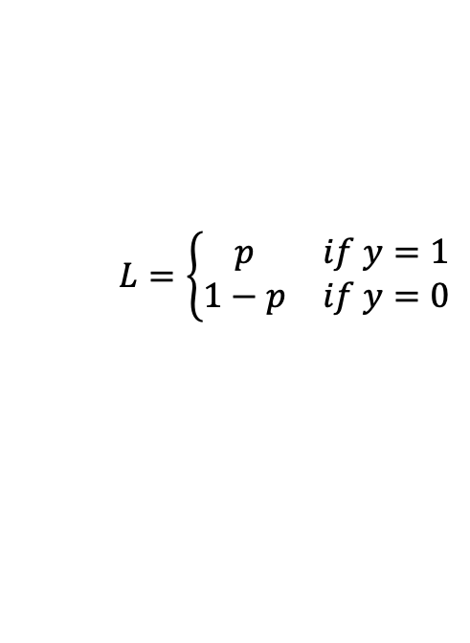
Bernoulli distribution example
$$L=\left\{\begin{matrix}p & if y=1 \\ 1−p & if y=0\end{matrix}\right.$$
$$L=y×p+\left(1−y\right)×\left(1−p\right)$$
y does not need to be 0,1!
Case number | Predictors and link | Predicted probability | Observed value | Likelihood
1 | …. | .7 | 1 | .7
2 | …. | .5 | 0 | .5
3 | …. | .1 | 0 | .9
4 | …. | .1 | 0 | .9
5 | …. | .01 | 1 | .01
6 | …. | .9 | 0 | .1
7 | …. | .5 | .4 | .5
8 | …. | .7 | .1 | 0.34

Slide 176
Quasi-maximum likelihood estimation
(QML /QMLE)
Intentional misspecification of the likelihood
  Consistent regression coefficients if the functional form is correctly specified
  Variance estimates are inconsistent – robust SEs required
  Likelihood is invalid – no LR tests
Bernoulli QML
  S curve model
  Dependent varible [0 - 1]
Poisson QML
  Exponential model
  Non-negative dependent variable
”Note: If you decide on a log link, you may want to call your model ’GLM with a log link,’ rather than a ’Poisson’ QMLE—some older reviewers believe Poisson regression is only for counts.” (Nichols 2010, slide 20)
Nichols, A. (2010). Regression for nonnegative skewed dependent variables. Presented at the Stata Conference, Boston.
Wooldridge, J. M. (2010). Econometric Analysis of Cross Section and Panel Data. MIT Press. Chapters 18.2-18.3

Slide 177
Example
Dahlander, L., O’Mahony, S., & Gann, D. M. (2016). One foot in, one foot out: how does individuals’ external search breadth affect innovation outcomes?: One Foot In, One Foot Out. Strategic Management Journal, 37(2), 280–302. https://doi.org/10.1002/smj.2342

Slide 178
When to use GLM

Slide 179
Question 1: Is transformation needed?
Not primarily about theory and not about the distribution of the dependent variable
Start with linear regression and consider alternatives after diagnostics
Has nothing to do with standard errors
Notes:
library(psych)
x <- seq(from = -5, to = 5, length = 100)
pdf("Plot.pdf", width = 4, height = 4)
plot(x,x, main ="Linear, additive", axes = FALSE, type="l", ylab = "", xlab = "")
box()
plot(x/3,exp(x/3), main ="Exponential, relative", axes = FALSE, type="l", ylab = "", xlab = "")
box()
plot(x,logistic(x), main ="S curve", axes = FALSE, type="l", ylab = "", xlab = "")
box()
dev.off()

Slide 180
Question 2: Should the dependent variable or the fitted values be transformed?
Simple points for transforming the dependent variable
Simple points against transforming the dependent variable
Simpler to apply
  No computational issues
  OLS diagnostics can be used
Commonly used
  Well-understood by readers and reviewers
Transforming a variable with few discrete values is problematic
  E.g. any transformation of a binary variable is binary
Ackward workarounds required at boundary
  E.g. log(y+1)

Slide 181
Question 2: Should the dependent variable or the fitted values be transformed?
More rigorous answer:
Nonlinear regression model:
y = f(β₀ + β₁x₁ + … + β_{k}x_{k}) + u
Regression with transformed DV:
log(y) = β₀ + β₁x₁ + … + β_{k}x_{k} + u
The transformed equation is an inconsistent estimator of the original equation
Wooldridge, J. M. (2010). Econometric Analysis of Cross Section and Panel Data. MIT Press. Chapters 18.2-18.3
Notes:
library(carData)
#pdf("Plot.pdf", height = 4, width = 4)
plot(density(Prestige$income[Prestige$women>50]), col ="red", xlim = range(Prestige$income), main = "Distribution of income of occupations by gender", xlab ="Income")
lines(density(Prestige$income[Prestige$women<50]), col ="blue")
abline(v=mean(Prestige$income[Prestige$women>50]), col="red", lty = 2)
abline(v=mean(Prestige$income[Prestige$women<50]), col="blue", lty = 2)
legend("topright",col=c("red","blue"), legend = c("More than half women", "Less than half women"), lty =1)
m1 <- lm(log(income) ~ women < 50,data = Prestige)
summary(m1)
plot(density(Prestige$income[Prestige$women>50]), col ="red", xlim = range(Prestige$income), main = "Distribution of income of occupations by gender", xlab ="Income")
lines(density(Prestige$income[Prestige$women<50]), col ="blue")
abline(v=mean(Prestige$income[Prestige$women>50]), col="red", lty = 2)
abline(v=mean(Prestige$income[Prestige$women<50]), col="blue", lty = 2)
abline(v=exp(coef(m1)[1]), col ="red", lty = 3)
abline(v=exp(sum(coef(m1))), col ="blue", lty = 3)
legend("topright",col=c("red","blue"), legend = c("More than half women", "Less than half women"), lty =1)
#dev.off()

Slide 182
Question 2: Should the dependent variable or the fitted values be transformed?
Transformed equation predicts the means incorrectly and their difference incorrectly
Call:
lm(formula = log(income) ~ women < 50, data = Prestige)
Residuals:
Min 1Q Median 3Q Max
-2.00803 -0.23304 0.02706 0.25907 1.33096
Coefficients:
Estimate Std. Error t value Pr(>|t|)
(Intercept) 8.1891 0.1003 81.635 < 2e-16 ***
women < 50TRUE 0.6412 0.1170 5.481 3.18e-07 ***
---
Signif. codes: 0 ‘***’ 0.001 ‘**’ 0.01 ‘*’ 0.05 ‘.’ 0.1 ‘ ’ 1
Residual standard error: 0.5212 on 100 degrees of freedom
Multiple R-squared: 0.231, Adjusted R-squared: 0.2233
F-statistic: 30.04 on 1 and 100 DF, p-value: 3.178e-07
Use of GLM should be preferred over transforming the dependent variable
Wooldridge, J. M. (2010). Econometric Analysis of Cross Section and Panel Data. MIT Press. Chapters 18.2-18.3

Slide 183
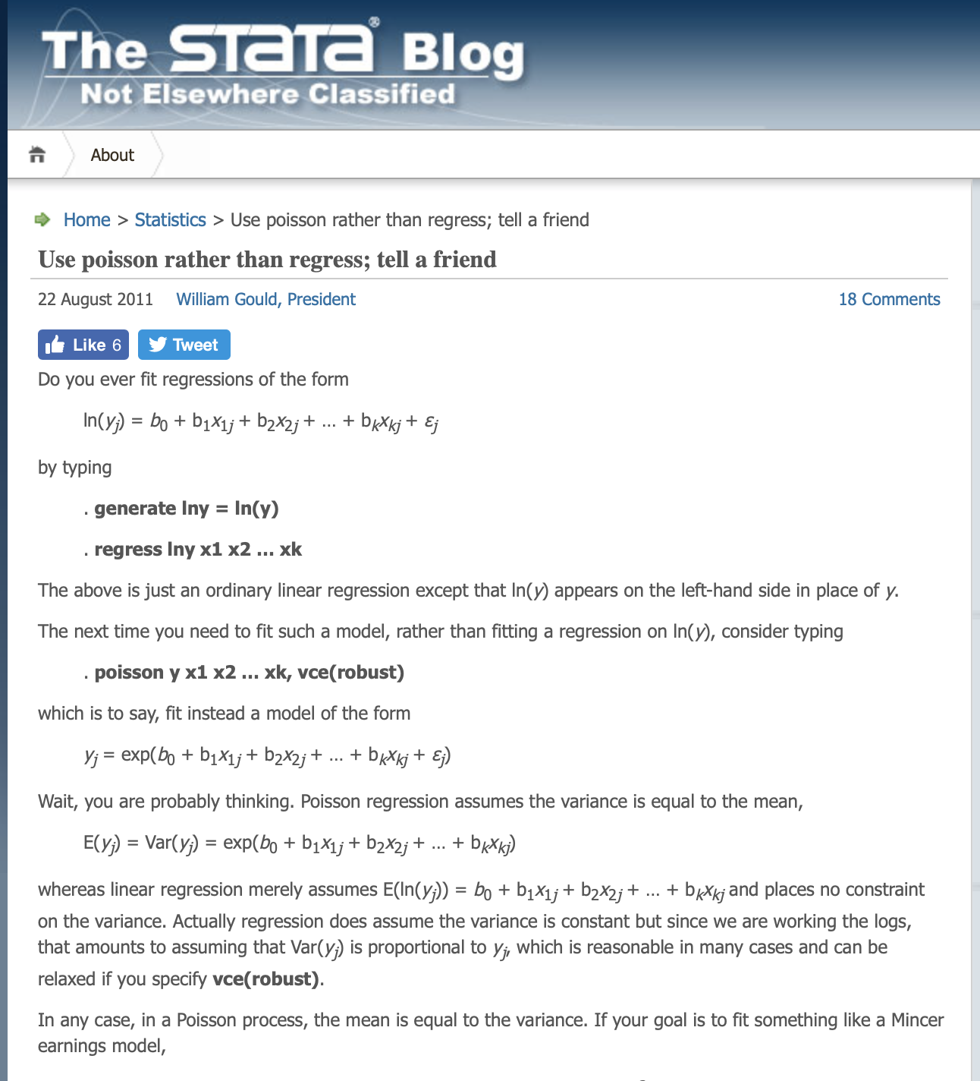

Slide 184
Practical recommendations
Always use OLS
If distribution known, ML GLM with correct distribution
If distribution known, ML GLM with correct distribution
If distribution unknown, Poisson QML with robust standard errors
If distribution unknown, Bernoulli QML with robust standard errors
Consider transformations of the independent variables
Notes:
library(psych)
x <- seq(from = -5, to = 5, length = 100)
pdf("Plot.pdf", width = 4, height = 4)
plot(x,x, main ="Linear, additive", axes = FALSE, type="l", ylab = "", xlab = "")
box()
plot(x/3,exp(x/3), main ="Exponential, relative", axes = FALSE, type="l", ylab = "", xlab = "")
box()
plot(x,logistic(x), main ="S curve", axes = FALSE, type="l", ylab = "", xlab = "")
box()
dev.off()

Slide 185
Is it a big deal to transform the dependent variable instead of using GLM?
+7.5% difference
===========================================
Model 1 Model 2
-------------------------------------------
(Intercept) 7.385 *** 7.390 ***
(0.201) (0.175)
education 0.119 *** 0.128 ***
(0.018) (0.016)
-------------------------------------------
R^2 0.300
Adj. R^2 0.293
Num. obs. 102 102
RMSE 0.497
AIC 136924.876
BIC 136930.126
Log Likelihood -68460.438
Deviance 135850.037
===========================================
*** p < 0.001, ** p < 0.01, * p < 0.05
Notes:
library(carData)
library(texreg)
library(sandwich)
pdf("Plot.pdf", height = 5, width = 5)
Prestige <- Prestige[order(Prestige$education),]
m1 <- lm(log(income) ~ education,data = Prestige)
m2 <- glm(income ~ education, family = poisson ,data = Prestige)
cov.m2 <- vcovHC(m2, type="HC0")
std.err2 <- sqrt(diag(cov.m2))
plot(Prestige$education, Prestige$income, main = "Income of occupations by education", xlab ="Years of education", ylab ="Income")
lines(Prestige$education,exp(predict(m1)), col="red")
lines(Prestige$education,predict(m2, type ="response"), col="blue")
legend("topleft", legend = c("Transformed","GLM"), col =c("red","blue"), lty =1)
screenreg(list(m1,m2), digits = 3,
override.se = list(summary(m1)$coefficients[,2], std.err2),
override.pvalues = list(summary(m1)$coefficients[,4],1-pnorm(coef(m2)/std.err2)),
)
dev.off()

