Slide 1
AFM vs STM

Slide 2
AFM in a nutshell
Surface topology measurement
Works in three modes: contact, no-contact and tapping.
Works in atmospheric pressure and can measure wet samples .
Can measure any sample.

Slide 3
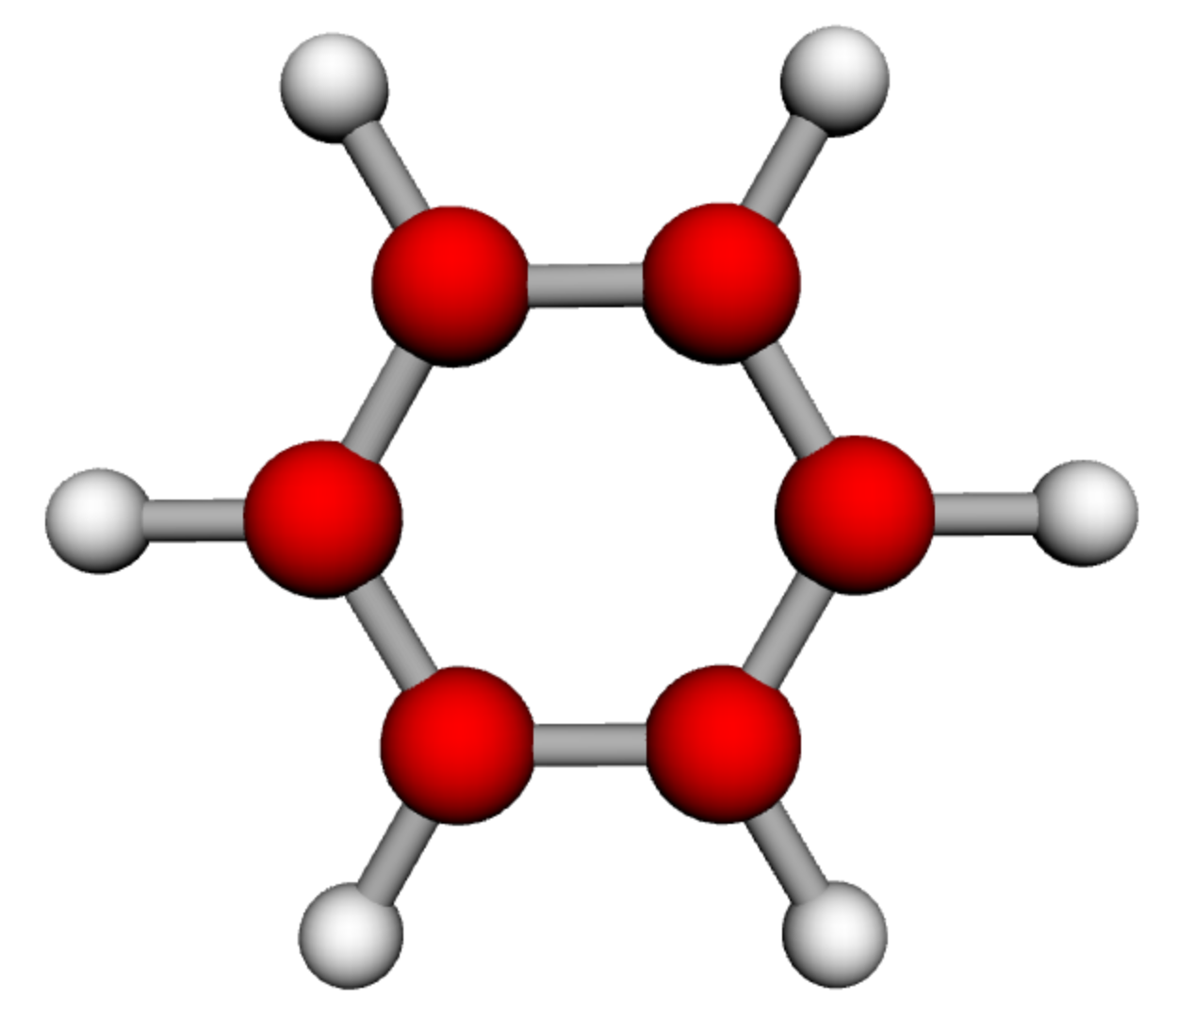
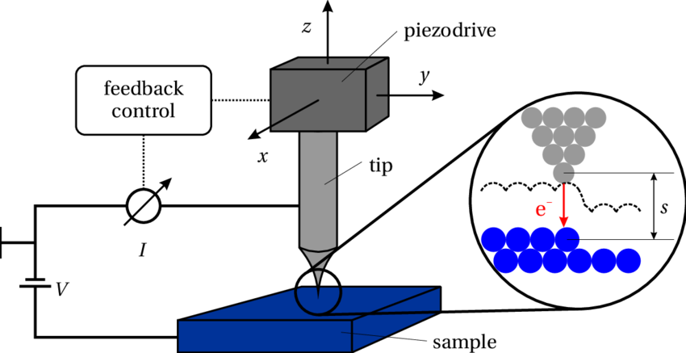
STM in a nutshell
Measures the electron density rather than physical height
Uses quantum tunneling for measurements
Experiments are performed under ultra high vacuum.
Requires conductive materials/molecules
C-C bond : 0.14 nm

