Slide 1
Exercise Session 1
Power systems

Slide 2
Question 1
  Show that the ratio of phase-to-phase-voltage and phase-to-earth-voltage is

Slide 3













Question 1 Show that the ratio of phase-to-phase-voltage and phase-to-earth-voltage is $√3$
$${\overline{U}}_{T,phase}$$
$${\overline{U}}_{T,phase}$$
$${\overline{U}}_{R,phase}$$
120°
$${−\overline{U}}_{S,phase}$$
$${\overline{U}}_{RS}$$
120°
120°
30°
$${\overline{U}}_{R,phase}$$
30°
120°
$${\overline{U}}_{R,phase}$$
120°
$${\overline{U}}_{R,phase}$$
30°
$${−\overline{U}}_{S,phase}$$
120°
120°
$${\overline{U}}_{RS}$$
30°
$${\overline{U}}_{S,phase}$$
$${\overline{U}}_{S,phase}$$

Slide 4




Question 1 Show that the ratio of phase-to-phase-voltage and phase-to-earth-voltage is $√3$
$${\overline{U}}_{T,phase}$$
$${\overline{U}}_{R,phase}$$
120°
$${−\overline{U}}_{S,phase}$$
$${\overline{U}}_{RS}$$
by Sine Rule:
120°
30°
30°
$${\overline{U}}_{R,phase}$$
120°
120°
$${\overline{U}}_{S,phase}$$

Slide 5
Question 2
Derive the equation for delta-star transformation.

Slide 6
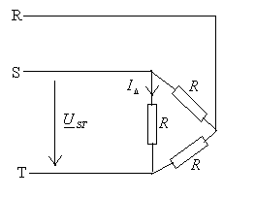
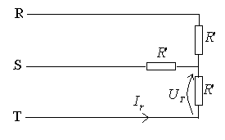
Question 2 Derive the equation for delta-star transformation
The power lost to resistance must remain unchanged

Slide 7
Question 3
A delta-connected three-phase load of (80+j60) Ω per phase is connected to a 440-V three-phase supply. Calculate:
the current in the load component
the current in the phase of power line
the total real power consumed (active power).

Slide 8



Question 3 a) Current in the load component
In delta connected load, the voltage across the load component is line voltage, i.e. phase-to-phase voltage:
And the current
flowing through the load is
Iphase, power system

Slide 9


Question 3 b) Current
Iline
For Δ-connected load, current in power line is $\sqrt{3}$times the current in load
Option 2) Solution using delta-star-transformation
Iline=Iphase

Slide 10
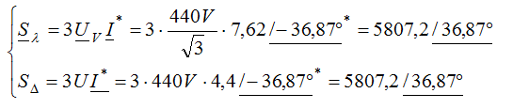
Question 3 c) Active power
Ipower line
Triple check…
Ipower line=Iphase

Slide 11
Question 4
A star-connected load consisting of a resistor of 80 Ω and and inductor of 0.191 H in each phase is connected to a 415-V, three-phase, 50-Hz supply. Calculate:
the phase current I;
the real power P consumed by the load; and
the reactive power Q consumed by the load.
From P and Q calculate the load phase angle φ, and show that:

Slide 12
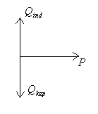
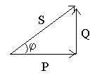
Question 4
a)
Inductor:
c)
Lagging current (inductive load)
d)
b)
=I*
Use of reactance (ind)
Consumption
Generation
“Generation” of reactance (cap)

