Slide 1
Exercises based on Lecture 12
Power systems

Slide 2
Question 6
In a 20 kV overhead line network the zero sequence capacitance is 6 nF/km per phase.
At a secondary substation occurs a single phase to earth fault. Grounding resistance is
20 Ω. Total length of lines is 300 km.
Calculate the earth fault current and the voltage in the grounded parts.
How quick should the relay trip to meet the safety requirements
c) If ground fault current is reduced be a compensation coil, how big a coil is needed

Slide 3
Question 6
Calculate the earth fault current and the voltage in the grounded parts.
Network ground capacitance Ce = 300 km * 6 nF/km = 1.8 μF
= 20A (earth fault current)
Voltage in grounded parts (like transformer tank)
Ue = RI = 20 Ω * 20 A = 400 V
R_{f}
I_{f}
E_{P}
3C_{e}
U₀

Slide 4
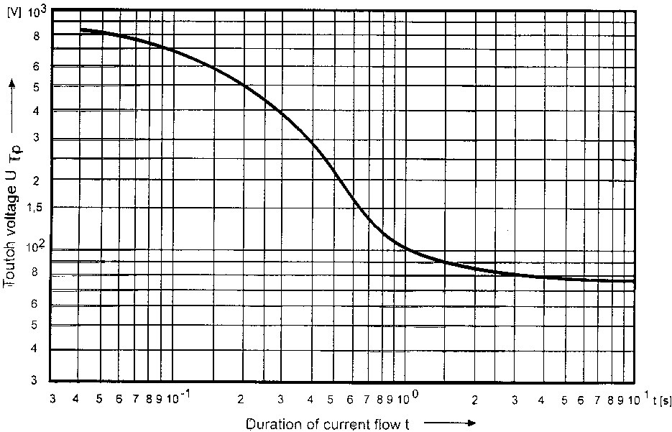
Question 6
b)How quick should the relay trip to meet the safety requirements
In base case, the earth fault voltage can be 2 x permissive touch voltage
The max touch voltage may be 0.5 * Ue = 200 V
From the figure:
200 V ⬄ 0.5 s
If we take 100 ms
for CB operation,
relay should trip
in 0.4 seconds

Slide 5
Question 6
c)If ground fault current is reduced be a compensation coil, how big a coil is needed
Ground fault current can effectively be reduced by compensation coil located in neutral.
It is hence in parallel to the earth capacitances and will be tuned in 50 Hz resonance.
L
I_{c}
I_{c}
C= 1.8μF & ω = 2πf & f=50 Hz ⬄ L=1.9 H

