Slide 1
Exercise Session 3
Power systems

Slide 2
Question 1
Transform load S=(200 + j150) kVA into equivalent resistance and reactance which are connected:
in series
in parallel
Voltage is 20 kV.

Slide 3
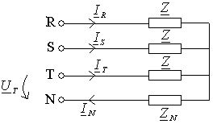
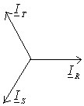
Question 1: Transform load S=(200 + j150) kVA into equivalent resistance and reactance
Three-phase equivalent circuit:

Slide 4

Question 1: Transform load S=(200 + j150) kVA into equivalent resistance and reactance
One-phase equivalent circuit:

Slide 5

Question 1: Transform load S=(200 + j150) kVA into equivalent resistance and reactance
a) In series:
Note: Reactance takes inductive reactive power (Q > 0)

Slide 6
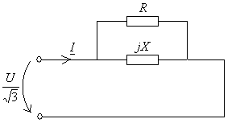
Question 1: Transform load S=(200 + j150) kVA into equivalent resistance and reactance
b). In parallel:
Whole of the voltage is across resistance R and reactance X
Note: Reactance takes inductive reactive power (Q > 0)

Slide 7
Question 2
A certain load curve can be presented with the following equation:
Calculate:
Annual energy
mean power for one year P_{k}
load factor
load duration time t_{k}

Slide 8
Question 2
a). annual energy

Slide 9
Question 2
b). mean power for one year P_{k}

Slide 10
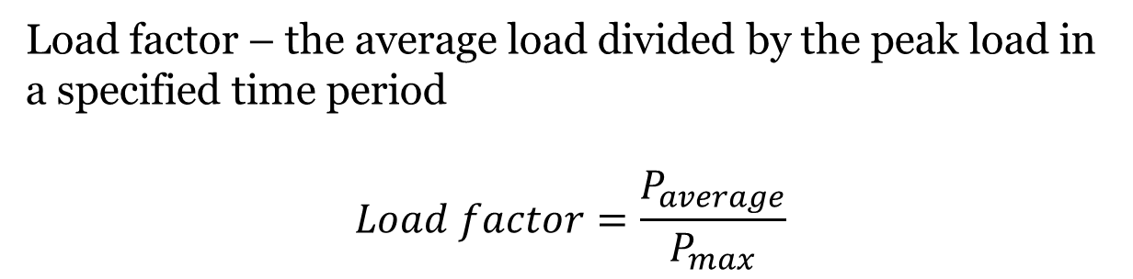
Question 2
c). load factor
Load factor – the average load divided by the peak load in a specified time period
$$Load factor=\frac{P_{average}}{P_{max}}$$

Slide 11
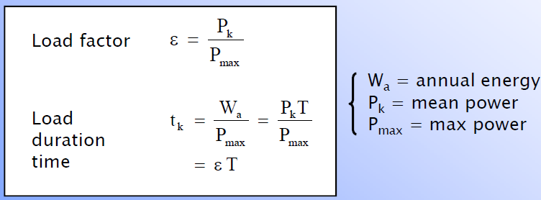
Question 2
d). load duration time

Slide 12
Question 3
At the end of a three-phase line the voltage is 20 kV. The line has following properties: resistance 0.8 Ω and reactance 0.6 Ω per phase. The load at the end of the line has a load duration curve as shown in the picture below. The power factor of the load is constant cosϕ=0.8_{ind}. Calculate:
active power losses P_{hmax} and P_{hmin}
reactive power losses
Q_{hmax} and Q_{hmin}
energy losses W_{h}

Slide 13
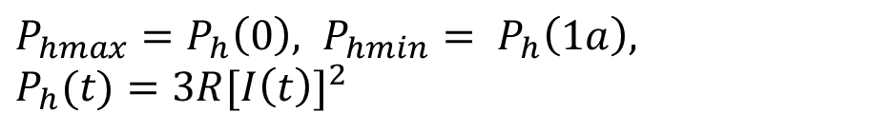
Question 3
$$P_{hmax}=P_{h}\left(0\right), { P}_{hmin} = P_{h}\left(1a\right),$$
$P_{h}(t)=3R{[I\left(t\right)]}^{2}$

Slide 14
Question 3
a). active power losses P_{hmax} and P_{hmin}

Slide 15
Question 3
b). reactive power losses Q_{hmax} and Q_{hmin}

Slide 16
Question 3
c). energy losses W_{h}

Slide 17
Question 4
The variation of load (P) with time (t) in a power supply system is given by the expression:
where t is in hours over a total period of one year.
This load is supplied by three 10-MW generators and it is advantageous to fully load machine before connecting the others.
Determine:
the load factor on the system as a whole;
the total magnitude of installed load if the diversity factor is equal to 3;
the minimum number of hours each machine is in operation;
the approximate peak magnitude of installed load capacity to be cut off to enable only two generators to be used.

Slide 18
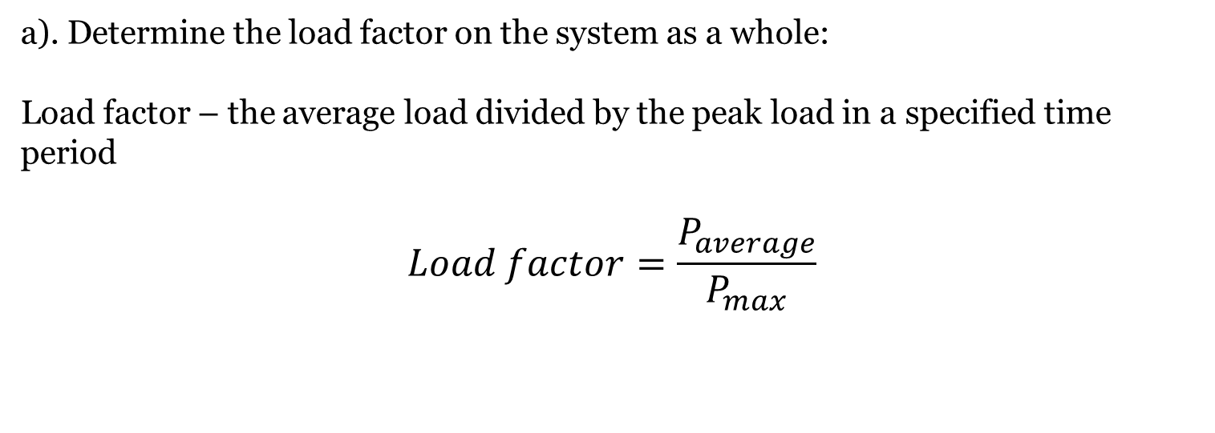
Question 4
a). Determine the load factor on the system as a whole:
Load factor – the average load divided by the peak load in a specified time period
$$Load factor=\frac{P_{average}}{P_{max}}$$

Slide 19

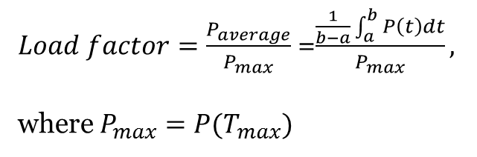
Question 4
a). Determine the load factor on the system as a whole:
$Load factor=\frac{P_{average}}{P_{max}}$ =$\frac{\frac{1}{b−a}\int_{a}^{b}{P\left(t\right)dt}}{P_{max}},$
where $P_{max}=P(T_{max})$
$$P_{\max{possible}}=3∗10 MW=30 MW$$

Slide 20
Question 4
a). Determine the load factor on the system as a whole:

Slide 21
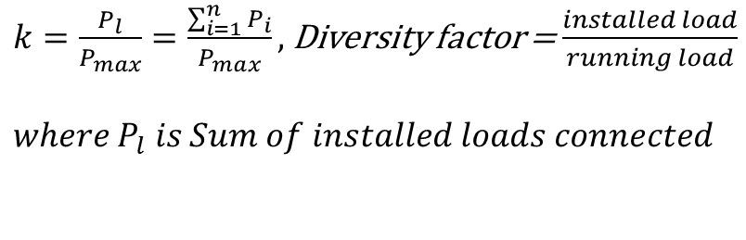
Question 4
b). The total magnitude of installed load if the diversity factor is equal to 3
Diversity factor - defined as the sum of individual maximum demands of the consumers, divided by the maximum load on the system. This factor measures the diversification of the load and is concerned with the installation of sufficient generating and transmission plant. If all the demands occurred simultaneously, that is, unity diversity factor, many more generators would have to be installed. Fortunately, the factor is much higher than unity, especially for domestic loads.
$k=\frac{P_{l}}{P_{max}}=\frac{\sum_{i=1}^{n}{P_{i}}}{P_{max}},$Diversity factor = $\frac{installed load}{running load}$
$$where P_{l} is Sum of installed loads connected$$

Slide 22
Question 4
c). The minimum number of hours each machine is in operation:
This load is supplied by three 10-MW generators and it is advantageous to fully load machine
before connecting the others.
Generator 1 works all year long (in this problem)
Power, MW

Slide 23
Question 4
c). The minimum number of hours each machine is in operation:
This load is supplied by three 10MW generators and it is advantageous to fully load machine
before connecting the others.
Generator 2 starts to work only when the load reaches over 10 MW
Power, MW

Slide 24
Question 4
c). The minimum number of hours each machine is in operation:
This load is supplied by three 10MW generators and it is advantageous to fully load machine
before connecting the others.
Generator 3 starts to work only when the load reaches over 20 MW
Power, MW
Power, MW

Slide 25
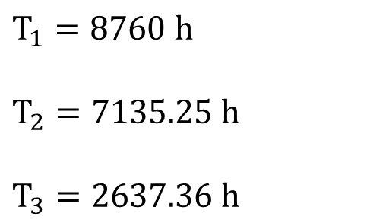
Question 4
c). The minimum number of hours each machine is in operation:
This load is supplied by three 10MW generators and it is advantageous to fully load machine
before connecting the others.
Generator 3 starts to work only when the load reaches over 20 MW
$$T_{1}=8760 h$$
$$T_{2}=7135.25 h$$
$$T_{3}=2637.36 h$$
Power, MW

Slide 26
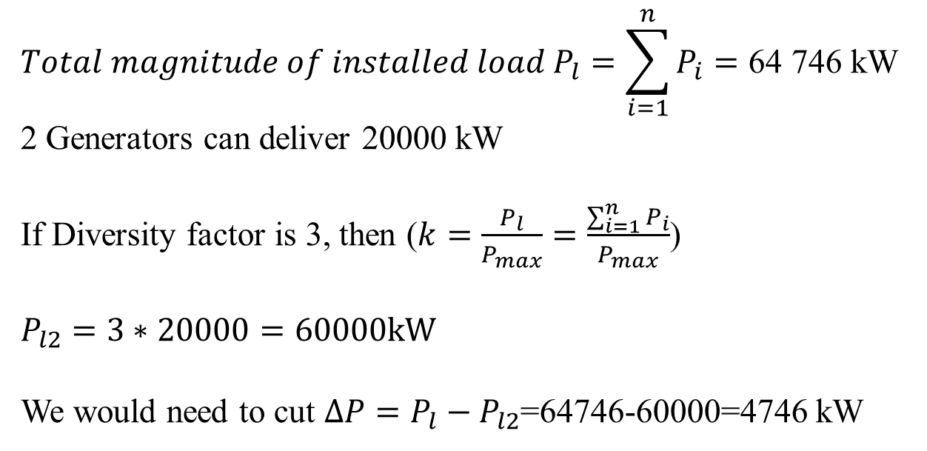
Question 4
d). The approximate peak magnitude of installed load capacity to be cut off to enable two generators to be used:
$$Total magnitude of installed load P_{l}=\sum_{i=1}^{n}{P_{i}}=\text{64} \text{746} \text{kW}$$
2 Generators can deliver 20000 kW
If Diversity factor is 3, then ($k=\frac{P_{l}}{P_{max}}=\frac{\sum_{i=1}^{n}{P_{i}}}{P_{max}}$)
$$P_{l2}=3∗20000=60000kW$$
We would need to cut $∆P=P_{l}−P_{l2}$=64746-60000=4746 kW

