Slide 1
Exercise 5
Power systems

Slide 2
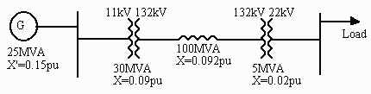
Question 1
A symmetrical three-phase short circuit occurs on the 22kV busbars of the circuit shown as a one-line diagram in the figure below. Calculate the fault current and the fault apparent power.

Slide 3

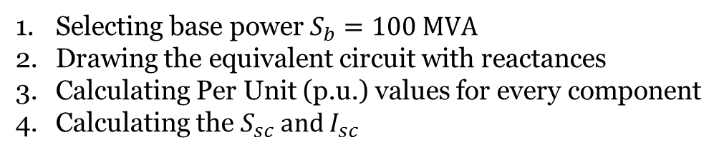
Question 1
Un2,t1
Un1,t2
Sn
Selecting base power $S_{b}=100 MVA$
Drawing the equivalent circuit with reactances
Calculating Per Unit (p.u.) values for every component
Calculating the $S_{sc} and I_{sc}$
Zk
$$S_{b}=100 MVA$$
Equivalent circuit:
x
x
x
x
t
g
t
2
1
l
Note: this simplifies
calculation if
Un2,t1 = Un1,t2

Slide 4

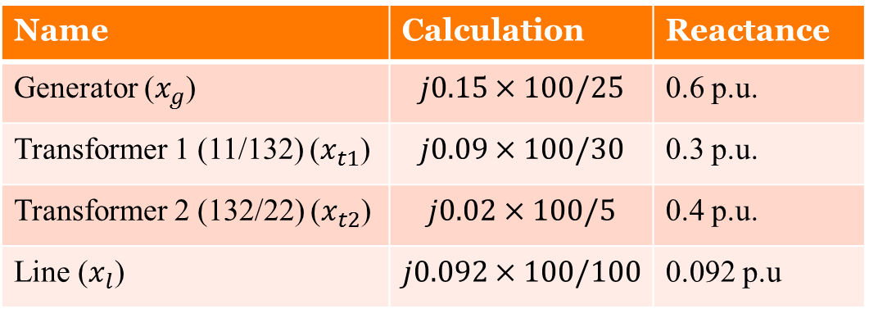
Question 1
Sn
Selecting base power $S_{b}=100 MVA$
Drawing the equivalent circuit with reactances
Calculating Per Unit (p.u.) values for every component
Calculating the $S_{sc} and I_{sc}$
Zk
x
x
x
x
t
g
t
2
1
l
Name | Calculation | Reactance
Generator ($x_{g}$) | $$j0.15×100/25$$ | 0.6 p.u.
Transformer 1 (11/132) ($x_{t1}$) | $$j0.09×100/30$$ | 0.3 p.u.
Transformer 2 (132/22) ($x_{t2}$) | $$j0.02×100/5$$ | 0.4 p.u.
Line ($x_{l}$) | $$j0.092×100/100$$ | 0.092 p.u
x
T
$x_{T}=x_{g}+x_{t1}$+$x_{t2}$+$x_{l}$=1.392

Slide 5
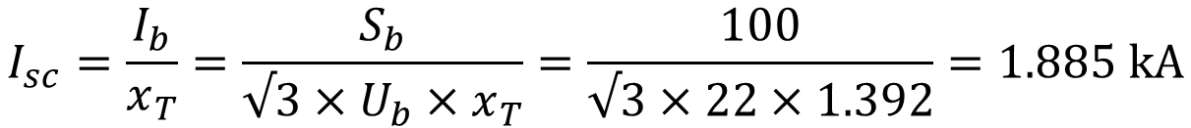
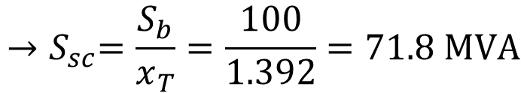

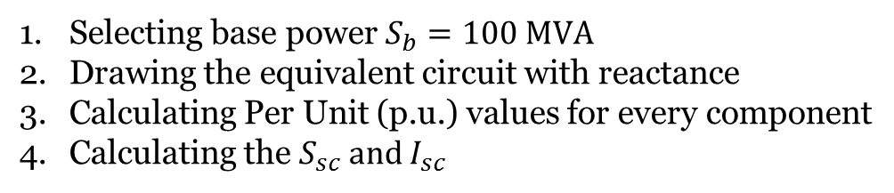
Question 1
Selecting base power $S_{b}=100 MVA$
Drawing the equivalent circuit with reactance
Calculating Per Unit (p.u.) values for every component
Calculating the $S_{sc} and I_{sc}$
$$S_{b}=100 MVA$$
Equivalent circuit:
X
T
$${→S}_{sc}=\frac{S_{b}}{x_{T}}=\frac{100}{1.392}=71.8 MVA$$
$$I_{sc}=\frac{I_{b}}{x_{T}}=\frac{S_{b}}{√3×U_{b}×x_{T}}=\frac{100}{√3×22×1.392}=1.885 kA$$

Slide 6
Question 2
Two 100-MVA, 20-kV turbo generators (each of transient reactance 0.2 pu) are connected, each through its own 100-MVA, 0.1 pu reactance transformer, to a common 132-kV busbar. From this busbar, a 132-kV feeder, 40 km in length, supplies an 11-kV load through a 132/11-kV transformer of 200 MVA rating and reactance 0.1 pu. If a balanced three-phase short circuit occurs on the low voltage terminals of the load transformer, determine, using a 100-MVA base, the fault current in the feeder and the rating of a suitable circuit breaker at the load end of the feeder. The feeder impedance per phase is (0.035+j0.14)Ω/km.

Slide 7
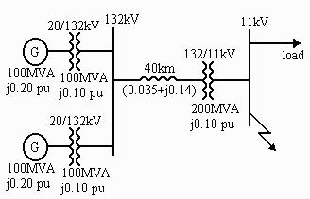
Question 2

Slide 8
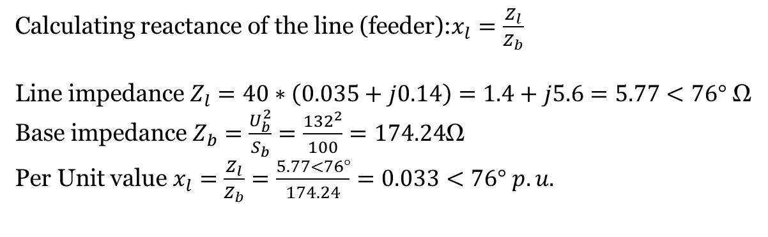
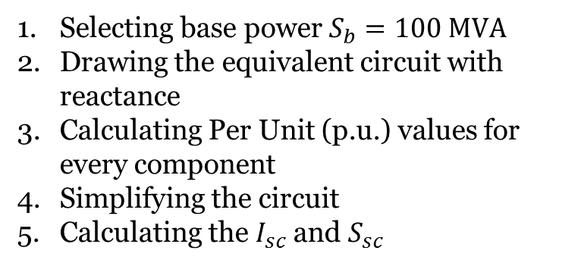
Question 2
Selecting base power $S_{b}=100 MVA$
Drawing the equivalent circuit with reactance
Calculating Per Unit (p.u.) values for every component
Simplifying the circuit
Calculating the$I_{sc}$ and $S_{sc}$
x
x
t
g
1
1
x
x
l
t
3
Equivalent circuit:
x
x
g
2
t
2
Calculating reactance of the line (feeder):$x_{l}=\frac{Z_{l}}{Z_{b}}$
Line impedance $Z_{l}=40∗\left(0.035+j0.14\right)=1.4+j5.6=5.77<76°$ Ω
Base impedance $Z_{b}=\frac{U_{b}^{2}}{S_{b}}=\frac{{132}^{2}}{100}=174.24$Ω
Per Unit value $x_{l}=\frac{Z_{l}}{Z_{b}}=\frac{5.77<76°}{174.24}=0.033<76° p.u.$

Slide 9


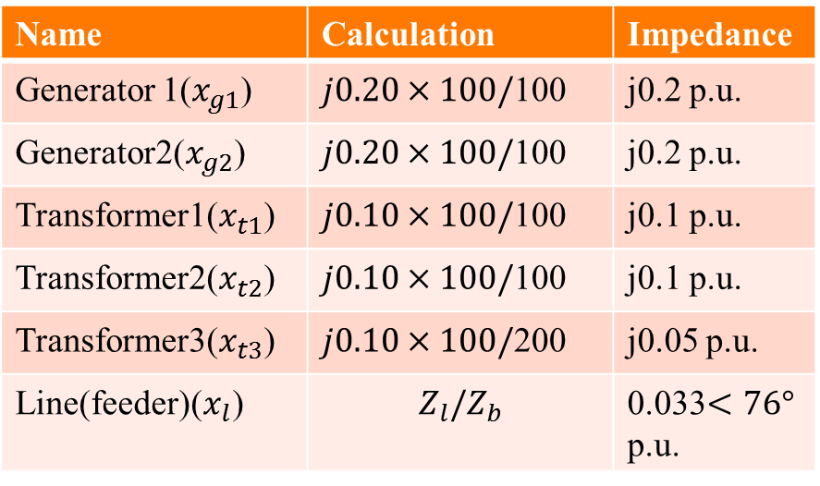
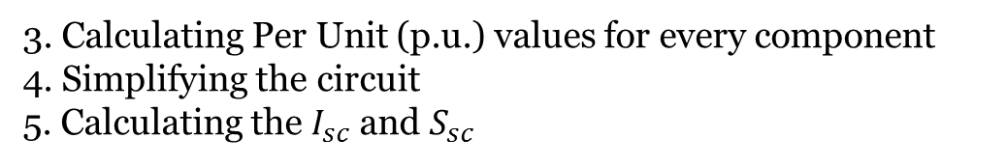
Question 2
3. Calculating Per Unit (p.u.) values for every component
4. Simplifying the circuit
5. Calculating the$I_{sc}$ and $S_{sc}$
j0.2
j0.1
Name | Calculation | Impedance
Generator 1($x_{g1}$) | $j0.20×100/$100 | j0.2 p.u.
Generator2($x_{g2}$) | $j0.20×100/$100 | j0.2 p.u.
Transformer1($x_{t1}$) | $j0.10×100/$100 | j0.1 p.u.
Transformer2($x_{t2}$) | $j0.10×100/$100 | j0.1 p.u.
Transformer3($x_{t3}$) | $j0.10×100/$200 | j0.05 p.u.
Line(feeder)($x_{l}$) | $$Z_{l}{/Z}_{b}$$ | 0.033$<76°$ p.u.
0.033$<76°$
j0.2
j0.1
j0.05
j0.3
j0.3
0.0824 $<84.44°$

Slide 10

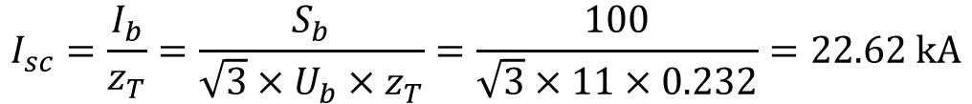




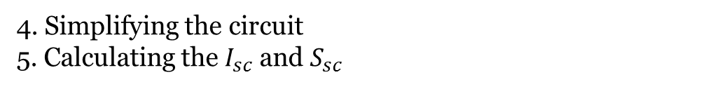
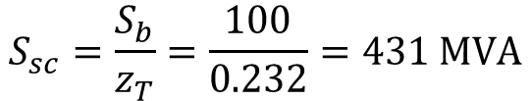
Question 2
4. Simplifying the circuit
5. Calculating the$I_{sc}$ and $S_{sc}$
j0.3
j0.3
Parallel: $x_{eq}=\frac{j0.3×j0.3}{j0.3+j0.3}=j0.15p.u.$
0.0824 $<84.44°$
j0.15
0.0824$<84.44°$
$z_{T}=0.232<88°p.u.$ ${ →z}_{T}=0.232p.u.$
$$I_{sc}=\frac{I_{b}}{z_{T}}=\frac{S_{b}}{\sqrt{3}×U_{b}×z_{T}}=\frac{100}{\sqrt{3}×11×0.232}=22.62 kA$$
0.232 $<88°$
$$S_{sc}=\frac{S_{b}}{z_{T}}=\frac{100}{0.232}=431 MVA$$

Slide 11
Question 3
A single line-to-earth fault occurs in a radial transmission system. The following sequences exist between the source of supply (an infinite busbar) of voltage 1 pu to the point of the fault: Z₁ = (0.3+j0.6)pu, Z₂ = (0.3+j0.55)pu, Z₀ = (1+j0.78)pu. The fault path to earth has a resistance of 0.66 pu. Determine the fault current and the voltage at the point of the fault.

Slide 12
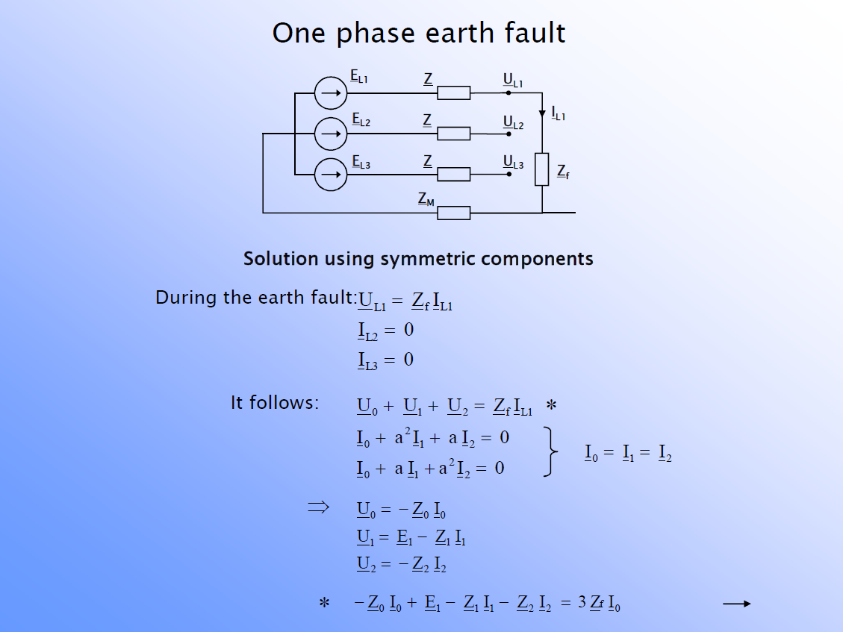
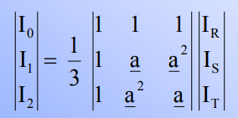
Question 3 (W 7.8)
Some background first
→I0 =1/3 x (IR+0+0)
→ IR=3 I0 (=IL1)
Inverse matrix also provides the same solution
IS =0 (= IL2)
IT=0 (= IL3)

Slide 13
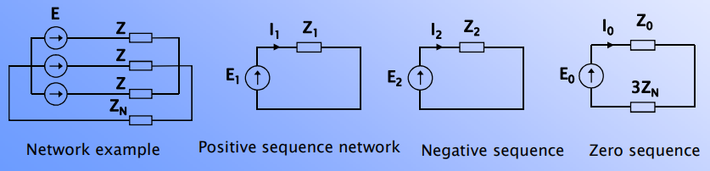

Question 3
Generally:
Z
U1
U2
U0
3ZM
ZM
From previous slide:
and IL1=3 I0

Slide 14
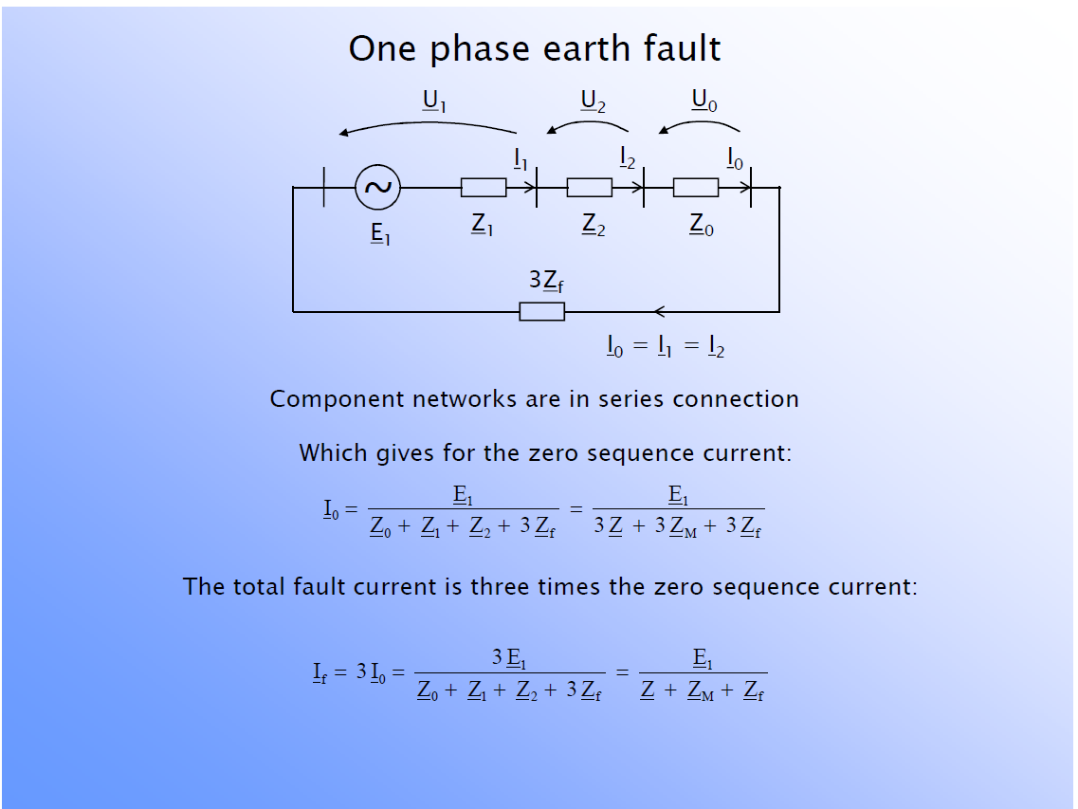
Question 3 (W 7.8)
in one-phase earth fault
=IL1

Slide 15
Question 3
So we can utilize the following equations:

