Slide 1
Lecture 2
Scarcity and choice
Juuso Välimäki
Sep 7, 2022

Slide 2
Main topic in this lecture: choice
How much should I work?
Tradeoff between free time and fruits of labor
  Home production: studying for an exam, agricultural production within the family
  Working for a wage
Should I spend now or should I save for retirement?
Tradeoff between consuming when young or in retirement
  Different ways to save
  How about borrowing now and paying later?

Slide 3
Continuing in the next lecture:
How can we understand work and consumption
Across countries?
Over time?
The role of technological progress in this?
Understanding individual labor market decisions
How do different welfare schemes affect the tradeoff between free time and work?
First insights into basic income and means tested social transfers

Slide 4
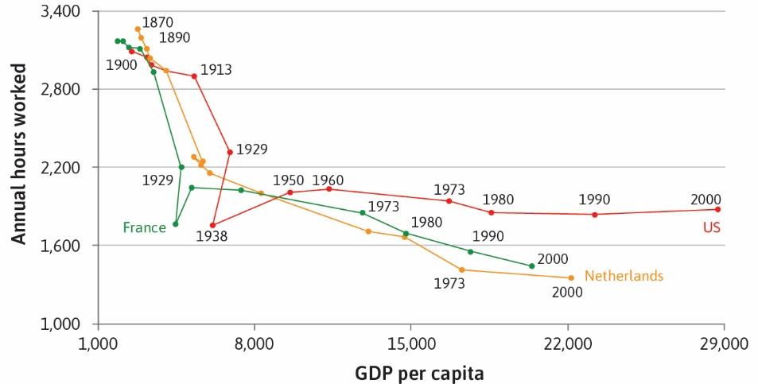
Big picture goal: how can we make sense of income and working hours across times and across countries?
Source: Maddison Project 2013 via The Economy

Slide 5
Trade-off between work and leisure:
studying to gain points on an exam
Students choose how many hours to study which affects
their grade (GPA).
Guided by introspection and also some empirical evidence,
we assume a positive relationship between expected GPA
and the number of hours studied.
Key issues:
i) What grade can you expect if you study 8 hours, 6 hours, etc.?
-> Feasible set, production function
ii) How do you compare 60 points at 4 hours of studying to 70 points
at 6 hours of study (or 80 at 9 hours etc.)? -> Preferences, indifference curves
These are conceptually different questions!

Slide 6
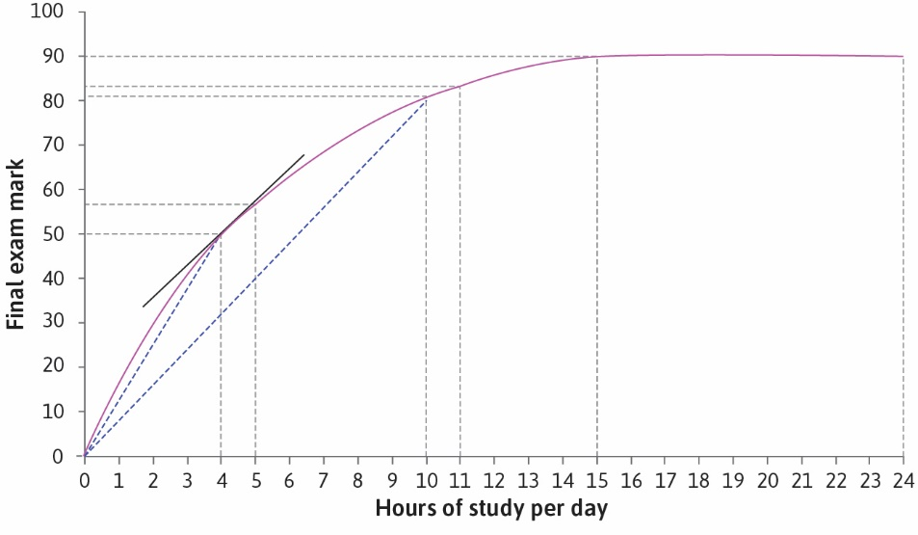
Production function for grade points
Here: How does studying (input into production) translate into points (output)?
More generally:
Production functions show how inputs (e.g. labour)
translate into outputs
(e.g. goods and services), holding other factors constant (e.g. production technology)

Slide 7
What can production functions tell us?
Marginal product
Change in output resulting from a small change in input (evaluated at a given point, holding other inputs constant)
2. Average product
Divide output by the units of input
Slope of tangent = Marginal product (4 hours of study)
Slope to origin = Average product
(4 hours of study)

Slide 8
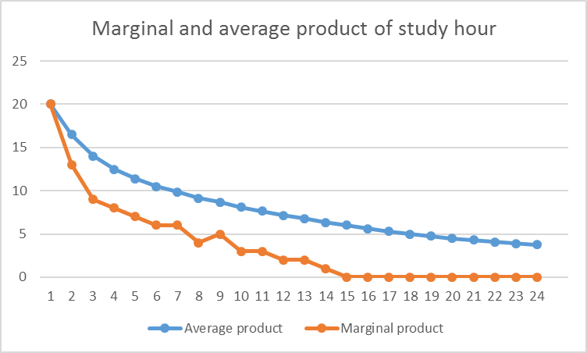
Studying example
Diminishing marginal product: Studying becomes (generally)
less productive, the more you study.

Slide 9
Indifference Curves
Choices depend on preferences:
Given two desirable goods (GPA and leisure), ask hypothetical questions:
Which of the two options would you choose:
  Option A giving x hours of leisure and a GPA of y
  Option B giving x’ hours of leisure and a GPA of y’
View the options as points in a coordinate system where leisure is on
The horizontal axis and GPA on the vertical axis
Now different points in the plane correspond to different combinations of GPA and leisure
How to picture preferences in this plane?

Slide 10
An indifference curve through point (x,y) in the plane gives all combinations (x’,y’) that are equally good as (x,y)
Since a higher GPA is preferred to a lower GPA and since more leisure is preferred to less leisure, (x,y) and (x’,y’) cannot be on the same indifference curve if x>x’ and y>y’
This means that indifference curves are downward sloping
We call the absolute value of the slope of an indifference curve the Marginal Rate of Substitution (MRS)
The MRS measures how many additional points on the GPA you need to give up a (small) unit of leisure or alternatively how many points on you GPA you are willing to lose to get an additional (small) unit of leisure

Slide 11
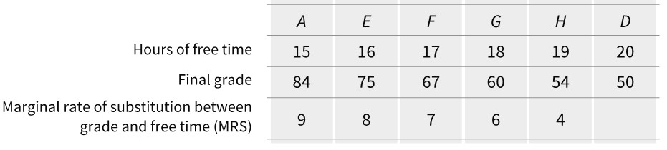
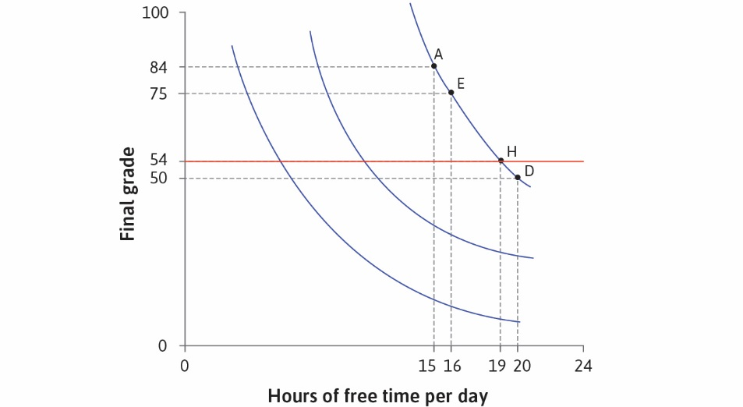
Indifference Curves: An Example

Slide 12
How to find the indifference curves?
Option A gives 15h of free time and GPA 84
Option B gives 16h of free time and GPA y
If y is larger than 84, you take option B
If y small enough, you take A
Calibrate y so that you like the two options equally much
This gives you the point (16, y(16)) on the same indifference curve as (15,84)
Repeat the process for each x hours of free time to get (x, y(x)) on the indifference curve through (15, 84)
For every in the plane, you can find an indifference curve through it using this procedure

Slide 13
Indifference maps 1
Grade points
Increasing preference
IC₃ IC₂
IC₁
0
Leisure
Figure: Indifference curves of a student

Slide 14
Indifference maps 2
Grade points
IC₁
IC₂
IC₃
Increasing preference
0 Leisure
Figure: Indifference curves of another student

Slide 15
How to think about indifference curves?
Indifference curves are individual and subjective:
  There are no right and wrong indifference curves
  Two decision makers have generally different shapes for their indifference curves: some people enjoy leisure more while some appreciate exam grades more
This is just one instance of choice under scarcity
  Time is scarce so you manage carefully your time budget
  But other resources are scarce too: choosing how to use a fixed budget on food or clothing, or more concretely between apples and oranges

Slide 16
Indifference maps 3
Grade points
IC₁
IC₃
0
Leisure
Figure: Is this possible?

Slide 17
How to think about indifference curves?
If we plot an indifference curve in the usual coordinate system and if the decision maker wants to have more of each good, indifference curves have a negative slope
Indifference curves do not cross each other
Curves closer to origin represent worse alternatives than curves further from the origin
Can indifference curves be straight lines?
Why are the indifference curves often drawn with a diminishing slope as we increase the amount of good on x-axis?

Slide 18
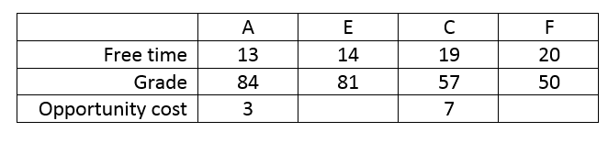
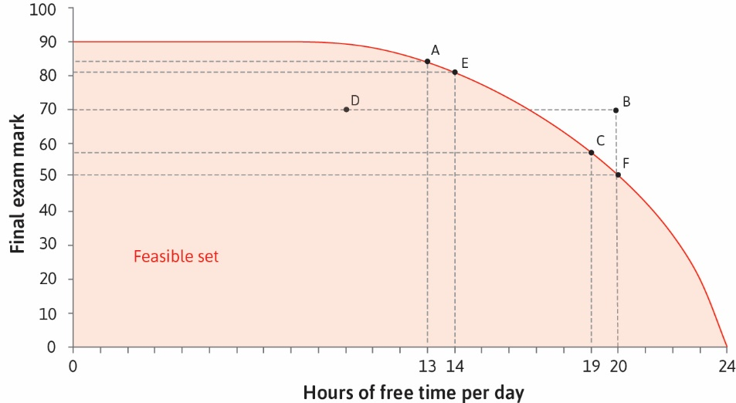
The Feasible Frontier
The feasible frontier shows the maximum output
that can be achieved with a
given amount of input
The marginal rate of transformation (MRT) is the
absolute value of the slope of the feasible frontier.
It tells how many points you lose if you increase your free time per day by an hour.

Slide 19
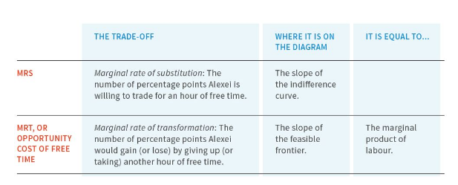
Constrained choice problem
Model of how individuals choose, given their preferences and the constraints they face, when the things they value are scarce.
Studying example: Free time and exam score are scarce because they are both goods, each with an opportunity cost.

Slide 20
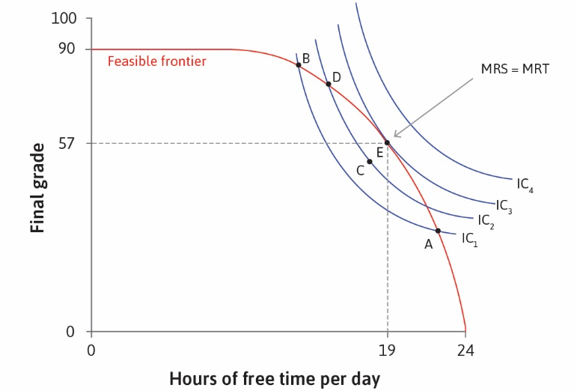
Optimal Decision Making
How to find optimal choices? Start by looking for points where
MRS = MRT
If MRS is larger than MRT as at point D in the figure, you should study less
If MRS is smaller than MRT (as at A), you should study more.
Can you give a formal argument for this?

Slide 21
More on optimal choice
It is optimal to choose an option such that no other option in the feasible set is better. This means that no other feasible option is on a better indifference curve
Does this imply that MRS = MRT?
What if the indifference curves are straight lines? In this case, we say that the goods on the two axis are perfect substitutes for the decision maker.
It could well happen that no point on the feasible frontier satisfies MRS=MRT
If this is the case, optimal choice is to choose zero of one of the goods (corner solution).
Draw a feasible frontier that is given by a line segment and a feasible frontier also given by a line segment but with a different slope.
Determine from the picture which of the goods is consumed (depending on the comparison of MRS and MRT) and interpret your finding in everyday language.

Slide 22
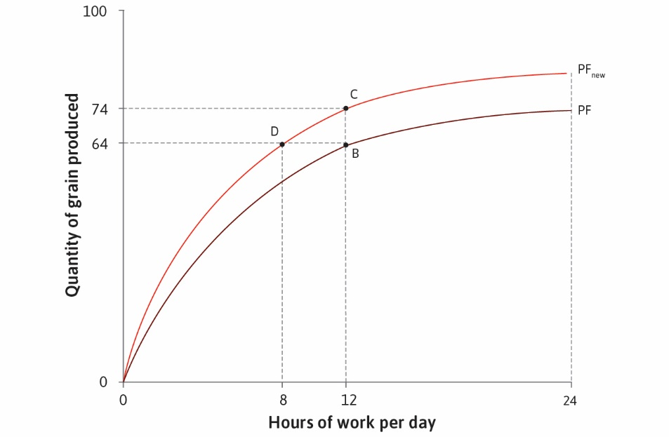
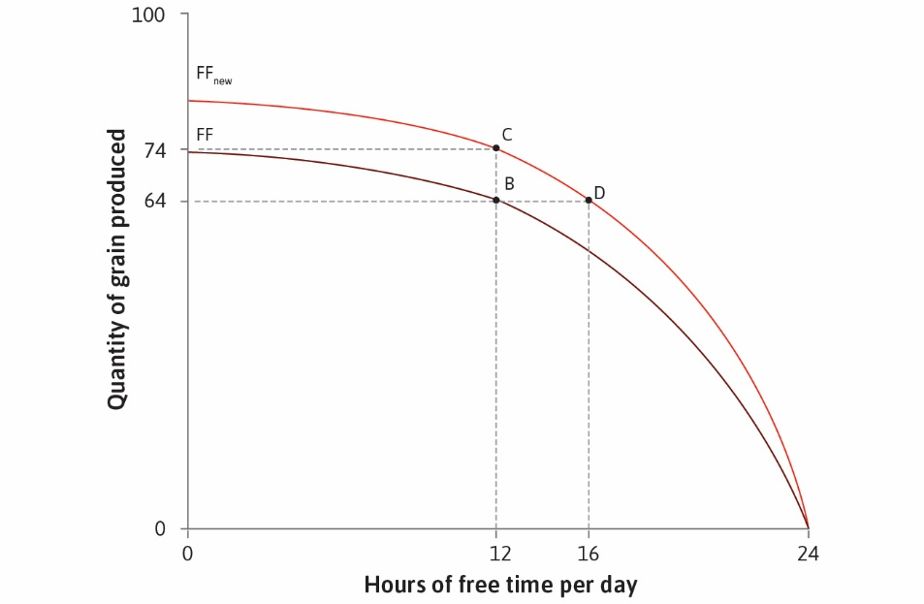
Another example: Grain production
Tradeoff between grain produced and free time
Technological change shifts the production function upwards,
and expands the feasible frontier

Slide 23
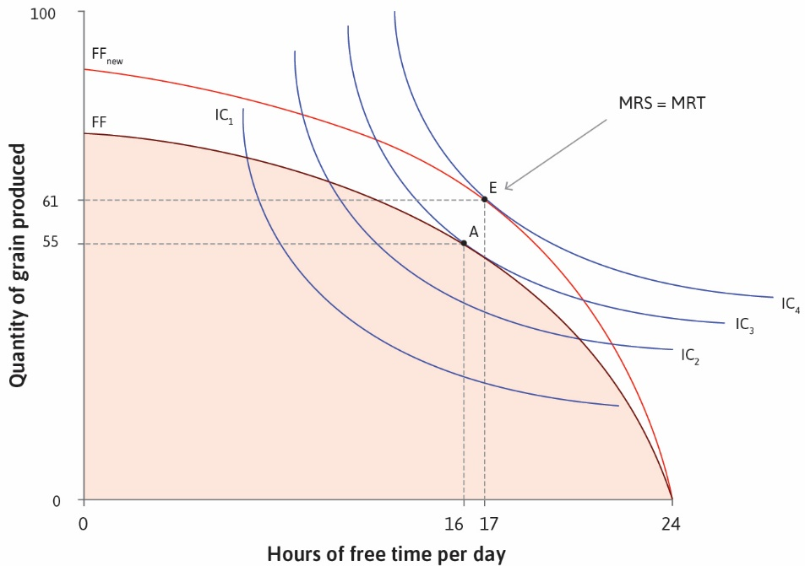
What happens when the feasible frontier changes?
Technological progress makes it feasible to both consume more and have more free time.
Choice of free time/consumption depends on relative preferences and willingness to substitute one good for another.
Can you say for sure if technological progress leads to more grain production? More leisure?

Slide 24
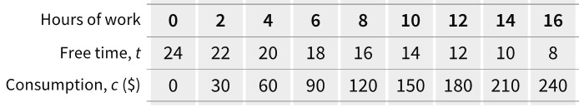
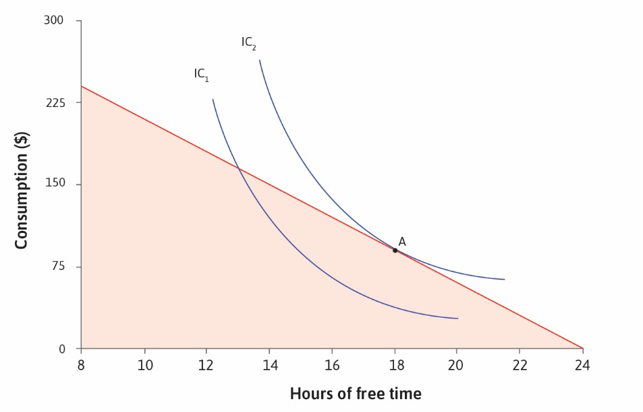
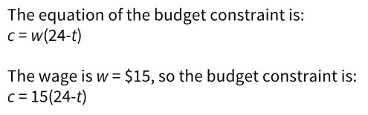
Market example: Working for wages
Budget constraint: consumption no larger than labor income. Feasible frontier is given by the budget constraint.
Indifference curves demonstrate preferences over consumption and free time

Slide 25
Other examples
We can think of choice under scarcity in a number of other examples:
Allocating budget between food and shelter
  Food and clothing on the axis
  Feasible set given by budget constraint that total spending cannot exceed total budget
  Any ideas for the shape of the indifference curves?
Saving for retirement
  Consumption when young and consumption when old on the axis
  Budget set depends on saving and borrowing possibilities
In problem set 1, you will get practice on these and other settings

Slide 26
Key ideas and concepts in this lecture
Feasible frontier, production function
Marginal rate of transformation
Indifference curves, marginal rate of substitution
Opportunity cost
Feasible set
Optimal choice from feasible set

Slide 27
Next lecture
Changes in the feasible set:
  changes in wealth
  changes in prices
  changes in technology
Income and substitution effects
Applications of the model:
  Consumption and work across time and space
  Social welfare schemes and the choice of working hours

