Slide 1

Principles of Economics I
Juuso Välimäki
Lecture 1: Introduction
Fall 2022

Slide 2
Welcome!
Teacher: Juuso Välimäki
  juuso.valimaki@aalto.fi
  https://people.aalto.fi/juuso.valimaki
TA and review sessions: Hung Le
  hung.h.le@aalto.fi
Lectures: Tue 10-12, Thu 10-12 V002
This week: No lecture on Thu (Walrus Day), Extra lecture Wednesday 7.9. 13-15 in U135a
Review Session: Fri 10-12 T004

Slide 3
Course organization
Course Homepage
  mycourses.aalto.fi -> my own courses-> Principles of Economics I
  Lecture slides, problem sets, return and grading of problem sets
Textbook
  CORE-team: The Economy
    Relevant chapters indicated in the Syllabus of the course (available in the Materials for week 1)
    Electronic version of the book free at www.core-econ.org/the-economy
Lectures
  Indicate the central content in the textbook and develop some themes further

Slide 4
Learning aims and objectives
Principles of Economics (4 separate units) aims to
  Provide an overall view of economic activity in modern societies
  Take a first look at economic modeling and economic analysis
  Give an introduction to the use of data in economics
  Introduce economics behind major societal challenges
Objectives for Part I
  Understanding individual economic decisions and decisions within a group
  Understand the functioning of different types of markets

Slide 5
Assessment and grading
80% of your grade is based on final examination
20% of your grade based on problem sets
Extra credit for active classroom participation
Answers to problem sets returned via MyCourses, peer grading of the exercises (explained in the review session on Friday)
Review sessions: discuss the lecture material and suggested solutions to problem sets
  An ideal place to ask questions regarding course material
It is essential to complete the problem sets!
The course (160h) assumes a large amount of independent work on top of the lectures

Slide 6
How to get the most from the course?
Familiarize yourself with the topic of the lecture in advance
  Syllabus indicates the relevant part of the course textbook
Check that you have understood the main concepts in the lecture. You can do this using the interactive tools in the textbook and by reviewing the list of concepts provided at the end of each chapter
Concentrate on the most relevant concepts and ideas
  One of the learning goals in this course is that you should learn to identify the key ideas
  Lecture material and problem sets are designed with this in mind

Slide 7
Feedback
You will get feedback on
  Performance in the problem sets
  Performance in the final examination
We want to get your feedback
  During lectures: ask questions! If you do not understand something, many others will have the same problem
  After lectures: I am available for short questions immediately after class and can set up an appointment for longer ones
  In review session

Slide 8
Lecture 1: Outline
Course Logistics
  Previous slides
The Economy: Big Picture
  What is an economy?
  Historical perspective (just a tiny glimpse…)
Economics: Big Picture
  What are economic models
  A first look at economic modeling: comparative advantage

Slide 9
The Economy: Big Picture

Slide 10
Who is in charge?
About two years after the break-up of the Soviet Union I was in discussion with a senior Russian official whose job it was to direct the production of bread in St. Petersburg. "Please understand that we are keen to move towards a market system", he told me. "But we need to understand the fundamental details of how such a system works. Tell me, for example: who is in charge of the supply of bread to the population of London?”
There was nothing naive about his question, because the answer ("nobody is in charge"), when one thinks carefully about it, is astonishingly hard to believe. Only in the industrialised West have we forgotten just how strange it is.
Paul Seabright (2010): The Company of Strangers: A Natural History of Economic Life

Slide 11
Coordination of activities?
Somehow all of the activities seem to get coordinated. There's a taxi to get you to the airport. There's butter and cheese for lunch on the airplane. There are refineries to make the airplane fuel and trucks to transport it, cement for the runways, electricity for the escalators, and, most important of all, passengers who want to fly where the airplanes are going. […] if you are in a mood to be amazed, it can amaze you that the system works at all. Amazement needn't be admiration: once you understand the system you may think there are better ones, or better ways to make this system work.
- Thomas Schelling (1978): Micromotives and Macrobehavior

Slide 12
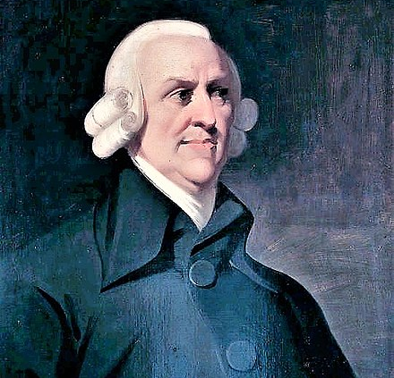
Adam Smith:
[...] he intends only his own gain, and he is in this, as in many other cases, led by an invisible hand to promote an end which was no part of his intention. Nor is it always the worse for the society that it was not part of it. By pursuing his own interest he frequently promotes that of the society more effectually than when he really intends to promote it.
Adam Smith (1776): An Inquiry into the Nature and Causes of the Wealth of Nations

Slide 13
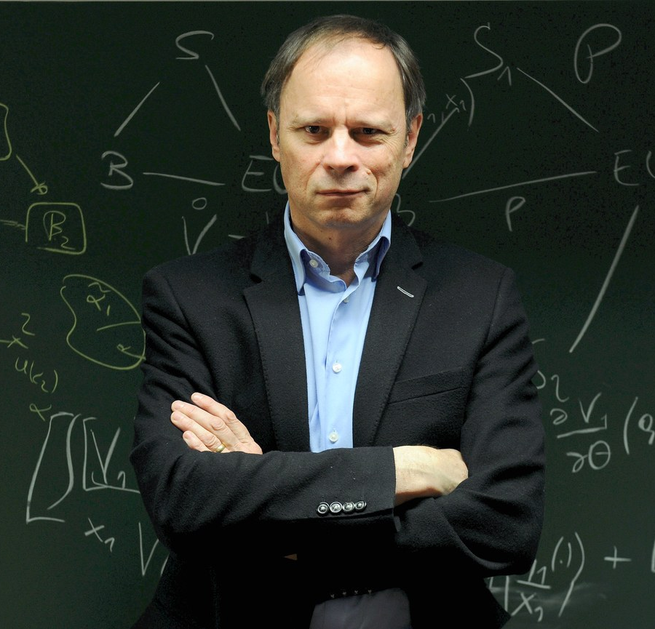
Jean Tirole:
Economists have long extolled the virtues of markets. Unfettered competition protects consumers from the political influence of lobbies and forces producers to deliver products and services at cost. Alas, competition is rarely perfect, markets fail, and market power—the firms’ ability to raise price substantially above cost or to offer low quality—must be kept in check.
2017 Nobel lecture by Jean Tirole: “Market Failures and Public Policy”

Slide 14
Was the world always like this?
Up to 1700, vast majority of world population almost at subsistence level
Malthusian view of the world as a biological system
  Economics: dismal science
How can we measure economic welfare in times before national accounts?
Historical data on living conditions: mortality, infant mortality, measures of agricultural production etc.
These days, fantastic datasources can give a quick answer, e.g. https://ourworldindata.org/a-history-of-global-living-conditions-in-5-charts

Slide 15
Case: Infant mortality in Finland: Deaths at 1 year of age per 1000 newborns
Source: Statistics Finland public database

Slide 16
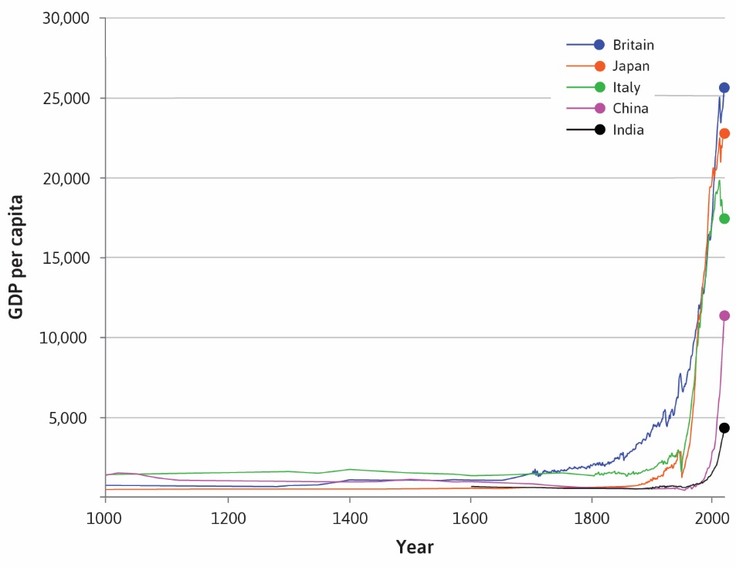
GDP per capita, the hockey stick of history
Source: Core Project: The Economy

Slide 17
What happened?
Technological progress
  But this has happened throughout history
Incentives for private risk taking
  Private ownership and freedom to trade
  Firms as a means of organizing production
Sufficiently large markets
  Colonial system
  Developments in transportation
Economic force of specialization and trade

Slide 18


Slide 19
Economics: Big Picture

Slide 20
What is economics?
Definitions…
Alfred Marshall (1890): Political Economy or Economics is a study of mankind in the ordinary business of life; it examines that part of individual and social action which is most closely connected with the attainment and with the use of the material requisites of wellbeing. Thus it is on the one side a study of wealth; and on the other, and more important side, a part of the study of man.
Lionel Robbins (1932): Economics is a science which studies human behaviour as a relationship between ends and scarce means which have alternative uses.
core-econ.org: The study of how people interact with each other and with their natural surroundings in providing their livelihoods, and how this changes over time.

Slide 21
Positive and normative economics
Positive economics:
How does the economy operate?
What drives economic decisions?
Typical question of positive economics:
  How does the composition of a living neighborhood affect the educational attainment of its children?
  How much economic output was lost due to the pandamic?
  What happens to the price of coal if the production of solar panels becomes cheaper?

Slide 22
Normative economics:
Starting point is a set of criteria for desirable societal outcomes
What kinds of systems produce desirable outcomes?
Typical questions of normative economics:
  What are the features of a fair tax system? Is flat tax or a progressive tax fair?
  When is an outcome deemed economically efficient? Does a competitive market generate an efficient outcome?
  Positive/Normative: How can we improve on the existing institutions to attain more efficient outcomes / more fair outcomes?
Choosing the criteria is outside of economics but economic analysis helps in implementing and understanding them

Slide 23
Scientific method
There is no final answer, our knowledge is always imperfect
  If we find contradicting evidence, we should be ready to re-evaluate our thinking and methods
Forming hypothesis and testing them
  Gather data on a phenomenon of interest
  Based on the data form a scientific hypothesis to explain the data
  Derive implications of the hypothesis that can be falsified
    Falsifiable claim = a claim that can be disproved with some data
  Test the hypothesis by a suitable empirical method
  Based on evidence, readjust the hypothesis

Slide 24
Economic models
The world is too complicated (everything depends on everything…). We need models that
  Simplify reality by concentrating on essential features (analysis)
  Clarify our understanding of the underlying reality
Thought experiments
  Idealizations, test tunnels, simulators…
  Never realistic (a feature and not a bug) but tells us something real
Language of economics is mathematics
  Makes the assumptions and the logical coherence of models transparent
    Dialect in this course mostly graphical analysis, but in later courses also statistics and calculus

Slide 25
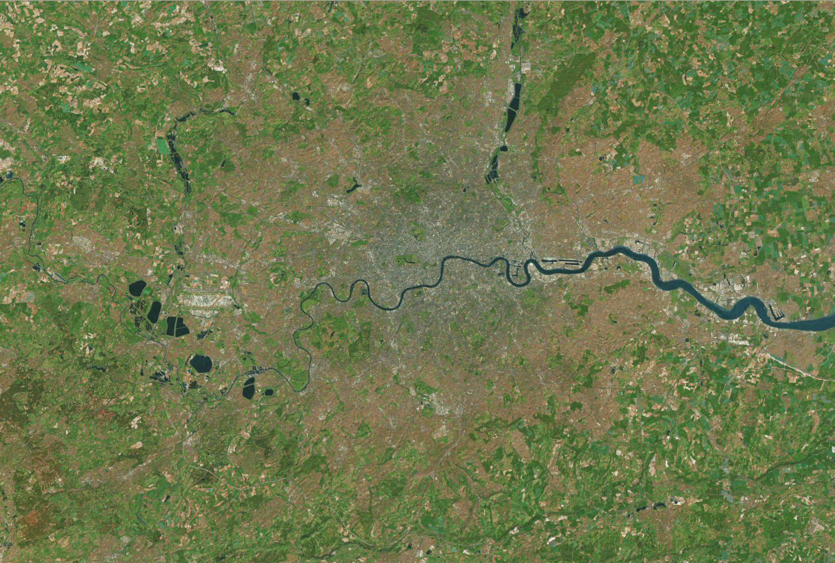
Map: London

Slide 26
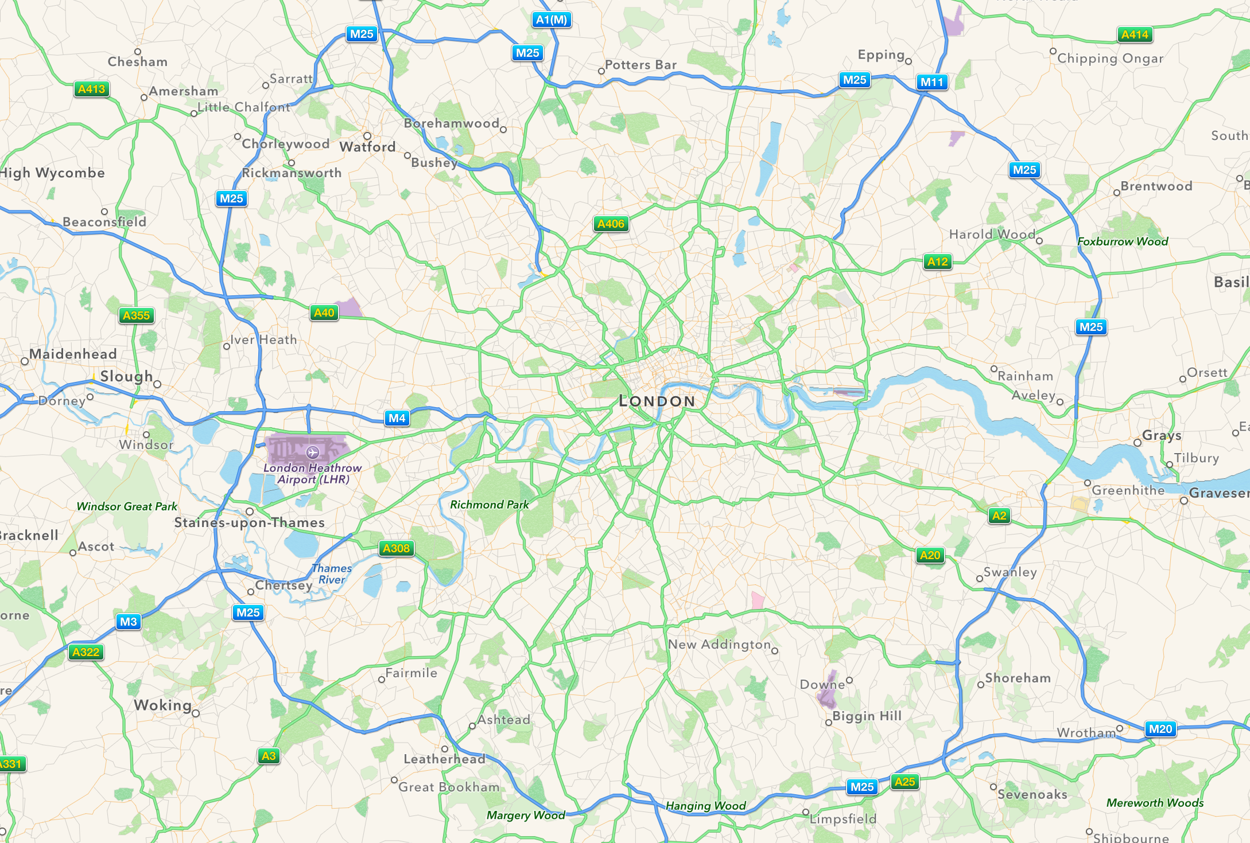
Model of London

Slide 27
Another model of London

Slide 28
Comparative advantage and specialization
A first look ot economic models

Slide 29
A simple economic model of trade
  Imagine a world with only two countries: England and Portugal
  Trading in two goods: cloth and wine
  A single factor of production (labor)
  England has 18 000 h of labor per year, Portugal has 8 000
Assume that production of
cloth and wine requires labor
as follows:
 | cloth | wine
England | 2 h / meter | 6 h / barrel
Portugal | 1 h / meter | 2 h / barrel
Can the two countries both benefit from trade?

Slide 30
England’s production possibilities
cloth
By splitting total hours between cloth and wine, England can achieve any combination on the green line:
9000
4500
cloth | wine
9000 | 0
4500 | 1500
0 | 3000
0
1500
3000
wine

Slide 31
Portugal’s production possibilities
cloth
By splitting total hours between cloth and wine, Portugal can achieve any combination on the green line:
8000
cloth | wine
8000 | 0
4000 | 2000
0 | 4000
4000
0
2000
4000
wine

Slide 32
Production and consumption in England
If England produces alone and does not trade, production equals consumption
What if the Portuguese are willing to sell a barrel of wine for 2,5 meters of cloth?
Without trade, a barrel of
Wine takes 6h of work
With trade
Producing 2,5 meters of cloth and trading for a barrel of wine takes 2,5x2h = 5h.
No trade
0
3000
3600

Slide 33
Portugal’s possibilities
If the Portuguese specialize in wine and sell it for 2,5 m of cloth / barrel their consumption possibilities improve
Trade is mutually beneficial
Why?
10000
8000
With trade
No trade
0
4000

Slide 34
Opportunity cost
Producing a barrel of wine costs three meters of cloth for England
  Six hours of work to produce the wine versus two hours for a meter of cloth
  The opportunity costs of a barrel of wine is three meters of cloth
  Trade is beneficial for England if they can exchange less than three meters of cloth for a barrel of wine
The opportunity cost of wine for Portugal is two meters of cloth by the same logic
  Trade benefits Portugal if they can get more than two meters of cloth for a barrel of wine
Trade is mutually beneficial if one barrel of wine trades for more than two but less than three meters of cloth

Slide 35
Comparative advantage
The country with the smallest opportunity cost of producing a good has a comparative advantage in it
  But countries do not trade: individuals and firms do!
  The same logic applies to firms, to individuals etc.
Trade allows for a specialization that is not possible alone
Notice thst specialization is advantageous here even without benefits from large scale
David Ricardo formulated the principle of comparative advantage, it is equally valid now 200 years later
Multiple other reasons for specialization: scale economies, learning by doing etc. Adam Smith had clearly some of these in mind in his praise for specialization.
More on trade in the section on competitive markets

Slide 36
Tentative course schedule
Lecture
1 | The economy and economics
2-3 | Scarcity and choice (Unit 3)
4-5 | Strategic Interactions (Unit 4)
6 | Surplus and conflict (Unit 5)
7-8 | The firm (Units 6 and 7)
9-10 | Competitive markets (Units 8 and 11)
11 | Banks, money and credit (Unit 10)
12 | Recap

