Slide 1
Calculating Marketing ROI

Slide 2
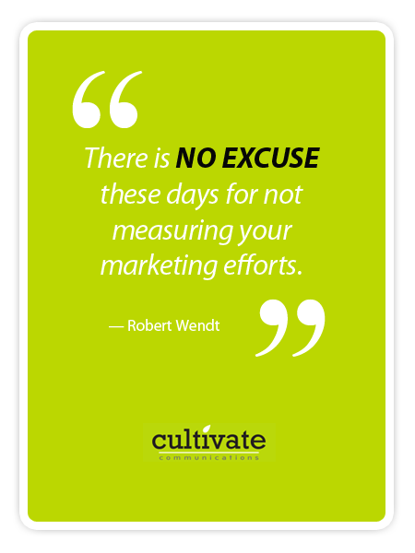
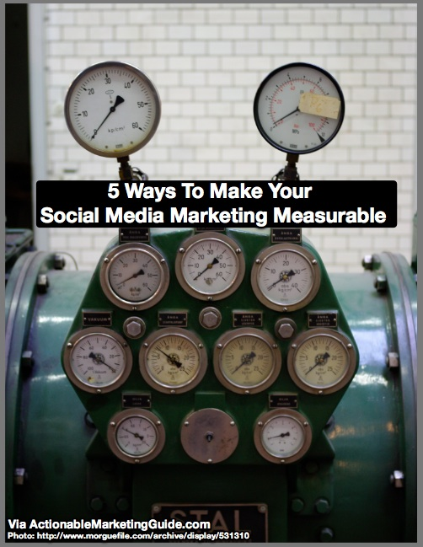
Age of Measurability & Metrics

Slide 3
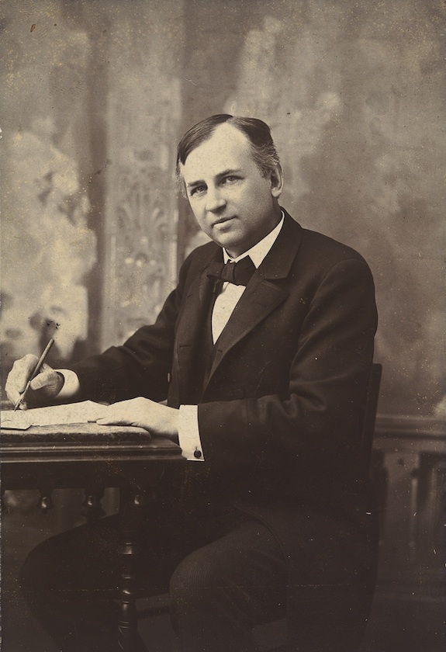
What’s the big deal?
Increase profits, transparency and accountability
Optimize marketing resource allocation
Legitimize Marketing’s influence within the firm
“Half the money I spend on advertising is wasted;
the trouble is I don’t know which half.”
- John Wanamaker

Slide 4
Marketing return on investment (ROI)
The net financial value attributable to specific marketing actions, as a percentage of the money invested into those specific activities.

Slide 5
Marketing return on investment (ROI)
Incremental financial value generated by marketing – Cost of marketing
Cost of marketing

Slide 6
Marketing return on investment (ROI)
Incremental financial value generated by marketing – Cost of marketing
Cost of marketing
I run a small online business. In October, I spent 1 000 EUR on Facebook advertising. My sales for October were 10 300 EUR, up 1 700 EUR compared to September (8 600 EUR). My Marketing ROI is (1700 – 1000) / 1000 = 70%.

Slide 7
Marketing ROI
The cost side of ROI
Easier to estimate:
Remember to include all costs
E.g., ad production costs as well as ad spend
Most digital analytics tools only take media expenditure into account
Generally a good idea to include the cost of goods/services sold in both the cost and return side, but many people don’t bother
Difficult to do in service business
Many digital businesses assume the cost of serving an additional customer is negligible
The return side of ROI
Much more difficult to calculate accurately:
Baseline/lift
Funnel conversions
Customer equity
Comparable costs
Marketing assets
Incremental financial value generated by marketing – Cost of marketing
Cost of marketing

Slide 8
Baseline/lift
How much more goods/services has the marketer sold as a result of a marketing investment?
Sales revenue = Baseline + Lift
Baseline: “Usual” revenue as a function of ongoing marketing activities, competitors’ actions, weather, etc.
Lift: Incremental revenue attributed to marketing investment
MROI =
Lift (€) * contribution margin (%) – Cost of marketing (€)
Cost of marketing (€)
Note: Contribution Margin Ratio = Sales Revenue – Variable Costs
Sales Revenue

Slide 9
*Explaining Contribution Margin
Sales price of 1 burger = 2$
Cost of all the ingredients and labor for making 1 burger = 1.5$
Contribution Margin = 2$ - 1.5$ = 25%
2$

Slide 10
Funnel conversions
8000 LinkedIn users click on an ad (€2 cost-per-click)
Instead of modeling sales directly, MROI can also be calculated based on generated leads and historical conversion rate and sales data.
8% leaves contact details
40% requests a quote
25% close rate
MROI = 1000 * 8000 * 8% * 40% * 25% - 16 000
16 000
MROI = 300%
Average transaction profit (€) * Leads * Conversion rate – Cost of marketing (€)
Cost of marketing (€)
Average transaction profit = € 1000

Slide 11
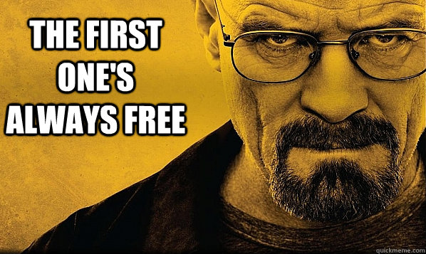
Customer equity
In addition to calculating short-term sales from a campaign (baseline/lift) OR
Projected one-off sales from leads (funnel conversions)
We can also estimate the value of a marketing investment by calculating changes to customer equity, i.e. change to the customer lifetime value* of the firm’s customers.
This way of estimating MROI is most applicable to business models that receive cashflows over extended periods of time rather than one-off sales.
*We will look at CLV during week 5 of the course.

Slide 12
Comparable cost savings
Estimated cost savings due to marketing activities
Anheuser-Busch-InBev spends ~$50 million annually on Superbowl ads for its brands (plus production costs!).
How much money would it cost to achieve equivalent increase in reach, customer-based brand equity, sales, etc.?
Cost savings from running Superbowl ads (€) – Cost of running the Superbowl ads(€)
Cost of running the Superbowl ads (€)

Slide 13
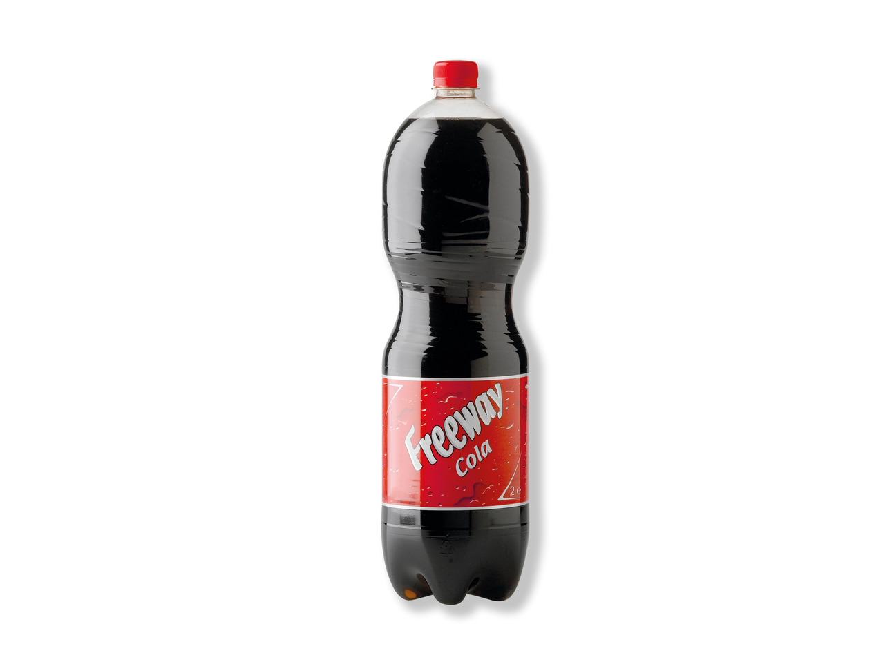
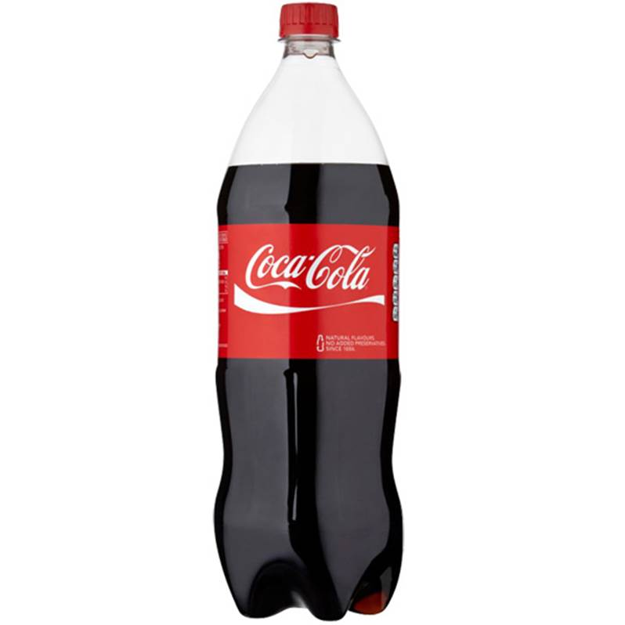
Building Marketing assets
Estimated value of accrued marketing assets (e.g., the brand value or ability to charge a premium) as a result of marketing activities.
Cost side is fairly straightforward
Revenue side requires assessing the impact of:
Marketing Activity => Marketing Asset (e.g., how did marketing activity affect metrics such as brand awareness, brand perception)
Marketing Asset => Buying Behavior (how does increased brand awareness affect sales, price premiums. etc.)
>2x

Slide 14
The return in MROI
Return-side valuation methods
Baseline/lift
Funnel conversions
Customer equity
Comparable costs
Marketing assets
Methods for estimating the return
Attribution (today)
Experiments (next week)
Modeling with regression (week 4)
Customer lifetime value (week 5)
Machine learning (week 6)

Slide 15
Attribution modeling

Slide 16
Attribution modeling
I run a small online business. In October, I spent 1 000 EUR on Facebook advertising. My sales for October were 10 300 EUR, up 1 700 EUR compared to September (8 600 EUR). My Marketing ROI is (1700 – 1000) / 1000 = 70%.
But what if I also advertised my business on Google, Instagram, and LinkedIn in October?
Attribution modeling is a way of ‘attributing’ a favourable marketing outcome (e.g. conversion of lead) to a particular marketing channel

Slide 17
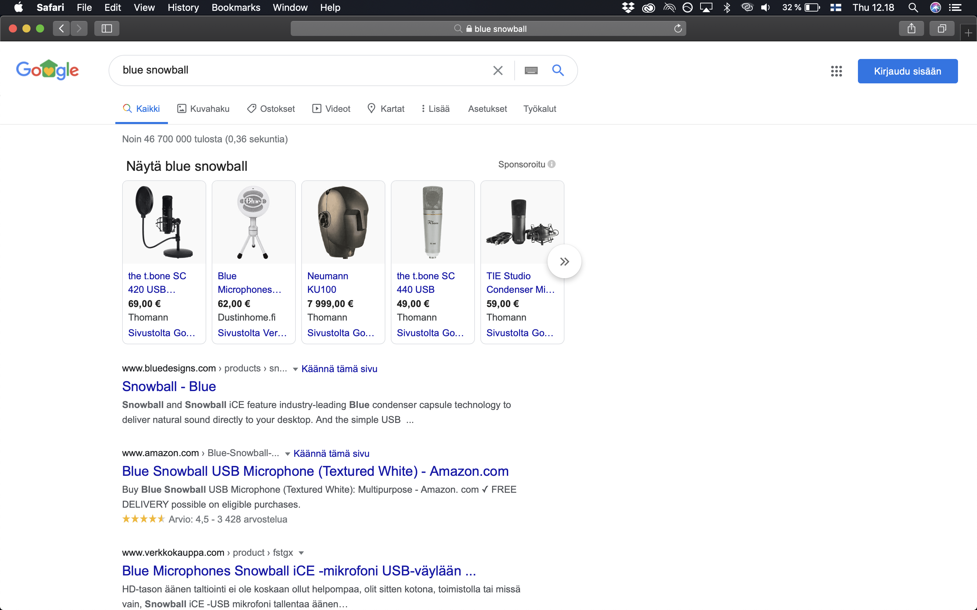
Facebook ad
YouTube ad
Google search ad and SEO
Which channel(s) should get credit for my purchasing the microphone?

Slide 18
How do we attribute conversions?
Rule-based attribution
Assign credit to different touchpoints based on pre-determined attribution rules (e.g., first-touch, last-touch, linear).
More commonly used.
Data-driven attribution
Attribution is inferred from data by a statistical model rather than based on a rule chosen by the manager.
More accurate, but requires a significant number of data-points for increased accuracy.
For most users, a black box.
0.1 * TV + 0.01 * FB + 0.03 * YT

Slide 19
Rule-based attribution
First-touch – first interaction receives 100 % of the credit for sales (leads)
Last-touch – last touch (before conversion) receives 100 % of the credit
Linear – all touchpoints receive equal credit
1/N, where N is the number of interactions on the conversion path
If a channel is touched X times, that channel receives X/N * 100 % of the credit
Time decay – all touches receive credit; the most recent ones get most of it
Position based – first and last touch receive 40 % credit each, rest divide the remaining 20 % equally (these percentages are from GA, other software may use different percentages)

Slide 20
Facebook ad
Referral ad
Google search ad and SEO
First-touch: Youtube ad gest 100% credit
Last-touch: Facebook ad get 100% of credit
Linear: Each ad receives 33% of the credit

Slide 21
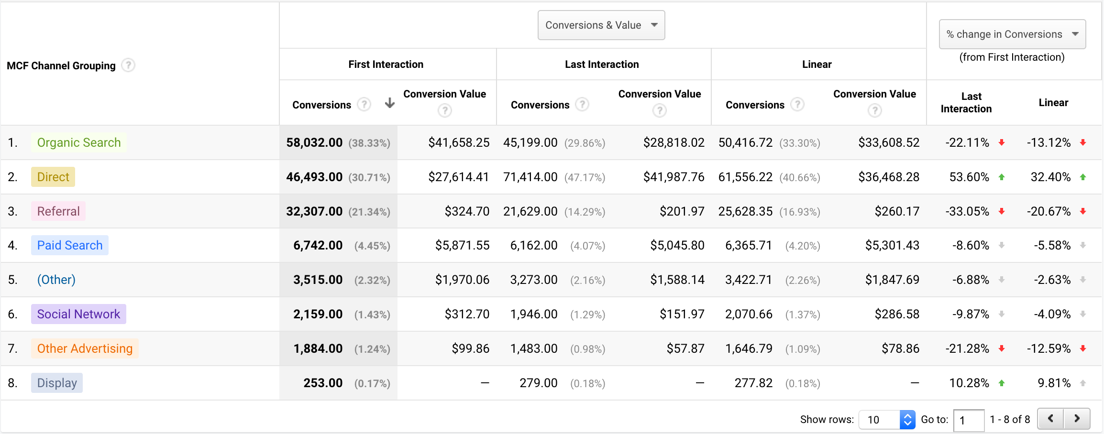
Attribution modeling in Google Analytics
Channels
Rules

Slide 22
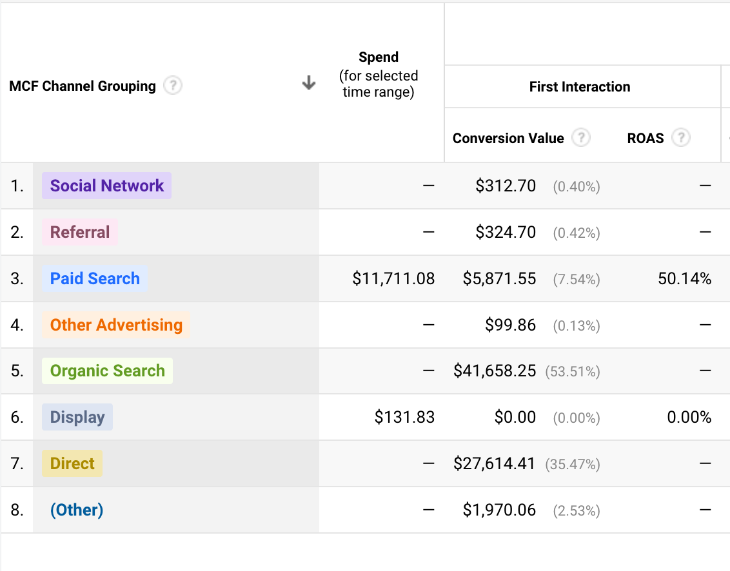
From attribution to ROI
Conversion value: 5 871,55 USD
Advertising spend: 11 711,08 USD
Contribution margin: 20% (assumed, not given)
MROI = ((5871,55 * 0,2) – 11 711,08) /
11 711,08 = – 90%.
ROAS: 5 871,55 / 11 711,08 = 50%
Incremental financial value generated by marketing – Cost of marketing
Cost of marketing

Slide 23
A Caveat: Marketing ROI is not just about efficient resource allocation
Some channels or campaigns can be important even if they show poor ROI
Channels/campaigns may serve strategic goals beyond short-term sales lift (e.g., brand building, competitive share of voice)
Low ROI may suggest that a channel is not being used optimally
ROI based on different attribution rules can also provide insights into the customer purchasing journey
Channels with high MROI based on first-touch attribution are likely to be the first point-of-contact between customer and brand
Channels with high MROI based on last-touch attribution are potentially good for closing the deal

Slide 24
R Tutorial
Attribution Modelling using Markov Chains

Slide 25
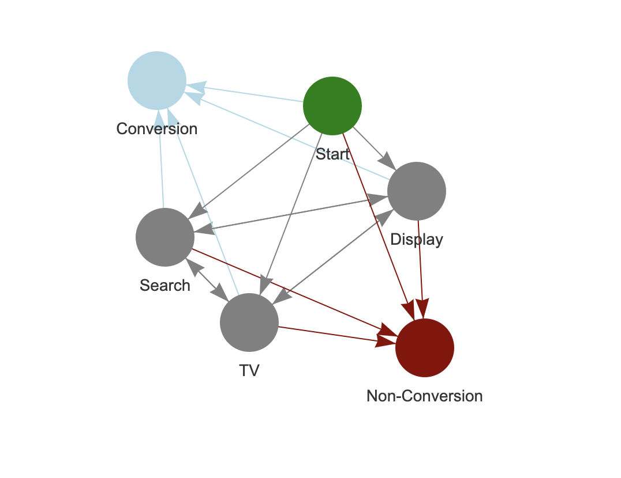
Absorbing State 1
MEMORYLESS (in theory)
Absorbing State 2
Pic credit: towards data science

