Slide 1
Experiments in Marketing
20.09.2022

Slide 2
In 2009, Tropicana wanted a new juicebox, so they redesigned the package.
Notes:
Anyone know (or remember) what happened?

Slide 3
In 2009, Tropicana wanted a new juicebox, so they redesigned the package.
Customers hate it!
Ad agency defends it.
Sales plunge 20%.
Ad agency CEO fired.
New packaged pulled after 2 months.
Ad agency shuts down.
Total cost: $33 Million.
Source: https://bettermarketing.pub/the-worst-rebrand-in-the-history-of-orange-juice-1fc68e99ad81
https://www.thebrandingjournal.com/2015/05/what-to-learn-from-tropicanas-packaging-redesign-failure/

Slide 4
In 2009, Tropicana wanted a new juicebox, so they redesigned the package.
What’s the moral of the story?
Should have A/B tested the new packaging!
Nowadays, there is no excuse not to A/B test.

Slide 5
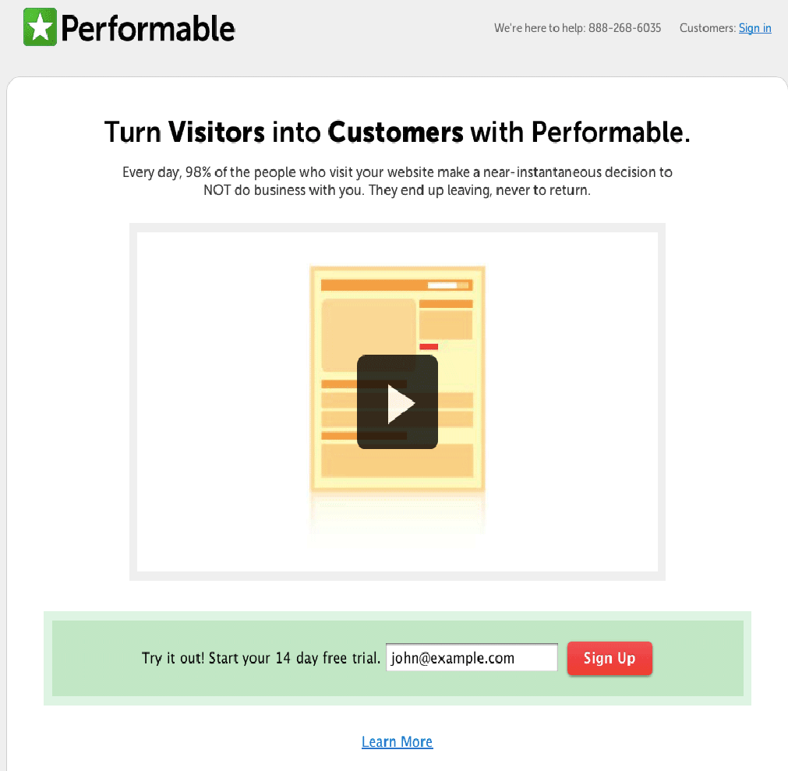
A/B test example

Slide 6
A/B test example
Source: www.abtests.com

Slide 7
https://variety.com/2016/digital/news/netflix-ab-tests-image-optimization-trick-1201674325/

Slide 8
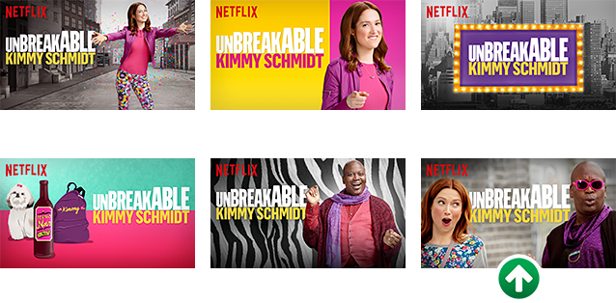
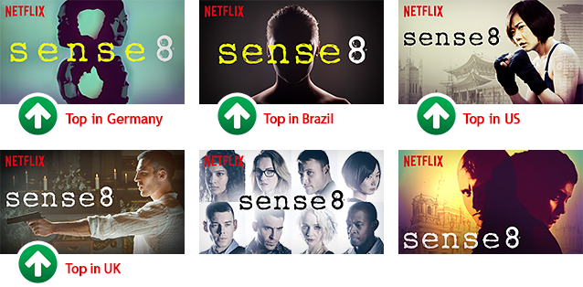
https://netflixtechblog.com/selecting-the-best-artwork-for-videos-through-a-b-testing-f6155c4595f6
https://about.netflix.com/en/news/the-power-of-a-picture

Slide 9
A/B tests and causal inference
A/B tests
Focus on the end result: maximizing revenue, conversion rates, etc.
Often test two or more competing elements without necessarily seeking to understand why one works better than another.
Ends justify the means: less concerned with applying proper experimental method
“Scientific” experiments
Focus on understanding and explaining why a particular element works better
In order to understand why, you need make sure that A vs. B is exactly the same content except for the “why” being tested.
More rigorous in terms of method
9

Slide 10
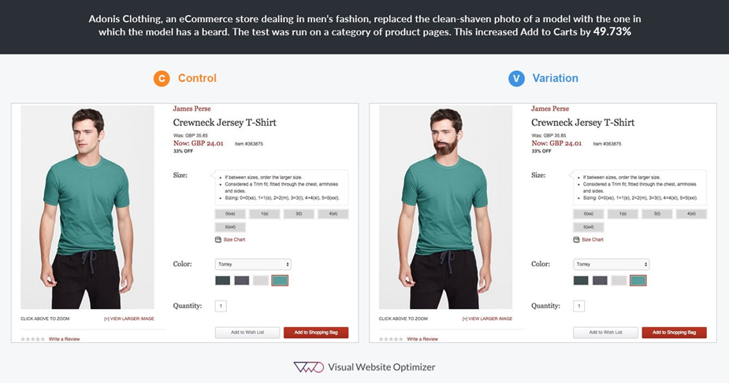
A/B tests and causal inference

Slide 11
A/B testing and causal inference
Criteria for causal inference:
X occurs before Y
There is a relationship between X and Y
Other causal factors are accounted for
(1.) is usually manipulated by experiment design, (2.) is measured afterwards.
(3.) is more complicated. We can try to hold other variables constant (e.g., lab experiments), controlling for variables you cannot manipulate (e.g., including them in the experiment), and randomization (e.g., of experiment participants).

Slide 12
Experiment design
Dependent variable: the outcome variable
Independent variable (factor): a manipulated variable for which the marketing analyst is interested in seeing an effect on the dependent (outcome) variable. Often one of the 4 Ps.
Moderator variable (2nd factor): a manipulated variable that changes the way the first independent variable affects the dependent variable.
Often a segmentation variable
It’s possible to have multiple factors (moderated moderation…)

Slide 13
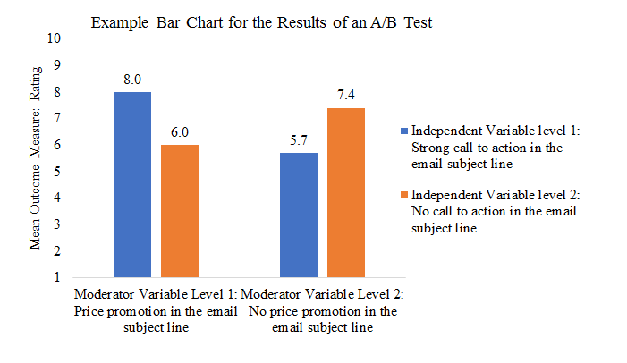
Experiment design
Dependent variable: Perceived attractiveness of a promotional email
Independent variable (factor): Call-to-action in the subject line (e.g., “Buy now!”)
Moderator variable (2nd factor): Price promotion in the subject line (e.g., “All shoes 25% off”).

Slide 14
Common experiment designs
One factor, before and after
One factor, after only
Two factor, before and after
Two factor, after only
 | t₀ | t₁ | t₂
EG* | O₁ | X | O₂
CG* | O₃ |  | O₄
 | t₀ | t₁ | t₂
EG | O₁ | X | O₂
EG | O₃ | Y | O₄
EG | O₅ | XY | O₆
CG | O₇ |  | O₈
 | t₁ | t₂
EG | X | O₁
CG |  | O₂
 | t₁ | t₂
EG | X | O₁
EG | Y | O₂
EG | XY | O₃
CG |  | O₄
X: call-to-action
Y: price promotion
XY: call to action AND price promotion
O: Attractiveness
A/B tests usually employ after-only designs!
*EG: Exposed Group
CG: Control Group

Slide 15
Participants
Randomization
Randomization is typically the way that other variables are controlled for (e.g., customer demographics, purchasing habits, browsing on mobile vs. desktop, etc.)
Essentially assign each customer to experiment group based on a coin-flip.
With random assignment into groups and a large enough sample size, any differences between experiment groups should be cancelled out, thus avoiding the danger of biasing the experiment results.
15

Slide 16
Participants
Sample size
Large sample sizes ensure randomization is effective and that experiments are sufficiently powered (i.e., we have a low probability of making a Type II error).
This is a complex issue not covered in this course.
A good rule of thumb is 50 participants for each cell you are testing.
You can find power calculators online that will tell you how many participants you need in your study depending on Type II error tolerance, estimated effect size, and significance level.
16

Slide 17
Quick Refresher about Errors

Slide 18
Some platforms that offer A/B testing

Slide 19
Example: A/B testing email subject lines
Exploration:
Use 20% of customer base to test two subject lines
Exploitation:
Send best performing subject line to remaining 80% of customers
Source: MailChimp

Slide 20
Experiments and channel attribution
Data-driven attribution
Uses algorithms to calclualte ROI/ROAS based on counterfactual cases
Compares marketing outcomes among customers who saw a display ad vs. among similar customers who did not see the ad
Requires a lot of data (not an option if you have a small business)
Experiments
Still the most reliable way to measure the effectiveness of advertising

Slide 21
Experiments and ROI
Revenue side
Optimizing the use of different marketing channels, and measuring their impact on the return-side of MROI
Different ad copy, ad formats, e-store layouts, promotional packages
Experiments of more strategic nature are possible but challenging (e.g., store layouts, customer service processes, (digital) product designs)
Cost side
Attribution modeling—or some other process—might suggest that a channel is ineffective
What happens if one channel is removed or investment levels are changed
Creation of ”moderator” variables is advised (e.g., customer segments, regions)

Slide 22
Experiments and attribution modeling
Group 1: Conversion value € 5 000
Group 2: Conversion value € 3 000
Search ad
Display ad
Marketing email
Conversion
Search ad
Display ad
Marketing email
Conversion

Slide 23
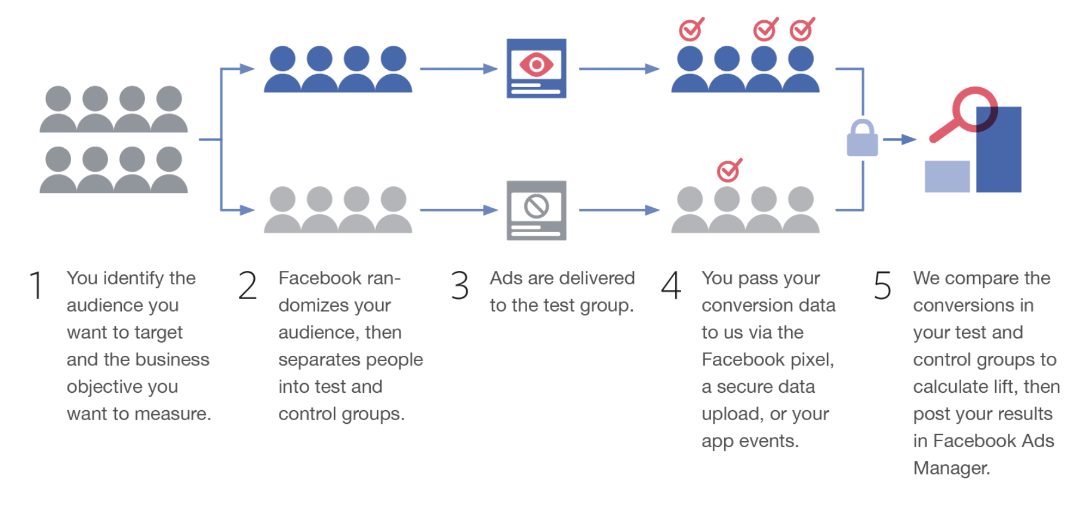
Example: Facebook’s “Conversion Lift”
Read more:
https://www.facebook.com/business/m/one-sheeters/conversion-lift
Notes:
https://www.facebook.com/business/m/one-sheeters/conversion-lift

Slide 24
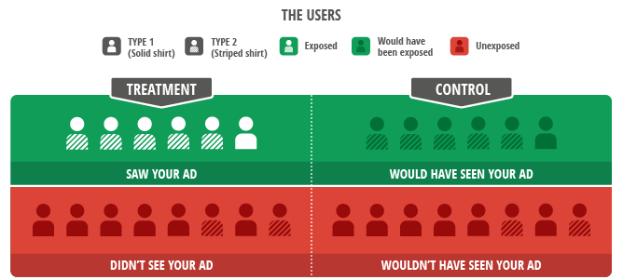
Example: “Ghost Ads”
Read more:
https://www.thinkwithgoogle.com/intl/en-gb/marketing-resources/data-measurement/a-revolution-in-measuring-ad-effectiveness/
https://www.ama.org/2019/01/02/predicted-ghost-ads-an-accurate-and-cost-effective-method-for-measuring-incrementality/

Slide 25
Analyzing experiment data in R

Slide 26
Chi-square test: are two nominal variables associated?
We want to test whether one display advertisement performs better than the other in terms of click-through rate.
Hypothesis: making the button (“Access FREE Demo”) more “clickable” will increase the number of clicks.

Slide 27
Chi-square test
 | t₁ | t₂
EG | X | O₁
CG |  | O₂
Part 1: Testing for the main effect
Single factor: Clickable button (yes vs. no)
DV: Number of clicks
Analysis: Chi-square test to compare whether two nominal variables (green button: yes/no) and clicks (yes/no) are associated.
X: Green button
https://www.spss-tutorials.com/chi-square-independence-test/

Slide 28
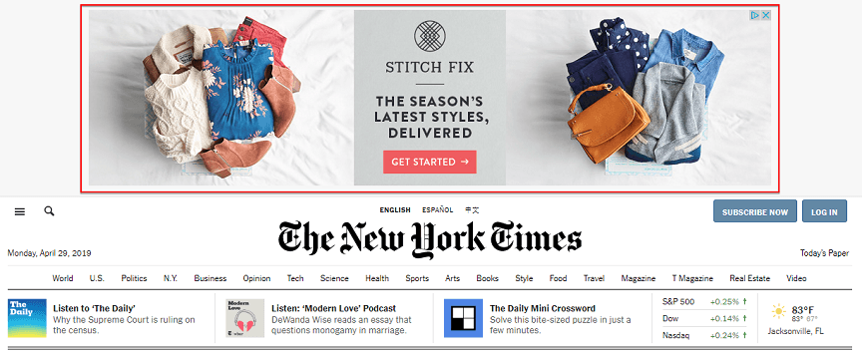
T-tests and ANOVA: comparing means of two or more groups
We want to test whether including a call-to-action in a display advertisement increases conversion revenue.
Hypothesis: adding a call-to-action button (“get started”) to display ads will increase average order value.

Slide 29
T-tests and ANOVA
 | t₁ | t₂
EG | X | O₁
CG |  | O₂
Part 1: Testing for the main effect
Single factor: CTA button (yes vs. no)
DV: order value
Analysis: t-test comparing average order value across two groups (consumers exposed to ads with and without the CTA button)
X: call to action button

Slide 30
T-tests and ANOVA
We further hypothesize that the effect of the CTA button is moderated by customer segment: whether or not a customer lives in the Helsinki metro area or not.
We call this a 2 (CTA: yes vs. no ) by 2 (demographics: metro vs. not ) factorial design:
 | t₁ | t₂
EG | X | O₁
EG | Y | O₂
EG | XY | O₃
CG |  | O₄
X: call-to-action
Y: lives in metro area
XY: call to action AND lives in metro area

Slide 31
T-tests and ANOVA
Analysis: since we now have more than two groups, we need to run an ANOVA to test for the interaction between X and Y in our design
 | t₁ | t₂
EG | X | O₁
EG | Y | O₂
EG | XY | O₃
CG |  | O₄
X: CTA
Y: lives in metro area
XY: call to action AND lives in metro area

