Slide 1
Modeling Marketing Mix and Marketing Communications

Slide 2
https://hbr.org/2014/02/how-to-explore-cause-and-effect-like-a-data-scientist

Slide 3
Marketing mix modeling
Online advertising
Endorsement deals
Price promotions
How do different marketing actions
influence marketing outcomes?
Unit sales
Revenue
Profit

Slide 4
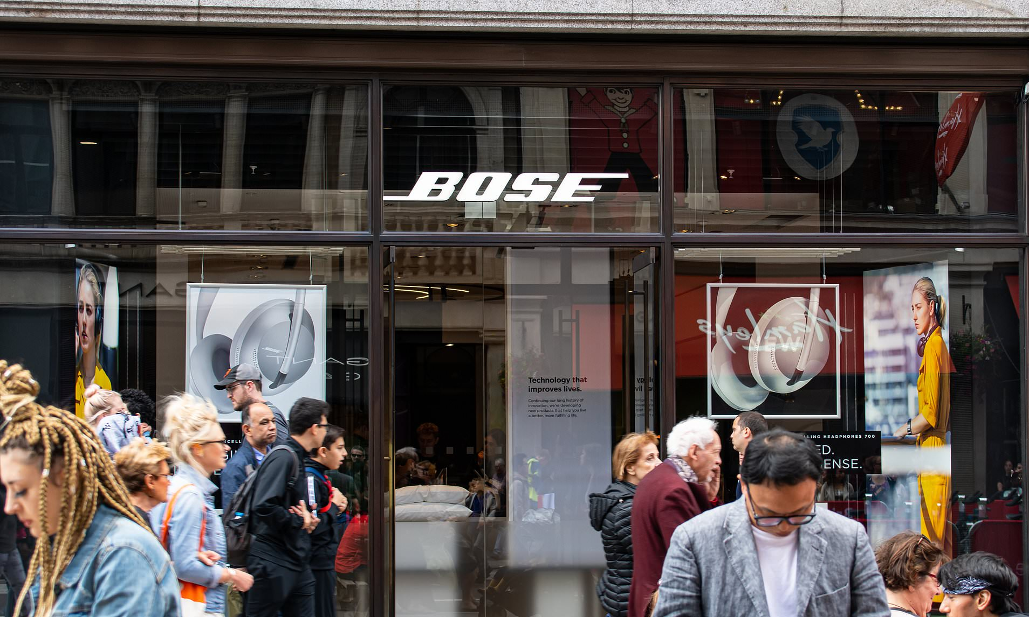
Marketing mix modeling
Marketing investments
Consumer attitudes and behavior
Sales revenue
Attention
Interest
Desire
Action

Slide 5
We use historical data on these to estimate the impact of marketing investments on sales
Marketing investments
Consumer attitudes and behavior
Sales revenue
Attention
Interest
Desire
Action
These are more of a “black box”

Slide 7
Linear regression
What is the association between two continuous variables?
x
y = b₀ + b₁x
y
Marketing investment
Sales revenue
https://hbr.org/2015/11/a-refresher-on-regression-analysis

Slide 8
Linear regression*
Let’s plot marketing investment (x) against sales revenue (y) based on data from the previous 12 months.
* This is not real data

Slide 9
Linear regression
The slope of the simple regression line (b₁ = 8.6014) tells us the relationship between marketing spend and sales:
For every € 1 000 spend on marketing, we can expect approximately € 1 000 x 8.6014 ≈ € 8 600 in sales revenue.
Think of this as “advertising elasticity of demand”:
How much does demand (y) increase, if marketing spend is increased by (x)?

Slide 10
Linear regression
The intercept (b₀ = -148.52) is useful if we want to calculate sales revenue for a specific investment amount:
If we spend € 30 000 on marketing, we can expect € 30 000 x 8.6014 – 148.52 ≈ € 258 164 in revenue.

Slide 11
Linear regression
Scope of the data
The intercept (b₀ = -148.52) is useful if we want to calculate sales revenue for a specific investment amount:
If we spend € 30 000 on marketing, we can expect € 30 000 x 8.6014 – 148.52 ≈ € 258 164 in revenue.
However, we should be careful when extrapolating beyond the scope of the data:
If we spend € 0 on marketing, our model suggests that we should expect - € 148.52k in sales revenue.

Slide 12
Multiple linear regression
Independent variables (x₁ – x_{m})
Marketing investments + control variables
If marketing spend on activity 1 increases by € 1 000, sales will increase by 1 000 * b₁
x₁
x₂
…
x_{k}
x_{k+1}
…
x_{m}
Regression coefficients (b₁ – b_{m})
“Elasticities” of demand
Marketing spend (€) or marketing activity as a result of spend (impressions, emails sent, etc.)
b₁
b₂
b_{k}
b_{k+1}
b_{m}
Dependent variable (y)
E.g., sales
y e
Error term (e):
Any variation in our dependent variable that is not explained by our independent vartiables
Control variables: factors that influence sales and may be correlated with marketing spend/activity (weather, competitors’ marketing actions, major holidays, etc.).
y = b₀ + b₁x₁ + b₂x₂ + … + b_{m}x_{m} + e
https://dss.princeton.edu/online_help/analysis/interpreting_regression.htm

Slide 13
Key Assumptions in Regression Analysis
Linearity
Independence of error terms
Normally distributed error terms
Error term is not related to the predictors/independent variables (no endogeneity)
No (severe) multicollinearity
http://www2.sas.com/proceedings/forum2007/131-2007.pdf

Slide 14
Marketing mix modeling in R
We have data on a headphone manufacturer’s sales and marketing expenditure:
> head(watch_data)
Product Year Sales EURSales PricePerUnit Mag News Outdoor Online Print Premium
<dbl> <dbl> <dbl> <dbl> <dbl> <dbl> <dbl> <dbl> <dbl> <dbl> <dbl>
1 15 1995 3000 352040 117. 25714. 291. 333. 1 26005. 1
2 15 1996 3340 370072 111. 25658 178. 625 1 25836. 1
3 15 1997 3440 381152 111. 27014. 202. 516. 1 27216. 1
4 15 1998 3630 419737 116. 27617 308. 1420. 162. 27925. 1
5 15 1999 4050 468302 116. 30605. 258. 1417. 70.3 30863. 1
6 15 2000 4605 560025 122. 33971. 533. 1337. 143. 34505. 1
Sales volume and revenue
Marketing investment and/or activity

Slide 15
Marketing mix modeling in R
Dependent variable (y)
Sales volume
> mmm_results <- lm(EURSales ~ Print+Outdoor+Online,
data=watch_data)
> summary(mmm_results)
Coefficients:
Estimate Std. Error t value Pr(>|t|)
(Intercept) 793.177087 48.813307 16.249 < 0.0000000000000002 ***
Print 6.7328 0.8265 8.146 0.000000000000019 ***
Outdoor 4.91994 1.35993 3.618 0.000361 ***
Online 2.61099 .85791 3.043 0.002593 **
---
Signif. codes: 0 ‘***’ 0.001 ‘**’ 0.01 ‘*’ 0.05 ‘.’ 0.1 ‘ ’ 1
Residual standard error: 695.3 on 246 degrees of freedom
Multiple R-squared: 0.506, Adjusted R-squared: 0.5
F-statistic: 84 on 3 and 246 DF, p-value: < 0.00000000000000022
Independent variables (x₁ – x_{m})
Spend on print and outdoor advertising
Impressions from online advertising
Regression coefficients
P-values for each coefficient
Statistically significant if < 0.05
Size and direction of the effect
Adjusted R2: How well does the data fit the model
% variation in sales revenue that is explained by our model (i.e., our independent variables)

Slide 16
From regression to ROI
MROI calculations (assuming a 40% contribution margin ratio)
The company spends €100 000 on an online advertising campaign that results in 220 000 impressions:
Sales lift: 220 000 * 2.61099 ≈ €574 000
Profit: €574 000 * 40% ≈ €230 000
MROI: (€230 000 – €100 000)/€100 000 = 130%.
The company then invests € 200 000 in a print advertising campaign:
Sales lift: €200 000 * 6.7328 ≈ €1.35M
Profit: €1.35M * 40% ≈ €0.54M
MROI: (€0.54M – €0.2M)/€0.2M = 170%.
> mmm_results <- lm(EURSales ~ Print+Outdoor+Online,
data=watch_data)
> summary(mmm_results)
Coefficients:
Estimate Std. Error t value Pr(>|t|)
(Intercept) 793.177087 48.813307 16.249 < 0.0000000000000002 ***
Print 6.7328 0.8265 8.146 0.000000000000019 ***
Outdoor 4.91994 1.35993 3.618 0.000361 ***
Online 2.61099 .85791 3.043 0.002593 **
---
Signif. codes: 0 ‘***’ 0.001 ‘**’ 0.01 ‘*’ 0.05 ‘.’ 0.1 ‘ ’ 1
Residual standard error: 695.3 on 246 degrees of freedom
Multiple R-squared: 0.506, Adjusted R-squared: 0.5
F-statistic: 84 on 3 and 246 DF, p-value: < 0.00000000000000022

Slide 17
Fine-tuning our models
All models are wrong… but we can make them less wrong!

Slide 18
Converting the Regression model to an equation
EurSales = 6.7238 * Print + 4.91994 * Outdoor + 2.6199 * Online + 793.177
E(EurSales) = 6.7238 * 26005 + 4.91994 * 333 + 2.6199 * 1 + 793.177
= 174852 + 1638 + 2.61 + 793
= 177285
O(EurSales) = 352040

Slide 19
Omitted variable bias
Occurs when a variable that is related to both the dependent variable and an independent variable is not included in our model.
Coefficient on the included variable will be biased.
This can lead to inflated or deflated ROI estimates.
Indepentent variable
(e.g. ice cream advertising)
b_{n}
Dependent variable
(e.g. ice cream consumption)
Omitted variable
(e.g. weather)

Slide 20
Direction of bias
If correlation between independent variable and omitted variable and effect of omitted variable on dependent variable have the same sign (+/-), bias will be positive (coefficient on the independent variable will be inflated compared to “reality”).
If the signs are different, bias will be negative.
Indepentent variable
(e.g. ice cream advertising)
b_{n}
Dependent variable
(e.g. ice cream consumption)
+
+
Omitted variable
(e.g. weather)
If we don’t include weather (e.g., temperature) in our model, our results will suggest that the effect of ice cream advertising on sales (b_{n}) is larger than it actually is!

Slide 21
Common sources of bias
Effect of price on sales
Product quality influences sales positively
Price and product quality are correlated positively
Effect of advertising on sales
Price influences sales negatively
Assume that product price and advertising of a given product are correlated positively (e.g., a firm advertises more expensive premium products).
Different sign => negative bias.
Estimates of advertising effectiveness on sales may be negatively biased (less positive) if price is omitted.
Same sign => positive bias.
If product quality is omitted, estimates of price elasticity on demand will be positively biased (i.e. less negative).

Slide 22
Common Sources of Bias
Price
-ve
Sales
Spend
+ve
Sales
+ve
+ve
+ve
-ve
Quality
Price
Estimate will be LESS NEGATIVE
than it should be
Estimate will be LESS POSITIVE
than it should be

Slide 23
Moderated effects
Moderation occurs when the effect of an independent variable on a dependent variable depends on the value of another independent variable.
Is it possible that the effect of online ad spend on sales is different for standard and premium products?
Online ad spend
(X₁)
Sales revenue
(Y)
Product type
(X₂)

Slide 24
Regression with moderators
y = b₁ + b₂ x₁ + b₃ x₂ + b₄ x₁ x₂ + e
Interpretation:
b₂ = the effect of online ad spend on sales revenue, all else being equal
b₃ = difference in sales between premium and standard products, all else being equal
b₄ =the difference in the effect of online ad spend on sales revenue for premium products vs. standard products
Online ad spend (€)
Product type: (premium = 1, standard = 0

Slide 25
Interpretation of results
If all independent variables are equal to zero (i.e. no advertising spend), we would expect to sales revenue to be €951.88.
The coefficient on online advertising is positive and statistically significant. This tells us that the effect of online advertising on sales revenue is €2.586 per impression, all other things being equal.
The coefficient on premium products is positive and statistically significant. We can expect premium products to contribute €363.69 to sales revenue on top of €951.88 (standard products), all other things being equal.
The coefficient on the interaction term is positive. This tells us that online advertising has a stronger positive effect on sales revenue for premium products. For premium products, we can expect online advertising to contribute €3.192 to sales revenue, over and above any effect for standard products. Note, however, that this effect is only marginally statistically significant.
> mmm_model<-lm(Sales~Online+Premium+Online*Premium, data=mmm_data)
> summary(mmm_model)
Coefficients:
Estimate Std. Error t value Pr(>|t|)
(Intercept) 951.881 64.814 14.686 <0.0000000000000002 ***
Online 2.586 0.1836 14.09 0.01602 ***
Premium 363.686 143.974 2.526 0.0122 *
Online:Premium 3.192 1.839 1.736 0.0838 .

Slide 26
Any questions?

