Slide 1
Welcome to Marketing Analytics
Course introduction
Kushagra Bhatnagar
05.09.2022

Slide 2
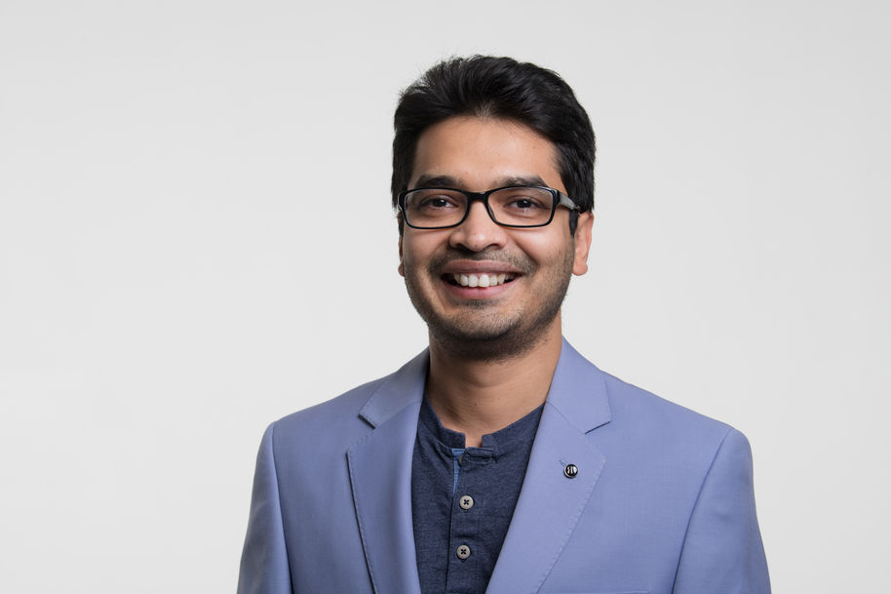
Course lecturer
Kushagra Bhatnagar, B. Tech, MBA, D.Sc.
Assistant Professor in Marketing
Currently teaching at Aalto:
Customer Experience Management (B.Sc.)
Marketing Analytics (B.Sc. & M.Sc.)
Current research interests:
Consumer wellbeing
Service Interactions
Reputation Economy

Slide 3
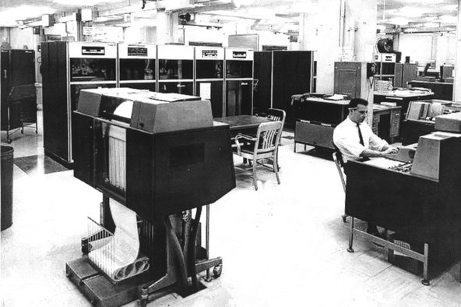
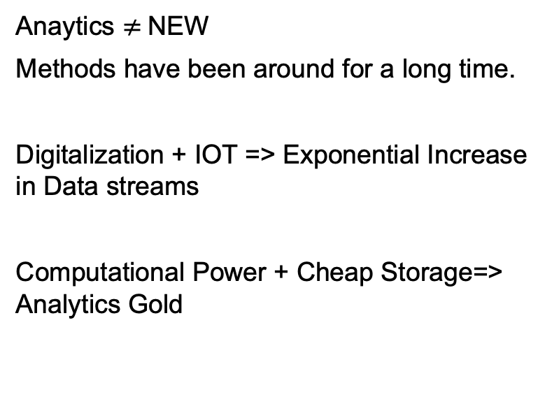
Why this course?
Anaytics $≠$NEW
Methods have been around for a long time.
Digitalization + IOT => Exponential Increase in Data streams
Computational Power + Cheap Storage=> Analytics Gold
Source: https://bits.blogs.nytimes.com/2013/06/10/big-data-intelligence-sleuthing-1960s-style/

Slide 4
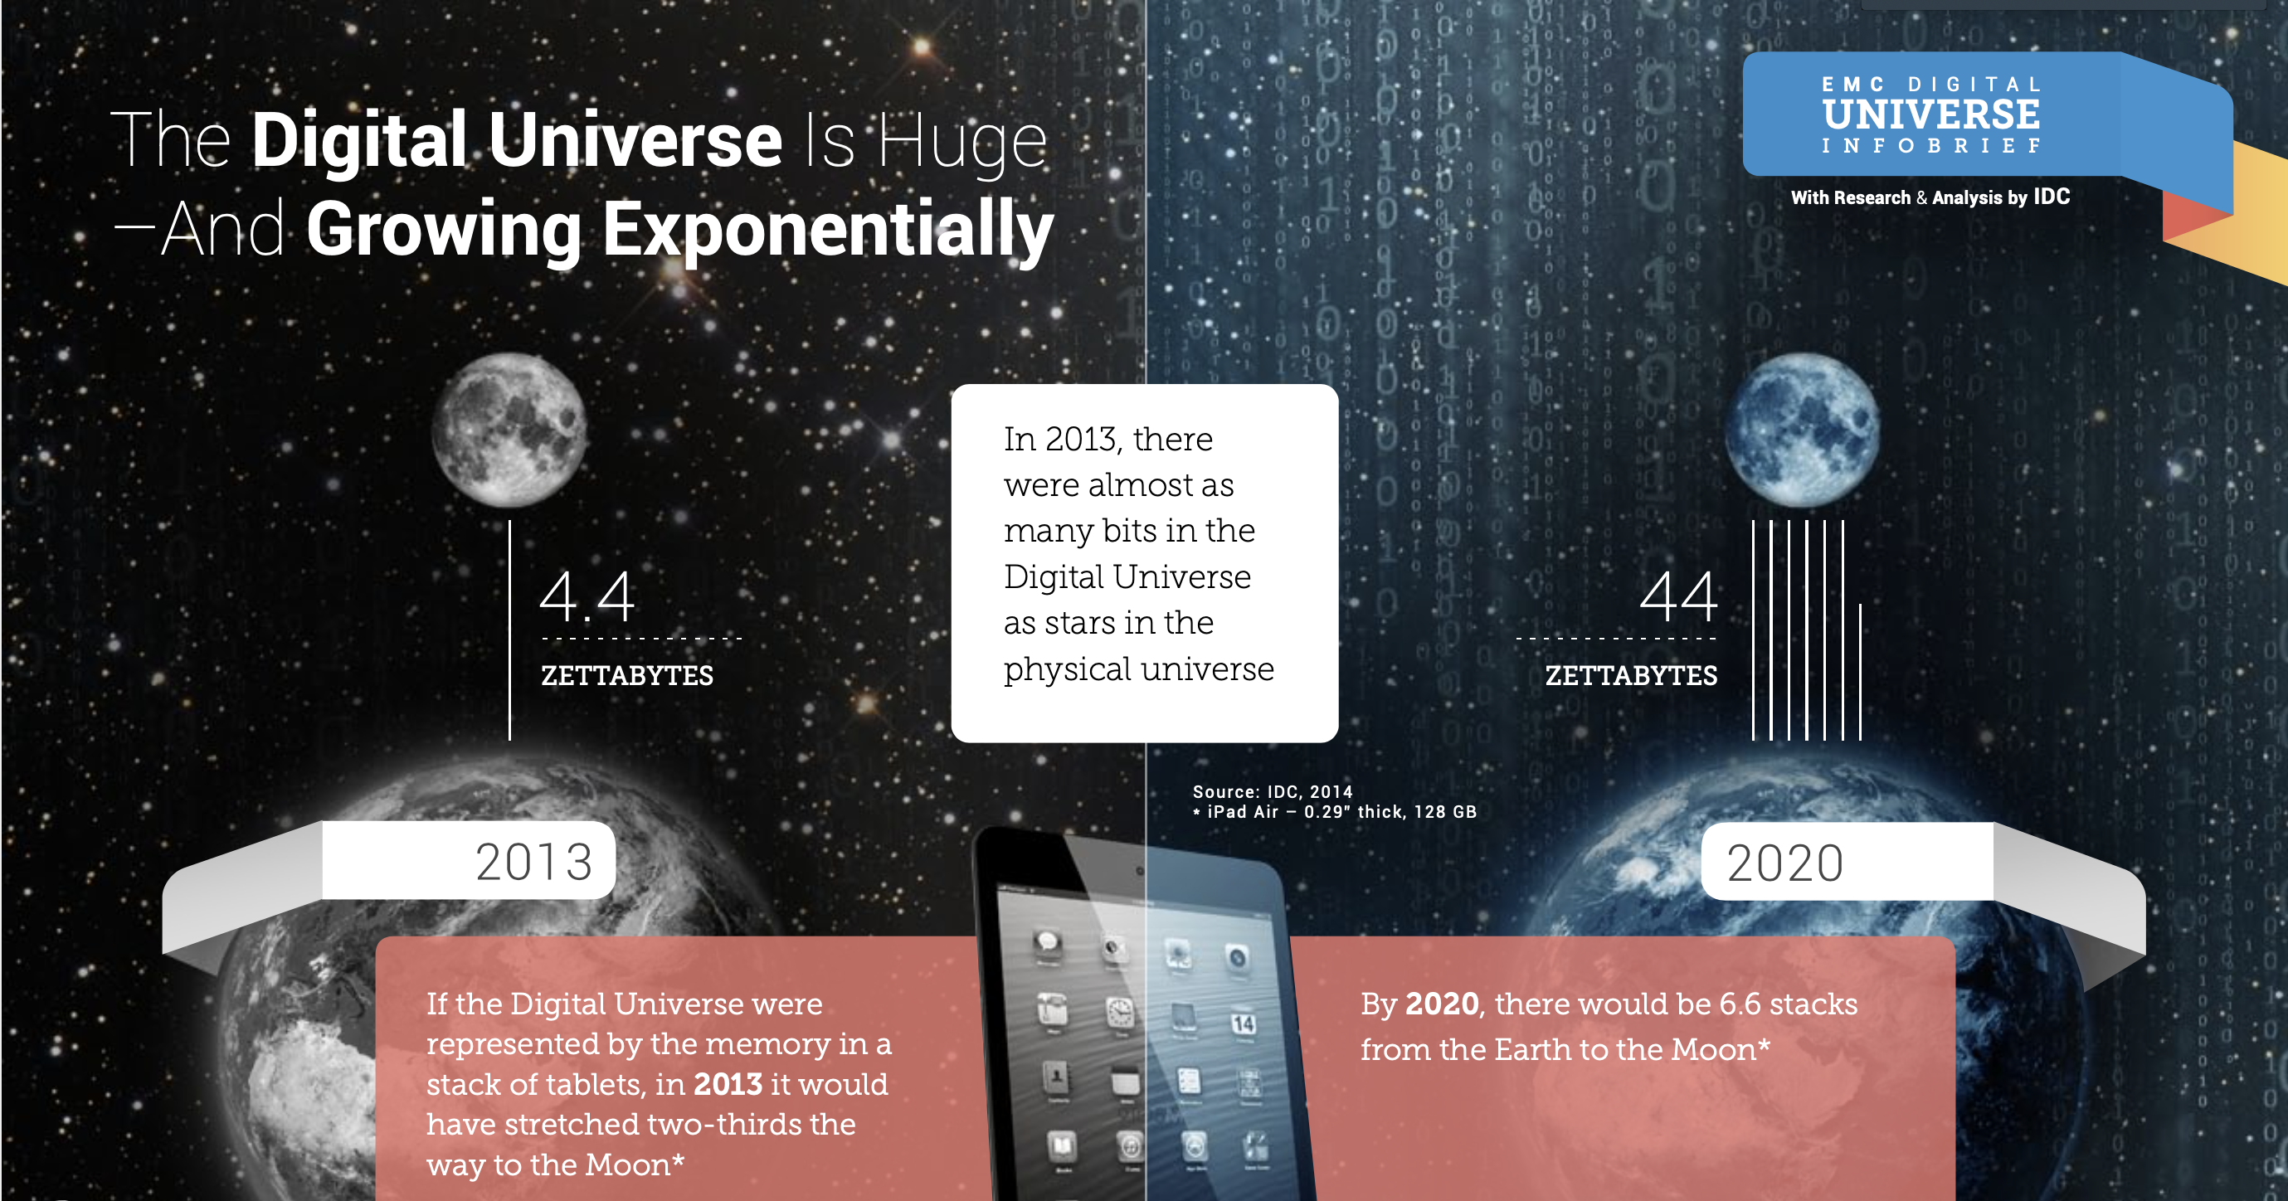

Slide 5
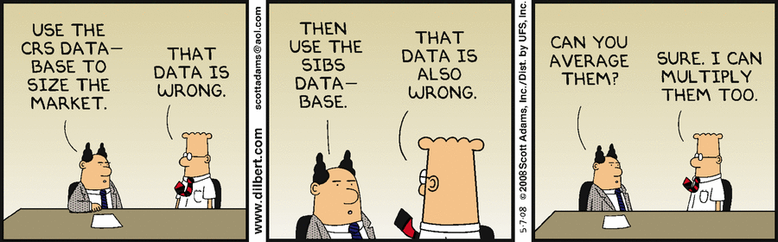
Why this course?
Nearly every organization is now collecting data
Our challenge as marketers or analysts is to make sense of this data

Slide 6
Using insights from data to maximize positive marketing outcomes
Organization
Market
Analytics
Insight
Market action
Data
6

Slide 7
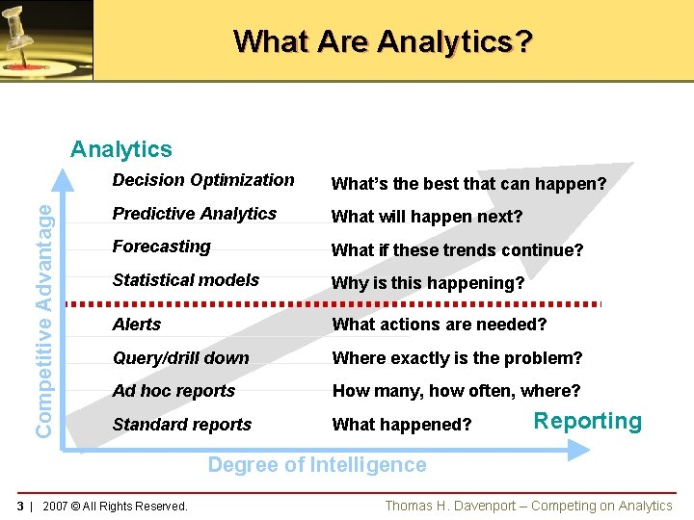

Slide 8
Foundations of Marketing Practice
Segmenting
Targeting
Positioning
Dependent on different kinds of analytics
Descriptive -> Past
Predictive -> Likely Future
Prescriptive -> Actionable Scenario
Notes:
Take examples from Marketing Analytics course – ice-cream vendor, football stadium etc.

Slide 9
Scope: How can analytics help understand/create relevant outcomes
Learn the basics of marketing analytics
Develop a broad understanding of the field in a way that:
Gives you an Analytics-grounded understanding of different topics
Provides a foundation for refining your skills and keeping up with methodological and technological advances in the field
Enables you to hold your own in a professional setting

Slide 10


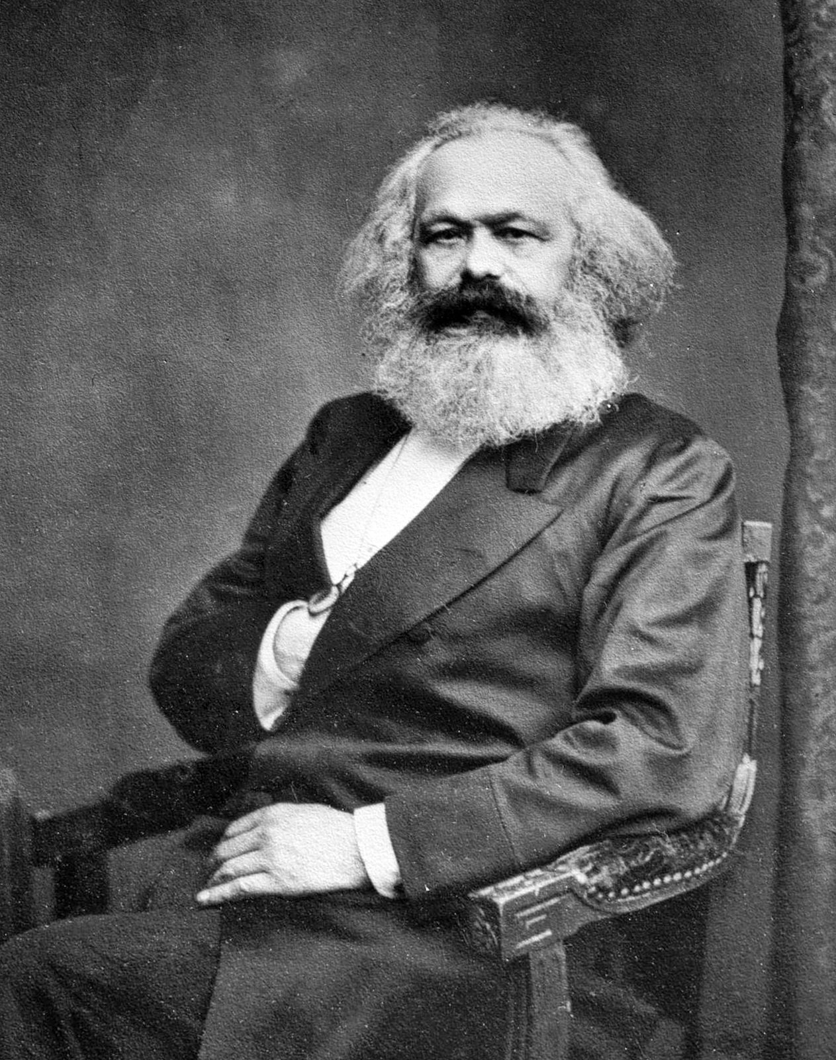
Useful Side Effects
This course will also help you form an informed opinion on
Advantages and potential blind sport of data analytics
Ethical issues surrounding analytics
Future of (marketing research & strategy) work

Slide 11
Focus Areas for the course
Marketing Analytics broadly involves
Data Management: collecting, cleaning, and integrating data
Analytics: using mathematical and statistical tool to analyze data
Generating actionable marketing insights and recommendations based on the analysis
Most of our examples will deal with well-structured problems and clean data
We will focus on these

Slide 12
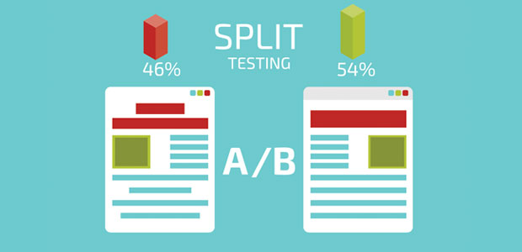
Topical Focus of the course
This course provides exposure to key topics in marketing analytics.
We cover some popular topics and discuss the underlying statistical models and principles.
For example, A/B tests:
What is an A/B test, what are they useful for, when should they be used
Priciples of experiment design
Statistical analysis: t-tests, chi-square tests

Slide 13
Scope of the course
Topics covered during the course:
Return on marketing investment
Inbound marketing analytics
Modelling marketing mix and advertising effectiveness
Customer analytics
Machine learning for marketers
A practice-oriented approach to analytics:
Relying on foundational statistical techniques (e.g., t-tests, ANOVA, linear regression)
Using open source R programming language to conduct data analysis

Slide 14
Course Design
The material is based on:
Contemporary textbooks
State-of-the-art research
Input from experts in academia and the field:
  “What are the essential things about analytics that marketing students must understand?”

Slide 15
Course Design
Some changes to reflect that the course is now a mandatory core course rather than a specialization course.
Slightly less emphasis on statistical methods and techniques
Slightly more emphasis on the substantive domain (i.e. Marketing).
Also minor changes based on student feedback from Fall 2021:
“I think the teams platform worked very well in this course. It is a little bit confusing that there are materials both in Teams and MyCourses, it would be easier is everything was in the same place.” >> All the materials will be on MyCourses. All interaction will be through Teams.
“The whole individual/group assignment thing didn’t work. When it’s individual, people are not pressured to do equal workloads, yet somehow our grades are still dependent on each other.” >> No more formal incentive for collaborating in study groups

Slide 16
Our starting point
What I assume you know enough:
Basic understanding of stats covered in mandatory courses (we will revise basics, but this will be a “refresher” rather than starting from scratch).
Basic understanding of marketing concepts (these will be introduced, but again, as a refresher).
What I assume you don’t know enough:
Applying marketing analytics
Programming languages (including R)

Slide 17
Session structure
Lectures on Tuesdays
New topic introduced
Basic theory
Applications
Guided walkthroughs of analysis
Exercise sessions on Thursdays
Work on the exercises in study groups
Opportunity to receive help from course instructor
Lectures will be recorded and available for viewing on Teams.
Exercise sessions are not recorded for privacy reasons.

Slide 18
Lectures
Tuesdays between 15:15-16:45
Will be held on Microsoft Teams.
Will be recorded and uploaded within 24 hours (usually sooner).
Attendance is not mandatory, but recommended.
PS: For 11th October, Tuesday, A pre-recorded session will be uploaded

Slide 19
Assessment and grading
Four independent exercises (40% of course grade)
Each worth 10 points
Published after Tuesdays lectures (13.09., 20.09., 27.09., 04.10.).
Due end of the following week (25.09., 02.10., 09.10., 16.10.).
Model answers will be published once everyone has submitted the exercises.
Exam (60% of course grade)
October 21st, between 13:00-16:00 (retake in January 2023).
Held online on MyCourses

Slide 20
Exercise sessions
Thursdays between 15:15-16:45
Everyone will be assigned to a study group on Teams.
During Thursday’s exercise sessions, course instructor will go from group to group to offer help where needed.
You are encouraged to collaborate within your study groups. Work on the exercise problems together, ask questions, and help each other.
Assignments still need to be submitted individually.
You can ask and receive help from your group, but ultimately everyone is responsible for their own work.
Notes:
The idea is that you are not penalized for collaborating. You can still receive full points for the course. But you have an incentive to collaborate and help each other.

Slide 21
Feedback on study groups
“At first, I was a bit sceptical, but it was nice to compare answers and get verification for answers. I think it turned out nicely!”
“I really liked the individual assignments format, where the work was done in small groups. Almost everyday someone was asking on the Whatsapp group with help and everyone was interested in helping each other. Much better than doing group assignments, which are plagued by freeriding, communications issues etc. Now everyone had the chance to put in as much effort as they liked.”
“The individual assignments should be group assignments as they are made together so they should be returned together.”
“The group work didn't really work out the way it should have. It was confusing, that we did the coding in r together, but then the assignments had to be returned individually. “
Why we’re sticking with individual assignments:
You learn 100% of the material, rather than only “your part” of group assignment
You are responsible for your own work and your grade. No free-rider issues.
Notes:
The idea is that you are not penalized for collaborating. You can still receive full points for the course. But you have an incentive to collaborate and help each other.

Slide 22
Form teams for group work
I will assign you to a study group on Tuesday September 21st.
If you wish to be placed in the same group as your friends, you may arrange your own group (4-6 people):
Check who else has joined the Microsoft Teams workspace
Use the chat function to arrange a group
Once you have arranged a group, send me an email by September 13th at the latest.
I will try to keep all study groups the same size. If you are a group of 2-4, I will likely add other students to your group.

Slide 23
Course literature
Course book
Not obligatory, will not be in the exam.
Lecture slides and readings sufficient to do well on the course.
Readings
Will be posted onto Teams in advance of the lectures.
Contextualize and explain some of the topics discussed in class, provide further examples of practical applications.
Not necessary to read in advance of lectures, but will be in the exam.

Slide 24
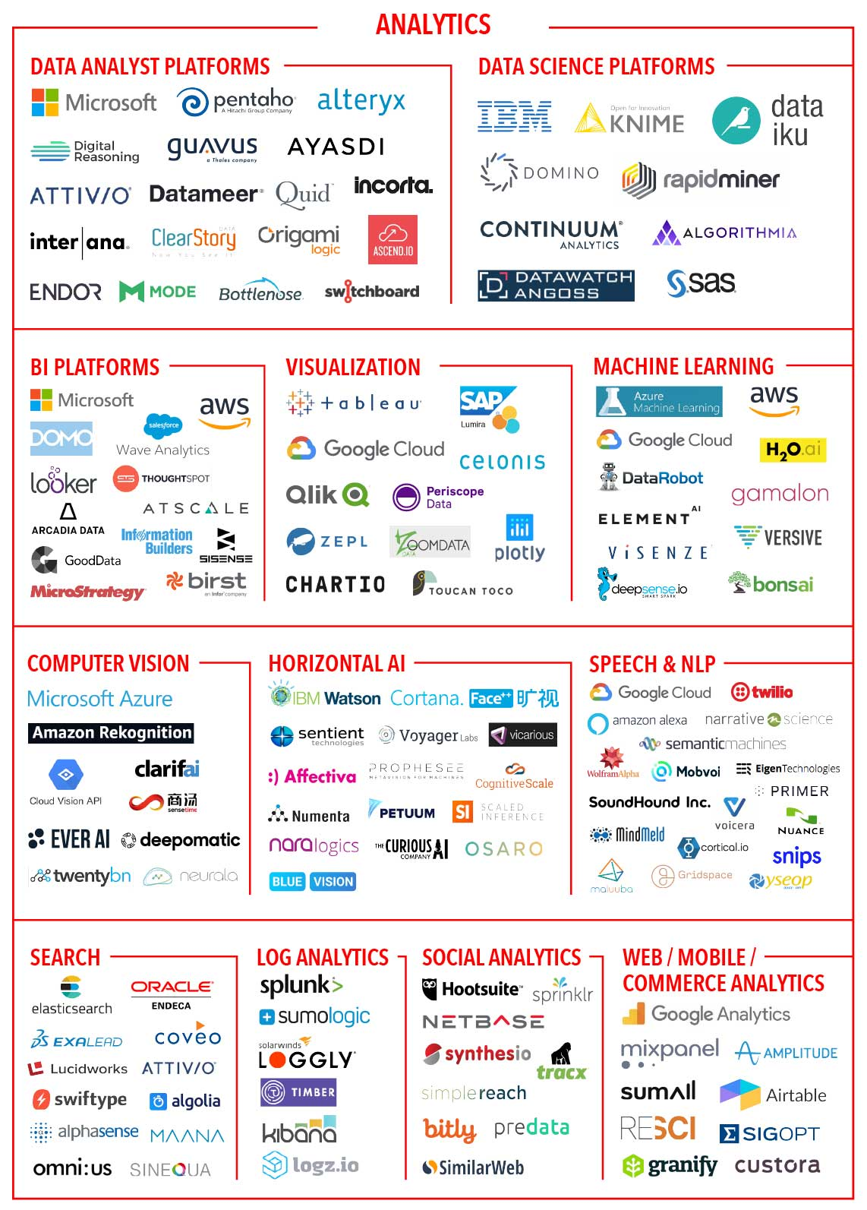
Our tools for this course
Source: kdnuggets.com “Python leads the 11 top Data Science, Machine Learning platforms: Trends and Analysis”

Slide 25
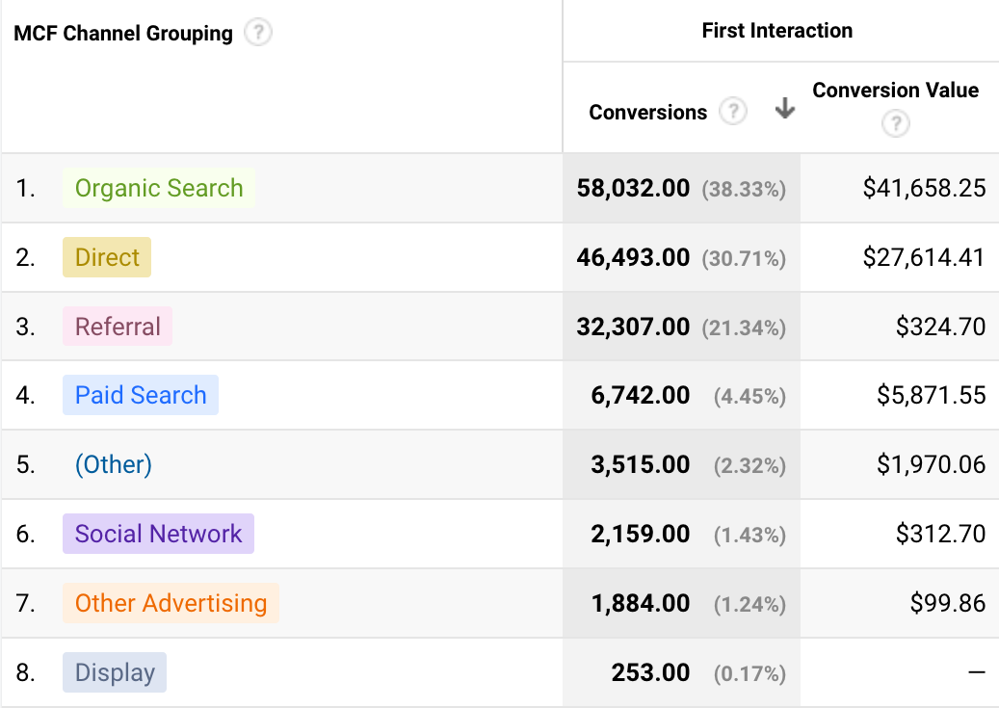
Two approaches to analytics
We will be doing this:
Point-and-click (e.g., Google Analytics):
Build from the ground up (e.g., using R):
> heuristic_models(ga_data_export,"path", "total_conversions", "total_conversion_value")
channel_name Conversions Conversion value
1 Organic Search 57892 41473.75
2 Direct 46418 27570.66
3 Referral 32170 324.70
4 Paid Search 6735 5871.55
5 (unavailable) 3507 1970.06
6 Social Network 2158 312.70
7 Other Advertising 1882 99.86
8 Display 253 0.00

Slide 26
Our Tools
R Studio is the official supported software in this course.
A “legitimate” programming language used by analytics professionals. Some advantages:
Versatility: you can do pretty much anything in R with the right package.
Collaboration: it’s free to download and use, so you can share your work with anyone anywhere in the world by sending your script and data
Another useful addition to your CV
If you have experience using other tools (e.g., Python), you may use them instead. However, you will be “on your own” as there will be no support provided for tools other than R.
Notes:
The goal: understand analytics in practice.
Why R?
Used by professionals
Looks good on CV
- Versatile: with the right package, you can do pretty much anything in R.
- Compatability. It’s free. Anyone can download. You can sendyour script and data, and anyone can run it anywhere in the world.

Slide 27
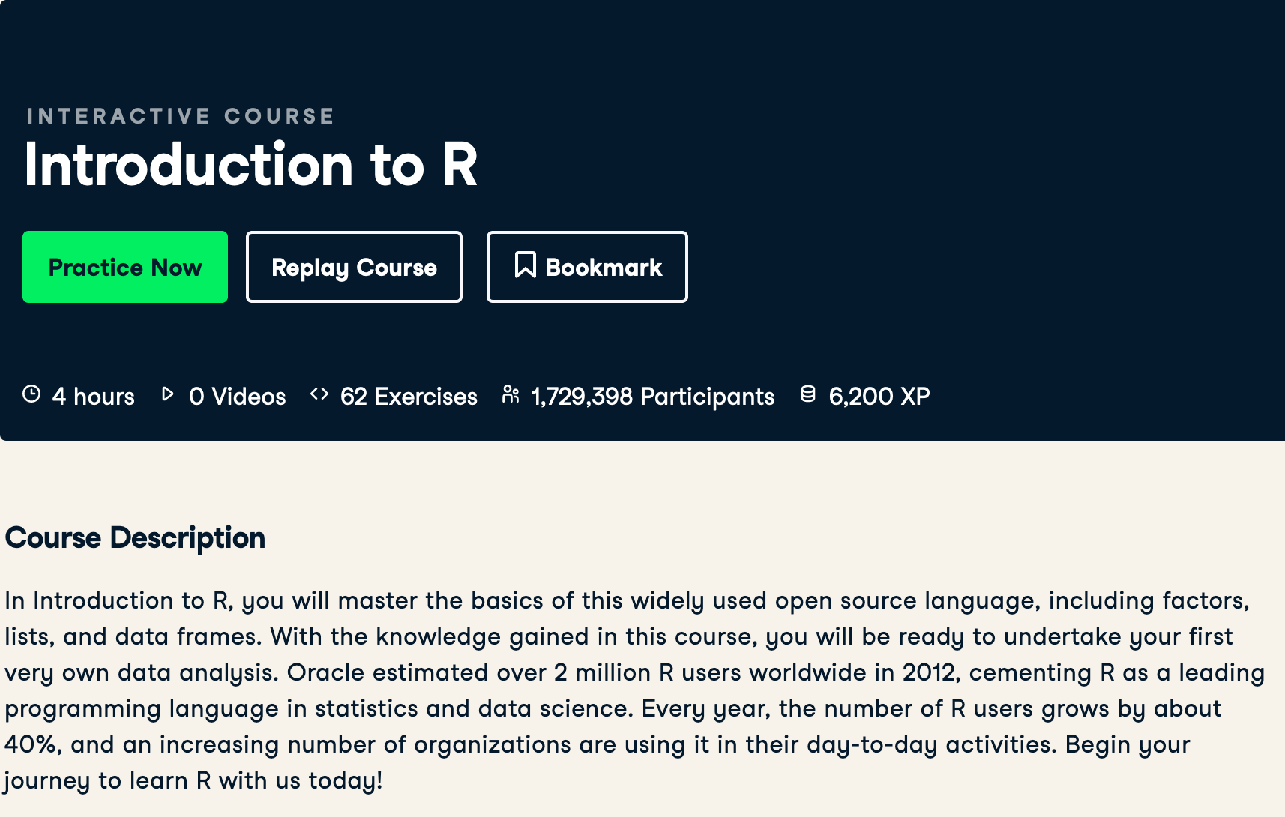
Our Tools
Your task this week is to complete the Introduction to R + Intermediate R courses on Datacamp.
You should have received a link to Datacamp by email along with other course material.
Click the link and register with your aalto.fi email address.
Please complete the courses before next Thursday’s working session
There will be no exercise session this week to allow you time to go through this course.
Notes:
The goal: understand analytics in practice.
Why R?
Used by professionals
Looks good on CV
- Versatile: with the right package, you can do pretty much anything in R.
- Compatability. It’s free. Anyone can download. You can sendyour script and data, and anyone can run it anywhere in the world.

Slide 28
Course Contents
Week 1: Course intro and introduction to R
Week 2: Marketing ROI and attribution modelling
Week 3: A/B testing and experiments in marketing
Week 4: Marketing mix modelling
Week 5: Customer analytics - modelling customer churn and customer lifetime value
Week 6: Applications of machine learning for marketers

Slide 29
Rules of engagement:
MyCourses:
Updates to course practicalities and general informational issues (you will receive these by email via the Announcement Forum)
Assignment instructions, Assignment submissions, lecture slides, assigned readings
Everything else will be done via Microsoft teams
Online lectures, lecture recordings,
Questions about assignments
Questions about course practicalities
Notes:
Also if you have anything personal you wish to discuss.

Slide 30
Question related to the course
All general questions about the course and its practicalities:
Teams
Chat function during the lecture
“Will this be on the exam?”
“I can’t get Teams to work. Help!”
“Can you clarify the assignment instructions?”
Personal questions related to you or your group specifically:
Email kushagra.bhatnagar@aalto.fi
Private message after the lecture
“I’m sick, can I get a deadline extension?”
“My group has a freerider. Can you help?”
“I spilled coffee on my laptop and couldn’t submit the assignment on time.”

Slide 31
Feedback mechanisms
Feedback for students:
In-person exercise sessions are the best opportunity for qualitative feedback.
You can stay and chat after lectures.
Ask questions in the General channel or in your private study group channel.
Weekly grades on exercises
Feedback for teacher:
Brief anonymous survey every other week (<1 min to complete).
Teams (after lectures and in the General channel), email.

Slide 32
Action points to be done by next week
Register to Datacamp with your Aalto email address and complete the “Introduction to R” + “Intermediate R” courses – budget around 6-8 hours for this.
Go over the list of students attending this course, contact anyone you want to work with, and once you have agreed on a group, please email me – deadline September 13th).

Slide 33
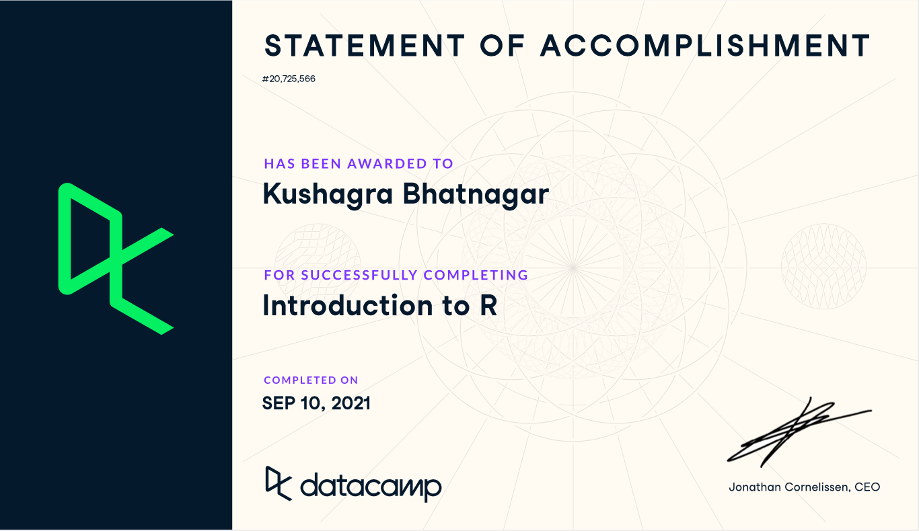

Slide 34
That’s it! Any questions?
Please take the rest of this lecture to get started on Datacamp!

