Slide 1
Machine learning for marketers

Slide 2
Agenda for today
Machine learning for marketers
Course wrap-up
Exam tips

Slide 3
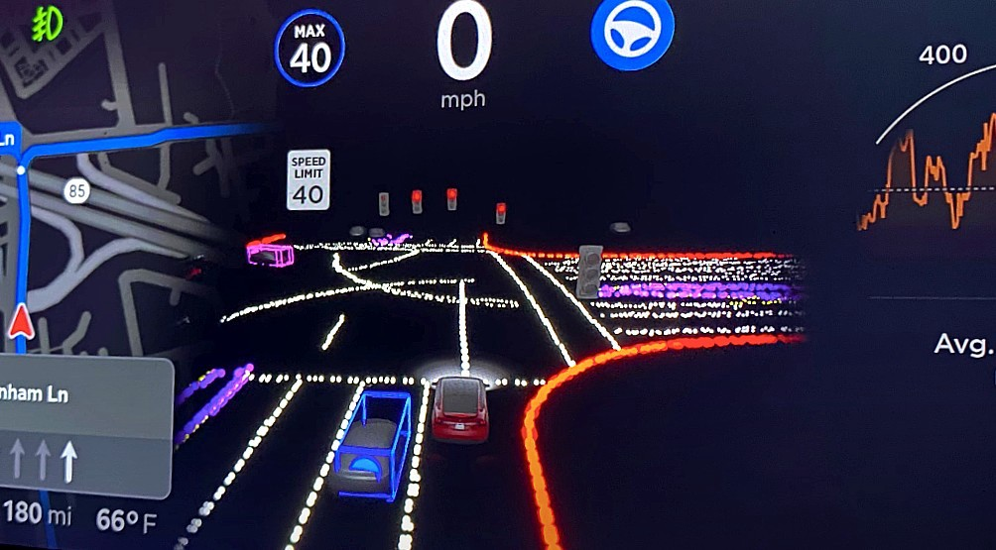

Slide 4
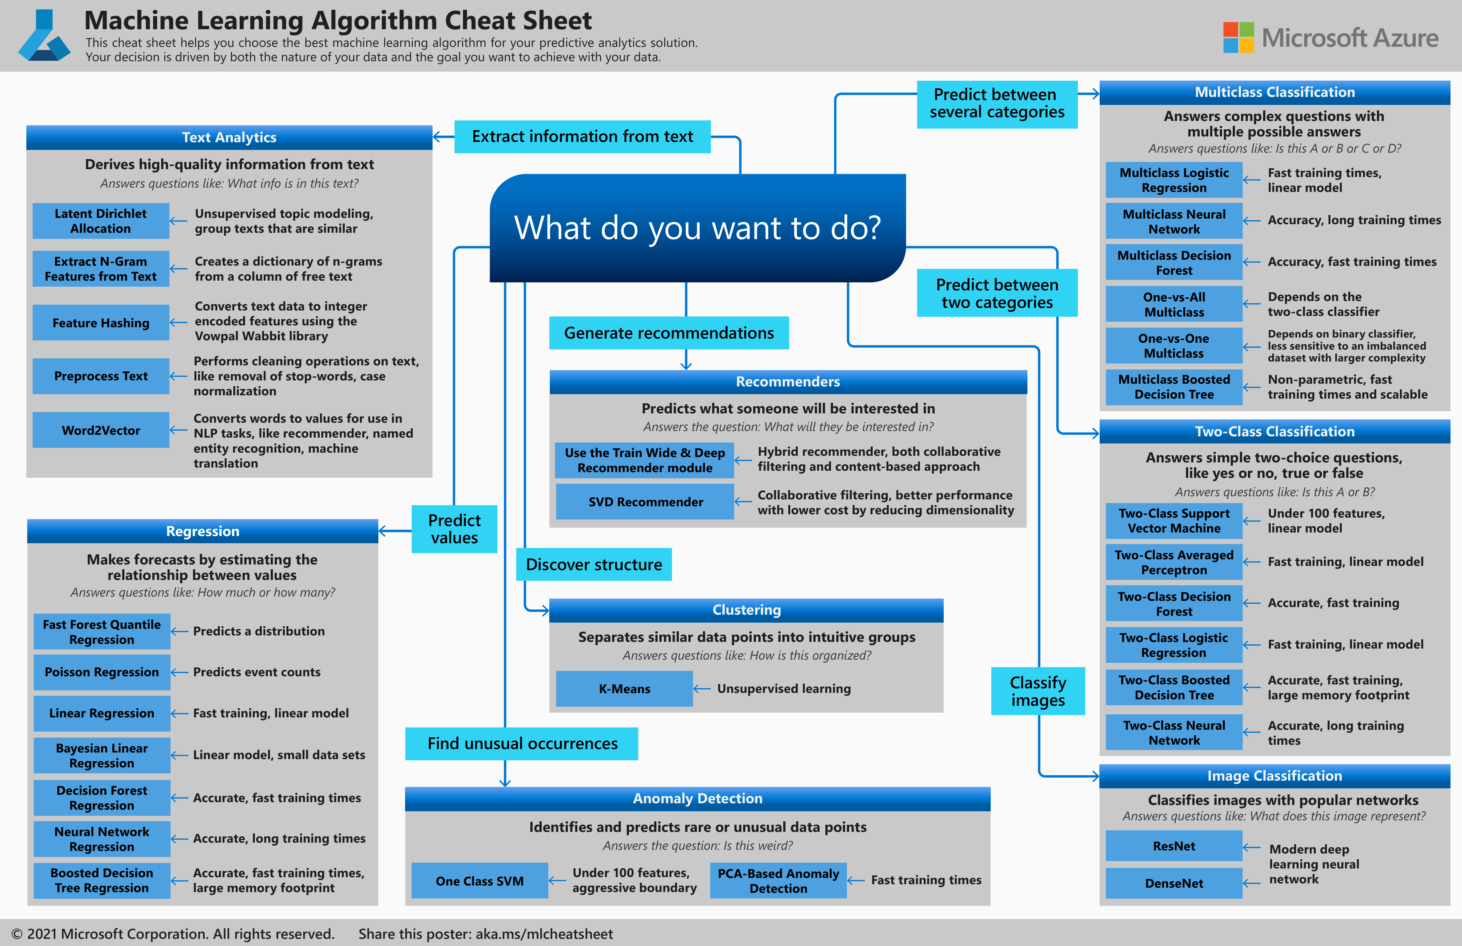
Machine Learning Azure ML Cheat Sheet

Slide 5
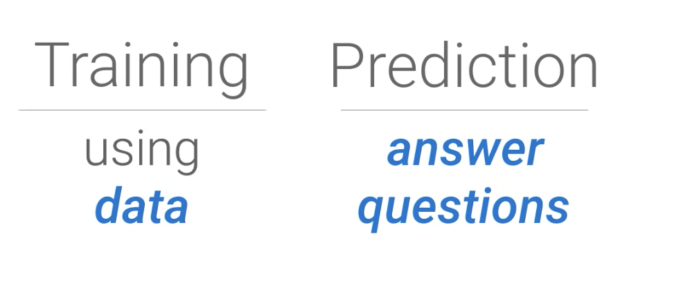
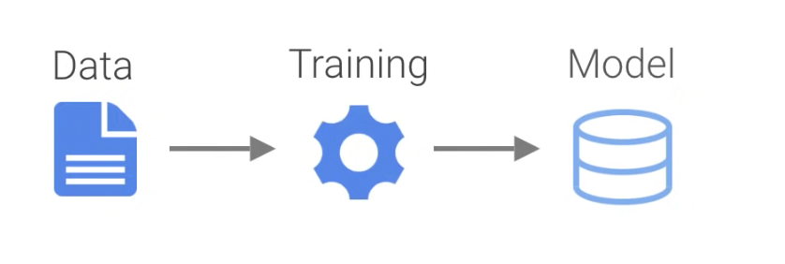
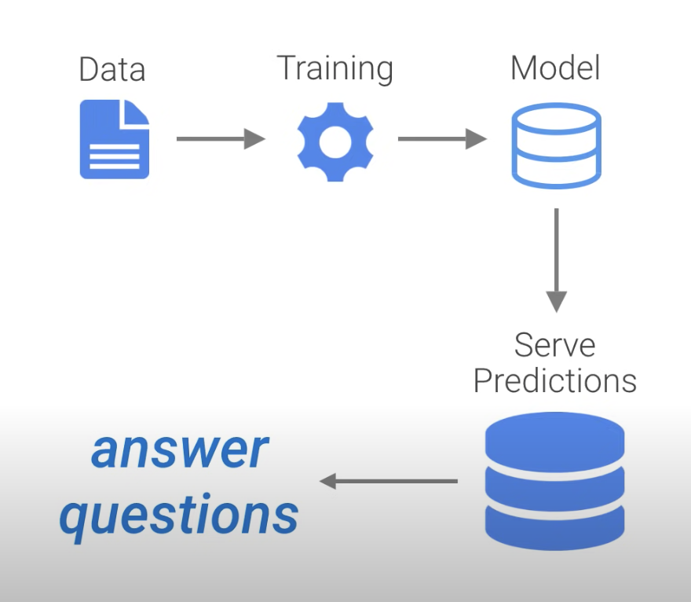
Creating and
Fine-Tuning Model
Serving-up
Predictions
Credit: Yufeng Guo @ Google

Slide 6
The First Rule of Machine Learning
Know Your Data
Structured vs Unstructured
Lists Text
Arrays Image
Vectors Audio

Slide 7
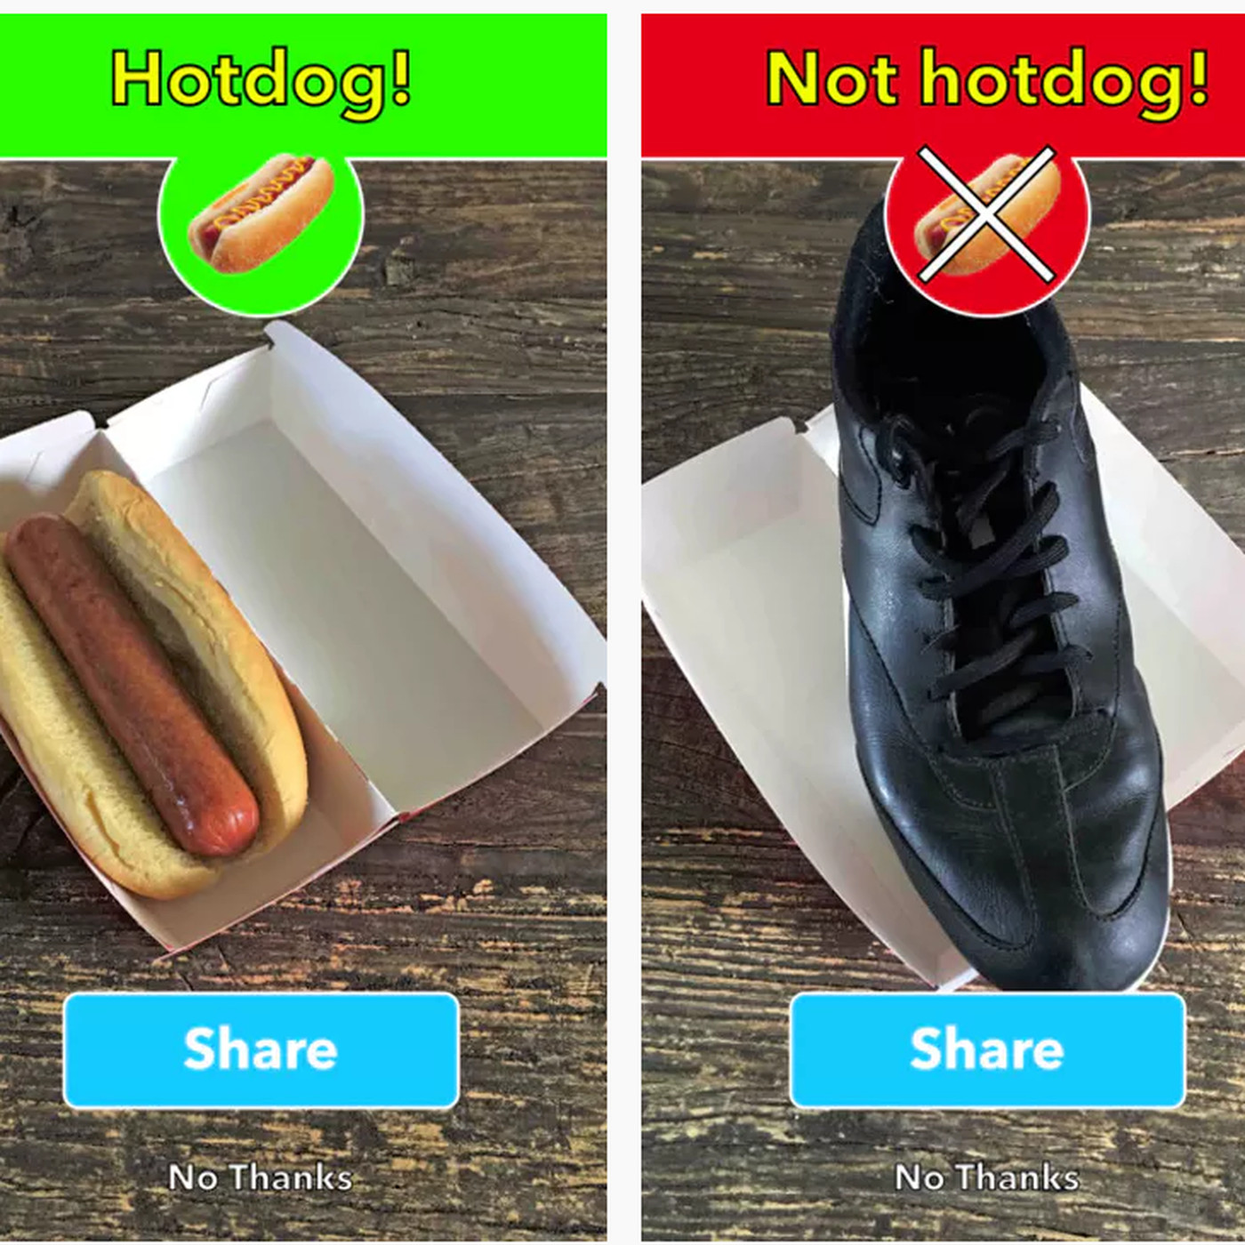

Slide 8
Machine learning
Systems that learn and improve on their own, independently, without being explicitly programmed or taught by a human being.
Example: How can we program a computer to recognize pictures of cats?
Knowledge-based approach
Program the machine with certain rules for recognizing cats
E.g., four legs, whiskers, pointy ears, long tail
Machine learning:
Show the machine lots of pictures of animals
Let the machine learn by finding patterns in the images, thus making up its own rules.

Slide 9
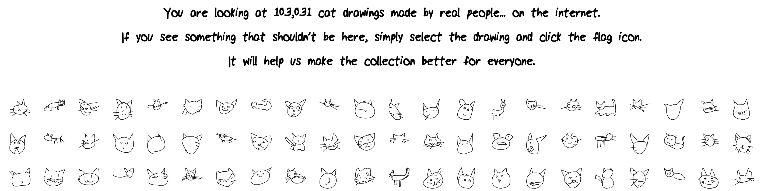
Machine learning: Quick, draw!
Can a machine learn to recognize the content of drawings based on a massive dataset of pictures?
https://quickdraw.withgoogle.com

Slide 10
Case: identifying the content of picture

Slide 11
Case: identifying the content of picture

Slide 12
Building a spam filter
Knowledge based approach
Teach the “machine” what we know about spam.
Program the machine with rules for identifying spam in incoming email based on subject lines, words in email.
Machine learning approach
Give the “machine” appropraite training data (email archives) and allow it to learn by itself.
Machine figures out rules by finding patterns in training data, and applies the rules to incoming email.

Slide 13
Screening patients
Knowledge based approach
Teach the “machine” what we know about disease symptoms.
Program the machine with rules for identifying disease based on bloodwork values, patterns in scans, etc.
Machine learning approach
Give the “machine” appropriate training data (patient data) and allow it to learn by itself.
Machine figures out rules by finding patterns in training data, and applies the rules when screening new patients.

Slide 14
Screening patients
Training data:
New patient:
Age | Sex | Cholesterol | Smoker | Family history | Blood sugar | Disease
55 | M | 221 | Yes | No | 100 | TRUE
43 | F | 196 | No | No | 98 | FALSE
56 | F | 215 | Yes | Yes | 103 | TRUE
67 | M | 190 | No | No | 125 | FALSE
54 | F | 200 | Yes | No | 102 | FALSE
Age | Sex | Cholesterol | Smoker | Family history | Blood sugar | Disease
50 | M | 200 | No | No | 110
Machine
Age | Sex | Cholesterol | Smoker | Family history | Blood sugar | Disease
50 | M | 200 | No | No | 110 | FALSE

Slide 15
Descriptive Statistics vs. Machine Learning
Descriptive Statistics
Describing and exploring phenomena
Primarily interested in the relationships between variables and the size of effects
The goal of statistical analysis is usually substantive learning about a phenomenon
Machine learning
Predicting and structuring complex data
Primarily interested in identifying the variables that predict an outcome
The goal is to help the machine learn and predict an outcome as accurately as possible, without necessarily exploring why a certain variable is linked to the outcome

Slide 16
Main types of machine learning
Supervised learning
Unsupervised learning
Reinforcement learning
Which actions maximize reward given the current state of the environment?
Attempt to predict target variable y based features x₁, x₂,…,x_{n}
When y is categorical: classification (e.g. logistic regression, classification trees, etc.)
No y, attempt to find patterns and clusters in features x₁, x₂,…,x_{n} (e.g. k-means clustering, principal component analysis, etc.)
When y is continuous: regression (e.g. least squares, random forest, etc.)
See, e.g., https://towardsdatascience.com/types-of-machine-learning-algorithms-you-should-know-953a08248861

Slide 17
Supervised learning
The computer is trained with data that contains both predictor features and “correct answers”
Machine will try to model relationships and dependencies between the predictor features and the target outcome variable, in order to predict outcome in future data.
Useful when we know what we want to predict (is this a cat, is this a bottle of beer or wine, does this patient have high odds of getting cancer).
Marketing applications: predicting customer behavior (churn, conversion), future sales, impact of brand-led measures.
See, e.g., https://towardsdatascience.com/types-of-machine-learning-algorithms-you-should-know-953a08248861

Slide 18
Creating value with machine learning
Right now, most practical applications of machine learning involve supervised learning.
Challenges: Difficult to implement, Requires proficiency in stats and programming languages
Advantages: Easy to formulate business-critical questions
1. Identify an outcome worth predicting (y)
2. Obtain predictors/features (x)
3. Train and test the model y = f(x)
See: Hume (2017)

Slide 19
Initiating a supervised learning model
Collect and format data
Split dataset
Training data
Train model
Test model
Does the model perform well?
Use model!
Testing data
Fine Tuning

Slide 20
Predicting future customer spending
Predictors:
Online store session logs
Returns history
Purchase history
Customer demographics
…
Target variable:
Customer spend
Marketing action:
Personalized customer engagement strategies

Slide 21
Predicting customer satisfaction
Predictors:
Wait time: reply time, ticket age
Ticket text: sentiment, words
Problem type
…
Target variable:
Customer satisfaction
Marketing action:
Escalate crucial tickets to minimize customer churn

Slide 22
Example: anticipatory shipping
Feature variables:
Previous orders
Search history
Wish list
Page views
…
Target variable:
Purchase likelihood
Marketing action:
Move product towards customer
Source: https://patents.google.com/patent/US8615473B2/en

Slide 23
Creating value with machine learning
Begin by identifying a problem that machine learning can solve:
What is the business result we are trying to achieve? What strategic or tactical decision to we need help with?
Data scientists may come to you with lots of interesting and innovative ideas. But just because you have the tech to offer personalized content, doesn’t mean you necessarily should do so.
See: Hume (2017)

Slide 24
Unsupervised learning
The computer is “trained” with unlabeled data (no testing data, since there is no correct answer to predict)
Machine will
detect patterns
summarize and group data points
Humans will
derive meaningful insights
describe the data better to different stakeholders
See, e.g., https://towardsdatascience.com/types-of-machine-learning-algorithms-you-should-know-953a08248861

Slide 25
Unsupervised learning
Useful in cases where the human expert doesn’t know what to look for in the data.
Results of unsupervised learning often become inputs for supervised learning.
Marketing applications: segmentation, detection of unusual customer activity, personalization.
See, e.g., https://towardsdatascience.com/types-of-machine-learning-algorithms-you-should-know-953a08248861

Slide 26
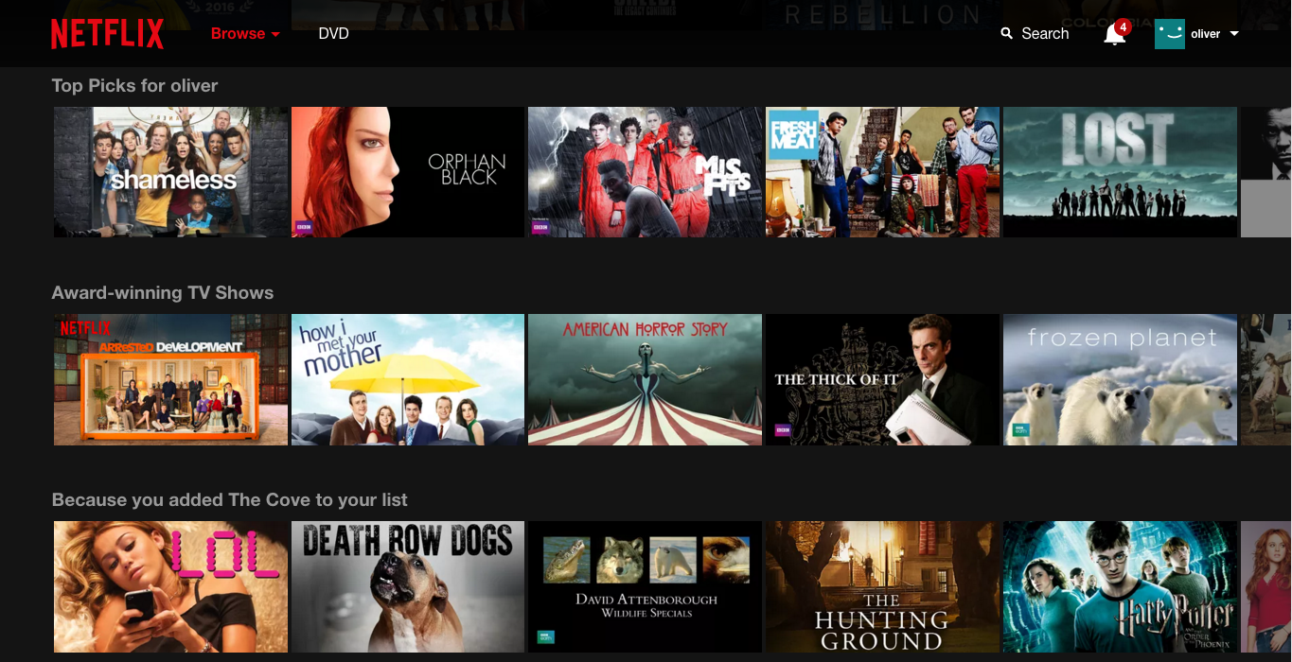
Unsupervised learning
Unstructured data of current customers
Unsupervised learning
Current customers segmented
Supervised learning
Predict segment membership of new customers
Results of unsupervised learning often become inputs for supervised learning:

Slide 27
Reinforcement learning
The computer learns to take actions that maximize reward or minimize the loss based on sequential interactions with its environment.
The computer, or “agent”, learns from its experiences of the environment until it explores the full range of possible states.
Simple reward feedback is required for the agent to learn its behavior; this is known as the reinforcement signal.
Example of marketing applications: personalization, A/B testing.
See, e.g., https://towardsdatascience.com/types-of-machine-learning-algorithms-you-should-know-953a08248861
Notes:
https://www.youtube.com/watch?v=Tnu4O_xEmVk

Slide 28
Example: A/B testing display ads
Traditional A/B testing
Randomly assign customers to view one of two (or more) display ads.
Once results are analyzed, present the best-performing display ad to remaining customers.
Multi-armed bandit A/Bn tests
Three or more options are tested simultaneously.
Traffic is diverted to the most successful option at a given point in time, while continuing to run and evaluate other options for a smaller percentage of the traffic.
Useful when traffic volume is high and campaign duration is short.

Slide 29
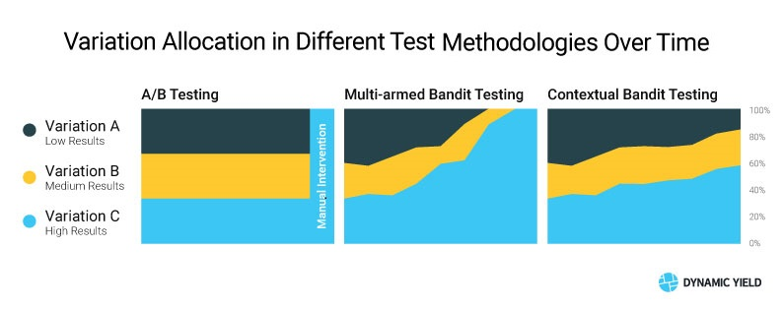
Example: A/B testing display ads

Slide 30
Multiple approaches can be used to solve the same problem
Supervised learning
Bot detection: use training data that consists of human and bot behavior on website
Personalized recommendations: use data to predict whether users will watch a movie
Unsupervised learning
Bot detection: look for patterns in behavior to detect abnormal website activity
Personalized recommendations: assign users into “taste communities”

Slide 31
Will artificial intelligence render human marketers useless?

Slide 32
Types of artificial intelligence
Type of intelligence | Description | Required technology
Mechanic | Minimal degree of learning, precision and efficiency is important | Marketing automation, robotic process automation, rule-based software solutions
Analytic | Learning and adaptation based on experience/data | Traditional machine learning – we are here!
Intuitive | Flexible learning and adaptation based on (lots of) data | Complex machine learning systems (e.g., deep learning)
Emphatic | Learning and adaptation based on understanding others | Pretty much sci-fi
Source: Huang & Rust 2017

Slide 33
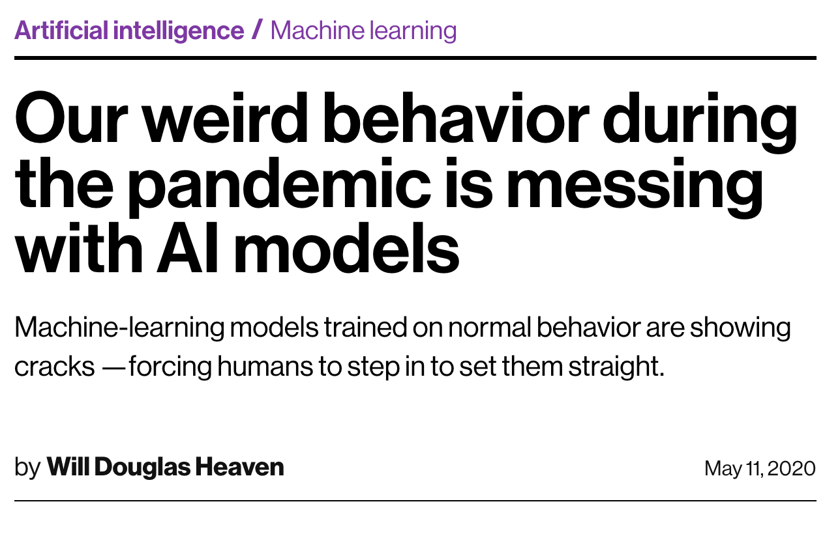
Cautionary tales
“Machine-learning models are designed to respond to changes. But most are also fragile; they perform badly when input data differs too much from the data they were trained on. It is a mistake to assume you can set up an AI system and walk away, says Rajeev Sharma, global vice president at Pactera Edge: ‘AI is a living, breathing engine.’”
“The current crisis has also shown that things can get worse than the fairly vanilla worst-case scenarios included in training sets.”
https://www.technologyreview.com/2020/05/11/1001563/covid-pandemic-broken-ai-machine-learning-amazon-retail-fraud-humans-in-the-loop

Slide 34
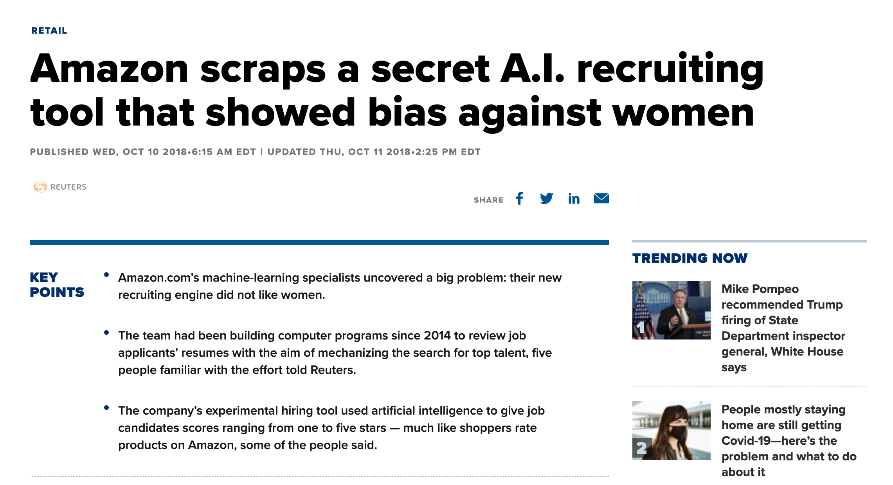
Cautionary tales
“The team had been building computer programs since 2014 to review job applicants’ resumes with the aim of mechanizing the search for top talent.”
“By 2015, the company realized its new system was not rating candidates for software developer jobs and other technical posts in a gender-neutral way. That is because Amazon’s computer models were trained to vet applicants by observing patterns in resumes submitted to the company over a 10-year period. Most came from men, a reflection of male dominance across the tech industry.”
https://www.cnbc.com/2018/10/10/amazon-scraps-a-secret-ai-recruiting-tool-that-showed-bias-against-women.html

Slide 35
Course wrap-up

Slide 36
Using data to maximize marketing outcomes
Organization
Market
Analytics
Insight
Market action
Data
36

Slide 37
Our starting point
This course provides exposure to key topics in marketing analytics.
The goal is to learn these techniques but, more importantly, to to develop:
A general understanding of the field of marketing analytics
The ability to keep up with the rapid technological changes in the field

Slide 38
Topics covered in the course
Return on marketing investment
Attribution modeling
Marketing experiments
Marketing mix and marketing communications modeling
Churn and conversion modeling
Customer lifetime value
Machine learning for marketers
Fundamentals of R (one of the most widely used software for data science and analytics)

Slide 39
Next steps: courses at Aalto BIZ
Analytics and data science
ISM-C1004 Business Analytics 1
ISM-C2002 MySQL For Data Analytics
Statistics
ISM-C1100 Tilastotieteen jatkokurssi ja R
30C00200 Econometrics
Digital marketing (analytics)
23E47000 Digital Marketing
MARK-E0046 Digitalization of Markets and Consumption
Programming
You have access to all programming courses on Datacamp until April 21st. This festive period, why not give yourself the gift of Python? ☺

Slide 40
Course feedback

Slide 41
Course feedback:
Data collected by Aalto University and the School of Business.
Tracking performance
Average course feedback for marketing courses 2020-21: 4.05
Faculty retention and promotion
Course feedback part of employment decisions

Slide 42
Exam

Slide 43
Exam tips
Exam will be held online in MyCourses on Friday the 21st of October between 13-16.
The exam will be held on MyCourses (Online Exam)
Please make sure you have access to a stable internet connection (does not need to be fast, as long as it’s stable).

Slide 44
Exam tips
6 questions, each worth 10 points (60 points max). Question formats:
Multiple choice
Short answer / mini-essay
Model interpretation
Basic calculations (e.g., CLV, MROI)
A combination of all of the above
Open book exam: you may use all available study materials.
Individual effort: you should not collaborate with your coursemates.

Slide 45
Exam tips
Tips for preparing for the exam:
Go over the course materials:
Lectures slides and videos
Review the assignments and model answers (will be posted asap).
You will not be asked to write or interpret R-code. You may be asked to read and interpret the output of certain code (e.g. regression results).
Questions? Ask questions on Teams if anything is unclear.

Slide 46
Practicalities
During this week’s exercise session, you will have the opportunity to test the MyCourses exam platform.
I will be online to answer any questions or address any concerns.
I will leave the mock exam open in you are unable to make it to the exercise session.
During the exam, I will be online and by my phone in case anyone has tech issues.
If you do experience technical issues, take a screenshot with your computer or phone.
If you can provide proof that you were unable to complete the exam due to tech issues, a re-take exam will be arranged as soon as possible for all affected parties.
Otherwise, the next opportunity to take the exam will be in February

Slide 47
Any questions about the exam, exercises, or anything else?

