Slide 1
Productizing
Copyright ©2022 Reino Iuganson
Notes:
Hello everyone, I am Reino, and I develop professional speakers and subwoofers for music studios and commercial spaces. I would like to share my experience working in research and development department as a mechanical engineer, so that you can learn something about the challenges of the product development process for your future projects.
Let’s talk about the process of productizing.

Slide 2
Definition
Productizing is the process of turning the product concept into the complete product that can be introduced to the market [1].
Figure 1. Productizing [2].
Notes:
In a real world, outside of university, if you have a product idea then you have to consider certain economic challenges to successfully turn your idea into a product that can survive in the competative market. In order to do that, the product has to satisfy cutomer needs and generate profit for you and your company.
So turning the idea into a real product that can be sold, is called productizing.
Let’s talk about the elements of the productizing process that you should consider as an engineer.

Slide 3
Manufacturability
Idea
Product concept
Industrial design
Components cost
Technical requirements
Figure 2. Industrial design and mechanical engineering [3].
Notes:
First of all, you should think about the begging of the product development process. You can come up with your own product idea and create a concept that would consist of some technical requirements and desired visual appearance. However, if you are working in a company, then most likely you will get the product concept already from the managament team.
The product concept is usually visualised by the industrial designer, then you will have to take the design and turn it into the product that can be manufactured. In order to achieve desired visual aesthetics, functionality and technical requirements, you should consider the cost of the product parts that you will have to design.

Slide 4
Production Cost
Material cost
Machine tooling
Batch size
Warehouse expenses
Assembly work
Packaging
Figure 3. Assembly line [4].
Notes:
When you design a product you should think about production cost which depends on the following elements, and there are many trade-offs that you will have to consider.

Slide 5
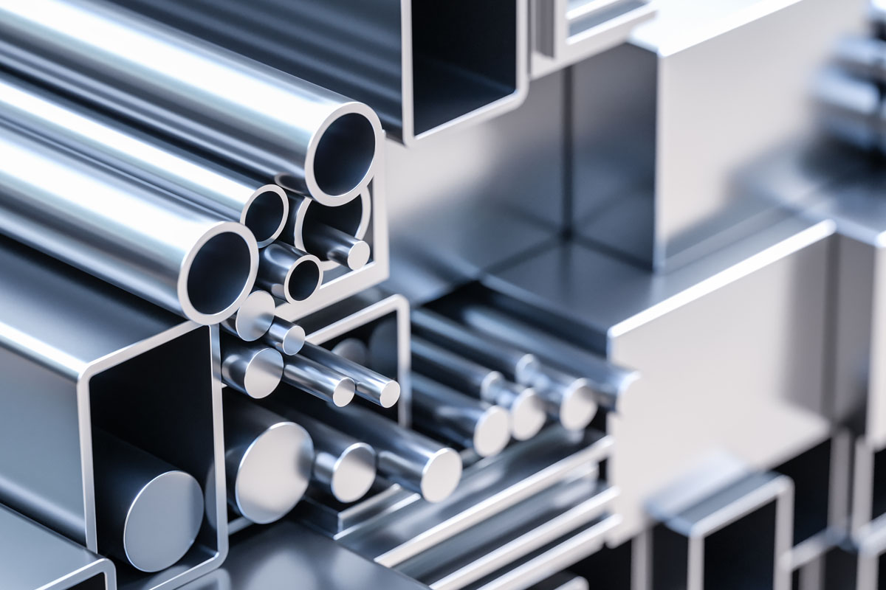
Material Cost
Properties
Cost
Application
Figure 4. Aluminum [5].
Notes:
First, you have to evaluate the cost of material. For example, if you design a metal enclosure then you could use steel or aluminum. Steel is usually cheaper than aluminum, steel weights more and it is more durable. However aluminum can be more suitable because of the light weight and the lower cost. So you have to think about the material application and the cost to decide what is more suitable for your product.

Slide 6
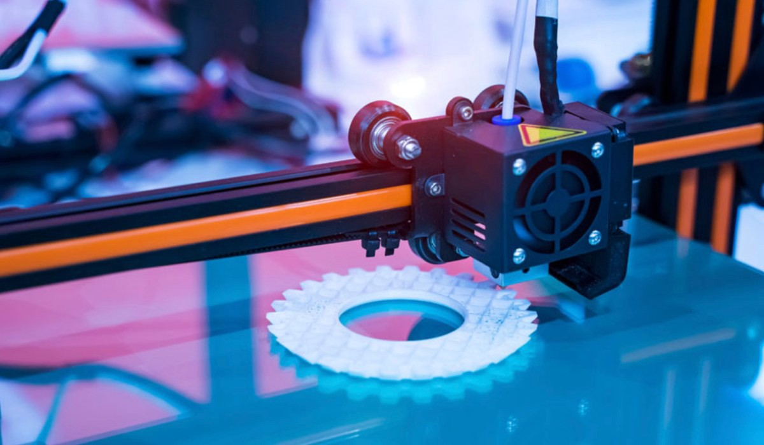
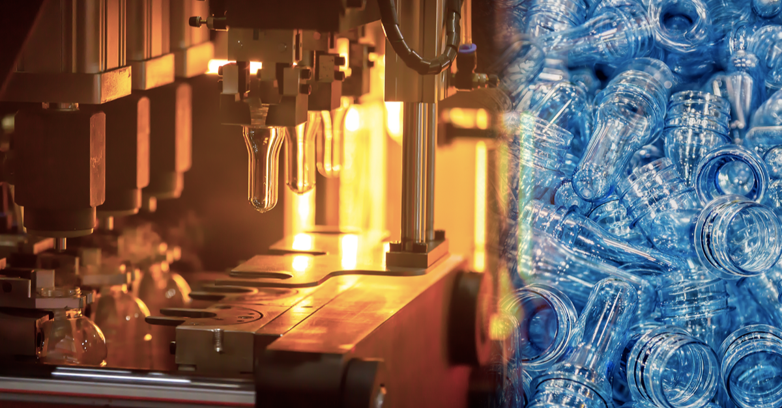
Machine tooling
Mass production
Small batches
Prototyping
Investment
Figure 5. Injection molding [6]. Figure 6. 3D Printing [7].
Notes:
Next, think about the machine tooling. Let’s say you need to design a plastic part. The cost of the mould for injection moulding can be really expensive, more than 20000 euros for large size plastic part, so the annual need for your product must be more than few thousand pieces. However, you will get quite cheap manufacturing cost per one unit. You can also use Reaction Injection Moulding (RIM) if you need to decrease the cost of the tooling, but it will increase the manufucturing cost of the plastic part. It is more suitable for products with annual need from 1 to few thousand pieces. If you have a really small batch, then 3D printing can be an option. The cost per part is expensive, but from the other hand you don’t have to invest in tooling, because the manufacturer already has the 3D printer. So always think about the investment into the manufacturing tooling and your annual need before you design any part. Otherwise you can end up with the high price for your product and your business team will not be able to sell it or you will have to sell it so cheap that you will barely make any profit.

Slide 7
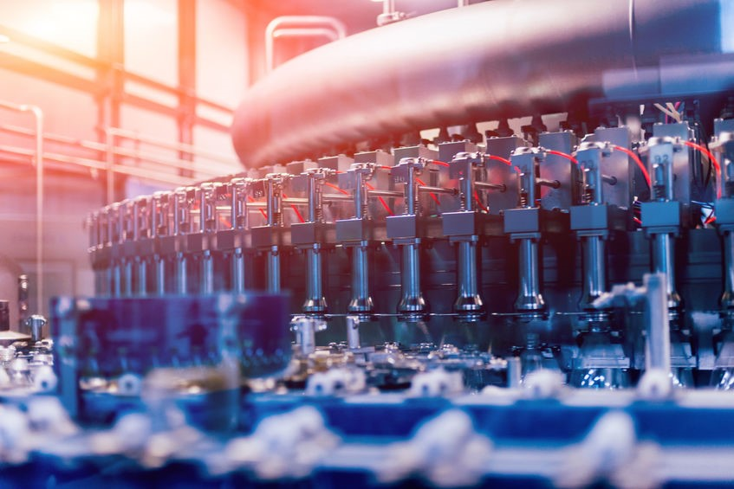
Batch size
Price per unit
Annual need
Changing demand
Figure 7. Production batch [8].
Notes:
The batch size is quite important. If you buy more parts then you get less price per unit, if you buy less then price is higher for each part. You should purchase according to your annual need. Various batch sizes should be considered as well to add flexibility for purchasing based on the changing demand. Expected annual need can change and you will need to adjust purchasing of parts. Usually, nobody buys the whole amount of the annual need for the production. It’s done in different parts with smaller batch sizes to reduce the risks related to the changing product demand.

Slide 8
Warehousing
Storage
Stock
Assembly need
Customer service
Figure 8. Warehouse [9].
Notes:
Warehousing. You have to store the parts before you use them in the product assembly. Keep in mind that you should always have some parts in stock if something goes wrong at the assembly line or if the product needs some service work in future. For example, the customer can have possible issues and then she or he will send you the product that you will have to repair. Without spare parts you will not be able to fix the broken product and that will affect the trust of your customers into your company, then the company can loose the reputation which will affect the amount of sales and your personal income.

Slide 9
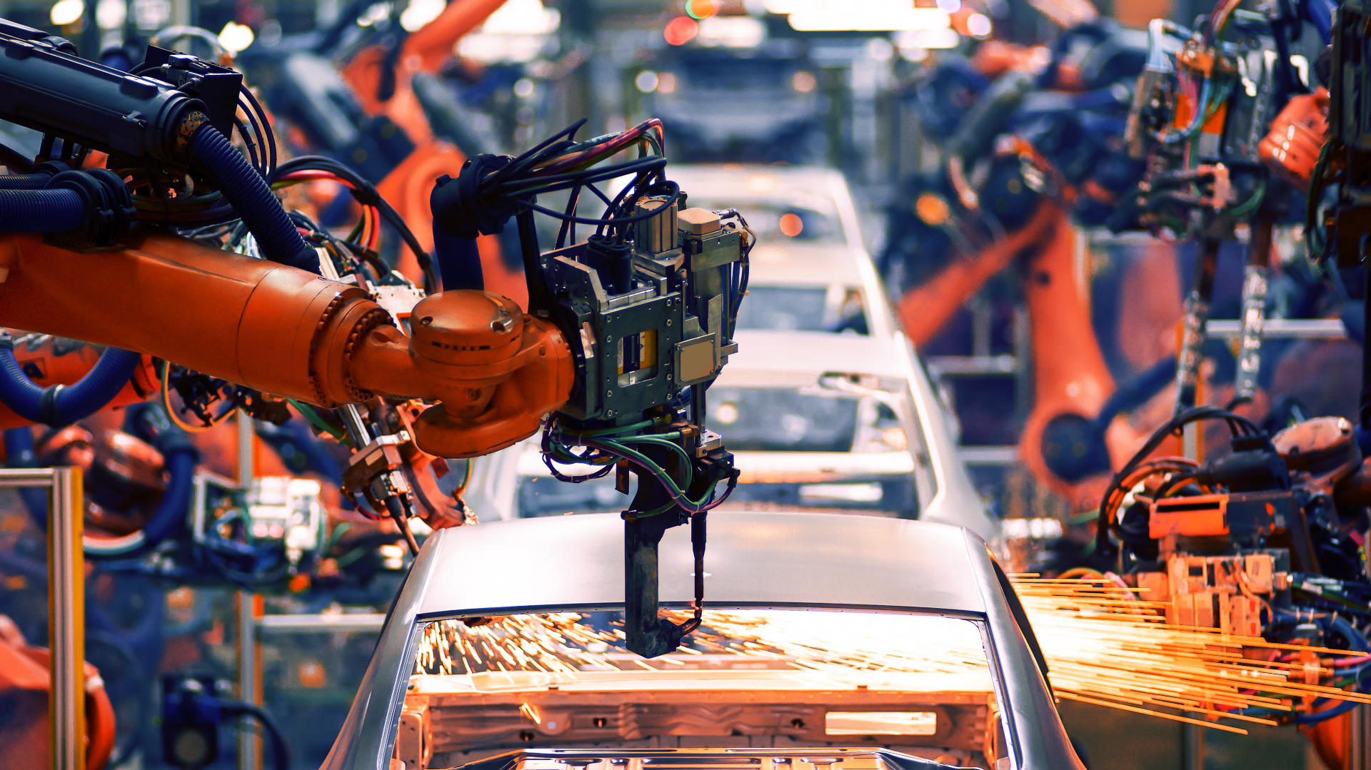
Assembly work
Design
Simplicity
Automation
Figure 9. Automated assembly [10].
Notes:
Assembly work should be also taken into consideration. Think about how hard it is to assemble and disassemble your product.
Don’t design too complicated parts, otherwise it will take a lot of time for assembly, and you will have to pay quite a lot to your workers. Also, product parts that have simple design are more suitable for automated assembly line.

Slide 10
Packaging materials
Safe delivery
User manual
Visual aesthetics
Figure 10. Packing [11].
Notes:
Finally, you have to buy packaging materials to secure safe delivery of your product to the customers. You might also design a print for the box. Packaging is a part of your product, so think from the customer perspective. It should be reliable, simple, probably good looking. There should be a user manual and some short instructions on the signle list of paper to explain how to use your product. Also unique packaging design can help your product to stand out.
Overall, all of these elements are included in the production cost.
So the production cost combined with the required profit that company has to generate to pay salaries and grow as a business will define the market price of the product.

Slide 11
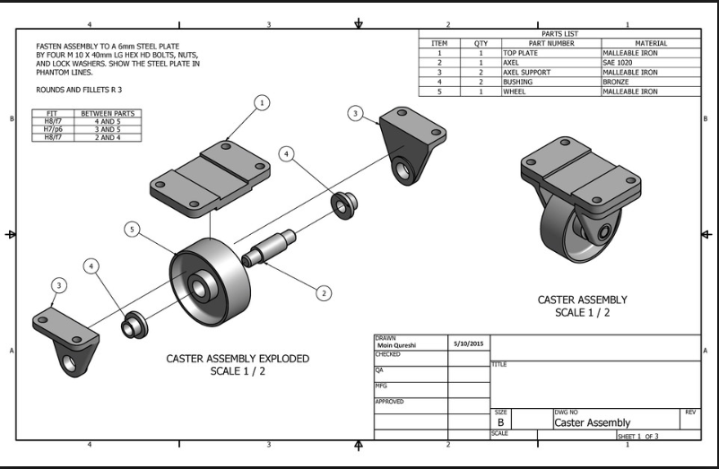
Technical Documentation
Revision
Paint color
Dimensions
Material name
Surface finish type
Engineering standard
Figure 11. Technical drawing [12].
Notes:
Let’s say now you considered all the elements that affect the production cost and you have designed product parts.
To get the cost of the product part from your supplier you will have to make a 3D model and convert it into the two dimensional drawing that has to include technical specifications.
Next, you will get the quotation, compare it to the quoatations from the other suppliers and choose the supplier with the most reasanoble price.
After that you will have to order the tooling and check the off-tooling samples if they can fit into your product assembly and if everything is done correctly according to what you requested from the supplier.
Usually you get the off-tooling sample, and you will have to modify some things. Therefore, you will have to update the revision of your technical drawing to make it clear for the supplier which changes were made and which document version is the correct one to secure that your product parts will be mass manufactured according to the specifications you need. That’s why technical documentation is really important for every part of your product.

Slide 12
Supplier Management
Quality
Working conditions
Sustainable manufacturing
International standards
Company reputation
Economic consequences
Figure 12. Factory [13].
Notes:
Choose your suppliers carefully. They should have sustainable manufacturing, appropriate working conditions and manufacturing quality that meets international standards. Reputation of your suppliers will affect reputation of your company. How is it related to the economic success of your product? The amount of the product sales depends on the reputation of the company. If the reputation is ruined, if there are any violations such as using child labour or inappropriate working conditions or any hazardous manufacturing methods for the environment, then the economic consequences for your company and for your income are catastrophic. Therefore, the selection of the suppliers is an essential aspect of the product development, because of the ethical and economic reasons.

Slide 13
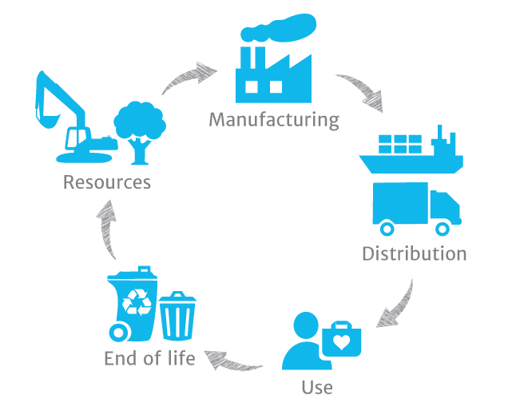
Product life cycle
Product launch
Mass manufacturing
Distribution
Customer use
Recycling
Figure 13. PLC [14].
Notes:
Product launch will include marketing and sales materials such as: product photos, videos, final technical specifications, user manual and product cost.
You will have to set up the assembly line with all required equipment for workers and start the mass manufacturing. Also, you will have to think about logistics and contact distributors to be able to deliver the product to the end user.
In case of any possible issues the product service should be provided to the customers to repair the broken parts.
Customers should be able to reach your team and get the answers for any possible questions regarding the product installation, usage and any technical issues.
You should try to select product materials that can be recycled. The end of the product life cycle is quite important. If you manage to design sustainable product, then it will positively affect reputation of your company, increase the number of sales and you will also save our environment.

Slide 14
Conclusion
Productizing
R&D work
Figure 14. Future projects [15].
Notes:
Overall, the elements of productizing process that we discussed today are very important for the product development results.
I shared the knowledge about what I learned in R&D work, and I hope you learned something today to succussed with your product development projects in future.

Slide 15
References
[1]. C. U. Press, ”Productize”, Cambridge University Press, 2022. [Online]. Available: https://dictionary.cambridge.org/dictionary/english/productize. [Accessed July 2022].
[2]. Figure 1. Productizing. ”Artboard-5”. Available: https://www.thesalesblog.com/hubfs/Artboard-5.jpg. [Accessed July 2022].
[3]. Figure 2. Industrial design and mechanical engineering. ”Computer-aided-design-cad-technician-job-description”. Available: https://www.totaljobs.com/advice/wp-content/uploads/computer-aided-design-cad-technician-job-description.jpg [Accessed July 2022].
[4]. Figure 3. Assembly line. ”Manufacturing-business-accounting-1024x576”. Available: https://mybillbook.in/blog/wp-content/uploads/2021/04/manufacturing-business-accounting-1024x576.png [Accessed July 2022].
[5]. Figure 4. Aluminum. ”Aluminum-vs-Aluminium-Eagle-Mouldings”. Available: https://eagle-aluminum.com/wp-content/uploads/2021/02/Aluminum-vs-Aluminium-Eagle-Mouldings.jpg [Accessed July 2022].
[6]. Figure 5. Injection molding. ”How-top-injection-molding-companies-drive-more-opportunity-with-digital-marketing”. Available: https://blog.thomasnet.com/how-top-injection-molding-companies-drive-more-opportunity-with-digital-marketing [Accessed July 2022].
[7]. Figure 6. 3D printing. ”Ge-research-blockchain-3d-printing-additive-manufacturing”. Available: https://www.ledgerinsights.com/ge-research-blockchain-3d-printing-additive-manufacturing/ [Accessed July 2022].
[8]. Figure 7. Production batch. ”Small-Batch-Beverage-Manufacturing-v2-1”. Available: https://goldratt.co.uk/wp-content/uploads/2022/01/Small-Batch-Beverage-Manufacturing-v2-1.jpg [Accessed July 2022].
[9]. Figure 8. Warehouse. ”ModernWarehouseTrendsin2021”. Available: https://www.18wheelslogistics.com/uploads/blog_post/large/ModernWarehouseTrendsin2021.jpg [Accessed July 2022].
[10]. Figure 9. Automated assembly. ”Automotive-automation-3-2”. Available: https://themanufacturer-cdn-1.s3.eu-west-2.amazonaws.com/wp-content/uploads/2022/04/22155513/Automotive-automation-3-2.jpg [Accessed July 2022].
[11]. Figure 10. Packing. ”What-are-corrugated-boxes”. Available: https://www.jamestowncontainer.com/wp-content/uploads/2020/06/what-are-corrugated-boxes.jpg [Accessed July 2022].
[12]. Figure 11. Technical drawing. Nick DiPietro. Available: https://forums.autodesk.com/t5/autocad-forum/how-can-i-organize-assemblies-and-parts/td-p/8787910 [Accessed July 2022].
[13]. Figure 12. Factory. Cynthia Challener. Available: https://www.paint.org/coatingstech-magazine/articles/sustainable-manufacturing/ [Accessed July 2022].
[14]. Figure 13. PLC. ”Packaging-life-cycle-analysis-what-it-tells-us-what-it-doesnt-”. Available: https://www.ecoenclose.com/blog/packaging-life-cycle-analysis-what-it-tells-us-what-it-doesnt-/ [Accessed July 2022].
[15]. Figure 14. Future projects. Will Morris. Available: https://www.elegantthemes.com/blog/marketing/product-name-generators [Accessed July 2022].

