Slide 1
Methods in Early Product Development personal reflection report: essay or manual… whaat???

Slide 3
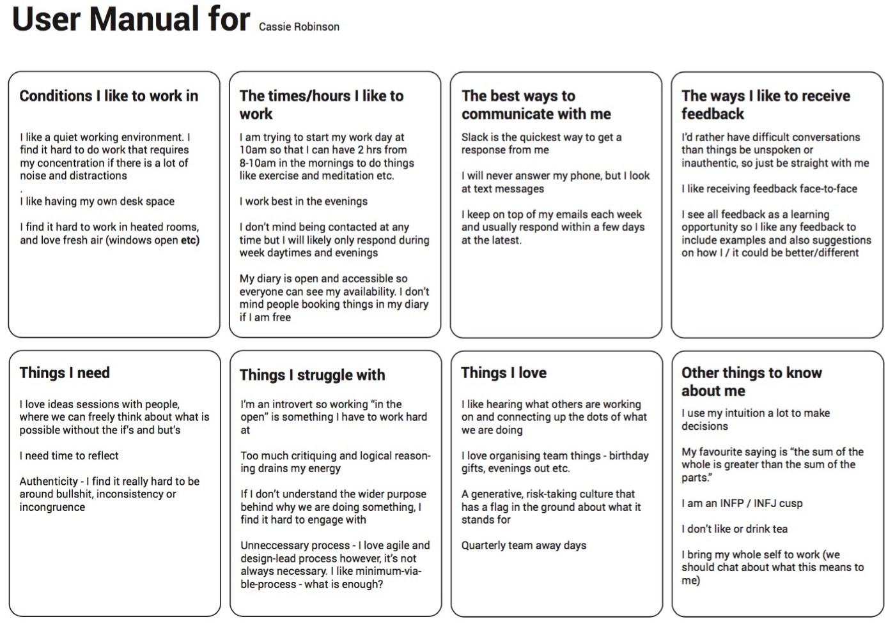

Slide 4
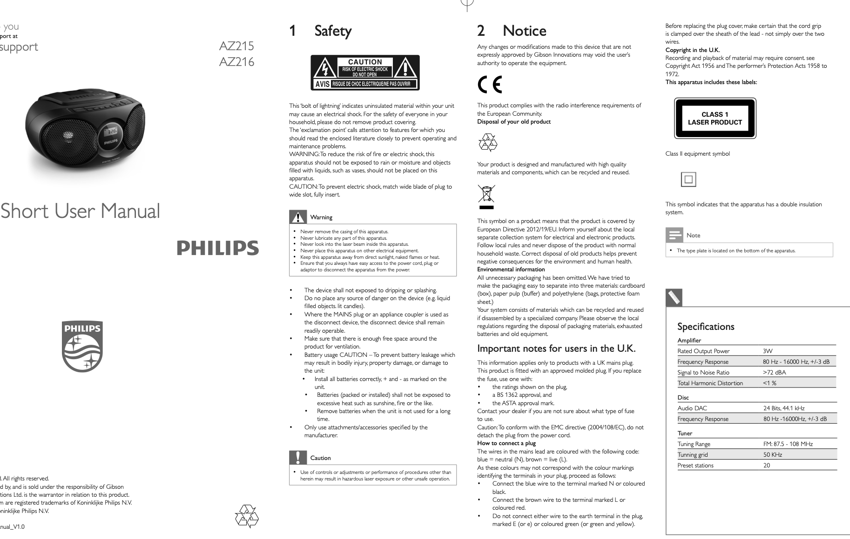

Slide 5
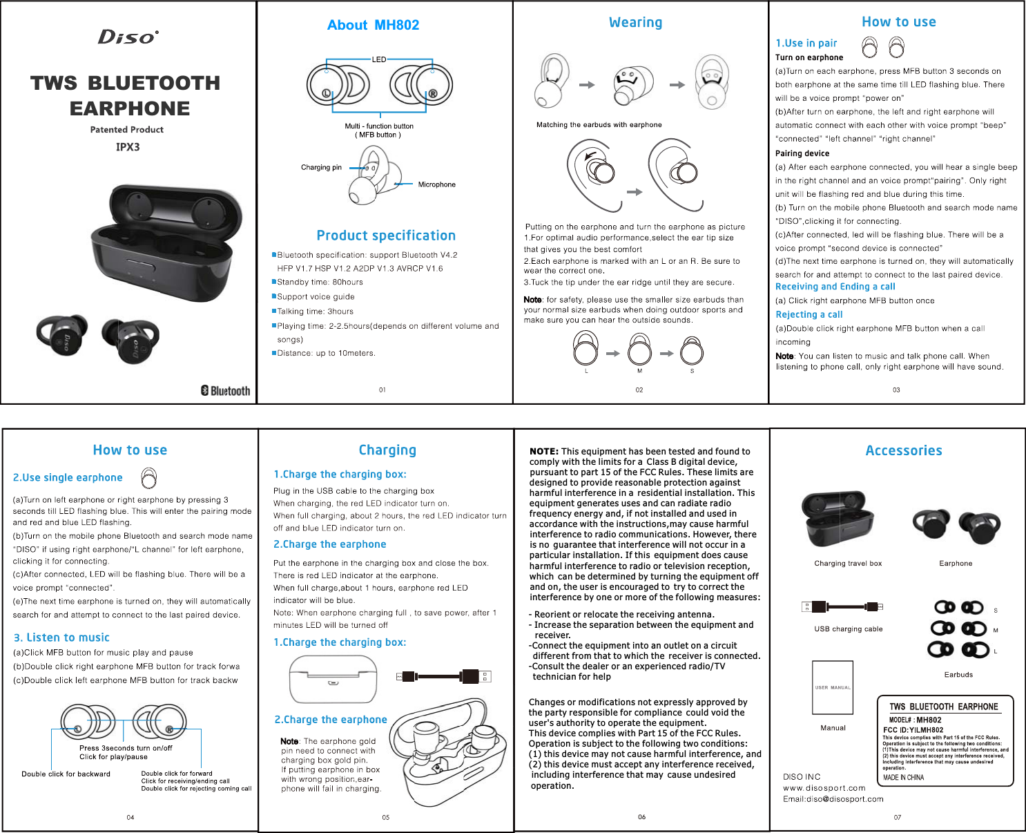

Slide 6
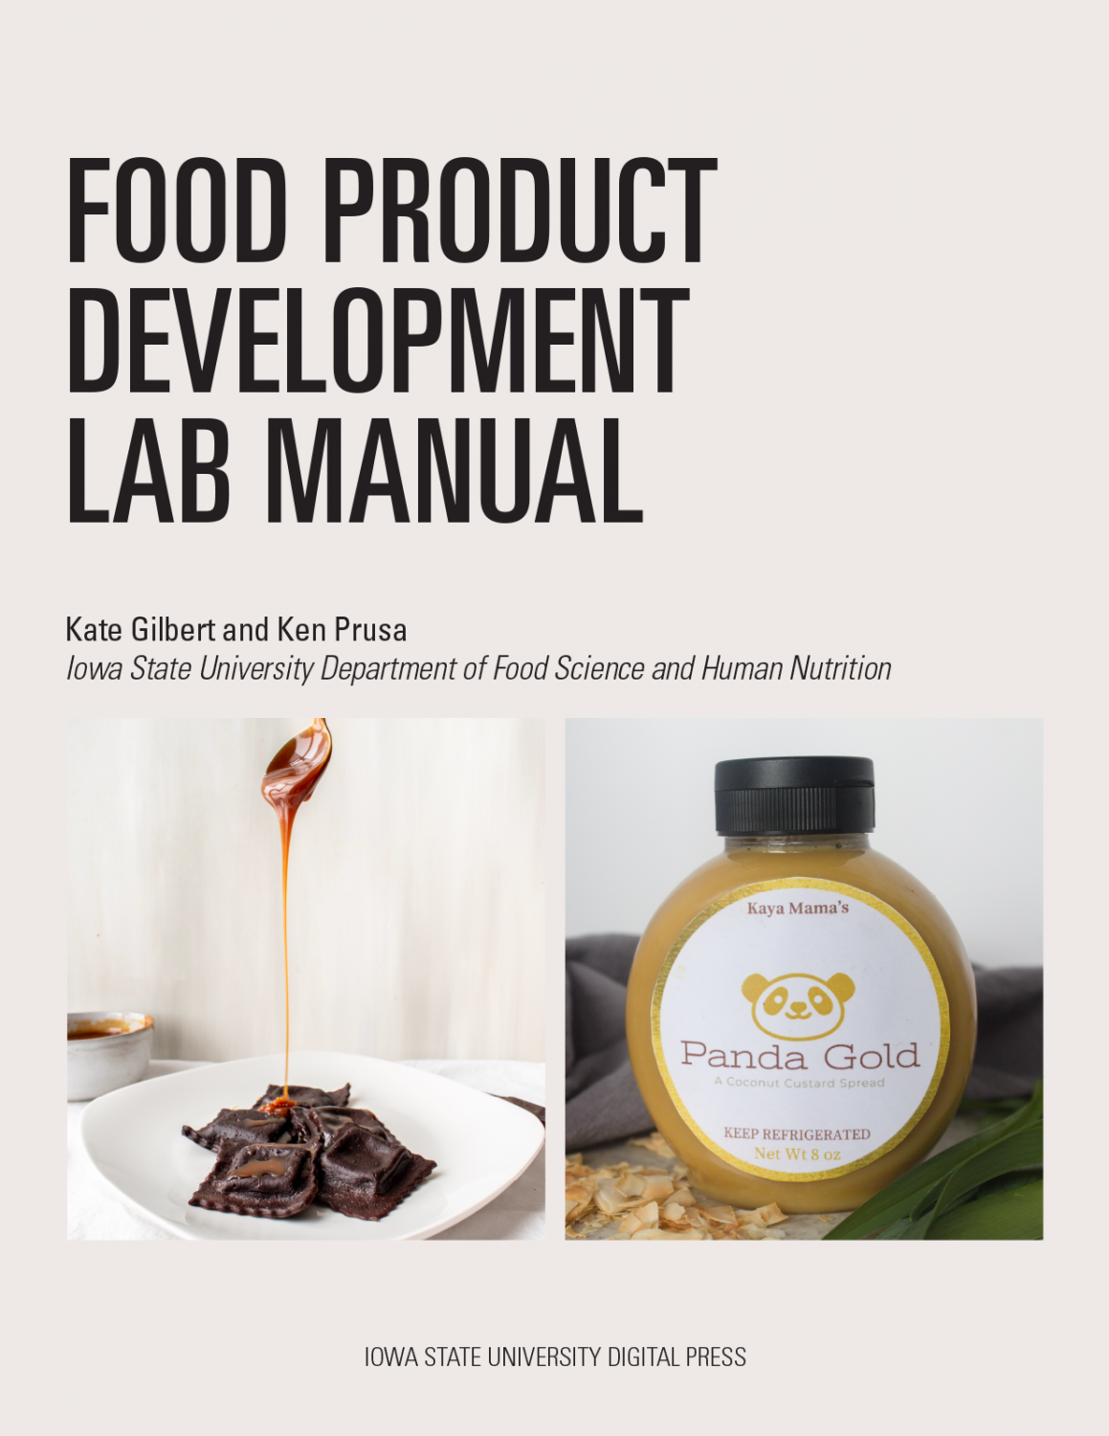

Slide 8
