Slide 1
Product Development Project Introduction to PDP 2022 - 2023

Slide 2
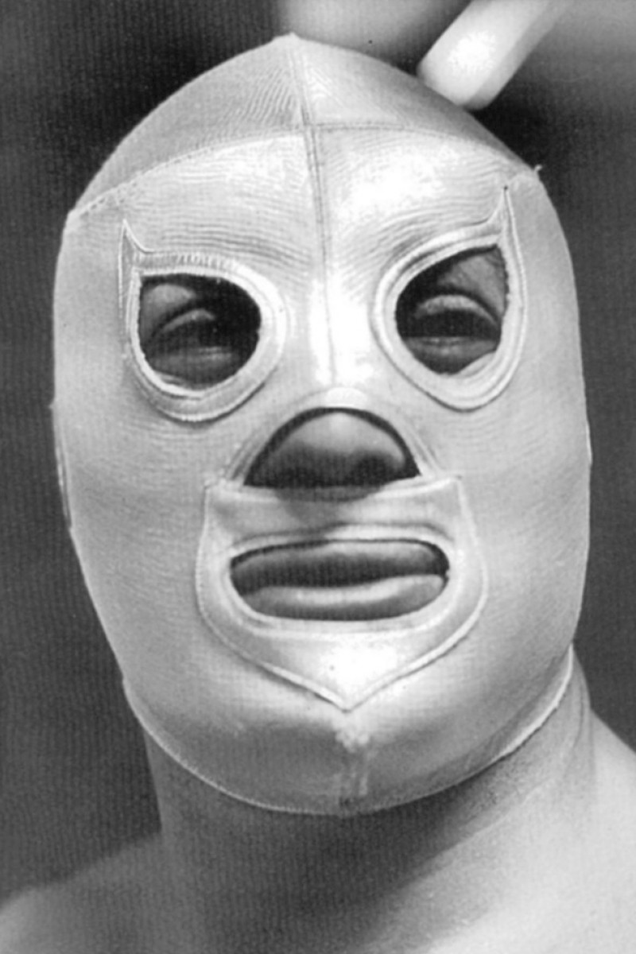
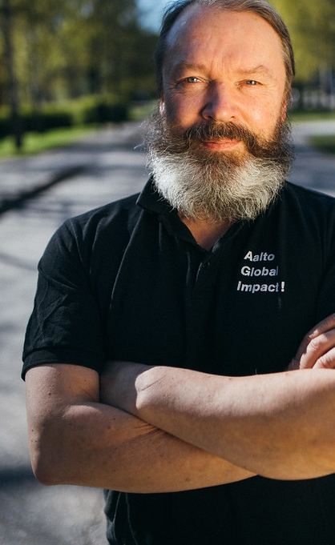

Slide 3
Gala
Why are we doing this?
12.05.2023
What are the expectations?
What roles are there?
How the work is evaluated?
How are projects resourced and supported?
Day 1
How does the learning happen?

Slide 5
Learning
Track record
Alumni
Research

Slide 9
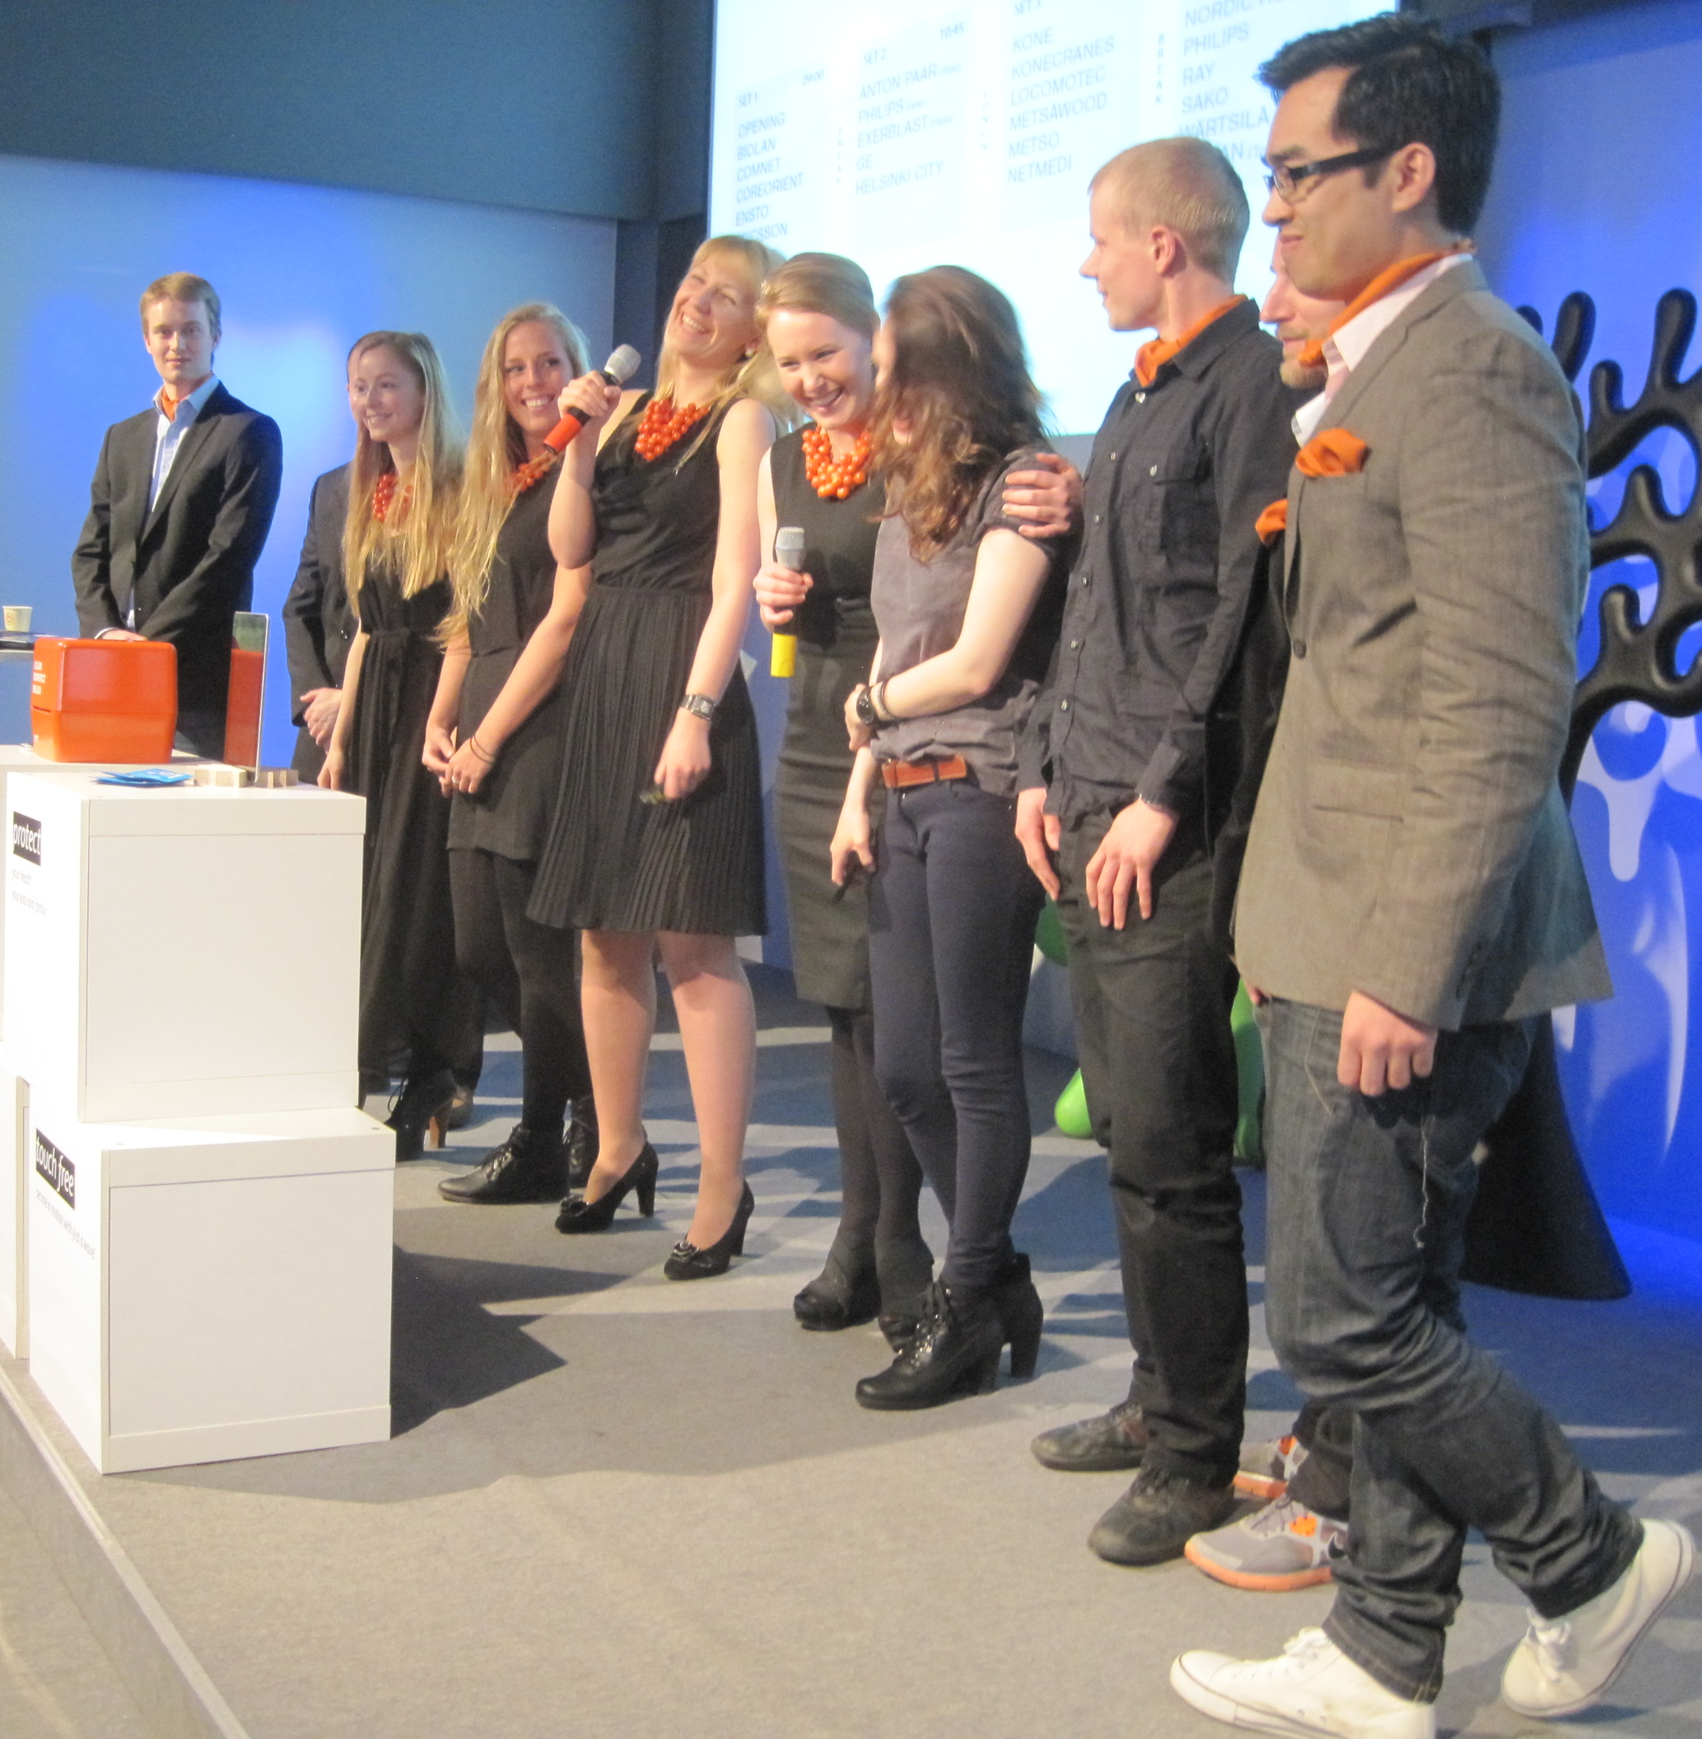
PdP – the academic years 1997-2022
308 projects
2972 students
25 universities
141 partners

Slide 10
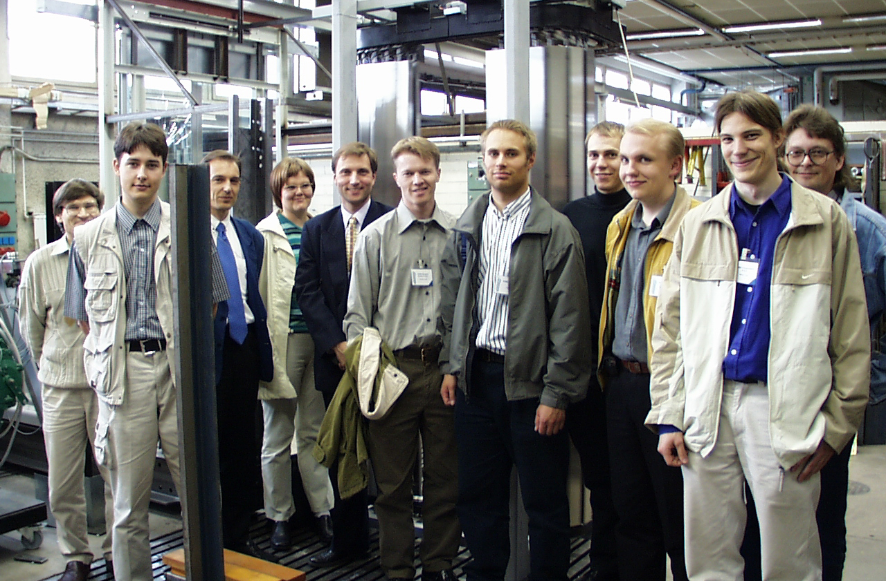
TEAM

Slide 11
SPONSOR

Slide 12
RESOURCES

Slide 13
DEMONSTRATION

Slide 14
PdP basic – always 10 ects

Slide 15
PdP Extended – up to 15 ects
-Ideation
-Electronics
-VR
-Futurism
-3D printing
-User validation
Requires:
-theory (lecture/minilecture)
-application (to your project)
+PM (2)

Slide 16
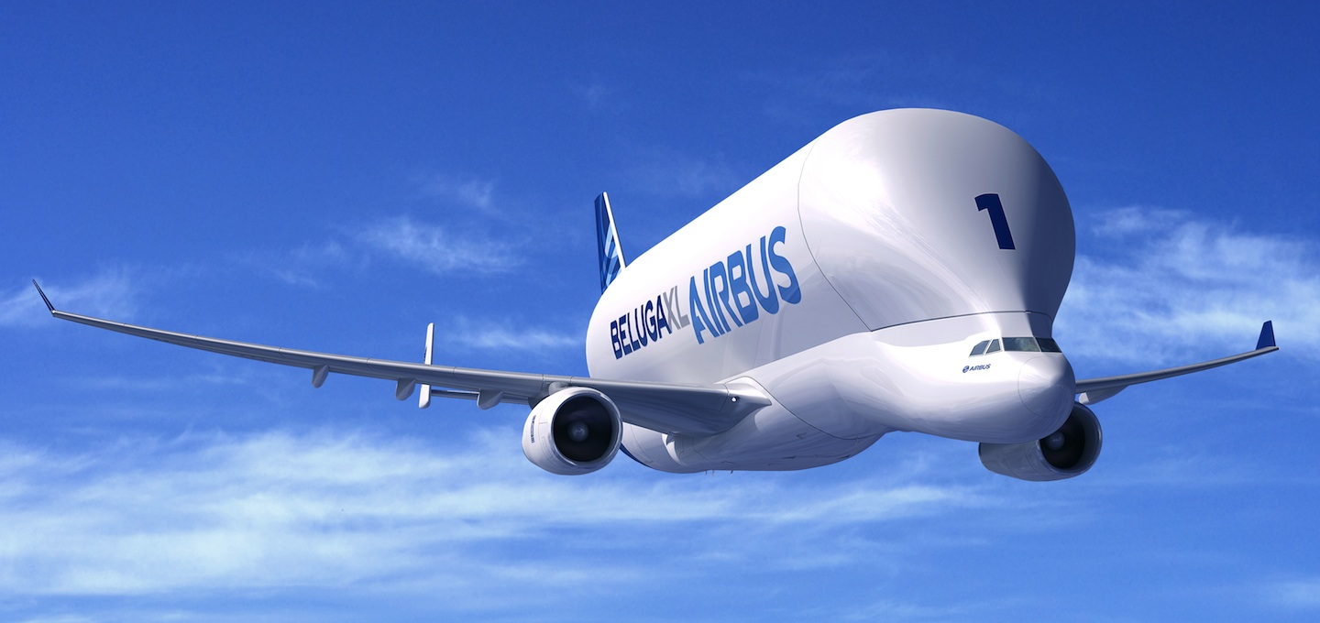
PdP Incredible = up to 25 ects by combining PdP (15) + MEC-E3999 (10) [tailor made for you – talk to the professor first]

Slide 17
Integrated studies Do you have any other course excercises that could be combined with PdP project?
Language…
CAD…
Manufacturing…
Materials…
Project…
Business…
Service…
Automation…
Electronics…
Software…
Communication…
FEM…
Simulation...
Testing…
Management…
Marketing…
UX…
Signal processing…
Radio engineering…
Quality…

Slide 18
TEAM
Learning objectives
all the necessary development phases are completed and a prototype introduced
by practicing project work in an interdisciplinary team, students shall become able to:
work out project plan & schedules
manage resources & risks
complete a project succesfully
communicate & document effectively

Slide 19
There is no ”I” in TEAM

Slide 20
PERSONAL
Learning objectives
becomes better aware of the quality of his or her own design, engineering, or business skills
understands the potential and the challenges of interdisciplinary teamwork
understands how successful PD is based on both traditional and exceptional methods and tools
understands PD costs and economy
is able to deliver high quality oral and written reports
is prepared for negotiation situations, and to deal with agreements, NDA’s and IPR’s ⁽¹
⁽¹ non-disclosure agreement
intellectual property rights

Slide 21
GRADING - aspects on quality
OUTCOME
(e.g. how tough was the challenge, patents, inventions, creativity, attractiveness, quality etc.) PROJECT
(e.g. planning, execution, risk management, keeping schedules, reporting etc.) R&D
(demonstrated use of proper R&D methods, e.g. from course text book) COMMUNICATION
(e.g. CPM’s, produced material, presentations, Gala)

Slide 22
GRADING – analogy to Court of Justice
JUDGE
responsible professor
WITNESSES
extended DF teaching team EVIDENCE
prototype, report, sponsor statement APPLICANT FOR THE DECISION
the team

Slide 23
GRADING – teams or individuals
ETHICAL
every students has the right to be graded fairly
TEAM
team grade supports team working
INDIVIDUALS
heroes may get a raise
DECISION
will be made together in the grading session

Slide 24
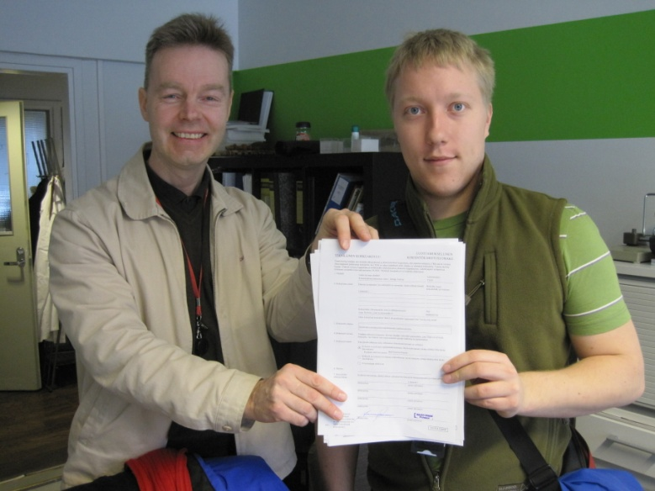
ROLES – team / sponsor / staff
Proper understanding of PDP
-what do we ”sell” for companies
-responsibilities
Contract
Project plan
Meetings
Decision making
Report
Prototype

Slide 25
PLUSCON
ENERGY-X
MICROALGAE
ATTRACT

Slide 26
Important dates – first weeks
07.09. Intro 1 all
09.09. Informal session interested ones
14.09. Intro 2 all
21.09. Toolbox all
23.09. Student Profile DL all
28.09. Team forming all
01.10. PM training interested ones
04.10. Economy economy officers
10.10. Economy economy officers
09.10. Safety safety officers
12.10. Join lecture. Reframing WS all + sponsors
19.10. Fruitful cooperation all

Slide 27
More important dates
07.-11.11. PD6 week all
27.01. Half-way Show all
03.-04.03. PM Winter Camp PMs
12.05. The Product Design Gala all
15.-19.05. Grading sessions all

Slide 28
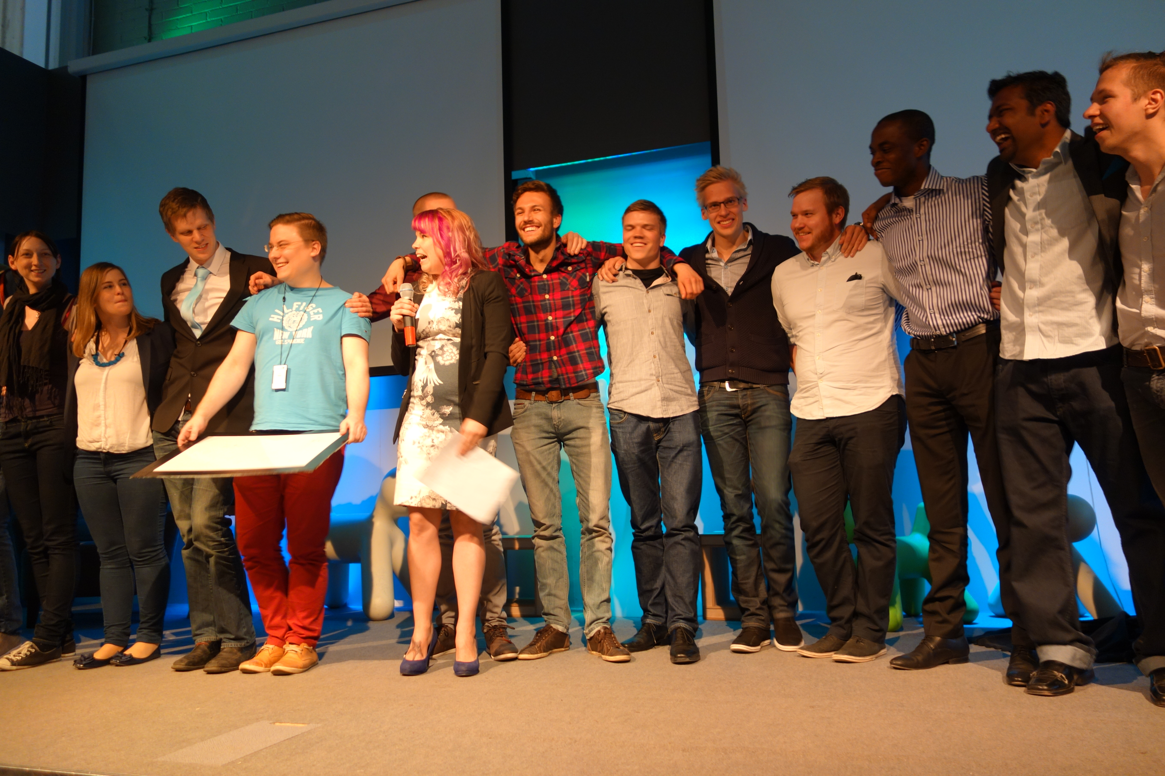
Project managers
Role of PM
Roles of team members
Should you become a team leader?

Slide 29
MOST IMPORTANTLY
The Project flyers at MyCourses after Sept 15th
Everything is still subject for change
Your profiles needed at 23.09.
Team forming at 28.09.

Slide 30
What if …?
I find myself in a wrong team
I find myself in a wrong project
There is a major misunderstanding

Slide 31
We promise that
You will become a team member
Your wish for project will be considered
Whatever happens is the right thing

Slide 32
There is one thing that is no right!
Face your moment of truth now
to quit now = OK
when teams are set, it’s not your private matter anymore
to quit later = to ruin your reputation, to let your team down

Slide 33
