Slide 1
Plastics product manufacturing
Teolliset Valmistustekniikat ja materiaalit

Slide 2
Plastics part production methods
Machining
Laminating
Thermoforming
Polyurethane methods
Rotational moulding
Blow moulding
Expandable Foam (Styrox)
Injection moulding
Extrusion

Slide 3
Production method / quantity
Injection moulding
Blow moulding
Rotational mounding
Vacuum forming
Resin Casting
Laminating
Cutting
Clueing
Bending
Quantity
1 10 100 1000 10 000 100 000

Slide 4
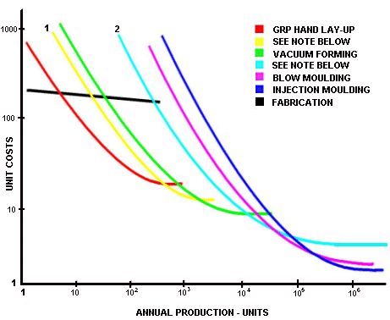

Slide 5
Methods for mass production
Extrusion
Injection moulding
Blow moulding

Slide 6
Extrusion
Profiles, tubes, sheets, film
Calibrating line for accurate shapes
Thermoplastics, (some thermosets) PE-HD, PP, PVC PMMA, rubbers

Slide 7
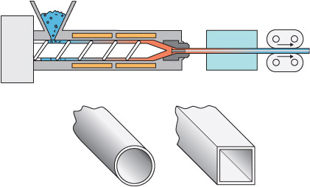
method
Plastics granulate plasticised by pressure, friction and heat
Screw pushes melt to nozzle
Calibrating / cooling

Slide 8
Typical products
Films
Pipes
Seals
Building profiles
Cover profiles
Sheets
Window frames

Slide 9
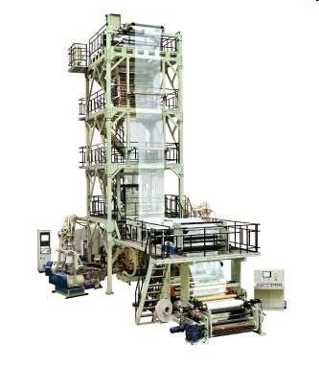
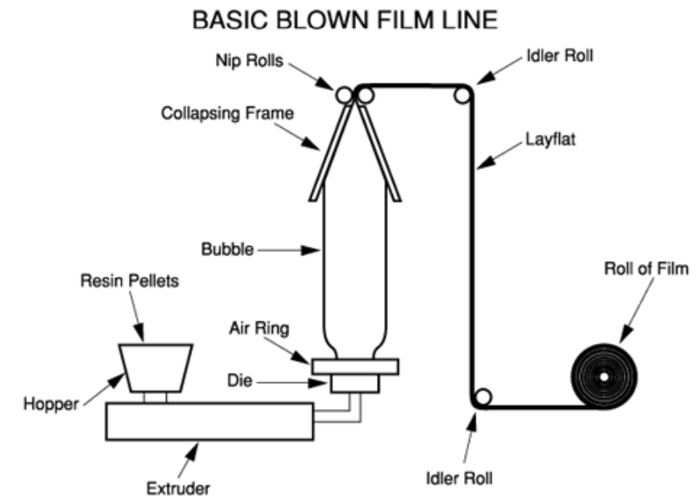
Special methods
Film production
Corrugated tube
Dual-extrusion
Big cylinders by adding small profile to the side of it self a thread like spiral
http://plastics.turkavkaz.ru/processes/extrusion/blown-film-extrusion/

Slide 10
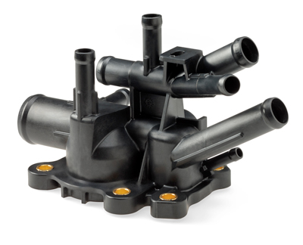
Injection moulding
Series size over 10 000
Structures and functions integration
Accurate products
Ready after moulding, no post processing
All thermoplastics and some others

Slide 11
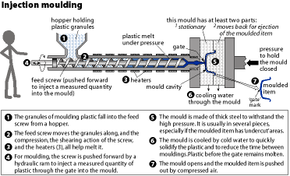
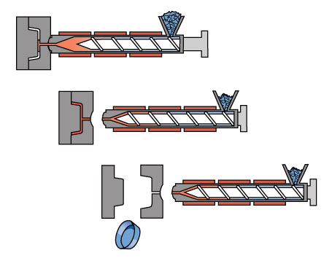
Injection moulding method
www.pac-it.org.nz/.../ plastics_injection_moulding.html.
Plastics granulates are melted by heating and friction while screw withdraws and collects melt to the front
Screw injects melt in to the mould
Part gets cooled
Mould opens and part is ejected
http://www.design-technology.org/injectiondrawing.JPG
http://www.design-technology.org/injectiondrawing.JPG
www.btinternet.com/~hognosesam/ gcse/page53.html.

Slide 12
Typical use
Most common method
Electronics, gadget chases
Dishes
Sport equipment
Car parts
E.G.

Slide 13
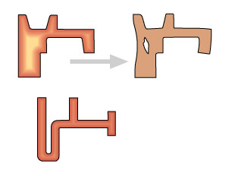
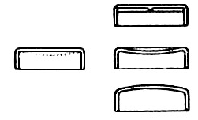
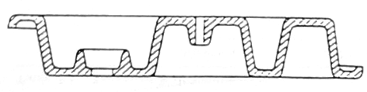
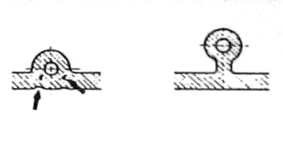
Design guides
Even wall thickness
Avoid planar surfaces

Slide 14
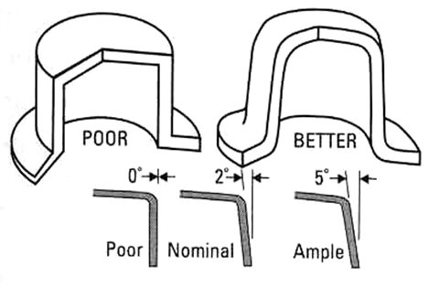
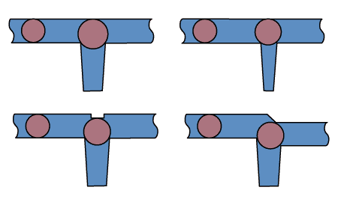
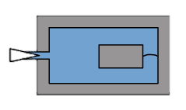
Design guidelines
Draft
Sink mark
Weld line

Slide 15
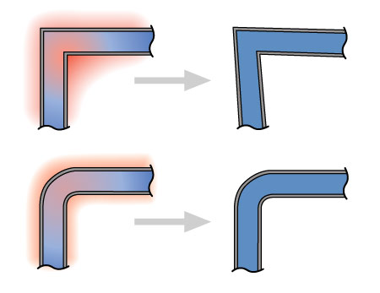
Mould shrinkage
Up to 3 %
Warp

Slide 16
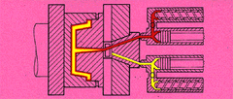
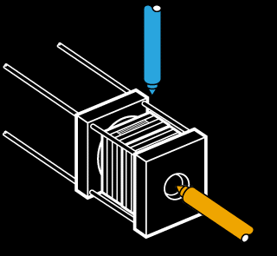
Co-injection moulding
Surface and core different material
  Recycled
  Soft surface
Joint in mould
  Technically superior
  Finished product
  Quicker cooling
  Aesthetics
  Expensive mould
www.bath.ac.uk/~en9ng/ page6.htm.
subscriber.scoot.co.uk/ hymid/4.htm.

Slide 17
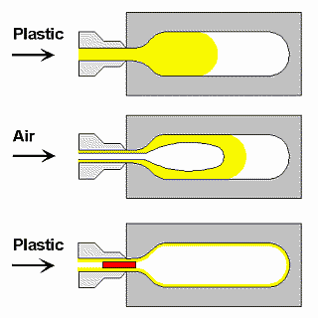
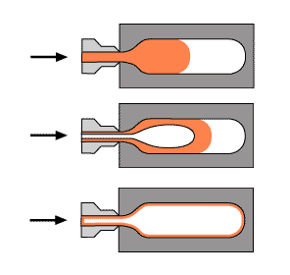
Gas assisted injection moulding
Thick parts
No sinks
Cheaper mould
Light weight part
Rigid
- Material distributes some random
- Rare method

Slide 18
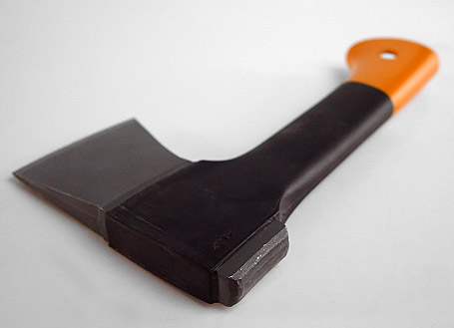
Erikoismenetelmiä
Foamed substances
To make a massive piece
Inserts in the mold
Threads
Textile strips
Nets

Slide 19
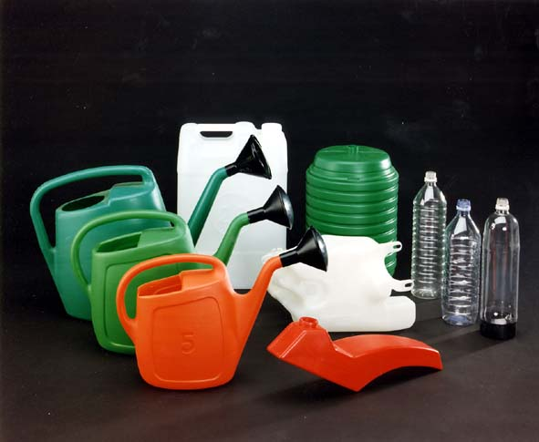
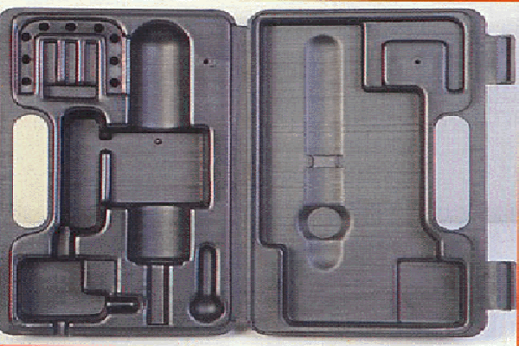
Blow moulding
www.portmanproducts.co.uk/ case.gif
Large series
Hollow barrel like parts, bottles, canisters air channels
Tool cases
PE, PET, PP, PS, etc.
www.blowmoulding.it/GRANDI/ Prodotto02.jpg

Slide 20
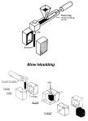
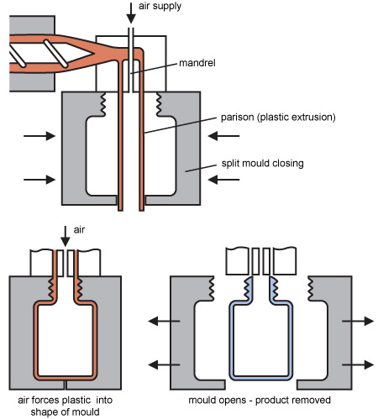
Method
extruded hose
Closed between mold halves
Pressurised air
cooling
opening
cutting
BlowMoulding.JPG
1200 x 1659 kuvapistettä - 137 kt
www.mech.uwa.edu.au/.../Scans-Polymers/ BlowMoulding.JPG

Slide 21
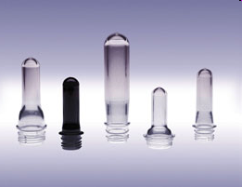
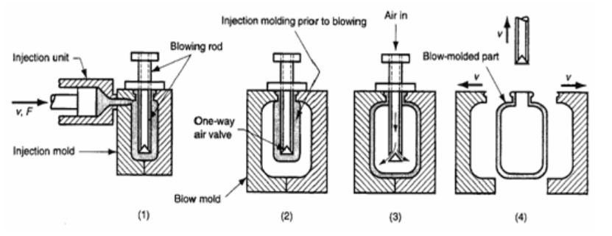
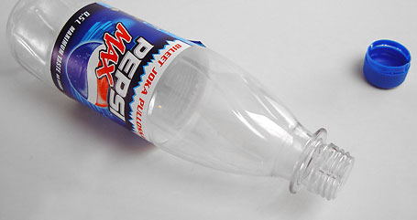
Injection blow moulding
Injection moulded preform, heated
Blown open in a mould
Accurate mouth
E.g water bottles
PET, PC

Slide 22
Design guidelines
Planar surfaces bends outwards
Corners stretch thin
Inserts possible
Double cavity bottles

Slide 23
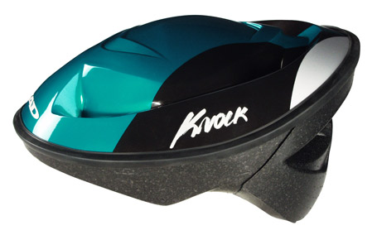
EPS Encapsulated Polystyrene (also PP, PA)
Pre-inflated grains to mould
Swelling by steam
Cooling with water
Opening
Steam and water vent marks

Slide 24
Typical products
Bicycle helmets
Shock absorption for packaging
Thermal insulation, cold boxes
Reinforced plastics laminate core

Slide 25
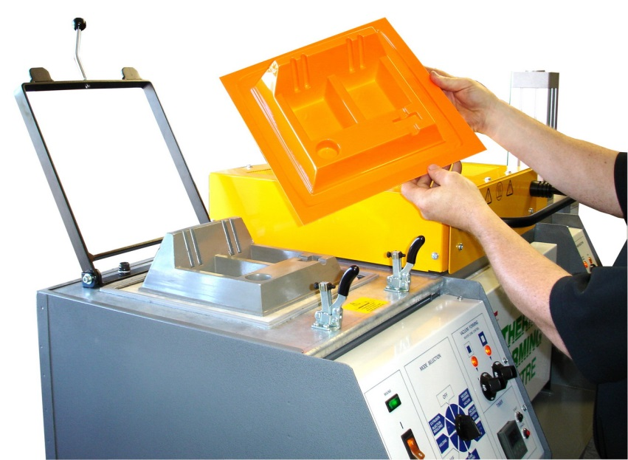
Thermoforming, Vacuum forming
Thermoplastics
Small series in large objects
Large quantities in thin packages
Material thinners unequally
Usually natural mold, E.G. wood, epoxy or aluminium
ABS, PS and PE-HD, thickness 1-8 mm
Often a lot vaste from a sheet

Slide 26
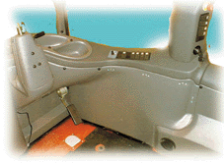

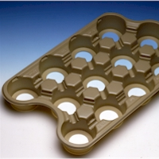
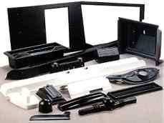
Use
Refrigerator inside
Terhi-boats
Vehicle
Small series device
Packaging
Briefcase
Tray
Ski box, trailer cover
http://www.terhi.fi/static_2003/fin/boat_bigfun.php
http://www.muoviura.fi/index2.htm

Slide 27

Vacuum forming method
Sheet is heated
Blow to a bubble
Lifting mould
Vacuum
Cooling off
Cutting

Slide 28
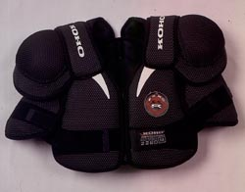
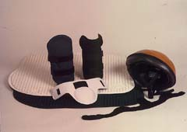
Kuumapuristus
Thermoplastic foam, often PE
Lamination to fabric
Aluminium or even wooden moulds
Inexpensive tools
Sewing industry
http://www.meluton.fi/muovaus.html

Slide 29
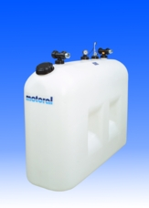
Rotational moulding
Big hollow objects
Unexpensive moulds,
Medium size series
Equal thickness
Production cycle 5-25 min
Thermoplastics PE-HD, PE-MD, PE-LD, (PA, PC)‏

Slide 30
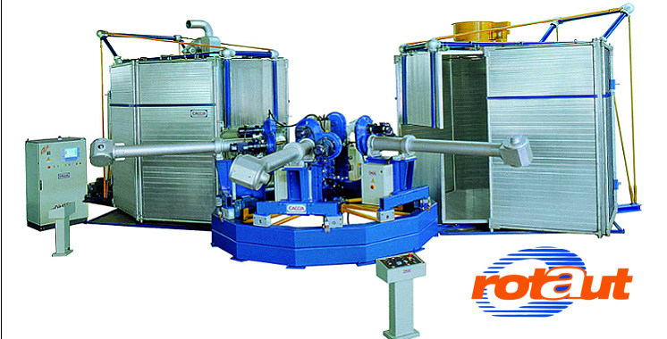
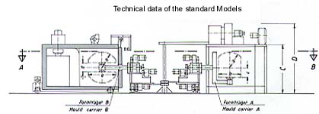
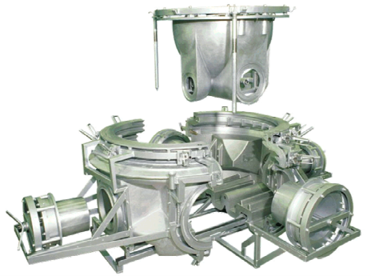
Rotational moulding method
Rotational moulding machine rotates mould around two axis
Closed thin walled metallic mould
Plastic powder in to cold mould
Rotating mould to oven
Plastic melts and gets sinter
Cooling and opening the mould
http://www.reinhardtindia.com/rotational.html

Slide 31
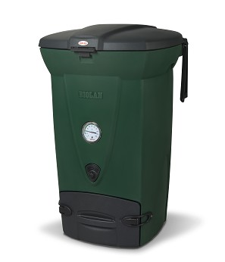
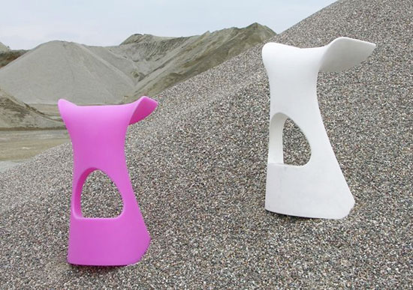
Typical products
Tanks and liquid containers
Composter
Planting plot
Rapids canoe
Fuel tanks
Balls
Toys
http://www.taloon.com/kuvat/k/biolan/biolan_pikakompostori_220_eco_vihrea.jpg
http://www.hometone.com/wp-content/uploads/2012/07/kon01_uExBR_1822.jpg

Slide 32
Casting
Kertamuovit (ja kestomuovit)
Sekoitetaan hartsi ja kovettaja
Irrotusaine
Kaadetaan muottiin

Slide 33
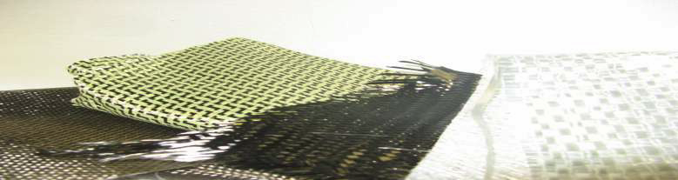
Composite plastics
Fibers
  Glass,
  Carbon
  Aramid
  Natural fibers
Matrix
  Polyester
  epoxy
http://w1.siemens.com

Slide 34
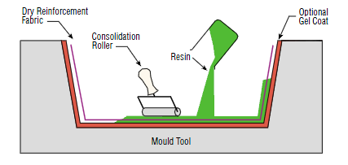
Hand lay up
Resin+fibre, 1+1>2
•Composite material properties:
+ Easy to produce complex shapes
+ Large one piece parts
+ In mould coating
+ Tailored strength properties (directional)
+ Chemical, corrosion resistance
+ Strength/weight ratio
+ Difficult to copy (piracy)
+/-Heat/electrical resistance
+/-Manufacturing
+/-Reparability
+/-Price

Slide 35
Suunnitteluohjeita
no sharp corners
possible to do by hand
laminating the parts together
inserts possible

Slide 36


Slide 37
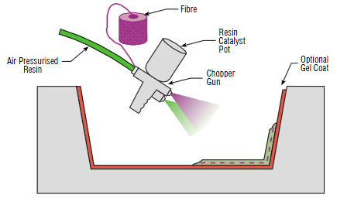
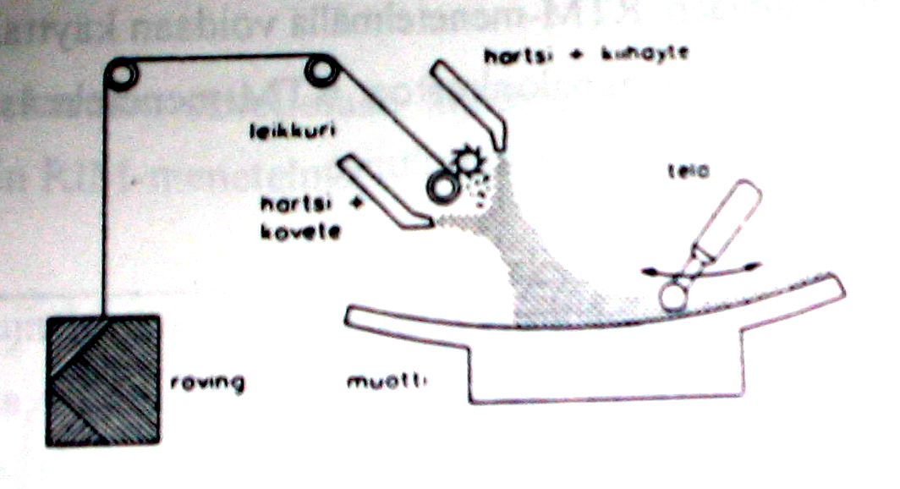
Ruiskulaminointi
kuten avolaminointi
ruiskulla hartsi ja katkokuitu muottiin
nopeampi
kuidun määrää vaikea hallita

Slide 38
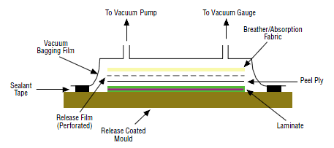
Säkkimenetelmä
kuten avolaminointi
alipainesäkillä ilman poisto

Slide 39
Polyurethane methods
Hard integral urethane
Flexible integral urethane
Cold cast cushion polyurethane
RIM reaction injection moulding
RRIM reinforced reaction injection moulding
Urethane elastomer

Slide 40
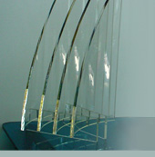
Machining plastics
No moulds needed
Methods
  Sawing
  Lathe
  Milling
  Punching
  Water and laser cutting
Semi-finished products
  Rods
  Sheets
  Profiles
  Tubes and pipes
  Films
Wood and metal machines
  Special blade
  Small series
  CAD

Slide 41
Hard integral polyurethane
Heat forms bubbles
Cold mould surface prevents bubbles
Small series gadget
Allows material thickness differences
Insert typical

Slide 42
Flexible integral urethane
Flexible
Skin and foamed core
Sprayed to open mould
Low mould pressure
Production cycle 20 min
Moulds
  Laminated
  CNC milled

Slide 43
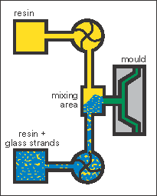
RIM (Reaction Injection Molding)
Thermoset method , polyurethane
Middle size series
Epoxy or aluminium moulds
Production cycle 0,5 min- minutes
Mould pressure high, lower than injection moulding
www.vetrotexeurope.com/fabrication_processes/ re_rim.html

Slide 44
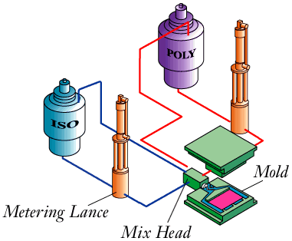
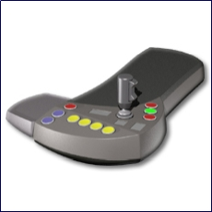
RIM method
polyol and isocyanate are mixed in a nozzle
Injected in a hot mould
Mixture reacts and hardens
http://www.profmer.com/
www.milfoam.com/ process.htm

Slide 45
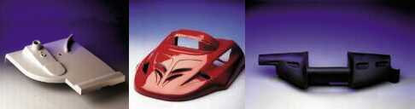
RIM, RRIM reaction injection molding
Micro shell, massive, flexible polyurethane
vehicles
Instead of large injection moulding
http://www.artekno.fi/artekno-pur_oy/polyuretaanituotteet/

Slide 46
Cold cast soft polyurethane, cushion
Soft foam
Little proses heat, no skin
Upholstering or in mould coating
Inserts
Seat padding

Slide 47

Urethane elastomer, Profmer Oy
Hardness rates
Dyed material
Soft moulds, copied by casting
Effect surface, flow marks

Slide 48
Design guidelines
Inserts are common
Allows thickness variation
Air departing problem
UV protection by paint

