Slide 1
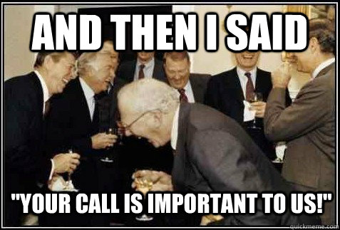
Customer Experience Management
Dr. Kushagra Bhatnagar
Sept-Oct 2022

Slide 2

About the instructor
Born in New Delhi, India
Bachelors in Computer Science
MBA (Triple Accredited)
Professional experience across Investment Banking, Advertising, Marketing Consulting
Co-founder – Brand consulting firm (2011-2015)
PhD, Aalto University School of Business (2015 - 2020)
Assistant Professor (2020 – current)

Slide 3














Consulting Experience

Slide 4
Today’s lecture
Introduction round
Course practicalities
Course overview
What is CXM?
Why CXM is important?

Slide 5
Let’s get to know each other better

Slide 6
Now it’s your turn!
Who are you?
And one of the following:
What are your expectations for this course?
Can you recall a memorable customer experience? (good or bad)

Slide 7
Course Objectives
To reinforce the relevance of focusing on customer experience
To understand the building blocks or antecedents of customer experience​
To understand customer experience from multiple perspectives and points of view
To introduce conceptual tools and techniques that can help create compelling customer experience
Capstone objective: To test/improve your ability to cohesively combine learning from multiple courses/sources

Slide 8
Learning Outcomes
On successful completion of this course, students will be able to:
Understand the need for customer experience management
Identify the drivers of outstanding customer experiences;
Systematically diagnose and review an existing customer journey and corresponding experiences

Slide 9
Assessment Plan
Two individual ”reading” assignments which will be due on 25.09, 09.10.
Assessment
Instructor Assessment
Formative
Summative
20%
Two individual ”real-world” assignments which will be due on 02.10 and 16.10.
20%
One individual Take-Home exam which will be due on 06.11.
25%
One Group presentation which will happen on 14.10 and project report which will be due on 23.10.
35%

Slide 10
Class schedule
(PLEASE CLICK A PHOTO FOR YOUR REFERENCE)
07.09 (13:15-15:00) – Individual Pre - Assignment
09.09 (13:15-15:00) - Classroom Session U356, Kandidatikeskus – This session was cancelled.
14.09 (13:15-15:00) - Classroom Session U356, Kandidatikeskus
16.09 (13:15-15:00) - Classroom Session U356, Kandidatikeskus
21.09 (13:15-15:00) - Classroom Session U356, Kandidatikeskus (Action session – Real World Task 1)
23.09 (13:15-15:00) - Classroom Session U356, Kandidatikeskus
28.09 (13:15-15:00) - Classroom Session U356, Kandidatikeskus
30.09 (13:15-15:00) - Classroom Session U356, Kandidatikeskus (Action Session – Real World Task 2)
05.10 (13:15-15:00) - Classroom Session U356, Kandidatikeskus
07.10 (13:00-14.45) - Classroom Session U356, Kandidatikeskus (Starts and ends 15 mins earlier)
12.10 (13:15-15:00) - Classroom Session U356, Kandidatikeskus (Introducing case and questions for Take-home exam)
14.10 (13:15-15:00) - Classroom Session U356, Kandidatikeskus (This will be reserved for group presentations)

Slide 11
Weekly plan
Week 2
Week3
Week4
Week5
Week 6
Introduction to CXM and practicalities
Approaches and Building blocks of Customer Experience
Action Session 1 - Touchpoints and Journies
Touchpoints, Journies and Narratives
Innovation through CXM
Action Session 2 – Personas, Profiles and Co-creation
Metrics and Measurement – Re-visting the Firm
Aligning Brand Strategy, Research and Context
Future of CXM
Presentations and Wrap Up

Slide 12
Course readings
The course readings include 20 mandatory articles, and 6 optional/additional yet highly recommended readings.
All readings will be uploaded in mycourses in folders labeled by Weeks (NOTE: We are now in Week 2 of the course)

Slide 13
Course practicalities

Slide 14
Assessment – Your road to success
Grading scale
90-100 % 5
80-89 % 4
70-79 % 3
60-69 % 2
50-59 % 1
0-49% Fail

Slide 15
Deliverables (1/4)
“Reading” Assignments (20%)
You will be given a set of articles and a set of open-ended questions.
You have to answer the questions based on your understanding of the articles.

Slide 16
Deliverables (2/4)
“Real-World” Assignments (20%)
You will be given a set of tasks about real-world issues/challenges/successes
You have to collect data using the format provided to you for the task.
You have to interpret your findings and report them in the given format

Slide 17
Deliverables (3/4)
Group Project (35%)
Overall task:
Please choose a well-known service brand (e.g. telecom, sports, music, hotel, restaurant, education, technology etc.)
Identify a customer experience innovation this brand might implement
Argue why this particular experience innovation will be relevant and impactful for the brand

Slide 18
Deliverables (3/4)
Group Project (35%)
Consists of three components:
1. Project proposal (max.1 page long)
2. Presentation (15 min presentation, 5 minutes Q&A) (Takes place of 14.10)
2. Management report (max. 10 pages) (Due on 23.10)
Form a team of 4-6 students.
It is your own responsibility to form a group (e.g. by posting on MyCourses)

Slide 19
Deliverables (3/4)
Group Project (35%)
Project proposal:
Submit a maximum of one-page long proposal which clearly indicates (1) a brand you chose (2) problem the brand is facing (3) customer experience innovation you suggest to mitigate the problem
1-inch margins, Times New Roman 12, 1.15 spacing
Please note that you may always change the originally proposed brand and/or innovation throughout the project

Slide 20
Deliverables (3/4)
Group Project (35%)
Presentation (15 minutes)
Guiding questions:
▪ What is the focal challenge this brand faces?
▪ Why can this challenge be addressed with a customer experience innovation?
▪ Why is your customer experience innovation particularly suited to address this problem?
▪ What is the outcome you want to achieve with this experience innovation (e.g., Sales, Brand Image...)?
▪ How can you be sure that your experience innovation will achieve this outcome?
▪ Why should the company invest in your idea and not in competing projects?
Goal of the presentation is to convince the audience that your project should be implemented.

Slide 21
Deliverables (3/4)
Group Project (35%)
Presentation should:
include supporting material, such as current managerial or trend studies (from Nielsen, Gfk, McKinsey, etc.) to illustrate upcoming business challenges
include a short analysis of a current customer experience related problem by looking at consumer reviews or consumer forums (e.g., some text excerpt from reviews)
emphasize the specific outcomes of your experience innovation and to provide reasoning why the experience innovation will reach the goal (e.g., innovation has been effective in another industry)
Do not forget to identify Customer Personas, sketch a CX journey and to utilize tools that are to be covered throughout the course

Slide 22
Deliverables (3/4)
Group Project (35%)
Management report (10 pages, 1-inch margins, Times New Roman 12)
A short explanation of your presentation following the same questions as the
presentation
• Summarize the most critical information to one (1) executive summary page
Justify your choices, i.e., develop a coherent line of argumentation
Include grounded argumentation of your suggested CXM innovation and
propose relevant CX measurements
Explain the research processes for the reader (customer persona, journey
mapping, ideation process, etc.)
Utilize course literature and additional sources

Slide 23
Group Project – Grading Rubrics
Group Project consists of three deliverables:
Project proposal (not graded)
Project presentation (max. 30 points)
Project report (max. 30 points)
Both presentation and the report are graded based on three rubrics: (1) description of the innovation idea (2) analysis and logic of idea development (3) reporting skills

Slide 24
Rubric 1: Description of the innovation idea (max. 10 points)
Poor (1-2 points) | Satisfactory (3-4 points) | Good (5-6 points) | Very good (7-8 points) | Excellent (9-10 points)
The innovation does not answer the needs of the company. Details of the innovation are random. | The innovation answers some of the needs of the company. Details of the innovation are basic or partly unsuitable. | The innovation answers some of the needs of the company. Details of the innovation are appropriate and somewhat interesting. | The innovation answers the needs of the company. Details of the innovation are mostly creative and interesting. | The innovation clearly answers the needs of the company. Details of the innovation are creative and interesting.

Slide 25
Rubric 2: Analysis and logic of idea development (max. 10 points)
Poor (1-2 points) | Satisfactory (3-4 points) | Good (5-6 points) | Very good (7-8 points) | Excellent (9-10 points)
The presentation/ report shows little evidence of analysis and uses few appropriate readings and other resources. Development of ideas is minimal. The innovation shows a low level of strategic understanding in the area of customer experience management. | The presentation/ report shows little evidence of analysis but uses some appropriate readings and other resources. Development of ideas needs some work. The innovation shows a low level of strategic understanding in the area of customer experience management. | The presentation/ report shows evidence of analysis and uses some appropriate and relevant course readings and other resources. Development of ideas is mostly logical. The innovation shows an adequate level of strategic understanding in the area of customer experience management. | The presentation/ report shows evidence of analysis and uses appropriate and relevant course readings and other resources. Development of ideas is logical. The innovation shows a good level of strategic understanding in the area of customer experience management. | The presentation/ report shows strong evidence of analysis and uses appropriate and relevant course readings and other resources. Development of ideas is insightful and logical. The innovation shows a high level of strategic understanding in the area of customer experience management.

Slide 26
Rubric 3: Reporting skills (max. 10 points)
Poor (1-2 points) | Satisfactory (3-4 points) | Good (5-6 points) | Very good (7-8 points) | Excellent (9-10 points)
The use of language has significant errors. Lacks basic reporting skills, stylistic choices are random. Significant errors in referencing or references are completely lacking. | The use of language has errors. Shows some reporting skills but stylistic choices and visuality does not support the delivery. Clear issues with referencing. | The use of language has few errors. Shows basic reporting skills; visuality does support the delivery. Referencing is adequate, with some mistakes. | The use of language is consistent and fluent. Shows good reporting skills and visual clarity. Referencing is mostly well done. | The use of language is consistent and fluent. Shows strong reporting skills and visual clarity. Excellent referencing.

Slide 27
Deliverables (4/4)
Take-home exam (25%)
Discussion of a case study guided by questions.
Case/brand and questions will be introduced during the second-last lecture (12.10.2022)

Slide 28
Deadlines
Group Composition (21.09.2022)
Group project proposal (28.09.2022 at 23.55)
Presentation submission (14.10.2022 at 11:55)
Management report submission (23.10.2022 at 23:55)
Take home exam (23.10.2022 at 23:55)

Slide 29
Break

Slide 30
What is Customer Experience Management?

Slide 31
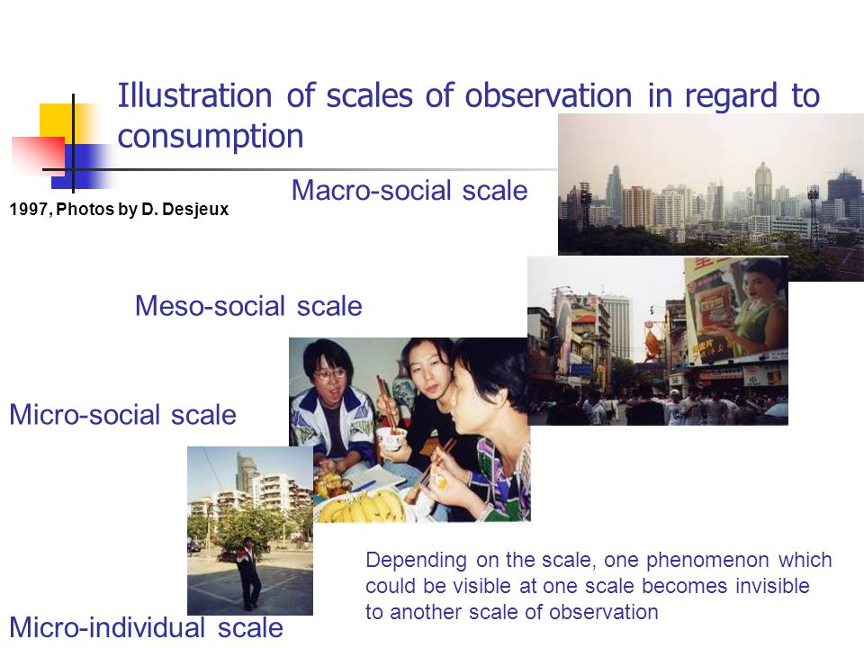
CUSTOMER

Slide 32

CUSTOMER

Slide 33
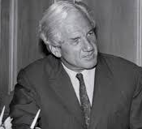
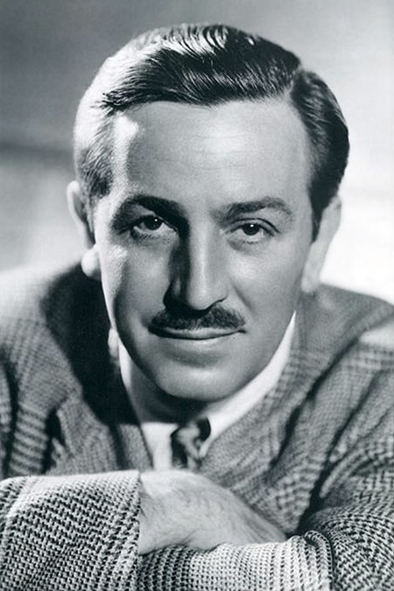
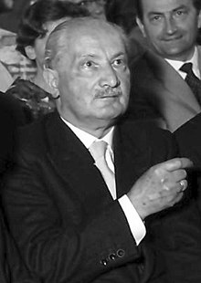
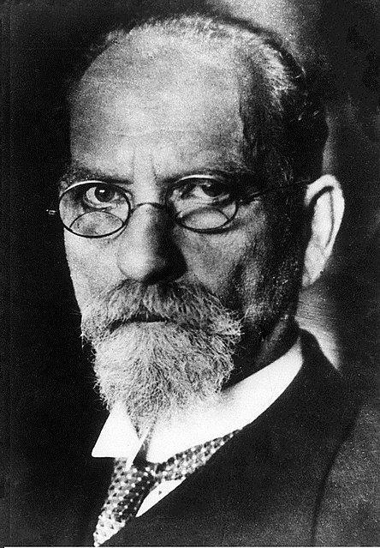




Blitz
Disney
Heidegger
Husserl
Dewey
EXPERIENCE

Slide 34


MANAGEMENT

Slide 35
Customer experience (definitions)
... customer’s cognitive, emotional, behavioral, sensorial, and social responses to a firm’s offerings across the customer journey.
... the subjective internal consumer response to any direct or indirect contact with a company along the customer journey.
Direct contact = initiated by the customer (e.g. purchase, use, and service)
Indirect contact = initiated by the company or other consumers (e.g., advertising or Word of mouth)
Meyer & Schwager, 2007; Verhoef et al., 2009 / 2016;
Brakuset al., 2009, Schmitt, 1999

Slide 36
Customer experience – what is it?
Adapted from: Brakuset al., 2009; Richardson, 2015

Slide 37
Any questions?

