Slide 1
PERSPECTIVES ON CXM
16 SEPTEMBER

Slide 2
Weekly plan
Week 2
Week3
Week4
Week5
Week 6
Introduction to CXM and practicalities
Approaches and Building blocks of Customer Experience
Action Session 1 - Touchpoints and Journies
Touchpoints, Journies and Narratives
Innovation through CXM
Action Session 2 – Personas, Profiles and Co-creation
Metrics and Measurement – Re-visting the Firm
Aligning Brand Strategy, Research and Context
Future of CXM
Presentations and Wrap Up

Slide 3
Why has Customer Experience become so important?

Slide 4
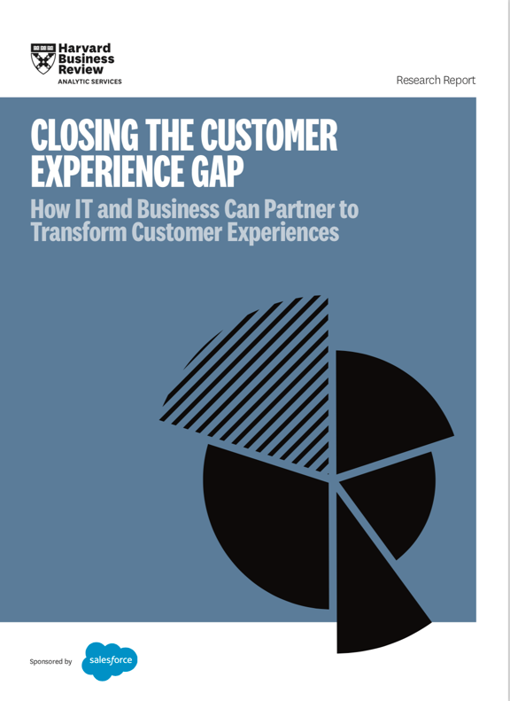
Harvard Business School Analytics Services (2017):
73% of CEO respondents named customer experience as a critical competitive advantage.
Its importance was expected to increase.

Slide 5
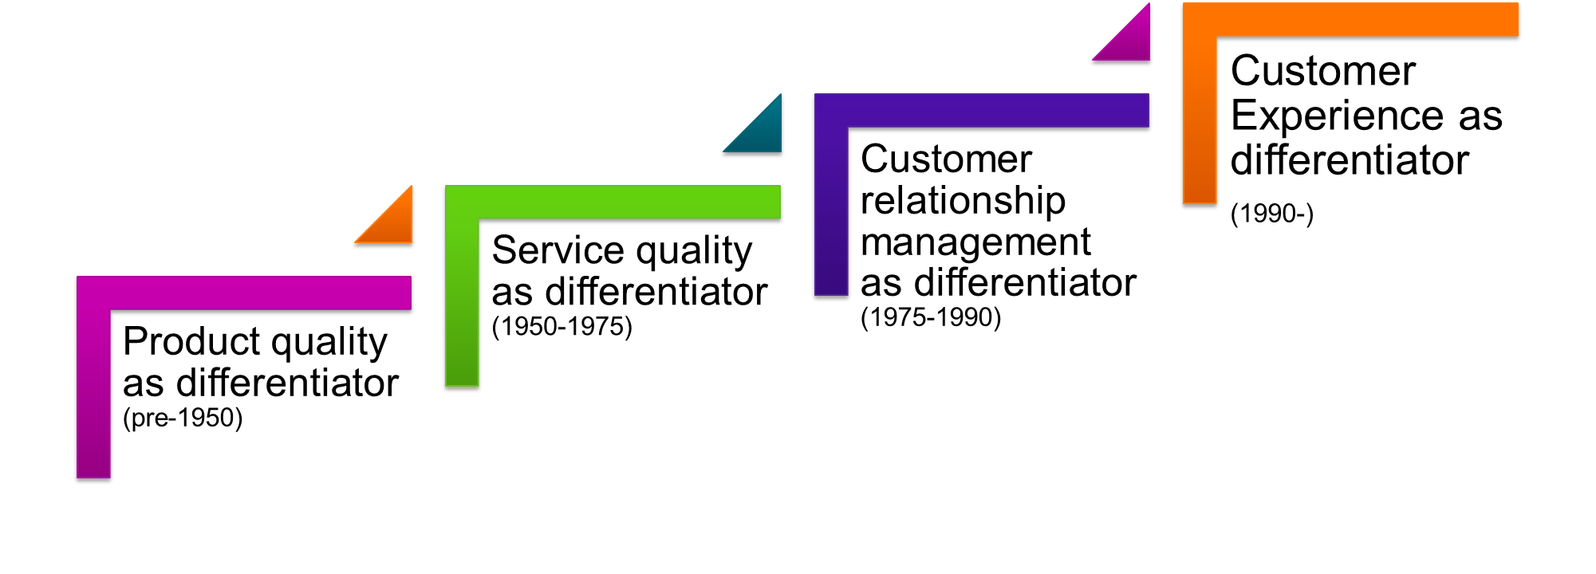
Experience Economy – from commodities to experiences
Customer-centric Insight
CRM –
Market Learning
HRM –
Service Management
Engineering - QA
Pine & Gilmore, 1998; Pine 2004

Slide 6
What drove the evolution
Product innovation no longer a competitive advantage
Customers expectations have become higher
Readily available Customer data and customer relationship management readily available for companies
Rising wealth, critical consumption, media literacy, and advertising resistance
Brand ubiquity
Customer experience and branded IP still difficult for competitors to copy

Slide 7

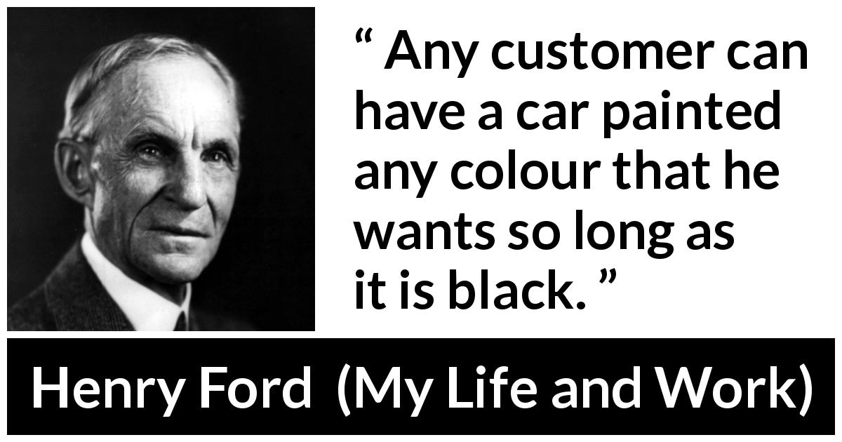
INSIDE-OUT VIEW of Marketing

Slide 8
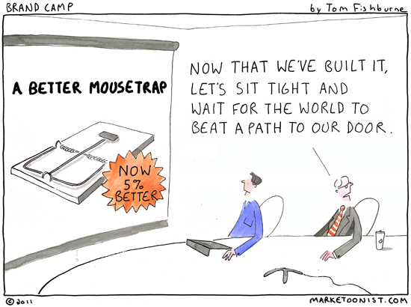

Slide 9
Challenges of experience economy
People don’t ‘only’ buy products, they buy experiences.
”An experience is not an amorphous construct; it is as real an offering as any service, good, or commodity” (Pine & Gilmore, 1998)

Slide 10
Current Trend – The ‘x’ Experience
Arms race of better, more engaging, exciting customer experience

Slide 11
Benefits of investing in CX
Revenue growth
(%, average)
Net income
growth
(%, average)
Companies investing in the
development of management
systems and customer experience*
Others
7.07 %
2.88 %
8.61 %
6.04 %
*= 250 largest companies in Finland based on revenue
NIBS, 2016/2017

Slide 12





Slide 13
Resulting Challenge
Companies need to embed customer experience strategies and activities within broader marketing goals

Slide 14
Despite the benefits, most companies still falter
Enormous room for improvement!
Most companies still lack a clear set of strategies for customer experience management.
Companies have difficulties to calculate the ROI of customer experiences and to link experiences to business outcomes.
80%
of the companies think they provide superior experiences
8%
of their customers describe their experiences as superior
Bain & Company, 2015

Slide 15
Customer Experience – Levers & Outcomes
86 % of customers would pay even more for better customer experience
Verhoef et al. 2009

Slide 16
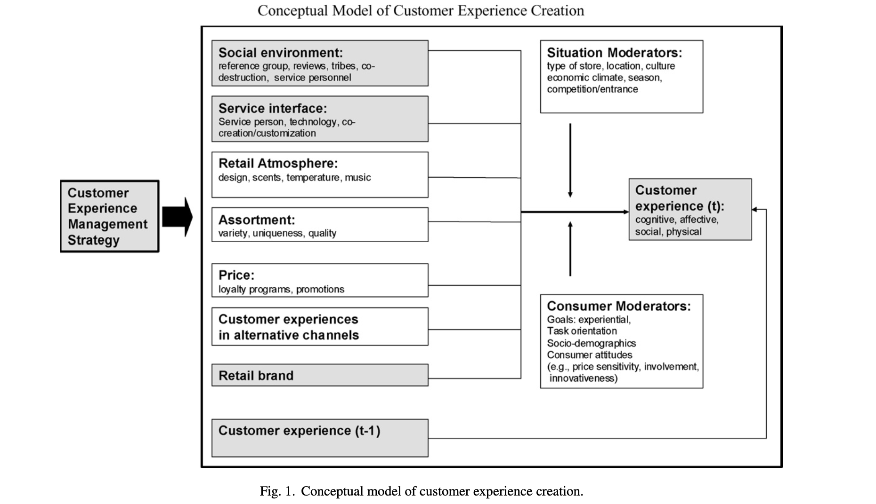

Slide 17
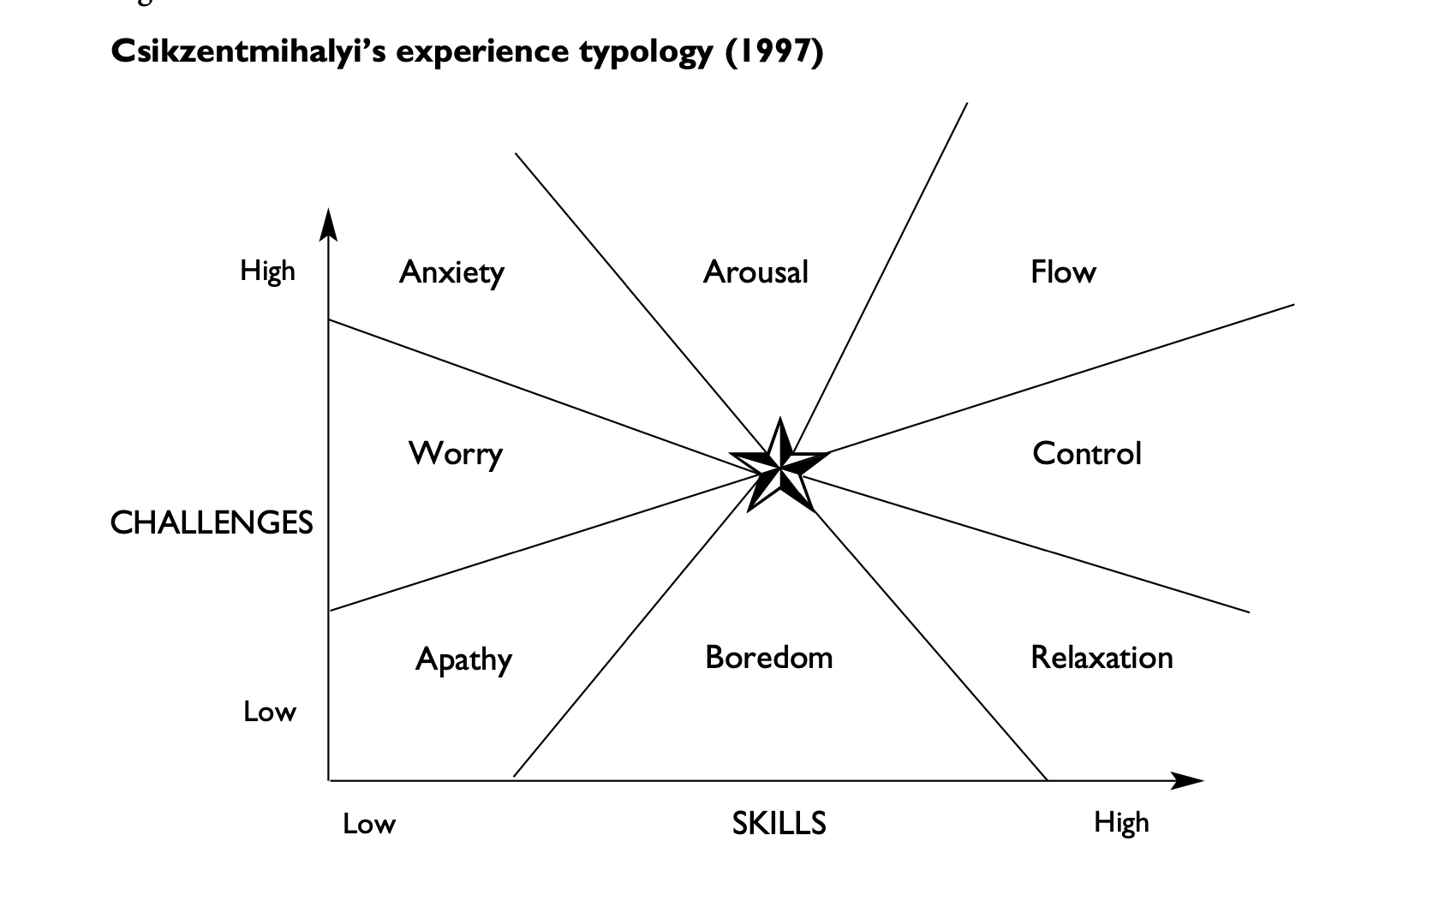

Slide 18
Customer Experience Management – Chasing Innovation!
“If I had asked people what they wanted, they would have said faster horses.”
– Henry Ford, Founder Ford Motor Company
However, there is the need to continuously test the innovation in the light of the customer’s perceptions and expectations
Vlaskovits 2011

Slide 19
Experiences are…
Momentary or Long-term?
Subjective or Shared?
Cumulative or Disjointed?

Slide 20





We interact with brands more than we think we do..
What was your last memorable customer experience?
Which of the following brands might provide you with a valuable customer experience?

Slide 21


Slide 22

Key Takeaways
1
People don’t buy products, the buy experiences.
Customer experience is the subjective internal consumer response to any direct or indirect contact with a company along the customer journey.
Companies need to stage the customer experience in order to create a competitive advantage.
2

