Slide 1
Session 3
Visualising Customer Journeys and Touchpoints
21.09.22

Slide 2
Recap and Reiterate
Customers buy experiences (most of the time)

Slide 3
Customer Experience Management
… is how the company orchestrates the customer’s experience along the customer journey in a mutually-valuable way
It should engage with every RELEVANT touchpoint that lies on the customer journey.
Those that are more controlled (e.g. owned & paid) as well as those that are less controlled (e.g. earned)
Meyer & Schwager, 2007; Verhoef et al., 2009

Slide 4
Customer Experience Innovation
Crafting new experiences OR bettering existing ones
Experience driven innovation is not product or operation focused; instead, it is a truly customer-centric process
Customer experience innovation makes customers perceive the company as more relevant

Slide 5
Experience is Multidimensional!!
Sense
Feel
Think
Act
Relate
Schmitt 1999
A Multidimensional perspective helps us reflect on
undercover or less-salient touchpoints

Slide 6
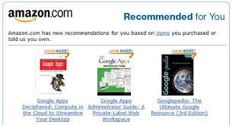
Amazon’s Star Rating system
Amazon’s “Recommendations” system

Slide 7
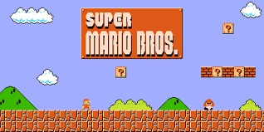
The LINEAR Gaming Experience

Slide 8
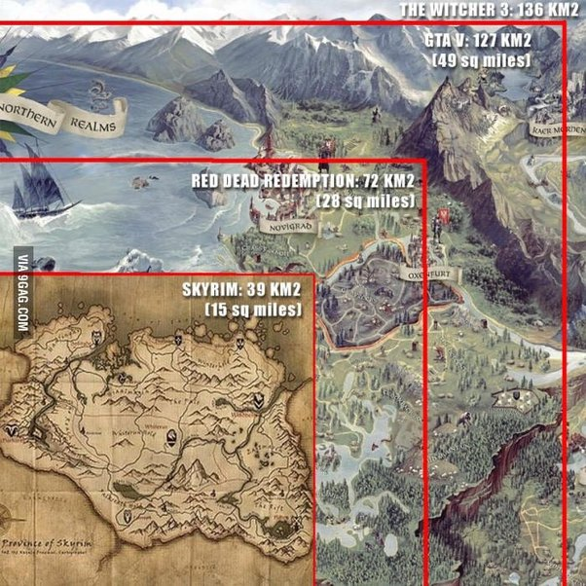
The Open-World Game Experience
“wide as an ocean,
deep as a puddle”

Slide 9
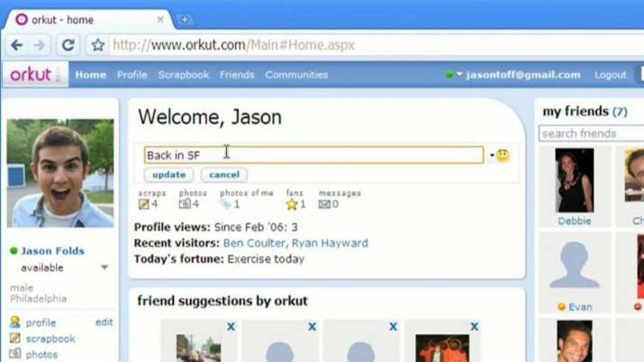

Slide 10
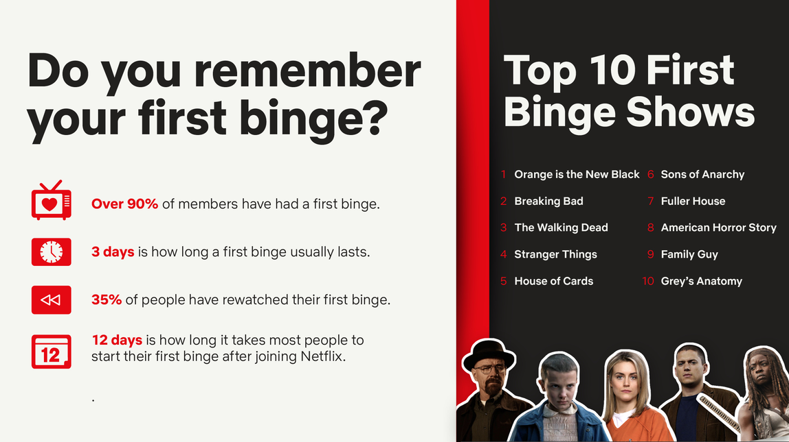
Netflix creates new “Think+Act” combination - Bingeing

Slide 11
Customer Experience and Journey are Intertwined
Customer Experience Management
The Designing and Staging of the customer experience along the customer journey in such a way that value for both customer and company is created
Consideration
Evaluation
Purchase
Enjoy
Bond/Advocate
Source:Meyer & Schwager, 2007, Verhoef et al. 2009/2016

Slide 12
What do we need to visualize journeys accurately?

Slide 13
Key Definitions
Customer Touchpoint
A direct or indirect brand encounter
Provides a view on a single customer interaction
Customer Journey
Flow of customer interactions
Provides a view on cumulative customer interactions and experiences
Customer Experience
Consumer’s overall response to any indirect or direct contact with a company along the customer journey
Considers the subjective internal consumer response
Source:Meyer & Schwager, 2007, Verhoef et al. 2009, Brakus et al. 2009, Court et al. 2009

Slide 14
TOUCHPOINTS

Slide 15
Customer touchpoint
...is any direct or indirect brand encounter
...provides a view on a single customer interaction
Direct encounter = initiated by the customer (e.g. purchase, use, and service)
Indirect encounter = initiated by the company or other consumers (e.g., advertising or Word of Mouth)

Slide 16
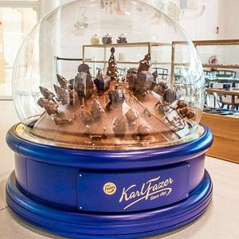
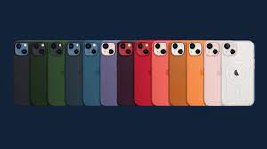
Brands are everywhere in our daily lives
Multiple touchpoints influence the customer experience

Slide 17
We encounter a variety of different touchpoints
Companies can easily have more than 100 different touchpoints
However about 50 different touchpoints need to be taken into consideration
Need to unveil
Identifying the relevant touchpoints is crucial
Number
Variety
Design
Impact
Source:ESCH. The Brand Consultants 2013; Esch et al., 2015; Puhlmann, 2013

Slide 18
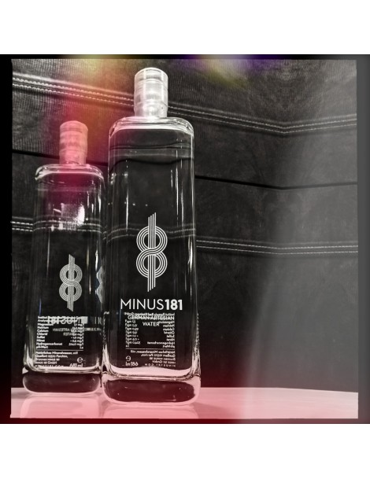
Do you think the quality is that better?
+2500%
+ 600%
Notes:
One of the most expensive water brands in the world, Minus 181 has done a lot of work to bring fresh water to your table.
By punching a 181-meter-deep (hence the name) drill down into a pocket of water encased between two impenetrable layers of Ice-Age clay, Minus 181 has tapped into a water source with exceptional quality and a well-balanced taste.

Slide 19
Fine-grained understanding of interactions
Does not yet include the “experiential” perspective very deeply
More granular way of identifying points of interaction

Slide 20
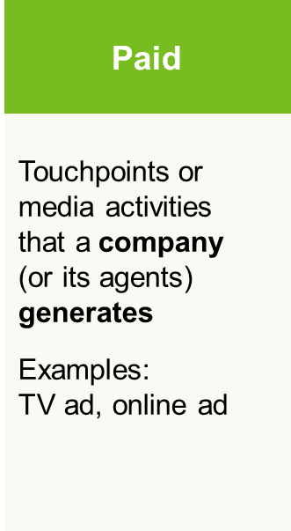
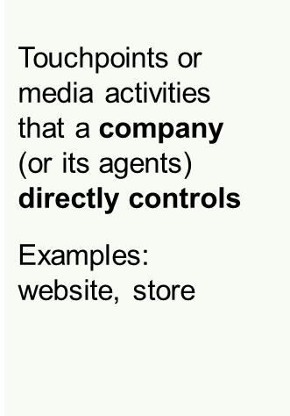
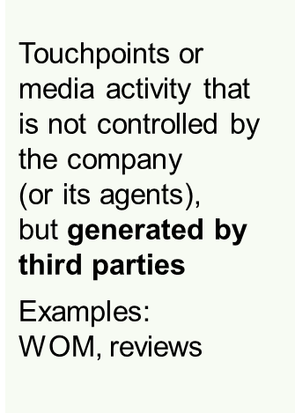
Classification of touchpoints by Media Type

Slide 21
Classification of touchpoints by channel
Offline Online

Slide 22
Classification of touchpoints by ownership/control
Brand owned
Partner-owned
Customer- owned
Social/external
Customer Experience
Brand

Slide 23
Short group work
How do consumers interact with brands?
2 Groups, 10 mins
Discuss the touchpoints a consumer may have with Finnair in a typical holiday or air-travel scenario
Write down all the touchpoints you may come up with
Try to summarize the encounters in categories

Slide 24
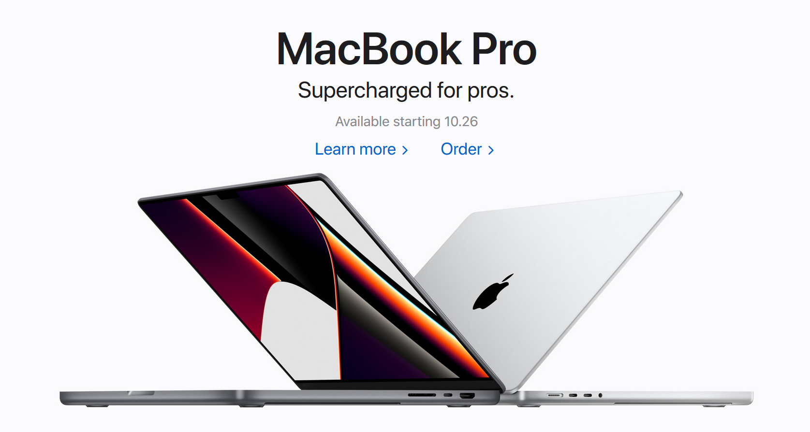
Customer response to touchpoint

Slide 25
JOURNIES

Slide 26
What is a customer journey?
Customer Journey
...is the flow of customer interactions across multiple touchpoints over time (e.g. before purchase, during purchase, after purchase)
...provides a view on cumulative customer interactions and experiences
Consideration
Evaluation
Purchase
Consumption
After-Sales

Slide 27
Use the “customer’s eye view” to overcome the fragmented, siloed understanding of customer journeys between different departments

Slide 28
Customer-side understanding
Includes the “experiential” perspective very deeply
Requires new kinds of insight, knowledge, data
What is the story you want customers to tell about your offering?

Slide 29
The full CX journey matters
Changing from a touchpoint to a journey orientation requires:
Not looking at single transactions
Identifying the entire journey of the customer (dynamic approach)
Managing the cumulative experience across multiple touchpoints over time
Accompanying the customer over the entire decision-making process & beyond
Challenges for Companies
No map of the customer journey
Cross-functional disconnections within companies
Common focus on touchpoint optimization, not journey orientation

Slide 30
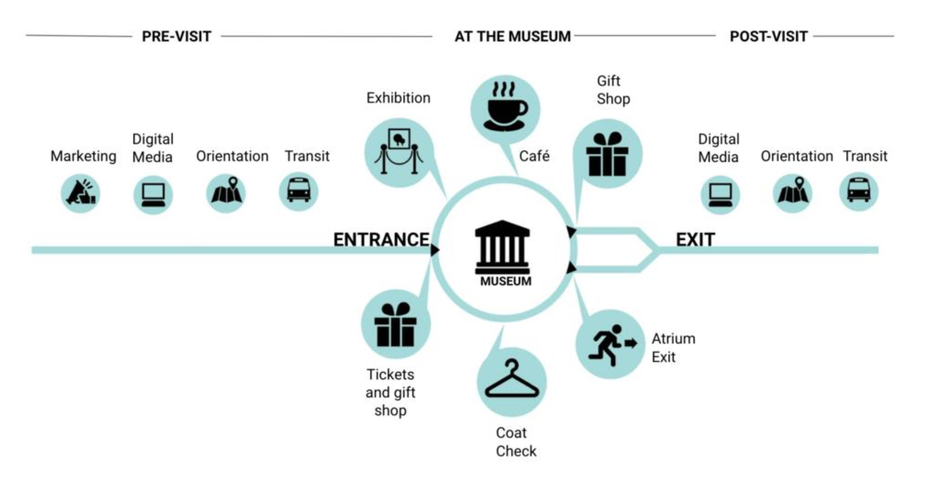

Slide 31
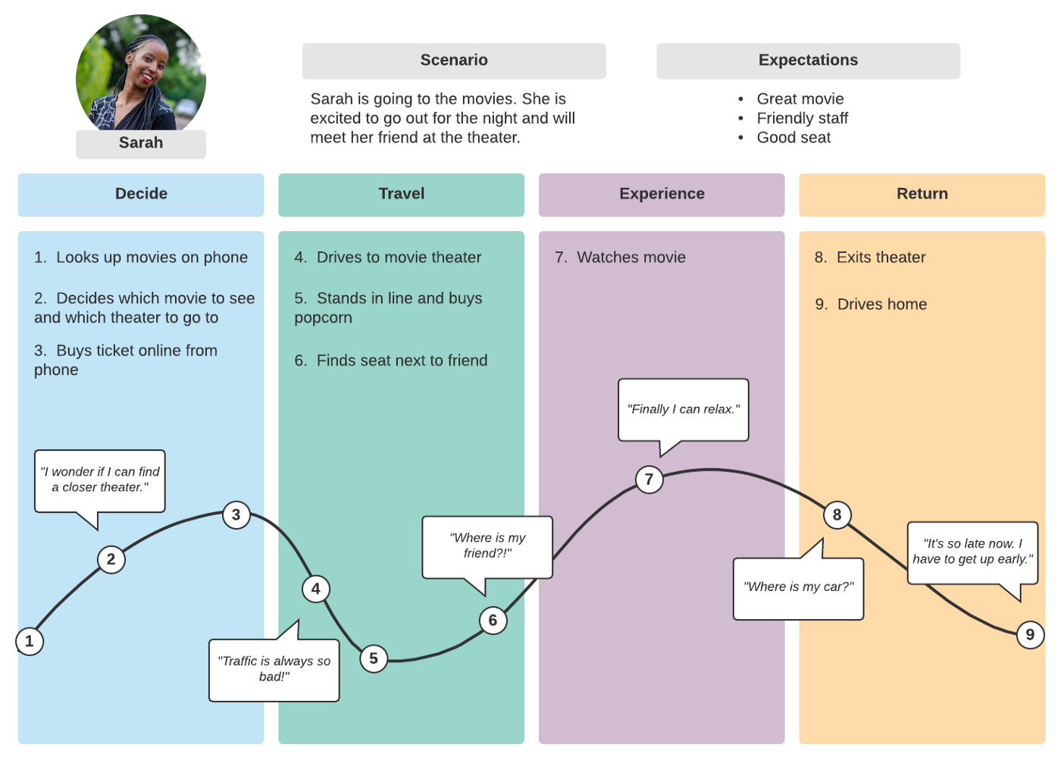

Slide 32
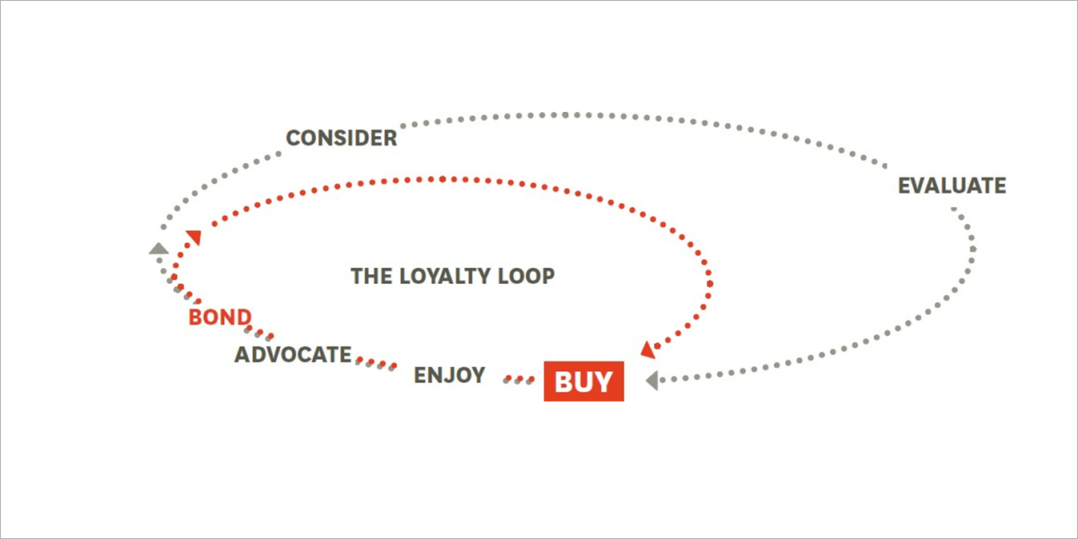
The customer journey
Edelman 2010

Slide 33
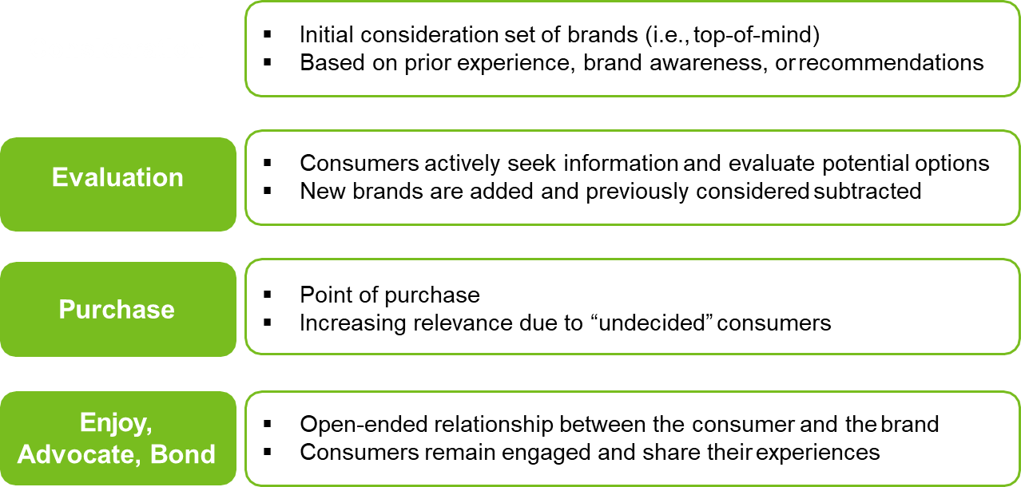
The Different Stages of the Customer Journey

Slide 34
Mapping the customer journey
What is Customer Journey Map
A diagram that identifies, aggregates and illustrates the key interactions a customer has with the company along the customer journey
Portrays the flow of customer experience across the major and minor touchpoints over time
Takes the customer’s perspective

Slide 35
Mapping the customer journey- Approach
Key Ingredients of a customer journey map
Motivation and Goals
What is the customer’s underlying motivation in every stage?
What does the customer expect? What do they wish to achieve?
Touchpoints
What are the most important touchpoints in each stage? (i.e. 80/20 rule)
How are the touchpoints connected? Which are the predominant paths?
Integration and Design
Does the customer always get the same impression/information along the touchpoints?
How should the touchpoint be designed to guide the customer to the next stage (emotionality, clarity, differentiation)

Slide 36
Mapping the customer journey- Approach
Key Ingredients of a customer journey map
Barriers and Opportunities
What are the current pain points that prevent customers from going to the next stage?
What would be the alternative journeys that bring the customer faster to the next stage?
Internal Ownership
Who is responsible for the touchpoints within the company?
Will the company need to exert more control over non-brand owned touchpoints?
Who will take ownership for key interactions and customer experience innovations?
Which business units need to work together to stage the customer experience along the customer journey?
Source:Richardson 2015, Verhoef et al, 2016

Slide 37
Mapping the customer journey - Summary
Tool for cross-department conversation and collaboration
From inside-out to outside-in: Needs to be based on customer input
Complementary to service blueprinting
Can be on a very general or more specific level
(e.g. , limited to a journey stage, customer group, channel type, product etc.)

Slide 38
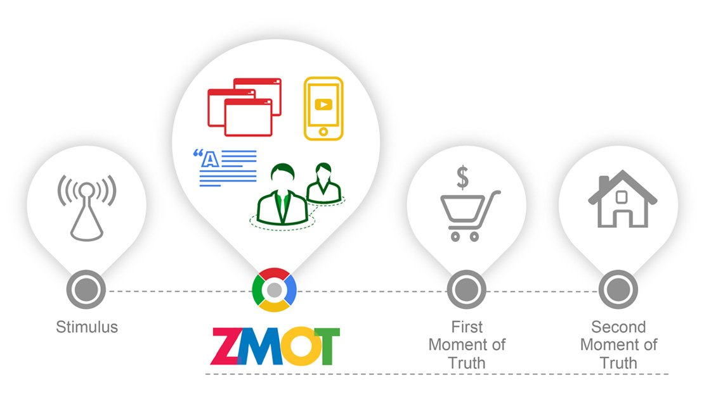
Pre-Purchase

Slide 39
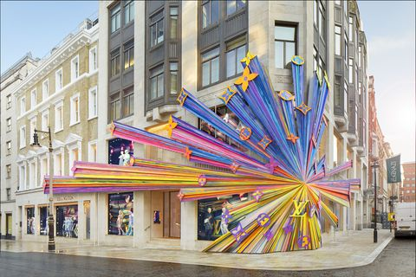
Mid-Purchase

Slide 40
Post-Purchase
Status needs

Slide 41
Important to remember!
Customer’s perspective, not internal ‘process view’
Different from service blueprinting, yet complementary methods
Complex task and no ‘right approach’

Slide 42
Integrating Journeys and Touchpoints

Slide 43
Data & Research + Empathy & Imagination
Can the marketer/designer/orchestrator put themselves in the customer’s shoes

Slide 44
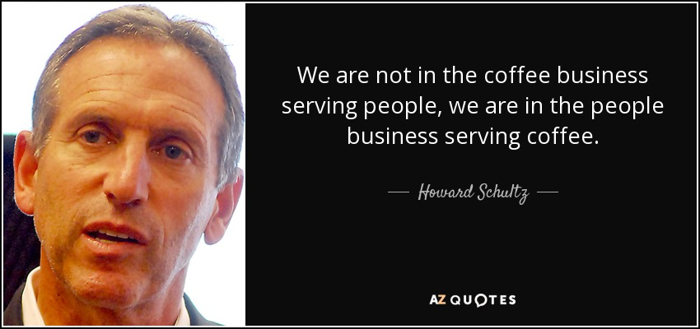
Reformulating the promised branded experience - Starbucks

Slide 45
Key takeaways
CXM is the company’s strategy to design and implement the customer’s experience along the customer journey in such a way that they create value for both to the customer and the company.
Multiple different touchpoint types determine the customer’s perception of the brand
Need to distinguish between (i) paid, owned, and earned, (ii) offline, online, mobile (iii) brand-owned, customer-owned, etc.
Not only the occurrence, but also the valence of touchpoints (i.e., consumer’s perceptual response to the touchpoint) matters
Need to manage cumulative experience over time, i.e., managing the customer journey
Distinguish the different stages of the customer journey: consideration, evaluation, purchase, enjoy-advocate-bond
1
2
5
6

Slide 46
Any questions?

