Slide 1
Weekly plan
Week 2
Week3
Week4
Week5
Week 6
Introduction to CXM and practicalities
Approaches and Building blocks of Customer Experience
Touchpoints, Journies and Narratives
Service Design, and Personas
Action Session 1 – Touchpoints, Journies, Personas
Innovation through CXM
Metrics and Measurement – Re-visting the Firm
Aligning Brand Strategy, Research and Context
Future of CXM
Presentations and Wrap Up

Slide 2
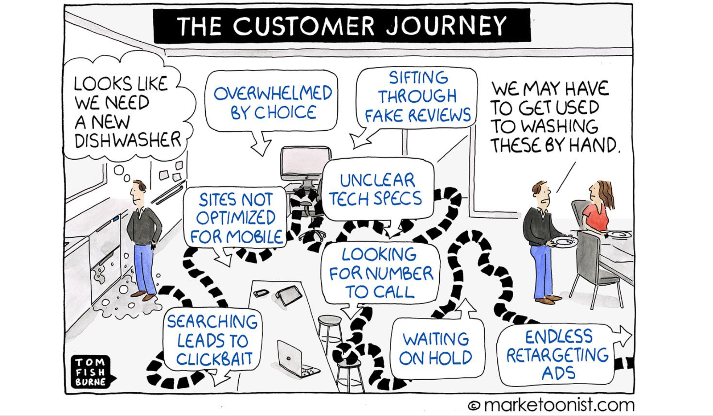

Slide 3
Innovation?
Where does it come from?

Slide 4
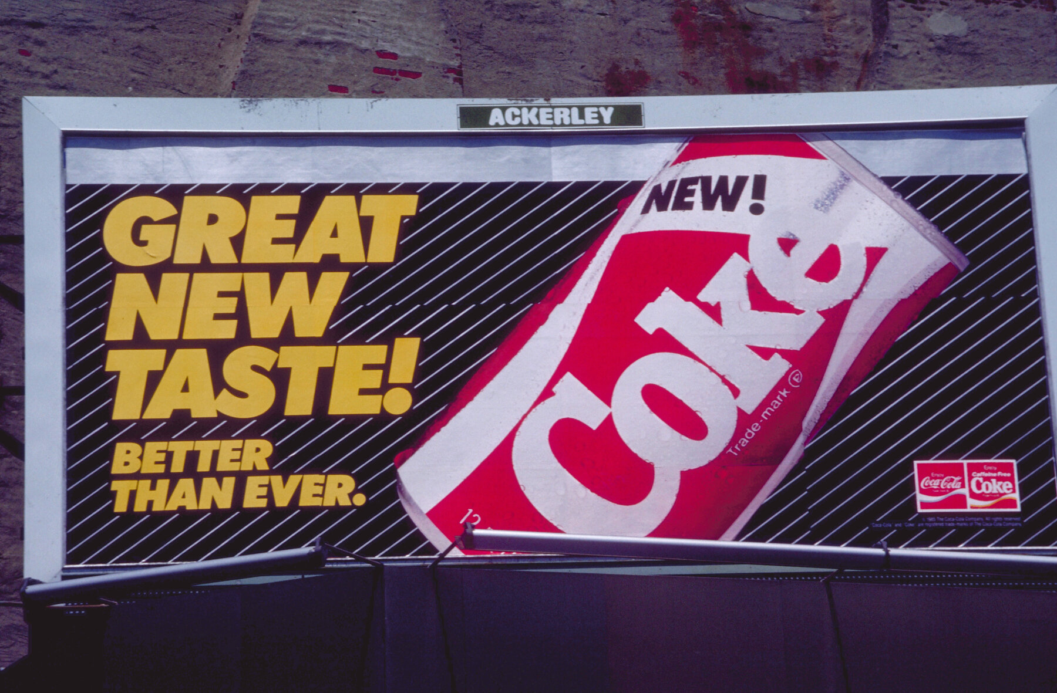

Slide 5
Co-created Innovation

Slide 6
Customer Experience Innovation – Co-Creation
General Idea
Co-creation principally refers to the joint value creation by both the company and the customer
Context specific
Customers co-create during new product development by customizing product functionality design, or both
Co-creation activities can take place along the entire customer journey (e.g., consideration, enjoyment, advocacy and bonding)
Constitutive dimensions
i) Customization as a key benefit
ii) Effort
iii) Information sharing, as primary costs
Source: Edgar 2008, Falk 2015, Prahalad and Ramaswamy 2004.

Slide 7
Innovation Customer Experiences - Steps
Experience Innovation
Overall Challenge?
Target Group?
Customer Benefit?
Focal Outcome?
Effect Assessment?
Implementation

Slide 8
Customer Experience Innovation – Crucial Considerations
Preliminary Considerations
What are current or upcoming challenges the company faces? (e.g., current customer complaints, increased competition, evolving trends)
Why will these challenges deteriorate the customer experience if no customer experience innovation is conducted now?
Strategic Considerations
Which target groups do you address with the customer experience innovation?
Why is your customer experience innovation relevant for this target group? ( especially considering the needs and wants of the target group?
How will the customer experience innovation influence the entire customer journey? (e.g., which barriers or opportunities do you address)
How will the experience innovation effect the business-units within the company? (especially consider how the business – units measure their success?
What is the exact outcome you aim to achieve with the customer experience innovation) (e.g., sales, brand image, Word of Mouth)

Slide 9
Customer Experience Innovation – Crucial Considerations
Effect Assessment
How much will the implementation of the customer experience innovation cost?
How do you expect the business performance to increase based on your customer experience innovation?
Implementation
Do you have direct control over the implementation of your customer experience innovation?
Who will be responsible for the customer experience innovation within your company?
How will the different units within the company need to work together to achieve the desired outcomes? (e.g., new structures and processes)
How can the effectiveness of your customer experience innovation be assessed? (e.g., pilot study, a/b testing)
Could the same effect be achieved by a competing customer experience innovation?

Slide 10
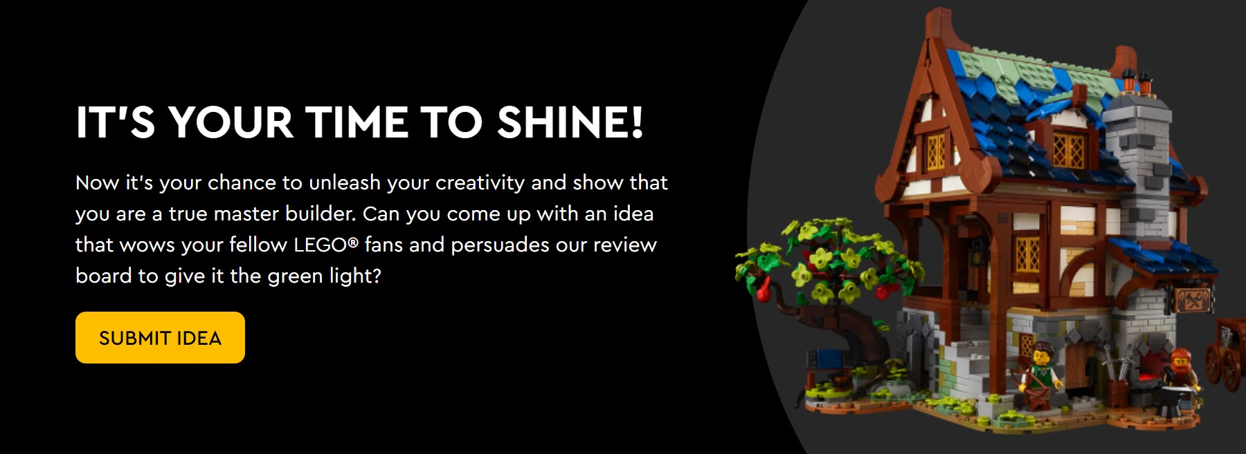
Customer Experience Innovation – Co-Creation
Lego Ideas
Do you have an idea for a Lego Product?

Slide 11
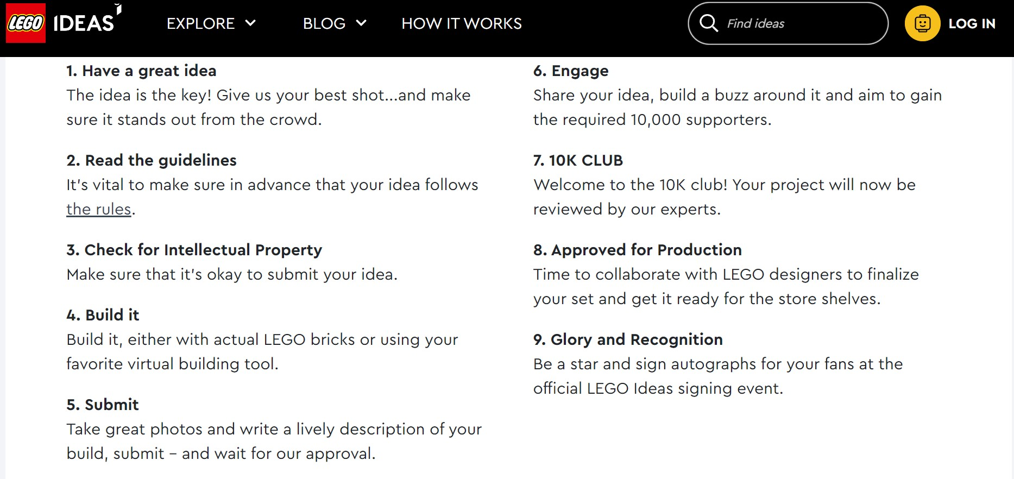
Customer Experience Innovation – Co-Creation
Lego Ideas
Source: ideas.lego.com

Slide 12
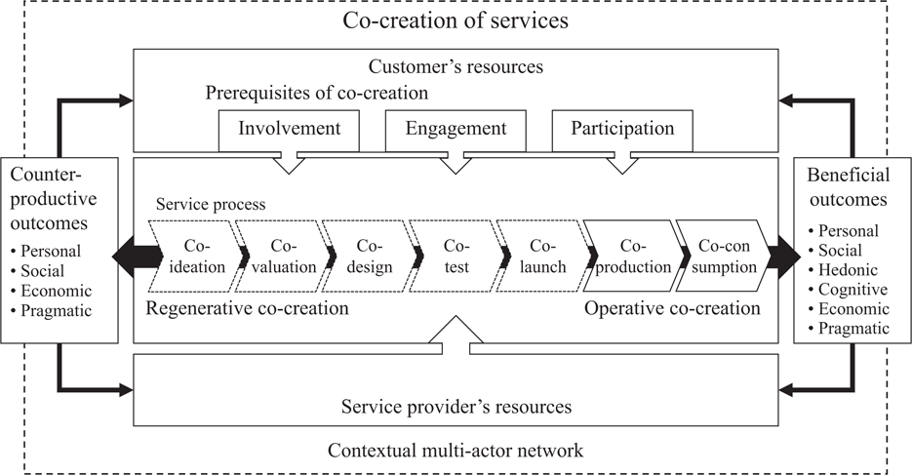
Expanded understanding of co-creation

Slide 13
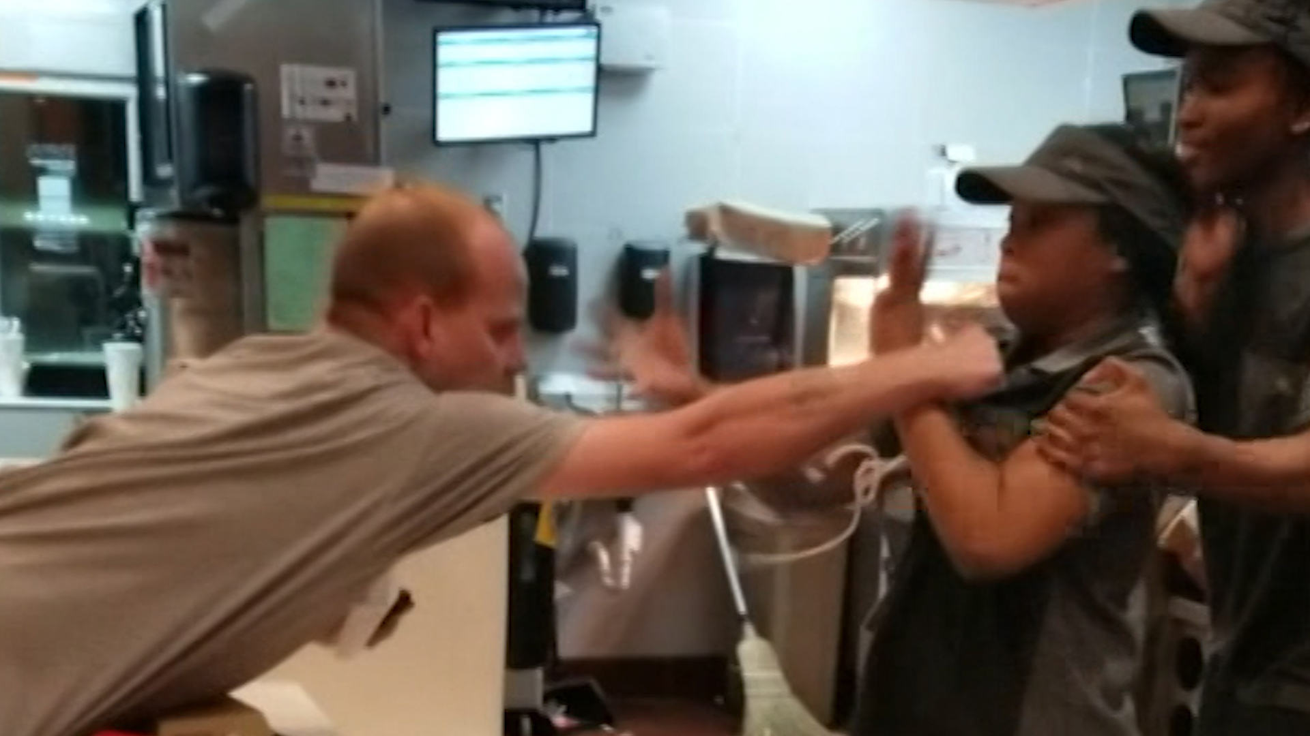
https://edition.cnn.com/videos/us/2019/01/03/customer-attacks-mcdonalds-employee-llr-orig.cnn

Slide 14
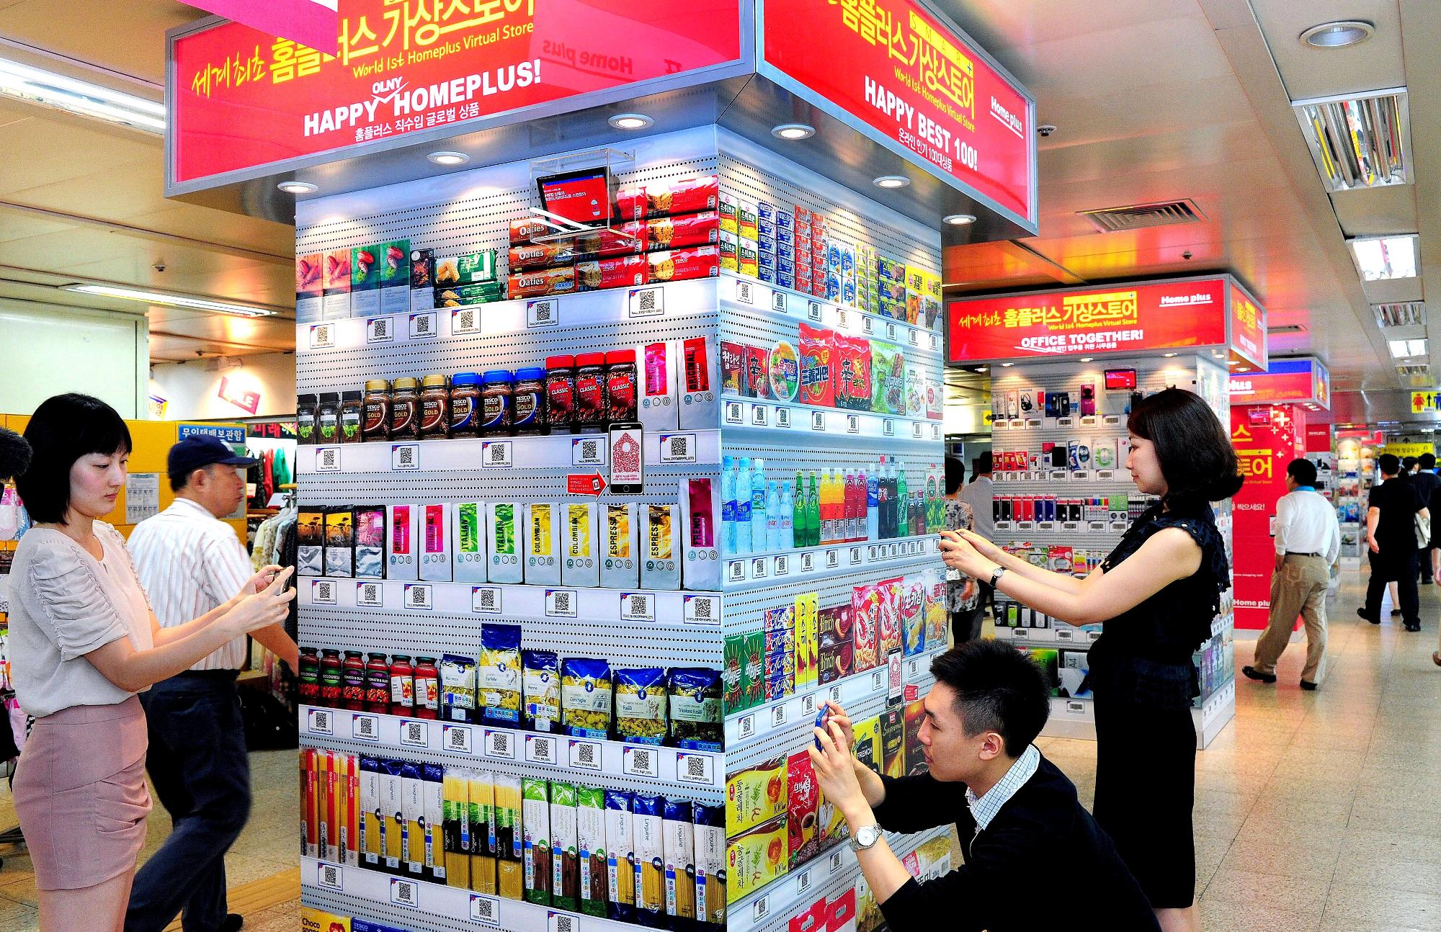
Customer Experience Innovation – Tesco Virtual Store

Slide 15
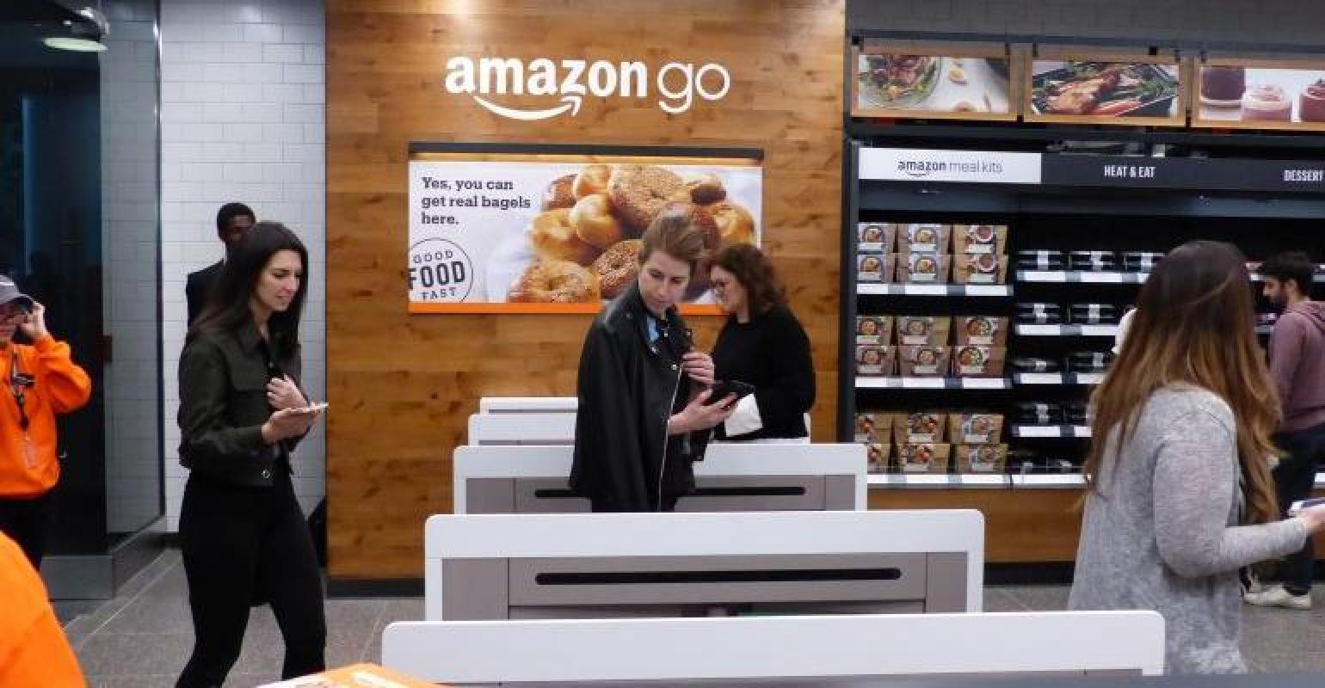
Customer Experience Innovation – Amazon Go

Slide 16
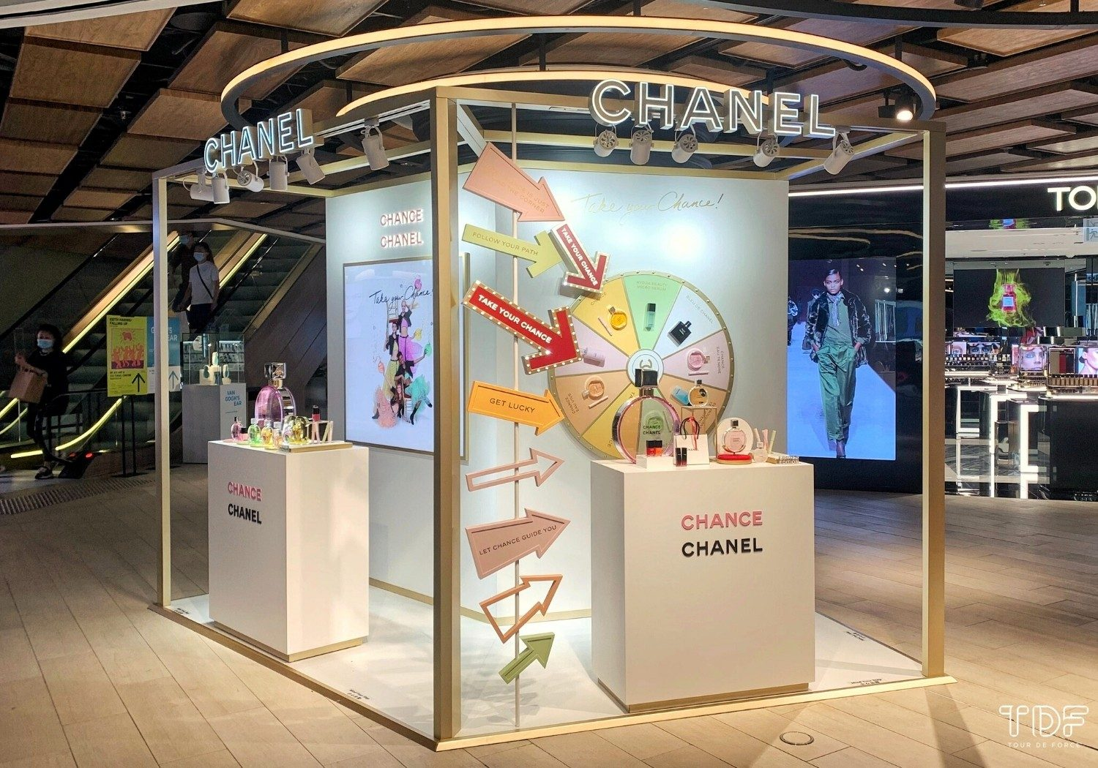
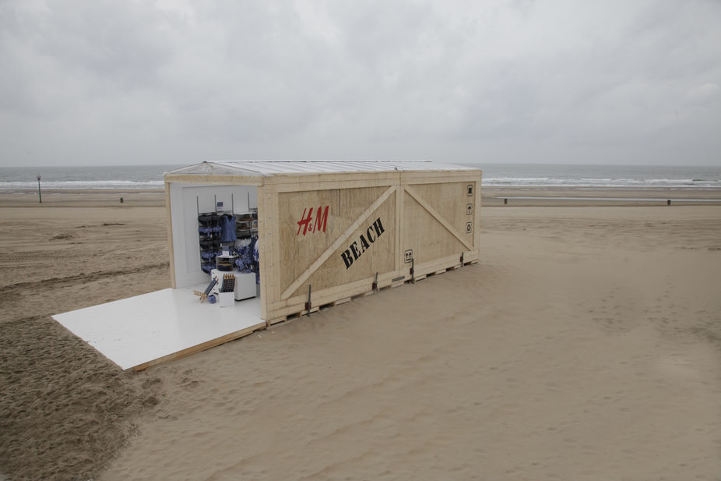
Customer Experience Innovation – Pop Up Brand Store

Slide 17
Innovation through Technology!!

Slide 18
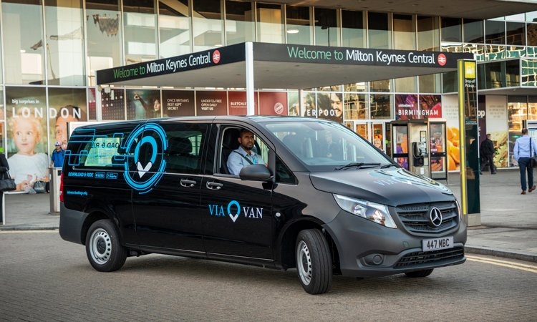

Slide 19
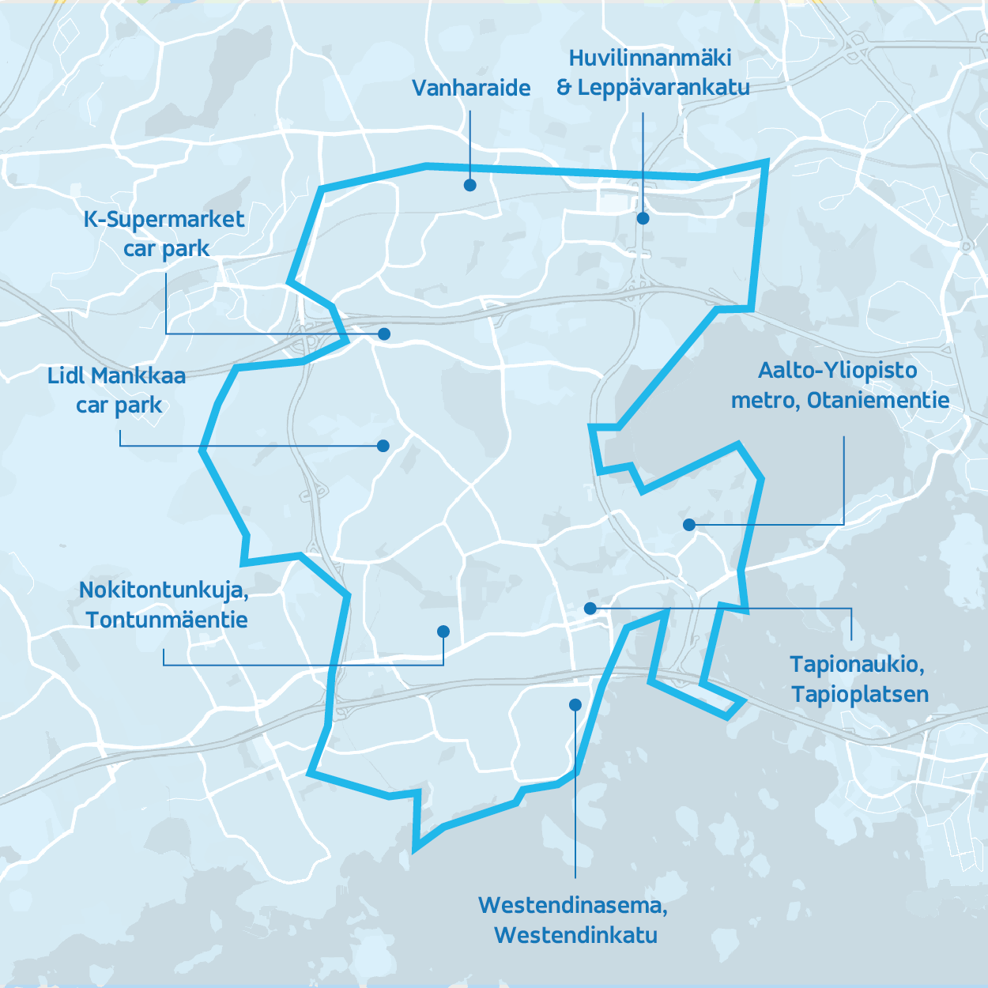

Slide 20
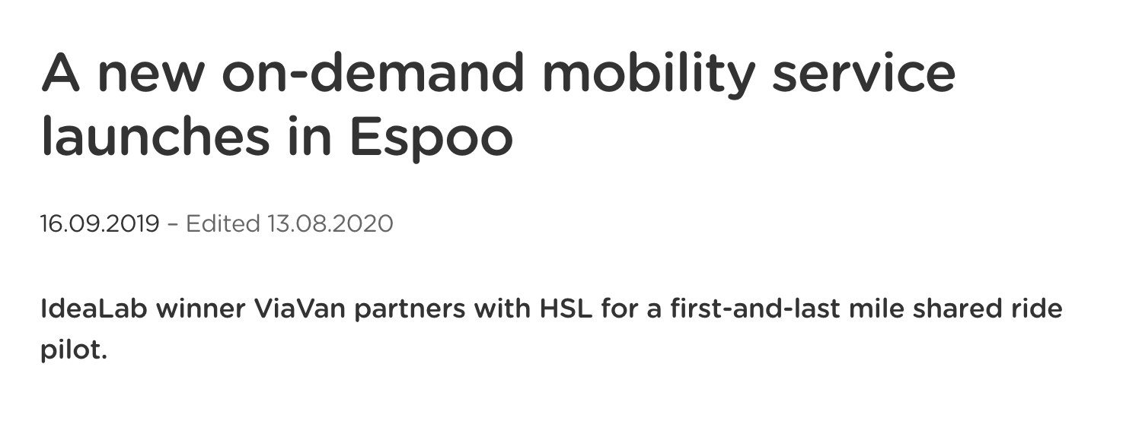
https://ridewithvia.com/news/viavan-launches-its-first-on-demand-mobility-service-in-finland-with-hsl

Slide 21
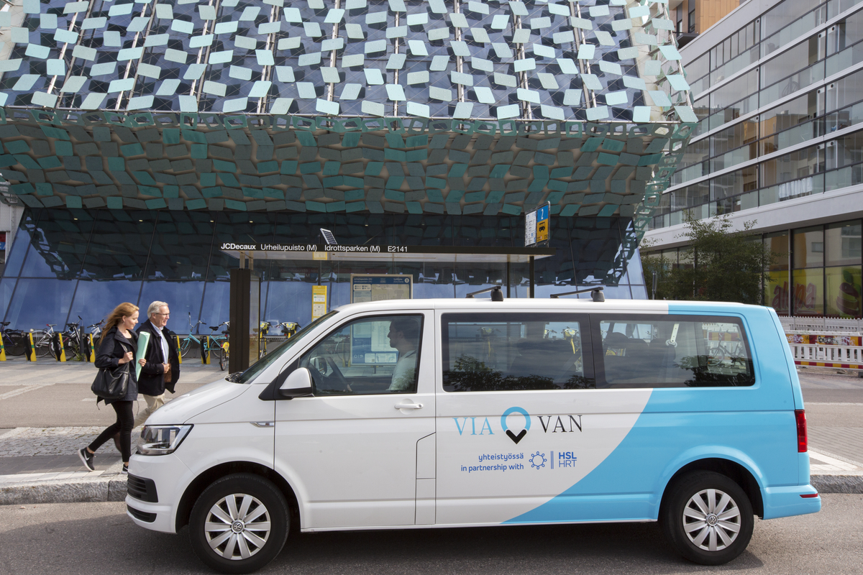

Slide 22
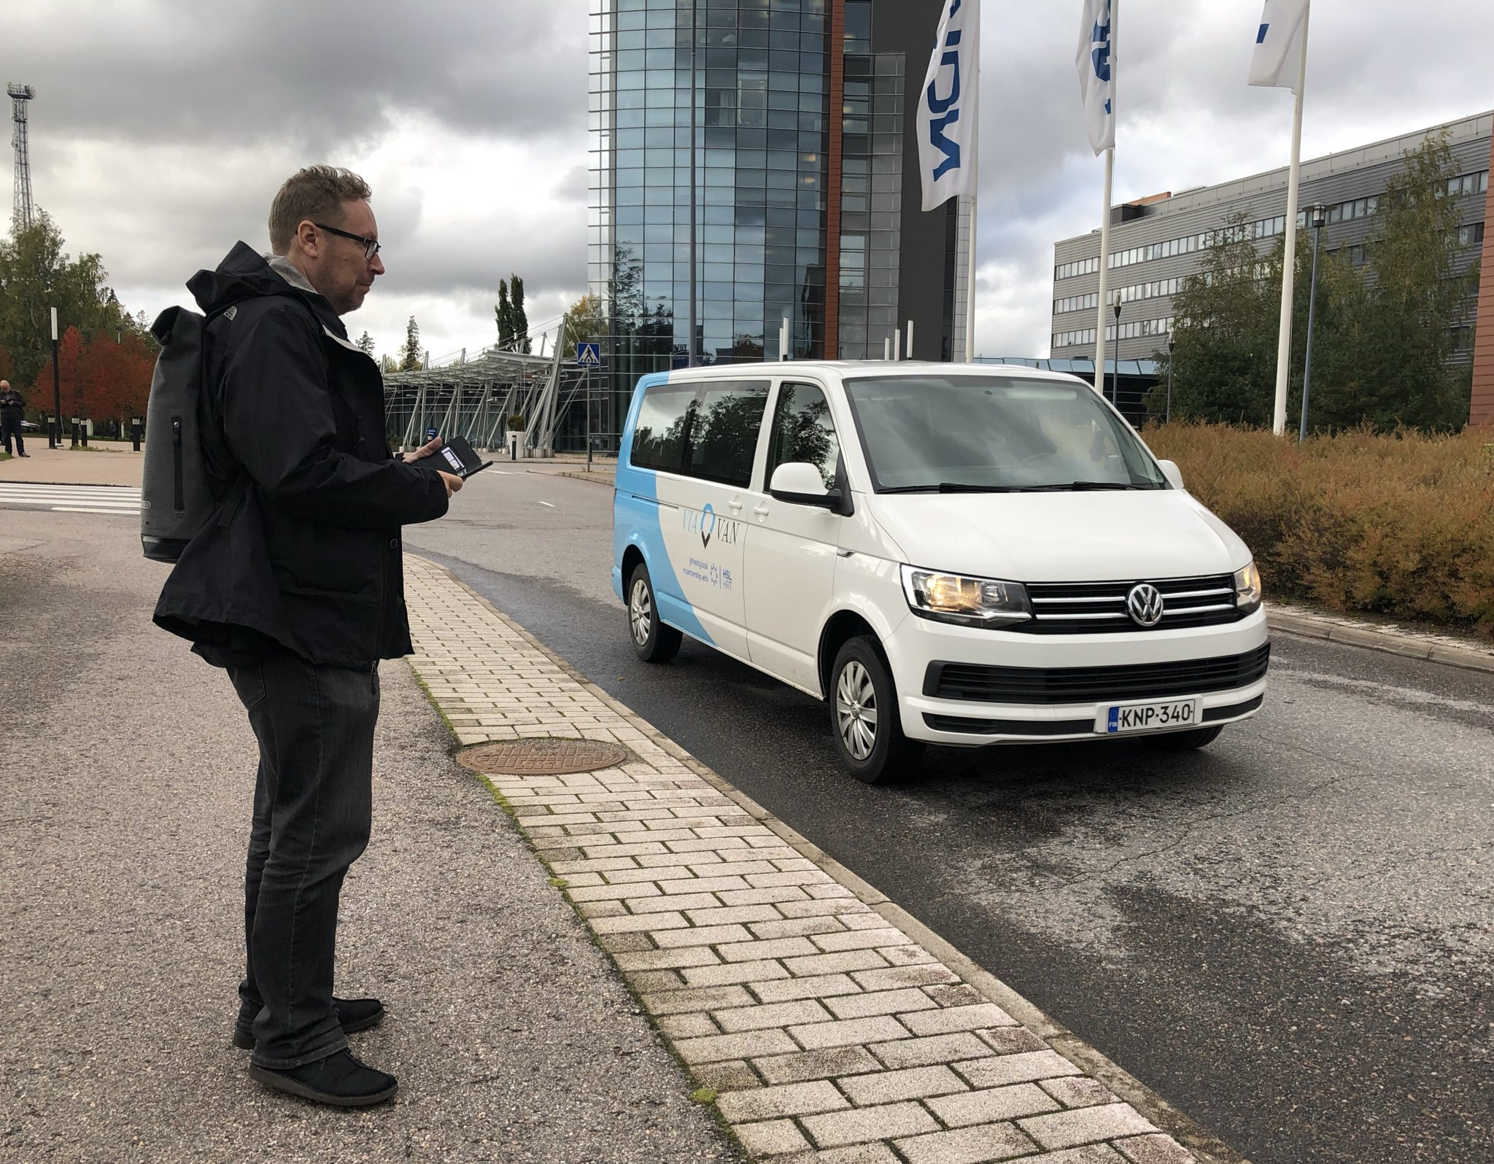

Slide 23
Identifying Partnerships
“ViaVan’s vision is to work with cities to launch efficient technology-based public transport solutions that have the power to reduce congestion and emissions in cities,” said Chris Snyder, ViaVan CEO. “The response from riders in Espoo has been extraordinarily positive, and through our partnership with HSL, we are one step closer to achieving our joint goal to make the private car obsolete."

Slide 26
MOBILITY - SCOOTERS

Slide 27
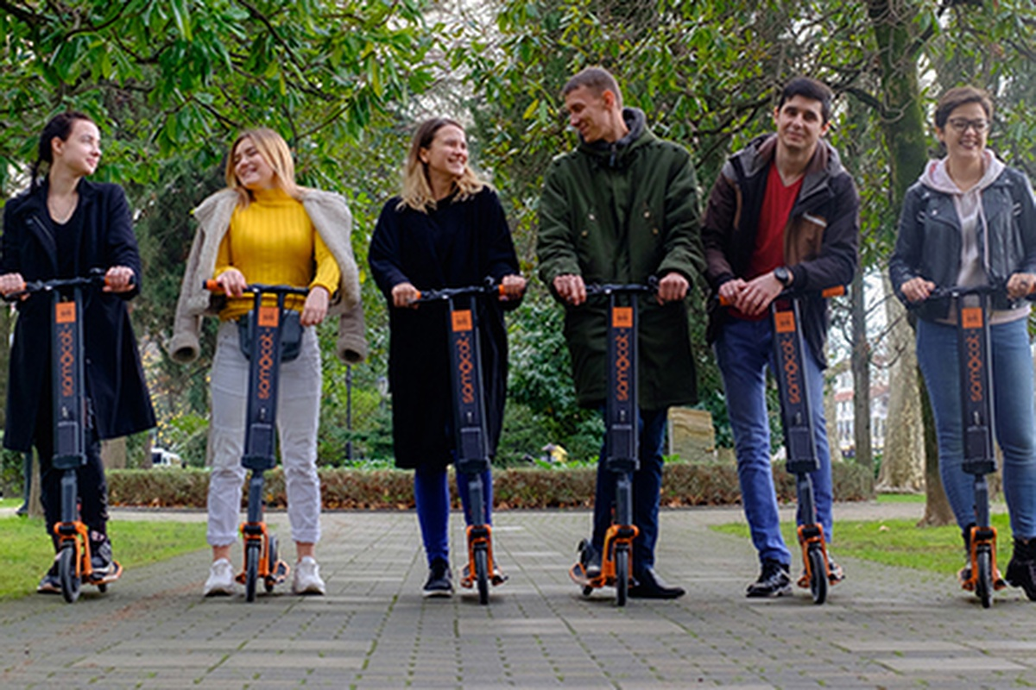

Slide 28
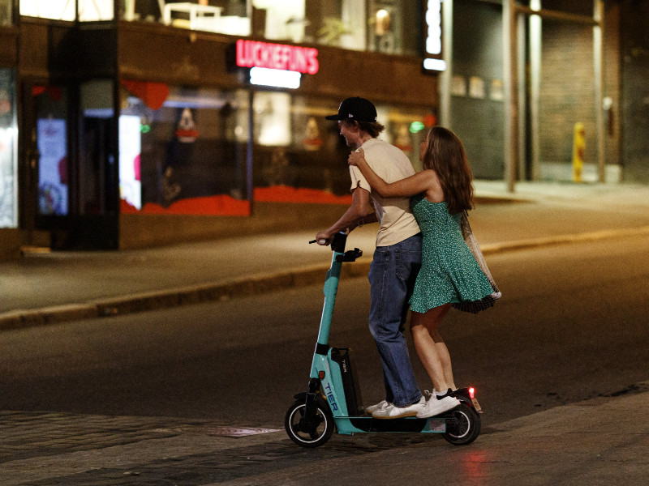

Slide 29
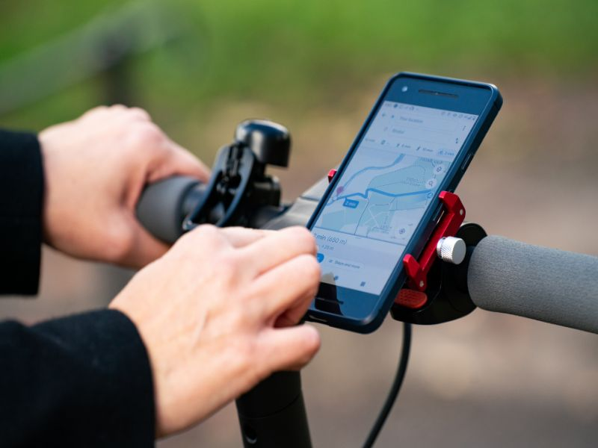

Slide 30
Contextualized Understanding of Innovation

Slide 31
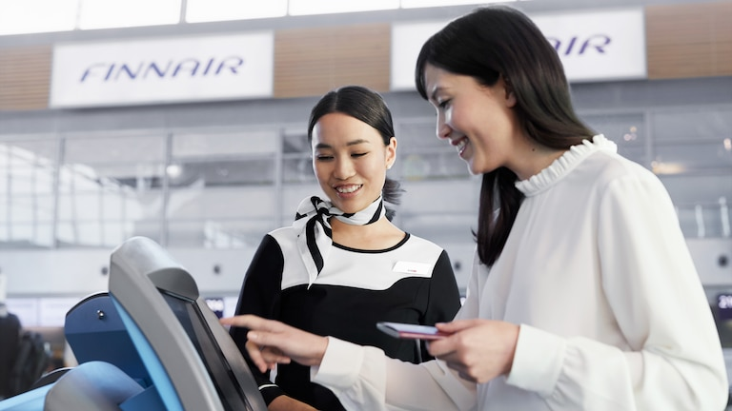

Slide 33
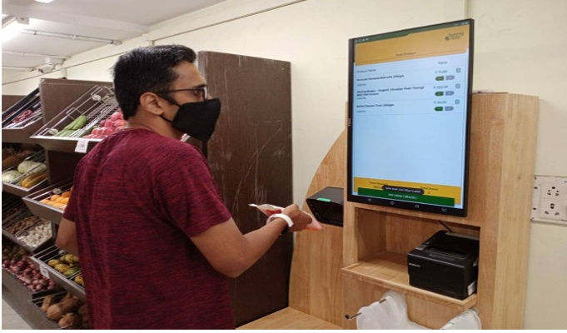

Slide 34
The Costs of Innovation
SunnyBee Market, founded in July 2015, is a one-stop premium food store that offers a wide assortment of more than 5,000 SKUs across multiple categories like regular & exotic F&V, Dairy, Staples, Indian and International foods. Operating 6 stores in Chennai, SunnyBee Market also conducts SunnyBee Santhai, a farmer and consumer connect platform where farmers sell their produce directly to consumers.

Slide 35
Key Takeaways
CXM approaches offer a significant advantage over engineering or other producer-centric modes of innovation
Innovation that takes a broadened view of the customer’s role in co-creating the experience will likely succeed

Slide 36
Any questions?

