Slide 1
Weekly plan
Week 2
Week3
Week4
Week5
Week 6
Introduction to CXM and practicalities
Approaches and Building blocks of Customer Experience
Touchpoints, Journies and Narratives
Service Design, and Personas
Action Session 1 – Touchpoints, Journies, Personas
Innovation through CXM
Metrics and Measurement – Re-visting the Firm
Aligning Brand Strategy, Research and Context
Future of CXM
Presentations and Wrap Up

Slide 2
Session 7
CXM as a firm-wide approach

Slide 3
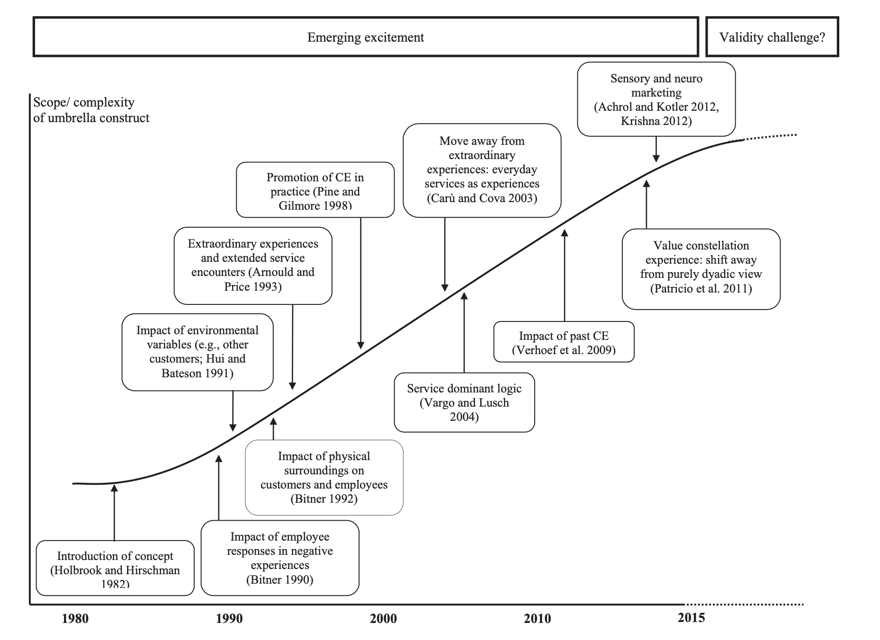
Notes:
Not a new construct, but still an ill-defined umbrella construct

Slide 4
What does it look like to “do” CXM

Slide 5
And why is it so d$mn hard
https://www.youtube.com/watch?v=r2O5qKZlI50

Slide 6
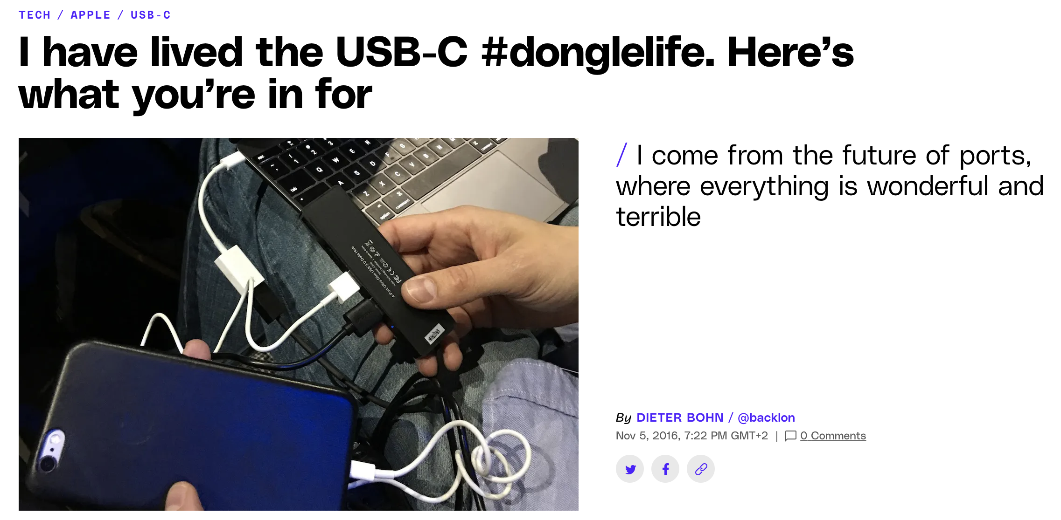
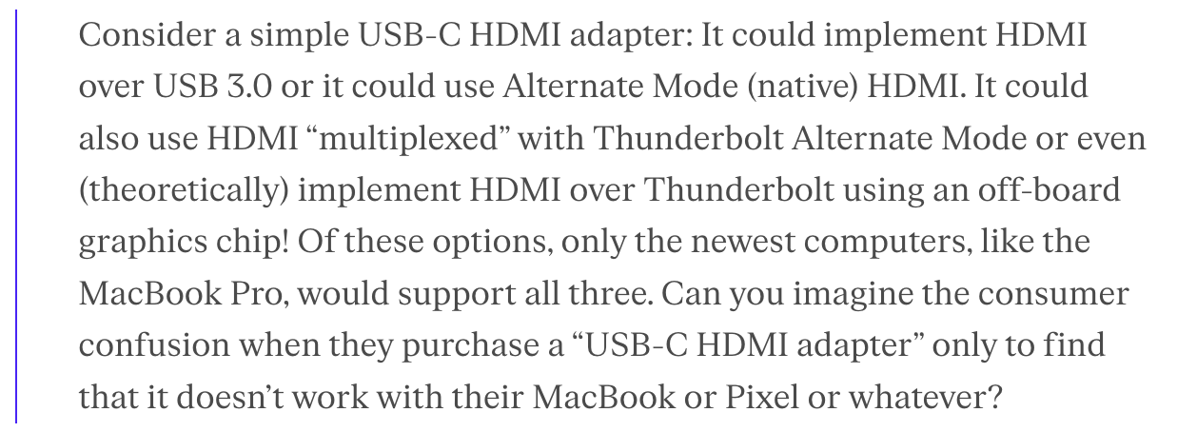

Slide 7
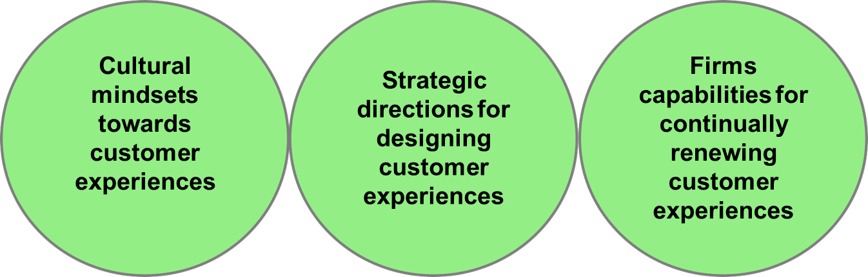
CXM is a firm-wide management approach that entails three main categories…
E.g. touchpoint journey orientation, alliance
orientation
E.g. connectivity of
touchpoints
(online and
offline)
E.g. CX modeling and
measurement skills
Homburg et al., 2017

Slide 8
Cultural Mindset within the firm
CXM approach Traditional approach
Approach to Failure
Expected
Fixed by iterating on ideas and pivoting away from ones that don’t work
Recovery is a key managerial tool
Exception
Fixed by firing executives
Recovery is an exception
Approach to Customer
Someone (initially) owns the whole of the customer
Seeing the full picture
Everyone owns some part of the customer
Turf battles

Slide 9
Customer Response Categories to Service Failures (1/2)
Customers seldom respond to Failures
Only 5-10% of the customers who have been unhappy with a service do actually complain
Customers are often unaware of complaint processes, perceive the complaint payoff as unworthy and feel that complaining is unpleasant
Consumers are more likely to complain about services that are expensive, high risk, and ego-involving (like vacation, air travel, and medical services)
Source: Wilson et al (2012), Witz & Lovelock (2017)

Slide 10
Building Effective Service Recovery Systems
Make it easy for customers to give feedback
Special toll-free phone lines
Links on websites and social media pages
Display customer comment cards clearly in their branches
Enable effective service recovery
Recovery procedures need to be planned
Recovery skills must be taught
Recovery requires empowered employees
Establish appropriate compensation levels depending on
the positioning of your firm (high vs. low-tier)
failure severity
customer tier
Source: Witz & Lovelock (2017)

Slide 11
Firm’s Strategic Approach
CXM approach Traditional approach
Strategy & organization
Hypothesis driven
Cross-functional teams
Implementation driven
Departments by Function
Business development
Customer centric
Get out of the office and test hypotheses
Build the product iteratively and incrementally
Product/feature centric
Prepare offering for market following a linear, step-by-step plan
Fully specify the product before building it

Slide 12
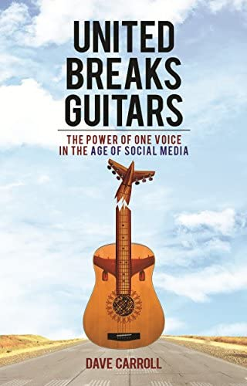
Customers can “fall through the cracks”
2008
Dave Carroll’s (a professional musician) Taylor guitar (worth 3,500 USD) had been damaged during transfer at Chicago’s O’Hare airport.
The flight attendant did not care when Carroll pointed to the potential mishandling of baggage. He was told to talk to a lead agent at the O’Hare airport, then to ground crew in Omaha, then to ground crew in Halifax.
Dave Carroll had spent numerous months seeking for compensation; he was redirected from a call center in India to baggage office in Chicago, to central baggage center in NYC, and back again to the call center.
Ms. Irlweg, customer service representative of United Airlines finally concluded that Dave Carroll’s complaint cannot be handled (checked in the guitar, did not make the claim within the 24-hour timeframe)
2009
Dave Carroll decided to produce three songs describing his experiences with United as a response and posted the video of the firstsong ”United breaks guitars” on YouTube on Monday, July 6th.
The clip quickly became popular on multiple platforms such as Twitter, Consumer Reports magazine, Los Angeles Times, HuffingtonPost, CNN, CBS Morning Show, and others picked up on the issue within 2-3 days after the video had been launched
Video had been viewed 4.6 million times within three weeks after its upload
Top 20 iTunes download in Canada in July 2009; number one country music download in UK in July 2009.
2012
Carroll and "United Breaks Guitars" were featured in the CBC/CNBC documentary Customer (Dis)Service
Carroll published a book, United Breaks Guitars: The Power of One Voice in the Age of Social Media

Slide 13
Embracing Iteration instead of linearity
An offering not previously available to customers that results from
Characteristics and Examples
the addition/removal of new elements to an existing offering (bundling/unbundling)
New services for markets as yet undefined: e.g., eBay, craigslist
New services for markets that already exist: e.g., Amazon
radical changes in the service delivery process (new delivery style)
Music or video on demand streaming services: Spotify or Netflix
Pure online banking providers: Nordea Netbank
incremental improvements to existing service elements or delivery styles
Service improvements: extended service hours, faster delivery
Multi-channel offerings: online check-in with Finnair App
Source: Fitzsimmons and Fitzsimmons (2000)

Slide 14
Building CXM-sensitive Strategy

Slide 15

Tools for CX strategy planning
The Environment Map
Helps you to understand the context in which you (re-) design customer experiences.
Business Model Canvas
Helps you to summarize your CX strategy.
Value Proposition Canvas
Helps you to create value for your customer.

Slide 16
The Environment map
Market forces
You never manage customer experiences in a vacuum.
You design, test, build, and manage them in a context.
Zoom out to the big picture to map the environment in which you are making your strategic choices related to CX.
Key trends
Key customer issues in your arena
(E.g., what kind of ”segments” are growing/ shrinking, customer switching costs)
Technology innovations
Regulatory constrains
Social trends
Industry forces
Macroeconomic forces
Key actors in your space, such as competitors, new/fading technology providers
Global market conditions
Access to resources
High or low commodities prices

Slide 17
Business Model Canvas

Slide 18
Business Model Canvas (BMC)
Business Model Canvas is a strategic tool for developing new business models or documenting and improving existing ones.
Business Model Canvas offers the rationale for how an organization creates, delivers, and captures value
→ a great starting point for structured conversations around customer experience management and strategy

Slide 19
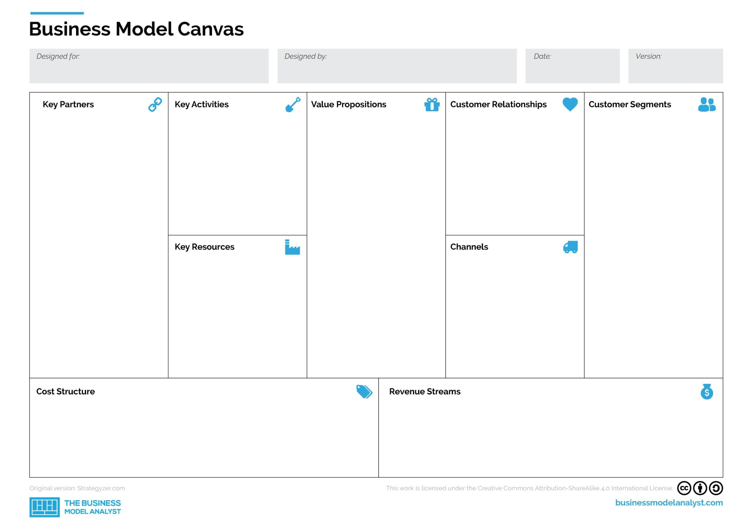
Business Model Canvas (BMC)
Who are our key partners?
What are the roles of our partners? What resources do we need from our partners?
How they (partners) benefit from the cooperation?
What key activities do our value proposition require?
Which one of our customer’s jobs are we helping get done?
How do we interact with our customers?
For whom are we
getting a job done?
Through which touchpoints do our customers want to be reached?
What skills and knowledge do our value proposition require?
What is our cost structure?
How do we make money/what we get? How is the price set?

Slide 20
Value Proposition Canvas

Slide 21
Value Proposition Canvas
The Environment Map
Helps you to understand the context in which you (re-)design customer experiences.
Business Model Canvas
Helps you to summarize your CX strategy.
Value Proposition Canvas
Helps you to create value for your customer.

Slide 22
Value Proposition Canvas
Value Proposition Canvas is a tool that helps CX managers to design relevant experiences. It can be used to map unique value proposition to address the customer pain points, while helping them complete their jobs and delight them with gains along the way.
After customer persona is made:
Identify customer jobs/tasks
Identify customer pains
Identify customer gains
Prioritize jobs, pains and gains

Slide 23
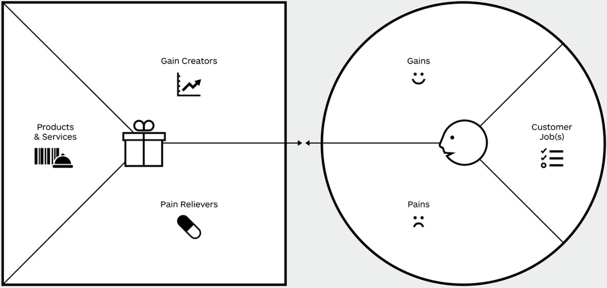
Value Proposition Canvas

Slide 24
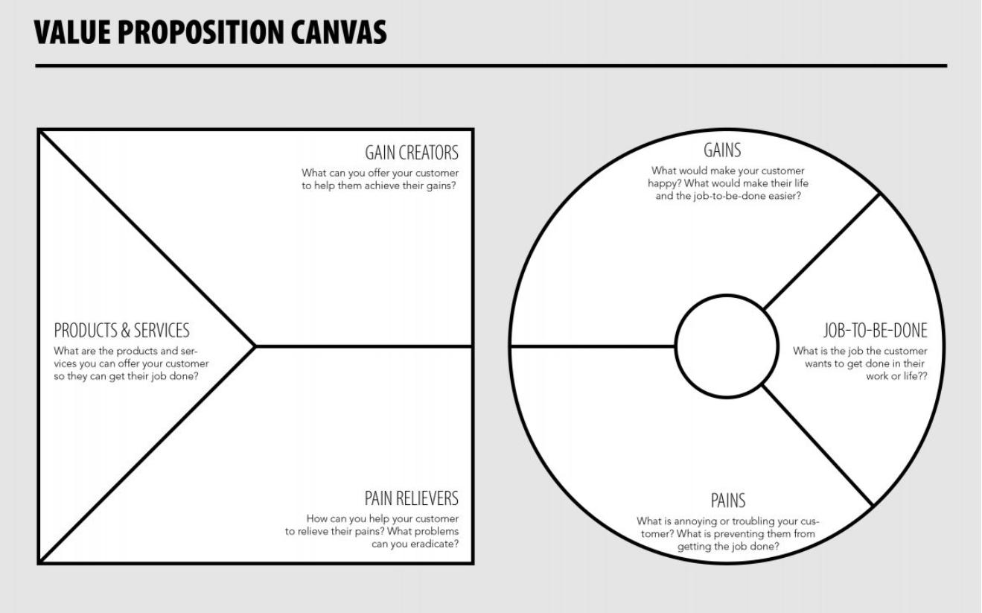

Slide 25

The ”usual” taxi

Slide 26

The “app” taxi – Uber or equivalent

Slide 27
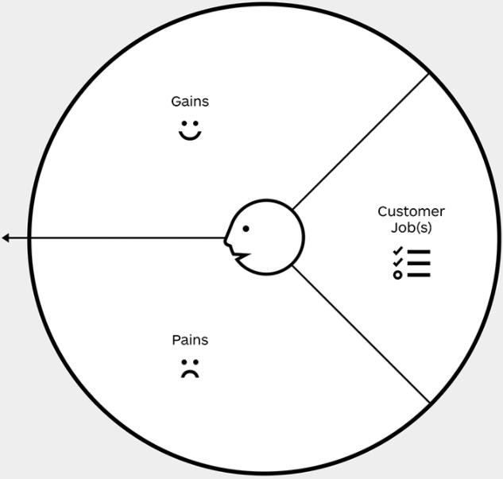
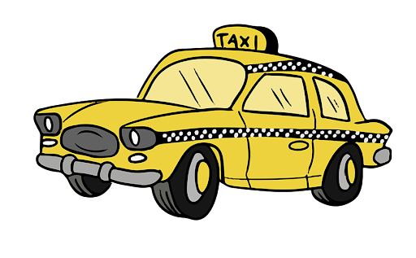
Discussion time
Easy payment
Compete with other customers
Unsafe driver?
Pay to driver
Find a taxi
Give directions

Slide 28

Discussion time
Fair price
Easy payment
Compete with other customers
Arrive on time
SOS button

Slide 29
Understanding Profitability and RoI
CXM approach Traditional approach
Financial reporting & monitoring
Metrics that matter
Metrics related to customer acquisition cost, customer lifetime value, etc.
Operates on good-enough data
Accounting
Income statement, balance sheet, cash flow statement
Operates on complete data

Slide 30
How does a firm “know” it’s doing well
And at what level of granularity?
How does it strike a balance between short-term and long-term, instantaneous and cumulative experience?

Slide 31
Measuring CX – Improvements and Alternatives
Continuous vs Discrete metrics/approaches

Slide 32
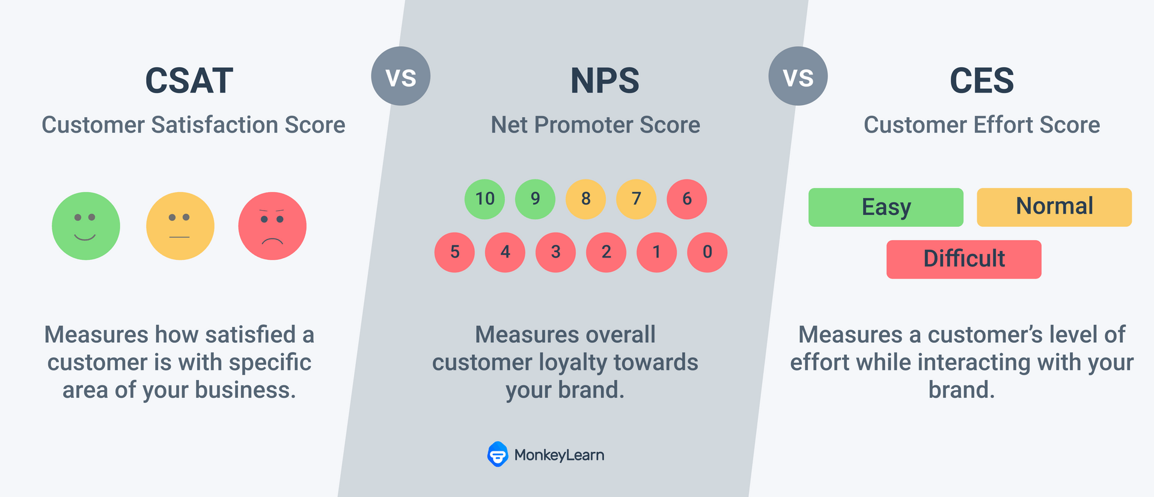

Slide 33
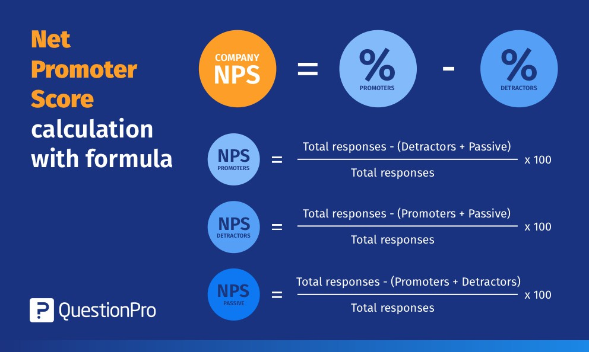
NPS

Slide 34
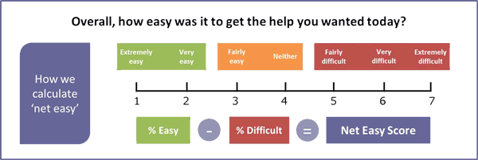

Slide 35
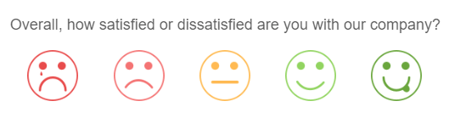

Slide 36
Key takeaways
To embody CXM, firms have to change cultural mindsets, strategic directions and firm capabilities, as well as identify relevant metrics to capture incremental success or failure
1

Slide 37
Any questions?

Slide 38
Important!
Please remember that on Friday 7th October class timings are 13:00-14:45

Slide 39
Alexa, play the song…
Master-Servant

