Slide 1
Weekly plan
Week 2
Week3
Week4
Week5
Week 6
Introduction to CXM and practicalities
Approaches and Building blocks of Customer Experience
Touchpoints, Journies and Narratives
Service Design, and Personas
Action Session 1 – Touchpoints, Journies, Personas
Innovation through CXM
Metrics and Measurement – Re-visting the Firm
Aligning Brand Strategy, Research and Context
Future of CXM
Presentations and Wrap Up

Slide 2
What is the relationship between branding and CX?

Slide 3

Notes:
Celebration of being a consumer

Slide 4
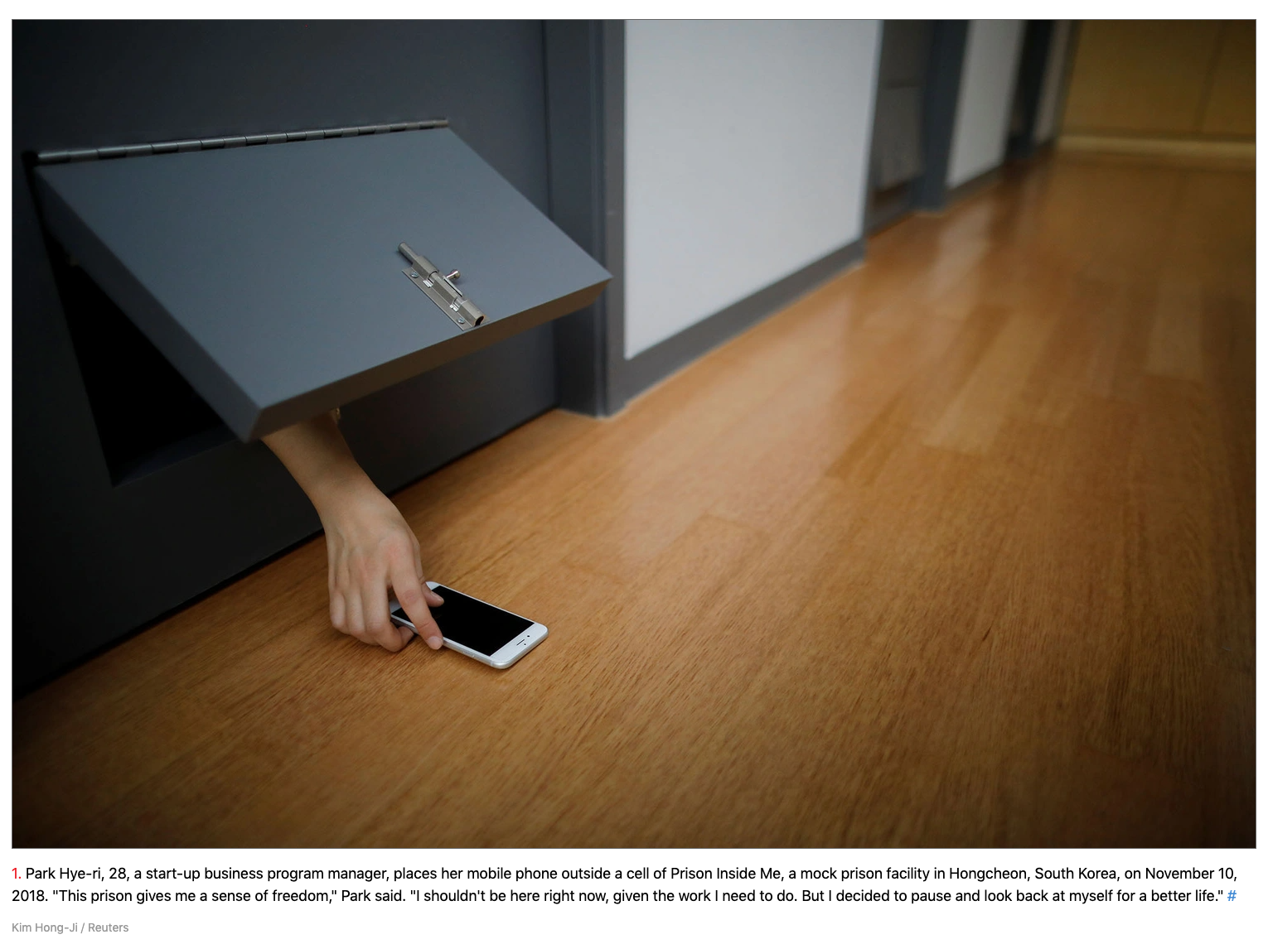
Giving-Up Consumer Roles Temporarily

Slide 5


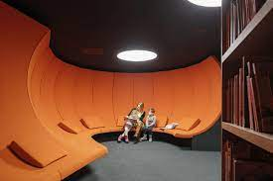
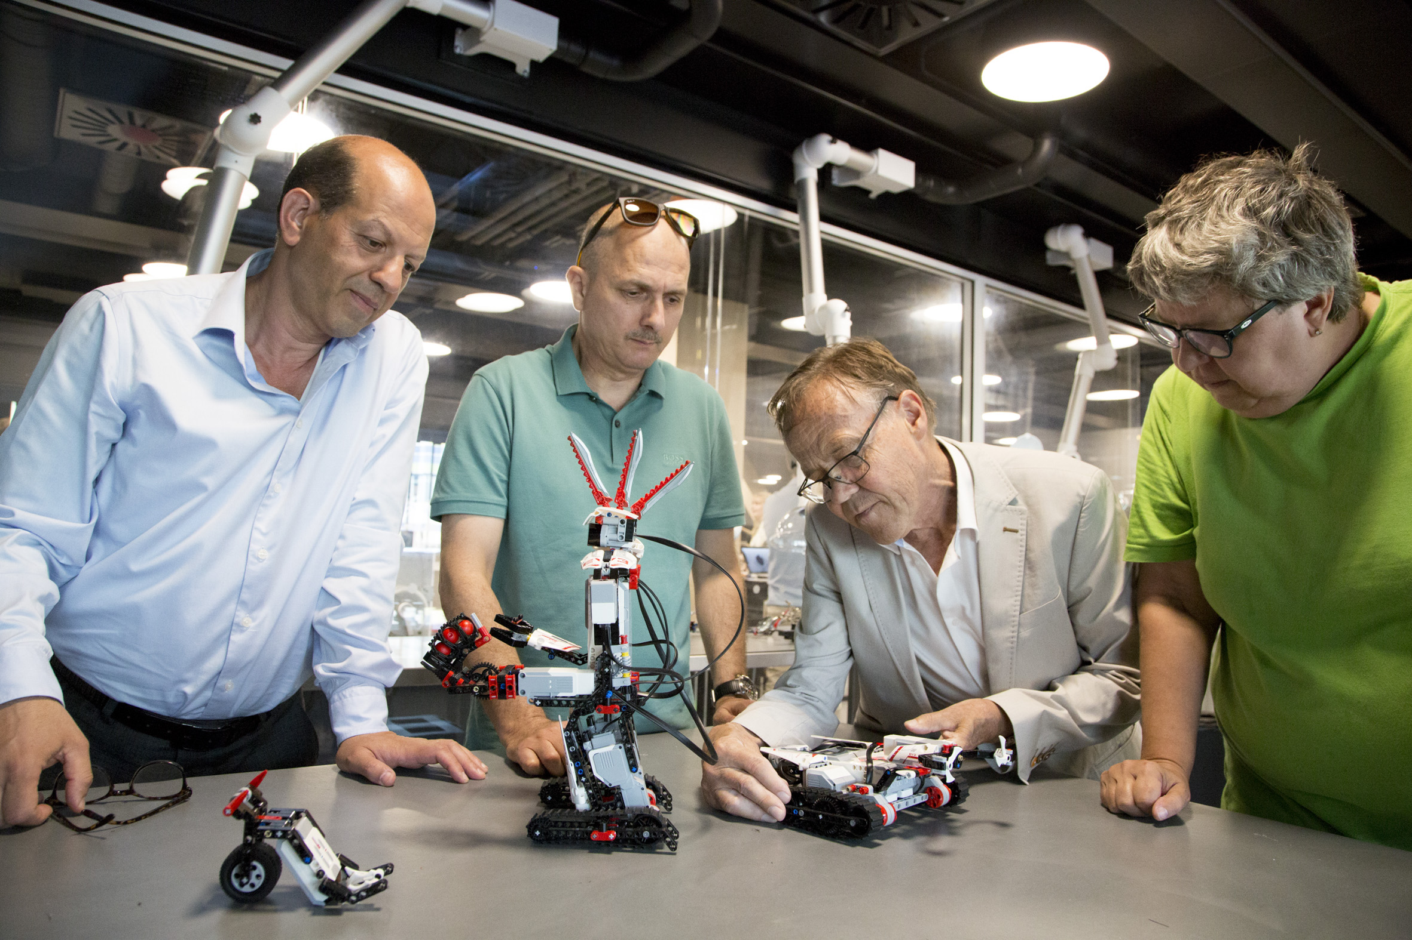
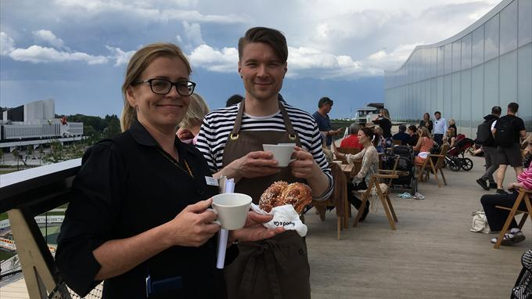

Oodi Library

Slide 6
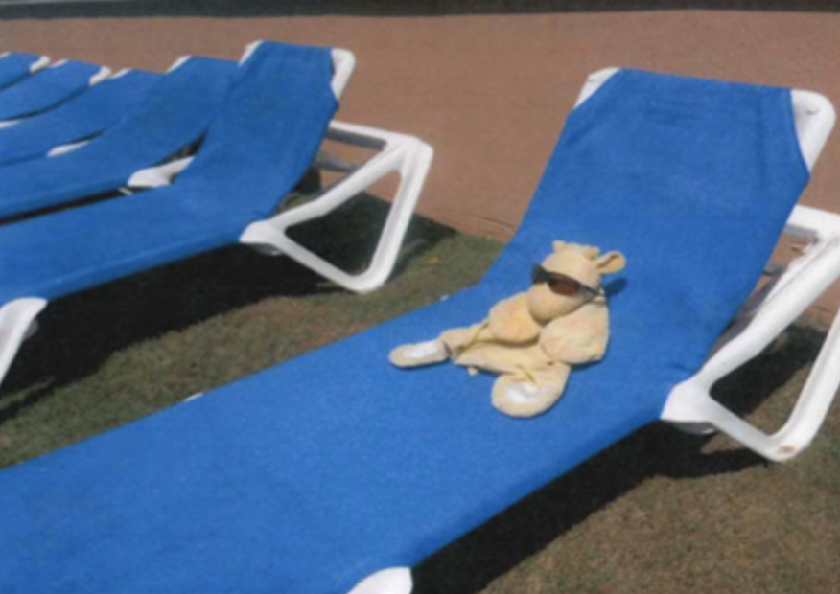
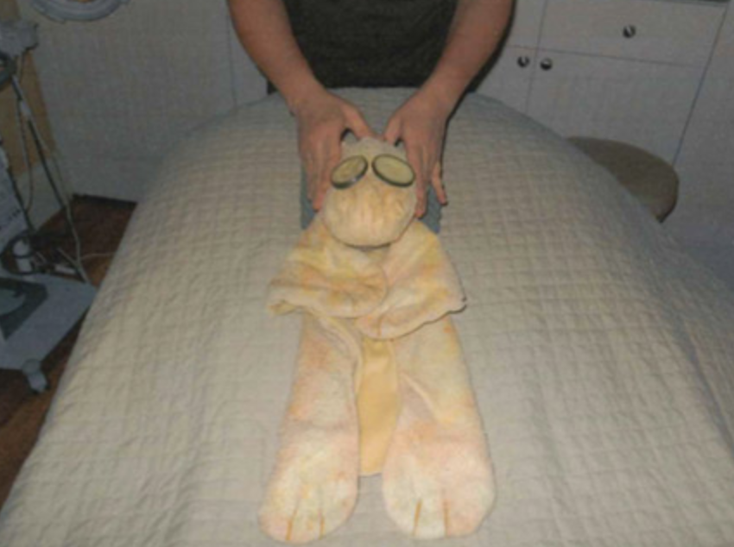
Ritz Carlton
Joshie on an extended vacation
https://www.huffpost.com/entry/stuffed-giraffe-shows-wha_b_1524038

Slide 7
experience, an experience OR Experience
experience : your basic unremarkable, unexamined experience
An experience : an event which becomes memorable
Experience : reflexive understanding of a specific part of life

Slide 8

An experience

Slide 9
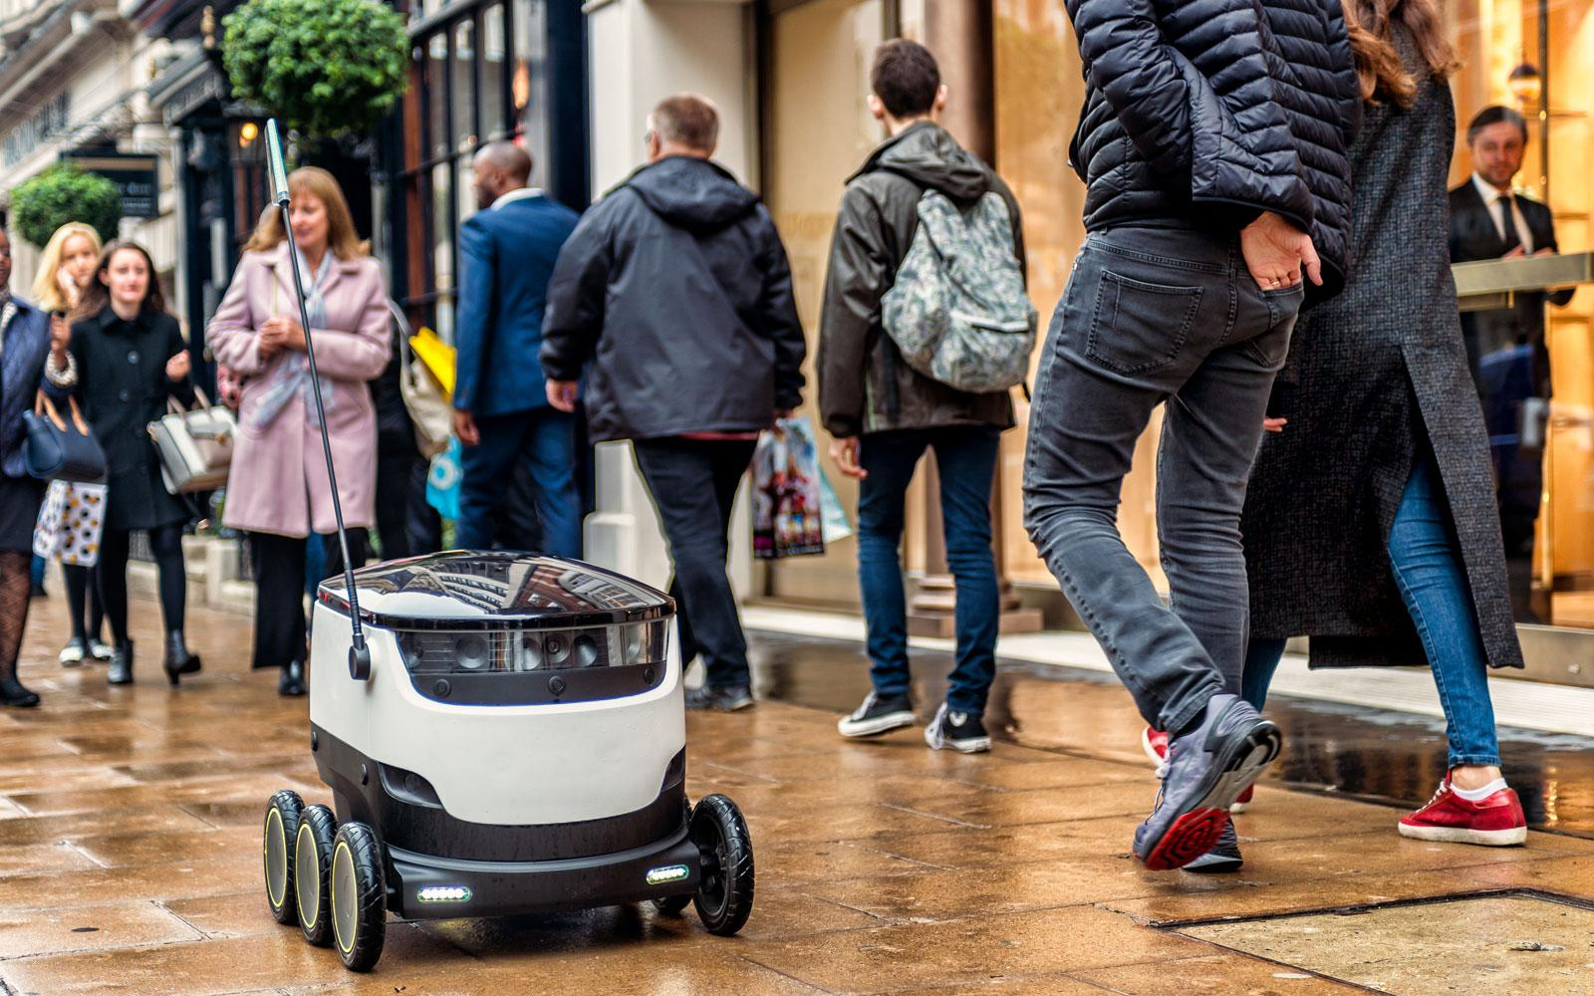
experience

Slide 10
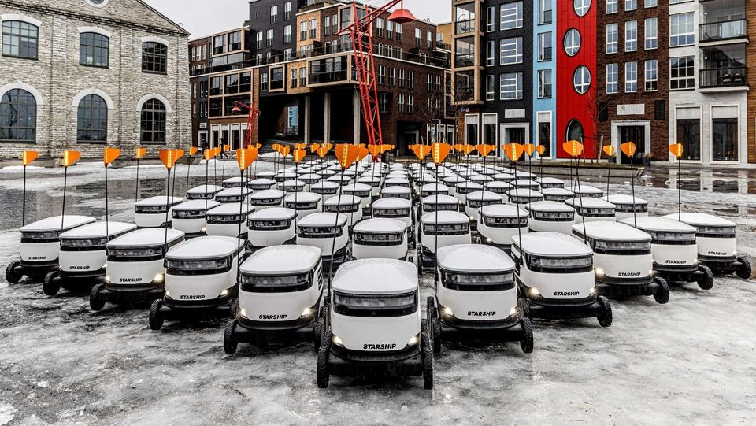
The “Starship Experience”

Slide 11
FrontStage
Line of Visibility
BackStage
Goffman 1963

Slide 12
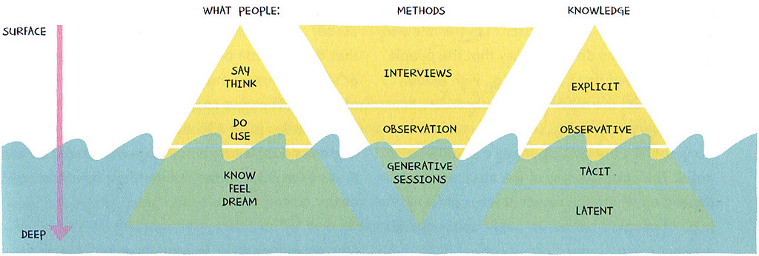
Source: Sanders & Stappers (2005)

Slide 13
FrontStage
Line of Visibility
BackStage
Goffman 1963

Slide 14
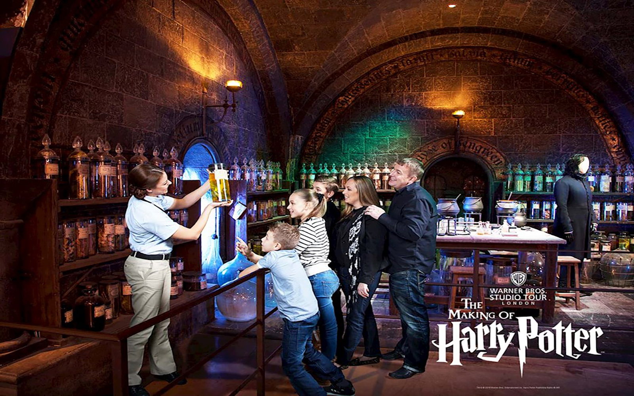
What do you offer?

Slide 15
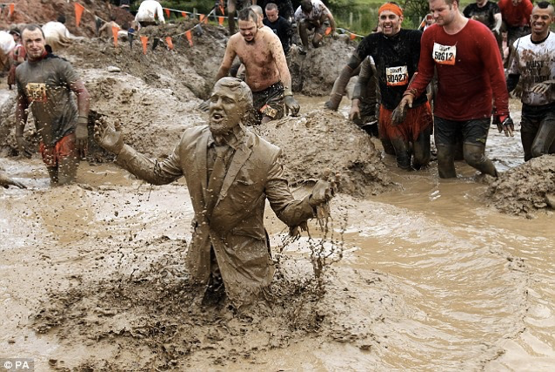
For those whose hands are “soft”

Slide 16

Antidote to Modern Life

Slide 17
FrontStage
Line of Visibility – Boundary Spanning
BackStage
Goffman 1963

Slide 18
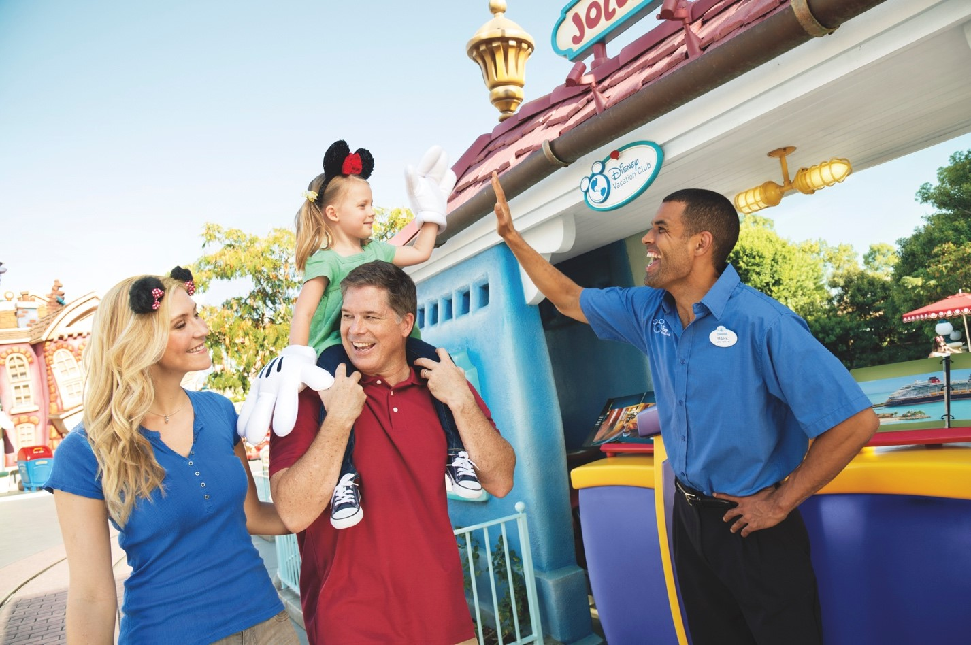

How do you offer what you offer?

Slide 19

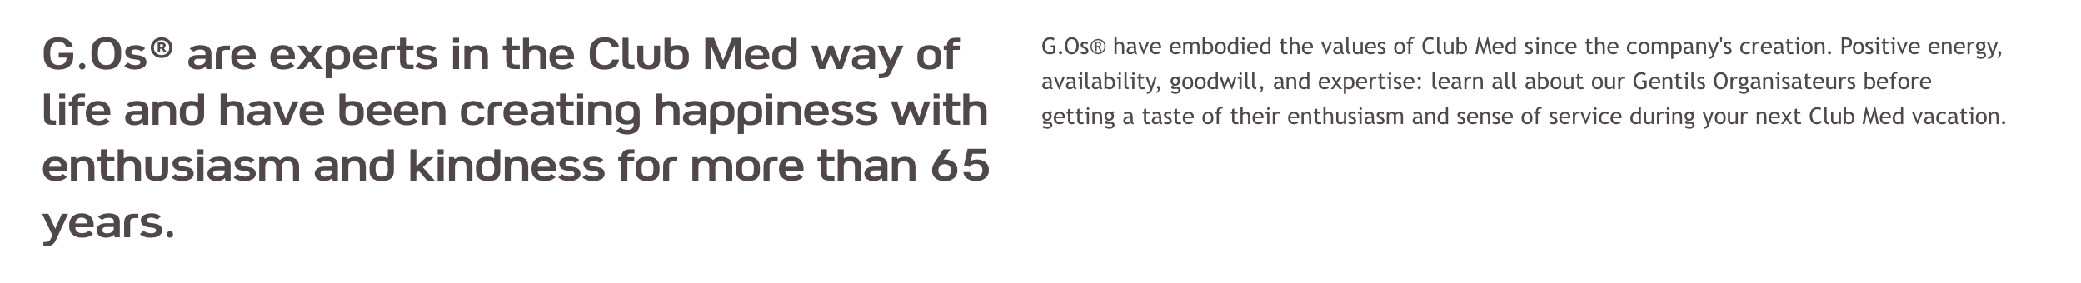

Slide 20
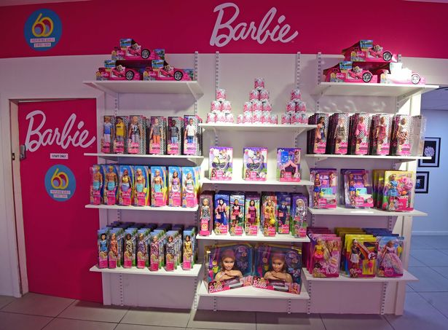
“Productization”

Slide 21
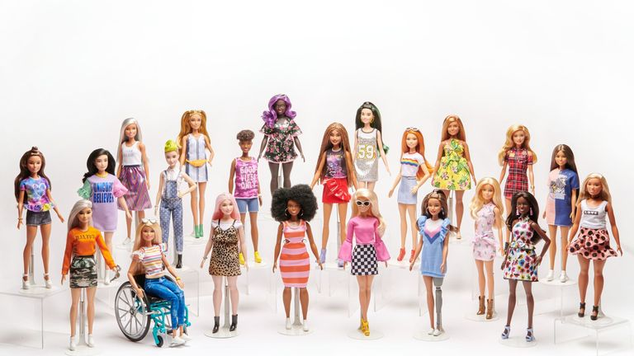
Creating a “wide” product assortment

Slide 22
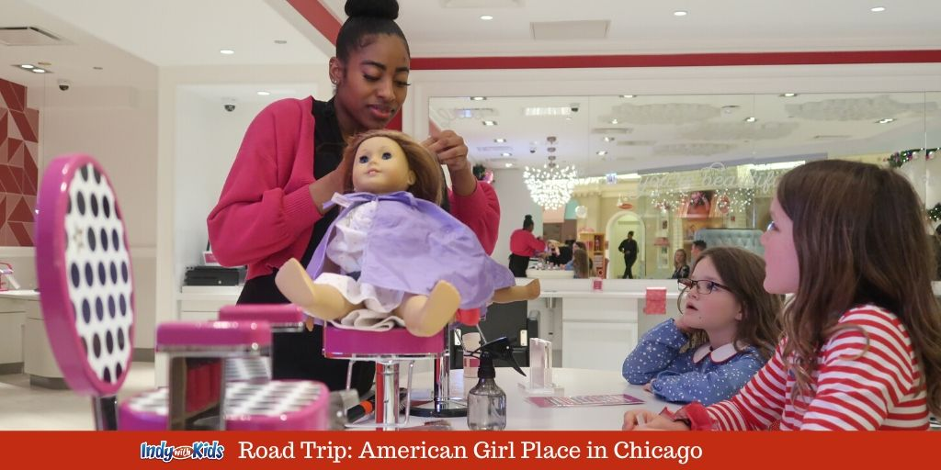
“Experientialization”

Slide 23
Creating Deeper engagement - A place for female kinship

Slide 24
Themed, Flagship Brand Store

Slide 25
Helping consumers “live” the brand

Slide 26
Creating a ‘Branded World’
Immersion/transportation/escape to a brand world
How much of the world do you want to open to the customer

Slide 27
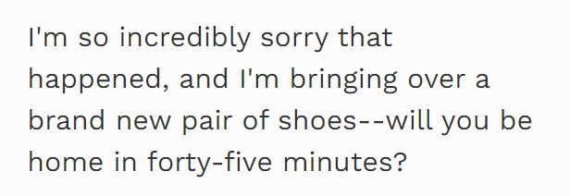
Nordstrom: Leaving your shoes in the rain!!
https://www.forbes.com/sites/micahsolomon/2017/08/01/three-wow-customer-service-stories-from-zappos-southwest-airlines-and-nordstrom/

Slide 28
Service-Dominant Marketing landscape
Making services/experiences
equivalent to goods
Services
Intangible
Heterogenous
Inseparable
Perishable

Slide 29
Branding = Commodification + Scripting

Slide 30
Pitfalls of being a Brand Manager

Slide 31
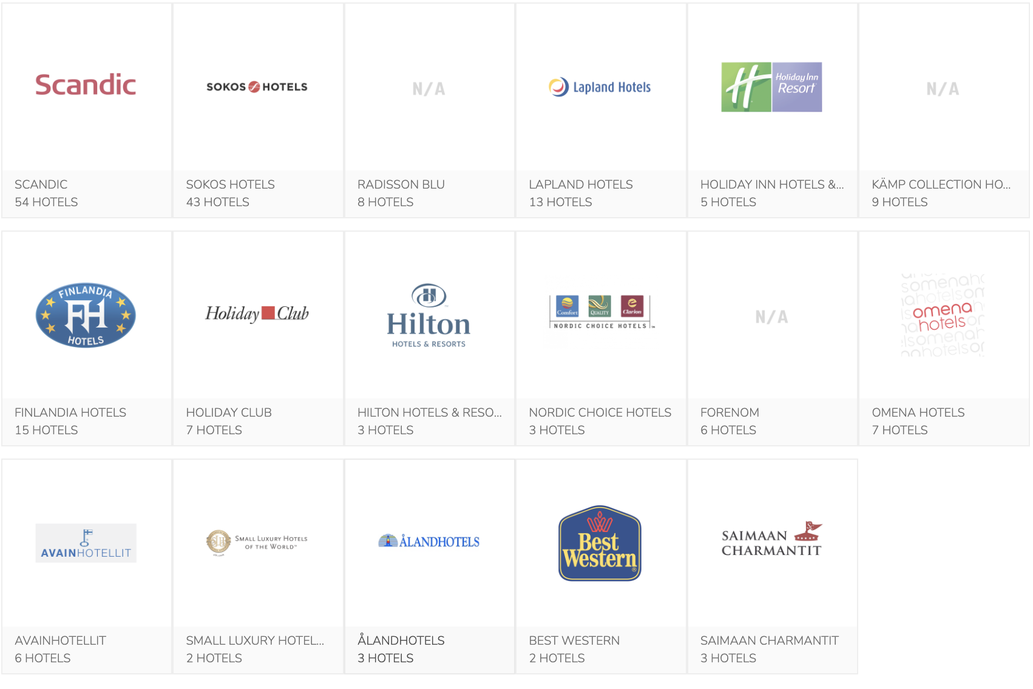
1. Looking narrowly at your brand
Hospitality brands in Finland

Slide 32
Asking context-independent questions
How many amenities should a luxury/superior/family room have?
What kind of locations?
What is the key consumer demographic?
What kind of architecture/lighting/interior should our rooms have?

Slide 33
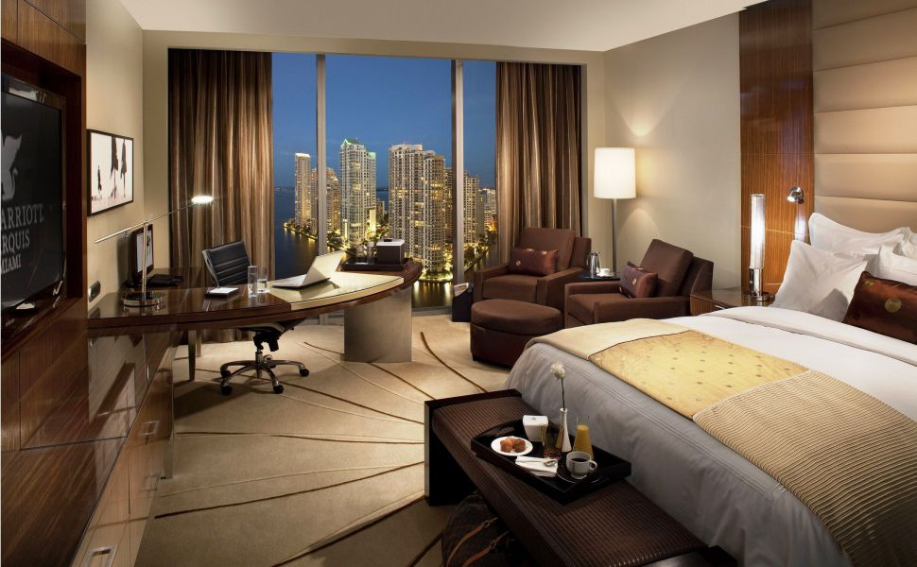

Slide 34
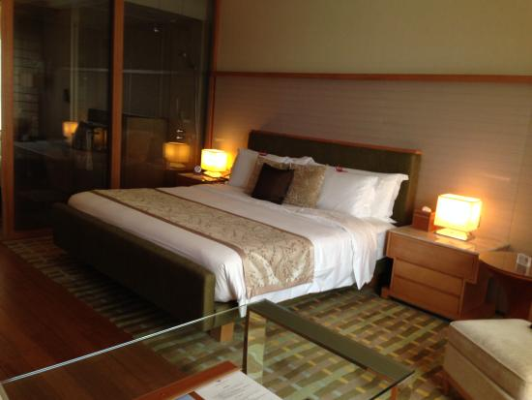

Slide 35


Slide 36
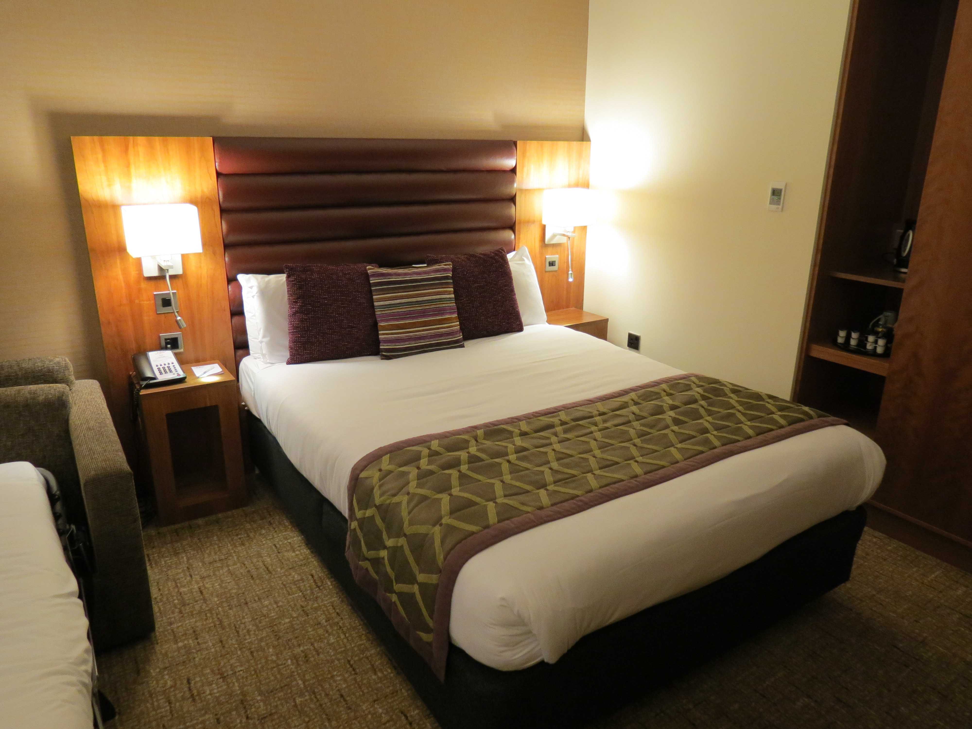

Slide 37

But it does not have to be homogenous
Why?
https://www.youtube.com/watch?v=hnSPmcZjEqs&t=310s

Slide 38
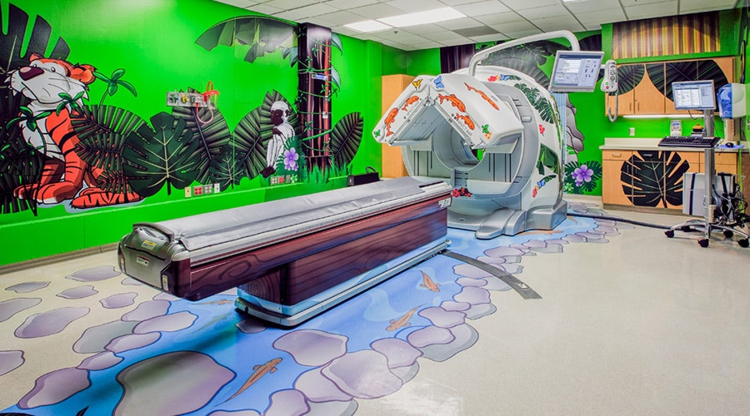
GE Adventure Series
Changing experiences through Empathy
Diagnostic imaging procedures are cutting-edge technology, but at the same time they are an unpleasant experience for patients – and even more for pediatric patients. Doug Dietz an industrial designer, working for GE healthcare since more than 20 years understood that -“The room itself is kind of dark and has those flickering fluorescent lights”.
This led to the innovation of the “Adventure Series” scanner, which was designed and developed by gaining empathy for young children and understanding what pediatric patients went through.
Impact: Patient satisfaction scores went up 90 percent. Children did not suffer of anxiety anymore.
Source: https://thisisdesignthinking.net/2014/12/changing-experiences-through-empathy-ge-healthcares-adventure-series/

Slide 39


Slide 40
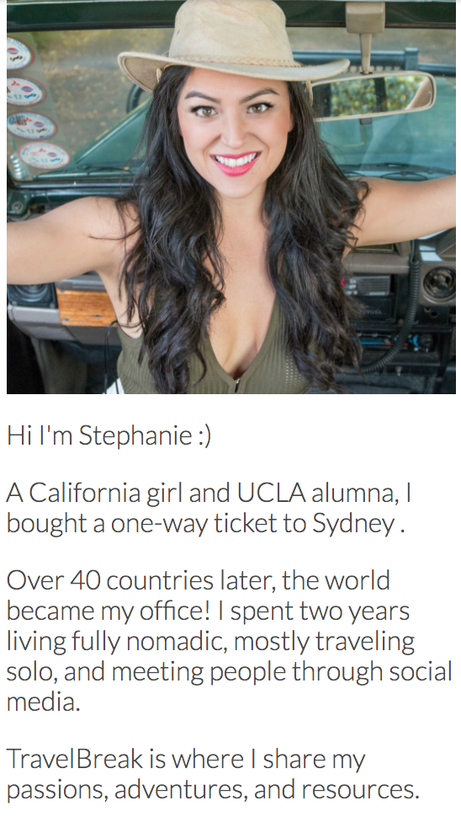
AirBnB - From Tourist to Traveller

Slide 41
Key takeaways
To do successful branding, companies must figure out which part of the offering ‘faces’ the customer
Companies must remember how much consistency vs dynamism can their brand tolerate
1
2

