Slide 1
Session 9
The Future of CXM

Slide 2
Weekly plan
Week 2
Week3
Week4
Week5
Week 6
Introduction to CXM and practicalities
Approaches and Building blocks of Customer Experience
Touchpoints, Journies and Narratives
Service Design, and Personas
Action Session 1 – Touchpoints, Journies, Personas
Innovation through CXM
Metrics and Measurement – Re-visting the Firm
Aligning Brand Strategy, Research and Context
Future of CXM
Presentations and Wrap Up

Slide 3
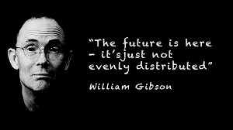
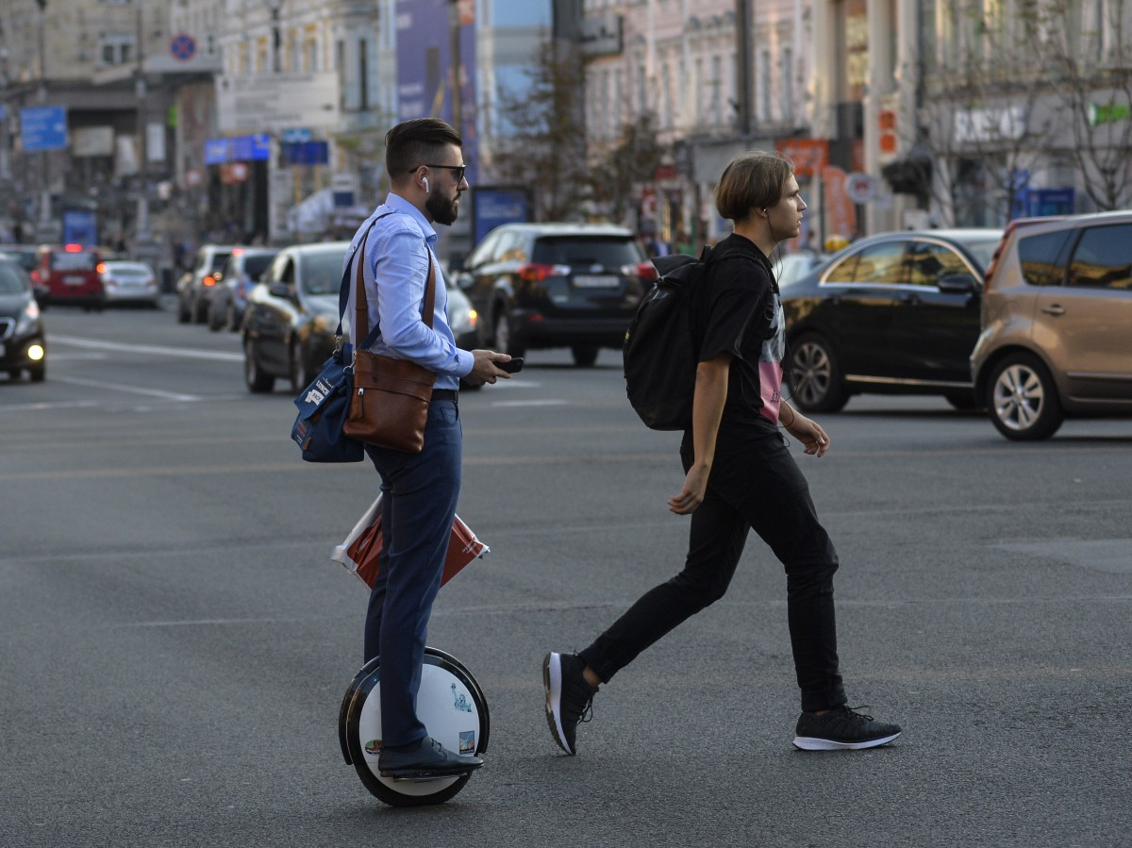
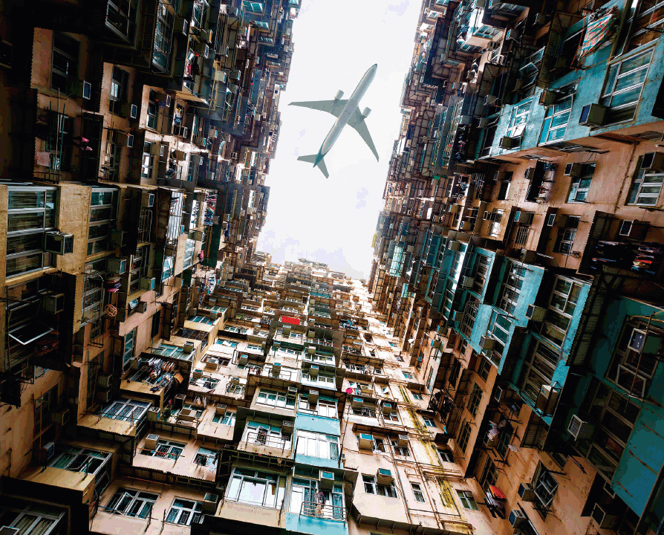

Slide 4
The future of Customer

Slide 5
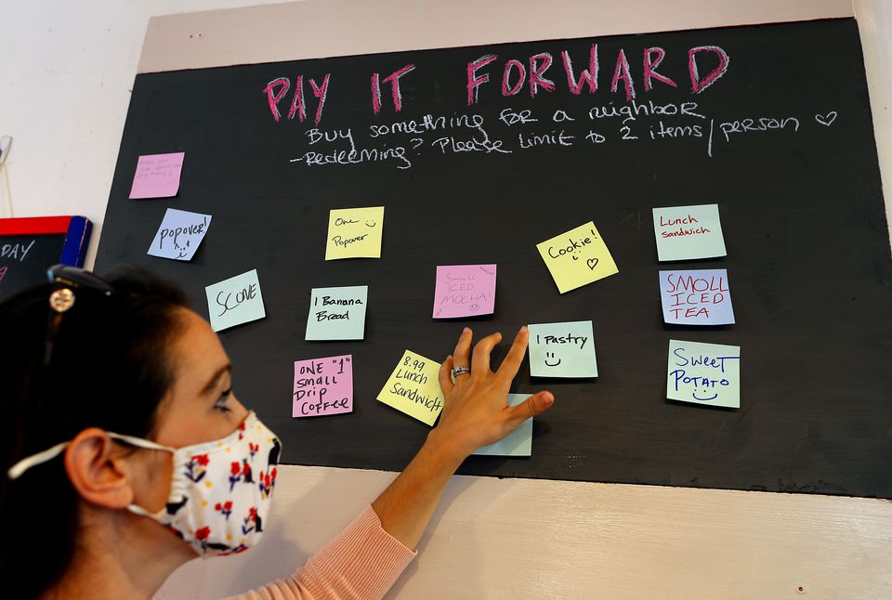
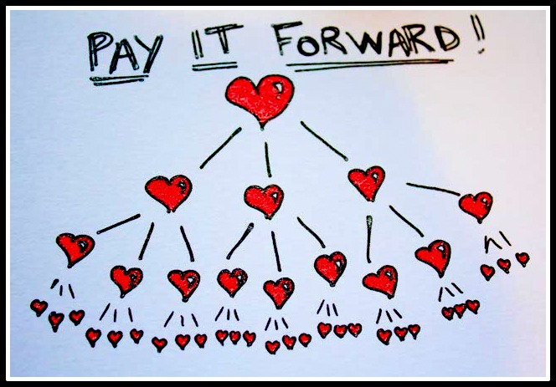
The ‘Conscious/Responsible’ Customer

Slide 6
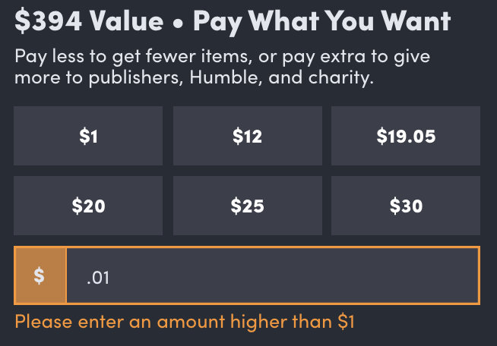
Widening Attitude-Behaviour gaps

Slide 7
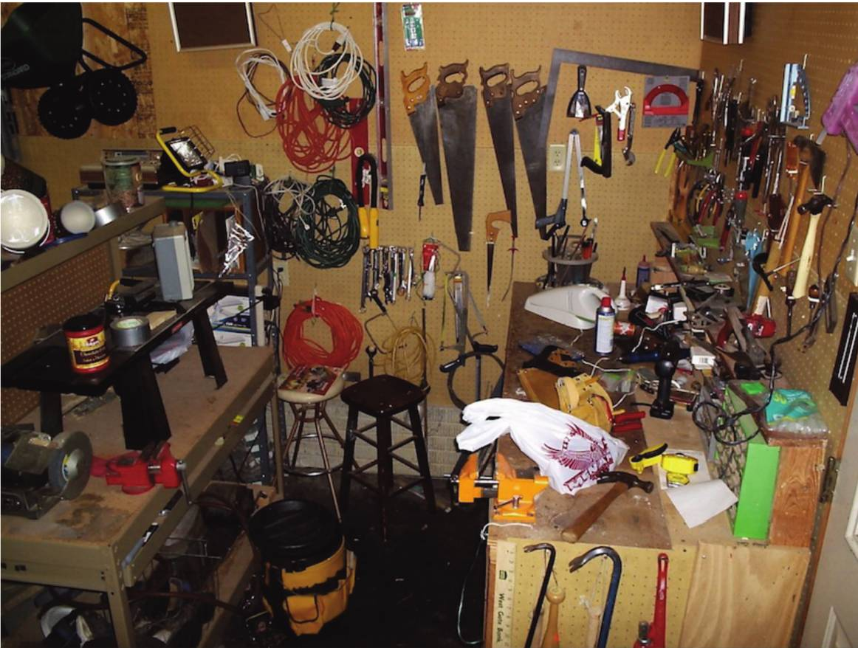
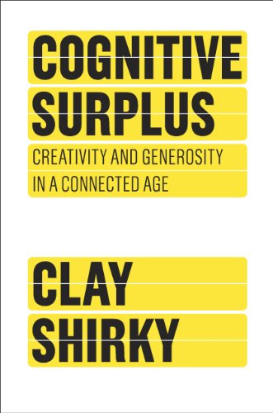
The Productive, Creative Consumer

Slide 8
Technology Readiness
Optimism (+)
Innovativeness (+)
Discomfort (-)
Insecurity (-)
The Human-Computer Interface
A positive view of technology and a belief that it offers people increased control, flexibility, and efficiency in their lives.
A tendency to be a technology pioneer and thought leader.
A perceived lack of control over technology and a feeling of being overwhelmed by it.
Distrust of technology and skepticism about its ability to work properly.
Source: Parasuraman (2000)

Slide 9
All that’s solid melts into thin air
Sociological + Psychological

Slide 10
Think through multiple lenses
Initial Feedback
We need the elevators to arrive faster
ONE Problem to solve
People get bored while waiting

Slide 11
The future of eXperience

Slide 12
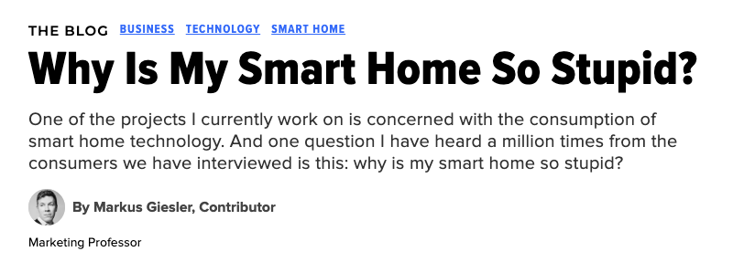

Slide 13
Everything is a ‘Destination’

Slide 14
Sedentarization vs Mobilization

Slide 15
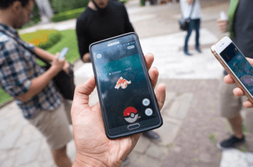
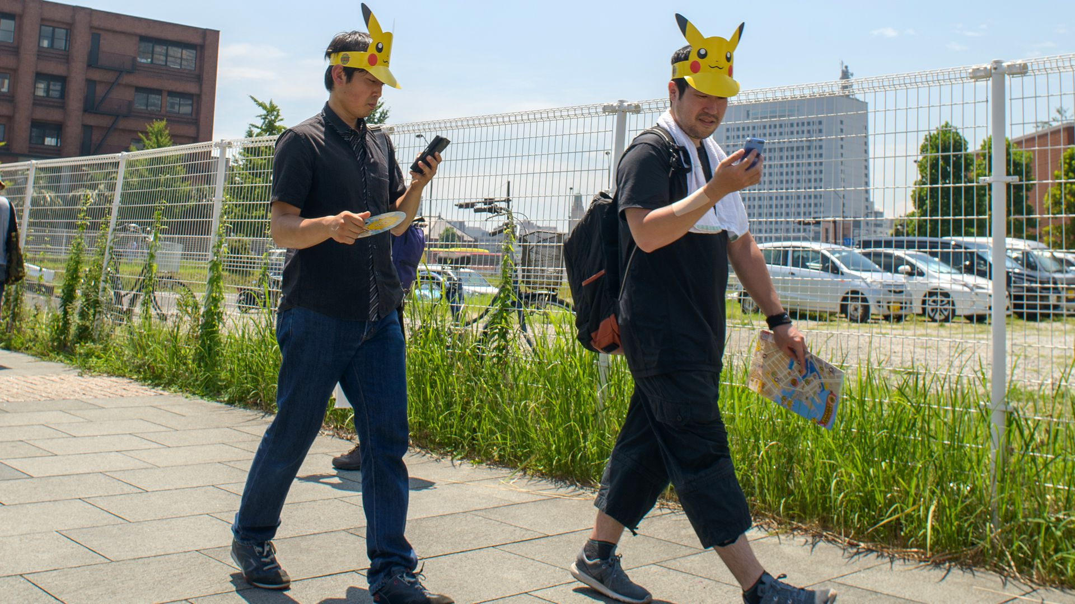
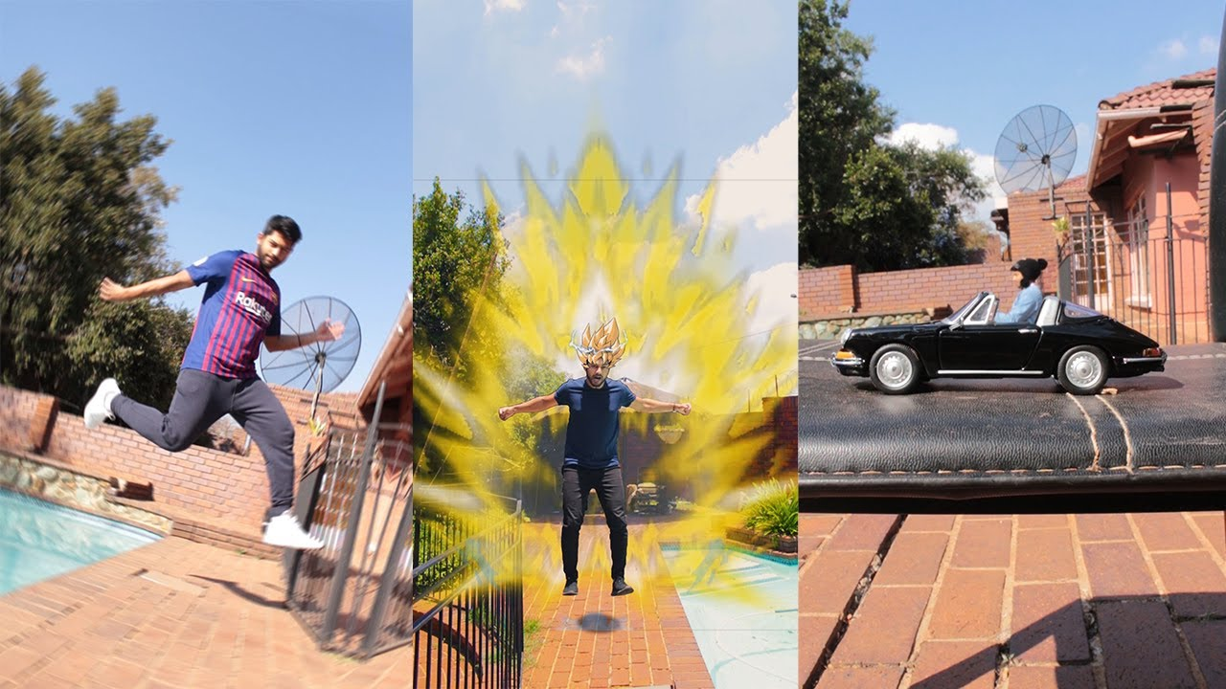
Sedentarization vs Mobilization

Slide 16
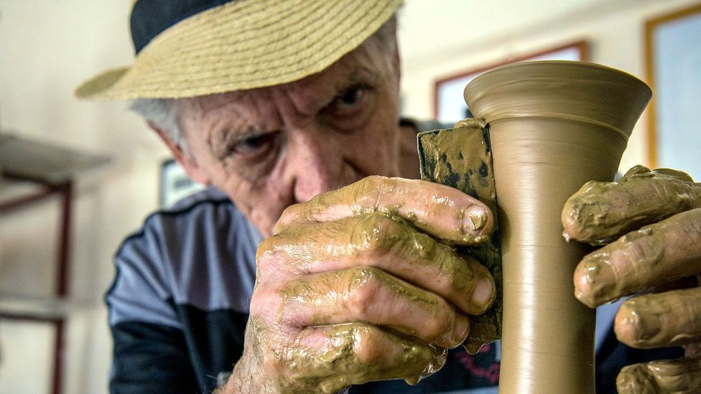
How many ‘flow’ experiences can I take?

Slide 17
Platformed Experiences?
Six of the ten most valuable companies in the world today are platform businesses: Apple, Alphabet, Amazon, Facebook, Tencent, and Alibaba
By early 2019, Uber had a higher market valuation (US$72bn) than the market capitalization of America’s largest car company GM (US$56bn)
Source: https://listwithclever.com/research/airbnb-vs-hotels-study/; https://www.statista.com/statistics/264810/number-of-monthly-active-facebook-users-worldwide/; Wirtz et al. 2019; https://bernardmarr.com/the-10-best-platform-business-model-examples/; https://www.forbes.com/sites/deloitte/2019/05/29/scaling-the-heights-digital-platforms-and-the-marketplace-of-the-future/

Slide 18
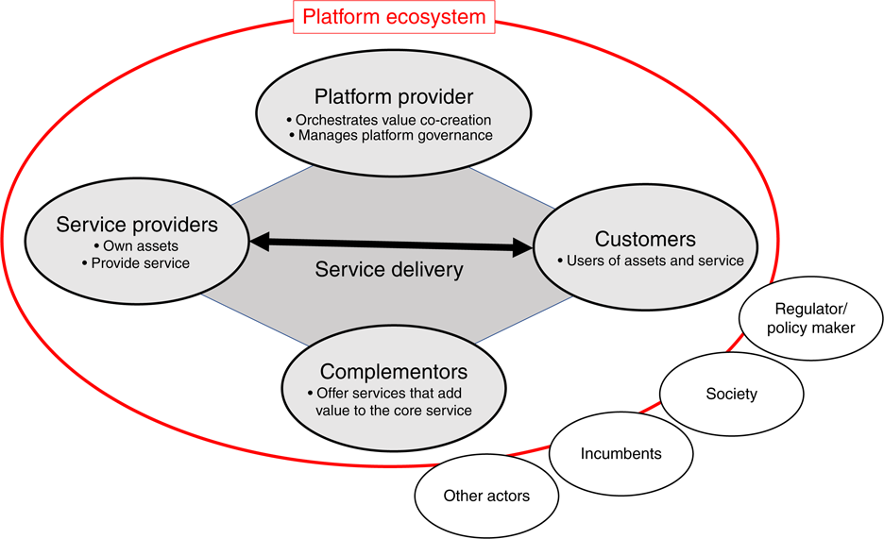
The ‘Sharing’ Experience
Sharing economy business models help people to transact directly with one another by connecting individuals in unprecedented ways
Specifically, (a) a platform provider enables exchange (e.g., Airbnb, Uber), (b) a customer seeks access to assets, and (c) a peer service provider (e.g., Airbnb host, Uber driver) grants this access
Source: Wirtz et al. (2019)

Slide 19
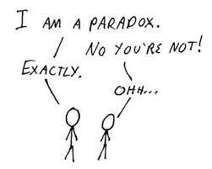
Technology Paradox
The term ‘technology’ can encompass both material and nonmaterial things (e.g., laws). In a narrower sense (…) technology ‘refers to artificial things, and more particularly modern machines: artificial things that (a) require engineering knowledge for their design and production, and (b) perform large amounts of operations by themselves
Anectodal evidence points to the existence of a technology paradox:
The same technology that creates radiant feelings of intelligence and efficacy can also precipitate feelings of stupidity and ineptitude
Technology assimilates people as well as isolates them
Appliances purchased for saving time regularly end up wasting time (Goodman 1988)
Paradox: technology is both X and not-X at the same time
Source: Mick & Fournier (1998); Joerges (1988)

Slide 20
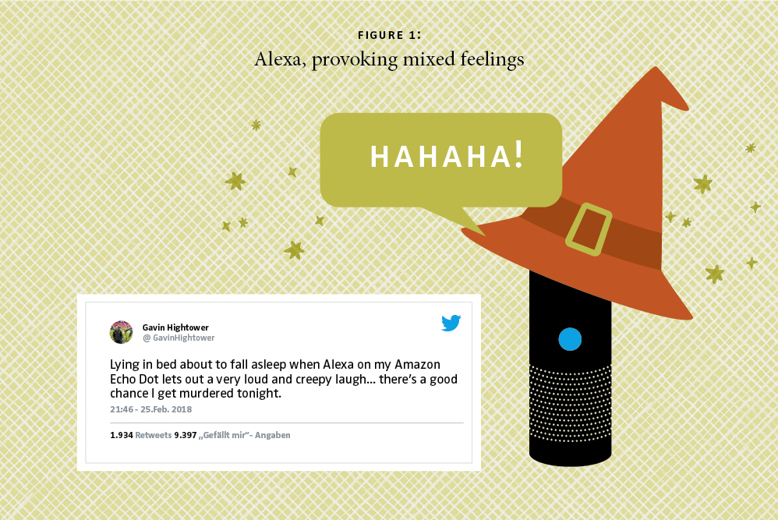

Slide 21
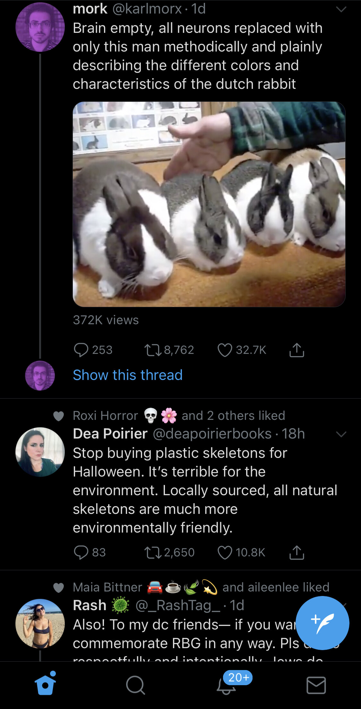
The ‘Doomscroll’ as eXperience
Credit: Eugene Wei

Slide 22
The future of Management

Slide 23
The future of CX measurement
What new metrics, approaches, assumptions will be in play?

Slide 24
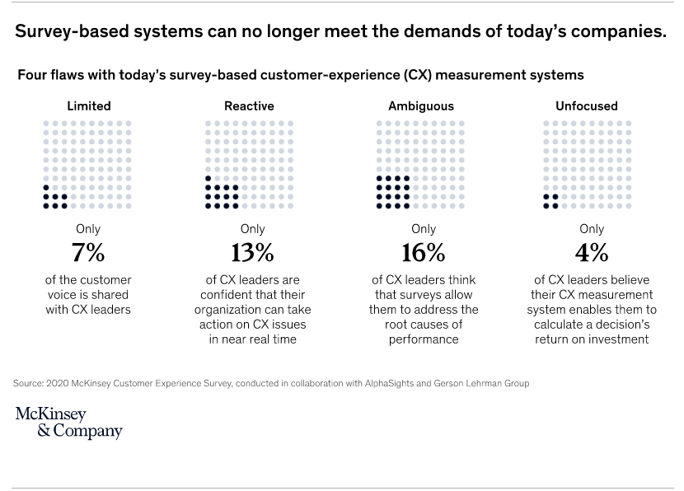

Slide 25
What did you do?
Watch it on loop?
Swipe it before it finished?
Share it?
Find the music score?
Follow the artist?
Visit her profile page?
Make your own video about this video?

Slide 26
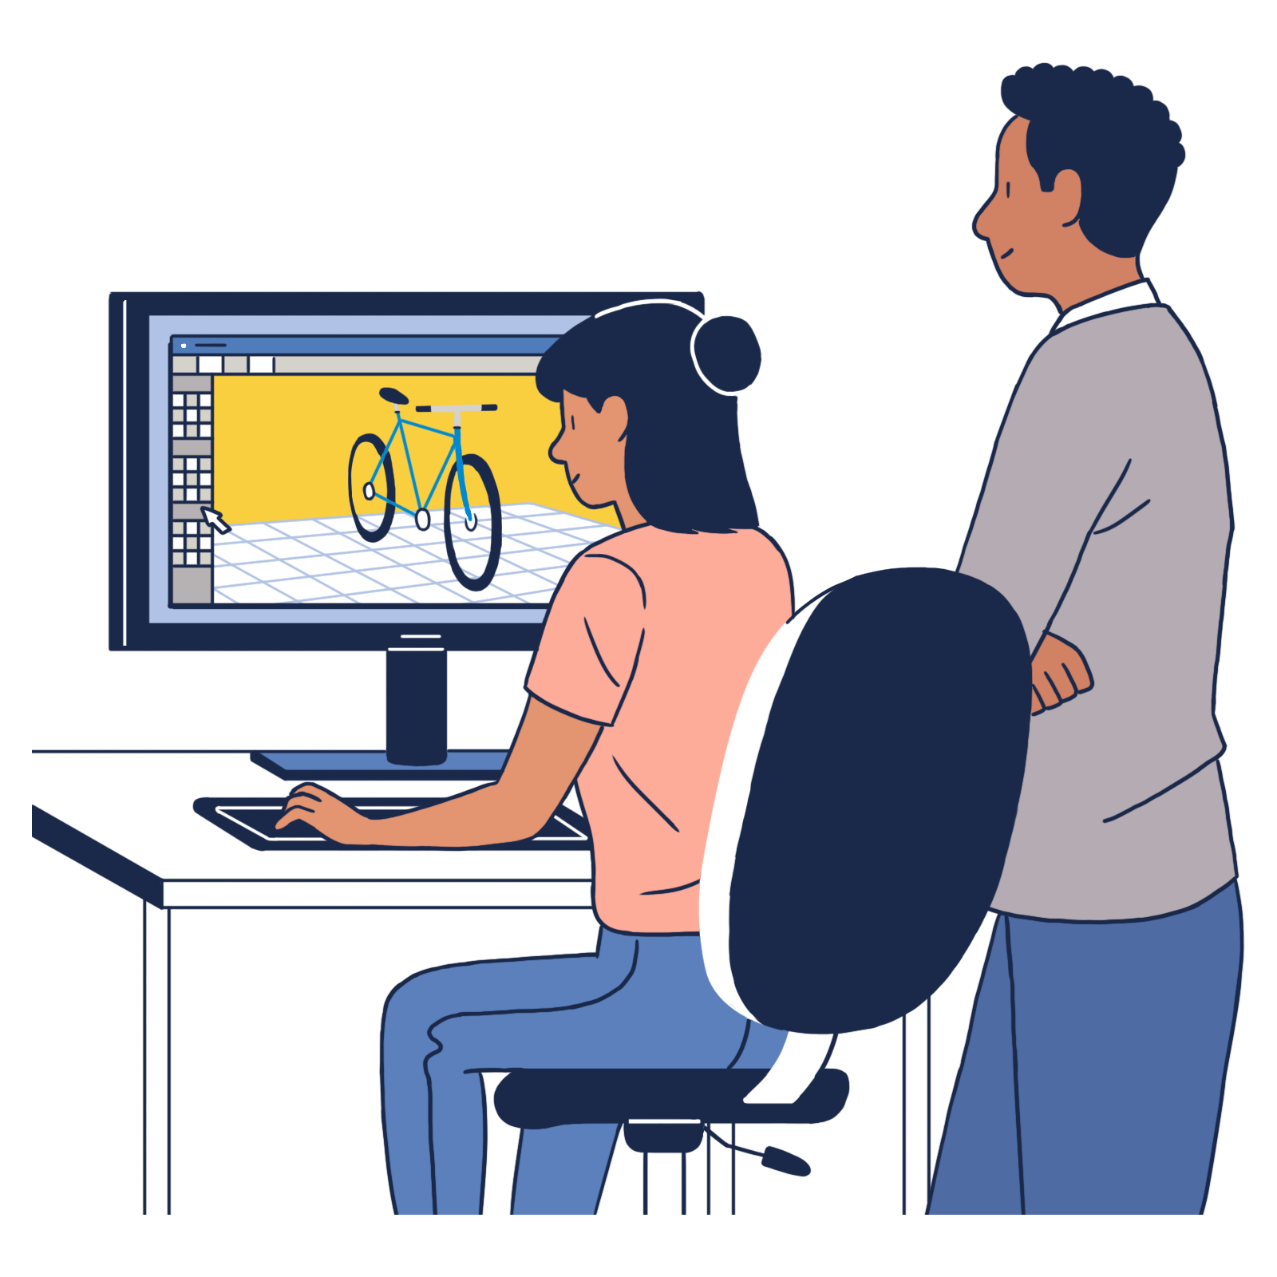
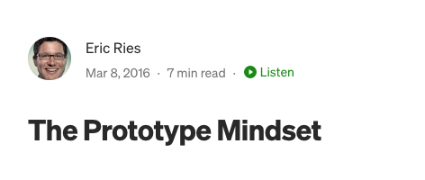
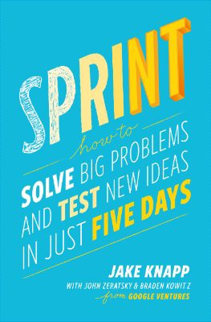
Prototyping CX concepts

Slide 27
Key takeaways
Customers will become more fragmented and confusing, but also more demanding
Technology-optimism is a misplaced ideal
Measurement will drive management
1
2
3

Slide 28
Questions?

