Slide 1
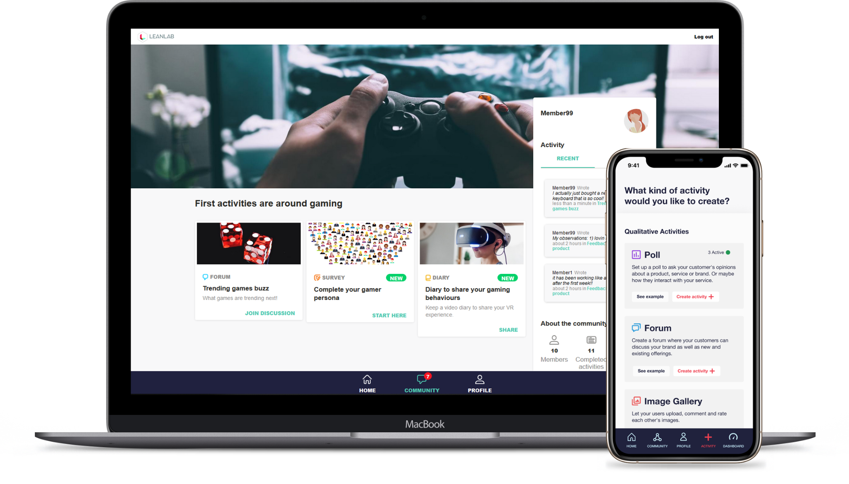
Competitive Analysis + Trends
Case: LeanLab
Mixed method platform for qualitative and quantitative research
Currently targeting Customer Insight and Customer Experience teams
www.leanlab.co

Slide 2
Analysis Scope
How might we develop our offering going forwards in the Nordics? We will be looking at our CURRENT market and close-by markets.
Product Management Software Market
Customer Feedback Software Market
01
03
Growth CAGR 11,1% to 2027
Size by 2030 5.6 bn USD Source: here
CURRENTLY
Market Research Online Community (MROC)
Growth CAGR 12,7% to 2027 Size by 2027 3,3 Billion Source: here
02
Innovation Management Market
04
UX Research Software Market
Growth CAGR 26.2% to 2026 Size by 2027 3,5 Billion Source: here
Growth CAGR 12% by 2026
Size 2026 356 MUSD
Sourve: here

Slide 3
Market Research Online Community ‘Market’
Some additional detail and areas of interest in the market place
There are players with heavy service offering and there are ‘purer’ software plays such as Recollective - interesting to learn what that ‘mix’ in the market is. Do purer Saas plays perform in the market too?
How do the different players position themselves on the partner (such as Market Research Agencies) vs direct to brands route. Recollective to our understanding is focusing more on the partner sales/track rather than selling direct to brands like we are.
Useful resource to take a closer look at selected 20 MROC players can be found here: https://www.insightplatforms.com/top-20-insight-community-platforms/
The market is global but look also for Nordic founded players or evidence of non-Nordic players operating in the Nordics
Competitor examples
Verve (addverve)
Cmnty.com
C-space.com
Incling
CrowdDNA
Recollective
Forsta (they are all arounder MR tech but have this offering too)

Slide 4
Product Management Software Market
Some additional detail and areas of interest in the market place
We are interested in the software side of the market. So focus on those companies and not on full service consulting houses.
Also we are particularly interested software companies that focus on providing end-user feedback and end-user interaction capabilities similar to LeanLab.
The market is global but look also for Nordic founded players or evidence of non-Nordic players operating in the Nordics
Competitor examples
ProductBoard
Pendo
Uservoice

Slide 5
Innovation Management Software Market
Some additional detail and areas of interest in the market place
With LeanLab you can also build ‘staff labs’ similar to customer labs. So involving internal stakeholders in the improvement and innovation process is an interesting angle for us.
Looking at the players in this market would be interesting to understand the enterprise grade (clearly for big corps) and those that sound more suited for SME’s.
Equally looking at different software vendors would be interesting to understand what level/kind of service they provide and do they sell to agencies or direct to brands.
The market is global but look also for Nordic founded players or evidence of non-Nordic players operating in the Nordics
You can find more innovation software companies through this link. https://www.predictiveanalyticstoday.com/top-idea-management-software/
Competitor examples
Brightidea, Inc.
Crowdicity Ltd.
Exago Inc.
IdeaScale
Imaginatik PLC.
Inno360, Inc.
Viima

Slide 6
Customer Feedback Software Market
Some additional detail and areas of interest in the market place
The angle with this market for LeanLab is around how LeanLab could provide continuous experience surveys (CES, NPS etc) that seek to measure in-moment experience with the customer and selected touchpoint in the customer journey.
In this market there are several well established online survey and research software brands that are in the enterprise grade (wide and deep offering) but there are also companies with narrower focus such as Lumoa.me which is focusing on open-ended verbatim/feedback analysis and GuestRevu that is focusing on hospitality industry feedback management. These companies with a particular focus than just ‘survey software’ are of particular interest.
The market is global but look also for Nordic founded players or evidence of non-Nordic players operating in the Nordics
Competitor examples
Momentive
Qualtricks
Clarabridge
Forsta
Lumoa.me
GuestRevu
GetFeedback

Slide 7
UX Research Software ‘Market’
Some additional detail and areas of interest in the market place
In this market we are particularly interested in companies that provide end-user interview/usability research solutions. Those companies focusing solely on passive website data analytics (e.g. Google Analytics) shouldn’t be totally ignored but don’t focus all your effort on those companies.
The market is global but look also for Nordic founded players or evidence of non-Nordic players operating in the Nordics
Competitor examples
DScout
Userlytics
Validately
UserZoom
Lookback
UserTesting
Hotjar (heavy on the passive analytics though)
See over the ‘tube map’ of different players in the market

Slide 9
Analysis Scope
The key areas we like to understand from the competition
MARKET: What are the key trends driving each software market growth? What footprint those companies have in the Nordics - what about local Nordic players?
MARKET: Who are the up & coming and who are the dominant players in each market?
POSITIONING: What is the key communication line used by each company?
TARGETING: Which customer profiles (Customer Experience, UX, Product, Design, Insight, Innovation) are being targeted specifically?
FEATURES: What are the dominant ‘must have features’ in each market and what are the differing features/propositions?
SERVICE: To what extent is the software product offered fully DIY - how much is there service?
PARTNER TRACK: Is the product offered direct to brands or is there a specific partner offering?
PRICING: what kind of pricing options there are, is there PLG (Free trial) track, is the pricing visible?

Slide 10
Analysis Scope
Considering our CURRENT market and potentially moving towards a new market how would your recommendations look like?
MARKET COMPARISONS: How would you compare (growth, level of competition, trends etc) our current market and the new market you have looked at?
STRATEGY: Which companies seem to have had success in our current and new market you have looked and potential reasons why?
POSITIONING: If we were moving towards the new market how should we talk about our product?
TARGETING: In the new market, which buyer profiles and company types should we address?
PRODUCT: Which features should we pack to be able to play in the new market? What features could help us to differentiate against others in the new space?
PRICING: Do you recommend PLG track and why?
PARTNERS: Do you recommend selling and working with partners? What kind of partner routes are available?

Slide 11
Task Instructions / Deliverables
You will compare our current market + one selected market
For the competitive analysis:
There will be about 10 companies in our current market and another 10 or so companies in the selected software market to be looked at. Please look for interesting additional competitors too
The information gathering will be desk-research for which in addition to Google etc. you can use Aalto’s available business intelligence tools to access financial data on companies.
Please add the company details on the excel and create a short powerpoint 1-2 page summary of each company
In addition to competitive analysis carry desk research to the market trends and create a short summary
Please compile your background research and findings into Powerpoint and get ready to present your market analysis and your recommendations (I created some dummy slides in this deck, check them out if they could be of any use)

Slide 12
Market Overview
Please create a summary / your take on the top competitors within given market
Please create any graphics / matrixes that you see fit to display the markets ideally with ‘snapshot’ graphs (where you have companies in one graph based on interesting dimensions)
If you decide to use matrix you could try a version of Gartners Magic Quadrant (as I have roughly tried here)
LeanLab is not looking for scientifically accurate position for each company but rather your impressions of where each company might be on the market ‘map’
If possible would be great to see the dubble size to vary in terms of turnover or smth. Also buddle colouring could indicate high / medium / low growth companies. Up to you.
High menas
Financial Status
in Between
Bootstrapped
Niche
In between
‘All-in-one”
Product Focus

Slide 13
Market Overview
Please create a summary the key features that you must have in order to ‘play’ in the market. And what are the differentiating features right now. Any new ideas outside the box?
‘Must’ have features:
A
B
c
Differentiating features
X
Y
z
Possible new ideas
X
Y
z

Slide 14
Company ‘sheets’
Please create a brief summary of each company assessed in 2-3 slides. Feel free to create your own format (keep it consistent though cross companies) but address the following aspects in your company sheet
Company stats
Geographic office locations + HQ
Active in Nordics?
Number of employees
Year founded
Insert screen capture of their landing page (can be e.g. half page screencrab)
Website link
Company performance
Revenue growth
EBIT growth
Employee growth
Funding background
Try to look for figures from the 2019-2021
The figures may not always be available.
Company positioning
What is their first tag-line / how do they talk about their company?
What is their main buyer(s) type that they target? (UX, Design, Product, Innovation, Market Research, Marketing, Other- what)
How does their customer reference base look like - fortune 500, mid-cap, SMEs?
Product
List the main features
List the possible features that are different compared to others in the market
Is there ‘AI enabled’ tools within the product
List the top 3 integration possibilities with the product (if they are mentioned)
Support
Is the product sold as DIY or is the company offering support.
Please also assess whether the company may provide full support or a limited support
Partners
Evidence of selling through partners, give examples if any
Is there a partner section on the website, if so, please link it.
By partners we mainly mean other agencies or channel partners etc who might be using / reselling the platform to brands.
Pricing
Describe shortly the pricing options and is it based on seats, features or on what dimensions?
Is the pricing visible?
Is the company offering a free trial?
Other
Are there other interesting notes to mention about the company?

