Slide 1
Forum posts
Politics driving location choice and supply chain decisions
Trade offs in decision making
Need for changes, e.g. pandemic, sustainability
Fragility and vulnerability of supply chains -> risks
Commenting others and providing readings, examples, experiences – great!

Slide 2
Feedback session with the student teams on the LeanLab case study
Meetings with Perttu between 23-30 September
All meetings in the meeting room 1004 Kyösti Järvinen, except those on Thu 29 Sep (Teams 1 & 5) in U113 Otto Stenroth
You should present your ideas and the focus of your project. This is a chance for you and your group to get feedback on your preliminary ideas and ask any questions you have about the case.

Slide 3
Born globals and platform business internationalization Thursday 27 September, Perttu Kähäri
Focus on the rapid internationalization of start-ups and small firms,
Effects of digitalization on international operations
Platform businesses and their international operations.
Aku Siukosaari, Program Manager for Global Support Operations and a former Launcher at Wolt will talk about Wolt internationalization
Picture source: https://expoeducate.wordpress.com/2015/06/24/companias-born-global-o-nacidas-globales/

Slide 4
Sustainability Paradox
The complex nature of CSR
Chilean Lithium Mining Case

Slide 5
Objectives
To explore the complex nature of sustainability and CSR, considering how this fits with internationalisation strategies (finishing with critical reflection of self)
Question the role of individuals, businesses, and the state
Should CSR practices be standardized?
Understand sustainability and CSR
Explore different stakeholder perspectives

Slide 6
Schedule
1
2
3
4
5
Introduction of Lithium Mining Case
Semi-Structured Group Discussion
(Short break)
Introduction of Sustainability
Evolution of CSR
Summary & Reflection

Slide 7
Do you think you or other consumers will prefer to buy Tony's, given its sustainability but higher prices?
the entire process that surrounds the product, … must be customer-centric.
Quick Quiz
reflecting on the social issues like inequity and poverty behind the product.

Slide 8
(X) percent of consumers are motivated to purchase from companies committed to making the world a better place, while (X) percent of investors state that efforts to improve the environment and society contribute to their investment decisions.
(X) percent of employees believe businesses should benefit all stakeholders—not just shareholders— including employees, customers, suppliers, and communities they operate within.
(X) percent of millennial investors put a significant amount of effort into understanding a company’s CSR practices, compared to 27 percent of Gen X and 16 percent of baby boomers.
Source: Aflac
Notes:
77%, 74% 2) 95% 3) 44% Millennials 1981 – 1996 26 – 41 Aflac is an American insurance company (ongoing commitment to Corporate Social Responsibility (CSR) Aflac has been sponsoring research since 2015 aimed at understanding what it means to be a socially responsible company.)

Slide 9
Lithium Mining in Chile
A drive towards sustainability?
Copyright Photographer, Tom Hegen. Capturing the impact of human presence on earth

Slide 10
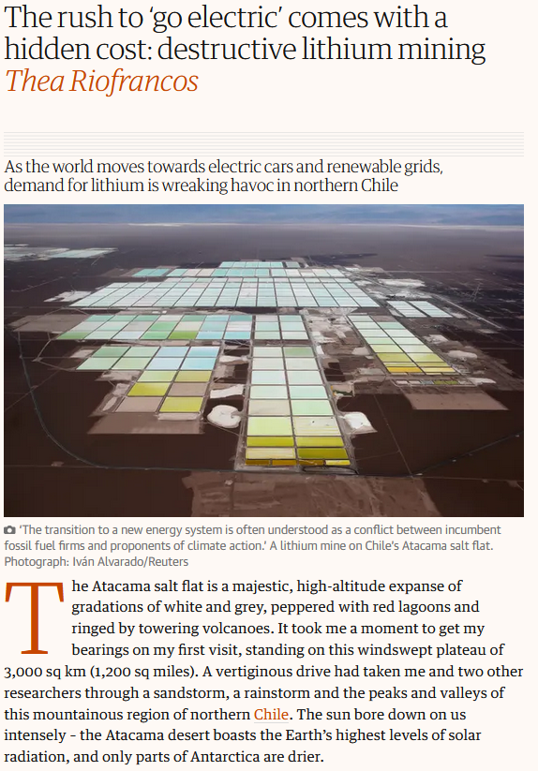

Slide 11
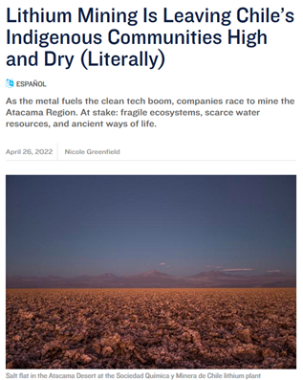

Slide 12
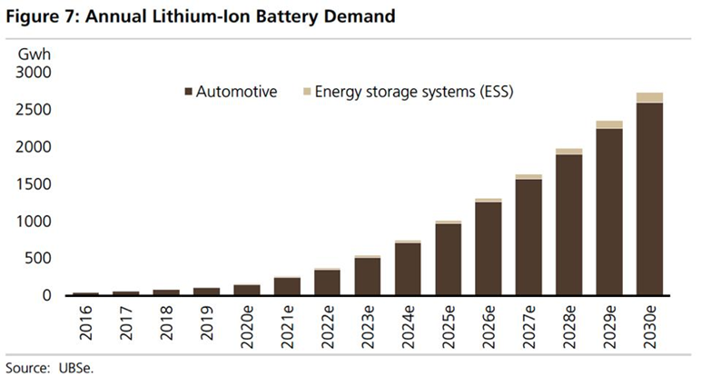
In the UK, companies will only be able to sell EVs after 2030
European Commission is targeting 30 million EVs on the road by 2030, currently at around 1.4

Slide 13
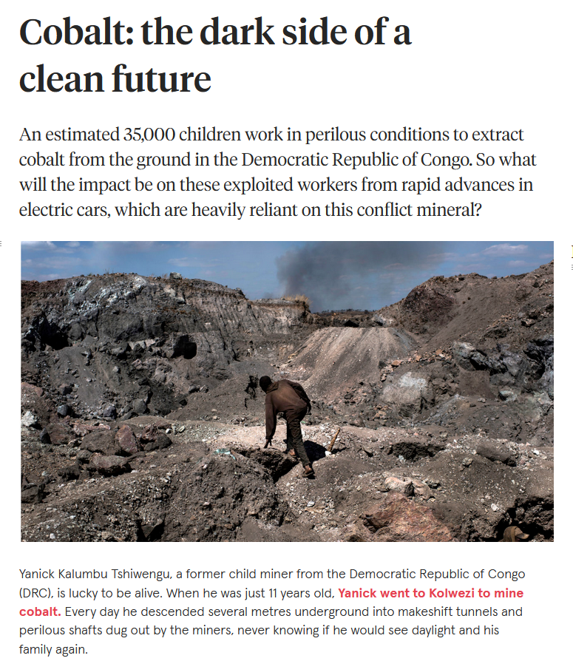
Are there spillover effects into other countries and industries?
https://www.youtube.com/watch?v=RFHvq-8np1o

Slide 14
Literature – Spillover effects?
Acemoglu, Daron, Simon Johnson, and James A. Robinson. 2001. “The Colonial Origins of Comparative Development: An Empirical Investigation.” American Economic Review 91: 1369–1401.
Unique study, exploring why the quality of institutions and levels of development are different today across previously colonized states. Essentially, we see that the type business activity (influenced by settler mortality rates)
Natural resource curse?
Effects of increased income / types of employment on things such as offspring’s education? Løken, K. V. (2010). Family income and children's education: Using the Norwegian oil boom as a natural experiment. Labour Economics, 17(1), 118-129.
Can you think of any more? Research into this and perhaps update the forum posts with your findings…
Notes:
Consider the type of work and spill over effects intergenerational effects on society
Norway oil, less incentives for children to stay in school, more incentive to leave school early and work in industry?
Low skilled vs high skilled labour force. Links with low skilled and worse health outcomes, less political involvement, ect…

Slide 15
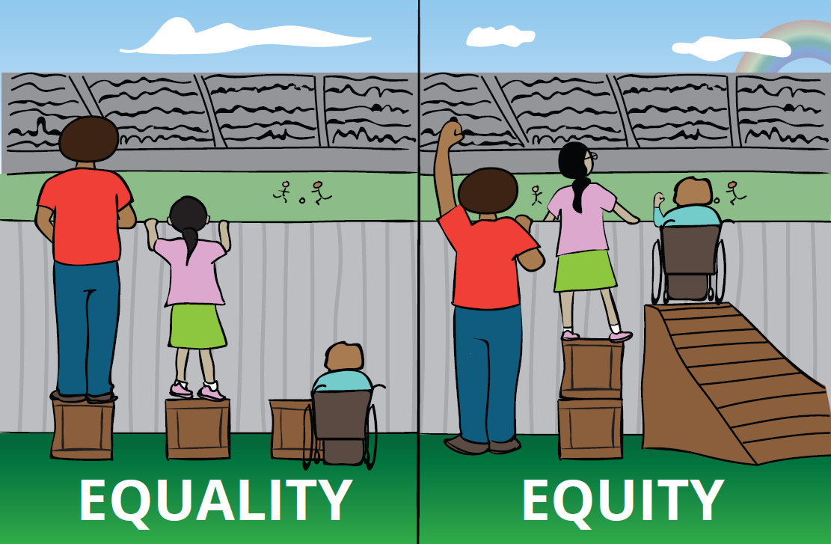
Presentation and discussion
Policymakers
Environmental Activists
MNE Executives
Local Employees

Slide 16
Presentation guidelines
Imagine that you are either policymakers/ environment activists/ MNE executives/ local employees.
What are your opinions regarding lithium mining in Chile? Do you support or oppose the lithium mining in Chile and why? your perspective on lithium mining in Chile? Do you support or oppose the li mining in Chile and why
Every group will have approximately 5 minutes to present, and then after, all the other groups can ask at least one question to the presenting group
Presentations can come in different formats (e.g., storytelling and poems) and the group can decide who presents, and how they present.

Slide 17
Introduction to Sustainability

Slide 18
SUSTAINABILITY?
Picture from: What is sustainability? (activesustainability.com)

Slide 19
The history of the word ‘sustainability’
Nachhaltigkeit (German, 1713): coined in forestry, meaning never harvesting more than what the forest yields in new growth
“Many dead, few living and countless others unborn”
(from a Nigerian tribal chief)
The report of the Club of Rome (1972): The Limits to Growth
The Brundtland Report by UN (1987): adopted the concept of sustainability
Kuhlman, Tom, and John Farrington. 2010. "What is Sustainability?" Sustainability 2, no. 11: 3436-3448. https://doi.org/10.3390/su2113436

Slide 20
The meaning of ‘sustainability’
The Brundtland report:
how can the aspirations of the world’s nations for a better life be reconciled with limited natural resources and the dangers of environmental degradation?
Sustainable development:
Development that meets the needs of the present without compromising the ability of future generations to meet their own needs.
World Commission on Environment and Development (WCED). Our Common Future; Oxford University Press: New York, NY, USA, 1987.

Slide 21
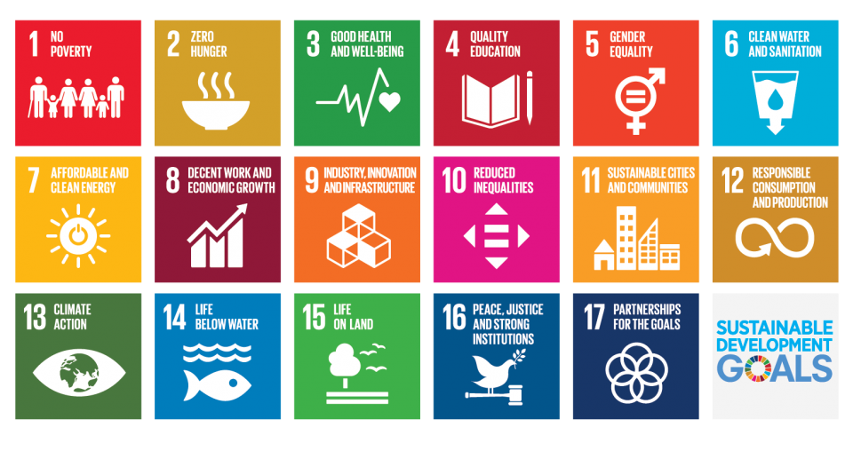

Slide 22
Sustainability today
Three dimensions:
Economic: profit/money (national level -GDP)
Social: equity (income distribution); inclusion (operationalized as employment); health (expressed by an indicator such as life expectancy or access to medical services)
Environmental: care about earth/planet
Transforming our world: the 2030 Agenda for Sustainable Development
“We resolve, between now and 2030, to end poverty and hunger everywhere; to combat inequalities within and among countries; to build peaceful, just and inclusive societies; to protect human rights and promote gender equality and the empowerment of women and girls; and to ensure the lasting protection of the planet and its natural resources. We resolve also to create conditions for sustainable, inclusive and sustained economic growth, shared prosperity and decent work for all, taking into account different levels of national development and capacities.”

Slide 23
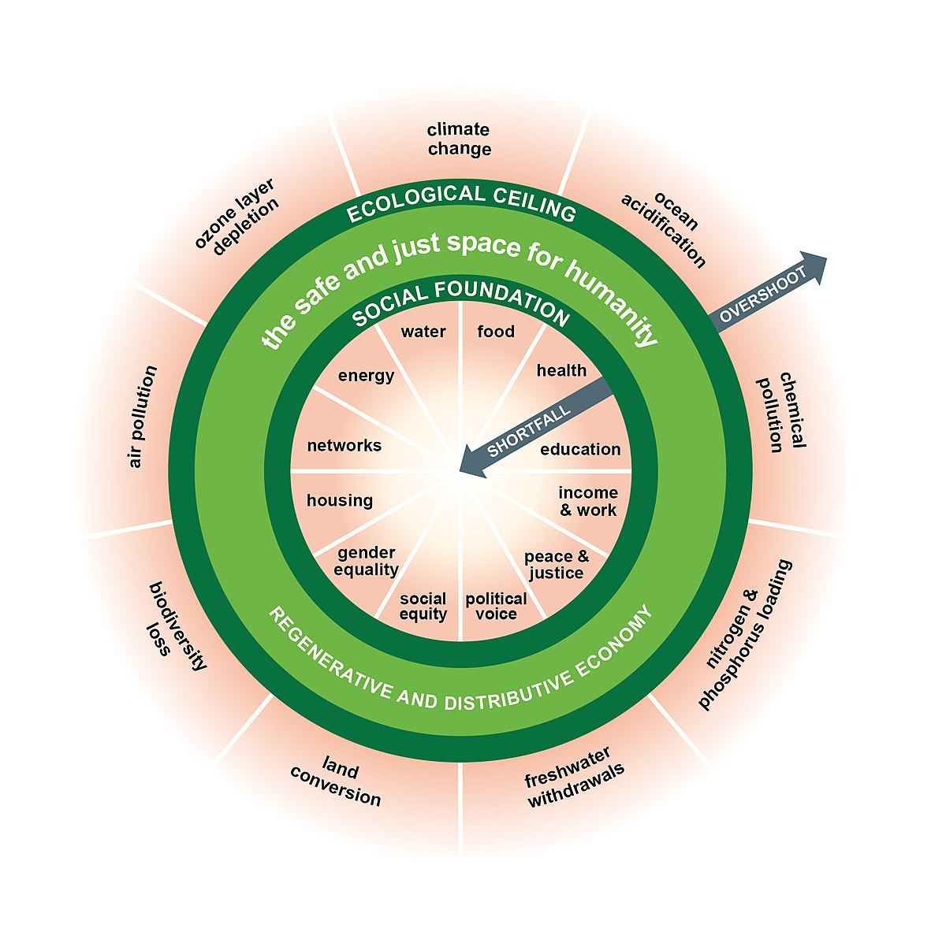
Circular Economy
Circular Economy, Sustainability, CSR,
Transparent Supply Chains and Operations
Ethical Sourcing and Disposal
J., Reike, D., & Hekkert, M. (2017). Conceptualizing the circular economy: An analysis of 114 definitions. Resources, conservation and recycling, 127, 221-232.
Geissdoerfer, M., Savaget, P., Bocken, N. M., & Hultink, E. J. (2017). The Circular Economy–A new sustainability paradigm?. Journal of cleaner production, 143, 757-768.
Kate Raworth: Doughnut Economics

Slide 24
Corporate Social Responsibility

Slide 25
Corporate Social Responsibility
A business’ responsibility to the society that exists around it (Havard Business School)
Traditionally, most large firms operated with one main goal in mind- profit.
Profit maximization was at the heart of key business decisions and initiatives.
In recent decades, more business leaders recognize their responsibility for stakeholders ranging further than just shareholders and executives.
Increasing prevalence is growing on firms’ social responsibility, considering the environment and society.
B
Notes:
CSR truly began to take hold in the U.S. in the 1970s, when the concept of the “social contract” between business and society was declared by the Committee for Economic Development in 1971
Why prevalent today? Younger generation, or the whole generation is more concerned about social costs. The increased popularity of CSR seems to be linked with other trends of attention like climate change, global warming, equality, ect…

Slide 26
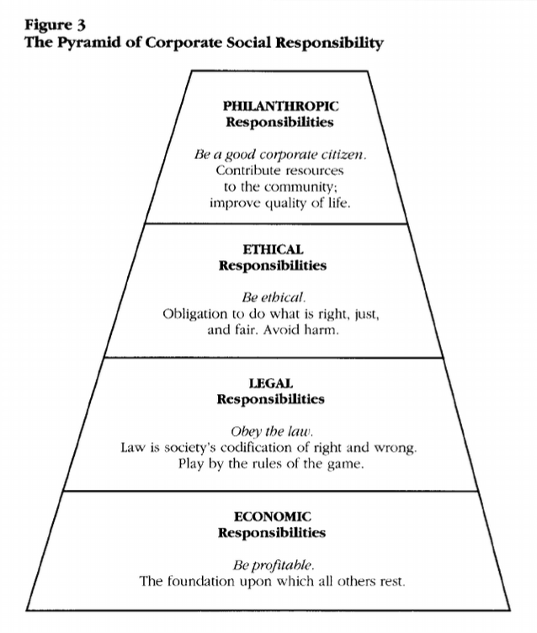
Carroll’s CSR Pyramid (1991)
?
Notes:
Environental Responsibility
Ecology concept,

Slide 27
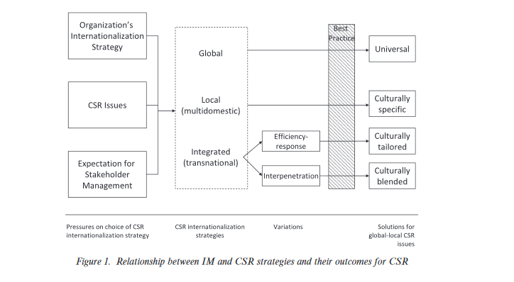
The Dilemmas of Internationalization: Corporate social responsibility in the multinational corporation (Bondy & Starkey, 2014)
Whether emphasizing local differences or global standards as the focus for CSR policy, the literature in this area shares stakeholder inclusion in decision making as a key aspect of organizational responsibility (Freeman, 1984; Fritzsche, 2000; Goodpaster, 1991).
For business operating across national borders, it is not enough to include stakeholders from the home country. Instead, there needs to be representation from a wide range of groups across a broad range of countries relevant to the business (Blowfield and Murray, 2008; Crane and Matten, 2007; Wheeler, Fabig and Boele, 2002).
Integrated internationalization strategies (efficiency responsiveness & interpenetration)
It is through broad representation of operational areas that issues are identified and managed in accordance with a commitment to responsibility.
Notes:
efficiency responsiveness, suggests that organizational efficiencies can be generated and opportunities exploited through standardization. These efficiencies can then be tailored to the tastes and regulations of local markets, responding to the needs of the market and creating opportunities for expansion within it. In other words, companies both standardize where possible across all operating units and adapt these standards where needed to ensure responsiveness to local needs.

Slide 28
Firms taking more responsibility, but how much should they take?
B Corporations (B Corps)
Social Purpose Corporations (SPCs)
Low-Profit Limited Liability Companies (L3Cs)
Notes:
B Corps, are companies verified by B Lab to meet high standards of social and environmental performance, transparency, and accountability.
A social purpose corporation (SPC) is a type of for-profit corporation in Washington State and some other US states.
What Is an L3C (Low-Profit Limited Liability Company): An Entity for Entrepreneurs Who Value Purpose and Profits.
CSR is good for business. But what is the incentive for the business to engage in ethical practices if say CSR does not affect profits? We can split this into 2, internal and external motivations for morality / ethical practices. Perhaps the best motivation for good CSR should come from morality and ethical sources, but in reality, businesses may be more strategic and aim for longer term profits.

Slide 29
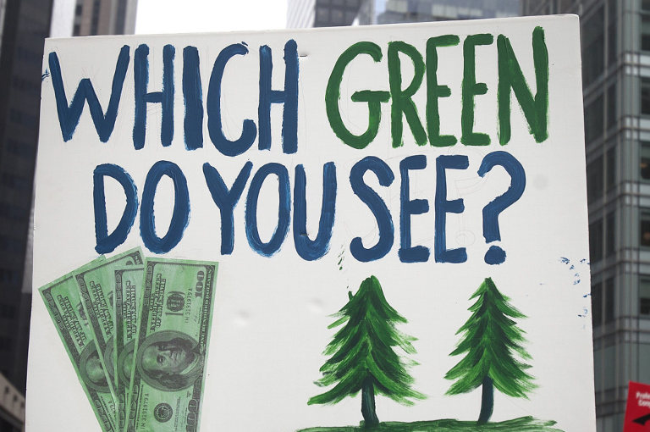
Critical Reflection
What do you think about the “green capitalism”?
Picture from: An Ecosocialist Reply to a Defender of ‘Green Capitalism’ - Resilience

Slide 30
“Insanity is doing the same thing over and over and expecting different results.”
- Albert Einstein
Link: (33) Slavoj Zizek: The Delusion of Green Capitalism - YouTube

Slide 31
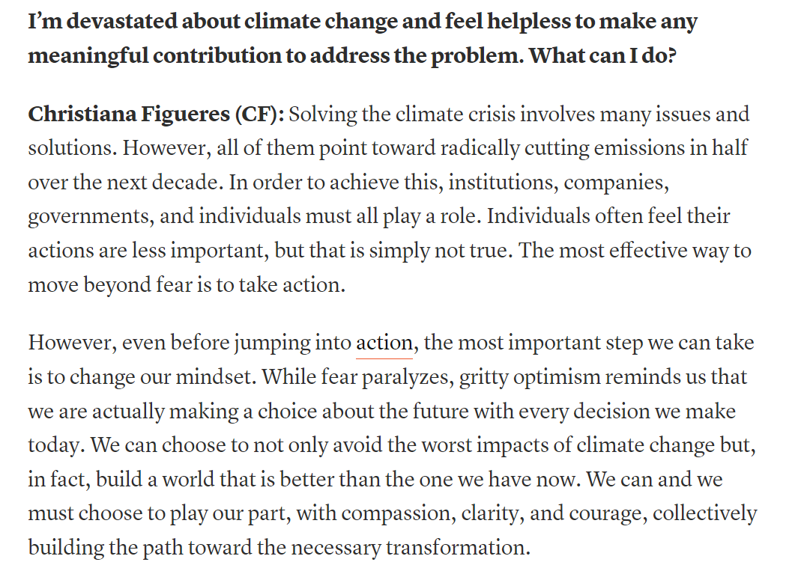

Slide 32
Conclude
How important is CSR for MNCs during international ventures? How should it be implemented?
Are businesses responsible for spill-over effects in the local host country and further?
How standardised should CSR practices be for MNCs across different countries?
At what point does strategic sustainable CSR turn into greenwashing, for example?
What is the real intention of sustainable CSR in capitalist world? (Competitive advantage vs genuine consideration)
It starts with the individual?

