Slide 1
Lecture 8: The firm and its customers
Juuso Välimäki
September 29, 2022

Slide 2
Outline
Introduction
Production: Key concepts
Pricing and Production Decisions: Profit maximization
Gains from Trade
Price Elasticity of Demand

Slide 3
Introduction

Slide 4
The Context for This Lecture
As we saw in Lecture 7, Interactions between firms and workers determine wages, which are part of a firm’s production costs.
Other key decisions for firms include choosing product prices and quantities to produce.
How do these decisions depend on demand and production costs?
How can policies affect the division of surplus between firms and customers?

Slide 5
This Lecture
Model of interactions between customers and profit-maximizing firms producing differentiated products
Factors that affect the firm’s choice of price and quantities produced (costs, price elasticity, market power)
Surplus: measuring the gains from trade

Slide 6
Production: Key concepts

Slide 7
Describing production: Economies of Scale
A firm’s costs depend on its scale of production and the type of production technology it has.
Large firms can be more profitable than small firms because of technological and/or cost advantages.
If inputs increase by a given proportion, and production… | Then the technology exhibits…
Increases more than proportionally | Increasing returns to scale in production Economies of scale
Increases proportionally | Constant returns to scale in production
Increases less than proportionally | Decreasing returns to scale in production Diseconomies of scale

Slide 8
Economies of Scale: Examples
Economies of scale includes:
Cost advantages – Large firms can purchase inputs on more favorable terms, because they have greater bargaining power when negotiating with suppliers.
Demand advantages - Network effects (value of output rises with number of users e.g. software application)
However, large firms can also suffer from diseconomies of scale, e.g. additional layers of bureaucracy due to too many employees.

Slide 9
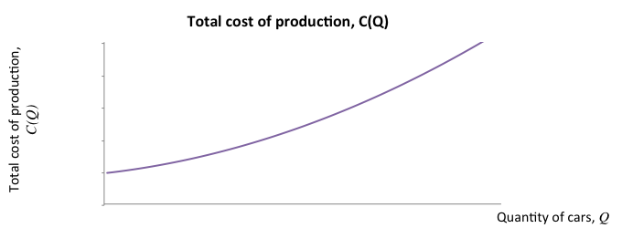
Cost functions
To make pricing and production decisions, managers need to know the costs of production.
Cost functions show how total production costs vary with quantity produced.

Slide 10
Cost functions: Origins
Cost functions compress all the engineering data available to the firm
This data comes from firm’s own experience
Experience of other firms in similar markets
To influence costs, firms engage in R&D and use research and knowledge created outside the firm
Cost functions are one of the most important components in understanding market prices
Unfortunately many empirical problems arise if an outsider tries to estimate C(Q). In particular:
Firm may know things the outsider does not when choosing -> endogeneity bias (discussed in Principles of Empirical Analysis)

Slide 11
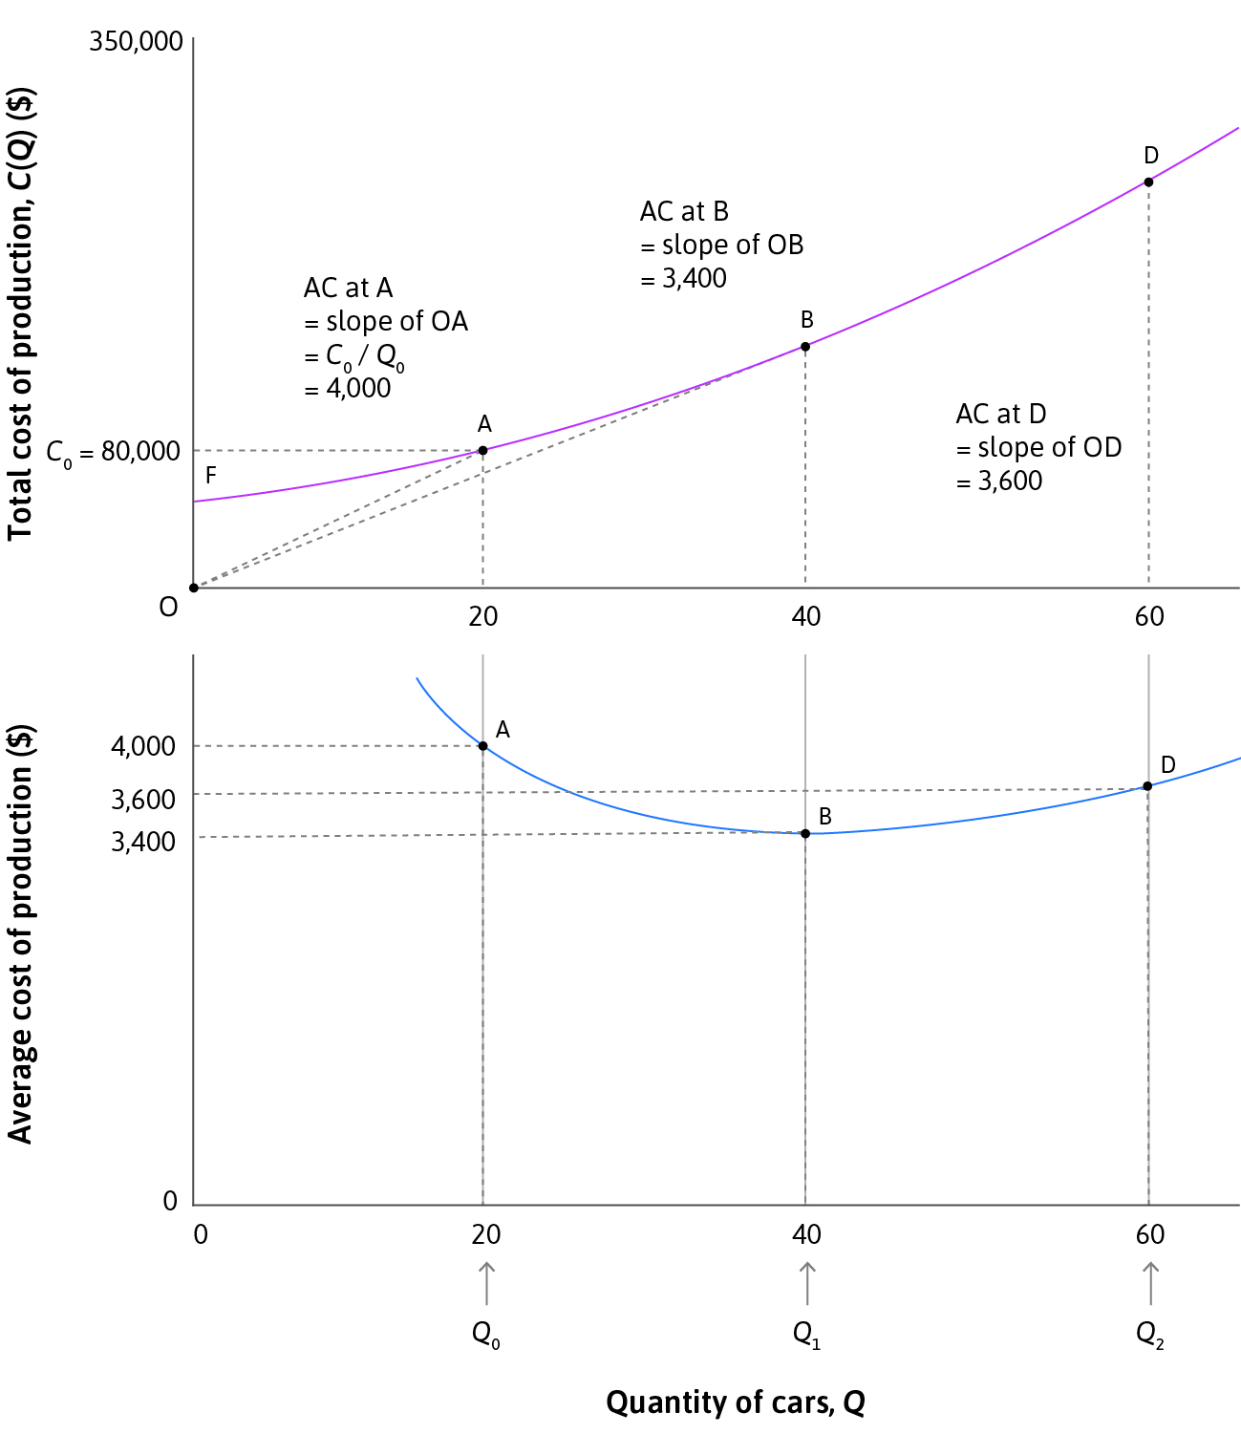
Average cost
Average cost (AC): Average cost per unit produced.
Calculated as the slope of the ray from the origin to a given point on the cost function.
In this example, average costs decrease at first (economies of scale) but then increase (e.g. overtime, machine breakdown).

Slide 12
Marginal cost
Marginal cost (MC): the effect on total cost of producing one additional unit of output.
Calculated as the slope of the cost function at a given point.
In this example, marginal costs increase with production.

Slide 13
Relationship between MC and AC
The following statements are always true:
If AC > MC: AC is decreasing. If AC < MC: AC is increasing.
The MC curve always intersects the AC curve at its lowest point.

Slide 14
Relationship between MC and AC
Since we started with the concept of a cost function, it is useful to make use of the mathematical tools for dealing with functions.
Average cost AC(Q) = $\frac{\text{C}\text{(}\text{Q}\text{)}}{\text{Q}}$.
Marginal cost at Q is the derivative of C(Q) measured at Q:
Marginal cost MC(Q) = C’(Q).
Average cost is increasing/decreasing if its derivative is positive/negative
AC’(Q) = $\frac{\text{QC}\text{’(}\text{Q}\text{)−}\text{C}\text{(}\text{Q}\text{) }}{{\text{Q}}^{2}}$ so that AC’(Q)=0 if MC(Q) = AC(Q).

Slide 15
Market demand side and profit maximization

Slide 16
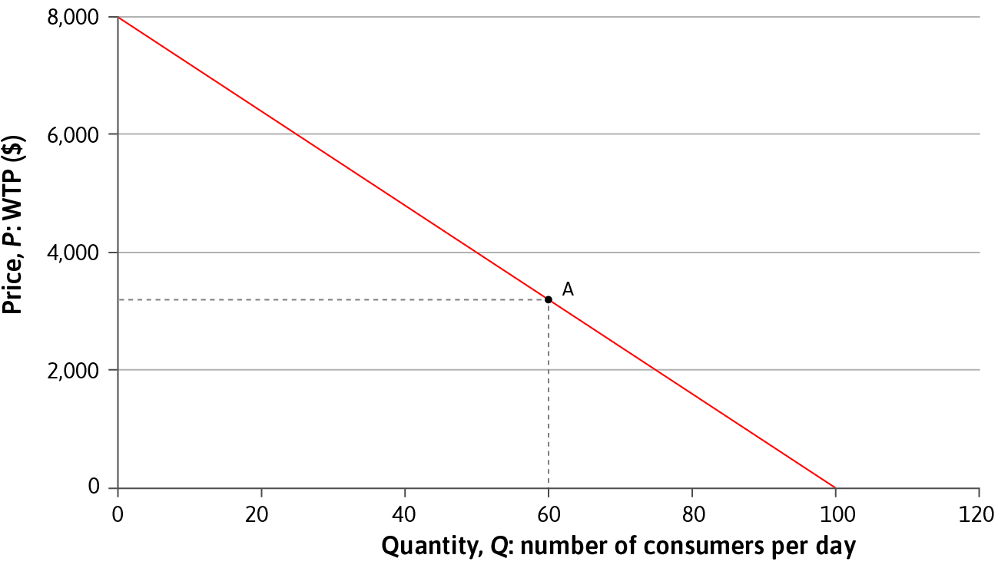
Demand curve
To make pricing and production decisions, managers also need to know the demand for the firm’s product.
Demand curve = quantity that consumers will buy at each price.
Reflection of the consumers’ willingness to pay for the product.

Slide 17
Demand curve: Origins
Individual demand curve: For a fixed product, consider the consumers’ problem of choosing along their budget line between the quantity q of the product and all other consumption y.
If total amount of income is w, then budget line is given by:
pq+y=w,
Where p is the price of the product
At optimum: MRS = p. The individual demand curve tells two things: i) how much the buyer chooses at price p, ii) at what price will the buyer choose q units of the product
Demand curve adds together all individual demands at p.

Slide 18
Demand curve: Simplest case
Individual demand curve: Each consumer decides whether to buy one unit of the good or not (no utility from additional units, e.g. subscription to Spotify etc.)
Suppose v is a number such that i) the buyer prefers to have the good and pay a price p to not having it whenever p<v and ii) the buyer prefers not having the good to having it and paying p if v < p.
Then we say that v is the willingness to pay (wtp) of the buyer for this good. We also say that the buyer values the good at v.
In this case, demand curve tells how many buyers have wtp > p and also the price P(Q) at which Q buyers have wtp above P(Q).

Slide 19
Demand curve: Some Remarks
In the simplest case, we see immediately that demand curves are downward sloping, i.e. there is more demand at lower prices or conversely the P(Q) at which Q buyers have wtp above P(Q) is decreasing in Q.
A firm can estimate its demand curve from data obtained by experimenting with different prices.
For new products, they can be estimated from questionnaires or from pilot studies.
Knowing one’s demand curve is probably the most important requirement for a successful firm.

Slide 20
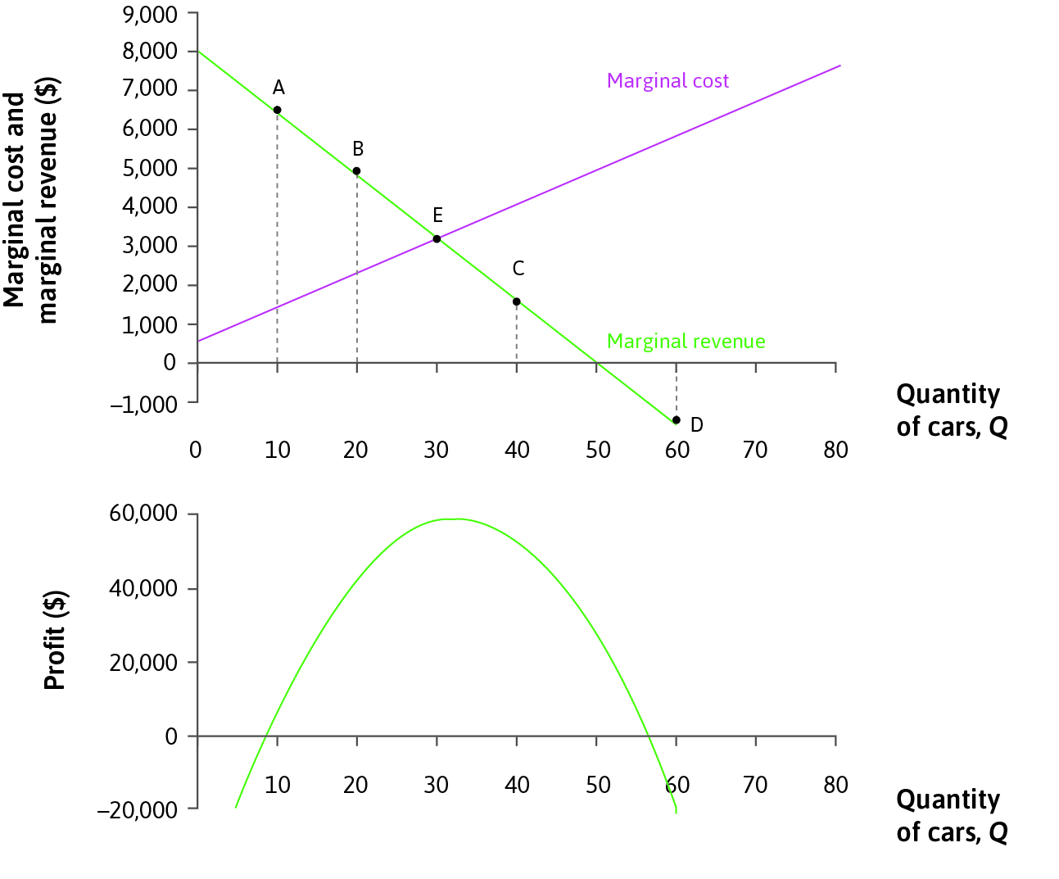
Profit Maximization
Profit-maximization can be described in terms of revenue and costs.
Marginal revenue (MR) = change in revenue from selling an additional unit (net effect of decreasing price and increasing quantity sold)
Firm maximizes profits by choosing
point where MR = MC

Slide 21
Profit Maximization: Calculus
We read from the demand curve the price P(Q) at which buyers are willing to buy Q units of the product
Revenue of the firm is R(Q) = QP(Q)
Cost of the firm is C(Q)
Hence the profit 𝚷(Q) of the firm at production level Q is
𝚷(Q) = QP(Q)-C(Q)
At optimum, the derivative of the profit must be zero (why)?
At optimal Q*,
MR(Q*) = Q*P’(Q*)+P(Q*) = C’(Q*) = MC(Q*).
Notice that since P’(Q*) < 0, MR(Q*) < P(Q*)
In fact, at optimally chosen Q*,
P’(Q*) = - (P(Q*) – C’(Q*))/Q*.

Slide 22
Gains from Trade

Slide 23
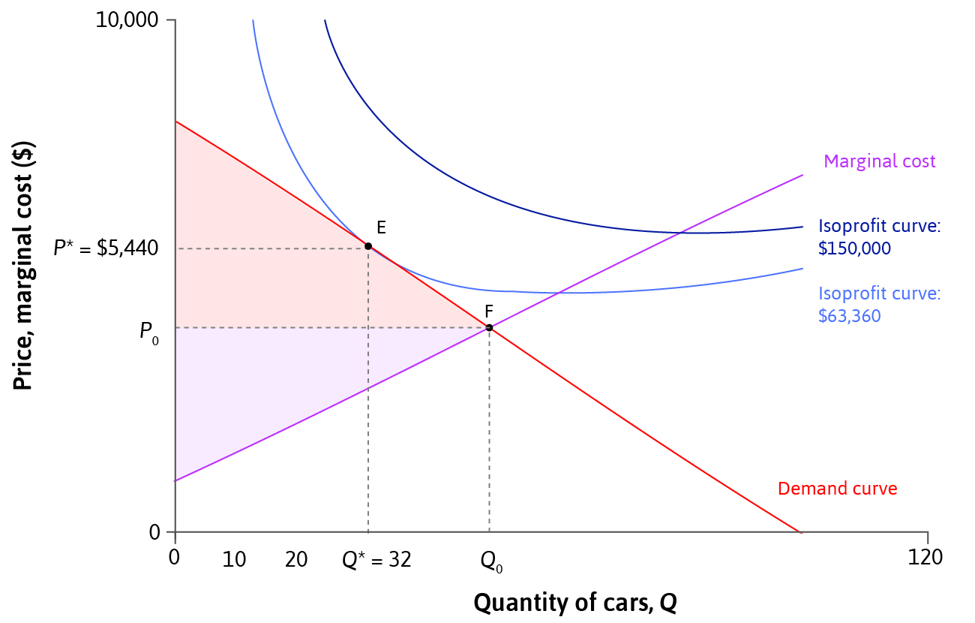
Measuring Surplus
Consumer surplus (CS) = the total difference between willingness-to-pay and purchase price
Producer surplus (PS) = the total difference between revenue and marginal cost
(Profit = PS – fixed costs)
Total surplus = Consumer surplus + Producer surplus
= Total gains from trade

Slide 24
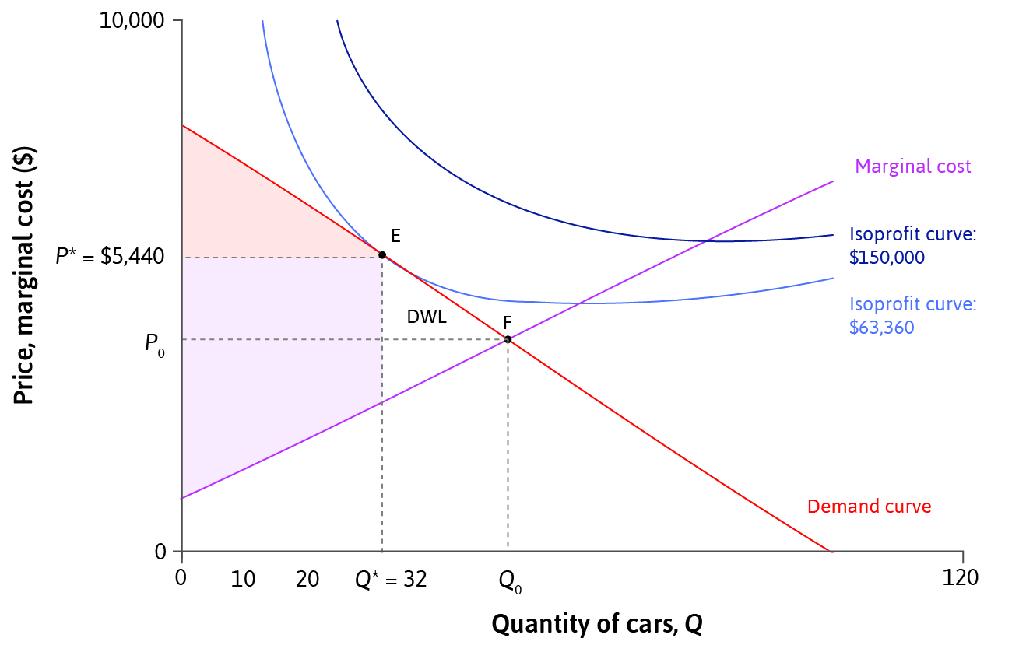
Deadweight Loss
Deadweight loss = a loss of total surplus relative to a Pareto efficient allocation (unexploited gains from trade)
Total surplus is highest when
Demand = Marginal Cost
(Pareto efficient allocation)

Slide 25
Understanding deadweight loss
When setting its price, a firm cares only about its own profit
Restricting the quantity to increase the price imposes a negative effect on the consumers
By allowing firms to set individual prices to individual consumers results in the firm capturing the entire surplus (if the firm knows the individual wtp)
In practice, the wtp is private information and the firm may try to find this out (privacy on the net)
Competition authorities care about the distribution of surplus between the firm and customers

Slide 26
Price Elasticity of Demand

Slide 27
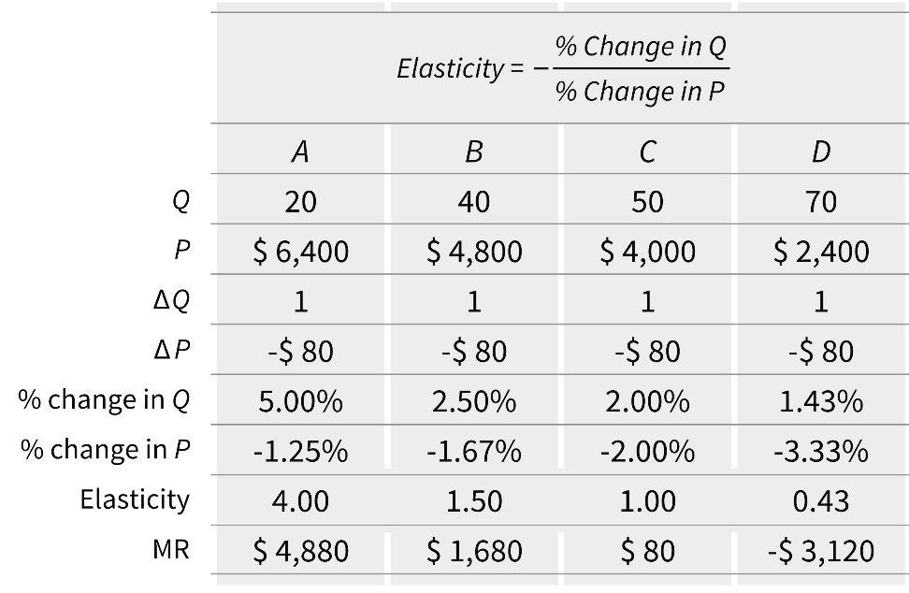
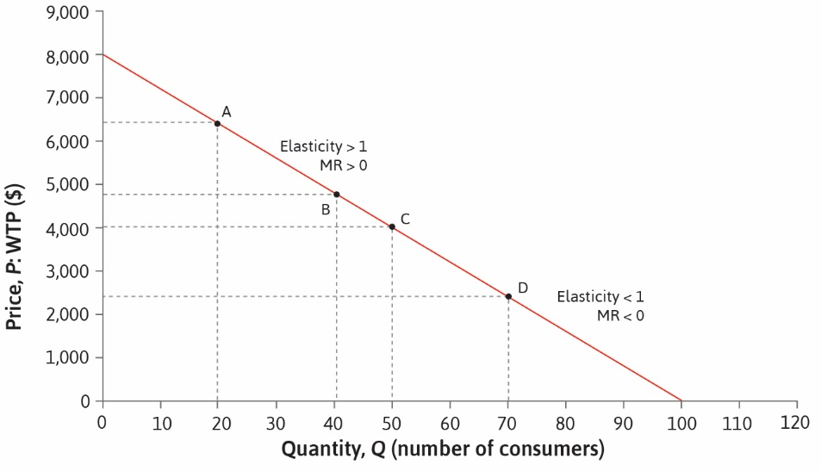
Price Elasticity of Demand
A firm’s pricing decision depends on the slope of the demand curve.
Price elasticity of demand = degree of responsiveness (of consumers) to price change.
We say that demand is elastic if 𝛆 > 1.

Slide 28
Price Elasticity of Demand
In the definition of the elasticity,
𝛆 = - $\frac{\frac{ΔQ}{Q}}{\frac{ΔP}{P}}=− \frac{\frac{P}{Q}}{\frac{ΔP}{ΔQ}}$ = - $\frac{P}{\frac{QΔP}{ΔQ}}$.
For small price changes, we can use P’(Q) to approximate $\frac{ΔP}{ΔQ}$ and we get:
𝛆 = - $\frac{\text{P}}{\text{QP}\text{’(}\text{Q}\text{)}}$.
Therefore MR(Q) ≥ 0 if and only if 𝛆 ≥ 1.
Price elasticity (and other elasticities) are some of the most important concepts in economics and will feature heavily in the coming lectures and courses.

Slide 29
Elasticity and profit maximization
Recall from profit maximization that at optimal Q*:
MR(Q*)=Q*P’(Q*)+P(Q*)= C’(Q*)=MC(Q*),
or:
P’(Q*) = - $\frac{\text{P}\text{(}\text{Q}\text{*}\text{)−}\text{C}\text{’(}\text{Q}\text{*)}}{\text{Q}\text{*}}$.
Divide both sides by P(Q*) and multiply by Q* to get:
$\frac{\text{Q}\text{*}\text{P}\text{’(}\text{Q}\text{*}\text{)}}{\text{P}\text{(}\text{Q}\text{*}\text{)}}$= - $\frac{\text{P}\text{(}\text{Q}\text{*)}\text{−}\text{C}\text{’(}\text{Q}\text{*)}}{\text{P}\text{(}\text{Q}\text{*}\text{)}},$
or:
$\frac{\text{P}\text{(}\text{Q}\text{*)}\text{−}\text{C}\text{’(}\text{Q}\text{*)}}{\text{P}\text{(}\text{Q}\text{*}\text{)}}$= $\frac{1}{\text{ε}}$.
We call $\frac{\text{P}\text{(}\text{Q}\text{*}\text{)−}\text{C}\text{’(}\text{Q}\text{*)}}{\text{P}\text{(}\text{Q}\text{*}\text{)}}$ the markup.
Markups are inversely related to the elasticity of demand
High elasticity leads to low markups (prices)

Slide 30
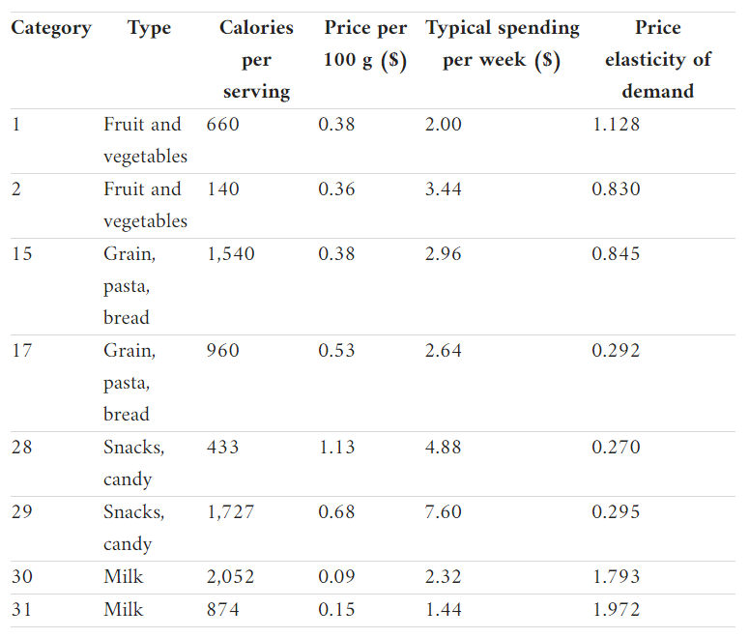
Price Elasticity and Policy
The effect of good-specific taxes depends on the elasticity of demand for those goods.
Governments raise more tax revenue by levying taxes on price-inelastic goods.
Several countries e.g. Denmark and France have introduced taxes on unhealthy foods – to reduce consumption not to raise revenue.

Slide 31
Price Elasticity and Market Power
A firm’s profit margin depends on the elasticity of demand, which is determined by competition:
Demand is relatively inelastic if there are few close substitutes
Firms with market power have enough bargaining power to set prices without losing customers to competitors
Competition policy (limits on market power) can be beneficial to consumers when firms collude to keep prices high.

Slide 32
Market Power: Monopolies
Example of market power: A firm selling specialized products.
They face little competition and hence have inelastic demand.
They can set price above marginal cost without losing customers, thus earning monopoly rents.
This is a form of market failure because there is deadweight loss.
A natural monopoly arises when one firm can produce at lower average costs than two or more firms e.g. utilities.
Instead of encouraging competition, policymakers may put price controls or make these firms publicly owned.

Slide 33
Gaining market power
Firms can increase their market power by:
Innovating – Technological innovation can allow firms to differentiate their products from competitors’ e.g. hybrid cars. Firms that invent a completely new product may prevent competition altogether through patents or copyright laws.
Advertising – Firms can attract consumers away from competing products and create brand loyalty. Advertising can be more effective than discounts in increasing demand for a brand.
Both of these tactics can shift the firm’s demand curve.

Slide 34
Summary
1. Model of a firm with market power (price-setter)
Price and production decisions depend on a firm’s demand curve and cost function.
Profit-maximising choice where MRS = MRT
Or, in terms of revenue and costs, where MR = MC
2. Surplus measures the gains from trade
Total surplus = Producer surplus + Consumer surplus
Deadweight loss when allocation not Pareto efficient
Price elasticity of demand affects surplus and profits

Slide 35
In the next two lectures
Model of supply and demand interactions under perfect competition (no market power)
Determinants of competitive equilibrium
Similarities and differences between price-taking and price-setting firms
Long-run and short-run equilibria

