Slide 1

Individual Internationalization
Linyu Liu
29th, September

Slide 2
Schedule
1
2
3
4
5
Introduction of Individual Internationalization
The Importance of Language
The Importance of Culture
Expatriation/
Repatriation
Guest lecture from Margit Suurnäkki

Slide 3
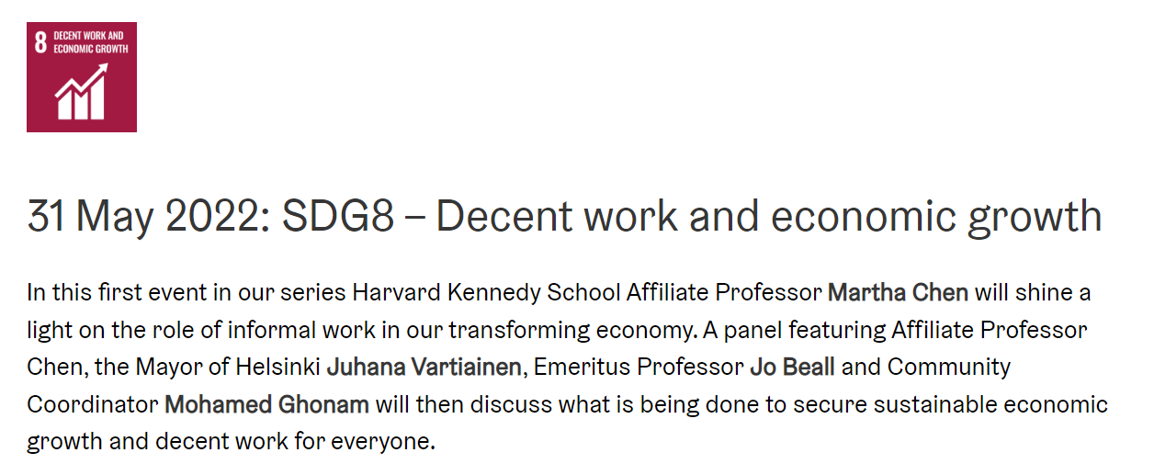
Forum Posts
Platform economies, rapid growth, sustainability, CSR, exploitation?
How competition influences internationalization, and market exit, strategies
Reborn globals
Fast development vs sustainability
Digitalisation and data dangers
Born globals reliance on pro globalisation related policies. How will this change moving into an era of ‘deglobalisation’ politics, Trump, Brexit, recent Brothers of Italy, Right wing win in Swedish elections..
Significance of timing in International ventures.
The biggest market is not always the best, use this consideration for the LeanLab casework
5 IT MegaTrends
Platform economies and political lobbying, Uber vs Wolt
Aku
Sustainable Cities Discussion Forum - Helsinki-kanava (helsinkikanava.fi)

Slide 4
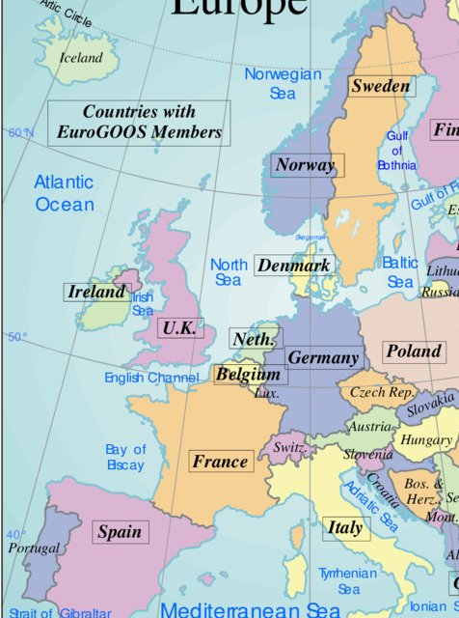
Personal Reflection

Slide 5
REFLECTION on being a global citizen:
“I would say that growing up in many different countries gives you a head start for travelling and for developing the mindset of a global citizen. It’s a mindset, where you feel at ease practically anywhere and are able to create yourself a ‘home’, by quickly building habits in a new place. For instance, I stayed one week in Yangon, Myanmar and went daily to the same stall to get a fresh coconut. Even though this seems trivial, it helped me to form a connection to a new place and a sense of rootedness. In this way, you don’t feel like a tourist anywhere. At the same time, the mindset of a global citizen can also give a false sense of security and confidence. When you are not scared to go to a new place and are quickly able to get a feel for the norms in a new place, you start to feel that you could be one of them and are entitled to the same behavior, when in fact you are not. This can lead you to ask too intimate or inappropriate questions, like where somebody is from or what a cultural habit means. You think nothing of it, as for you, foreign cultures give a sense of empowerment and freedom, whereas for others they might carry a sense of insecurity. You might start to look at cultures through a collector’s eyes and start to mix and match the best parts of the cultures that you like or have lived in. This can be very problematic for dealing with ‘real’ locals, even though for you it might feel like the most natural thing to do.”

Slide 6
Discussion
What does internationalization mean for you?
Understanding cultures, changing personal mindsets, experiencing international encounters, exchanging experiences and beliefs.
Through which ways do we internationalize, from your point of view?
Exchange, travel, language, news, consumptions. Essentially, we can seek, or receive, but we need to be open to experience this.
What may stop someone from internationalizing?
Social, political, geographic and economic reasons. Many intercorrelations exist here.

Slide 7
Schedule
1
2
3
4
5
Introduction of Individual Internationalization
The Importance of Language
The Importance of Culture
Expatriation/
Repatriation
Guest lecture from Margit Suurnäkki

Slide 8
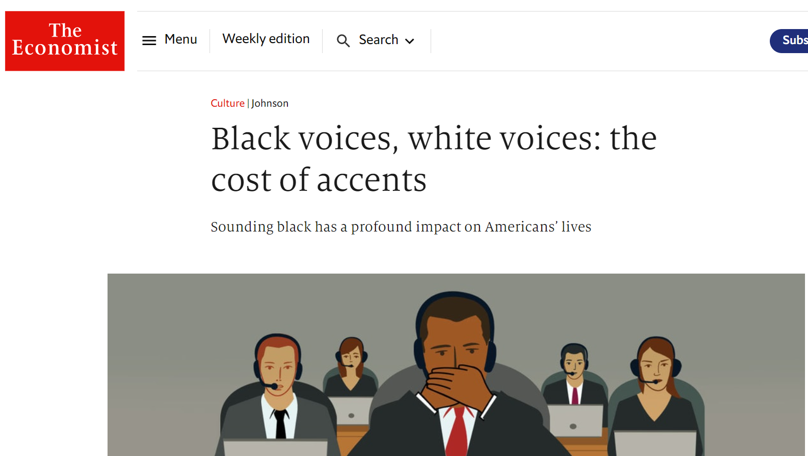
Language
The language for globalization – English
  Anglosaxon cultural dominance
Hierarchy of languages, language capital
  “Shadow structures” may be formed, where English language skills determine positions of power rather than the official hierarchies (Marschan-Piekkari et al., 1999)
  People with a black accent judged to be more
  difficult and poor; White accent considered most pleasant, educated, attractive, confident, trustworthy and rich (The Economist, August 4 (2018)
Fundamental role of language competence
  Language skills decisive for influence, participation, career progression and access to labor market
Marschan-Piekkari, R., Welch, D. & Welch L. (1999) In the shadow: the impact of language on structure, power and communication in the multinational. International Business Review 8(4), 421–440.

Slide 9
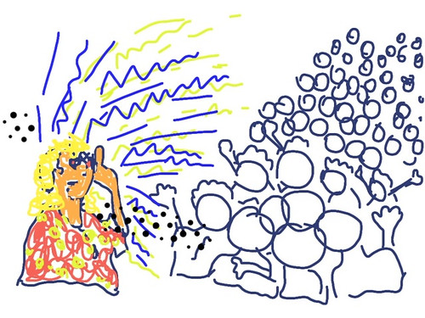
Discussion:
How do we foster a psychologically safe language climate in the classroom?
Psychological safety
Feelings of belonging to the group
Safe to express opinions
Safe to make mistakes
Safe to be yourself

Slide 10
Nurmi and Koroma (2020) - psychologically safe language climate in MNCs
Language challenges hindered global collaboration in both case companies, KONE and NOKIA
Yet, non-natives did not feel stress about the language due to the collectively developed psychologically safe language climate
Three language coping mechanisms for psychologically safe language climate
Inclusiveness
non-native English speakers made explicit attempts to involve other project members” – expertise-based appreciation
Empathy
empathizing with co-workers’ challenges related to working in a foreign language
Acceptance
acceptance of non-native speakers’ varying proficiency levels and language mistakes

Slide 11
Schedule
1
2
3
4
5
Introduction of Individual Internationalization
The Importance of Language
The Importance of Culture
Expatriation/
Repatriation
Guest lecture from Margit Suurnäkki

Slide 12
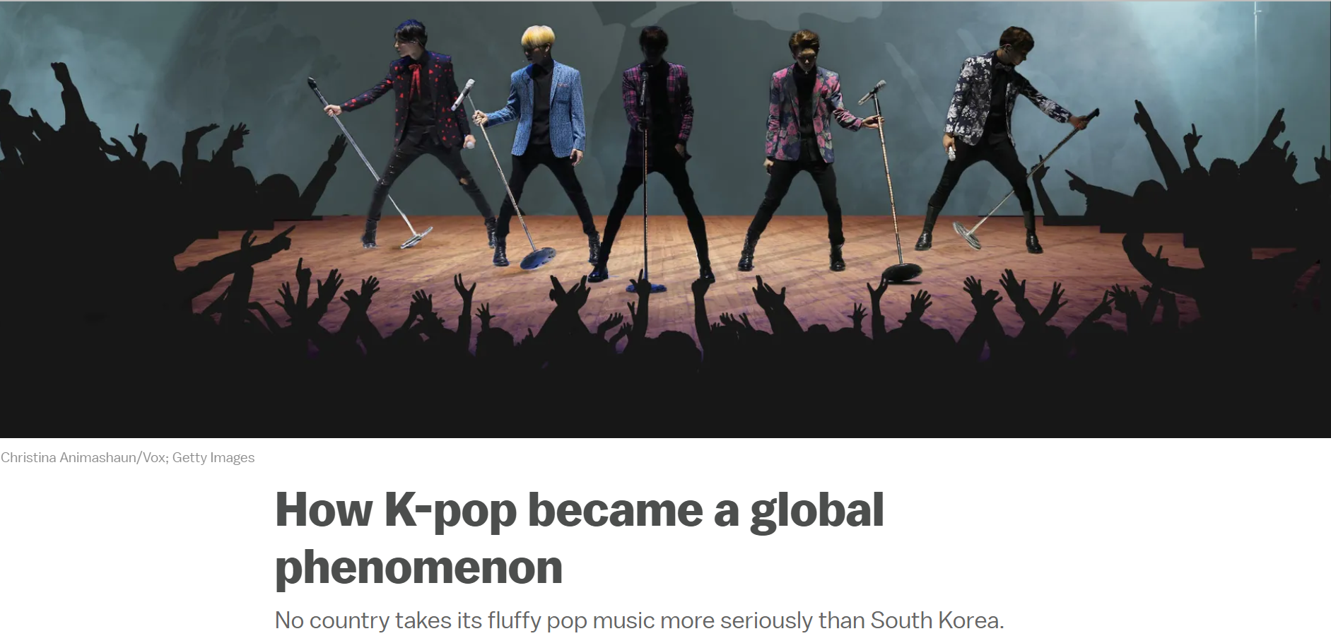
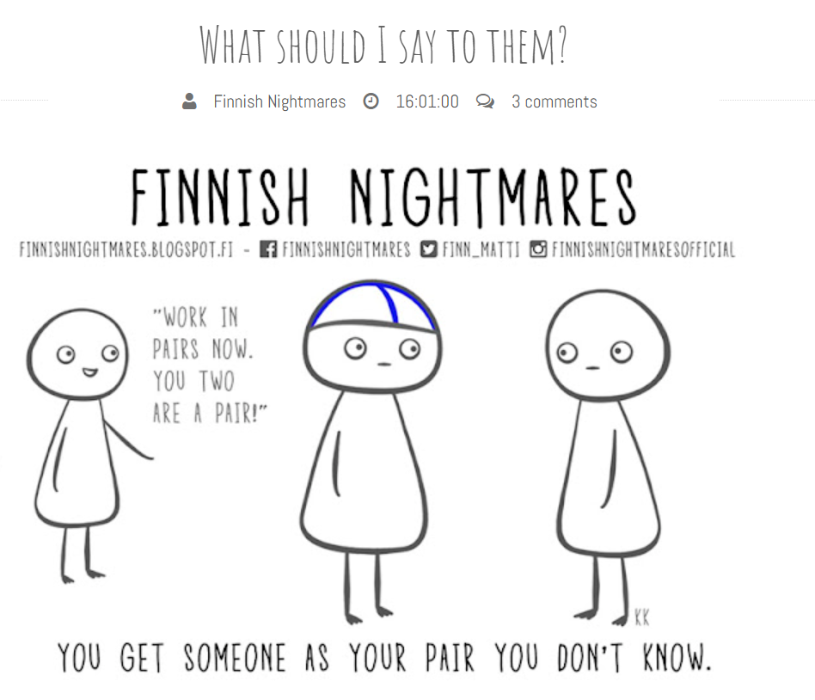

Photo from: Finnish Nightmares

Slide 13

What is CULTURE?
Please write your answers in a paper.
Photo from: Cultural appropriation and cultural appreciation – Where are we leading? - The Asian Mirror
Notes:
Something don’t work because of the culture

Slide 14
What is CULTURE?
Often used for differences in:
  Etiquette (e.g., greetings)
  Customs (e.g., routines for sleeping, bathing)
  Ways of thinking (e.g., cognitive schema)
  Ways of doing (e.g., values structures)
Photo from: Cultural appropriation and cultural appreciation – Where are we leading? - The Asian Mirror

Slide 15
Is not universal
(human nature)
Culture is shared norms,
values and behaviors
distinguishes one group from another (not only
national, also organizational, professional, etc.)
shared by all or almost all members
learned (passed on) through socialization
relatively stable
shapes the behavior of the members of that culture
and structures their perception of the world
Is not specific to individuals (personality)
CREATES IDENTITY
DRAWS A BOUNDARY

Slide 16
Interacting Spheres of Culture
History and traditions,
Religion,
Artifacts and
overt behavior,
Language,
Societal values
and practices,
Basic assumptions
Professional identity,
Ethos,
Community,
Socialisation,
Peer pressure
National
Professional
Functional mindset
and approach,
Task variety,
Task environment,
Time horizon
Functional
Organizational
Founder, heritage,
Purpose and mission,
Shared values,
Organizational practices,
Rituals and routines,
Material symbols,
Myths, sagas and heroes stories
Industry trends,
Responses to competitive pressures,
Product, Market,
Resources,
Technology
Industry
Adapted from: Schneider, Barsoux & Stahl (2014). Managing across cultures (3rd ed.). Prentice Hall Financial Times.
Notes:
Edgar Schein, in his “three levels of culture” model (also known as “iceberg model”), disting­uishes between 1) the visible manifestations of culture (“artifacts”) and overt behavior; 2) espoused values (values, norms, and beliefs that people talk about and acknowledge); and 3) and the fundamental premises that people hold about the world (“basic assump­tions”). This model can be applied to national culture, organi­za­tional culture, and other spheres of culture. Source: Schein (2004). Organizational culture and leadership (3rd ed.). London: Jossey-Bass.

Slide 17
Levels of Organizational Culture
Artifacts
Manifest culture and visible behavior
Language and communication, architecture,
surveillance systems, leadership style,
HRM policies and practices, etc.
Espoused Values
Values, beliefs, and norms
that people talk about
and acknowledge
Importance of hard work and discipline,
empowerment, diversity, equality, responsibility, fairness, etc.
Basic Assumptions
Fundamental premises that people hold about the world and that are usually not articulated and
rarely questioned in everyday life
Beliefs about human nature,
social relationships,
time, space, etc.
Source: Schein (2004). Organizational culture and leadership (3rd ed.). London: Jossey-Bass.
Notes:
Check the linkn

Slide 18
National cultural differences
Basic questions existing everywhere,
but answered differently in different societies (groups):
Relation to Authority: Equality versus Hierarchy
Conception of Self: Individuals versus Groups
Conception of Societal Order: Rules versus Relationships
What Determines Status: Achievements (what you have done) vs. Ascribed Status (who you are)
What’s Important: Past, Present, or Future?
How do people communicate: Provide direct (negative) feedback vs. indirect (negative) feedback
….

Slide 19
Hofstede’s study of cultural differences
Power Distance:
the extent to which the less powerful members of institutions and organizations within a country expect and accept that power is distributed unequally
2. Uncertainty Avoidance:
the extent to which the members of a culture feel threatened by ambiguous or unknown situations and have created beliefs and institutions that try to avoid these
3. Individualism:
the extent to which people feel responsible only for themselves (and very close ones)
4. Masculinity:
the extent to which assertiveness, work, and career (success) is important in life
Long term vs. Short term orientation
the extent to which the society has to maintain some links with its own past while dealing with the challenges of the present and future
Notes:
Power distance: children, students, employees
Individualism: identification with self and own opinions rather than relationships
Collectivism: value standards different for in-groups and out-groups (particularism vs. universalism)
Maculinity: G & P use the term ‘goal orientation’
Some of these deal with basic questions that have to be answered in all societies

Slide 20
View from the Bund in Shanghai (1990, 1994, 2018)

Slide 21
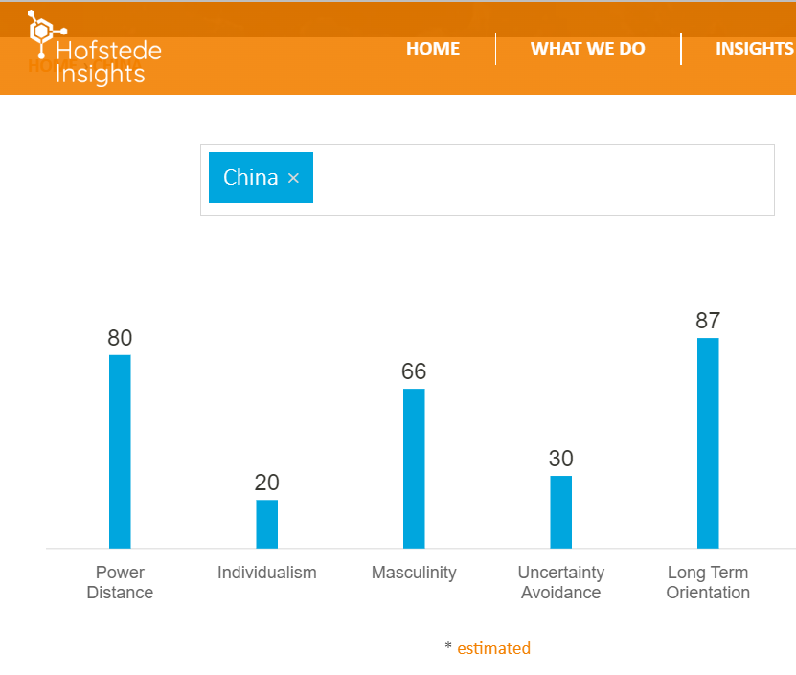
Questions:
Based on your knowledge about China/ your interactions with Chinese, how accurately do they describe the culture of China?

Slide 22
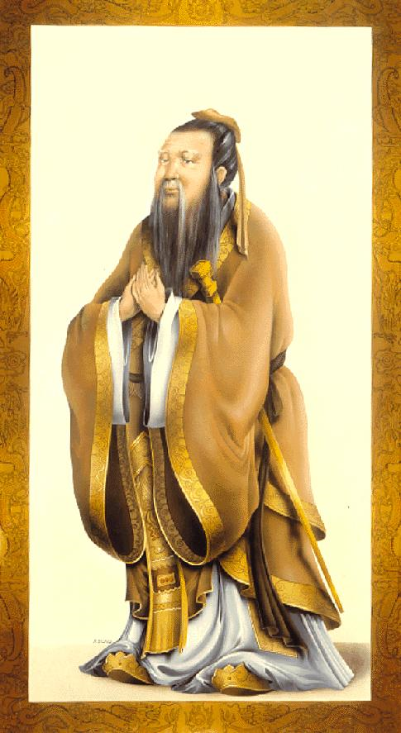
Confucianism: Social Harmony
Confucius (551-479 B.C.?): How to achieve social harmony?
==> The Five (cardinal) Relationships:
Prince-Minister, Father-Son, Husband-Wife, Older- Younger Brother, Friend-Friend
  = Hierarchy, superiors & subordinates guided by rules of behavior:
  Subordinates: Respect & Obedience => lack of initiatives, feedback
  Superiors: Protection & Consideration
“One mountain cannot hold two tigers” 一山不容二虎
Rothacher, A. Clashes and dialogues of civilizations revisited— the case of contemporary East Asia and Europe. AEJ 6, 129–143 (2008). https://doi.org/10.1007/s10308-007-0144-0
Yao, S. (2013). Confucian capitalism: Discourse, practice and the myth of Chinese enterprise. Routledge.
Notes:
To understand today we have to go back into history!
CONFUCIANISM
Practical, not theoretical or spiritual. ‘The Four Books’, no deity. Became mixed with Taoism and Buddhism ==> neo-Confucianism
THE FIVE CARDINAL RELATIONSHIPS:
- “wu lun”, obs. 4 hierarchical! Different words for older-younger sister (jie jie - mei mei) brother (ge ge - di di), cousins, etc.
=> Who’s the boss is very important. Staff positions not taken very seriously!
Legalist tradition: father can punish family members
Groups: should appoint somebody as responsible. Otherwise nothing will happen!
Delegations: must be a boss. Confusing if several voices, they don’t know whom to turn to!
EDUCATION:
The communists have strongly believed in the power of education and indoctirination. Have frequently used model workers and model villages(Dazhai) to spread the kind of values that they want people to adhere to. For example, Lei Feng was a soldier back in the early 60s who did all kinds of miraculous things, and fortunately there was always a photographer present when he helped farmer, etc. He finally died trying to help somebody from drowning. This is still very common, e.g. when reading the Chinese press.
CHINESE ORGANIZATIONS:
- power is centralized, very much so in overseas Chinese family-owned companies
- the combination of harmony together with Communist ideology & hierarchy: an effort in groups not to offend somebody, but in reality the top leaders have power.
THE POSITION OF FEMALES IN CHINA
- Mao, 1949: “Women carry half of the sky” ==> should participate in developing the counry
- more female managers than in the West, equal pay law
- however, survey in 1993 showed that 70% of the women would like to stay at home
- Confucius: “it is a virtue if a woman has no ability”, should be soft, flexible, kind, quiet, introvert & take care of the home ===>societal perception that men are more able, and therefore resistance esp. in rural areas; socialization: females more shy and unassertive
- problem: often excluded fromthe large male army & CCP networks, not seldom fired when pregnat; advantages: day care centers, grandmothers to take care of children
- not socially accepted to stay single; 30 years old: family & friends start to arrange marriage
TAOISM
harmonization with order of nature, more passive than confucianism, don’t interfere in the course of events
NATURALISM
Yin and Yang

Slide 23
An Example of Chinese not being collectivistic
From the website:
“At a score of 20 China is a highly collectivist culture where people act in the interests of the group and not necessarily of themselves.”
My research project on the justice perceptions of Chinese digital talent regarding the rewards allocation:
=> Our case MNC’s ‘pay for performance’ practice did not meet Chinese digital talent’s expectations because the case company emphasized team- and corporate-level performance in the bonus target setting, leaving a small share for individual targets.
Why? Aren’t Chinese collectivistic?
Liu,L. & Suurnäkki, M. (forthcoming). Chinese digital talents and monetary rewards: A case study of justice perceptions in a Nordic multinational.
Notes:
Something don’t work because of the culture
Can we describe Finnish? What are their personalities? You are so lucky because you can see the Northern light

Slide 24

A possible explanation of Chinese preferring ‘pay for individual performance’
Most Chinese believe that “inequality in a necessary stimulus for economic development, as unequal rewards motivate individuals to work hard” (Xie et al., 2012: 1071).
Digitalization in China nowadays
Average ages in China’s Internet Giants: 27 – 33 years old (Sohu, 2021)
Fierce competition for digital talents in China (Prophet, 2019)
Only 20% of Chinese digital talents can speak English
Economic reforms in China:
China changed from a centrally planned to a market based institutional environment
Chinese gradually replaced their egalitarianism ideology with a philosophy that accepted unequal rewards (Whyte,2010)
Chinese state-owned enterprises had adopted an egalitarian approach to rewards: everyone got a fixed compensation package regardless of their performance or capabilities.
1978
1980
1984
1992
2015
One Child Policy
29.9.2022
Xie et al. (2012). Societal projection: Beliefs concerning the relationship between development and inequality in China. Social Science Research, 41 (5), 1069- 1084
Whyte, M. (2010). Myth of the social volcano: Perceptions of inequality and distributive injustice in contemporary China. Stanford university press.
Sohu. (2021). 中国互联网公司员工平均年龄出炉: 拼多多，字节跳动最年轻仅27岁. https://www.sohu.com/a/493645707_639898
Prophet. (2019). 数字化转型下半场:企业如何在数字化时代更胜一筹. https://prophet.cn/2019/06/state-of-digital-transformation-china/
24

Slide 25
What may go wrong with Hofstede’s cultural dimensions?

Slide 26
What may go wrong with Hofstede’s cultural dimensions?
through surveys:
  Can answers of a group of people represent the entire national population?
  Is what people do align with what people say?
Nations as an analytical unit
  Do nations have a culture?
  Is there a national culture?
  What about national borders?
  Does a culture end at a national border?
Dangerous to generalize within a society
May contribute to the strengthening of stereotypes

Slide 27

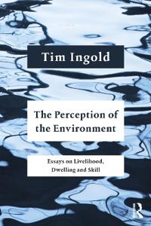
An alternative way to conceptualize CULTURE
- Tim Ingold (Social Anthropologist)
It is problematic if we say that “cultural differences are due to culture”
“Culture is the name of a question but it’s not the answer”
  “How do people come to know what they do? Is it through apprenticeship, training in practice, or is it through some kind of inculcation or indoctrination? What different forms of learning are there?”

Slide 28
Multiculturalism within individuals (Vora et al., 2019)
Multiculturalism defined by
  context (history, geography, cultural heritage, interpersonal relations, and national policies)
  the acculturation process (cultural changes in an individual arising from sustained, first-hand intercultural contacts
  skills and abilities (such as bilingual skills)
  cognition (internalized cultural schemas)
  integration (the degree to which multicultural individuals mentally integrate or separate their cultural identities)
Their definition: Multiculturalism within individuals is defined as the degree to which they know, identify with, and internalize more than one culture
How much knowledge do you have about each of your cultures?
How much do you identify with more than one culture?
How much have you internalized more than one culture?

Slide 29
Multiculturalism can spark positive and effective organizational change through the development of social capital and positive relationships at work. (Stevens et al. 2008)
When employees perceive equal access to opportunities and fair treatment, staff turn-over decreases. (Martin 2014)
Diversity can reduce intra-group cohesiveness, it can lead to conflicts and misunderstandings which, in turn, can lower employee satisfaction, citizenship behaviors and increase turnover. On the other hand, there is also beneficial effects of diversity because it can improve creativity and innovation through the team members' greater variety of perspectives. (Roberge and van Dick 2010)
So the role of an international individual in an MNC can be both beneficial but also conflicting.
Discussion:
What would ensure the more beneficial effects of diversity in an international team?
If culture appreciation is necessary

Slide 30
Schedule
1
2
3
4
5
Introduction of Individual Internationalization
The Importance of Language
The Importance of Culture
Expatriation/
Repatriation
Guest lecture from Margit Suurnäkki

Slide 31
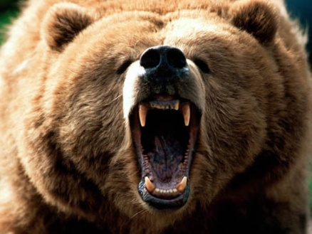
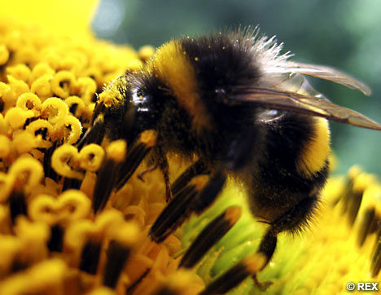
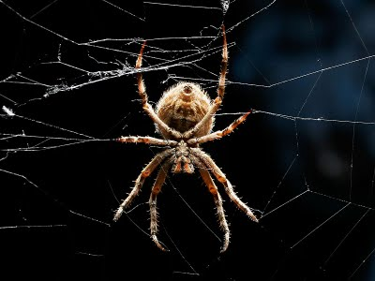
The Roles of Expatriates
Source: Adapted from Harzing (2001)
The Bear
Reinforces the centralization of decision-making in the multinational corporation and provides a direct means of controlling subsidiary operations (through personal control).
The Bumble Bee
Fly from “plant to plant” and facilitate cross-pollination of ideas & practices between various units => transfer of knowledge & practices across units, innovations when ideas are combined.
The Spider
Socialization of host employees into the culture (values, norms, beliefs) of the corporation and the development of informal social networks (capital) throughout the multinational corporation.
+ Development purpose of expatriation: the individual, host employees (coaching)

Slide 32
Managing the Expatriation Process
Purpose of expatriate assignment
Preparation and orientation
Adjusting to the expatriate role
Managing the performance of expatriates
Repatriation
Compensation and rewards
Selecting expatriates
The Expatriate
Cycle
Expatriation is a process, not an event !

Slide 33
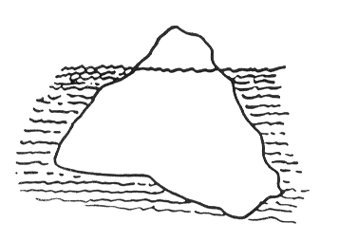
Adjusting to the Expatriate Role
Satisfaction & work performance
0 3 6 9 12 15 18
Months
Stages in the Adjustment Process:
Honeymoon
Culture shock: depression, anger, frustration – but it is the first step towards learning
Adjustment
“Mastery”
Notes:
33

Slide 34

Characteristics of Successful Expatriates
Professional/technical competence (vis-à-vis role)
Good personal network in the multinational
Interpersonal relationship & communication skills
Cultural sensitivity and flexibility
Self-efficacy and tolerance for ambiguity
Family factors
Language skills (sometimes)
Photo by Charles Deluvio on Unsplash

Slide 35
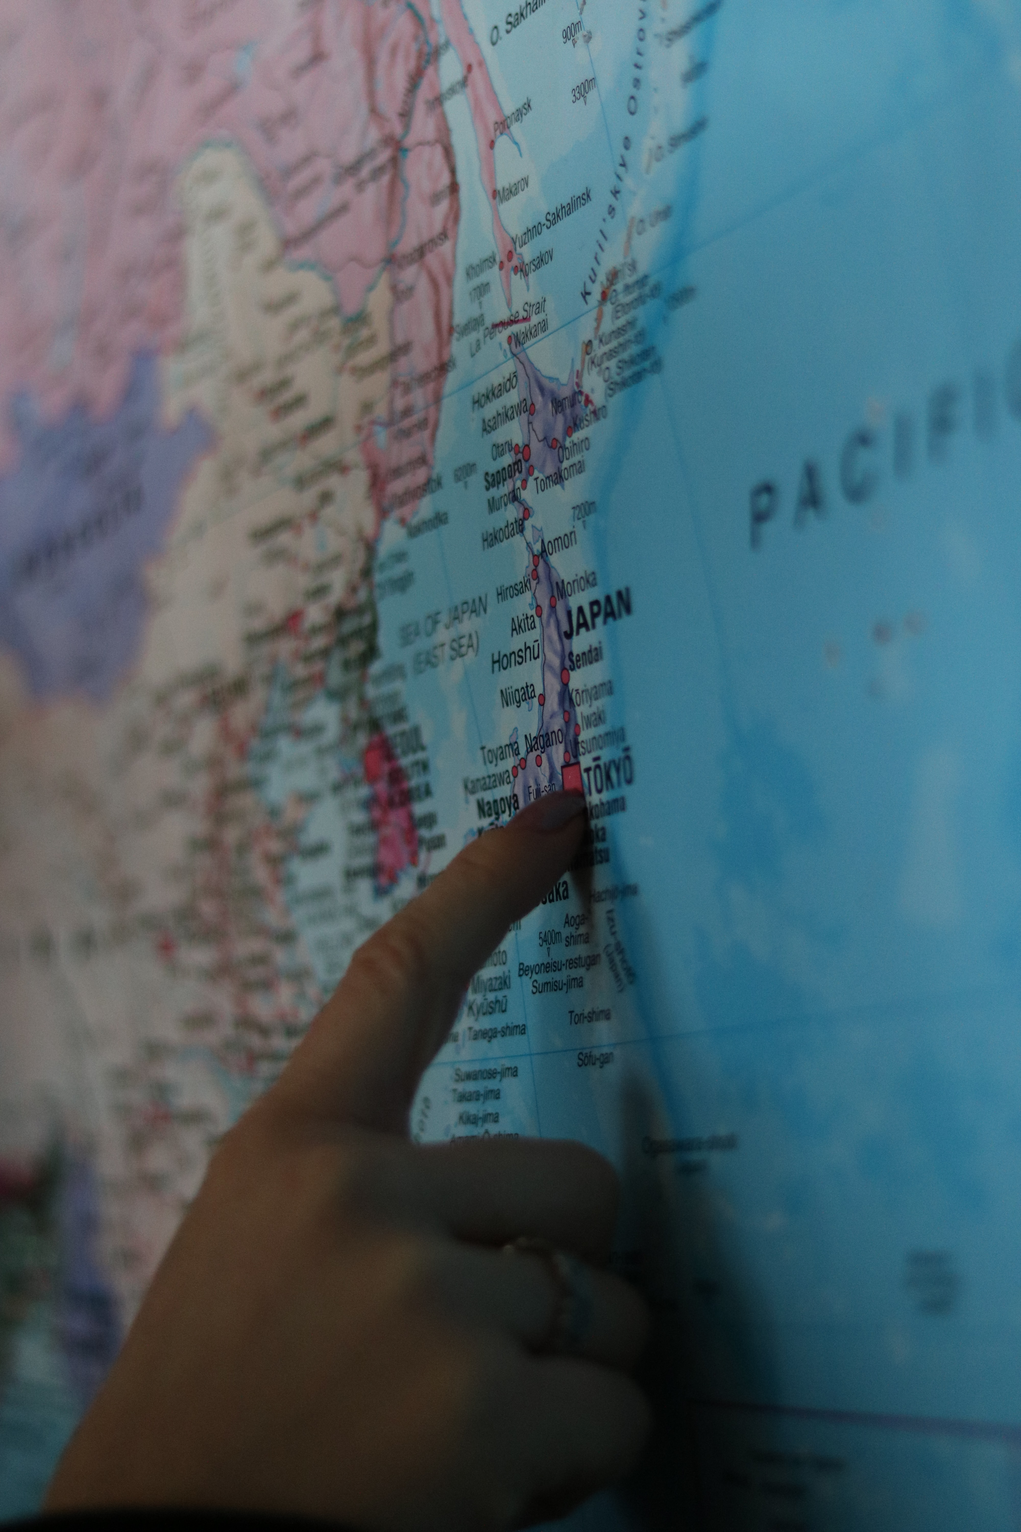
Alternatives to Expatriation
Increasing global integration without traditional expatriation
  More short-term assignments
  Self-initiated assignments
  Returnee assignments
  International commuter assignments (‘frequent flyers’)
  Virtual assignments
  Rotational assignments
  Inpatriation
Increasing global integration via other means….
  Procedural control
  Output control
But expatriate assignments
likely to remain important for control & coordination,
and individual & unit development!
Photo by Luke Jones on Unsplash

