Slide 1
Teams inauguration

Slide 2
STUDENTS PROFILES, PRIORITIES AND WISHES
Teams shouldn’t have members with fully conflicting priorities
Every team should have candidates for PM and CDO

Slide 3
15 TEAMS MASTERPLAN
48 volunteers for PM
Observations on team mate wishes
Fine tuning and trading

Slide 4
TEAMS – first things to do
Get to know each other
Check: no terrible mistake
Check: calendars for success
Check: safety (7.10.) & economy (4. and 10.10.)
Talk about leadership (1.10. and 3.-4.3.)

Slide 5
TEAMS – next
Talk about project proposals
Develop your questions to sponsors
How to test your interpretations
Team excel sheet
Assignment of rights

Slide 6
TEAMS – communication
Email, phone…
Zoom, Teams…
Whatsapp, Telegram…
Slack, Trello…
Mural, Miro…
Googledrive, Dropbox…

Slide 7
TEAMS – mental side
Imagine & talk: best possible start
Team work, more than project
Now, more than in the long run

Slide 8
TEAMS – mental side
Empathy
Shared vision: why, what, how
Various personalities; support
Honesty, openness; trust
Decision making

Slide 9
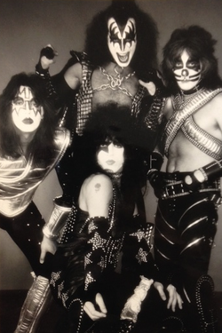
KISS
FUN
SPICES
You are a student just
once, why not taking
it beyond the ordinary

Slide 10
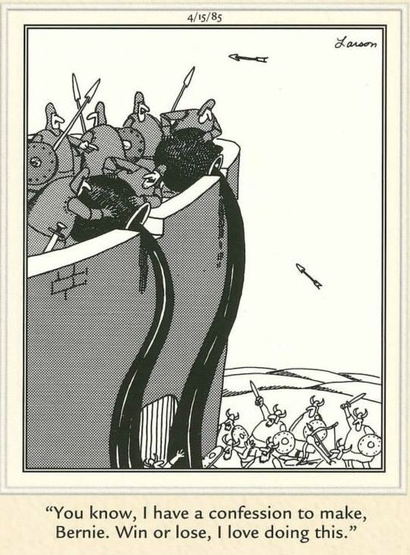
Attitude
“Whether you think you can, or you think you can’t -- you're right.”

Slide 11
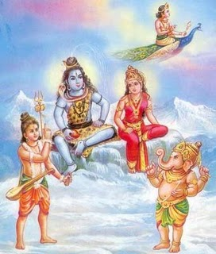
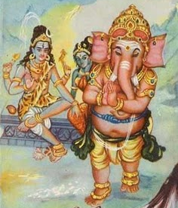
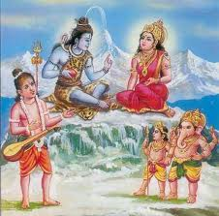

Slide 12
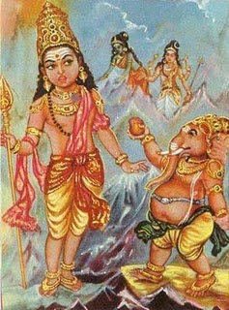
Many times customers don’t state the requirements explicitly.
It is the job of the Product designers to understand the requirements. Ultimately, a new product should satisfy the user.
Listen
Ask
Repeat by own words

Slide 13
Team 1
Valentin Poliakov
Aaro Packalén
Henri Nisonen
Reetta Antila
Azin Alesafar
Elena Amagilo
Global team: TBD
Team 2
Tero Rontti
Trung Nguyen
Miran Ghafoori
Arkar Nan Htike
Stefanos Zafiris
Umair Muhammad
Global team: Hamk
Grem Ringor
Karim Ghosn
Jan Schmider
Team 3
Theo Weckström
Mohammad Talib Haseeb Khan
Timon Behrendt
Kim Hirvonen
Sneha Saj
Anastasiia Tochenaia
Tuomas Auvinen
Global team: Colombia
Adriana Calpa Londono
Juan José López Pava
David Alejandro Zemanate Duque

Slide 14
Team 4 | Team 5
Matias Parviainen | Ville Mansikkaniemi
Nitija Thapa | Riku Piensalmi
Jenni Alitalo | Simon Renlund
Yu Dikai | Yin Xinyi
Aarni Ahvonen | Nicholas Oja Zdroy
Verneri Mäntysaari | Sibila Domiziana Silbano
Annu Mathew | Sakari Miettinen
Global team: LUT | Global team: Munich
Hemananth Shanmugam | Stefan Stegmair
Joona Ikonen | Stephan May
Joseph Zinno | Nabila Djobo
Team 6
Jonas Nikolas Kirner
Mikael Rosin
Yagya Adhikari
Onni Järvi
William Skog
Oskari Ponkala
Yunhao Zhong
Global team: Munich
Bastian Stumpfl
Michael Werner
Raphael Schmidt

Slide 15
Team 7 | Team 8 | Team 9
Nina Zdral | Haoxuan You | Rajat Atul Kaul
Linnéa Hammarberg | Svetlana Eggen | Krishan Chamalka
Utshav Bhattarai | Kim Wolf | Linh Nguyen
Ahmed Uzair Nasir | Totti Berg | Oliver Olin
Shri Vigneshwar Sivakumar | Min Hein Htike | Chen Wang
Swetha Authilingam | Subhadyuti Sahoo | Matias Seppälä
Jarno Lauronen | Jiaqi Wang | Kalle Nikula
Global team: TBD | Global team: LUT | Global team: Jefferson University
 | Parisa Marivani | Timothy McBride
 | Resham Tamang | Nicholas Galie
 | Arho Happonen | Ryan Black
 |  | Kostas Vasileiadis
 |  | Joshua Lim

Slide 16
Team 10
Elias Puolakka
Xueqi Qu
Hitesh Chander Monga
Hajiba Legrara
Gert Hendrik Kauniste
Oliver van der Weij
Jan Nyberg
Global Team: Pace
Tushar Verma
Sanket Koli
Federico Gutierrez
Team 11 | Team 12
Viktor Törhönen | Ahmed Mazhar
San Vo | Ganesh Neupane
Hammad Hassan | Ivan Mazanikov
Baoquan Yao | Johannes Vänskä
Muhammad Zohaid | Tejaswi Kalimisetty
Marie Sourroubille | Anni-Elina Seipäjärvi
Silvia Puukko | Vivian Stolt
Global team: Hannam University | Global team: TBD
Jeon Hyeryeong (Jerry)
Park Jiyun (Jay)
Seo Jisu (Jisu)

Slide 17
Team 13 | Team 14 | Team 15
Topi Nurmi | Aref Ghaemi | Joakim Kapp
Vatsal Mandlesara | Sara Kujanpää | Sanyong Lamsal
Timo Salmi | Joona Huikuri | Otso Saarinen
Kanna Koyama | Sashank Neelamraju | Hussaini Fayezullah Syed
Ferdinand Wittman | Aaro Vasama | Justus Manner
Xiaolin Jiang | Tomi Valkonen | Sakari Harjunpää
Avashesh Kumar | Charlotta Carvalho | Vilhelmiina Skyttä
Global team: Hamk | Global team: RTU | Global team: Colombia
Polina Halmetoja | Kristine Irtiseva | Juanita Velásquez Páez
Sarvenaz Radgoudarzi | Rolands Hartmans | Santiago Andres Rivera Camargo
Wahagan Brown | Janis Veveris | Edwin Andrés Calvo Rincón

Slide 18
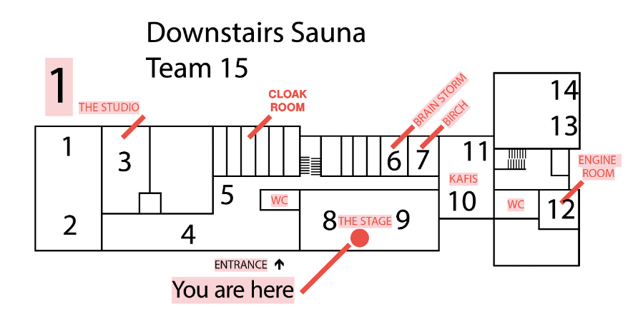
If you have a global team, join the PDP zoom session (can be found in previous announcements, https://aalto.zoom.us/j/2587120461 ) and go to your Team’s breakout room – your global team is waiting for you!

