Slide 1
Lecture 10: Interventions in the market, long-run equilibria and rent-seeking behavior
Juuso Välimäki
October 6, 2022

Slide 2
Commodity taxes and equilibrium

Slide 3
Commodity taxes
Value added tax (vat) is an extremely important source of tax revenue in Finland and EU
  As the name suggests, tax on additional value
  Added to the price of the good, at the moment 24%
    some groups of goods have lower vat (food, pharmaceuticas, magazine subscriptions, some cultural services)
  Tax independent of income
Consider a situation where the state government levies a 50 cent tax on loaves of bread
  The baker pays 50 cents per loaf to the state -> marginal cost goes up by 50%. The case with taxes as a percentage of price is similar and yilds the same conclusions
I leave the discussion of the purposes of taxation and forms of taxes to Principles II

Slide 4
Bread tax levied on bakers
Supply after tax
Supply curve
Demand curve
2,30
Bakers must get 50 cents more than before tax to be willing to sell the same amount
1,80
In the new equilibrium, buyers pay 2,30€. Baker pays 50 cents to the state and gets 1,80€. Less bread sold than before tax

Slide 5
Fiscal burden on buyer
Bakers’ union lobby for consumers to pay the tax
Supply curve
Demand curve
To buy the same amount of bread, buyers must get it 50 cents cheaper from the bakers
D
2,30
A
1,80
Demand after tax
In new equilibrium, buyer pays 2,30€: baker gets 1,80€ and state takes 50 cents.
Same outcome as before

Slide 6
Who bears the economic burden?
Situation before tax.
Supply curve
Demand curve
Consumer
surplus
A
Producer
surplus

Slide 7
And who bears the economic cost?
Consumer surplus
Both the buyers and the bakers pay their share (as lower prices and smaller quantities)
Supply curve
Demand curve
The tax causes also a deadweight loss (the black trianglre) = the loss in consumer and producer surplus not collected in taxes
Tax revenue
Producer surplus

Slide 8
The effect of price elasticity of demand: elastic demand
Consumer surplus
Supply curve
Demand curve
Tax revenue
Producer surplus

Slide 9
Demand elasticity and deadweight loss
Consumer surplus
Tax revenue
Price change has a smaller effect on quantities and hence a smaller deadweight loss
Producer surplus

Slide 10
Price elasticity of demand and deadweight loss
Consumer
surplus
Tax revenue
For inelastic demand, no deadweight losses, consumers bear the economics cost of the taxes
In the past, salt
Producer
surplus

Slide 11
Price elasticity of supply and dwl
With perfectly inelastic supply, no dwl and producers bear the cost of tax
Example: land (not real necessarily real estate tax as applied now)
Consumer surplus
ylijäämä
Tax revenue
Producer surplus

Slide 12
Market interference: tariffs and rent controls

Slide 13
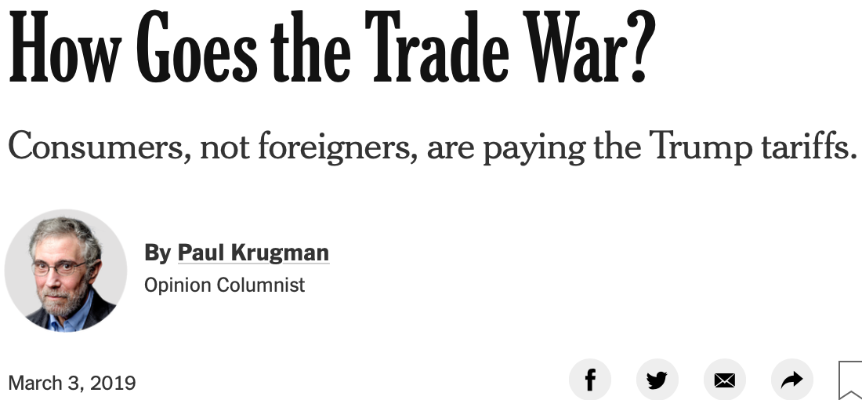
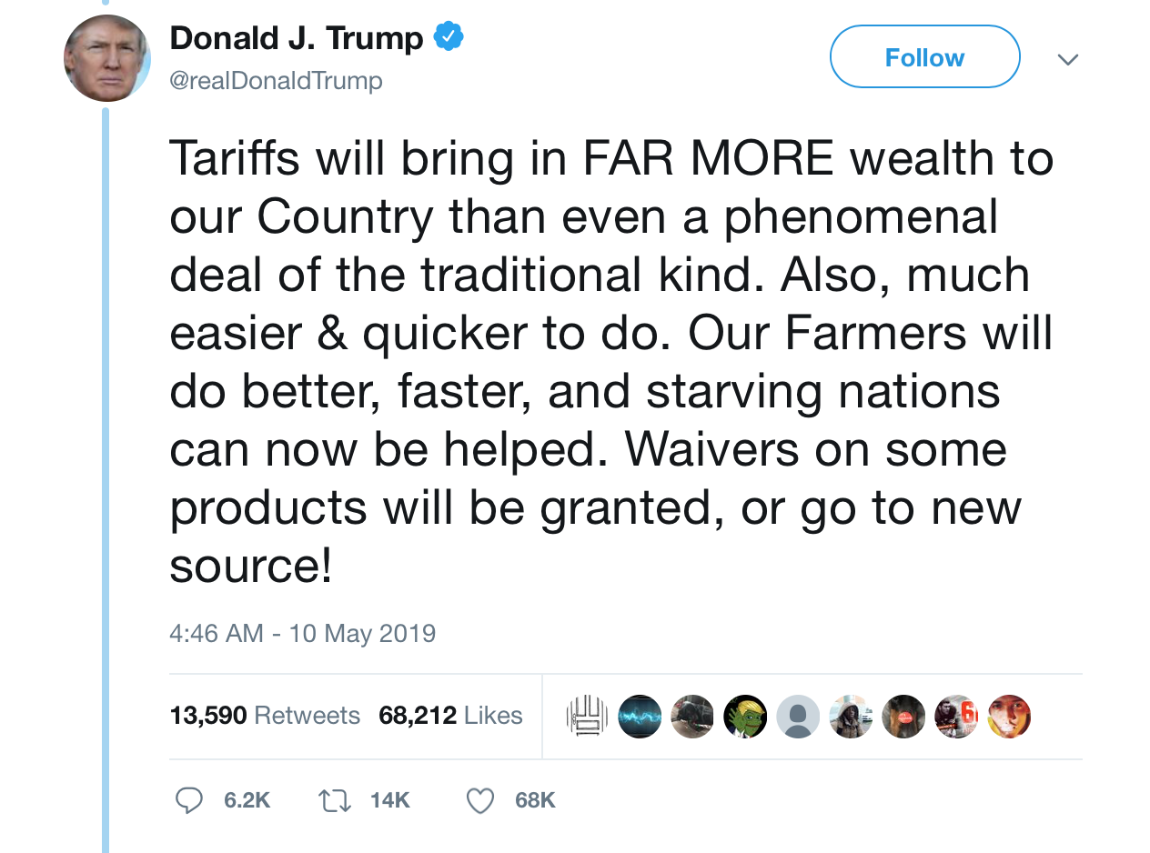

Trade wars are good?

Slide 14
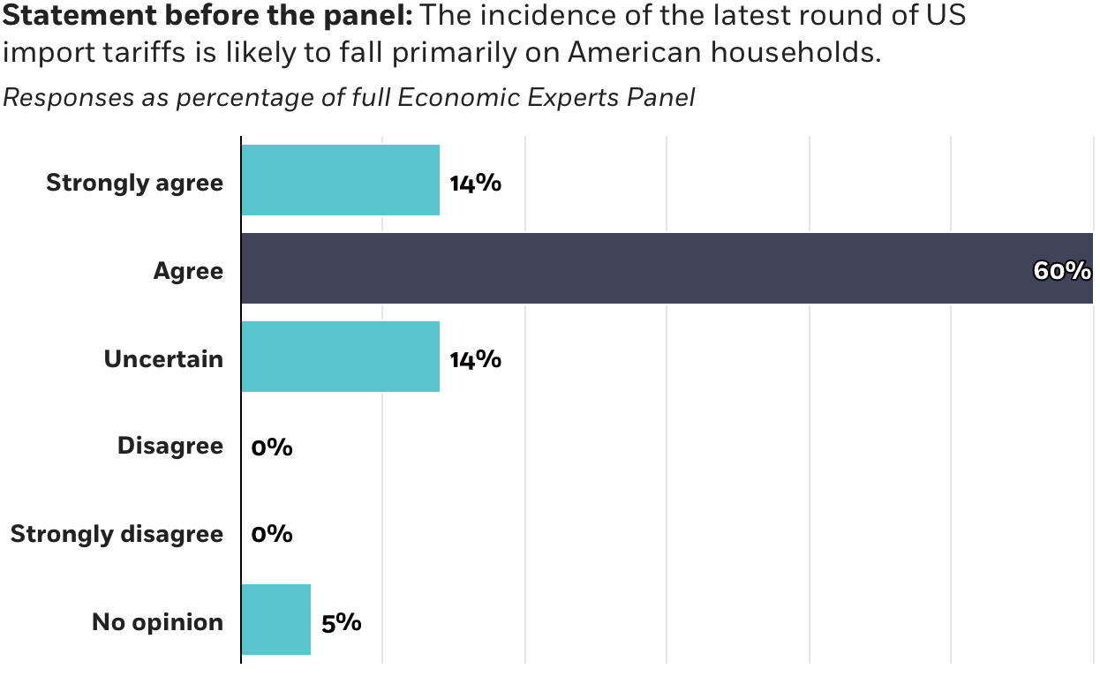
Who pays the tariffs?
Source: IGM Economic Experts Panel 29.5.2019. http://www.igmchicago.org/surveys/china-us-trade-war

Slide 15
Import tariff in a small open economy
price
price
Domestic supply
Domestic demand
(1+τ)P^{int}
Price with tariff
(1+τ)P^{int}
Drop in
consumer
surplus
Increase in
producer
surplus
tariffs
paid
dwl
dwl
P^{int}
World
market
price
P^{int}
After tariff:
domestic
production
imports
quantity
quantity
Before tariff:
domestic
production
imports

Slide 16
Equilibrium with two countries:
How to determine equilibrium price? (In principle, we could add together all supplies and demands and find equilibrium price as before, but to make the effect of tariffs clear, keep the markets separate in the picture)
price
domestic
price
foreign
supply
demand
exports
supply
Too high price (why?)
demand
imports
quantity
quantity

Slide 17
Two countries: equilibrium
Total supply = total demand. Therefore imports = exports at equilibrium prices.
price
domestic
price
foreign
supply
demand
supply
demand
exports
equilibrim price
imports
quantity
quantity

Slide 18
Two countries: import tariffs
If domestic country sets an import tariff, imports fall and as a result, at old prices, there is excess supply. Competitive process causes a fall in the equilibrium price
price
domestic
price
foreign
supply
demand
supply
demand
exports
tariff
imports
quantity
quantity

Slide 19
The effect of a domestic import tariff with two countries
price
domestic
price
foreign
P^{d}
e
a
D
b
P^{FT}
tariff
g
f
C
price drop
In foreign price
P^{f}
quantity
quantity
How do you evaluate the domestic effects of the tariff in terms of this picture?
What about global effects?

Slide 20
Consider different elasticities
Discuss the effect of elasticities on the economic cost of tariffs
price
domestic
price
foreign
P^{A}
P^{A}
D
e
a
b
tariff
P^{FT}
C
price drop
In foreign
quantity
quantity

Slide 21
Who pays for Trump trade wars?
US is large so its tariffs may have an impact on world market prices
  Maybe the Chinese end up paying?
  This depends on the elasticities in the markets affected
The best guess based on evidence thus far:
  ”in principle the effect of higher tariffs on domestic prices could be offset by foreign exporters lowering the pre-tariff prices”
  ”we find little evidence of such an improvement […] implies that the full incidence of the tariff has fallen on domestic consumers so far […] tariff revenue the U.S. is now collecting is insufficient to compensate the losses being born by the consumers of imports.”
Source: Amiti, Redding, Weinstein (2019). The Impact of the 2018 Trade War on U.S. Prices and Welfare. Journal of Economic Perspectives, taitossa.
http://www.princeton.edu/~reddings/papers/CEPR-DP13564.pdf

Slide 22
Example: prices of large appliances after imposing a 20% tariff on washing machines
No evidence on
lower export prices
for Chinese
producers.
Steady decline of 30% during 2013–2017.
Lähde: Amiti, Redding, Weinstein (2019). The Impact of the 2018 Trade War on U.S. Prices and Welfare. Journal of Economic Perspectives, taitossa.
http://www.princeton.edu/~reddings/papers/CEPR-DP13564.pdf

Slide 23
Tariffs: summary
Tariff is a tax on foreign production
  Transfer of surplus from domestic consumers to the government and domestic producers
    For small economies consumer losses are higher than the gains for domestic producers and the government
Tariffs in a large country may affect world market prices
  part of the cost falls on foreign producers
    incidence of the losses depends on the domestic and foreign elasticities
  in any case, a domestic transfer from consumers to producers and government
    in foreign country, a transfer to consumers (due to falling market price)
  ... A deadweight loss in both countries

Slide 24
Rent controls and housing subsidies

Slide 25
Housing market with rent control
rental supply
rental demand
Rental price
Equilibrium rent
Drop in
consumer
surplus
Controlled rent
Quantity of housing
Excess demand

Slide 26
Rental market interventions
Who gets to buy at controlled price
  Many buyers willing to pay much more than the controlled rent
    How can we make sure that those with the highest willingness to pay for the rental houses get them?
    Big deadweight loss from reduced supply
    Some lucky winners on the consumer side, sellers lose
    What about the welfare of those that did not get a house at controlled rent?
Are there alternatives to rent controls
  presumably the motivation for controls is the high cost of living
    Are there other policies that can make housing more affordable
    Housing subsidies?

Slide 27
Subsidized housing market
subsidized
rental demand
rental supply
rental demand
Subsidized equilibrium rent
Rental price
equilibrium rent
Drop in
consumer
surplus
Quantity of housing
Excess demand

Slide 28
Rental market interventions
Welfare analysis
  Who is really hurt by rent control?
    Think this through in terms of the elasticities
    When are the deadweight losses big?
    Is it likely that there will be a secondary market of housing in rent controlled cities (a lot of evidence of this in NYC, Stockholm and also some evidence with Hitas)
  Who is hurt with subsidies?
    Taxpayer picks up the tab
    What about the landlords and tenants
    Notice that the inefficiency is now that too much traded in the market
    Is this still better than rent controls? As often in economics, no absolute answers, but if the reason for interventions is limited housing opportunities, subsidies at least increase access to housing

Slide 29
Free entry and long-run supply

Slide 30
Perfect competition with free entry
Up to now the number of firms is fixed
  Individual supply decisions add up to market supply
  If marginal costs are inreasing, firms revenues exceed variable costs
    Total profit of the firms depends on fixed cost
    For a fixed number of firms, they may earn economic rent (if revenue exceeds the sum of fixed and variable costs)
Free entry
  If all technologies are available to all potential entrants into the market, rents will be competed away
    Entry by a single firm does not have much effect on the market price. The number of entering firms is determined from the requirement that any additional entrant would not earn a rent (or would make a loss)
    All firms operate at the efficient scale where average cost is minimized

Slide 31
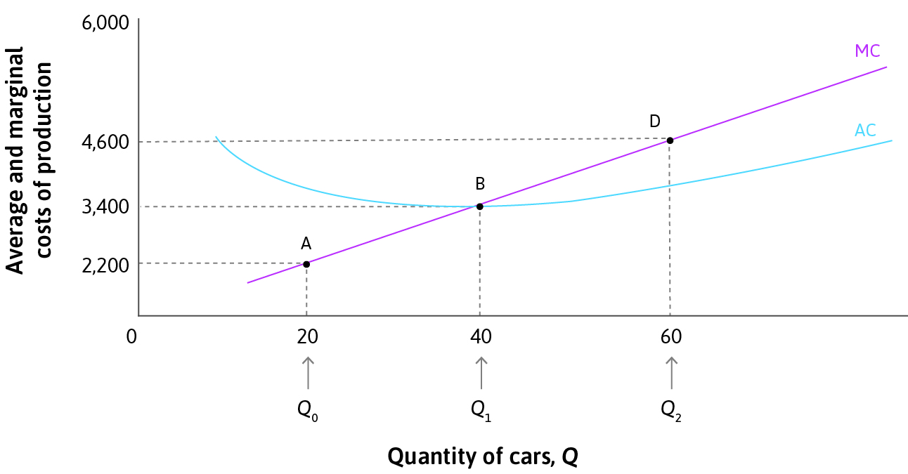
Recall Average cost curve from Lecture 8
For a price-taking firm, P=MC(q)
Average cost is minimized where MC(q) = AC(q)
Since profit 𝚷(q) = q (P – AC(q)), zero profit implies P = AC(q) = MC(q)
Since P depends on Q and Q is the number of firms times individual supply q, these equations determine the long run number of firms in the market

Slide 32
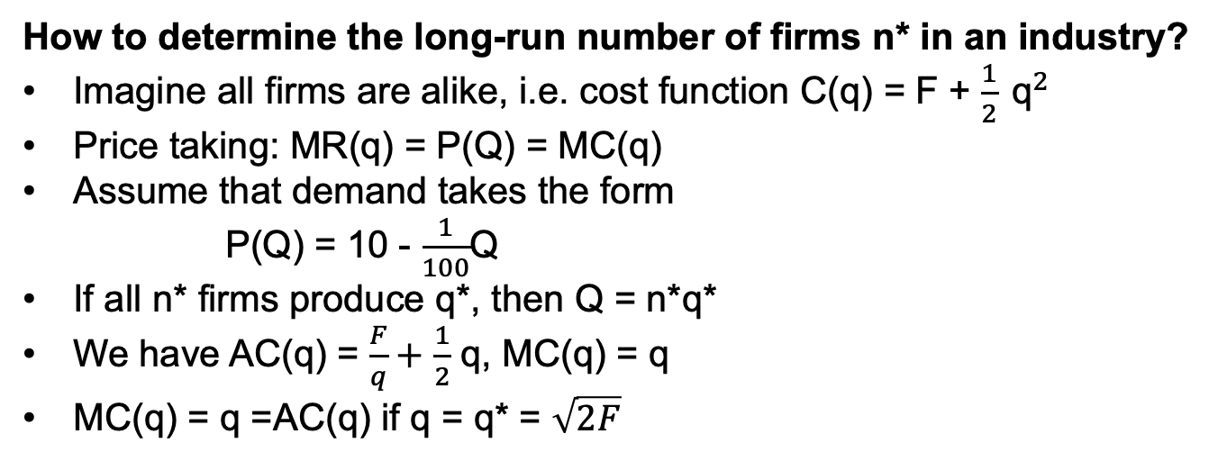
Back to example from Lecture 9
How to determine the long-run number of firms n* in an industry?
Imagine all firms are alike, i.e. cost function C(q) = F + $\frac{1}{2} {\text{q}}^{2}$
Price taking: MR(q) = P(Q) = MC(q)
Assume that demand takes the form
  P(Q) = 10 - $\frac{1}{100}$Q
If all n* firms produce q*, then Q = n*q*
We have AC(q) = $\frac{F}{q}+$ $\frac{1}{2}$ q, MC(q) = q
MC(q) = q =AC(q) if q = q* = $\sqrt{2F}$

Slide 33
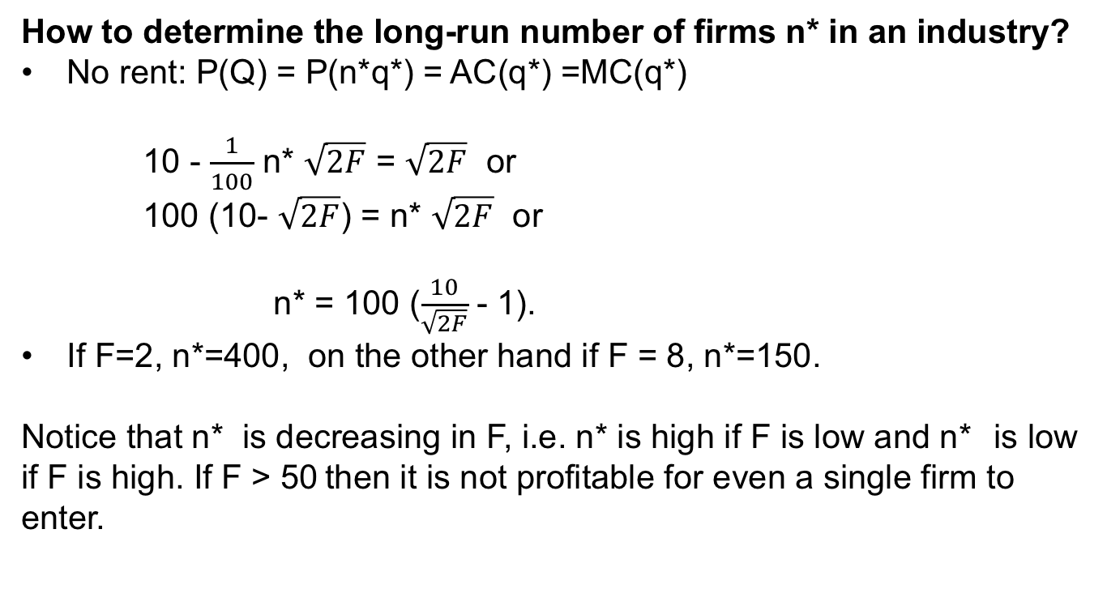
Free entry equilibrium
How to determine the long-run number of firms n* in an industry?
No rent: P(Q) = P(n*q*) = AC(q*) =MC(q*)
    10 - $\frac{1}{100}$ n* $\sqrt{2F}$ = $\sqrt{2F}$ or
    100 (10- $\sqrt{2F}$) = n* $\sqrt{2F}$ or
    n* = 100 ($\frac{10}{\sqrt{2F}}$ - 1).
If F=2, n*=400, on the other hand if F = 8, n*=150.
Notice that n* is decreasing in F, i.e. n* is high if F is low and n* is low if F is high. If F > 50 then it is not profitable for even a single firm to enter.

Slide 34
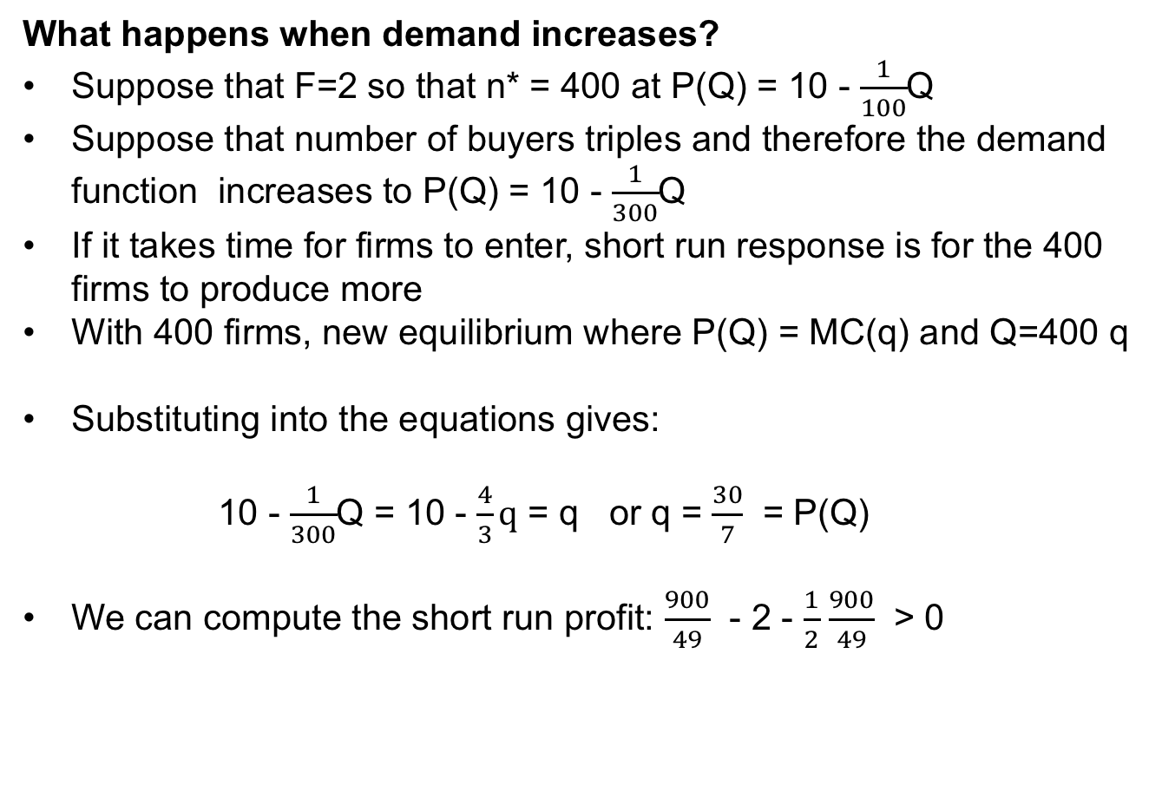
Short-run and long-run adjustments
What happens when demand increases?
Suppose that F=2 so that n* = 400 at P(Q) = 10 - $\frac{1}{100}$Q
Suppose that number of buyers triples and therefore the demand function increases to P(Q) = 10 - $\frac{1}{300}$Q
If it takes time for firms to enter, short run response is for the 400 firms to produce more
With 400 firms, new equilibrium where P(Q) = MC(q) and Q=400 q
Substituting into the equations gives:
  10 - $\frac{1}{300}$Q = 10 - $\frac{4}{3}q$ = q or q = $\frac{30}{7}$ = P(Q)
We can compute the short run profit: $\frac{900}{49}$ - 2 - $\frac{1}{2}$ $\frac{900}{49}$ > 0

Slide 35
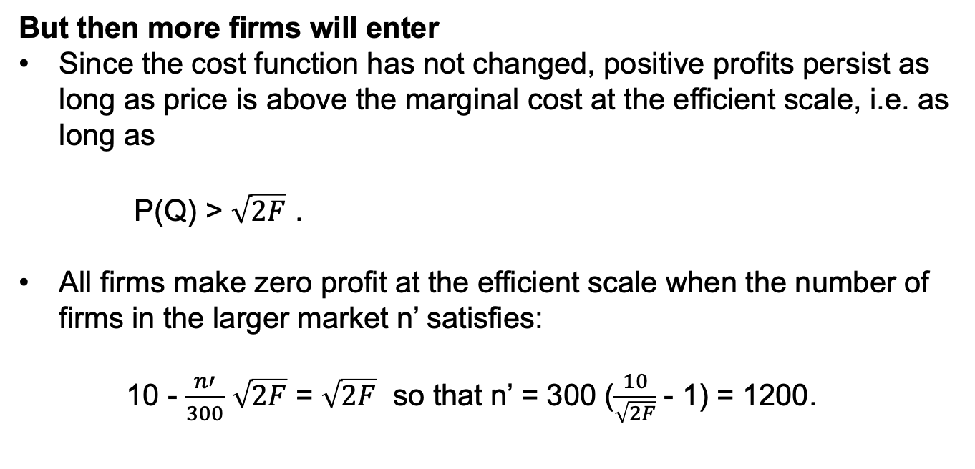
Short-run and long-run adjustments
But then more firms will enter
Since the cost function has not changed, positive profits persist as long as price is above the marginal cost at the efficient scale, i.e. as long as
    P(Q) > $\sqrt{2F}$ .
All firms make zero profit at the efficient scale when the number of firms in the larger market n’ satisfies:
    10 - $\frac{n′}{300}$ $\sqrt{2F}$ = $\sqrt{2F}$ so that n’ = 300 ($\frac{10}{\sqrt{2F}}$ - 1) = 1200.

Slide 36
Horizontal long-run supply
As long as we concentrate only on the long-run, we notice that the supply curve is horizontal at the price determined by the average cost at the efficient scale of operating
If demand changes, in the long run, only the number of firms in operation changes
Some textbooks assume free availability of all technologies and therefore firms cannot make rents in the long run
This is an incredibly static view of competition
Where are the incentives to innovate if all firms earn zero rents in the market?
The word competition already seems to suggest that agents involved in competition struggle to become better than others
None of this is present in the long-run competitive model

Slide 37
Increasing or decreasing long-run supply
Of course, it is not possible to reproduce existing production indefinitely in all industries at constant cost
  Mining
  Some agricultural products (fine wine)
  Very specialized professions
For some industries, costs might be decreasing as industry size grows
  Advantages of agglomeration
  Emergence of cities
  Silicon Valley, etc.
In such cases, the long-run supply curve slopes up (with increasing costs) or down (with decreasing costs) and entry and exit of firms represent movements on this long run curve.

Slide 38
Competition and rent-seeking

Slide 39
The engine of the capitalist vehicle: looking for a competitive edge
Hayek on competition:
Now, how many of the devices adopted in ordinary life to that end would still be open to a seller in a market in which so-called ‘perfect competition’ prevails? I believe that the answer is exactly none. Advertising, undercutting, and improving (‘differentiating’) the goods or services produced are all excluded by definition—’perfect’ competition means indeed the absence of all competitive activities. (Hayek: The Meaning of Competition, 1946)
Economic progress results from conscious efforts to improve
  Product quality
  Production processes
These efforts are costly and therefore they must result in a profit in the product market. This requires at least temporary market power or property rights to the new products or processes

Slide 40
The engine of the capitalist vehicle: looking for a competitive edge
Hayek was writing on planned versus market economies.
In a planned economy, the planning officer must know all features of the economy.
In a market economy, the entrepreneur needs to look only at prices to evaluate the usefulness of potential innovations
Hayek on information:
Which of these systems [central planning or competition] is likely to be more efficient depends mainly on the question under which of them we can expect [to make fuller use] of the existing knowledge. This, in turn, depends on whether we are more likely to succeed in putting at the disposal of a single central authority all the knowledge which ought to be used but which is initially dispersed among many different individuals, or in conveying to the individuals such additional knowledge as they need in order to enable them to dovetail their plans with those of others. (Hayek: The Use of Knowledge in Society, The American Economic Review, Vol. 35, No. 4. (Sep., 1945), pp. 519-530).

Slide 41
The engine of the capitalist vehicle: looking for a competitive edge
There is wide agreement amongst economists that an important virtue of the market mechanism is that it provides the right information for investments in new product and process innovations
Markets provide a method for aggregating dispersed information in a very efficient manner (more on this in the next lecture)
Rent-seeking is the term given to the process where innovators come up with new ideas or ways of conducting business
Since trying new methods is expensive and inherently risky, the rewards for success must be considerable to make rent-seeking worthwhile

Slide 42
Is rent-seeking always good?
Suppose that a firm discovers that by investing F in a new production process, it can make a profit above F and earn a rent at existing market prices
  Do we know that total surplus is increased by adopting this process?
  If the firm is small and the market price does not change, only the firm’s own profit is affected and therefore surplus is increased
Suppose a firm can hire a team of lawyers at a great cost to lengthen the copyright protection for an existing product
  Is this type of rent-seeking increasing total surplus?
In general, rent seeking can involve market expansion and business stealing, the first increases surplus, the second shifts surpluses

Slide 43
Creative destruction
Joseph Schumpeter:
[...] The opening up of new markets, foreign or domestic, and the organizational development from the craft shop and factory to such concerns as U.S. Steel illustrate the process of industrial mutation that incessantly revolutionizes the economic structure from within, incessantly destroying the old one, incessantly creating a new one. This process of Creative Destruction is the essential fact about capitalism. It is what capitalism consists in and what every capitalist concern has got to live in. (Capitalism, Socialism and Democracy, 1942)
A central issue for understanding economic progress:
  What kinds of markets perform the best in producing innovations?

Slide 44
Cycle of economic progress
A firm obtains an innovation
  Either a process innovation shifting its own marginal cost down or a product innovation shifting its demand up
  Firm starts making profit
  With process innovations, the firm can expand capacity by building new production facilities
  With product innovations, firm obtains some market power and to make best use of this, expands capacity
The firm may protect its innovation by copyright or patent
  In either case, must disclose its information that then becomes available to its competitors
  Through this information or through reverse engineering the products or processes, competitors catch up until rent is dissipated
A new innovation arrives and the process is repeated

Slide 45
Summary
Interventions in markets
  Tariffs
    Distributional effects, deadweight losses
  Rent controls and housing subsidies
    Distortions of different signs
Short-run and long-run equilibria
  Efficient scale of production
  Horizontal long-run supply
Rent-seeking and the dynamic economic process
  Economic progress from rent-seeking activities
  The role of entrepreneur as the economic engine
  Creative destruction

Slide 46
In the next lecture
Asset markets and investing
  Special features of such markets
Money, banking and financial markets
  Money creation
  Asymmetric information in the financial markets

